Slide 1
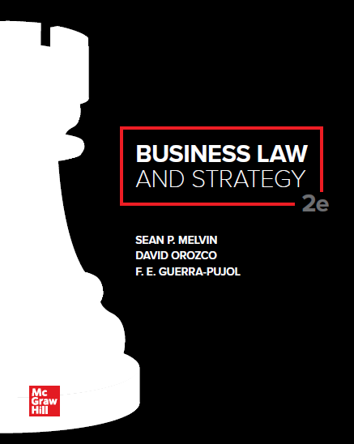

Slide 2
Chapter 3
Business and the Constitution

Slide 3
Chapter Learning Objectives
Understand the structure of the Constitution and the strategic system of checks and balances.
Identify the main powers of each branch of the federal government.
Describe the broad scope of Congress’s power to regulate commerce under the Commerce Clause.
Identify the individual rights and guarantees protected by the Bill of Rights.
Define due process and equal protection.
List the methods and steps for amending the Constitution.
Compare and contrast two major theories of constitutional interpretation: originalism and the living Constitution.

Slide 4
Structure of the Constitution
Articles and Amendments of the Constitution
Preamble contains goals of the Constitution: a more perfect union, justice, domestic tranquility, national defense, general welfare, and liberty.
Seven Articles as Originally Drafted. First three articles establish a strong federal government with three separate but coequal branches—Congress, the president, and the federal courts.
First Ten Amendments are the Bill of Rights which set forth individual rights and fundamental protections such as freedom of speech.
Unique Structural Features
Federalism defines the relationship between state governments and national government.
Separation of powers defines the relationship among the executive, legislative and judicial branches.

Slide 5
Federalism
National Powers | Concurrent Powers | State Powers
Coin Money | Levy and collect taxes | Regulate trade and business within the state
Regulate interstate and foreign trade | Borrow money | Establish public schools
Raise and maintain armed forces | Establish courts | Enact license requirements for professionals
Declare war | Define crimes and set punishments | Regulate alcoholic beverages
Govern U.S. territories and admit new states | Claim private property for public use | Conduct elections
Conduct foreign relations |  | Establish local governments

Slide 6
Federal Powers: Separation of Powers
Congress (Article I of the U.S. Constitution)
Power to regulate commerce, power to lay and collect taxes, power to borrow money, power to coin money, power to enact bankruptcy, patent, and copyright laws.
May impeach President and federal judges
President (Article II of the U.S. Constitution)
Commander-in-chief of armed forces, power to enforce laws passed by Congress, power to conduct foreign relations, power to appoint federal judges (subject to Senate approval).
Federal Courts (Article III of the U.S. Constitution)
Supreme Court and lower federal courts, judicial review of legislation and executive action.

Slide 7
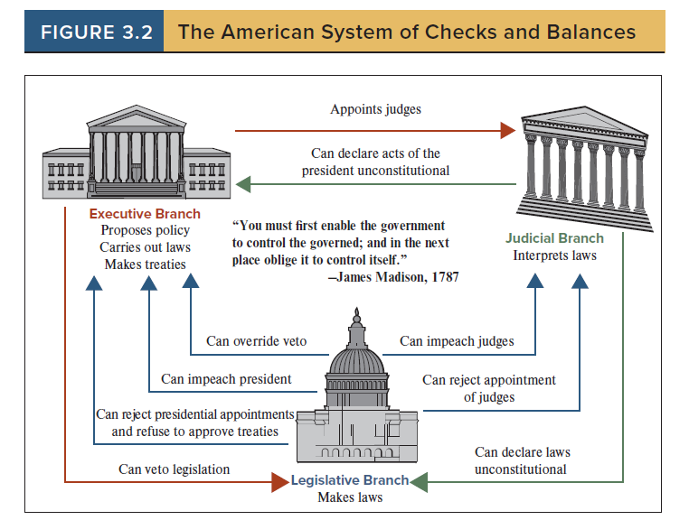
The American System of Checks and Balances

Slide 8
Regulation of Commerce: Commerce Clause
Article I, Section 8, Clause 3
The Congress shall have the Power to regulate Commerce with foreign nations, and among the several States, and with Indian Tribes.
SCOPE OF INTERSTATE COMMERCE.
Channels such as canals, highways, and railways.
Instrumentalities such as vehicles used in shipping products.
Persons and Articles moving in interstate commerce, such as passengers, finished goods, and raw materials.

Slide 9
Negative (Dormant) Commerce Clause
States May Regulate Interstate Commerce provided:
State laws must be legitimate effort to regulate health, safety and welfare of its citizens, and,
State law must not discriminate or impose an undue burden on out of state businesses.

Slide 10
Bill of Rights: Amendments to Constitution 1
First Amendment (4 Freedoms).
Press.
Speech.
Religion.
Assembly.
Second Amendment (Right to Bear Arms).
Applies to individuals
Does not prohibit all government regulation of firearms.
Third Amendment (Housing of Soldiers).

Slide 11
Bill of Rights: Amendments to Constitution 2
Fourth Amendment (Search and Seizure).
Government must have probable cause for a search, seizure of an object, or arrest of a person.
Government must obtain a warrant signed by a judge.
Evidence obtained in violation of the Fourth Amendment is inadmissible in criminal trials.
Types of Searches and Seizures:
Physical searches of a person or property are searches when they violate a person’s reasonable expectation of privacy.
Seizures of a person (arrest) occurs when a person is not free to ignore the police and leave at will.
Electronic searches occur when a reasonable expectation of privacy is violated. Most employees are not considered to have a legitimate expectation of privacy to information stored on a company-owned computer.

Slide 12
Bill of Rights: Amendments to Constitution 3
Fifth Amendment (Criminal and Property Rights).
In federal court, an individual must be indicted by a grand jury.
Individuals cannot be compelled to be witnesses against themselves in criminal trials.
The power of eminent domain (the power of the government to take private property) may only be exercised for a “public use” and with just compensation.
Property, life, or liberty may not be taken away without due process of law.

Slide 13
Bill of Rights: Amendments to Constitution 4
Sixth Amendment (Criminal Trials).
Criminal defendants are entitled to a speedy trial by a jury.
Criminal defendants must have the opportunity to confront and question (cross-examine) witnesses.
Criminal defendants have the right to be represented by a lawyer.

Slide 14
Bill of Rights: Amendments to Constitution 5
Seventh Amendment (Civil Trials).
In federal court, there is a right to a trial by jury for any dispute involving money damages.
Eighth Amendment (Bail, Fines and Punishments).
Prohibits excessive bail or fines.
Prohibits Cruel and Unusual Punishment.

Slide 15
Bill of Rights: Amendments to Constitution 6
Ninth Amendment (Unenumerated Rights).
The enumeration of certain rights in the Constitution shall not be construed to deny unenumerated rights of the people.
Tenth Amendment (Federalism-Popular Sovereignty).
Powers not delegated to the federal government by the Constitution, nor prohibited by it to the States, are reserved to the States or to the people.

Slide 16
Commercial Speech
Commercial speech (most commonly, advertising) now enjoys Constitutional protection and regulation of commercial speech must pass a four-part test:
So long as the commercial speech concerns lawful activities and is not misleading, the speech qualifies for protection.
The government must show that it has a substantial government interest in regulating the speech.
The government must demonstrate that the restriction directly advances the government’s interest.
The government’s restriction must be not more extensive than necessary (not too broad) to achieve the government’s asserted interest.

Slide 17
Due Process and Equal Protection: Fourteenth Amendment
Due Process.
Substantive: Laws cannot be vague, overly broad or arbitrary.
Procedural: Government must provide reasonable notice, afford a hearing and meaningful opportunity to present evidence.
Equal Protection.
People who are similarly situated must be treated equally.

Slide 18
Court Standards of Regulatory Review
Rational Basis Test: (used in most tax and business cases)
Government actions advances a legitimate state interest or objective.
The challenged law or action has some relation to this objective.
Intermediate Scrutiny Test:
Government action furthers an important state interest.
The challenged law or action is substantially related to the government interest.
The means used to achieve this interest are reasonable.
Strict Scrutiny Test:
Government must demonstrate a compelling state interest.
The means used to achieve this interest are narrowly tailored.
The challenged law or action is the least restrictive means to achieve the objective.

Slide 19
AMENDING THE CONSTITUTION: [Article V]
Amendment proposed by either house of Congress (or by Constitutional Convention of two-thirds of the states).
Passed by two-thirds vote of both House and Senate (or by Constitutional Convention of two-thirds of the states).
Ratified by three-fourth of the States.

Slide 20
Constitutional Interpretation
Originalism.
Original intent of the Constitution Framers.
Original public meaning of the words of the Constitution.
Living Constitution.
Purpose of the Constitution.
Flexible adaptation of language to meet changes in modern times.

Slide 21
Accessibility Content: Text Alternatives for Images

Slide 22
The American System of Checks and Balances—Text Alternative
The slide shows three buildings representing the executive, legislative, and judicial branches. The White House represents the executive branch, the Capitol Building represents the legislative branch, and the Supreme Court Building represents the judicial branch.
There are lines with arrows running from each branch to another branch. The lines have labels that describe ways in which one branch limits the power of another branch.
For example, the President has a veto power over Congressional legislation. However, Congress can override the President’s veto.

