Slide 1
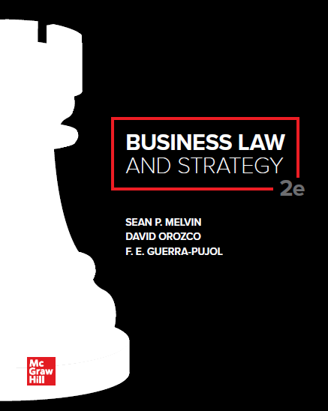

Slide 2
Chapter 4
The American Judicial System, Jurisdiction, and Venue

Slide 3
Chapter Learning Objectives
Explain the roles of courts and the structure of the American judiciary.
Differentiate state courts from federal courts.
Identify responsibilities of trial courts versus appellate courts.
Articulate how courts apply precedent.
Differentiate and explain concept of subject matter jurisdiction versus personal jurisdiction.
Apply minimum-contacts test in cyber setting and describe importance of Zippo sliding scale.
Recognize how rules of venue affect location of trials.

Slide 4
State Courts Versus Federal Courts
State Trial Courts.
Deal with matters of state constitutions, statutes, common law and local ordinances.
Federal Trial Courts.
Deal with matters of federal Constitution, statutes and administrative agencies.

Slide 5
State Trial Courts
Plaintiff- brings the lawsuit against another party.
Defendant- the alleged legal violator.
State Courts (depending on state) may have:
General Authority: Courts of general authority are organized into geographic districts and hear many types of cases
Limited Authority: Courts of limited authority are often confined to a particular type of dispute such as family law matters (divorce or adoption) or probate matters (wills and trusts)
Local Courts: handle minor matters such as small claims, ordinance violations, and so on.

Slide 6
State Appellate Courts
In some states, appeals are at the discretion of the court.
Appeals Courts
Review lower court transcripts and rulings.
Read “briefs” written by attorneys for each side stating legal reasons for or against appeal, and
May allow attorneys to engage in oral argument before the appellate judges on the legal issues in the case.
Courts decide based on the trial record (no new evidence) and determine if trial court outcome was correct or needs to be sent back “remand” for rehearing.

Slide 7
Federal Courts
U.S. District Courts (Trial Courts).
At least one U.S. District Court in each state and the District of Columbia.
Specialized Courts such as: Tax Court, Bankruptcy Court, Court of International Trade.
U.S. Circuit Courts of Appeal (13 Circuits).
Eleven Geographic Circuits covering multiple states.
United States Court of Appeals for the District of Columbia Circuit hears cases originating in Washington, DC.
United States Court of Appeals for the Federal Circuit hears cases involving exclusively federal issues such as patent, copyright, and trademark cases, as well as cases where the United States is named as a defendant.
U.S. Supreme Court.
Final authority in the interpretation of federal law and the U.S. Constitution.
Court grants only one percent of the requests for review.
Most cases that it decides are because appellate courts have issued conflicting opinions (referred to as circuit splits or conflict among the circuits).

Slide 8
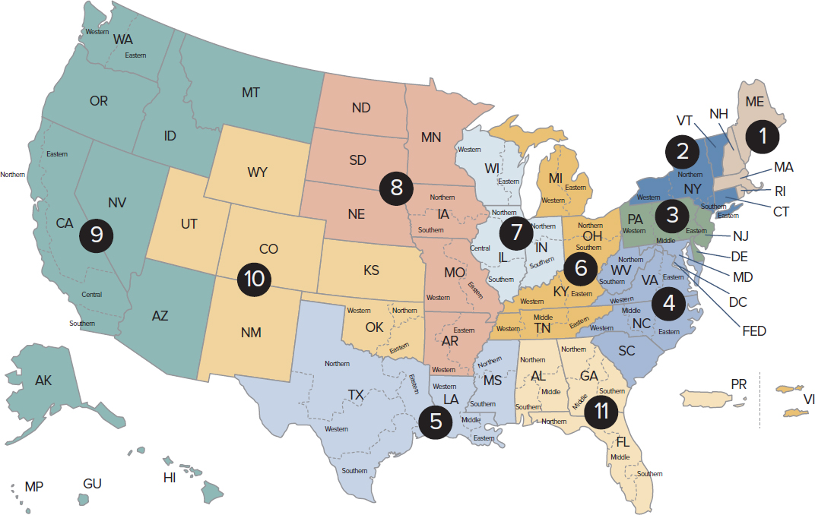
U.S. Circuit Courts of Appeals
Figure 4.1 Map of the U.S. Circuits
2The Court’s original jurisdiction is limited to cases involving ambassadors and selected other public officials and those cases where the disputing parties are two states.
Access the text alternative for slide images.

Slide 9
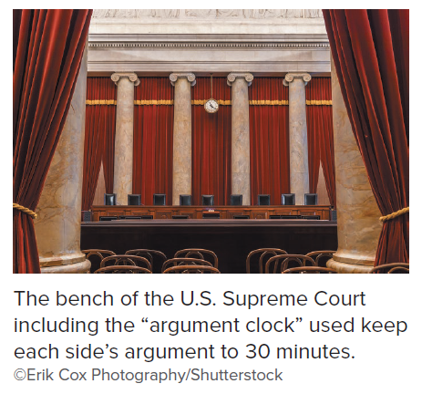
Supreme Court

Slide 10
Case 4.1: Caniglia v. Strom
HELD: The U.S. Supreme Court resolved a circuit split by reversing the First Circuit and holding that the “community caretaking” exception to the Fourth Amendment did not apply to searches of a home.

Slide 11
Judicial Selection
Federal Judges (Article III).
Appointed by the President, confirmed by the Senate.
Have lifetime appointments.
May not have salary reduced during term in office.
State Judges (Varies by State).
Some states appoint, while others elect judges or have periodic retention elections of sitting judges.

Slide 12
The Role of Precedent
Precedent (or Stare Decisis) from prior cases is used by courts to keep rulings consistent and efficient.
Concept | Effect | Example
Precedent established by court of authority | Binding on all lower courts in that jurisdiction. | U.S. Supreme Court decision on the First Amendment binding on all courts in the United States.
Case of first impression | Courts look to lower courts and courts outside their jurisdiction for persuasive reasoning. | Wyoming Supreme Court finds reasoning of Florida Supreme Court to be persuasive on an issue where no Wyoming precedent has been set.
Distinguishable | Factual or legal difference from precedent. | Trial court deviates from precedent because of a factual difference in cases.

Slide 13
Jurisdiction and Business Strategy
Jurisdiction is a court’s authority to decide a particular case based on
Who the parties are
The subject matter of the dispute
Venue is the location where a case is tried.
Businesses need to consider what courts would have jurisdiction and where a case could be tried because the location of trial may impact costs of trial and the receptiveness of a judge and jury to a business’s arguments.

Slide 14
Categories of Jurisdiction
Subject Matter Jurisdiction
Court’s authority over the dispute between the parties.
Federal court jurisdiction arises from a federal question (e.g., some issue involving a federal statute or the U.S. Constitution) or diversity of citizenship (parties from two different states).
Personal Jurisdiction (In personam).
Court’s authority over the parties themselves.
Focused on whether it is fair for the court to have jurisdiction over the defendant and the analysis focuses on the conditions of the controversy and the actions of the defendant.
Out-of-State Defendants.
Determined by states’ “Long-Arm Statutes.” Typically, long-arm statutes provide jurisdiction where an out-of-state defendant (1) transacts business within the state’s borders, (2) commits a negligent act within those borders, or (3) owns property in the state.

Slide 15
Court Tests Over Personal Jurisdiction
Minimum Contacts: (1) Does the defendant have minimum contacts with the state such as regularly shipping products? (2) Has the defendant purposefully availed himself by some affirmative act directed to that specific state?
Injurious Effect: Is it reasonably foreseeable that the defendant’s actions would have an injurious effect on a resident of the court’s state?
Physical Presence: The physical presence of an office, agent, or personnel (e.g., a sales team) in a state creates jurisdiction.
Voluntary: The parties may agree to litigate in a particular court through, for example, a forum selection clause in a contract.

Slide 16
Case 4.2: Goodyear Dunlop Tires v. Brown
HELD: The U.S. Supreme Court reversed the decision of the appellate court and ruled in favor of Goodyear’s foreign subsidiaries. The Court concluded that jurisdiction was lacking because the foreign subsidiaries’ contacts with North Carolina were too limited. A corporation is only subject to general jurisdiction of a state’s courts if the corporations contacts with the forum state are so continuous and systematic as to make the corporation “at home” in the forum state.

Slide 17
Case 4.3: Clemens v. McNamee
HELD: The U.S. Court of Appeals for the Fifth Circuit held that a Texas court did not have jurisdiction when a Texas plaintiff sued a New York defendant for defamation based on statements made to Sports Illustrated. The court held that to support personal jurisdiction in a defamation claim, the forum must be the “focal point” of the story.

Slide 18
Case 4.4: Franklin v. Facebook
HELD: The U.S. District Court for the Northern District of Georgia granted Facebook’s motion to transfer, enforcing the forum selection clause that Franklin agreed to when he accepted Facebook’s terms of service.

Slide 19
Definitions for the Zippo Standard
Courts determine how interactive is the Web site to determine jurisdiction.
Passive: A website that simply provides information accessible by any Internet user cannot be the sole basis for jurisdiction.
Interactive: A website that provides an interactive function may create personal jurisdiction based on the nature of the interaction.
Integral to Business Model: A business where the use of a website is an integral part of the business model and the website is used to accomplish commercial transactions in the state of the court’s jurisdiction.

Slide 20
Minimum Contacts and the Internet: Zippo Standard
FIGURE 4.3 Zippo Sliding Scale Test
Figure 4.3 is an illustration of the Zippo sliding scale used by many courts to analyze minimum contacts via the Internet.
Access the text alternative for slide images.

Slide 21
Case 4.5: Shisler v. Sanfer Sports Cars, Inc.
HELD: The California Court of Appeals ruled that a California court did not have personal jurisdiction over a car dealership when the car dealership did not purposefully direct any acts toward California. The car dealership had a website accessible anywhere but it had never owned or leased property in California, had never advertised directly to residents of California, and had never intentionally focused on selling cars specifically to residents of California.

Slide 22
VENUE
Venue is the legal concept that defines the most appropriate location for the trial.
Attorneys attempt to move trials to venue’s they believe are more favorable to their client and not favorable to the other party in lawsuits.

Slide 23
Thinking Strategically: Jurisdiction and Venue
Large business risk is threat of litigation.
This risk is increased if the litigation is in a state far from the headquarters of a business because the judge and jury may be friendlier to a local party.
The best way to mitigate this risk is to place forum selection clauses in contracts with customers, suppliers, and other business partners. The forum selection clause will ensure that a trial will be held in a narrower set of courts that might be more favorably disposed to a business.

Slide 24
Accessibility Content: Text Alternatives for Images

Slide 25
U.S. Circuit Courts of Appeals – Text Alternative
Return to parent-slide containing images.
First Circuit: Maine, Massachusetts, New Hampshire, Puerto Rico, Rhode Island.
Second Circuit: Connecticut, New York, Vermont.
Third Circuit: Delaware, New Jersey, Pennsylvania, The Virgin Islands.
Fourth Circuit: Maryland, North Carolina, South Carolina, Virginia, West Virginia.
Fifth Circuit: Louisiana, Mississippi, Texas.
Sixth Circuit: Kentucky, Michigan, Ohio, Tennessee.
Seventh Circuit: Illinois, Indiana, Wisconsin.
Eighth Circuit: Arkansas, Iowa, Minnesota, Missouri, Nebraska, North Dakota, South Dakota.
Ninth Circuit: Alaska, Arizona, California, Guam, Hawaii, Idaho, Montana, Nevada, The Northern Mariana Islands, Oregon, Washington.
Tenth Circuit: Colorado, Kansas, New Mexico, Oklahoma, Utah, Wyoming.
Eleventh Circuit: Alabama, Florida, Georgia.
District of Columbia Circuit.
Return to parent-slide containing images.

Slide 26
Supreme Court—Text Alternative
This picture shows the bench of the United States Supreme Court. The bench is the place where the justices sit during oral argument. The argument clock, which keeps the time for oral argument, is above the justices.

Slide 27
Minimum Contacts and the Internet: Zippo Standard – Text Alternative
Return to parent-slide containing images.
At the left end of the Interactive spectrum is Passive/Billboard; at the right end is Integral to Business Model.
At the left end of the Case-by-case spectrum is No personal jurisdiction; at the right end is Minimum contacts established.
Return to parent-slide containing images.

