Slide 1
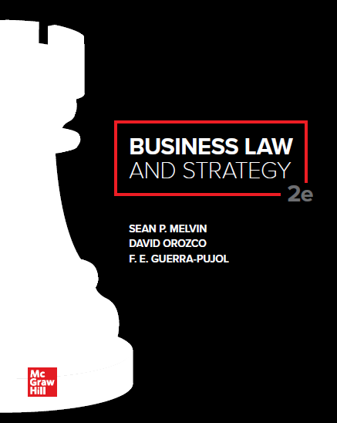
© McGraw Hill LLC. All rights reserved. No reproduction or distribution without the prior written consent of McGraw Hill LLC.

Slide 2
Chapter 10
Enforceability

Slide 3
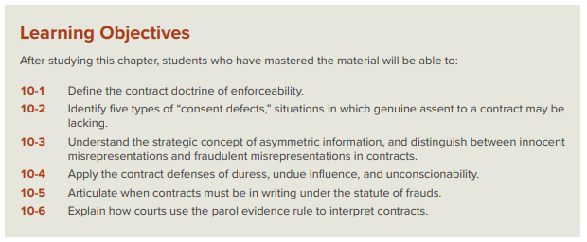
Chapter Learning Objectives

Slide 4
Enforceability of Contracts
If the parties have formed a valid contract, the legal analysis turns to the issue of enforceability.
A contract is of little use if it is not enforceable in a court of law, so business firms must ensure that their contracts are not only properly formed but also legally enforceable.
Even if the required elements of a contract (i.e., agreement, consideration, capacity, and lawful purpose) are present, the contract must also be the product of genuine assent, and it must be in writing under certain circumstances.

Slide 5
Consent Defects
There are five situations in which genuine assent may be lacking:
Misrepresentation;
Fraud;
Duress;
Undue influence; and
Unconscionability
If any of these five consent defects are present, there is no genuine assent, and the contract may not be enforceable.

Slide 6
Misrepresentation
Misrepresentation: Occurs when one party to an agreement makes a promise or representation about a material fact that is not true.
The common law recognizes two types of misrepresentation:
Innocent misrepresentations; and
Fraudulent misrepresentations.

Slide 7
Innocent Misrepresentation
An innocent misrepresentation can occur even if the misrepresenting party does not actually know that the promise or representation is false.
For a party to avoid a contract based on innocent misrepresentation, he must prove:
The misrepresentation was material;
He justifiably relied on the misstatement when forming the agreement; and
The misrepresentation was one of fact and not just someone’s opinion or mere puffing.

Slide 8
Case 10.1: Vokes v. Arthur Murray, Inc.
HELD: Although the court of appeals conceded that a misrepresentation, to be actionable, must be one of fact rather than one of opinion, the court identified several exceptions to this general rule: (1) where there has been a fiduciary relationship between the parties, (2) where there has been some artifice or trick employed by the representor, (3) where the parties do not in general deal at “arm’s length,” or (4) where the representee does not have equal opportunity to become apprised of the truth or falsity of the fact represented.

Slide 9
Fraud
When one party has engaged in conduct that meets the standards for misrepresentation and has actual knowledge that the representation is false, this conduct is classified as fraudulent misrepresentation (also known as fraud).
Misrepresentation plus guilty knowledge (also known as scienter) equals fraudulent misrepresentation.
In cases of fraudulent misrepresentation, most states classify the contract as void and the aggrieved party is generally entitled to recover money damages for any losses incurred, plus additional damages for such things as loss of future profits.
Some states go so far as to allow an award of treble damages (three times the amount of actual damages)

Slide 10
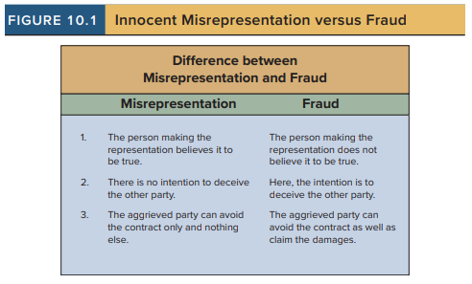
Innocent Misrepresentation versus Fraud

Slide 11
Strategic Digression: Asymmetric Information and Concealment of Material Fact
Information Asymmetry occurs when one contracting party has more or better information than the other.
Although many fraudulent misrepresentations arise out of affirmative promises, sometimes a fraudulent misrepresentation may occur when one party conceals a material fact.
Although parties do not have a general duty to disclose all information to each other, some courts have allowed the use of misrepresentation as a valid defense when:
A party has asserted a half-truth that leads to an overall misrepresentation;
One party takes an affirmative action to conceal the truth from the other party; or
One party fails to correct a past statement the other party subsequently discovers to be untrue.
Even when a party owes no general duty to disclose facts within their knowledge or to answer inquiries respecting such facts, if they undertake to do so they must disclose the whole truth.

Slide 12
Additional Contract Defenses
In addition to misrepresentation, the common law recognizes several other contract defenses, including:
(1) Duress;
(2) Undue Influence; and
(3) Unconscionability.
All these contract defenses manifest ways in which genuine assent might be lacking during the formation stage of a contract.

Slide 13
Duress
If one party to a contract uses any form of unfair coercion to induce another party to enter or modify a contract, the coerced party may avoid the contract based on duress.
Generally, the law recognizes three categories of duress:
Violence or threats of a violent act;
Economic threats (such as wrongful termination or threats to breach a contract); and
Threats of extortion (or other threats whereby the other party has no meaningful choice).

Slide 14
Undue Influence
The defense of undue influence gives legal relief to a party who has been induced to enter a contract through the improper pressure of a trusted relationship.
Undue influence allows the influenced party to avoid a contract when the court determines that the terms of the contract are unfair, and the parties had some type of relationship that involved a fiduciary duty or some duty to care for the influenced party.

Slide 15
Unconscionability
The defense of unconscionability gives the court the tools to refuse to enforce a contract where the consideration is grossly unequal.
Courts have been suspicious of standardized, preprinted contracts, known as adhesion contracts, because there is an assumption that the non-drafter has not genuinely bargained for the terms of the agreement.

Slide 16
Case 10.2: Williams v. Walker-Thomas Furniture Co.
HELD: The court of appeals reversed the decision of the lower court, applying the doctrine of unconscionability to the facts of the case and concluding that genuine assent could be negated in circumstances involving “gross inequality of bargaining power.” The court of appeals sent the case back to the trial court to determine whether the installment contracts in the case were procured through unconscionable means.

Slide 17
The Statute of Frauds
The statute of frauds refers to the law in each state governing which contracts must be in writing to be enforceable.
The main purpose of the statute of frauds is to prevent fraud by requiring that certain types of contracts have written evidence of their existence and terms.

Slide 18
The Statute of Frauds (Cont.)
The statute of frauds applies to the following types of contracts:
Contracts that involve the sale or use of land;
Contracts that cannot be (i.e., are not able to be, by their terms) performed in under one year;
Contracts to pay the debt of another (e.g., a loan surety);
Contracts made in consideration of marriage (e.g., a prenuptial agreement);
Contracts by the executor of a will to pay the debts of an estate with their own money; and
Contracts for the sale of goods for $500 or more and lease transactions for goods amounting to $1,000 or more.

Slide 19
Contract Interpretation and the Parol Evidence Rule
The parol evidence rule states that any writing intended by the parties to be the final expression of their agreement may not be contradicted by any oral or written agreements made prior to the writing.
The parol evidence rule does not bar admission of preliminary documents when they are being used to determine the meaning that the parties intended concerning a particular term in the contract.

Slide 20
Other Rules of Contract Interpretation
In cases involving ambiguous terms, the terms are construed by the court against the interest of the side that drafted the agreement.
Courts may also supply a reasonable term in a situation where the contract is silent or has omitted terms.

