Slide 1
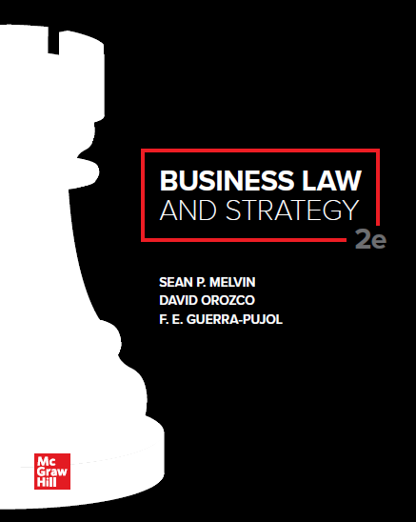
© McGraw Hill LLC. All rights reserved. No reproduction or distribution without the prior written consent of McGraw Hill LLC.

Slide 2
Chapter 13
Sales: Overview of Article 2

Slide 3
Chapter Learning Objectives

Slide 4
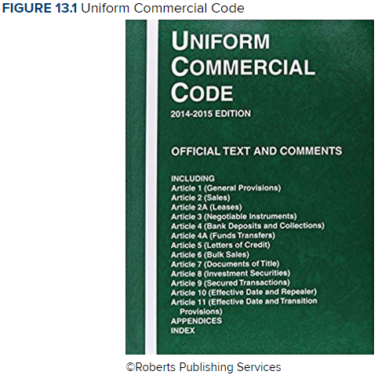
Uniform Commercial Code

Slide 5
Introduction to the UCC
The Uniform Commercial Code (UCC) is a model statute published by the National Conference of Commissioners of Uniform State Laws (NCCUSL).
Every state has adopted all (or substantially all) of the provisions of the UCC.
UCC Article 2 governs contracts for the sale of goods.

Slide 6
Purpose of Article 2 of The UCC
The underlying policy goal of Article 2 of the UCC is to promote commercial efficiency and the completion of business transactions.
UCC Article 2 facilitates business transactions by providing simple and standardized procedures that merchants and consumers may rely on in cases involving unforeseen contingencies.
These simple and standardized rules and procedures are also called default rules.

Slide 7
Default Rules
A default rule is a rule of law designed to fill “gaps” in business contracts (i.e., unexpected or unforeseen situations that might occur after a deal is made).
Default rules, like the rules in Article 2 of the UCC, help courts resolve problems that were not anticipated or addressed by the parties when they made their deal.
Default rules can be modified by agreement of the parties.

Slide 8
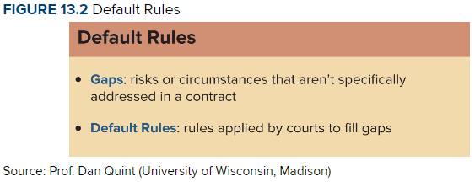
Default Rules

Slide 9
UCC Article 2 Coverage and Definitions
UCC Article 2 applies only to agreements for the sale of goods.
What are “goods”? Goods refers to property that are:
Tangible and
Movable from place to place
Real estate contracts or employment contracts are not covered by the UCC.

Slide 10
UCC Article 2 Coverage and Definitions (Cont.): Mixed Contracts
Mixed contracts involve the sale of goods and the provision of a service.
Generally, courts have applied the predominant purpose test to determine when UCC Article 2 applies to mixed contracts.

Slide 11
UCC Article 2 Coverage and Definitions (Cont.): Mixed Contracts
Under the predominant purpose test, courts must determine whether the predominant purpose of the contract is the rendition of a service, with goods only incidentally involved, or whether the main purpose of the contract is the transaction of a sale, with labor incidentally involved.
The UCC will govern if the predominant purpose is the sale of goods.
The common law will control if the predominant purpose is the provision of a service.

Slide 12
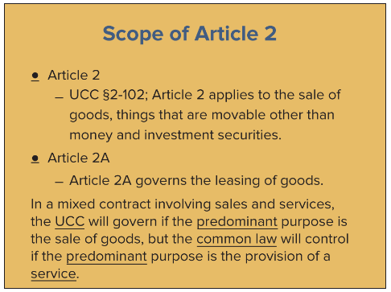
Overview: Scope of UCC Article 2

Slide 13
UCC Article 2 Coverage and Definitions (Cont.)
Article 2 contains special provisions that apply only to transactions involving merchants.
A merchant is anyone who is regularly engaged in the sale of a particular good.
“Merchant” also includes any person who employs a merchant as a broker, agent, or intermediary.
The UCC imputes a certain level of knowledge and awareness to merchants and allows their transactions to proceed in an expedited matter without the necessity for safeguards intended for average consumers.

Slide 14
Landmark Case 13.1: ProCD v. Zeidenberg
HELD: The Seventh Circuit Court of Appeals reversed the district court’s holding regarding the subject shrinkwrap license (The district court had granted Zeidenberg’s motion for summary judgment, holding that ProCD’s shrinkwrap license was unenforceable because Zeidenberg did not consent to the terms on the interior of the package at the time of purchase.) The court of appeals held that a database is a “good” and that shrinkwrap licenses in mass-market consumer transactions are enforceable under the Uniform Commercial Code. According to UCC Section 2-204(1), a contract for the sale of goods may be made in any manner sufficient to show agreement, including conduct by both parties which recognizes the existence of such a contract. A vendor, as master of the offer, may invite acceptance by conduct, and may propose limitations on the kind of conduct that constitutes acceptance. A buyer may accept by performing the acts the vendor proposes to treat as acceptance. That is what happened in the subject case. ProCD proposed a contract that a buyer would accept by using the software after having an opportunity to read the license. Zeiderberg did this; in fact, he had no choice, because the software displayed the license on the screen and would not let him proceed without indicating acceptance.

Slide 15
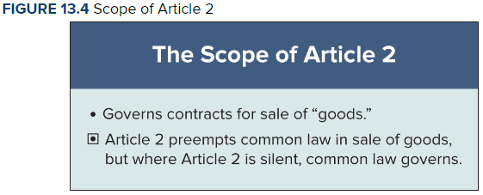
UCC and the Common Law

Slide 16
UCC and the Common Law
In summary, the common law applies to contracts involving the provision of services, while Article 2 of the UCC applies to contracts involving the sale of goods.
The UCC thus preempts or displaces the common law when goods are being sold.
Among other things, Article 2, for example, relaxes some of the stricter common law contract requirements, such as the doctrine of consideration.

