Slide 1
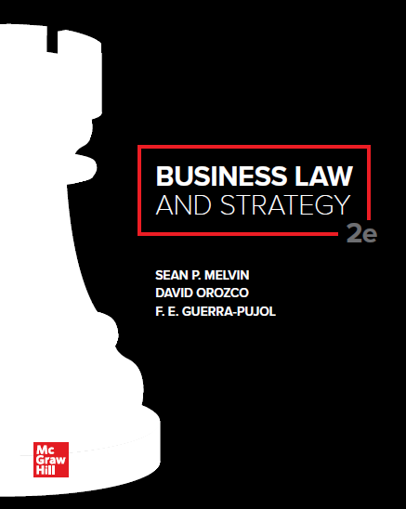
© McGraw Hill LLC. All rights reserved. No reproduction or distribution without the prior written consent of McGraw Hill LLC.

Slide 2
Chapter 14
Sales Contracts: Agreement, Consideration, and the Statute of Frauds

Slide 3
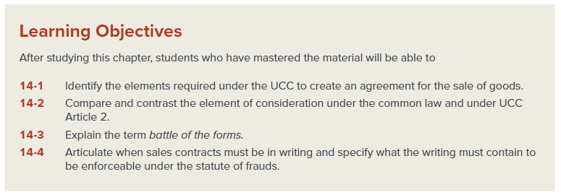
Chapter Learning Objectives

Slide 4
Formation of Agreement for Sale of Goods
The Uniform Commercial Code (U C C) allows a contract to be enforced based on:
Past commercial conduct;
Correspondence or verbal exchanges between the parties; and
Industry standards and norms.

Slide 5
Firm Offers by Merchants
If the seller is a merchant and promises in a signed writing to keep an offer for the sale of goods open for a period of time, under UCC Article 2 this action creates a firm offer that is irrevocable.
The firm offer will only last for the period of time stated in the offer.
If no time period for the offer to remain open is stated, it will stay open for a maximum of three months.
This offer is binding on the offeror even if the offeree has paid no consideration.

Slide 6
Offers with Open Terms
Sometimes merchants wish to engage in a sales transaction, but the parties overlook or are unsure about some key element of the contract (e.g., quantity, delivery, payment terms, or the price of the goods).
The missing provisions, known as open terms, are acceptable under the UCC if there is evidence the parties entered a contract and the other terms are sufficiently articulated to provide a basis for some appropriate remedy in case of breach.
The UCC’s approach toward open terms is an example of its gap-filling role; that is, the UCC fills gaps in the parties’ contract by providing a variety of answers based on what terms are missing

Slide 7
Quantity
GENERAL RULE:
Quantity is a required term in contracts for the sale of goods (i.e., necessary to create an enforceable sales contract).
TWO EXCEPTIONS:
Quantity may be an open term if the buyer agrees to purchase all the goods that a seller produces (known as an output contract).
In the alternative, quantity may be an open term when the buyer agrees to purchase all or up to an agreed amount of what the buyer needs for a given period (known as a requirements contract).

Slide 8
Other Open Terms—UCC Gap-Filling Rules
Delivery: If the place of delivery is not specified in the contract, the buyer takes delivery at the seller’s place of business (i.e., the seller is not responsible for delivery). Also, if no time of delivery is specified, the UCC provides for a reasonable time under the circumstances.
Payment: Payment is due at the time and place where the seller is to make delivery and may be made in any commercially reasonable form (such as a business check).
Price: The UCC requires the court to determine a reasonable price at the time of delivery, based on industry customs and market value.

Slide 9
Acceptance
The rules provided by UCC Article 2 for accepting an offer in a sales contract are not as rigid as the common law rules.
If an offeror does not clearly provide for a method of acceptance, the UCC allows an offeree to accept the offer in any reasonable manner.
Under the UCC, acceptance may still be effective even if the acceptance does not match the offer exactly.

Slide 10
Consideration
Common law contracts must be supported by bargained-for consideration, and most contracts involving non-goods (i.e., those governed by the common law) cannot be modified without some additional consideration.
Difference Between the Common Law and the UCC Regarding Consideration
While the UCC follows a similar rule that consideration must support a sales contract, a major difference is that the UCC allows contracts to be modified even without any additional consideration.
Rationale: The UCC recognizes that market conditions are not static and that the parties have good faith reasons for modifying a contract without having to comply with some additional legal burden to continue its enforceability.

Slide 11
The Battle of the Forms
Business frequently use preprinted forms to initiate or respond to an offer to sell a good, and these forms usually have some blanks for the negotiated terms unique to the transaction.
Normally, the offer takes the form of a purchase order from the buyer that contains preprinted clauses (which typically favor the buyer) and blanks that a purchase manager fills in with terms (e.g., shipment date, product information, quantity, etc.).
The seller will then typically issue an acknowledgement form, also called an invoice, which also has preprinted provisions (typically favoring the seller) and blanks to accommodate the specifies of that transaction.

Slide 12
The Battle of the Forms (Cont.)
In some cases, one merchant proposes a certain term in the offering document (e.g., the purchase order), but the other merchant’s acceptance (e.g., the invoice or acknowledgement form) states a term that is different from the offer.
In such a case, most states use the knockout rule, under which the conflicting clauses knock each other out and neither clause becomes part of the contract; instead, the courts look to the UCC’s gap-filler provisions to supply the term.

Slide 13
The Battle of the Forms (Cont.)
Nonmerchant Transactions—If one of the parties to a sales contract is not a merchant, the contract is formed as originally offered. The contract is considered accepted, but the additional terms are not part of the contract.
Merchant Transactions—In a sales contract acceptance between merchants, additional terms automatically become part of the enforceable contract unless:
The buyer has expressly and clearly limited acceptance to the original terms;
The additional term is a material change that diverges significantly from those contained in the offer; or
The seller raises an objection to the additional terms within a reasonable time period according to industry standards.

Slide 14
The Battle of the Forms (Cont.)
The UCC provides guidelines on how to resolve a dispute when the terms in a purchase order and an invoice conflict, a dilemma is known as the battle of the forms.
In a battle of the forms case, the UCC provides that: (1) a document may constitute acceptance even though it states terms that are additional to or different from those offered by the offeror; and
(2) in certain transactions, the additional terms proposed in the acceptance may become part of the sales contract.

Slide 15
Statute of Frauds
Statute of Frauds: A legal requirement that certain contracts be in writing to be enforceable.
Under the UCC, any sales contract for goods valued at $500 or more must be in writing.

Slide 16
UCC Statute of Frauds
To satisfy the UCC statute of frauds requirement, the sales contract must contain the following in writing:
The quantity;
The signature of the party against whom enforcement is sought; and
Language that would allow a reasonable person to conclude that the parties intended to form a contract.
All other terms and conditional may be proved by testimony concerning oral agreements, past practices, and industry standards.

Slide 17
UCC Statute of Frauds (Cont.)
The UCC statute of frauds provides a relatively lenient rule for sales contracts between two merchants.
A merchant who receives a signed confirmation memorandum from the other merchant will be bound by the memorandum just as if they had signed it, unless they promptly object.
Also, the UCC recognizes electronic records and signatures in a sales transaction as valid.
This means that the hard copies of documents with original signatures are not always necessary.
Although the UCC does not require electronic transactions, it makes clear that a sales contract cannot be held unenforceable simply because it is in electronic form.

Slide 18
Case 14.1: Rosenfeld v. Basquiat
HELD: The U.S. Court of Appeals for the Second Circuit concluded that a brown piece of wrapping paper that had in crayon the quantity, price, deposit amount, the name of the goods to be sold, and the signature of both parties (also in crayon) complied with Article 2 of the UCC and that the delivery terms were not required to satisfy the UCC’s statute of frauds. As a result, the court affirmed the trial court’s decision on the statute of frauds.

