Slide 1
Process Costing and Analysis
Chapter 16
Wild and Shaw
Financial and Managerial Accounting
9th Edition
Copyright ©2022 McGraw-Hill Education. All rights reserved. No reproduction or distribution without the prior written consent of McGraw-Hill Education.

Slide 2
Chapter 16 Learning Objectives
CONCEPTUAL
C1 Explain process costing and contrast it with job order costing.
C2 Appendix 16A- Compute process activity costs and prepare a production cost report using FIFO.
ANALYTICAL
A1 Illustrate a hybrid costing system and analyze process system yield.
PROCEDURAL
P1 Compute process activity costs using weighted average.
P2 Prepare a production cost report using weighted average.
P3 Record the flow of production costs in process costing.
P4 Record the transfer of goods across departments, to Finished Goods Inventory, and to Cost
of Goods Sold.
© McGraw-Hill Education
16-2

Slide 3
Explain process costing and contrast it with job order costing.
Learning Objective C1
16-3
© McGraw-Hill Education

Slide 4
Process Operations
Used for mass production of similar items.
Continuous flow of sequential processes.
Standardized process to make large volumes of similar products.
© McGraw-Hill Education
16-4
Learning Objective C1: Explain process costing and contrast it with job order costing.
Notes:
Process operations involve the mass production of similar products in a continuous flow of sequential processes. Process operations use a standardized process to make large volumes of similar products; job order operations use a customized process to make unique products.
Each of the products shown on this slide is made in a series of repetitive processes, or steps. Understanding such processes is crucial for measuring product costs. Increasingly, process operations use machines and automation to control product quality and reduce manufacturing costs.

Slide 5
Organization of Process Operations
Each process is a separate production department.
Each process applies direct labor, overhead, and direct materials to move product to completion.
Final process in series finishes goods and makes them ready for sale.
Exhibit 16.1
© McGraw-Hill Education
16-5
Learning Objective C1: Explain process costing and contrast it with job order costing.
Notes:
In a process operation, each process is a separate production department or workstation. Each process applies direct labor, overhead, and often direct materials to move the product toward completion. The final process or department in the series finishes the goods and makes them ready for sale. Exhibit 16.1 shows the production of FitMix, an organic trail mix by GenX Company. FitMix is manufactured in a continuous, two-process operation: Roasting and Blending.
In the first process (Roasting department), the company roasts with oils, salts, and organic peanuts. The roasted peanuts are then passed to the Blending department, the second process. In the Blending department, workers blend organic chocolate pieces and organic dried fruits with the peanuts from the first process. The blended mix is then inspected and packaged for sale.

Slide 6
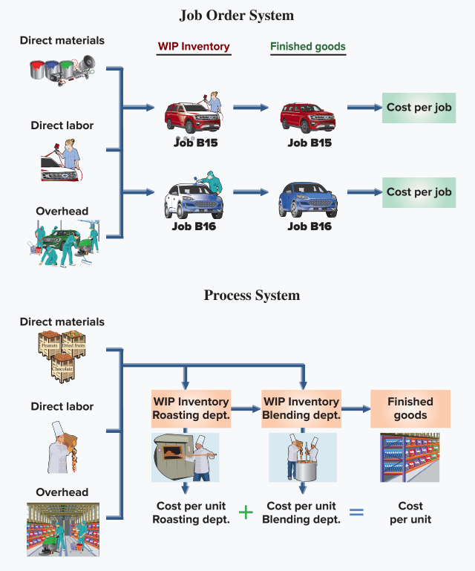
Comparing Process and Job Order Costing Systems
Exhibit 16.2
© McGraw-Hill Education
16-6
Learning Objective C1: Explain process costing and contrast it with job order costing.
Notes:
Both job order costing systems and process costing systems use materials, labor, and overhead costs. Both aim to compute the cost per unit of product (or service).
Differences include:
Cost object: Job order system: cost object is a job or job lot; Process system: cost object is the process or department.
Cost per unit: Job order system: measures cost per unit after completion of a job; Process system: measures unit costs at the end of a period (such as a month) by combining costs per unit from each process.
Internal reporting: Job order system: job cost sheets; Process system: production cost report.
Work in Process inventory: Job order system: one Work in Process Inventory account; Process system: one Work in Process Inventory account per process.

Slide 7
Compute process activity costs using weighted average.
Learning Objective P1
© McGraw-Hill Education
16-7

Slide 8
Process Costing Demonstration
The following four steps demonstrate process costing using the weighted average method:
Determine physical flow of units.
Compute equivalent units of production.
Compute cost per equivalent unit of production.
Assign and reconcile costs.
© McGraw-Hill Education
16-8
Learning Objective P1: Compute process activity costs using weighted average.
Notes:
The weighted-average method combines units and costs across two periods in computing equivalent units and cost per equivalent unit.
The four-steps demonstrate process costing using a weighted average method:
1. Determine physical flow of units.
2. Compute equivalent units of production.
3. Compute cost per equivalent unit of production.
4. Assign and reconcile costs.

Slide 9
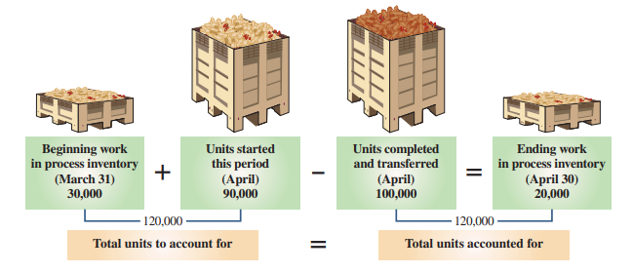
Step 1: Determine Physical Flow of Units
Exhibits 16.3 & 16.4
© McGraw-Hill Education
16-9
Learning Objective P1: Compute process activity costs using weighted average.
Notes:
Step 1 is to determine the number of units to account for and units accounted for. For FitMix, a unit is a cup of trail mix.
Exhibit 16.3 shows production data in units for the first process: Roasting department. On the left we compute the 120,000 units to account for, which are the 30,000 units in beginning work in process inventory plus 90,000 units started this period. On the right we reconcile (match) with the 120,000 units accounted for, which are the 100,000 units completed and transferred out plus 20,000 units in ending work in process inventory.
A physical unit flow reconciliation proves that (1) beginning units in process plus those started in the period equals the (2) ending units in process plus those completed and transferred out in the period. A physical unit flow reconciliation for the Roasting department for April is shown in Exhibit 16.4.

Slide 10
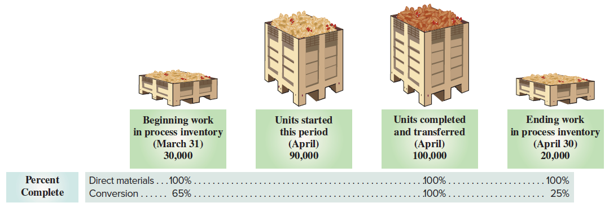
Step 2: Compute Equivalent Units of Production (1 of 2)
Exhibit 16.5
© McGraw-Hill Education
Learning Objective P1: Compute process activity costs using weighted average.
16-10
Notes:
Step 2 is to compute equivalent units of production. Equivalent units of production (EUP) is the number of whole units that could have been started and completed given the costs incurred in the period. The reason we use equivalent units of production is that some units are not finished at the end of a period, but still need to be assigned costs.
Exhibit 16.5 shows percent of complete data for direct materials and conversion for the Roasting department. Those percents are needed to compute equivalent units of production. In both Roasting and Blending, direct materials enter production at the beginning of the process, while conversion costs occur throughout each department’s processing. Conversion costs consist of direct labor and applied overhead. They are called conversion costs because those are the costs of converting raw materials into finished goods.
We see that beginning work in process inventory is 100% complete for direct materials but only 65% complete for conversion. Ending work in process inventory is 100% complete for direct materials but only 25% complete for conversion. Units completed and transferred to the Blending department are 100% complete for both direct materials and conversion.
We separately compute equivalent units of production for direct materials and conversion costs. This is because direct materials and conversion costs typically enter processes at different rates. We see this for FitMix in Exhibit 16.5 where there are different percents of completion for direct materials and conversion costs for both beginning and ending work in process inventories.

Slide 11
Step 2: Compute Equivalent Units of Production (2 of 2)
Exhibit 16.6
Exhibit 16.7
© McGraw-Hill Education
16-11
Learning Objective P1: Compute process activity costs using weighted average.
Notes:
Exhibit 16.6 shows the formula to compute equivalent units of production under the weighted-average method for both direct materials and conversion costs.
We compute the equivalent units of production (EUP) for both direct materials and conversion in Exhibit 16.7. We start with the 120,000 units accounted for from Step 1 and convert them to EUP.
Units completed and transferred out are always 100% complete for both materials and conversion. This means the Roasting department completed and transferred 100,000 EUP for both materials and conversion.
Ending work in process inventory has 20,000 partially complete units. Direct materials is 100% complete. This means it has 20,000 EUP (20,000 units x 100%). Conversion is 25% complete. This means it has 5,000 EUP (20,000 x 25%).
Total equivalent units of production equals 120,000 for direct materials (100,000 + 20,000) and 105,000 for conversion (100,000 + 5,000). The amount of inputs used to produce 100,000 completed units and to start 20,000 additional units is equivalent to the amount of direct materials in 120,000 whole units and the amount of conversion in 105,000 whole units.

Slide 12
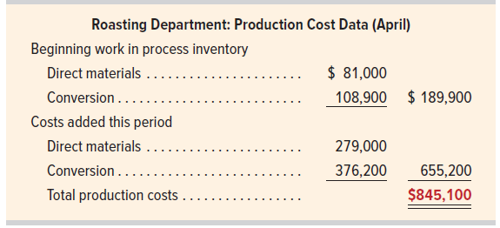
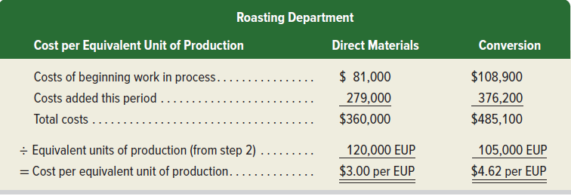
Step 3: Compute Cost Per Equivalent Unit
Exhibit 16.8
Exhibit 16.9
© McGraw-Hill Education
16-12
Learning Objective P1: Compute process activity costs using weighted average.
Notes:
Step 3 uses equivalent units of production from Step 2, along with cost data, to compute cost per equivalent unit. Production cost data for the Roasting department are in Exhibit 16.8. Recall: Conversion costs equals direct labor costs plus factory overhead costs applied.
To compute cost per equivalent unit, we add costs for beginning work in process to costs added this period, and then divide by equivalent units of production from Step 2. Exhibit 16.9 shows this separately for direct materials and for conversion. The cost for direct materials is $3.00 per EUP, and for conversion is $4.62 per EUP.

Slide 13
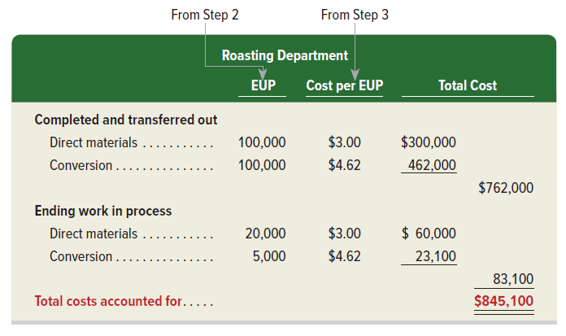
Step 4: Assign and Reconcile Costs
Exhibit 16.10
© McGraw-Hill Education
16-13
Learning Objective P1: Compute process activity costs using weighted average.
Notes:
Step 4 uses the EUP from Step 2 and the cost per EUP from Step 3 to assign costs to the 100,000 units completed and transferred out and to the 20,000 units in ending work in process. Those costs are accounted for in Exhibit 16.10.
Cost of Units Completed and Transferred Out: The 100,000 units completed and transferred out used 100,000 EUP of direct materials and 100,000 EUP of conversion. Thus, we assign $300,000 (100,000 EUP x $3.00 per EUP) of direct materials cost to those units and $462,000 (100,000 EUP x $4.62 per EUP) of conversion to those units. Total cost of the 100,000 units completed and transferred out is $762,000 ($300,000 + $462,000).
Cost of Units in Ending Work in Process Inventory: There are 20,000 units in work in process inventory at period-end. For direct materials, those units have 20,000 EUP (from Step 2) at a cost of $3.00 per EUP (from Step 3), which results in direct materials cost of work in process inventory of $60,000 (20,000 EUP x $3.00 per EUP). For conversion, we use the 5,000 EUP (from Step 2) and $4.62 conversion cost per EUP (from Step 3) to compute conversion costs for work in process inventory of $23,100 (5,000 EUP x $4.62 per EUP). Total cost of work in process inventory at period-end is $83,100 ($60,000 + $23,100).
Reconciliation: Management verifies that total costs assigned to units completed and transferred out plus the costs of units in ending work in process (from Exhibit 16.10) equal the costs incurred by production. Exhibit 16.10 shows total costs accounted for of $845,100 equals total production costs of $845,100 from Exhibit 16.8.

Slide 14
Using Process Cost Information
Control costs: compare to prior months and take necessary corrective action.
Evaluate performance: evaluate department managers based on their control of costs.
Evaluate process improvements: examine how costs per EUP change after process improvements.
Prepare financial statements: cost of goods sold and ending inventory are reported on income statement and balance sheet.
© McGraw-Hill Education
16-14
Learning Objective P1: Compute process activity costs using weighted average.
Notes:
Using Process Cost Information Process cost information is used to:
Control costs—The department’s equivalent costs per unit can be compared with prior months. If materials and/or conversion costs have changed a lot, managers should determine why and take corrective action.
Evaluate performance—Top management can evaluate department managers based on their control of costs. Costs per equivalent unit are often compared to budgeted amounts.
Evaluate process improvements—Organizations strive to improve processes. The success of process improvements can be evaluated by examining how costs per equivalent unit change after process improvements.
Prepare financial statements—Cost of goods sold and ending inventory amounts computed from process cost data are reported on the income statement and balance sheet, respectively.

Slide 15
Prepare a production cost report using weighted average.
Learning Objective P2
© McGraw-Hill Education
16-15

Slide 16
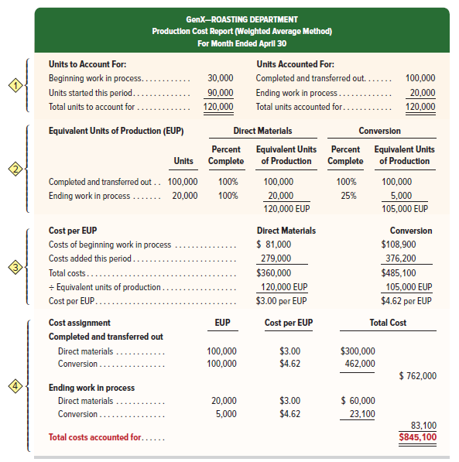
Process Cost Report
Exhibit 16.11
© McGraw-Hill Education
16-16
Learning Objective P2: Prepare a production cost report using weighted average.
Notes:
The production cost report, or process cost summary, summarizes the four-step process. It shows the results of Exhibits 16.4, 16.7, 16.9 and 16.10 in one report. The production cost report for the Roasting department is shown in Exhibit 16.11.
This report includes:
Physical flow of units. This reconciles the beginning units in process and those started in a period with the ending units in process and those completed and transferred out.
Equivalent units of production for direct materials and for conversion.
Costs per equivalent unit of production for direct materials and for conversion.
Assignment of total costs among units worked on in the period.
The $762,000 is the total cost of the 100,000 units transferred out of the Roasting department to the Blending department. The $83,100 is the cost of the 20,000 partially completed units in ending work in process inventory in the Roasting department. The assigned costs are then added to show that the total $845,100 cost charged to the Roasting department is now assigned to the units.

Slide 17
Record the flow of production costs in process costing.
Learning Objective P3
© McGraw-Hill Education
16-17

Slide 18
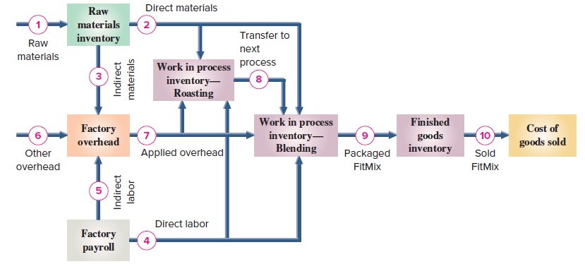
Accounting for Process Costing
Exhibit 16.12
© McGraw-Hill Education
16-18
Learning Objective P3: Record the flow of production costs in process costing.
Notes:
Exhibit 16.12 shows the flow of materials, labor, and overhead costs through the manufacturing processes. There are separate Work in Process Inventory accounts for the Roasting and Blending departments; when goods are packaged and ready for sale, their costs are transferred to the Finished Goods Inventory account. When goods are sold, their costs are transferred to Cost of Goods Sold.
While many companies combine direct labor and overhead into conversion costs when computing costs per equivalent unit (as we showed), direct labor and overhead costs are accounted for separately in general ledger accounts. Because overhead costs typically cannot be tied to individual processes, most process operations use a single Factory Overhead account to accumulate actual and applied overhead costs.

Slide 19
Accounting for Production Costs
Exhibit 16.13
© McGraw-Hill Education
16-19
Learning Objective P3: Record the flow of production costs in process costing.
Notes:
Exhibit 16.13 presents cost data for GenX’s Roasting and Blending departments. We use these data to show the journal entries in a process costing system.

Slide 20
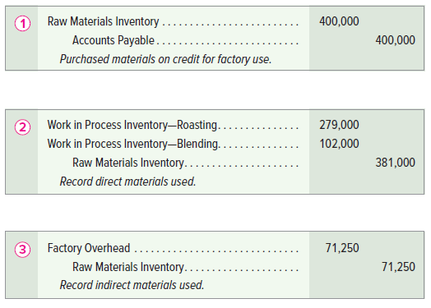
Accounting for Material Costs
© McGraw-Hill Education
16-20
Learning Objective P3: Record the flow of production costs in process costing.
Notes:
Arrow line 1 (from Exhibit 16.12) reflects the purchase of raw materials. GenX uses a perpetual inventory system and makes all purchases on credit.
Arrow line 2 (from Exhibit 16.12) shows the flow of direct materials to production in the Roasting and Blending departments. The manager of a process usually obtains materials by submitting a materials requisition to the materials storeroom manager. The entry to record the use of direct materials follows. These direct materials costs flow into each department’s separate Work in Process Inventory account.
Arrow line 3 (from Exhibit 16.12) reflects the flow of indirect materials to factory overhead. These materials cannot be cost-effectively traced to any specific production process or department but are used in production. These costs are recorded in the single Factory Overhead account with the entry shown.

Slide 21
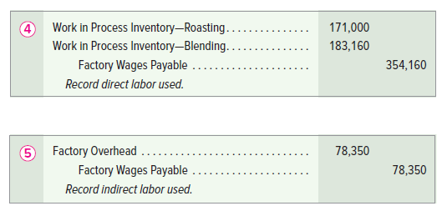
Accounting for Labor Costs
© McGraw-Hill Education
16-21
Learning Objective P3: Record the flow of production costs in process costing.
Notes:
Factory payroll costs are $171,000 for Roasting department direct labor, $183,160 for Blending department direct labor, and $78,350 for indirect labor. This total factory payroll of $432,510 is assigned to either Work in Process Inventory (direct labor) or Factory Overhead (indirect labor).
Arrow line 4 shows use of direct labor. This entry records direct labor used. Direct labor costs flow into each department’s separate Work in Process Inventory account.
Arrow line 5 reflects indirect labor costs. These employees assist in or supervise production in both the Roasting and Blending departments. For example, they order materials and deliver them to the factory floor, repair equipment, operate and program computers used in production, clean up, and move goods across departments. The entry shown records indirect labor costs.

Slide 22
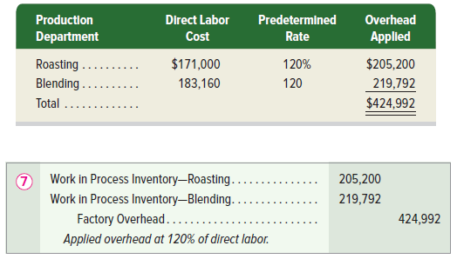
Accounting for Factory Overhead
Exhibit 16.14
© McGraw-Hill Education
16-22
Learning Objective P3: Record the flow of production costs in process costing.
Notes:
Overhead costs other than indirect materials and indirect labor are reflected by arrow line 6. Other overhead items include costs of insuring production assets, renting the factory building, using factory utilities, and depreciating factory equipment not directly related to a specific process. This entry records these other overhead costs.
Companies use predetermined overhead rates to apply overhead. These rates are estimated at the beginning of a period and used to apply overhead during the period. This is important for process costing, where goods are transferred across departments before the entire production process is complete. Factory overhead is applied to processes using activity bases such as direct labor or machine hours.
Arrow line 7 shows factory overhead applied to the two production departments. GenX applies overhead using a predetermined rate of 120% of direct labor cost and records the journal entry shown here.

Slide 23
Record the transfer of goods across departments, to Finished Goods Inventory, and to Cost of Goods Sold.
Learning Objective P4
© McGraw-Hill Education
16-23

Slide 24
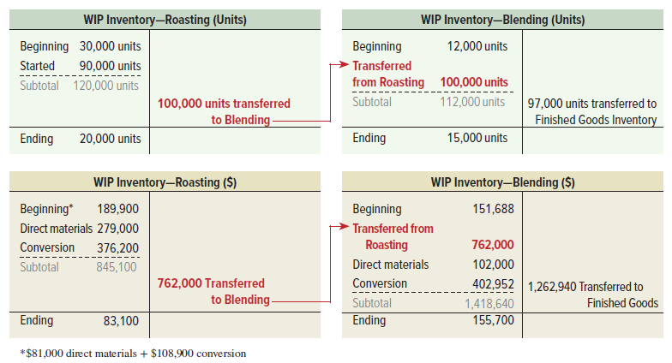
Transfers Across Departments
Exhibit 16.15
Learning Objective P4: Record the transfer of goods across departments, to Finished Goods Iinventory, and to Cost of Goods Sold.
© McGraw-Hill Education
16-24
Notes:
Arrow line 8 shows the transfer of partially completed units from Roasting to Blending. The production cost report for the Roasting department (Exhibit 16.11) shows that the 100,000 units transferred to the Blending department are assigned a cost of $762,000. The entry to record this transfer is shown here.
Units and costs transferred out of the Roasting department are transferred into the Blending department. Exhibit 16.15 shows this transfer using T-accounts for the separate Work in Process Inventory accounts (first in units and then in dollars).
We see that the Blending department began the month with 12,000 units in beginning inventory with a cost of $151,688. Then 100,000 units and costs of $762,000 are transferred to the Blending department from the Roasting department. The Blending department adds direct materials costs of $102,000 and conversion costs of $402,952 during the month.

Slide 25
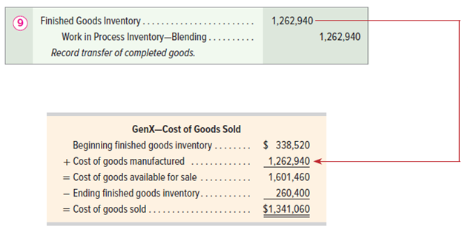
Accounting for Transfer to Finished Goods
Exhibit 16.16
Learning Objective P4: Record the transfer of goods across departments, to Finished Goods Inventory, and to Cost of Goods Sold.
© McGraw-Hill Education
16-25
Notes:
Arrow line 9 in Exhibit 16.16 shows the transfer of units and costs from the Blending department to finished goods inventory. The Blending department transferred 97,000 completed units along with costs of $1,262,940 to finished goods. The entry to record this transfer is shown here.

Slide 26
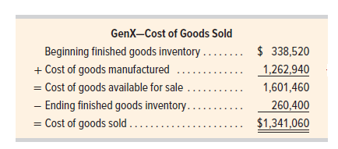
Accounting for Cost of Goods Sold
Exhibit 16.16
Learning Objective P4: Record the transfer of goods across departments, to Finished Goods Inventory, and to Cost of Goods Sold.
© McGraw-Hill Education
16-26
Notes:
Arrow line 10 shows the sale of finished goods. Assume that GenX sold 103,000 units of FitMix this period, and that its beginning finished goods inventory was 26,000 units with a cost of $338,516. Also assume that its ending finished goods inventory consists of 20,000 units at a cost of $260,400. Using this information, cost of goods sold is computed as in Exhibit 16.16.
GenX’s selling price for FitMix is $18.60 per unit. The entry to record sales of 103,000 units (on credit) for this period is shown with a debit to Accounts Receivable and a credit to Sales in the amount of $1,915,800.
The entry to record cost of goods sold for this period includes a debit to Cost of Goods Sold and a credit to Finished Goods Inventory for $1,341,060.

Slide 27
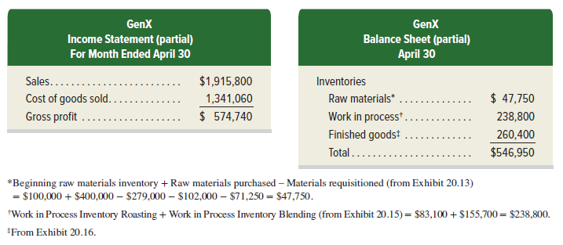
Financial Statement Reporting
Learning Objective P4: Record the transfer of goods across departments, to Finished Goods Inventory, and to Cost of Goods Sold.
© McGraw-Hill Education
16-27
Notes:
GenX prepares monthly financial statements. It reports the following on its April income statement (partial) and April 30 balance sheet (partial).
In making pricing decisions, managers often use the cost per completed unit. This computation for FitMix is $13.02.
The cost of goods manufactured for a process manufacturer equals the costs transferred from the last production process to finished goods inventory. GenX must set the price of FitMix high enough to cover its cost of completed units, plus its selling and general and administrative costs, to be profitable.

Slide 28
Trends in Process Operations
Process design
Just-in-time production
Customer orientation
Robotics &
Automation
Services
Continuous Processing
Learning Objective P4: Record the transfer of goods across departments, to Finished Goods Inventory, and to Cost of Goods Sold.
© McGraw-Hill Education
16-28
Notes:
Recent trends in process operations include:
Process design - Concerns with production efficiency can lead companies to reorganize production processes. For example, instead of producing different types of computers in a series of departments, a separate work center for each computer can be setup in one department. The process cost system is then changed to account for each work center’s costs.
Just-in-time production – With a just-in-time production system, inventory levels can be minimal. If raw materials are not ordered or received until needed, a Raw Materials Inventory account might be unnecessary. Instead, direct materials cost is immediately debited to Work in Process Inventory. Similarly, a Finished Goods Inventory account may not be needed. Instead, cost of goods manufactured might be immediately debited to Cost of Goods Sold.
3. Robotics and Automation - Many production processes are automated. This results in reduced direct labor costs. Machine learning can lead to process improvements that reduce costs and increase efficiency.
4. Continuous Processing - In some companies, like Pepsi Bottling, materials move continuously through the manufacturing process. In these cases, a materials consumption report summarizes the materials used and replaces materials requisitions.
5. Services - Service-based businesses are common. For standardized services like oil changes and simple tax returns, computing costs based on the process is simpler and more useful than a cost per individual job.
6. Customer orientation - Focus on customer orientation leads to improved processes. A manufacturer of control devices improved quality and reduced production time by forming teams to study processes and suggest improvements.

Slide 29
Illustrate a hybrid costing system and analyze process system yield.
Learning Objective A1
© McGraw-Hill Education
16-29

Slide 30
Hybrid Costing System
Hybrid system (operation costing system) contains features of both process and job order operations.
Requires a hybrid costing system to determine cost of products/services.
Companies try to standardize processes while also meeting customer needs.
Important to monitor and control costs.
© McGraw-Hill Education
16-30
Learning Objective A1: Illustrate a hybrid costing system and analyze process system yield.
Notes:
A hybrid system contains features of both process and job order operations and is also called operation costing system.
A hybrid system of processes requires a hybrid costing system to properly cost products or services.
Assembly costs per car are computed using process costing. The costs of additional components are computed using job order costing. The costs of custom choices are then added to the assembly process costs to determine each car’s total cost.

Slide 31
Hybrid Costing System – Illustration and Yield
© McGraw-Hill Education
16-31
Learning Objective A1: Illustrate a hybrid costing system and analyze process system yield.
Notes:
To illustrate, consider the following information for a daily assembly process.
The assembly process costs $22,600 per car. Depending on the type of wheels and sound system the customer requests, the cost of a car can range from $23,460 to $24,440. If the company’s target markup is 20% above cost, its selling prices would range from $28,152 ($23,460 × 120%) to $29,328 ($24,440 × 120%).
Yield: a measure of output divided by input and can be used to measure the efficiency of process operations.
If Ford entered enough direct materials into production to produce 10,000 Mustangs, but only 9,900 nondefective cars were produced, yield is computed as 99% as shown on this slide.
If a trail mix manufacturer started 10,000 pounds of peanuts in production and ended with processed peanuts of 9,650 pounds, its yield is 96.5% (9,650/10,000). Yield might be less than expected due to inferior direct materials or issues with the production process. When yields are lower than expected, managers ask why and take corrective action.

Slide 32
AppendixꟷCompute process activity costs and prepare a production cost report using FIFO.
Learning Objective C2
© McGraw-Hill Education
16-32

Slide 33
FIFO Method of Process Costing
The following four steps demonstrate process costing using the FIFO method:
Determine physical flow of units.
Compute equivalent units of production.
Compute cost per equivalent unit of production.
Assign and reconcile costs.
© McGraw-Hill Education
16-33
Learning Objective C2: Compute process activity costs and prepare a production cost report using FIFO.
Notes:
We provide a step-by-step demonstration of process costing for GenX's production of FitMix, an organic trail mix. FitMix is manufactured in a continuous, two-process operation: Roasting and Blending. Accounting for each process or department in a process operation follows four steps:
1. Determine the physical flow of units.
2. Compute equivalent units of production.
3. Compute cost per equivalent unit of production.
4. Assign and reconcile costs.
In each step, we demonstrate process costing using the first-in, first-out (FIFO) method. FIFO assigns costs to units assuming a first-in, first-out flow of product. We explain how this affects process costing accounting in each step.

Slide 34
Step 1: Determine Physical Flow of Units – (1 of 2)
Exhibit 16A.1
© McGraw-Hill Education
16-34
Learning Objective C2: Compute process activity costs and prepare a production cost report using FIFO.
Notes:
Step 1 is to determine the number of units to account for and units accounted for. For FitMix, a unit is a cup of trail mix. Exhibit 16.A1 shows production data in units for the first process: Roasting department.
Units to Account For: beginning work in process inventory + units started this period.
Units Accounted For: Using FIFO, we look at three groups of units when determining units accounted for:
• Beginning work in process inventory
• Units started and completed this period
• Ending work in process inventory
Beginning work in process inventory for Roasting is 30,000 units, and its ending work in process inventory is 20,000 units (from Exhibit 16A.1). To get the number of units started and completed this period we apply the following procedure.
Units Started and Completed: FIFO assumes that the units in beginning work in process inventory are the first units completed in the period. For Fitmix, this means that of the 100,000 units completed and transferred out this period, we assume 30,000 are from beginning work in process inventory. This implies that 70,000 (100,000 − 30,000) units were started and completed this period.

Slide 35
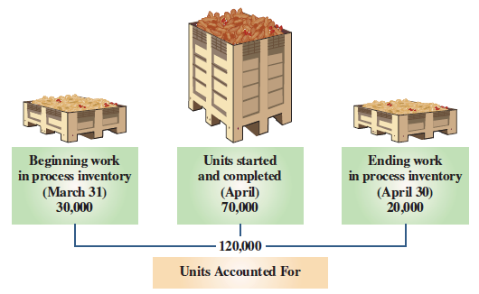
Step 1: Determine Physical Flow of Units – FIFO (2 of 2)
Exhibit 16A.2
Exhibit 16A.3
© McGraw-Hill Education
16-35
Learning Objective C2: Compute process activity costs and prepare a production cost report using FIFO.
Notes:
Exhibit 16A.2 shows the three groups of units for determining units accounted for.
Determine Flow of Units: A physical unit flow reconciliation proves that (1) beginning units in process plus units started in the period equals the (2) beginning units in process plus units started and completed plus units in ending work in process. A physical unit flow reconciliation for the Roasting department for April is in Exhibit 16A.3.

Slide 36
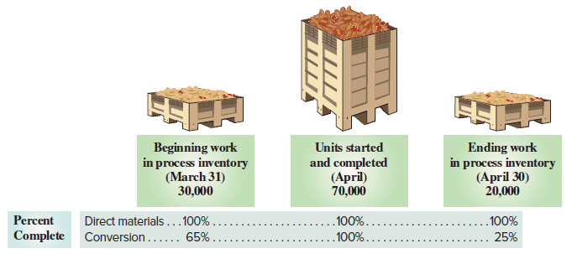
Step 2: Compute Equivalent Units of Production – FIFO
Exhibit 16A.4
Exhibit 16A.5
© McGraw-Hill Education
16-36
Learning Objective C2: Compute process activity costs and prepare a production cost report using FIFO.
Notes:
Step 2 is to compute equivalent units of production. Equivalent units of production (EUP) is the number of whole units that could have been started and completed given the costs incurred in the period.
Exhibit 16A.4 shows percent complete data for direct materials and conversion for the Roasting department. The percents are needed to compute equivalent units of production. In both Roasting and Blending, direct materials enter production at the beginning of the process, while conversion costs occur throughout each department’s processing. Conversion costs consist of direct labor and overhead. They are called conversion costs because those are the costs of converting raw materials into finished goods.
We see that beginning work in process inventory is 100% complete for direct materials but only 65% complete for conversion. Ending work in process inventory is 100% complete for direct materials but only 25% complete for conversion. Units started and completed that are sent to the Blending department are 100% complete for both direct materials and conversion.
We separately compute equivalent units of production for direct materials and conversion costs. This is because direct materials and conversion costs typically enter processes at different rates. We see this for FitMix in Exhibit 16A.4, where there are different percents of completion for direct materials and conversion costs for both beginning and ending work in process inventories.
Exhibit 16A.5 shows the formula to compute equivalent units of production under the FIFO method for both direct materials and conversion.

Slide 37
Step 2: Compute Equivalent Units of Production – FIFO Illustration
Exhibit 16A.6
© McGraw-Hill Education
16-37
Learning Objective C2: Compute process activity costs and prepare a production cost report using FIFO.
Notes:
Direct Materials: Total equivalent units of production is 90,000 for direct materials (0 + 70,000 + 20,000).
• Beginning work in process had 30,000 units that were 100% complete with respect to direct materials. EUP is 0 as no direct materials were added to complete these units.
• Started and completed units were 70,000. These units received 100% of direct materials during the month, so EUP is 70,000.
• Ending work in process had 20,000 units started but not completed during the month. These units received 100% of its direct materials this period, so EUP is 20,000.
Conversion: Total equivalent units of production is 85,500 for conversion (10,500 + 70,000 + 5,000).
• Beginning work in process had 30,000 units that were 65% complete for conversion. These units needed another 35% (100% − 65%) of conversion costs to complete them, so EUP is 10,500 (30,000 × 35%).
• Started and completed units were 70,000. These units received 100% of conversion costs during the month, so EUP is 70,000.
• Ending work in process had 20,000 units started but not completed during the month. These units received 25% of its conversion costs this period, so EUP is 5,000 (20,000 × 25%).

Slide 38
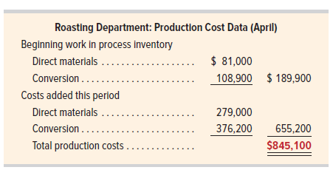
Step 3: Compute Cost Per Equivalent Unit – FIFO
Exhibit 16A.7
Exhibit 16A.8
© McGraw-Hill Education
16-38
Learning Objective C2: Compute process activity costs and prepare a production cost report using FIFO.
Notes:
Step 3 uses equivalent units of production from Step 2, along with cost data, to compute cost per equivalent unit. FIFO computes the cost per equivalent unit based solely on this period’s costs (unlike weighted-average method, which includes costs of beginning work in process inventory). Production cost data for the Roasting department are in Exhibit 16A.7. Recall: Conversion costs equals direct labor costs plus factory overhead costs applied.
To compute cost per equivalent unit, we take the direct materials and conversion costs added this period and then divide by equivalent units of production from Step 2. Exhibit 16A.8 shows this separately for direct materials and for conversion. The cost for direct materials is $3.10 per EUP, and for conversion is $4.40 per EUP.

Slide 39
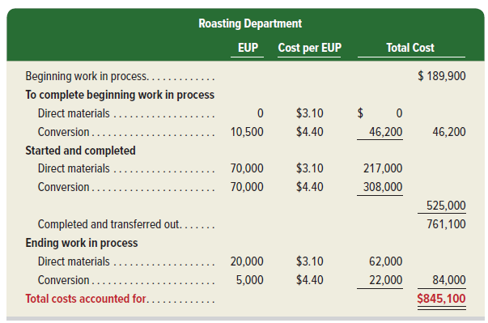
Step 4: Assign and Reconcile Costs – FIFO
Exhibit 16A.9
© McGraw-Hill Education
16-39
Learning Objective C2: Compute process activity costs and prepare a production cost report using FIFO.
Notes:
Step 4: Assign and Reconcile Costs. The EUP from step 2 and the cost per EUP from step 3 are used in step 4 to assign costs to (a) units that the Roasting department completed and transferred out to the Blending department and (b) units that remain in process in the Roasting department. This is shown in Exhibit 16A.9.
Beginning Work in Process Inventory The cost of beginning work in process is $189,900 (from Exhibit 16A.7). These costs were carried over from the prior period for work already completed on the 30,000 units in beginning work in process inventory.
To Complete Beginning Work in Process Inventory The cost to complete beginning work in process inventory is $46,200. We assign $0 of direct materials as there were 0 equivalent units. Recall, EUP is 0 because beginning inventory was already 100% complete for direct materials. We assign $46,200 (10,500 EUP × $4.40 per EUP) of conversion cost. This is the remaining conversion costs required on beginning work in process inventory to complete it for the next department.
Started and Completed The 70,000 units started and completed this month used 70,000 EUP of direct materials and 70,000 EUP of conversion. We assign $217,000 (70,000 EUP × $3.10 per EUP) of direct materials cost and $308,000 (70,000 EUP × $4.40 per EUP) of conversion cost to these units. Completed and transferred-out costs total $761,100 ($189,900 + $46,200 + $525,000). This consists of the cost of beginning work in process, the costs to complete beginning work in process, and the cost of started and completed units. These units and costs move on to Blending.
Ending Work in Process Inventory There are 20,000 units in work in process inventory at period-end. We assign $62,000 (20,000 EUP × $3.10 per EUP) of direct materials cost and $22,000 (5,000 EUP × $4.40 per EUP) of conversion cost to these units. Total cost of work in process inventory at period-end is $84,000 ($62,000 + $22,000).
Reconciliation Management verifies that total costs assigned to units completed and transferred out plus the costs of units in ending work in process equal total production costs. Exhibit 16A.9 shows total costs accounted for of $845,100, which equals total production costs of $845,100 from Exhibit 16A.7.

Slide 40
End of Chapter 16
© McGraw-Hill Education
16-40

