Slide 1
Activity-Based Costing and Analysis
Chapter 17
Wild and Shaw
Financial & Managerial Accounting
9th Edition
Copyright ©2022 McGraw-Hill Education. All rights reserved. No reproduction or distribution without the prior written consent of McGraw-Hill Education.

Slide 2
Chapter 17 Learning Objectives
CONCEPTUAL
C1 Describe the four types of activities that cause overhead costs.
ANALYTICAL
A1 Allocate selling, general and administrative expenses to products and assess profitability.
PROCEDURAL
P1 Allocate overhead costs using the plantwide overhead rate method.
P2 Allocate overhead costs using the departmental overhead rate method.
P3 Allocate overhead costs using activity-based costing.
P4 Allocate overhead costs to service companies using activity-based costing.
© McGraw-Hill Education
17-2

Slide 3
Overhead Cost Allocation Methods
Direct
Materials
Indirect
Factory Overhead
Allocate
Goods in Process
Finished Goods
Indirect
Cost of Goods Sold
Labor
Direct
© McGraw-Hill Education
17-3
Notes:
Manager decisions involving product pricing, product mix, and cost control depend on accurate product cost information. Because direct materials and direct labor can often be reliably traced to units of output, allocating these costs to products is clear.
Overhead costs, however, cannot be traced to units of product like direct materials and direct labor can. We must use an allocation method to assign overhead costs.

Slide 4
Summary of Overhead Cost Allocation Methods
Exhibit 17.1
© McGraw-Hill Education
17-4
Notes:
Plantwide overhead rate method and Departmental overhead rate method use volume-based measures like direct labor hours or machine hours to allocate overhead costs. The plantwide method uses a single rate for allocating overhead costs, and the departmental rate method uses at least two rates.
Activity-based costing focuses on activities and their costs. Activity-based costing typically uses more overhead allocation rates than the plantwide and departmental methods.

Slide 5
Allocate overhead costs using the plantwide overhead rate method.
Learning Objective P1
© McGraw-Hill Education
17-5

Slide 6
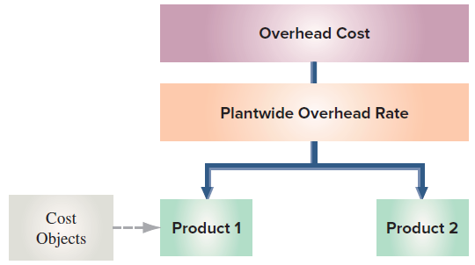
Plantwide Overhead Rate Method
Plantwide overhead rate method uses one overhead rate to allocate overhead costs.
Cost object is the unit of product.
Allocation base: direct labor hours or machine hours.
Total budgeted overhead costs / allocation base.
Same rate used to assign overhead costs to all products.
Exhibit 17.2
17-6
© McGraw-Hill Education
Learning Objective P1: Allocate overhead costs using the plantwide overhead rate method.
Notes:
The plantwide overhead rate method, uses one overhead rate to allocate overhead costs. The target of the cost assignment, or cost object, is the unit of product—see Exhibit 17.2. The rate is determined using volume-related measures such as direct labor hours or machine hours.

Slide 7
Applying Plantwide Overhead Rate Method (1 of 2)
Exhibit 17.3
Actual Usage
17-7
© McGraw-Hill Education
Learning Objective P1: Allocate overhead costs using the plantwide overhead rate method.
Notes:
To illustrate, consider data from KartCo, a go-kart manufacturer that produces both standard and custom go-karts for amusement parks. The standard go-kart is a basic model sold primarily to amusement parks that service county and state fairs. Custom go-karts are produced for theme parks that need unique go-karts to fit their themes. KartCo allocates overhead using direct labor hours and reports the following budgeted overhead cost and direct labor hours for this year.
Actual direct labor hours used for the two go-kart models are in Exhibit 17.3.

Slide 8
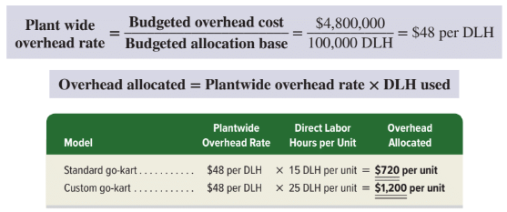
Applying Plantwide Overhead Rate Method (2 of 2)
© McGraw-Hill Education
17-8
Learning Objective P1: Allocate overhead costs using the plantwide overhead rate method.
Notes:
The single plantwide overhead rate is computed as $4,800,000 / 100,000 DLH = $48 per DLH.
This plantwide overhead rate is then used to allocate overhead cost to products based on the actual direct labor hours used to produce each unit as follows: plantwide overhead rate x DLH used.
For KartCo, overhead cost is allocated to its two models as follows (on a per unit basis): Standard go-kart: $48 per DLH x 15 DLH/unit = $720 per unit.
Custom go-kart: $48 per DLH x 25 DLH/unit = $1,200 per unit

Slide 9
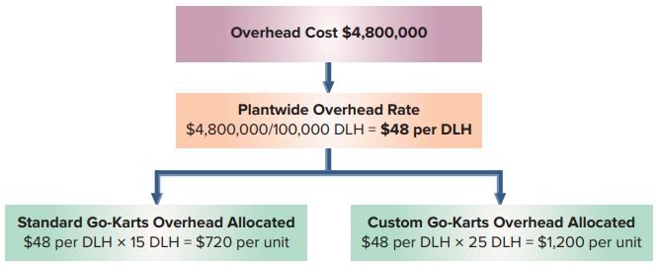
Plantwide Rate Method -- KartCo
Exhibit 17.4
Product Cost
17-9
© McGraw-Hill Education
Learning Objective P1: Allocate overhead costs using the plantwide overhead rate method.
Notes:
Exhibit 17.4 summarizes overhead allocation for KartCo using the plantwide method.
KartCo uses the per unit overhead costs to compute the product cost per unit. Direct materials and direct labor costs per unit are taken from its cost records.

Slide 10
Allocate overhead costs using the departmental overhead rate method.
Learning Objective P2
© McGraw-Hill Education
17-10

Slide 11
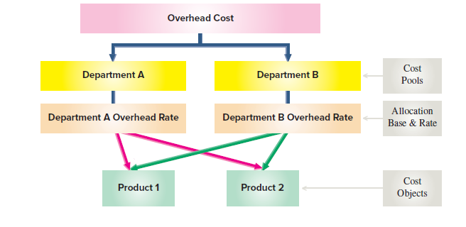
Departmental Overhead Rate Method
Exhibit 17.5
17-11
Learning Objective P2: Allocate overhead costs using the departmental overhead rate method.
© McGraw-Hill Education
Notes:
The departmental overhead rate method uses a different overhead rate for each department.
We use a three-step process in Exhibit 17.5 that shows two departments and two products).
Assign budgeted overhead cost to departmental cost pools.
Select an allocation base and compute an overhead allocation rate for each department.
Allocate overhead costs to cost objects.
Each department has its own overhead rate and its own allocation base. An Assembly department might use direct labor hours to allocate its overhead cost, and a Machining department might use machine hours.

Slide 12
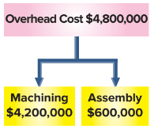
Departmental Overhead Rate Method: Step 1
17-12
Learning Objective P2: Allocate overhead costs using the departmental overhead rate method.
© McGraw-Hill Education
Notes:
Let’s return to KartCo and calculate their departmental overhead rates. KartCo has two production departments, machining and assembly.
KartCo assigns its $4,800,000 budgeted overhead cost to its two production departments: $4,200,000 of overhead is traceable to Machining and $600,000 is traceable to Assembly.

Slide 13
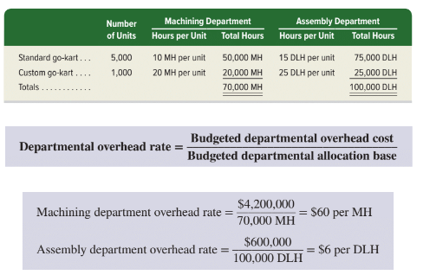
Departmental Overhead Rate Method: Step 2
17-13
Learning Objective P2: Allocate overhead costs using the departmental overhead rate method.
© McGraw-Hill Education
Notes:
Each department determines an allocation base. Machining uses machine hours (MH) and Assembly uses direct labor hours (DLH). Machining budgets 70,000 MH and Assembly budgets 100,000 DLH. Actual production information for Machining and Assembly is shown in the upper graph.
Then, each department computes an overhead rate by dividing its budgeted departmental overhead cost by the budgeted departmental allocation base.
KartCo’s departmental overhead rates are computed as shown in the lower graph.

Slide 14
Departmental Overhead Rate Method: Step 3
Exhibit 17.6
Product Cost
© McGraw-Hill Education
Learning Objective P2: Allocate overhead costs using the departmental overhead rate method.
17-14
Notes:
Step three allocates overhead cost to each product using departmental overhead rates along with the actual allocation bases used. Because each standard go-kart uses 10 MH from the Machining department and 15 DLH from the Assembly department, the overhead cost allocated to each standard go-kart is $600 from the Machining department (10 MH × $60 per MH) and $90 from the Assembly department (15 DLH × $6 per DLH). The same procedure is applied for its custom go-kart. Exhibit 17.6 summarizes KartCo’s overhead allocation per go-kart using the departmental method.
Using the per unit overhead cost from the departmental overhead rate method yields the following total product cost per unit for each model. Direct materials and direct labor costs per unit are taken from its cost records.

Slide 15
Plantwide versus Departmental Overhead Rate Methods
Exhibit 17.7
© McGraw-Hill Education
17-15
Learning Objective P2: Allocate overhead costs using the departmental overhead rate method.
Notes:
Exhibit 17.7 compares the allocated overhead costs per unit for standard and custom go-karts under the plantwide overhead rate and the departmental overhead rate methods.
The overhead cost allocated to each standard go-kart decreased from $720 under the plantwide overhead rate method to $690 under the departmental overhead rate method, whereas overhead cost allocated to each custom go-kart increased from $1,200 to $1,350. These differences occur because the custom go-kart requires more hours in the Machining department(20 MH) than the standard go-kart requires (10 MH). Compared to the plantwide overhead rate method, the departmental overhead rate method arguably results in more accurate overhead allocations.

Slide 16
Assessing Plantwide and Departmental Overhead Rate Methods
Strengths
Use readily available information like direct labor or machine hours.
Easy to implement.
Comply with GAAP and can be used for external reporting
Weakness
Overhead cost is often too complex to be explained by factors like direct labor hours or machine hours.
© McGraw-Hill Education
17-16
Learning Objective P2: Allocate overhead costs using the departmental overhead rate method.
Notes:
Both the plantwide and departmental overhead rate methods have three strengths:
They use readily available information like direct labor hours or machine hours.
They are easy to implement.
They comply with GAAP and can be used for external reporting.
Both have a weakness: Overhead cost is often too complex to be explained by factors like direct labor hours or machine hours.

Slide 17
Assumptions of Plantwide and Departmental Overhead Rate Methods
Plantwide Overhead Rate Method
Overhead costs change with the allocation base
All products use overhead in the same proportions.
Departmental Overhead Rate Method
Different products are similar in volume, complexity, and batch size
Departmental overhead costs are proportional to department allocation base.
© McGraw-Hill Education
17-17
Learning Objective P2: Allocate overhead costs using the departmental overhead rate method.
Notes:
The usefulness of the single plantwide overhead rate depends on two assumptions:
overhead costs change with the allocation base and
all products use overhead cost in the same proportions. For companies with many different products or those with products that use overhead cost in different ways, the assumptions of the single plantwide rate are not reasonable. When overhead cost bears little relation to the allocation base, allocating overhead cost using a single plantwide overhead rate can distort product cost and lead to poor managerial decisions.
The departmental overhead rate method assumes that
different products are similar in volume, complexity, and batch size, and
Departmental overhead costs are proportional to the department allocation base. When products differ in batch size and complexity, they usually consume different amounts of overhead cost. This can distort product costs. Because the departmental overhead rate method allocates overhead cost based on measures closely related to production volume, it fails to accurately assign many overhead costs, like warehouse depreciation or factory insurance, that are not driven by production volume.

Slide 18
Allocate overhead costs using activity-based costing.
Learning Objective P3
© McGraw-Hill Education
17-18

Slide 19
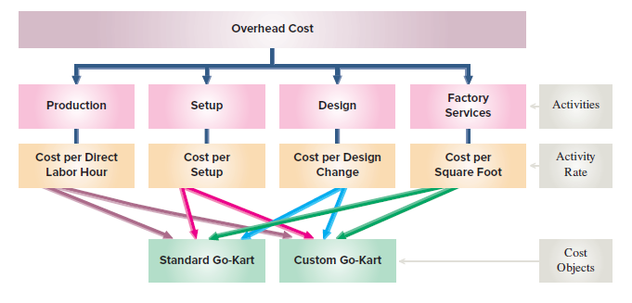
Cost Flows under Activity-Based Costing
Activity-based costing (ABC) focuses on activities and follows three steps.
Identify activities and assign costs to activity cost pools.
Compute an overhead activity rate for each activity cost pool.
Assign overhead costs to cost objects (products).
Exhibit 17.8
© McGraw-Hill Education
17-19
Learning Objective P3: Allocate overhead costs using activity-based costing.
Notes:
Activity-based costing (ABC) allocates overhead costs by focusing on activities. Unlike the plantwide rate method, ABC uses more than a single rate, and unlike the departmental rate method, ABC focuses on activities rather than departments.
The basic principle underlying activity-based costing is that an activity, which is a task, operation, or procedure, is what causes overhead cost to be incurred. Examples of activities are production setups, machine usage, fabrication, design, assembly, and inspections. Activity-based costing follows three steps—see Exhibit 17.8.
1 Identify activities and assign budgeted costs to activity cost pools.
2 Compute an overhead activity rate for each activity cost pools.
3 Allocate overhead costs to cost objects (products).

Slide 20
Applying Activity-Based Costing: Step 1
Identify Activities and Their Budgeted Overhead Cost
Identify individual activities, grouped into cost pools.
Activity cost pool is group of costs related to the same activity.
Activity cost driver is a factor that causes cost of activity to go up or down.
© McGraw-Hill Education
17-20
Learning Objective P3: Allocate overhead costs using activity-based costing.
Notes:
Step 1 identifies individual activities, which are grouped into cost pools. An activity cost pool is a group of costs that are related to the same activity. An activity cost driver, or cost driver, is a factor that causes the cost of an activity to go up or down. For example, factory maintenance, cleaning, and utilities can be grouped into a “factory services” activity cost pool because they are related to square feet of space.
KartCo budgets total overhead cost of $4,800,000. Management assigns its overhead cost to four activity cost pools: production, setup, design, and factory services. To assign costs to activity cost pools, management looks for costs that are caused by similar activities. The table shows that $600,000 of overhead cost is assigned to the production cost pool; $2,000,000 to the setup cost pool; $1,200,000 to the design cost pool; and $1,000,000 to the factory services cost pool.

Slide 21
Applying Activity-Based Costing: Step 2
Compute Overhead Activity Rate for Each Activity
Compute an activity rate for each cost pool
Activity rate = budgeted activity cost / budgeted activity usage.
Exhibit 17.9
© McGraw-Hill Education
C-21
Learning Objective P3: Allocate overhead costs using activity-based costing.
Notes:
Step 2 computes an activity rate for each activity cost pool. KartCo collects the information shown here for this purpose.
Each activity rate is computed as: budgeted activity cost / budgeted activity usage.
Activity rates for KartCo are computed as shown in Exhibit 17.9.

Slide 22
Applying Activity-Based Costing: Step 3
Allocate Overhead Cost to Cost Objects
Allocate overhead cost to products as shown below.
Multiply product’s actual activity usage by the activity rate to get overhead cost allocated to each activity.
Exhibit 17.10
© McGraw-Hill Education
17-22
Learning Objective P3: Allocate overhead costs using activity-based costing.
Notes:
Step 3 allocates overhead costs to products using activity rates and the actual amount of the cost driver used as shown in Exhibit 17.10.
We multiply a product’s actual activity usage by the activity rate as follows to get the overhead cost allocated to each activity.
For each product, the allocated activity costs are added together and divided by the number of units to compute the overhead cost per unit. The company produced 5,000 standard go-karts and 1,000 custom go-karts.
Standard go-karts used 75,000 direct labor hours, so we allocate $450,000 (75,000 × $6 per DLH) of costs to that product. Custom go-karts used 25,000 direct labor hours, so we allocate $150,000 (25,000 DLH × $6 per DLH) of costs to that product.
We similarly allocate the setup, design, and factory services costs to each model of go-kart. KartCo assigned no design costs to standard go-karts because standard go-karts are sold with no design changes.
Using ABC, $1,450,000 of overhead cost is allocated to standard go-karts and $3,350,000 is allocated to custom go-karts. While the total cost allocated of $4,800,000 is the same as under the plantwide method, the amounts allocated to the two product lines differ.

Slide 23
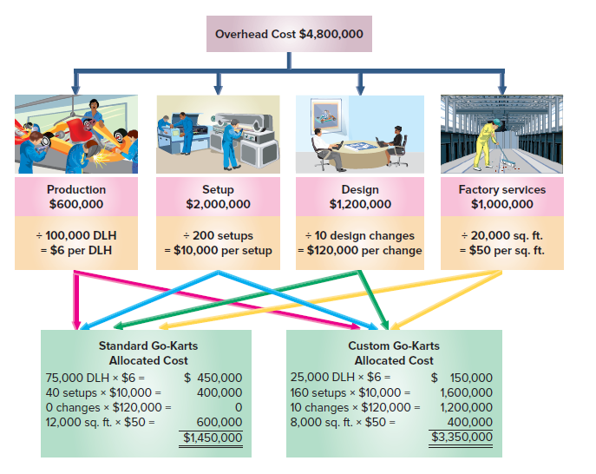
Overhead Allocated to KartCo
Exhibit 17.11
© McGraw-Hill Education
17-23
Learning Objective P3: Allocate overhead costs using activity-based costing.
Notes:
Overhead cost per unit is computed by dividing total overhead cost allocated to each product by the number of product units. KartCo’s overhead cost per unit is $290 for its standard model and $3,350 for its custom go-kart. Exhibit 17.11 summarizes the overhead cost per unit calculations using ABC.
Total product cost per unit for KartCo using ABC is shown in Exhibit 17.11. Direct materials and direct labor cost per unit are taken from its cost records.

Slide 24
Comparing Overhead Cost Allocation Methods
Overhead cost allocated to custom models is higher under ABC because custom models use more activities that drive overhead costs.
ABC emphasizes activities and their costs and better reflects how overhead cost is used.
Plantwide and departmental methods do not capture products’ different use of activities and can distort overhead cost allocations.
Low-volume complex products are undercosted and high-volume simpler products are overcosted under plantwide and departmental methods.
Exhibit 17.12
17-24
Learning Objective P3: Allocate overhead costs using activity-based costing.
© McGraw-Hill Education
Notes:
Exhibit 17.12 summarizes KartCo’s overhead allocation per go-kart under the three different methods. Overhead cost allocated to custom go-karts is much higher under ABC than under the other methods. This is because the custom model uses more of the activities that drive overhead costs. ABC emphasizes activities and their costs, and arguably better reflects how overhead cost is used in making products. The plantwide and departmental methods do not capture the products’ different use of activities, and can distort overhead cost allocations. With the plantwide and departmental methods, low-volume complex products are often undercosted, and high-volume simpler products are often overcosted.

Slide 25
Comparing Overhead Allocation Methods for Business Decisions
Product unit cost is lower for standard go-kart versus custom.
Cost difference is largest using ABC.
More accurate overhead allocation leads to better product pricing and product mix decisions.
© McGraw-Hill Education
17-25
Learning Objective P3: Allocate overhead costs using activity-based costing.
Notes:
As we would expect, product cost per unit is lower for the standard go-kart compared with the custom go-kart. The cost difference between standard and custom go-karts is largest using activity-based costing. More accurate overhead allocation leads to better product pricing and product mix decisions.
Standard Go-Karts: What are the implications if standard go-karts sell for $1,200 per unit? Using the plantwide or departmental methods, KartCo would not make standard go-karts as their product cost per unit ($1,470 or $1,440) would exceed the selling price. Using activity-based costing, however, the standard go-kart shows its $1,040 product cost per unit is below the $1,200 price per unit.
Custom Go-Karts: If the selling price of custom go-karts is $3,500 per unit, the plantwide and departmental methods both show that it exceeds the product cost per unit. Using activity-based costing, however, its $4,450 product cost per unit exceeds the price. The table below shows gross profit per unit (selling price−product price) for the plantwide and ABC methods.

Slide 26
Describe the four types of activities that cause overhead costs.
Learning Objective C1
© McGraw-Hill Education
17-26

Slide 27
Types of activities
Unit level – performed on each unit
Batch level – performed only on batches
Product level – performed on product line
Facility level – sustain facility capacity as a whole
17-27
Learning Objective C1: Describe the four types of activities that cause overhead costs.
© McGraw-Hill Education
Notes:
There are four types of activities that cause overhead costs. As mentioned earlier in this presentation, one of the biggest challenges is to identify the activities which cause the costs to occur.
Activities causing overhead cost in an organization are typically separated into four levels:
Unit-level activities – performed on each unit.
Batch-level activities – performed only on each batch of units.
Product-level activities – performed on each product line and not affected by number of units or batches.
Facility-level activities – sustain facility capacity as a whole and are not caused by any specific product.

Slide 28
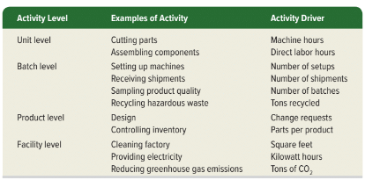
Examples of Activity Levels
Exhibit 17.13
© McGraw-Hill Education
Learning Objective C1: Describe the four types of activities that cause overhead costs.
17-28
Notes:
For KartCo, the production pool reflects unit level costs, the setup pool reflects batch level costs, the design pool reflects product level costs, and factory services reflect facility level costs. Exhibit 17.13 shows additional examples of activities and activity drivers commonly found with each of the four activity levels.
Understanding the four levels of overhead cost can help control costs. Activity-based management (ABM) is an outgrowth of ABC that uses the link between activities and costs for better management. Activity-based management can help distinguish value-added activities, which add value to a product, from non-value-added activities, which do not. KartCo’s value-added activities are production and design changes. Its non-value-added activities are setups and factory services. ABM aids cost control by reducing how much of an activity is performed.

Slide 29
Allocate overhead costs to service companies using activity-based costing.
Learning Objective P4
© McGraw-Hill Education
17-29

Slide 30
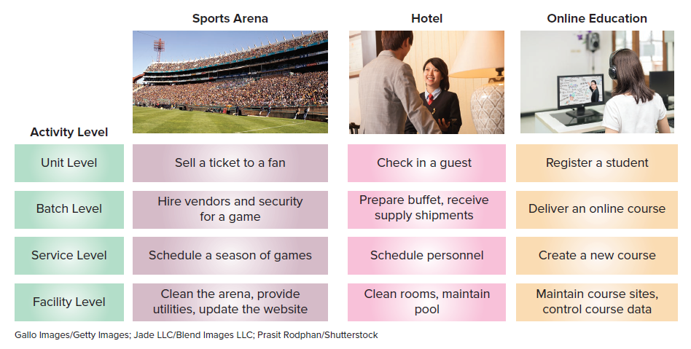
ABC for Service Providers
ABC also applies to service providers.
Service companies must classify costs by activity levels of unit, batch, service, and facility.
Exhibit 17.14
17-30
Learning Objective P4: Allocate overhead costs to service companies using activity-based costing.
© McGraw-Hill Education
Notes:
ABC also applies to service providers. In applying ABC, service companies classify costs by activity levels. Exhibit 17.14 shows typical activities within the four activity levels (unit, batch, service, and facility) for three service providers.

Slide 31
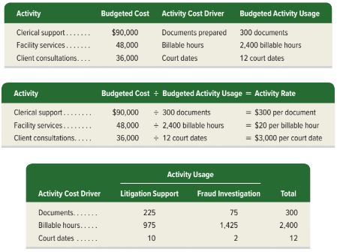
Applying Activity-Based Costing to a Service Provider
Step 1
Step 2
Step 3
17-31
© McGraw-Hill Education
Learning Objective P4: Allocate overhead costs using activity-based costing.
Notes:
Step 1 Identify activities and their budgeted overhead cost.
Step 2 Compute overhead activity rate for each activity.
Step 3 Allocate overhead cost to cost objects.

Slide 32
Applying Activity-Based Costing to a Service Provider – Cost per Unit
17-32
© McGraw-Hill Education
Learning Objective P4: Allocate overhead costs using activity-based costing.
Notes:
This exhibit shows allocated overhead cost to each service line and overhead cost per unit.

Slide 33
Allocate selling, general and administrative expenses to products and assess profitability.
Learning Objective A1
17-33
© McGraw-Hill Education

Slide 34
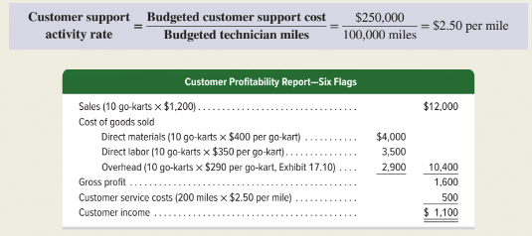
Customer Profitability
Customer profitability report determines the profitability of each customer.
Can compute customer activity rate by dividing budgeted customer support cost by budgeted base to determine a per base amount.
17-34
Learning Objective A1: Allocate selling, general, and administrative expenses to products and assess profitability.
© McGraw-Hill Education
Notes:
ABC can be used to allocate selling, general and administrative costs to products and determine the profitability of individual customers.
As an example, let’s return to KartCo and assume that costs of providing customer support (such as delivery, installation, and warranty work) are related to the distance a technician must travel to provide services. Assume that, as a result of applying activity-based costing, KartCo plans to sell its standard go-kart for $1,200 per unit. KartCo budgets $250,000 per year for customer support. It allocates customer support costs based on 100,000 budgeted miles traveled by customer support technicians. The customer support activity rate follows.
KartCo can add the costs of customer support to the costs of goods sold for an order to get the order’s income. A customer profitability report for one of its customers, Six Flags, follows. KartCo sold 10 standard go-karts to Six Flags and a technician drove 200 miles to provide customer support.
Income of $1,100 is generated from Six Flags. ABC encourages management to consider all resources used to serve a customer, not just manufacturing costs that are the focus of traditional costing methods. Customer support costs can also be allocated to product lines, for example to KartCo’s standard and custom models, to determine their profitability.

Slide 35
End of Chapter 17
© McGraw-Hill Education
17-35

