Slide 1
Cost Behavior and Cost-Volume-Profit Analysis
Chapter 18
Wild and Shaw
Financial and Managerial Accounting
9th Edition
Copyright ©2022 McGraw-Hill Education. All rights reserved. No reproduction or distribution without the prior written consent of McGraw-Hill Education.

Slide 2
Chapter 18 Learning Objectives
CONCEPTUAL
C1 Describe different types of cost behavior in relation to production and sales volume.
C2 Describe several applications of cost-volume-profit analysis.
ANALYTICAL
A1 Compute the contribution margin and describe what it reveals about a company’s cost
structure.
A2 Analyze changes in sales using the degree of operating leverage.
PROCEDURAL
P1 Estimate costs using the scatter diagram, high-low method, and regression.
P2 Compute the break-even point for a single-product company.
P3 Compute the break-even point for a multiproduct company.
P4 Appendix 18B‒Compute unit cost and income under both absorption and variable costing.
© McGraw-Hill Education
18-2

Slide 3
Describe different types of cost behavior in relation to production and sales volume.
Learning Objective C1
© McGraw-Hill Education
18-3

Slide 4
Identifying Cost Behavior
Managers use cost-volume-profit analysis to make predictions such as:
How many units must we sell to break even?
What sales volume is needed to earn a target income?
How much will income change if we buy a new machine to reduce labor costs?
What is the change in income if selling prices decline and sales volume increases?
How will income change if we change the sales mix of our products or services?
© McGraw-Hill Education
Learning Objective C1: Describe different types of cost behavior in relation to production and sales volume.
18-4
Notes:
Planning a company’s future activities is crucial to successful management. Managers use cost-volume-profit (CVP) analysis to predict how changes in costs and sales levels affect profit.
Managers use CVP analysis to make predictions such as:
How many units must we sell to break even?
What sales volume is needed to earn a target income?
How much will income change if we buy a new machine to reduce labor costs?
What is the change in income if selling prices decline and sales volume increases?
How will income change if we change the sales mix of our products or services?
We describe CVP analysis in this chapter. We first review cost classifications and then show several methods for measuring and analyzing costs.

Slide 5
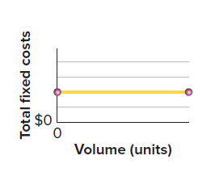
Fixed Costs
Total fixed costs do not change as volume changes.
Unit fixed costs decreases as volume increases.
© McGraw-Hill Education
Learning Objective C1: Describe different types of cost behavior in relation to production and sales volume.
18-5
Notes:
Fixed costs do not change when the volume of activity changes (within a relevant range). For example, $32,000 in monthly rent paid for a factory building remains the same whether the factory operates with an eight-hour shift or 24 hours per day. This means that rent cost is the same each month at any level of output from zero to the plant’s full productive capacity.
Though the total amount of fixed cost does not change as volume changes, fixed cost per unit of output decreases as volume increases. For instance, if 200 units are produced when monthly rent is $32,000, the average rent cost per unit is $160 (computed as $32,000/200 units). When production increases to 1,000 units per month, the average rent cost per unit decreases to $32 (computed as $32,000/1,000 units).

Slide 6
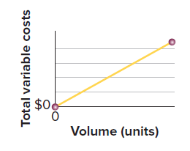
Variable Costs
Total variable costs change in proportion to volume changes.
Unit variable costs stay the same as volume changes.
© McGraw-Hill Education
Learning Objective C1: Describe different types of cost behavior in relation to production and sales volume.
18-6
Notes:
Variable costs change in proportion to changes in volume of activity. The direct materials cost of a product is one example of a variable cost. If one unit of product requires materials costing $20, total materials costs are $200 when ten units of product are manufactured, $400 for 20 units and so on.
While the total amount of variable cost changes with the level of production, variable cost per unit stays the same as volume changes.

Slide 7
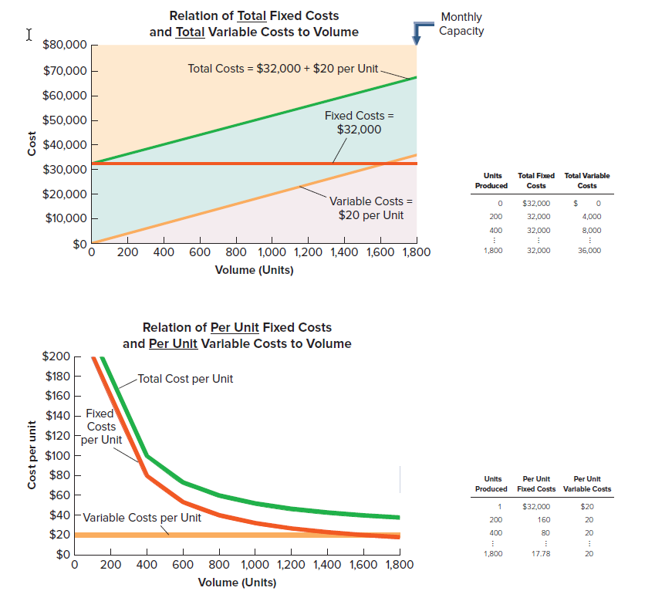
Graphing Fixed and Variable Costs
Exhibit 18.1
© McGraw-Hill Education
Learning Objective C1: Describe different types of cost behavior in relation to production and sales volume.
18-7
Notes:
The upper graph in Exhibit 18.1 shows the relation between total fixed costs and volume, and the relation between total variable cost and volume. Total fixed costs of $32,000 remain the same at all production levels up to the company’s monthly capacity of 1,800 units. Total variable costs increase by $20 per unit for each additional unit produced.
The lower graph in Exhibit 18.1 shows that fixed costs per unit decrease as production increases. This drop in per unit costs as production increases is known as economies of scale. This lower graph also shows that variable costs per unit remain constant as production levels change.

Slide 8
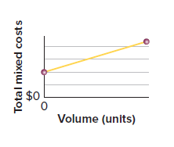
Mixed Costs
Mixed costs include both fixed and variable cost components.
Mixed costs is greater than zero when volume is zero (fixed component) and increases steadily in proportion to increases in volume (variable component.
Learning Objective C1: Describe different types of cost behavior in relation to production and sales volume.
© McGraw-Hill Education
18-8
Notes:
Mixed costs include both fixed and variable cost components. For example, compensation for sales representatives often includes a fixed monthly salary and a variable commission based on sales. Utilities costs such as electricity, water, and natural gas include a fixed service fee plus an amount that varies with usage. Like a fixed cost, a mixed cost is greater than zero when volume is zero; like a variable cost, it increases steadily in proportion to increases in volume.
Graphing mixed costs: the green total cost line in the top graph in Exhibit 18.1 starts on the vertical axis at the $32,000 fixed cost point. At the zero volume level, total cost equals the fixed costs. As the volume of activity increases, the total cost line increases at an amount equal to the variable cost per unit. This total cost line is a “mixed cost.”

Slide 9
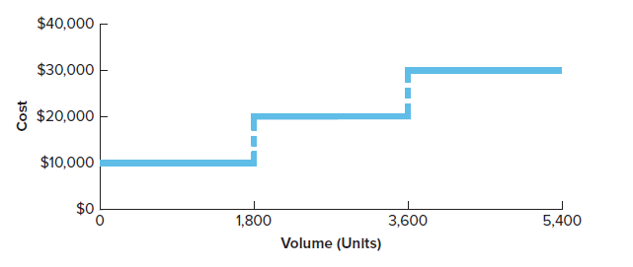
Step-Wise Costs
Exhibit 18.2
Step-wise cost has a step pattern in costs within a relevant range of current production volume.
Relevant range is the normal operating range for a business.
Learning Objective C1: Describe different types of cost behavior in relation to production and sales volume.
© McGraw-Hill Education
18-9
Notes:
A step-wise cost, or stair-step cost, has a step pattern in costs. Salaries of production supervisors are fixed within a relevant range of the current production volume. The relevant range of operations is the normal operating range for a business.
If production volume greatly increases such as with the addition of another shift, additional supervisors must be hired. This means that the total cost for supervisory salaries steps up by a lump-sum amount. This behavior is graphed in this slide.
Graphing step-wise costs: step-wise behavior is graphed in Exhibit 18.2. For Rydell, each shift can produce up to 1,800 units, and requires one supervisor at a salary of $10,000 per month. Each added shift can produce up to 1,800 units and requires additional supervisor help at $10,000 per month. See how the step-wise cost line is flat within each relevant range.

Slide 10
Cost Examples
Exhibit 18.3
Learning Objective C1: Describe different types of cost behavior in relation to production and sales volume.
© McGraw-Hill Education
18-10
Notes:
This exhibit lists examples of fixed, variable, mixed, and step-wise costs for a manufacturer of footballs.

Slide 11
Estimate costs using the scatter diagram, high-low method, and regression.
Learning Objective P1
© McGraw-Hill Education
18-11

Slide 12
Measuring Cost Behavior
CVP analysis identifies and measures costs using fixed and variable components.
Three methods to estimate fixed and variable costs:
Scatter Diagram
High-Low Method
Regression
Exhibit 18.4
© McGraw-Hill Education
Learning Objective P1: Estimate costs using the scatter diagram, high-low method, and regression.
18-12
Notes:
Cost-volume-profit analysis identifies and measures costs using their fixed and variable cost components. Managers do this by collecting cost data at various levels of activity. We then identify and measure the fixed and variable cost components.
Three methods are commonly used to analyze past costs:
Scatter Diagram
High-Low Method
Regression

Slide 13
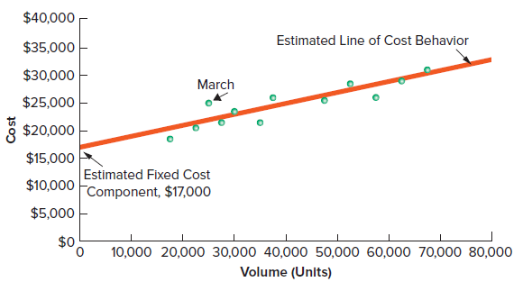
Scatter Diagram
Exhibit 18.5
© McGraw-Hill Education
Learning Objective P1: Estimate costs using the scatter diagram, high-low method, and regression.
18-13
Notes:
A scatter diagram is a graph of unit volume and cost data. In Exhibit 18.5, each point reflects total costs and units produced during each of the last 12 months. For example, March shows units produced of 25,000 and costs of $25,000.
The estimated line of cost behavior is drawn on a scatter diagram to show the relation between cost and unit volume. This line best visually “fits” the points in a scatter diagram. Fitting this line is sometimes done with spreadsheet software.
The line in Exhibit 18.5 shows a mixed cost. The total cost is greater than zero even when no units are produced, and it increases in proportion to increases in units produced.

Slide 14
The High-Low Method
Exhibit 18.4
The following relationships between units produced and total cost are observed:
The high-low method uses just two points to estimate the cost equation: the highest and lowest volume levels.
© McGraw-Hill Education
Learning Objective P1: Estimate costs using the scatter diagram, high-low method, and regression.
18-14
Notes:
The high-low method uses just two points to estimate the cost equation: the highest and lowest volume levels. The high-low method follows these steps:
Step 1: Identify the highest and lowest volume: these might not be the highest or lowest levels of costs.
Step 2: Compute the slope (variable cost per unit) using the high and low volume levels.
Step 3: Compute total fixed costs by computing the total variable cost at either the high or low volume level, and then subtracting that amount from the total cost at that volume.

Slide 15
The High-Low Method Example
Exhibits 18.4, 18.6 & 18.7
Total cost = $14,125 + $0.25 per unit produced
© McGraw-Hill Education
Learning Objective P1: Estimate costs using the scatter diagram, high-low method, and regression.
18-15
Notes:
Step 1: In Exhibit 18.4, the lowest number of units produced is 17,500 and the highest is 67,500. The costs corresponding to these unit volumes are $18,500 and $31,000.
Step 2: The variable cost per unit is calculated as: change in cost divided by change in units. Using data from the highest and lowest unit volumes, this results in a slope, or estimated variable cost per unit, of $0.25 as computed in Exhibit 18.6.
Step 3: To estimate fixed cost for the high-low method, we know that total cost equals fixed cost plus variable cost per unit times the number of units. Then we pick either the highest or lowest to compute fixed cost. This is shown in Exhibit 18.7—where we use either the highest volume (67,500 units) or the lowest volume (17,500 units) in determining the fixed cost of $14,125.
The cost equation from the high-low method is $14,125 plus $0.25 per unit.

Slide 16
Regression
Regression is covered in Appendix 18A. It is commonly used with spreadsheet programs or calculators.
The objective of the cost analysis remains the same: determination of total fixed cost and the variable unit cost.
© McGraw-Hill Education
Learning Objective P1: Estimate costs using the scatter diagram, high-low method, and regression.
18-16
Notes:
Least-squares regression, or simply regression, is a statistical method for identifying cost behavior. Excel has functions to determine the fixed cost (= Intercept) and the variable cost (= slope) components of a ‘best fit’ line for the cost data. This is shown in Appendix 18A.
Using regression, the cost equation for the data presented in Exhibit 18.4 is $16,688 plus $0.20 per unit produced. This means that the fixed cost is estimated as $16,688 and the variable cost at $0.20 per unit.

Slide 17
Comparing Cost Estimation Methods
Exhibit 18.8
© McGraw-Hill Education
Learning Objective P1: Estimate costs using the scatter diagram, high-low method, and regression.
18-17
Notes:
Different cost estimation methods usually result in different estimates of fixed and variable costs as summarized in this slide. Regression uses more data and therefore should be more accurate than the high-low method. However, the high-low method is easier to apply and often useful for quick cost estimates.

Slide 18
Compute the contribution margin and describe what it reveals about a company’s cost structure.
Learning Objective A1
© McGraw-Hill Education
18-18

Slide 19
Contribution Margin
Exhibit 18.9
Exhibit 18.10
Learning Objective A1: Compute the contribution margin and describe what it reveals about a company’s cost structure.
© McGraw-Hill Education
18-19
Notes:
After we classify costs as fixed or variable we can compute the contribution margin, which equals sales minus variable costs. The contribution margin goes to cover fixed costs and any excess is income.
Contribution margin per unit is the amount by which a product’s unit selling price exceeds its variable cost per unit. The top graphic shows the formula to calculate contribution margin per unit.
Contribution margin ratio is the percent of each sales dollar that remains after deducting the unit variable cost. The second graphic shows the formula for the contribution margin ratio.
As an example, Rydell sells footballs for $100 each and has variable costs of $70 per football. Its fixed costs are $24,000 per month with monthly capacity of 1,800 units (footballs). Rydell’s contribution margin per unit is $30, and its contribution ratio is 30%, computed as shown here.
At a selling price of $100 per football, Rydell covers its per unit variable costs and makes $30 per unit to contribute to fixed costs and profit. Its contribution margin ratio is 30%, computed as $30∕$100. A contribution margin ratio of 30% means that for each $1 in sales, we get 30 cents to cover fixed costs and produce income.

Slide 20
Compute the break-even point for a single-product company.
Learning Objective P2
© McGraw-Hill Education
18-20

Slide 21
Break-Even Point
Sales level where total sales equal total costs, resulting in zero income.
Can be stated in units or dollars of sales.
Three methods to find break-even point:
Formula method
Contribution margin income statement
Cost-volume-profit chart
© McGraw-Hill Education
Learning Objective P2: Compute the break-even point for a single-product company.
18-21
Notes:
The break-even point, or break-even sales, is the sales level at which total sales equal total costs, resulting in zero income. The break-even point can be stated in either units or dollars of sales. To illustrate, Rydell sells footballs for $100 per unit and has $70 of variable costs per football sold. Its fixed costs are $24,000 per month. We show three different methods to find the break-even point.
Formula method
Contribution margin income statement
Cost-volume-profit chart

Slide 22
Formula Method
Exhibit 18.11
Exhibit 18.12
© McGraw-Hill Education
Learning Objective P2: Compute the break-even point for a single-product company.
18-22
Notes:
We compute the break-even point (in units) using the formula in Exhibit 18.11. This formula uses the contribution margin per unit, which for Rydell is $30 ($100 - $70). The break-even sales in units is $24,000 / $30 = 800 units per month.
If Rydell sells 800 units, its income will be zero. Income increases or decreases by $30 for each unit sold above or below that break-even point; if Rydell sells 802 units, income equals $60.
We can calculate the break-even point in dollars. This uses the contribution margin ratio (30%, or 0.30) to determine the required sales dollars to break even. Exhibit 18.12 shows the formula and Rydell’s break-even point in dollars.

Slide 23
Contribution margin income statement method
Exhibit 18.13
© McGraw-Hill Education
Learning Objective P2: Compute the break-even point for a single-product company.
18-23
Notes:
The left side of Exhibit 18.13 shows the general format of a contribution margin income statement. It is an important tool for internal decision making but not a replacement for a traditional income statement for external reporting as indicated here. It separately classifies costs as variable or fixed and reports contribution margin.
The right side of this exhibit shows the contribution margin income statement at the break-even point. We set income to zero and set contribution margin equal to fixed costs ($24,000). For Rydell’s contribution margin to equal $24,000, it must sell 800 units ($24,000/$30). The resulting contribution margin income statement shows that the $80,000 (or 800 units) revenue from sales is needed to cover variable ($56,000) and fixed costs ($24,000).

Slide 24
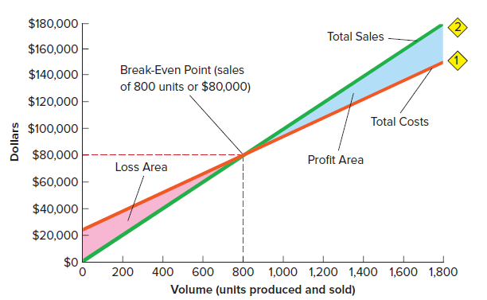
Cost-Volume-Profit Chart
Exhibit 18.14
© McGraw-Hill Education
Learning Objective P2: Compute the break-even point for a single-product company.
18-24
Notes:
A third way to find the break-even point is by examining a cost-volume-profit (CVP) chart (break-even chart). Exhibit 18.14 shows Rydell’s CVP chart. Two key lines in the chart show sales and costs at different output levels.
Total costs. This line starts at the $24,000 fixed costs level on the vertical axis. The slope of this line is the $70 variable cost per unit.
Total sales. This line starts at zero on the vertical axis (zero units and zero dollars of sales). The slope of this line equals the $100 selling price per unit. This line ends at Rydell’s maximum capacity level of 1,800 units. Total sales at that point are $180,000: $100 sales price per unit times 1,800 units.
The CVP chart provides some key observations.
Break-even point, where the total cost line and total sales line intersect—at 800 units, or $80,000.
Income or loss, measured as the vertical distance between the sales line and the total cost line at any level of units sold (a loss is to the left of the break-even point; a profit is to the right). As the number of units sold increases, the loss area decreases or the profit area increases.
Maximum productive capacity, which is 1,800 units (the largest units on the CVP chart). At this point we expect sales of $180,000 and its largest income of $30,000.

Slide 25
Changes in Estimates
Exhibit 18.15
Exhibit 18.16
Exhibit 18.17
© McGraw-Hill Education
Learning Objective P2: Compute the break-even point for a single-product company.
18-25
Notes:
CVP analysis uses past data as estimates of the future to make managerial decisions. We can change those estimates if we believe another set of estimates is more likely to occur or if we wish to see how sensitive the results are to a change in estimates. To illustrate, assume Rydell’s managers provide the sets of estimates in this in exhibit 18.15.
Using the pessimistic estimates, Rydell’s contribution margin per unit is $24 ($96 − $72), and the revised break-even in units is in Exhibit 18.16.
Exhibit 18.17 summarizes the effects of changes in CVP inputs on break-even. If the sales price per unit increases, then break-even decreases. If the sales price per unit decreases, then break-even increases. If either variable cost per unit or total fixed cost increases, then break-even increases. If either variable cost per unit or total fixed cost decreases, then break-even decreases.

Slide 26
Describe several applications of cost-volume-profit analysis.
Learning Objective C2
© McGraw-Hill Education
18-26

Slide 27
Margin of Safety
Exhibit 18.18
© McGraw-Hill Education
Learning Objective C2: Describe several applications of cost-volume-profit analysis.
18-27
Notes:
All companies want to do better than break-even. A company’s margin of safety, is expected sales minus break-even sales. It is also the amount that sales can decline before the company incurs a loss. It is often expressed in dollars or as a percent of the expected sales level.
To illustrate, recall that Rydell’s break-even point in dollars is $80,000. If its expected sales are $100,000, the margin of safety is $20,000 ($100,000 - $80,000). As a percent, the margin of safety is 20% of expected sales as shown in this slide.
Management must decide whether the margin of safety is adequate in given factors such as sales variability, competition, consumer tastes, and economic conditions.

Slide 28
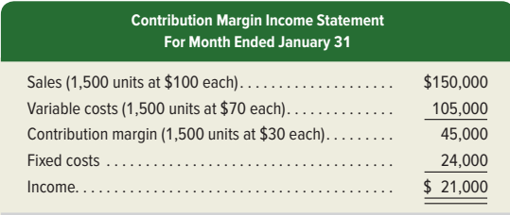
Computing Income from Expected Sales and Costs
Exhibit 18.19
© McGraw-Hill Education
Learning Objective C2: Describe several applications of cost-volume-profit analysis.
18-28
Notes:
Managers can use contribution margin income statements to forecast future sales or income. Exhibit 18.19 shows the key variables in CVP analysis—sales, variable costs, contribution margin, and fixed costs, and their relations to income. To answer the question “What is the expected income if this level of sales is achieved?”
To illustrate, let’s assume that Rydell’s management expects to sell 1,500 units in January. What is the amount of income if this sales level is achieved? Using the calculation in the contribution margin income statement we can see that income will be $21,000.

Slide 29
Computing Sales for a Target Income ‒ Dollars
Exhibit 18.20
© McGraw-Hill Education
Learning Objective C2: Describe several applications of cost-volume-profit analysis.
18-29
Notes:
Evaluating target income is a key application of CVP analysis. CVP analysis helps to determine the sales level needed to achieve the target income.
We use the formula shown in Exhibit 18.20 to compute sales for a target income. To illustrate, Rydell has monthly fixed costs of $24,000 and a 30% contribution margin ratio. Assume that it sets a target income of $12,000. Using the formula in Exhibit 18.20, Rydell needs $120,000 of sales to produce a $12,000 target income.

Slide 30
Computing Sales for a Target Income ‒ Units
Exhibit 18.21
© McGraw-Hill Education
Learning Objective C2: Describe several applications of cost-volume-profit analysis.
18-30
Notes:
Alternatively, we can compute unit sales needed to achieve a target income. To do this, we use contribution margin per unit. This gives the number of units to sell to reach the target income. Exhibit 18.21 illustrates this for Rydell. The two computations in Exhibits 18.20 and 18.21 are equivalent because sales of 1,200 units at $100 sales price per unit equal $120,000 of sales.

Slide 31
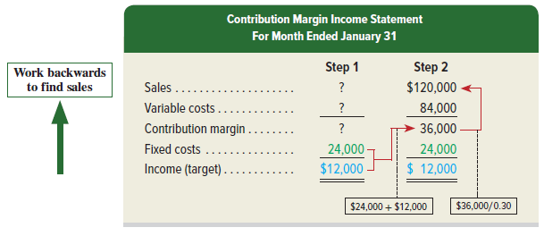
Contribution Margin Income Statement
Exhibit 18.22
© McGraw-Hill Education
Learning Objective C2: Describe several applications of cost-volume-profit analysis.
18-31
Notes:
We can use the contribution margin income statement approach to compute sales for a target income, in two steps:
Step 1: Calculate contribution margin at target income. Working backwards, we begin at the bottom and insert the $24,000 fixed costs and the $12,000 target income. This means contribution margin is $36,000 (computed as $24,000 plus $12,000).
Step 2: Calculate sales. Divide the $36,000 contribution margin by 30% contribution margin ratio to solve for sales of $120,000, or 1,200 units at $100 each. This also means variable costs are 70% of sales, or $84,000.

Slide 32
Evaluating Business Strategies
Exhibits 18.23, 18.24, & 18.5
© McGraw-Hill Education
Learning Objective C2: Describe several applications of cost-volume-profit analysis.
18-32
Notes:
We can use CVP to analyze the effects of alternative business strategies. For instance, we might want to know what happens to income if we automate a manual process. Below are two examples:
Capital expenditures – new machinery. Assume a new machine increases monthly fixed costs from $24,000 to $30,000 and decreases variable costs by $10 per unit (from $70 per unit to $60 per unit). Rydell’s break-even point in dollars is currently $80,000. How would the new machine affect Rydell’s break-even point in dollars? If Rydell maintains its selling price of $100 per unit, its contribution margin per unit increases to $40—computed as $100 per unit minus the (new) variable costs of $60 per unit. With this new machine, the revised contribution margin ratio per unit is 40% (computed as $40∕$100). Rydell’s revised break-even point in dollars is $75,000, as computed in Exhibit 18.23. The new machine would lower Rydell’s break-even point by $5,000, or 50 units, per month.
Spending – Advertising. The manager proposes that an increase of $3,000 in monthly advertising will increase sales by $25,000 per month (at a selling price of $100 per unit). Fixed costs before the advertising increase are $24,000. The contribution margin ratio will continue to be 30%. With the advertising increase, the revised break-even point in dollars is $90,000, as computed in Exhibit 18.24.
Exhibit 18.18 showed Rydell’s margin of safety was 20% when expected sales is $100,000. Rydell expects sales of $125,000 ($100,000 + $25,000) after the advertising increase. The revised margin of safety is computed in Exhibit 18.25. The advertising campaign would increase Rydell’s margin of safety from 20% to 28%.

Slide 33
Compute the break-even point for a multiproduct company.
Learning Objective P3
© McGraw-Hill Education
18-33

Slide 34
Sales Mix and Break-Even
The CVP formulas can be modified for use when a company sells more than one product.
The unit contribution margin is replaced with weighted-average contribution margin per unit.
Sales mix is the proportion of sales volume for each product.
© McGraw-Hill Education
Learning Objective P3: Compute the break-even point for a multiproduct company.
18-34
Notes:
For companies that sell more than one product or service, sales mix is the proportion of sales volume for each product.
For example, if a company normally sells 1,200 footballs and 800 basketballs each month, its sales mix is 60% footballs (1,200/2,000) and 40% basketballs (800/2,000). This sales mix is expressed as 6:4.

Slide 35
Weighted-Average Contribution Margin per Unit
Exhibit 18.26
Exhibit 18.27
© McGraw-Hill Education
Learning Objective P3: Compute the break-even point for a multiproduct company.
18-35
Notes:
When a mix of products is sold, break-even can be computed with a weighted-average contribution margin per unit. This measure combines the per unit contribution margins of each product by their weights in the sales mix. To demonstrate, assume Rydell expands its product line to include basketballs. It adds another production shift, increasing its fixed costs to $48,000. Information for the two products is in Exhibit 18.26.
Using the data in Exhibit 18.26, the weighted-average contribution margin is computed as $32 per unit as shown in exhibit 18.27.

Slide 36
Weighted-Average Break-Even in Unit Sales
Exhibit 18.28
Exhibit 18.29
© McGraw-Hill Education
Learning Objective P3: Compute the break-even point for a multiproduct company.
18-36
Notes:
The break-even point in unit sales is computed with the formula from Exhibit 18.11, but using the weighted-average contribution margin per unit, as shown in Exhibit 18.28.
The number of units of each product type is then computed by multiplying the break-even point in units (1,500) by the sales mix percent, as shown in the second column of Exhibit 18.29. The right three columns compute contribution margin at break-even. We multiply unit sales by the contribution margin per unit to get contribution margin for each product. The $48,000 total contribution margin exactly equals the $48,000 fixed costs, resulting in zero income at break-even.

Slide 37
Assumptions in Cost-Volume-Profit Analysis
Costs can be classified as variable or fixed.
Costs are linear within the relevant range.
Units produced are sold (inventory is constant).
Sales mix is constant.
© McGraw-Hill Education
Learning Objective P3: Compute the break-even point for a multiproduct company.
18-37
Notes:
CVP analysis relies on several assumptions:
Costs can be classified as variable or fixed.
Costs are linear within the relevant range.
Units produced are sold (inventory is constant).
Sales mix is constant.
If costs and sales differ from these assumptions, the results of CVP analysis can be less useful. Managers understand that CVP analysis gives approximate answers to questions and enables them to make rough estimates about the future.

Slide 38
Analyze changes in sales using the degree of operating leverage.
Learning Objective A2
© McGraw-Hill Education
18-38

Slide 39
Degree of Operating Leverage
Degree of operating leverage: a measure of the effects of change in the level of sales on income.
Exhibit 18.31
© McGraw-Hill Education
Learning Objective A2: Analyze changes in sales using the degree of operating leverage.
18-39
Notes:
CVP analysis is especially useful when management wishes to predict income from alternative strategies. These strategies can involve changes in selling prices, fixed costs, variable costs, sales volume, and product mix. Managers are interested in seeing the effects of changes in some or all of these factors. Contribution margin per unit is one way to predict income effects; for every additional unit sold, income increases by contribution margin per unit.
A useful measure to assess the effect of changes in the level of sales on income is the degree of operating leverage (DOL), shown in Exhibit 18.31.

Slide 40
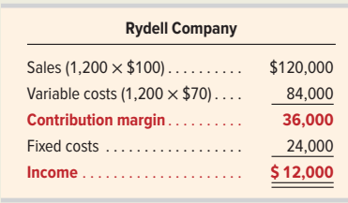
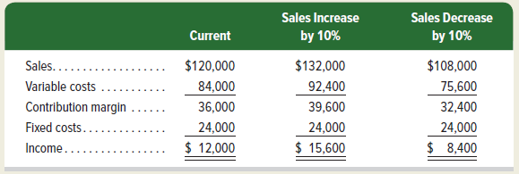
Operating Leverage
Exhibit 18.32
Exhibit 18.33
© McGraw-Hill Education
Learning Objective A2: Analyze changes in sales using the degree of operating leverage.
18-40
Notes:
To demonstrate, assume Rydell Company sells 1,200 footballs. At this sales level, its contribution margin and income are computed as shown here.
Rydell’s degree of operating leverage (DOL) is computed in Exhibit 18.32. We then use DOL to predict the change in income from a change in sales. For example, if Rydell expects sales can either increase or decrease by 10%, and these changes would be within Rydell’s relevant range, we can compute the change in income using DOL as shown in Exhibit 18.33.
If Rydell’s sales increase by 10%, its income will increase by $3,600 (computed as $12,000 × 30%), to $15,600. If, instead, Rydell’s sales decrease by 10%, its income will decrease by $3,600, to $8,400. We can prove these results with contribution margin income statements, as shown.

Slide 41
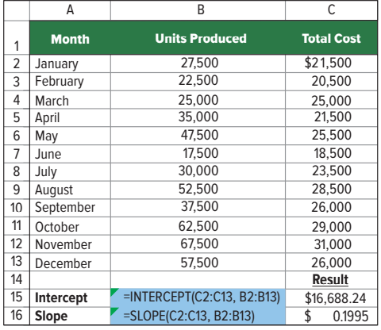
Appendix 18A: Using Excel for Cost Estimation
© McGraw-Hill Education
18-41
Notes:
Microsoft Excel® and other spreadsheet software can be used to perform least-squares regressions to identify cost behavior. In Excel, the INTERCEPT and SLOPE functions are used. The following screen shot reports the data from earlier in the presentation in cells A1 through C13 and shows the cell contents to find the intercept (cell B15) and slope (cell B16). Cell B15 uses Excel to find the intercept from a least-squares regression of total cost (shown as C2:C13 in cell B15) on units produced (shown as B2:B13 in cell B15). Spreadsheet software is useful in understanding cost behavior when many data points (such as monthly total costs and units produced) are available.
Excel can also be used to create scatter diagrams such as that in Exhibit 18.5. To draw a scatter diagram with a line of fit, follow these steps:
Highlight the data cells we wish to diagram; in this example, start from cell C13 and highlight through cell B2.
Then select “Insert” and “Scatter” (X,Y) from the drop-down menus. Selecting the chart type in the upper left corner of the choices under “Scatter” will produce a diagram that looks like that in Exhibit 18.5, without a line of fit.
To add a line of fit (also called a trend line), select “Design,” “Add Chart Element,” “Trendline,” and “Linear” from the drop-down menus. This will produce a diagram that looks like that in Exhibit 18.5, including the line of fit but without the formatting.
To have the trendline intersect the y-axis, add one more row to the data for zero units produced (0) and the fixed cost from the Excel slope function ($16,688.24 in this example).

Slide 42
Learning Objective P4
Appendix Compute unit cost and income under both absorption and variable costing.
© McGraw-Hill Education
18-42

Slide 43
Appendix 18B: Variable Costing and Performance Reporting
Contribution margin income statement or variable costing income statement.
Variable costing – costs that change in total with changes in production levels included in product costs.
Variable costs include: direct materials, direct labor, and variable overhead.
Fixed overhead costs excluded from product costs.
GAAP requires absorption costing - direct materials, direct labor, and all overhead (variable and fixed).
© McGraw-Hill Education
Learning Objective P4: Compute unit cost and income under both absorption and variable costing.
18-43
Notes:
The contribution margin income statement introduced in this chapter is also known as a variable costing income statement. In variable costing, only costs that change in total with changes in production levels are included in product costs. These costs include direct materials, direct labor, and variable overhead costs. Thus, under variable costing, fixed overhead costs are excluded from product costs. As we showed in this chapter, a variable costing approach can be useful in many managerial analyses and decisions.
The variable costing method is not allowed, however, for external financial reporting. Instead, GAAP requires absorption costing. Under absorption costing, product costs include direct materials, direct labor, and all overhead, both variable and fixed. Managers can use variable costing information for internal decision making, but they must use absorption costing for external reporting purposes.
.

Slide 44
Computing Unit Cost
Exhibit 18B.1
Exhibit 18B.2
© McGraw-Hill Education
Learning Objective P4: Compute unit cost and income under both absorption and variable costing.
18-44
Notes:
To illustrate the difference between absorption costing and variable costing, let’s consider the product cost data in Exhibit 18B.1 from IceAge, a skate manufacturer.
18B.2 shows the product cost per unit computations for both absorption and variable costing. These computations are shown both in a tabular format (left side of exhibit) and a visual format (right side of exhibit). For absorption costing, the product cost per unit is $25, which consists of $4 in direct materials, $8 in direct labor, $3 in variable overhead ($180,000∕60,000 units), and $10 in fixed overhead ($600,000∕60,000 units).
For variable costing, the product cost per unit is $15, which consists of $4 in direct materials, $8 in direct labor, and $3 in variable overhead. Fixed overhead costs of $600,000 are treated as a period cost and are recorded as expense in the period incurred. The difference between the two costing methods is the exclusion of fixed overhead from product costs for variable costing.

Slide 45
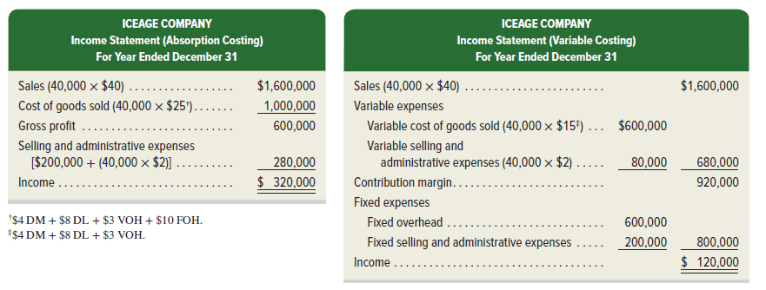
Income Reporting
Exhibit 18B.3
© McGraw-Hill Education
Learning Objective P4: Compute unit cost and income under both absorption and variable costing.
18-45
Notes:
Let’s return to IceAge Company. Below are the manufacturing cost data for IceAge as well as additional data on selling and administrative expenses. Assume that IceAge began the year with no units in inventory. During the year, IceAge produced 60,000 units and sold 40,000 units at $40 each, leaving 20,000 units in ending inventory.
Let’s prepare income statements for IceAge both under absorption costing and under variable costing. Under variable costing, expenses are grouped according to cost behavior—variable or fixed, and production or nonproduction. Under absorption costing, expenses are grouped by function but not separated into variable and fixed components.
Units Produced Exceed Units Sold. Exhibit 21B.3 shows absorption costing and variable costing income statements. During the year, 60,000 units were produced, but only 40,000 units were sold, which means 20,000 units remain in ending inventory. Income is $320,000 under absorption costing. Under variable costing, income is $120,000. This $200,000 difference is due to the treatment of fixed overhead. Because the variable costing method expenses fixed overhead (FOH) as a period cost of $600,000, and the absorption costing method expenses FOH based on the number of units sold (40,000 × $10), income is lower under variable costing by $200,000 (20,000 units × $10).
When production exceeds sales by 20,000 units (60,000 versus 40,000), the $200,000 ($10 × 20,000 units) of fixed overhead cost allocated to these 20,000 units is included in the cost of ending inventory. This means that $200,000 of fixed overhead cost incurred in 2021 is not expensed until future years under absorption costing, when it is reported in cost of goods sold as those products are sold. Consequently, income for the current year under absorption costing is $200,000 higher than income under variable costing. Even though sales (of 40,000 units) and the number of units produced (totaling 60,000) are the same under both costing methods, income differs greatly due to the treatment of fixed overhead. We can generalize this result to link units produced and sold to income under absorption costing versus variable costing.

Slide 46
Converting Income Under Variable Costing to Income under Absorption Costing
© McGraw-Hill Education
Learning Objective P4: Compute unit cost and income under both absorption and variable costing.
18-46
Notes:
Converting Income under Variable Costing to Income under Absorption Costing In the current year, IceAge produced 20,000 more units than it sold. Those 20,000 units remaining in ending inventory will be sold in future years. When those units are sold, the $200,000 of fixed overhead costs attached to them will be expensed, resulting in lower income under the absorption costing method. This leads to a simple way to convert income under variable costing to income under absorption costing.
For example, if IceAge produces 60,000 units and sells 80,000 units next year, it reports income under variable costing of $1,040,000. Income under absorption costing is then computed as $1,040,000 + $0 - $200,000 = $840,000.

Slide 47
End of Chapter 18
© McGraw-Hill Education
18-47
Notes:
End of Chapter 18.

