Slide 1
Variable Costing and Analysis
Chapter 19
Wild and Shaw
Financial and Managerial Accounting
9th Edition
Copyright ©2022 McGraw-Hill Education. All rights reserved. No reproduction or distribution without the prior written consent of McGraw-Hill Education.

Slide 2
Chapter 19 Learning Objectives
CONCEPTUAL
C1 Describe how absorption costing can result in overproduction.
ANALYTICAL
A1 Apply contribution margin ratio for business decisions.
A2 Appendix 19A Convert income under variable costing to the absorption cost basis.
PROCEDURAL
P1 Compute unit cost under both absorption and variable costing.
P2 Prepare and analyze an income statement using absorption costing and using variable costing.
P3 Determine product selling price and analyze special orders.
© McGraw-Hill Education
19-2

Slide 3
Compute unit cost under both absorption and variable costing.
Learning Objective P1
© McGraw-Hill Education
19-3

Slide 4
Absorption Costing versus Variable Costing (1 of 2)
Two product costing methods:
Variable costing includes direct materials, direct labor, and variable overhead.
Absorption costing includes direct materials, direct labor, and both variable and fixed overhead.
Absorption costing required by GAAP for external reporting purposes but can result in misleading product cost information and poor managerial decisions.
Learning Objective P1: Compute unit cost under both absorption and variable costing
© McGraw-Hill Education
19-4
Notes:
This chapter illustrates and compares two costing methods:
Variable costing—includes direct materials, direct labor, and variable overhead costs in product costs. This method is useful for many managerial decisions but cannot be used for external financial reporting.
Absorption costing—includes direct materials, direct labor, and both variable and fixed overhead in product costs.
Absorption costing is used for external reporting purposes under GAAP but this method can result in misleading product cost information and poor managerial decisions.

Slide 5
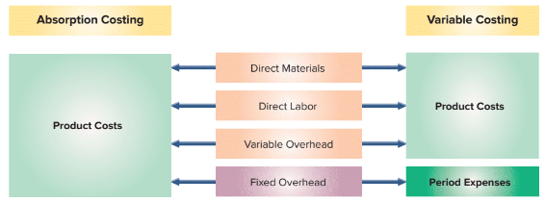
Absorption Costing versus Variable Costing (2 of 2)
Exhibit 19.1
Learning Objective P1: Compute unit cost under both absorption and variable costing
© McGraw-Hill Education
19-5
Notes:
Both methods include direct materials, direct labor, and variable overhead in product costs. Key difference is their reporting of fixed overhead costs. Fixed overhead costs are included in product cost under absorption costing but included in period expenses under variable costing. Product costs are included in inventory until the goods are sold at which time they are included in cost of goods sold. Period expenses are reported as expenses immediately in the period incurred.

Slide 6
Computing Unit Product Cost
Exhibit 19.2
Exhibit 19.3
Learning Objective P1: Compute unit cost under both absorption and variable costing
© McGraw-Hill Education
19-6
Notes:
Consider the product cost data for IceAge, a skate manufacturer. In Exhibit 19.2 we can see the product cost data for the company. Direct materials cost per unit is $4. Direct labor cost is $8 per unit. The overhead is split between variable at $3 per unit and fixed at $600,000 per year. The total units that IceAge expects to manufacture this period is 60,000 units. Keep your eye on the fixed overhead of $600,000 …that is the key difference between absorption costing and variable costing.
Exhibit 19.3 shows the product unit cost computations for both absorption and variable costing.
For absorption costing, product cost per unit is $25, which consists of $4 in direct materials, $8 in direct labor, $3 in variable overhead ($180,000/60,000 units), and $10 in fixed overhead ($600,000/60,000 units).
For variable costing, the product cost per unit is $15, which consists of $4 in direct materials, $8 in direct labor, and $3 in variable overhead. Fixed overhead costs of $600,000 are treated as a period cost (not product cost) and are recorded as an expense in the period incurred. For absorption costing, the product cost per unit includes fixed overhead costs; this means its product cost per unit is $15 plus the $600,000 fixed overhead costs allocated to the units.

Slide 7
Prepare and analyze an income statement using absorption costing and using variable costing.
Learning Objective P2
© McGraw-Hill Education
19-7

Slide 8
Income Reporting
Learning Objective P2: Prepare and analyze an income statement using absorption costing and using variable costing.
© McGraw-Hill Education
19-8
Notes:
The different treatment of fixed overhead costs leads to different product costs per unit under absorption and variable costing. This also impacts income reporting. Below are data for IceAge Company. Assume its variable costs per unit, annual fixed costs, and sales price do not change.
Sales and production information for IceAge follows. Units produced equal those sold for Year 1 but exceed those sold for Year 2. Units produced are less than those sold for Year 3. IceAge began Year 1 with no units in beginning inventory.
We prepare income statements for IceAge under absorption costing and under variable costing. We consider three cases: when units produced are equal to, exceed, or are less than units sold. Income differs between the costing methods when inventory levels change. Inventory levels change when units produced do not equal units sold.

Slide 9
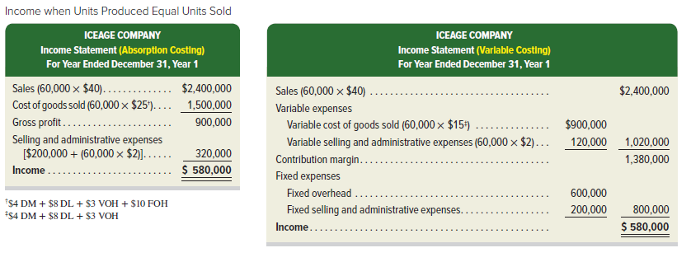
Income Reporting: Units Produced Equal Units Sold
Exhibit 19.4
Learning Objective P2: Prepare and analyze an income statement using absorption costing and using variable costing.
© McGraw-Hill Education
19-9
Notes:
Exhibit 19.4 presents the Year 1 income statement for both costing methods. The income statement under variable costing (on right) is a contribution margin income statement. Contribution margin is sales minus variable costs. Variable cost of goods sold is the direct materials, direct labor, and variable overhead costs for units sold. The absorption costing income statement (on left) does not separate expenses into variable and fixed components.
Exhibit 19.4 shows that income is identical under absorption costing and variable costing when the units produced equal the units sold. This is because the $600,000 fixed overhead (FOH) that is expensed under variable costing is equal to the $600,000 (60,000 units × FOH per unit) that is included in cost of goods sold under absorption costing when units produced equal units sold.

Slide 10
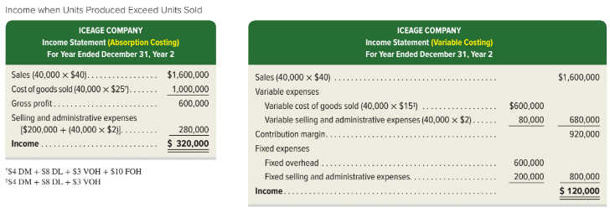
Income Statement: Units Produced Exceed Units Sold
Exhibit 19.5
Learning Objective P2: Prepare and analyze an income statement using absorption costing and using variable costing.
© McGraw-Hill Education
19-10
Notes:
Exhibit 19.5 shows absorption costing and variable costing income statements for Year 2 when 60,000 units were produced, but only 40,000 units were sold. This means 20,000 units remain in ending inventory. For Year 2, income is $320,000 under absorption costing. Under variable costing, income is $120,000. The cause of this $200,000 income difference is the different treatment of fixed overhead. The $600,000 of fixed overhead (FOH) is expensed under variable costing as a period cost, but under absorption costing the FOH is expensed based on the number of units sold (40,000 × $10). This means income is lower under variable costing by $200,000 (20,000 units x $10).
When the number of units produced differs from the number of units sold, inventory levels change. The dollar amount for finished goods inventory reported on the balance sheet will also differ between absorption and variable costing. From Exhibit 19.3, product costs per unit are $25 under absorption costing and $15 per unit for variable costing. With 20,000 units in ending finished goods inventory (60,000 units produced−40,000 units sold), the inventory balances under each costing method follow for Year 2. The $200,000 difference between the two methods is due to fixed overhead costs being included in finished goods inventory under absorption costing and not under variable costing. This $200,000 of fixed overhead cost is included in cost of goods sold under absorption costing when that inventory is sold.

Slide 11
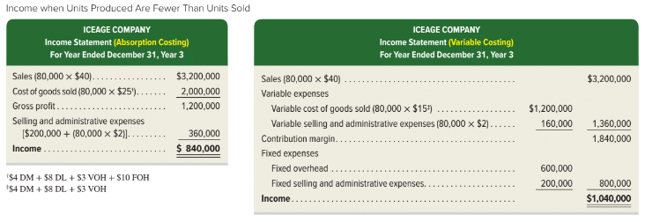
Income Statement: Units Produced Less Than Units Sold
Exhibit 19.6
Learning Objective P2: Prepare and analyze an income statement using absorption costing and using variable costing.
© McGraw-Hill Education
19-11
Notes:
Exhibit 19.6 shows absorption costing and variable costing income statements for Year 3 when IceAge produced 60,000 units and sold 80,000 units. This means IceAge sold all that it produced in Year 3, and it sold all of its beginning finished goods inventory. Its income is $840,000 under absorption costing, but it is $1,040,000 under variable costing.
The $200,000 income difference is due to fixed overhead (FOH). Beginning inventory in Year 3 under absorption costing includes $200,000 of fixed overhead cost incurred in Year 2, which is included in cost of goods sold in Year 3 under absorption costing when the units are sold. When 80,000 units are sold in Year 3, total cost of goods sold under absorption costing is $2,000,000 (80,000 units × $25). Of this amount, $800,000 is FOH (80,000 units × $10), which consists of $600,000 from the current year and $200,000 from the prior year. However, variable costing reports $600,000 in FOH expenses as it has for all 3 years.

Slide 12
Summarizing Income Reporting
Exhibit 19.7
Learning Objective P2: Prepare and analyze an income statement using absorption costing and using variable costing.
19-12
© McGraw-Hill Education
Notes:
IceAge’s income reported under both variable costing and absorption costing for Year 1 through Year 3 is summarized in Exhibit 19.7. Total income is $1,740,000 for this time period for both methods. Income under absorption costing and income under variable costing differ whenever the units produced differ from units sold. These differences in income are due to the different timing with which fixed overhead costs are reported in income under the two methods. Income under absorption costing is higher when more units are produced than sold and is lower when fewer units are produced than sold.
For IceAge, the 180,000 total units produced over the three-year period exactly equal the 180,000 units sold over that period. This means that the difference between total absorption costing income and total variable costing income for the three-year period is zero. In reality, production and sales quantities rarely exactly equal each other over a short period of time. We normally see differences in income for these two methods extending over several years.

Slide 13
Describe how absorption costing can result in overproduction.
Learning Objective C1
© McGraw-Hill Education
19-13

Slide 14
Planning Production: Unit Cost under Absorption Costing
Exhibit 19.8
Learning Objective C1: Describe how absorption costing can result in overproduction.
© McGraw-Hill Education
19-14
Notes:
Many companies link manager bonuses to income computed under absorption costing because this is how income is reported to shareholders (per GAAP). This can lead some managers to overproduce and create excess inventory.
Let’s use IceAge’s Year 1 data with one change: its manager decides to produce 100,000 units instead 60,000. Because only 60,000 units are sold, the 40,000 units of excess production will be in ending finished goods inventory. The left side of Exhibit 19.8 shows the $25 product cost per unit under absorption costing when 60,000 units are produced (same as Exhibit 19.3). The right side shows the $21 product cost per unit when 100,000 units are produced. Total product cost per unit is $4 less when 100,000 units are produced. This is because the company is spreading the $600,000 fixed overhead cost over 40,000 more units when 100,000 units are produced than when 60,000 units are produced. The $4 per unit difference in product cost impacts income.

Slide 15
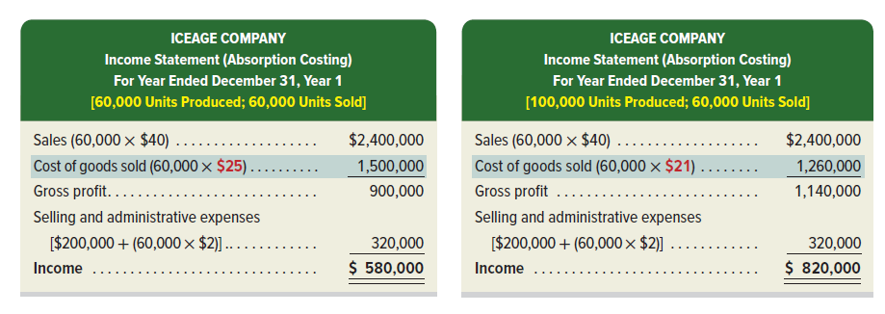
Planning Production: Income under Absorption Costing
Exhibit 19.9
Learning Objective C1: Describe how absorption costing can result in overproduction.
© McGraw-Hill Education
19-15
Notes:
Exhibit 19.9 shows the Year 1 income statement under absorption costing for the two production levels.
Common sense suggests that overproducing and creating excess inventory should not increase income. Yet, income under absorption costing is $240,000 greater if IceAge produces 40,000 more units than it sells. The reason is that $240,000 of fixed overhead (40,000 units ×$6) is assigned to ending inventory instead of being expensed as cost of goods sold in Year 1. This shows that under absorption costing, a manager can increase current year income just by producing more and disregarding whether the excess units can be sold or not. This incentive problem encourages inventory buildup, which leads to increased costs in storage and obsolescence.

Slide 16
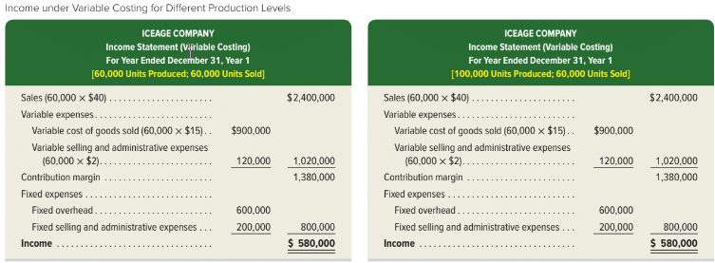
Planning Production: Income under Variable Costing
Exhibit 19.10
Learning Objective C1: Describe how absorption costing can result in overproduction.
© McGraw-Hill Education
19-16
Notes:
This manager incentive problem is avoided when income is measured using variable costing.
To illustrate, Exhibit 19.10 reports income under variable costing for the same production levels used in Exhibit 19.9. Under variable costing, managers cannot increase income by merely increasing production without increasing sales. Income under variable costing is not affected by production-level changes because all fixed overhead costs are expensed in the year when incurred. Under variable costing, companies increase income by selling more units, not by producing excess inventory.

Slide 17
Determine product selling price and analyze special orders.
Learning Objective P3
© McGraw-Hill Education
19-17

Slide 18
Setting Target Price
Three-step process to determine selling price:
Determine the product cost per unit using absorption costing.
Determine the target markup on product cost per unit.
Add the target markup to the product cost to find the target selling price.
Learning Objective P3: Determine product selling price and analyze special orders.
© McGraw-Hill Education
19-18
Notes:
Over the long run, prices must be high enough to cover all costs and provide an acceptable return to owners. For this purpose, absorption cost is useful because it reflects the full costs that selling prices must exceed for the company to be profitable.
We use a three-step process to determine product selling price:
Step 1: Determine the product cost per unit using absorption costing.
Step 2: Determine the target markup on product cost per unit.
Step 3: Add the target markup to the product cost to find the target selling price.

Slide 19
Setting Target Price Illustration
Exhibit 19.11
© McGraw-Hill Education
Learning Objective P3: Determine product selling price and analyze special orders.
19-19
Notes:
To illustrate, under absorption costing, IceAge’s product cost is $25 per unit (from Exhibit 19.3). IceAge’s management determines a target markup to cover selling and administrative expenses. IceAge targets a markup of 60% of absorption cost and computes a target selling price in Exhibit 19.11.
While absorption cost information is useful in setting long-run prices, it can lead to poor decisions in analyzing special orders. We show how variable cost information can be used to analyze special-order decisions next.

Slide 20
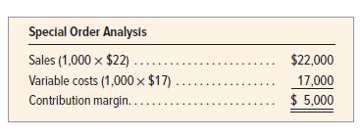
Analyzing Special Orders
Need to cover all fixed and variable costs over the long run.
Since fixed costs don't change, should accept special order if price exceeds variable costs, over the short run.
Exhibit 19.12
© McGraw-Hill Education
Learning Objective P3: Determine product selling price and analyze special orders.
19-20
Notes:
Over the long run, prices must cover all fixed and variable costs. Over the short run, fixed costs do not change with changes in production levels. This means that managers should accept special orders if the special-order price exceeds variable cost.
To illustrate, let’s return to IceAge. Its variable cost of goods sold per unit is $15 and its variable selling and administrative expenses are $2 per unit. Assume that it receives a special order for 1,000 pairs of skates at an offer price of $22 per pair from a foreign skating school. This special order will not affect IceAge’s regular sales and it has excess capacity to fill the order.
Using absorption costing, the product cost is $25 per unit compared with the special-order price of $22 per unit. This might suggest that management should reject the order. Closer analysis shows this order should be accepted. The $22 special-order price exceeds the $17 variable cost of the product. Specifically, Exhibit 19.12 reveals that contribution margin (and income) would increase by $5,000 from accepting the order. The reason for accepting the special order lies in the different behavior of variable and fixed costs. If the order is rejected, only variable costs are saved. Fixed costs do not change in the short run regardless of rejecting or accepting this order. Because sales exceed variable expenses for this order, accepting the special-order increases contribution margin.

Slide 21
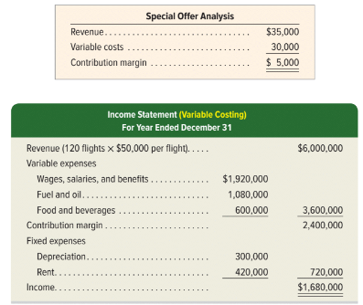
Variable Costing for Services
Exhibit 19.13
19-21
Learning Objective P3: Determine product selling price and analyze special orders.
© McGraw-Hill Education
Notes:
Variable costing also applies to service companies. Since service companies do not produce inventory, the differences in income from absorption and variable costing do not apply. Still, a focus on variable costs can be useful in managerial decisions for service firms.
For service firms, variable costs change as the volume of services provided change. Fixed costs do not change as the volume of services provided change. One example is a hotel receiving an offer to reserve a large block of rooms at a discounted price. Another example is “special-order” pricing for airlines when they sell tickets shortly before a flight at deeply discounted price. If the discounted price exceeds variable costs, such sales increase contribution margin and income.
To illustrate, BlueSky provides charter airline services. Its variable costing income for the year is in Exhibit 19.13. Based on an activity level of 120 flights (60% of its capacity), variable cost per flight is $30,000, computed as $3,600,000/120. BlueSky’s normal price is $50,000 per flight. A group has offered BlueSky $35,000 to fly its members to Washington, D.C. In making its decision, BlueSky should ignore fixed costs and focus on variable costs. The company’s expected contribution margin from the special offer is shown here.
BlueSky should accept the special offer because it provides a contribution margin of $5,000.

Slide 22
Apply contribution margin ratio for business decisions.
Learning Objective A1
© McGraw-Hill Education
19-22

Slide 23
Contribution Margin Ratio
Percent of sales that remain after subtracting variable expenses.
Exhibit 19.15
Learning Objective A1: Apply contribution margin ratio for business decisions.
© McGraw-Hill Education
19-23
Notes:
Variable costing is useful in analyzing performance of business divisions such as sales territories and product lines. From the variable costing income statement, we compute the following contribution margin ratio for the business division under analysis. Recall: Contribution margin = Sales − Variable expenses.
Contribution margin ratio is the percent of sales that remains after subtracting variable expenses. For example, if contribution margin is $200,000 and sales are $500,000, the contribution margin ratio is 0.40($200,000/$500,000), or 40%. This means 40% of each sales dollar remains to cover fixed costs and contribute to income. A higher contribution margin ratio is better.
We return to Year 1 of our IceAge example to show the use of contribution margin ratio in analyzing sales territories. IceAge has two sales territories, Western and Eastern, and each sells 30,000 units. Selling prices ($40 per unit) and variable costs of goods sold ($15 per unit) are the same in each territory. Variable selling and administrative expenses differ for the territories. Contribution margin ratio for each territory is in Exhibit 19.15.

Slide 24
Contribution Margin by Product Line
Analysis of contribution margin by product line can impact managerial decisions like:
Increasing selling price per unit
Decreasing variable cost of goods sold per unit
Increasing sales efforts
Exhibit 19.16
© McGraw-Hill Education
Learning Objective A1: Apply contribution margin ratio for business decisions.
19-24
Notes:
We can also apply this analysis to IceAge’s two product lines: hockey skates and figure skates. Units sold, selling prices per unit, and variable selling and administrative expenses per unit are the same for each product line, but variable cost of goods sold per unit is higher for figure skates. With this information we compute the contribution margin ratio by product line in Exhibit 19.16. Contribution margin ratio for hockey skates of 60% ($720,000/$1,200,000) is higher than that for figure skates of 55%. The difference in contribution margin ratio is due to higher variable cost of goods sold per unit for figure skates. Analysis of contribution margin ratio by product line can impact managerial decisions such as:
Increasing the selling price per unit for figure skates.
Decreasing the variable cost of goods sold per unit for figure skates.
Increasing sales efforts for hockey skates.

Slide 25
Appendix 19A Convert income under variable costing to income under absorption costing.
Learning Objective A2
© McGraw-Hill Education
19-25

Slide 26
Converting Income under Variable Costing to Absorption Costing
Companies must use absorption costing for external reporting and tax reporting.
Income under variable costing is restated to that under absorption costing utilizing the following formula:
Exhibit 19A.1 & 19A.2
Learning Objective A2: Convert income under variable costing to the absorption cost basis.
© McGraw-Hill Education
19-26
Notes:
Income under variable costing is converted to income under absorption costing by adding the fixed overhead cost in ending finished goods (FG) inventory and subtracting the fixed overhead cost in beginning finished goods (FG) inventory. Exhibit 19A.1 shows this calculation.
Exhibit 19A.2 shows the computations for IceAge. To convert variable costing income to absorption costing income for Year 2, add the fixed overhead in ending FG inventory. To restate variable costing income to absorption costing income for Year 3, subtract the fixed overhead in beginning FG inventory, which was incurred in Year 2 but expensed in the Year 3 cost of goods sold when the inventory was sold.
Differences between absorption costing income and variable costing income are smaller when:
Fixed overhead is a small percentage of total manufacturing costs.
Inventory levels are low, as with just-in-time systems.
Inventory turnover is rapid. The more quickly inventory turns over, the greater proportion of product costs are included in cost of goods sold relative to that remaining in ending inventory.
Period of analysis is long. Income differences between absorption costing and variable costing decrease as income is compared over longer period.

Slide 27
End of Chapter 19
© McGraw-Hill Education
19-27

