Slide 1
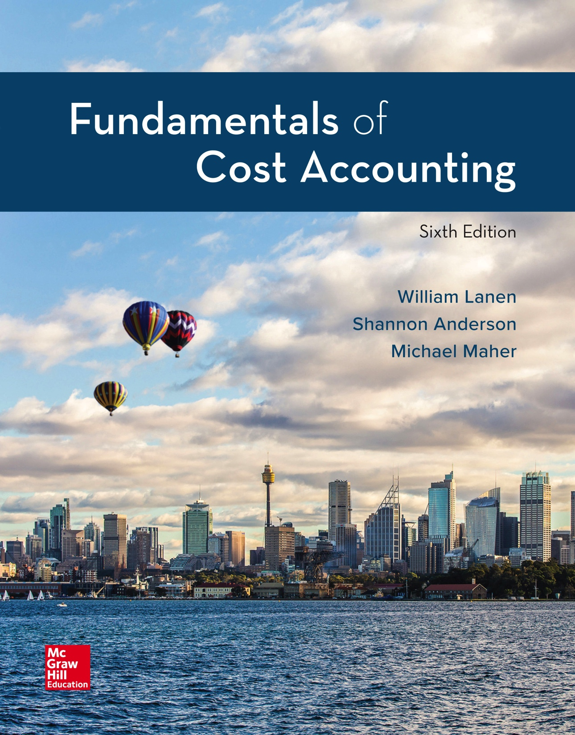
Copyright ©2020 McGraw-Hill Education. All rights reserved. No reproduction or distribution without the prior written consent of McGraw-Hill Education.
Notes:
Fundamentals of Cost Accounting, 6th edition
Lanen/Anderson/Maher

Slide 2
Fundamentals of Cost Analysis for Decision Making
Chapter 4
Notes:
Chapter 4: Fundamentals of Cost Analysis for Decision Making
Now that you are comfortable with CVP analysis and the impact of fixed versus variable costs, we can extend the concepts and apply the theories to a multitude of business conditions.

Slide 3
Learning Objectives
LO 4-1 Use differential analysis to analyze decisions.
LO 4-2 Understand how to apply differential analysis
to pricing decisions.
LO 4-3 Understand several approaches for establishing
prices based on costs for long-run pricing decisions.
LO 4-4 Understand how to apply differential analysis to
production decisions.
LO 4-5 Understand the theory of constraints.
Notes:
After you finish this chapter you should be able to understand and use differential analysis, and understand several approaches for establishing prices and the theory of constraints. This chapter begins by discussing differential analysis and then presents conditions that are conducive to the model.
Most of us use differential analysis on a daily basis without even knowing we are implementing a management tool!

Slide 4
Differential Analysis
LO 4-1
LO 4-1 Use differential analysis to analyze decisions.
Differential Analysis
The process of estimating revenues and costs
of alternative actions available to decision makers
and of comparing these estimates to the status quo.
Short Run
The period of time over which capacity will be
unchanged, usually one year.
Notes:
Now that you see the value of CVP analysis for decision-making, let’s move on to other decisions. In Chapter 1 we discussed differential costs and differential revenues. Today, every decision that a manager makes requires comparing one or more proposed alternatives with the status quo. Differential analysis is the process of estimating revenues and costs of alternative actions and comparing these estimates to the status quo. Differential analysis is used for both short-run decisions and long-run decisions. Short run is defined as the period over which capacity will be unchanged.

Slide 5
Differential Costs
LO 4-1
With two or more alternatives, costs that differ
among or between alternatives
Costs that change in response to an alternative
course of action
Differential costs differ between actions.
Alternative A
Alternative B
Notes:
Remember from Chapter 1, differential costs differ between actions. In Chapter 1, Desert Adventures was trying to decide whether it should expand operations or not. In Chapter 1, you looked at Desert Adventure’s differential revenues and differential costs to determine if it was beneficial for expansion. If a cost is differential, or differs between alternatives, it is relevant to the decision-making analysis. Differential costs are sometimes called relevant costs. If the cost does not differ between alternatives it is not relevant to the decision making analysis.

Slide 6
Sunk Costs
LO 4-1
Costs incurred in the past that cannot be
changed by present or future decisions
A sunk cost is NOT relevant for making decisions.
Notes:
An important category of cost to identify when making decisions includes costs that were incurred in the past and cannot be changed regardless of the decision made. These costs are called sunk costs and are not relevant for a decision.

Slide 7
Differential Costs versus Total Costs
LO 4-1
Information presented to management can show the detailed costs that are included for making a decision, or it can show just the differences between alternatives, as follows.
Status Quo
Alternative
Difference
Sales revenue
Variable costs
Contribution margin
Fixed costs
Operating profit
$750
(250)
$500
(350)
$150
$900
(300)
$600
(350)
$250
$150
(50)
$100
-0-
$100
Notes:
Information presented to management can show the differences between alternatives.

Slide 8
Differential Analysis and Pricing Decisions
LO 4-2
LO 4-2 Understand how to apply differential
analysis to pricing decisions.
Variable costs must
always be covered.
Fixed costs must be
covered in the long run.
Notes:
Differential analysis is useful for many decisions that managers make about pricing because it provides information about the likely impact of these decisions on profit. Variable costs must always be covered and fixed costs must be covered in the long run.

Slide 9
Short-Run versus Long-Run Pricing Decisions
LO 4-2
Year 0
Year 1
Short-run
pricing decision:
Less than one year
Long-run
pricing decision:
Longer than one year
Pricing a one-time
special order
Pricing a new product
Notes:
For example, if a manager is pricing a one-time special order he asks: How much material is required for the order? But if the manager is pricing a new product he asks: Do I need a new plant?

Slide 10
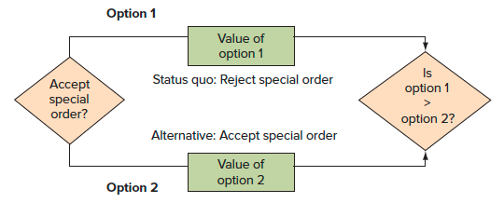
Short-Run Pricing Decisions: Special Orders
LO 4-2
An order that will not affect other sales and is usually a short-run occurrence
Notes:
A special order is an order that will not affect other sales and is usually a one-time occurrence. The manager has two alternatives. One alternative is to reject the special order and maintain the status quo. Another alternative is to accept the special order.

Slide 11
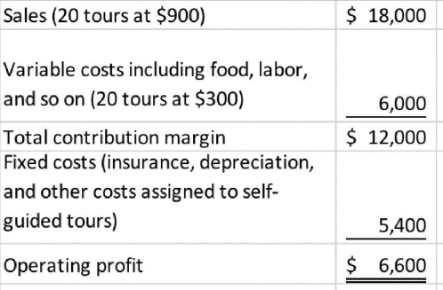
Short-Run Pricing Decisions: Special Orders (2)
LO 4-2
Desert Adventures has received a one-time offer for 5
additional tours at a discounted price of $700 per tour.
The regular price is $900 per tour and they have enough
idle capacity in the month to take the offer.
Notes:
Back to Desert Adventures. A local museum director asks Desert Adventures about offering discounted self-guided tours to museum members who donate above a certain level during the next monthly fund drive. The museum expects that five members will want to do this. Desert Adventures has idle capacity adequate for these additional five tours, which will not affect the demand for other self-guided tours for the month. The museum director asks Desert Adventures to offer the members a special price of $700 for the tours, a discount off the regular price of $900. Since Desert Adventures has idle capacity, there are no additional long run costs associated with the special order. The special order is a short-run pricing decision based on differential cost. The differential cost associated with the special order is the variable costs of the tours. Variable costs are $300 per tour.

Slide 12
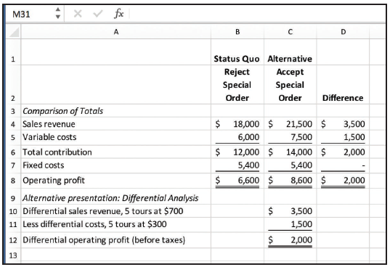
Short-Run Pricing Decisions: Special Orders (3)
LO 4-2
Analysis of Special Order: U-Develop
Notes:
A sales price of $700 per unit minus variable costs of $300 per unit results in an increase in operating profit before taxes of $400 per tour, or $2,000 for 5 tours. Notice the fixed costs of $5,400 do not change between alternatives.

Slide 13
Long-Run Pricing Decisions
LO 4-3
LO 4-3 Understand several approaches for establishing
prices based on costs for long-run pricing decisions.
Full cost is the sum of all fixed and variable costs of manufacturing and selling a unit.
Full costs are relevant for the long-term pricing decisions.
Notes:
Most firms rely on full cost information reports when setting prices.

Slide 14
Long-Run versus Short-Run Pricing
LO 4-3
In the short run, differential costs may be very low.
In the long run, differential costs are higher than in the short run.
Notes:
We must always keep in mind differential costs in the short run as well as in the long run.

Slide 15
Cost Analysis for Pricing
LO 4-3
In the long run, an organization must cover all variable and fixed costs—both manufacturing and selling.
Notes:
In the long run, all costs must be covered. We will look at life-cycle and target costing.

Slide 16
Life-Cycle Product Costing and Pricing
LO 4-3
Product life-cycle is concerned with covering costs in all categories of the life cycle.
R & D
Design
Manufacturing
Marketing and
distribution
Customer
service
Take back
(disposal)
Notes:
Product life-cycle is the time from initial research and development of the product to the time that support to the customer ends and the product is disposed of. Life-cycle costing is concerned with covering costs in all categories of the life-cycle. To be profitable, companies must generate enough revenue to cover costs incurred in all categories of the value chain.

Slide 17
Target Costing from Target Pricing
LO 4-3
Target Price
The price based on customers’ perceived value for the product and the price that competitors charge.
What would a customer pay?
How much profit do I need?
Can I make it at this cost?
Target price – Desired profit = Target cost
Notes:
Target costing is the concept of “price-based costing” instead of “cost-based pricing.” A target price is the estimated price for a product or service that potential customers will be willing to pay. A target cost is the estimated long-run cost of a product or service whose sale enables the company to achieve a targeted profit.

Slide 18
Legal Issues Relating to Costs and Sales Price
LO 4-3
Predatory Pricing
Practice of setting price below cost with the intent to drive competitors out of business
Dumping
Exporting a product to another country at a price below domestic price
Price Discrimination
Practice of selling identical goods to different customers at different prices
Notes:
There are many issues related to pricing products. Some are legal and fair, some legal and unethical, others are illegal yet ethical, and several are both illegal and unethical. A few are mentioned in this chapter. These include predatory pricing, dumping, and price discrimination.

Slide 19
Legal Issues Relating to Costs and Sales Price (2)
LO 4-3
Peak-load Pricing
Practice of setting prices highest when the quantity demanded for the product approaches capacity.
Price Fixing
Agreement among businesses to set prices at a particular level.
Notes:
Peak-loading pricing and price fixing are also discussed.

Slide 20
Use of Differential Analysis for Production Decision
LO 4-4
LO 4-4 Understand how to apply differential
analysis to production decisions.
Make or buy
Decision to make goods or services
internally or purchase them externally
Add or drop
a segment
Decision to add or drop a product
line or close a business unit
Product
choice
Decision on what products or
services to offer (product mix)
Notes:
We now apply our cost analysis concepts to production and operating decisions. Typical production and operating questions that managers often ask are: Should we make the product internally or buy it from an outside source? Should we add to or drop parts of our operations? Which products should we continue to produce and which should we drop? To make these decisions, the manager asks what costs and revenues will differ as a result of the choices made and which course of action would be the most profitable for the company?

Slide 21
Make-or-Buy Decisions
LO 4-4
Desert Adventure’s current costs of developing prints:
This year’s expected volume is 150 tours, so the full cost of operating one of these tours is:
$222,000 ÷ 150 tours = $1,480
Notes:
A make-or-buy decision is any decision by a company to acquire goods or services internally or externally. The make-or-buy decision is often part of the Company’s long-run strategy. Whether to rely on outsiders for a substantial amount of materials depends on both differential cost comparisons and other factors that are not easily quantified, such as suppliers’ dependability and quality control.
Let’s look at Desert Adventure’s costs. The current cost of providing 150 tours is $222,000. This includes costs directly traceable to the variable costs and $48,000 of direct fixed costs. Costs not directly traceable (common costs) of $24,000, are allocated to the cost of the tours. The full cost of tours is $1,480 per unit ($222,000 ÷ 150 tours).

Slide 22
Make-or-Buy Decisions (2)
LO 4-4
Desert Adventures has received an offer from a local tour operator to organize and lead these tours for a cost (to Desert Adventures) of $1,400.
Does Desert Adventures accept the offer?
The accounting department prepared cost analyses at volume levels of 150 and 100 tours per year.
Notes:
Desert Adventures has received an offer from an outsider to lead tours for a cost of $1,400 each.

Slide 23
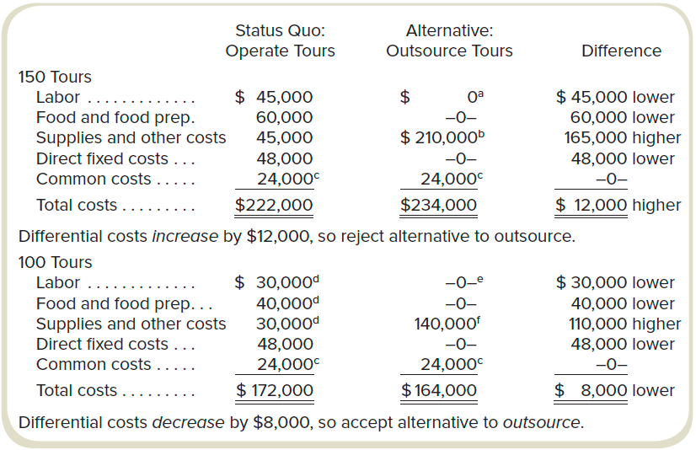
Make-or-Buy Decisions (3)
LO 4-4
ª If tours are outsourced, no Desert Adventures labor is required for leading the tours.
^{b} Pay outside supplier $210,000 (=150 tours x $1,400) to operate tours.
^{c} These common costs remain unchanged for these volumes. Because they do not change, they could be omitted from the analysis.
^{d} Total variable costs reduced by 1/3 because volume was reduced by 1/3 (=[150 tours – 100 tours]/150 tours).
^{e} 50,000 units purchased at $0.25 = $12,500
^{f} Pay outside supplier $140,000 (= 100 tours x $1,400) to operate tours.
Notes:
Differential costs of labor, food, and food preparation will be saved by outsourcing. The direct fixed cost is the cost of leasing the building where the equipment used on the tours is staged. The building is also where equipment for the tour is stored and maintained. Although the building cost is fixed for levels of any tour activity up to 200 tours, we can eliminate it if we stop leading these tours and outsource them instead. Thus, although the building cost is a fixed cost of leading these tours, it is a differential cost if we eliminate the service. The common costs, however, remain unchanged. At a volume of 150 tours, the differential costs would increase by $12,000, which means rejecting the alternative of outsourcing the best alternative.
Suppose Desert Adventures decreases tours to 100 per year. Doing the same differential analysis, we see that the differential costs decreased by $8,000 if Desert Adventures outsources the tour operation. Why is it that at 150 tours it is cheaper to operate the tours but at 100 tours it is cheaper to outsource them? The common costs still remain unchanged and are still omitted from the analysis. The cost paid to the outside processor and the variable costs were reduced by one-third because volume was reduced by one-third. Remember, variable costs vary in total as activity changes. Therefore, at a volume of 150 tours, the differential costs would decrease by $8,000, which means accepting the alternative of outsourcing the best alternative.

Slide 24
Opportunity Costs of Making
LO 4-4
Desert Adventures expected volume is 150 trips.
Assume that the building used to store and maintain equipment could be used for aerial excursions of the local canyons. This new service would provide a $40,000 differential contribution.
Should Desert Adventures accept or reject the alternative?
Notes:
Recall from Chapter 2 that opportunity costs are the foregone benefits from the best alternative course of action. Suppose Desert Adventure’s building could be used for aerial excursions of the local canyons.

Slide 25
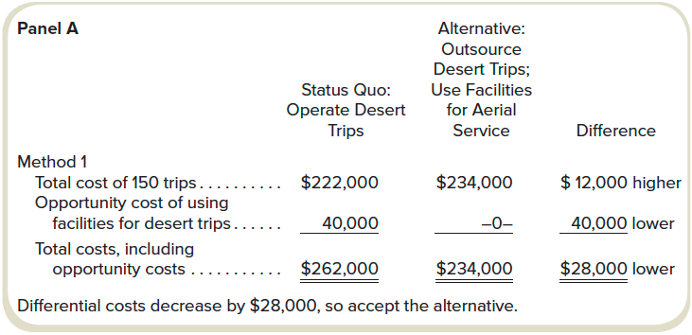
Opportunity Costs of Making (2)
LO 4-4
“Higher” or “lower” indicates whether the alternative is higher or lower than the status quo.
Differential costs decrease by $28,000, so accept the alternative.
Notes:
If that is the case, the total cost of providing 150 tours (including the $40,000 opportunity cost) would be $262,000. The alternative of outsourcing for tours and using the facilities for aerial service has a total cost of $234,000. Therefore, the differential costs decrease by $28,000, which means they should accept the alternative.

Slide 26
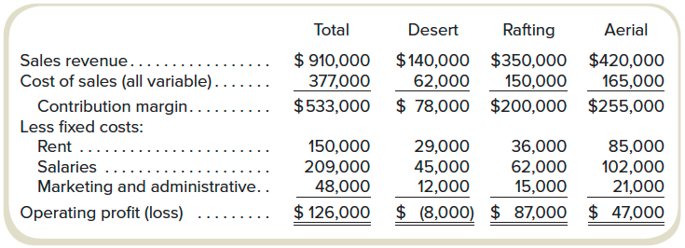
Add or Drop Decisions
LO 4-4
Desert Adventures
Fourth Quarter Product Line Income Statement
Notes:
Managers often must decide whether to add or drop a product line or close a business unit. Product lines or business units that were formerly profitable may no longer be profitable. In fact, Desert Adventures is looking at their product line income statement and sees that desert trips are no longer profitable. They are considering dropping desert trips. It appears that operating profit would increase by $8,000 if they discontinued the trips. So the accountant was asked to do a differential analysis.

Slide 27
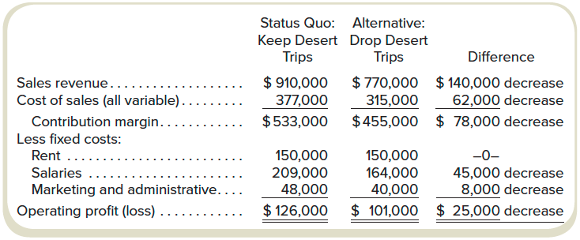
Add or Drop Decisions (2)
LO 4-4
Desert Adventures
Differential Analysis
Profits decrease $25,000. Therefore, keep desert trips.
Notes:
The differential analysis shows that rent is not relevant for the decision. The rent must be paid whether the tours are dropped or not. Therefore, profits would decrease $25,000 if desert trips are dropped.

Slide 28
Product Choice Decisions
LO 4-4
Constraints
Activities, resources, or policies that limit or bound the attainment of an objective
Contribution Margin per Unit of Scarce Resource
Contribution margin per unit of a particular input with limited availability
Notes:
Another common managerial decision is determining what products or services to offer. This choice directly affects costs and profits. By now you clearly understand contribution margin. Constraints are activities, resources, or policies that limit or bound the attainment of an objective. With a constrained resource, the important measure of profitability is not the contribution margin per unit of product, but the contribution margin per unit of scarce resource.

Slide 29
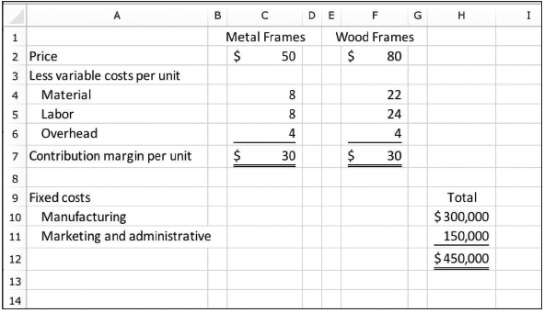
Product Choice Decisions (2)
LO 4-4
Southwestern Frames
Revenue and Cost Information
Notes:
Let’s look at the revenue and cost information for Desert Adventures metal and wood frames (purchased from Southwestern Frames). Metal frames require a half an hour of machine time and wood frames require an hour. The revenue and cost information indicates that both metal and wood frames have a contribution margin per unit of $30. Fixed manufacturing costs are $300,000 per month and fixed marketing and administrative costs are $150,000 per month. Are metal and wood frames equally profitable?

Slide 30
Product Choice Decisions (3)
LO 4-4
Southwestern Frames
Revenue and Cost Information
Metal
frames
Wood
frames
Per unit:
Contribution margin
Machine hours required
Contribution margin per machine hour
$ 30
÷ 0.5
$ 60
$ 30
÷ 1.0
$ 30
Metal Frames have a higher contribution margin per machine hour.
Notes:
If metal frames require half an hour of machine time, Southwestern Frames can produce two metal frames per hour. This means that even though the contribution margin per unit is $30, the contribution per machine hour is $60 for the metal frames. However, Southwestern Frames can only produce one wood frame per hour. So the contribution margin per machine hour is $30 for wood frames.

Slide 31
Product Choice Decisions (4)
LO 4-4
Suppose Southwestern Frames has 20,000 machine hours per month available.
Metal
frames
Wood
frames
Capacity
Contribution margin per unit
Total contribution margin
Less: Fixed manufacturing costs
Less: Fixed marketing and admin. costs
Operating profit
40,000
× $30
1,200,000
300,000
150,000
$ 750,000
20,000
× $30
600,000
300,000
150,000
$150,000
Selling metal frames will result in higher profits than selling wooden frames.
Notes:
Machine hours is a constrained resource. Suppose Southwestern Frames has 200 machine hours available per month. Southwestern Frames can produce 40,000 metal frames for an operating profit of $750,000. Only 20,000 wood frames can be produced for an operating profit of $150,000.

Slide 32
The Theory of Constraints
LO 4-5
LO 4-5 Understand the theory of constraints.
Theory of Constraints
Focuses on revenue and cost management when faced with bottlenecks
Bottleneck
Operation where the work required limits production;
a bottleneck is the constraining resource
Throughput Contribution
Sales dollars minus direct materials costs and variables such as energy and piecework labor
Notes:
The theory of constraints focuses on revenue and cost management when faced with bottlenecks. In essence, bottlenecks are constraints. Throughput contribution is sales dollars minus direct materials costs and variables such as energy and piecework labor. The objective of the theory of constraints is to maximize throughput contribution given investments and operating costs. The theory of constraints assumes a short-run time horizon and few variable costs.

Slide 33
End of Chapter 4
Notes:
End of Chapter 4.

