Slide 1
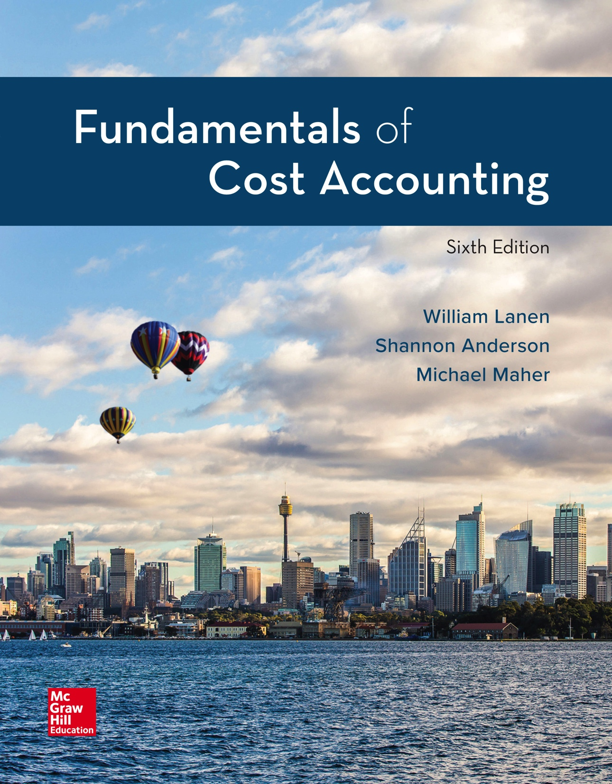
Copyright ©2020 McGraw-Hill Education. All rights reserved. No reproduction or distribution without the prior written consent of McGraw-Hill Education.
Notes:
Fundamentals of Cost Accounting, 6th edition
Lanen/Anderson/Maher

Slide 2
Fundamentals of Product and Service Costing
Chapter 6
Notes:
Chapter 6: Fundamentals of Product and Service Costing
This chapter provides an overview of alternative cost systems for product and service costing. Details and extensions to the basic models described here are presented in the following three chapters.

Slide 3
Learning Objectives
LO 6-1 Explain the fundamental themes underlying
the design of cost systems.
LO 6-2 Explain how cost allocation is used in a cost
management system.
LO 6-3 Explain how a basic product costing system works.
LO 6-4 Understand how overhead cost is allocated to products.
LO 6-5 Explain the operation of a two-stage allocation system
for product costing.
LO 6-6 Describe the three basic types of product costing systems:
job, process, and operations.
Notes:
After studying this chapter, you should be able to: 1. Explain the fundamental themes underlying the design of cost systems. 2. Explain how cost allocation is used in a cost management system. 3. Explain how a basic product costing system works. 4. Understand how overhead cost is allocated to products. 5. Explain the operation of a two-stage allocation system for product costing. And, 6. Describe the three basic types of product costing systems: job, process, and operations.

Slide 4
Cost Management Systems
Keys to a good cost management system:
Oriented to the needs of the decision makers
Designed so that benefits exceed costs
Notes:
A good cost management system is oriented to the needs of the decision makers and designed so that benefits exceed costs.

Slide 5
Cost Management Systems (2)
LO 6-1
LO 6-1 Explain the fundamental themes underlying
the design of cost systems.
The objective of the cost management system
is to provide information about costs relevant
for decision making.
The cost management system accumulates and reports costs about processes, products, and services.
Notes:
A well-designed cost management system accumulates and reports costs that are relevant to the decisions that managers make.

Slide 6
Reasons to Calculate Product or Service Costs
LO 6-1
For decision making
For deciding what to sell
For setting prices
For knowing the cost of goods sold
For knowing the cost of inventory
Notes:
What decisions do managers make? In Chapter 4, you saw examples of many of the decisions managers make using information about product costs. What to sell? At what price? What is the cost of the goods sold? What is the cost of inventory?

Slide 7
Cost Allocation and Product Costing
LO 6-2
LO 6-2 Explain how cost allocation is used
in a cost management system.
Basic Cost Flow Diagram
Cost
pools
Direct
materials
Direct
labor
Manufacturing
overhead
Cost
allocation
rule
Indirect
(allocated
by direct
labor cost)
Direct
Cost
objects
Alpha
Beta
Notes:
Chapter 1 introduced cost allocation and product costing. We know that costs that are common to two or more cost objects are likely to be allocated to those cost objects on a somewhat arbitrary basis. A manufacturing or service firm that buys different resources (materials, labor, supplies, etc.) and combines them into two or more finished products must allocate the cost of the resources to the finished products. Suppose a company produces two products—Product A and Product B—and uses direct materials, direct labor, and overhead to make these products. This cost flow diagram shows that the direct materials and direct labor are traced directly to the products. We can observe a link between these resources and the products. However, overhead is an indirect cost and cannot be traced directly to the products. Therefore, it must be allocated.

Slide 8
Fundamental Themes Underlying the Design of Cost Systems
LO 6-2
Cost systems should have a decision focus.
Different cost information is used for
different purposes.
Cost information for managerial purposes
must meet the cost-benefit test.
Notes:
Cost systems should have a decision focus that meets the needs of decision makers, the customers of the cost system. Remember what works for one purpose will not necessarily work for another purpose. Cost information can always be improved. However, the benefits of improvement (i.e., better decision making) must outweigh the cost of making the improvements.

Slide 9
Basic Cost Flow Model
LO 6-3
LO 6-3 Explain how a basic product costing system works.
How costs and units move through inventories:
This is true for the following accounts:
– Raw Materials (RM)
– Work-in-Process (WIP)
– Finished Goods (FG)
Notes:
The basic cost flow model: beginning balance plus transfers in minus transfers out equals ending balance is true for all three inventory accounts: Raw Materials (RM), Work-In-Process (WIP), and Finished Goods (FG).

Slide 10
Costing with No Work-in-Process Inventories
LO 6-3
Miller Paints begins production on April 1
(Year 2).
It starts and completes production of 100,000
gallons of paint in April and has no ending
work-in-process inventory.
Cost of resources used in April:
Materials $ 400,000
Labor 100,000
Manufacturing overhead 500,000
Total $1,000,000
Notes:
The inventory equation is true for both units and costs. Let’s look at Miller Paints. At the beginning of April, Miller Paints had no work-in-process inventory. 100,000 gallons of paint were started during the month of April.

Slide 11
Costing with No Work-in-Process Inventories (2)
LO 6-3
Finished Goods
Notes:
All 100,000 gallons were finished and transferred out of Work-in-Process Inventory and into Finished Goods.

Slide 12
Costing with No Work-in-Process Inventories (3)
LO 6-3
What are the costs at the end of the period?
$1,000,000 was added to work-in-process
and then transferred out to finished goods.
Since Miler Paints produced 100,000 gallons of
paint, then the cost per gallon of paint is $10.
Notes:
Look at work-in-process costs. Miller Paints had no beginning balance. During April, Miller Paints added the following costs to work-in-process: direct materials of $400,000, direct labor of $100,000, and overhead of $500,000. Total costs added to work-in-process equaled $1 million. All of the paint, and therefore, all of the costs, were transferred out of work-in-process and in to finished goods. If Miller Paints produced 100,000 gallons of paint at a cost of $1,000,000, the cost per gallon of paint is $10.

Slide 13
Costing with Ending Work-in-Process Inventories
LO 6-3
Production for Miller Paints for May (Year 2)
follows (gallons):
Beginning inventory -0-
Started in May
Total 110,000
Ending WIP (50% complete) 20,000
Transferred out 90,000
Notes:
Now let’s look at an example where some product remains in ending inventory.

Slide 14
Costing with Ending Work-in-Process Inventories (2)
LO 6-3
Finished goods
Notes:
Suppose during May, Miller Paints started 110,000 gallons of paint, completed and transferred out 90,000 gallons and had 20,000 gallons that were half finished still in work-in-process at the end of the month.

Slide 15
Costing with Ending Work-in-Process Inventories (3)
LO 6-3
How do we cost Miller Paints 20,000 gallons of paint that
are only half finished?
20,000 gallons half finished is equivalent to 10,000
gallons finished.
90,000 gallons transferred out plus 10,000 equivalent gallons
of finished paint equals 100,000 equivalent gallons of paint.
Gallons of paint transferred out 90,000
Equivalent gallons of finished paint 10,000
Total equivalent gallons of paint 100,000
Notes:
How much paint did Miller Paints produce in May? Miller Paints transferred out 90,000 gallons to finished goods, but there are still 20,000 gallons in work in process that are only half finished.
How do we account for Miller Paints 20,000 gallons of paint that are only half finished? The half-finished 20,000 gallons of paint are equivalent to 10,000 gallons of finished paint.
When products remain in ending work-in-process inventory, we use equivalent units. Miller Paints transferred out 90,000 gallons of paint plus 10,000 equivalent gallons of finished paint in ending inventory. That equals 100,000 equivalent gallons of paint.

Slide 16
Costing with Ending Work-in-Process Inventories (4)
LO 6-3
Costs incurred in May (Year 2):
Materials $390,000
Labor 100,000
Manufacturing overhead 500,000
Total $990,000
$990,000/100,000 gallons = $9.90 per gallon
Costs transferred to finished goods:
90,000 gallons × $9.90/gallon = $891,000
Notes:
If Miller Paints transferred in $990,000 of cost during the month of May, the question we ask is: Where are those costs at the end of the period? What is the cost of the 90,000 gallons transferred to finished goods inventory?

Slide 17
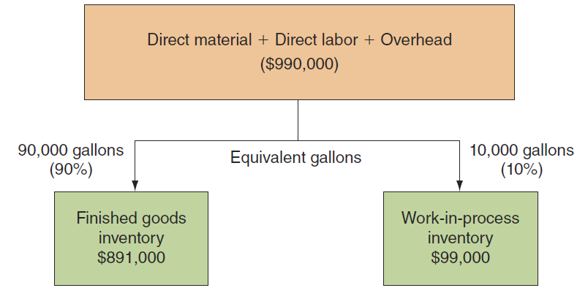
Costing with Ending Work-in-Process Inventories (5)
LO 6-3
Notes:
Compute the cost per equivalent gallon of paint. Miller Paints incurred $990,000 of cost and produced 100,000 equivalents gallons of paint, so the paint cost $9.90 per gallon ($990,000/100,000). Because 90,000 gallons were transferred out, assign $891,000 (90,000 gallons x $9.90) to the units transferred to finished goods and $99,000 (10,000 equivalent gallons x $9.90) to the ending work-in-process inventory.

Slide 18
Costing in a Multiple Product, Discrete Process Industry
LO 6-3
Sandia Custom Furniture
Cost Flow Diagram: Cost Allocation Bases
Cost
pools
Direct
materials
Direct
labor
Manufacturing
overhead
Direct
cost
Direct
cost
Indirect
cost
(allocated by
direct labor-hours)
Cost
objects
S-72s
S-66s
Notes:
Now let’s look at costing in a multiple-product process. Consider the costing system for Sandia Custom Furniture, which makes a variety of products. For our purposes, we will consider only two—a 66 inch mahogany desk, the S-66, and a 72 inch mahogany desk, the S-72. Unlike Miller Paints, Sandia’s manufacturing process takes place in a series of discrete steps that differ in detail depending on the product. As this diagram shows, the cost system must take costs from three basic cost pools and allocate them to the two cost objects.

Slide 19
Costing in a Multiple Product, Discrete Process Industry (2)
LO 6-3
Product Costs for January, Year 2—Sandia Custom Furniture
S-27s
S-66s
Total
Units produced
Direct labor-hours
Costs:
Direct materials
Direct labor
Manufacturing overhead
Total
80
2,400
$40,000
72,000
240
3,900
$36,000
78,000
320
6,300
$ 76,000
150,000
252,000
$478,000
Notes:
In a firm with multiple products, a manager making pricing decisions needs cost information at the product level. Look at Sandia Custom Furniture. How do we cost these two individual products – the S-72 and the S-66?

Slide 20
Costing in a Multiple Product, Discrete Process Industry (3)
LO 6-3
Cost
pools
Direct
materials
Direct
labor
$76,000
$150,000
Direct cost
Direct cost
Cost
objects
S-72s
S-66s
$40,000
$36,000
$72,000
$78,000
Notes:
We know that, by definition, direct materials and direct labor can be traced to the individual products. Of the $76,000 of direct materials, $40,000 is directly traceable to S-72s and $36,000 to S-66s. Of the $150,000 of direct labor, $72,000 is directly traceable to S-72s and $78,000 is directly traceable to the S-66s.

Slide 21
Predetermined Overhead Rates
LO 6-4
LO 6-4 Understand how overhead cost is allocated to products.
Indirect costs are allocated using a predetermined
overhead rate (POHR).
POHR is the cost per unit of the allocation base used
to charge overhead to products.
POHR = $ ÷ Base
Notes:
But what about overhead costs? Overhead is indirect. Should the indirect costs go to the S-72s or the S-66s? Indirect costs are allocated using a predetermined overhead rate. The predetermined overhead rate is the cost per unit of the allocation basis that is used to charge overhead to products. Let’s see what this means.

Slide 22
Predetermined Overhead Rates (2)
LO 6-4
What are the estimated costs?
POHR
=
Estimated overhead $
Estimated allocation base
What activity drives the overhead costs?
Why use estimates?
Products need to have costs applied
during the period.
The exact amount of indirect costs are
not known until the end of the period.
Notes:
The predetermined overhead rate equals the estimated overhead costs divided by the estimated allocation basis. Recall from Chapter 2 that the allocation base will be the activity that drives the overhead cost. We use estimated costs and estimated allocation base because we need to cost the products during the period and we won’t know the exact amount of the indirect costs or the actual activity until the end of the period.

Slide 23
Predetermined Overhead Rates (3)
LO 6-4
S-72s
S-66s
Total
Direct labor hours
Estimated overhead costs
2,400
3,900
6,300
$252,000
POHR = $252,000 ÷ 6,300 = $40/DLH
Notes:
Suppose Sandia Custom Furniture estimates overhead cost for the period of $252,000. Sandia also estimates a total of 6,300 direct labor hours will be worked during the period. Sandia’s predetermined overhead rate is $252,000 divided by 6,300 direct labor hours. The predetermined overhead rate is $40 per direct labor hour.

Slide 24
Product Costing of Multiple Products
LO 6-4
Cost
pool
Manufacturing
overhead
$252,000
Cost
allocation
rule
Direct labor hours ($40/DLH)
Cost
objects
S-72s
$96,000
(2,400 DLH × $40)
S-66s
$156,000
(3,900 DLH × $40)
Notes:
Now allocate overhead to the S-72s and S-66s. The cost pool is $252,000 of overhead. The cost allocation rule is $40 per direct labor hour. Producing S-72 required 2,400 direct labor hours and producing S-66s required 3,900 direct labor hours. Therefore, we allocate $96,000 (2,400 x $40) to S-72s and $156,000 (3,900 x $40) to S-66s.

Slide 25
Product Costing of Multiple Products (2)
LO 6-4
Product Costs for January—Sandia Custom Furniture
(allocation base is direct labor hours)
S-72s
S-66s
Total
Units produced
Direct labor-hours
Costs:
Direct materials
Direct labor
Manufacturing overhead
(@ $40/hour)
Total
Cost per unit
80
2,400
$ 40,000
72,000
96,000
$208,000
$ 2,600
240
3,900
$ 36,000
78,000
156,000
$270,000
$ 1,125
320
6,300
$ 76,000
150,000
252,000
$478,000
Notes:
The total cost of producing 80 S-72s was $208,000 or $2,600 per unit.
The total cost of producing 240 S-66s was $270,000 or $1,125 per unit.

Slide 26
Choice of the Allocation Base
LO 6-4
The choice of the allocation base is somewhat arbitrary.
What will be the result if management chooses direct labor cost as the allocation base?
The rate then becomes 168% (= $252,000 ÷ $150,000).
Notes:
What will be the result if a different allocation base is chosen? Let’s assume that management uses direct labor cost as the allocation base. The rate then becomes 168%.

Slide 27
Choice of the Allocation Base (2)
LO 6-4
Product Costs for January—Sandia Custom Furniture
(allocation base is direct labor dollars)
S-72s
S-66s
Total
Units produced
Direct labor-hours
Costs:
Direct materials
Direct labor
Manufacturing overhead
(@ 168%)
Total
Cost per unit
80
2,400
$ 40,000
72,000
120,960
$232,960
$ 2,912
240
3,900
$ 36,000
78,000
131,040
$245,040
$ 1,021
320
6,300
$ 76,000
150,000
252,000
$478,000
Notes:
The manufacturing overhead allocated to S-72s is $120,960 and to S-66s is $131,040.

Slide 28
Multiple Allocation Bases and Two-Stage Systems
LO 6-5
LO 6-5 Explain the operation of a two-stage allocation
system for product costing.
We can use two or more allocation bases to allocate
manufacturing overhead to products.
Notes:
Now let’s look at two allocation bases to allocate manufacturing overhead.

Slide 29
Multiple Allocation Bases and Two-Stage Systems (2)
LO 6-5
Cost
pool
Manufacturing overhead
First stage
Machine-related
costs
Direct labor-related
costs
Cost
allocation
rules
Second
stage
Indirect costs
Indirect costs
(allocated in proportion
to machine hours)
(allocated in proportion
to direct labor hours)
Cost
objects
S-72s
S-66s
Notes:
Let’s look a little closer at the overhead costs for Sandia. A closer inspection of the overhead accounts suggest that some of the overhead seems to be related more to machine utilization than direct labor. If this is the case, we can use two allocation bases to allocate overhead to the products.

Slide 30
Multiple Allocation Bases and Two-Stage Systems (3)
LO 6-5
Cost
pool
Overhead
$252,000
Intermediate
cost pools
Machine-related
$100,800
Labor-related
$151,200
Cost allocation
rule
Machine-hours
Direct
labor-hours
Notes:
First we will assign the overhead cost pool of $252,000 to the intermediate cost pools. $151,200 of overhead is labor-related and $100,800 is machine-related. The labor-related costs will be allocated using direct labor-hours and the machine-related costs will be allocated using machine-hours.

Slide 31
Multiple Allocation Bases and Two-Stage Systems (4)
LO 6-5
$100,800 ÷ 5,600 machine-hours = $18
$151,200 ÷ 6,300 direct labor-hours = $24
Notes:
Machine-related costs of $100,800 divided by 5,600 machine-hours will be allocated at the rate of $18 per machine-hour. Labor-related overhead costs of $151,200 divided by 6,300 direct labor-hours will be allocated at the rate of $24 per direct labor-hour.

Slide 32
Two-Stage Cost Allocation— Sandia Custom Furniture
LO 6-5
Intermediate
cost pools
Machine-related
$100,800
Labor-related
$151,200
Cost
Allocation
5,600
Machine-hours
$18/MH
6,300
Machine-hours
$24/DLH
Cost
Objects
S-66s
$93,600 DLH cost
$75,600 MH
S-72s
$57,600 DLH cost
$25,200 MH
Allocated
overhead
$169,200 Total
$82,800 Total
Notes:
The $100,800 of machine-related costs are allocated $25,200 to the S-72s and $75,600 to the S-66s.
The $151,200 of labor-related costs are allocated $57,600 to the S-72s and $93,600 to the S-66s.

Slide 33
Two-Stage Cost Allocation— Sandia Custom Furniture (2)
LO 6-5
S-72s
S-66s
Total
Costs:
Direct materials
Direct labor
Overhead:
Machine-related
@$18/machine-hour
Labor-related
@$24/direct labor-hour
Total cost
Unit cost
$ 40,000
72,000
25,200
57,600
$ 82,800
$194,800
$ 2,435
$ 36,000
78,000
75,600
93,600
$169,200
$283,200
$ 1,180
$ 76,000
150,000
100,800
151,200
$252,000
$478,000
Notes:
Using the two-stage allocation process we see the total cost allocated to S-72s is $194,800. The total cost allocated to S-66s is $283,200. The cost per unit changed substantially from the examples where only one allocation base was used.

Slide 34
Product Costing Systems
LO 6-6
LO 6-6 Describe the three basic types of product costing
systems: job, process, and operations.
Job Costing
An accounting system that traces costs to individual units
or to specific jobs, contracts, or batches of goods.
(custom homes, movies, services)
Process Costing
An accounting system used when identical units are
produced through a series of uniform production steps.
(corn flakes, facial tissues, paint)
Notes:
Different companies have different production and costing systems. A job costing system is used when costs can be traced to a specific job, for example, building custom homes, making a movie, or providing a service. But imagine a company making corn flakes or facial tissues. Here it would be very difficult to trace costs to an individual box of corn flakes or box of facial tissues. This company would use process costing, an accounting system that traces costs to a production process. The details of these two costing systems are discussed in Chapters 7 and 8.

Slide 35
Product Costing Systems (2)
LO 6-6
Operations Costing
A hybrid costing system used in manufacturing
goods that have some common characteristics
and some individual characteristics.
(automobiles, computers, clothing)
Notes:
Operations costing is a hybrid of job and process costing. An operation is a standardized method or technique that is performed repeatedly in production. However, materials can be different for each product.

Slide 36
End of Chapter 6
Notes:
End of Chapter 6.

