Slide 1
Process Costing and Analysis
Chapter 16
Wild and Shaw
Financial and Managerial Accounting
8th Edition
Copyright ©2019 McGraw-Hill Education. All rights reserved. No reproduction or distribution without the prior written consent of McGraw-Hill Education.
Notes:
Chapter 16: Process Costing and Analysis

Slide 2
Chapter 16 Learning Objectives
CONCEPTUAL
C1 Explain process operations and the way they differ from job order operations.
C2 Define and compute equivalent units and explain their use in process costing.
C3 Describe accounting for production activity and preparation of a process cost summary
using weighted average.
C4 Appendix 16-A Describe accounting for production activity and preparation of a process
cost summary using FIFO.
ANALYTICAL
A1 Compare process costing and job order costing.
A2 Explain and illustrate a hybrid costing system.
PROCEDURAL
P1 Record the flow of materials costs in process costing.
P2 Record the flow of labor costs in process costing.
P3 Record the flow of factory overhead costs in process costing.
P4 Record the transfer of goods across departments, to Finished Goods Inventory, and to Cost
of Goods Sold.
© McGraw-Hill Education
2

Slide 3
C1: Explain process operations and the way they differ from job order operations.
Learning Objective
© McGraw-Hill Education
3

Slide 4
Process Operations
Used for production of identical, low-cost items.
Mass produced in automated continuous production process.
Costs cannot be directly traced to each unit of product.
Series of repetitive processes.
Each process applies direct materials, labor, and overhead to move toward completion.
Final process produces finished goods ready for sale to customers.
© McGraw-Hill Education
4
Learning Objective C1: Explain process operations and the way they differ from job order operations.
Notes:
Process operations involve the mass production of similar products in a continuous flow of sequential processes. A key feature of process operations is the high level of standardization needed if the system is to produce large volumes of products. Thus, process operations use a standardized process to make similar products; job order operations use a customized process to make unique products.
Involves operations having a series of repetitive processes resulting in a noncustomized product or service. Understanding processes for companies with process operations is crucial for measuring their costs. Increasingly, process operations use machines and automation to control product quality and reduce manufacturing costs.
In a process operation, each process is identified as a separate production department. With the exception of the first process or department, each receives the output from the prior department as a partially processed product. Depending on the nature of the process, each process applies direct labor, overhead, and additional direct materials to move the product toward completion. Only the final process or department in the series produces finished goods ready for sale to customers.

Slide 5
A1: Compare process costing and job order costing.
Learning Objective
© McGraw-Hill Education
5

Slide 6
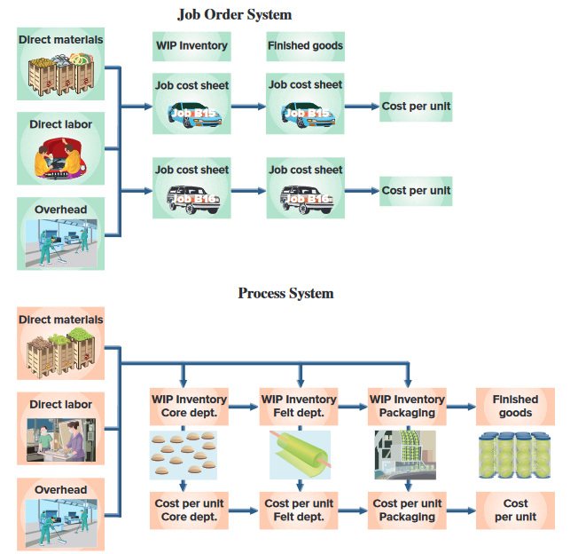
Comparing Process and Job Order Costing Systems
Exhibit 16.2
© McGraw-Hill Education
6
Learning Objective A1: Compare process costing and job order costing.
Notes:
Both job order costing systems and process costing systems use direct materials, direct labor, and overhead costs. The measurement focus in a job order costing system is on the individual job whereas in a process costing system, it is on the individual process.
A job order system measures cost per unit upon completion of a job, by dividing the total cost for that job by the number of units in that job. As we showed in the previous chapter, job cost sheets accumulate the costs for each job.
A process costing system measures unit costs at the end of a period (for example, a month) by combining the costs per equivalent unit from each separate department. In process costing, the cost object is the process.
Only job order systems use job cost sheets.
Job order costing systems often use one Work in Process Inventory account. Process costing systems use a separate Work in Process Inventory account for each process.

Slide 7
Transferring Costs across Departments
Exhibit 16.3
© McGraw-Hill Education
7
Learning Objective A1: Compare process costing and job order costing.
Notes:
In process costing, manufacturing costs are transferred across Work in Process Inventory accounts. After production is complete, the completed goods and their accumulated costs are transferred from the Work in Process Inventory account for the final department in the series of processes to the Finished Goods Inventory account.
Exhibit 16.3 summarizes the journal entries to capture this flow of manufacturing costs for a tennis ball manufacturer—from A , to B , to C .

Slide 8
C2: Define and compute equivalent units and explain their use in process costing.
Learning Objective
© McGraw-Hill Education
8

Slide 9
Equivalent Units of Production (EUP)
Number of units that could have been started and completed during the period given the costs incurred during the period.
© McGraw-Hill Education
9
Learning Objective C2: Define and compute equivalent units and explain their use in process costing.
Notes:
Companies with process operations typically end each period with inventories of both finished goods and work in process.
A key idea in process costing is that of Equivalent Units of Production (EUP), a term that refers to the number of units that could have been started and completed given the costs incurred during the period. For example, 100,000 tennis balls that are 60% through the production process is equivalent to 60,000 (100,000 units x 60%) tennis balls that have completed the entire production process. This means that the cost to put 100,000 units 60% of the way through the production process is equivalent to the cost to put 60,000 units completely through the production process. Having information about the costs of partially
completed goods makes it possible to measure the firm’s production activity for the period.

Slide 10
EUP for Materials and Conversion Costs
© McGraw-Hill Education
10
Learning Objective C2: Define and compute equivalent units and explain their use in process costing.
Notes:
In many processes, the equivalent units of production for direct materials are not the same with respect to direct labor and overhead. For example, direct materials, like rubber for tennis ball cores, might enter production entirely at the beginning of a process; direct labor and overhead, in contrast, might be used continuously throughout the process. How does a manufacturer account for these timing differences? Again, by measuring equivalent units of production. For example, if all of the direct materials to produce 10,000 units have entered the production process, but those units have received only 20% of their direct labor and overhead costs, equivalent units would be computed as shown in this slide.
Direct labor and factory overhead are classified as conversion costs – the costs of converting direct materials into finished products. Conversion cost per equivalent unit is the combined costs of direct labor and factory overhead per equivalent unit.

Slide 11
Weighted Average versus FIFO
versus
Weighted Average
FIFO
© McGraw-Hill Education
11
Learning Objective C2: Define and compute equivalent units and explain their use in process costing.
Notes:
The weighted-average method combines units and costs across two periods in computing equivalent units. The FIFO method computes equivalent units based only on production activity in the current period. The objectives, concepts, and journal entries (but not dollar amounts) are the same under the weighted-average and FIFO methods; the computations of equivalent units differ. While the FIFO method is generally considered to be more precise than the weighted-average method, it requires more calculations. Often, the differences between the two methods are small. With a just-in-time inventory system, these different methods yield very similar results because inventories are immaterial.

Slide 12
C3: Describe accounting for production activity and preparation of a process cost summary using weighted average.
Learning Objective
© McGraw-Hill Education
12

Slide 13
Process Costing Illustration
GenX uses a weighted average cost flow system with the following four steps:
Determine physical flow of units.
Compute equivalent units of production.
Compute cost per equivalent unit.
Assign and reconcile costs.
Learning Objective C3: Describe accounting for production activity and preparation of a process cost summary using weighted average.
© McGraw-Hill Education
13
Notes:
As with all situations involving inventory costs, we must choose a cost flow method. We will use the weighted average method for GenX. Process cost applications can be overwhelming if we do not use a well-planned approach. The four-step procedure will enable us to solve a process cost application in manageable parts. The four steps are:
1. Determine physical flow of units.
2. Compute equivalent units of production.
3. Compute cost per equivalent unit.
4. Assign and reconcile costs.

Slide 14
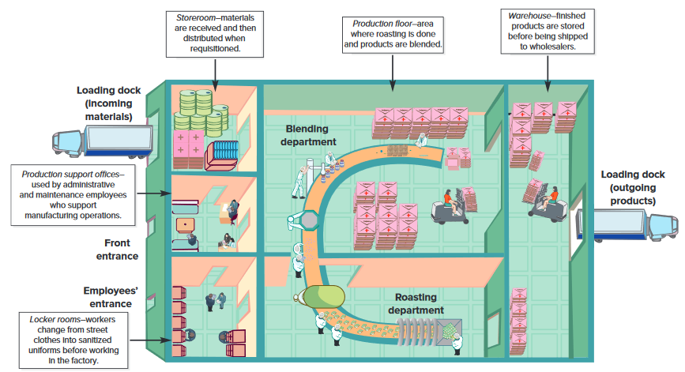
Overview of GenX Company’s Process Operation
Exhibit 16.4
Learning Objective C3: Describe accounting for production activity and preparation of a process cost summary using weighted average.
© McGraw-Hill Education
14
Notes:
The GenX Company produces an organic trail mix called FitMix. Its target customers are active people who are interested in fitness and the environment. GenX sells FitMix to wholesale distributors, who in turn sell it to retailers. FitMix is manufactured in a continuous, two-process operation (roasting and blending), shown in this slide.
In the first process (roasting department), GenX roasts, oils, and salts organically grown peanuts. These peanuts are then passed to the blending department, the second process. In the blending department, machines blend organic chocolate pieces and organic dried fruits with the peanuts from the first process. The blended mix is then inspected and packaged for delivery. In both departments, direct materials enter production at the beginning of the process, while conversion costs
occur continuously throughout each department’s processing.

Slide 15
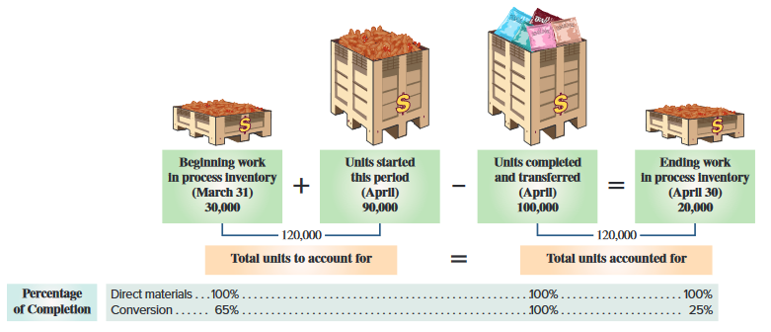
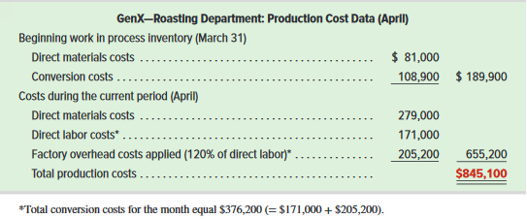
Process Operations – GenX
Exhibit 16.5
Exhibit 16.6
Learning Objective C3: Describe accounting for production activity and preparation of a process cost summary using weighted average.
© McGraw-Hill Education
15
Notes:
Here we see the units processed and the completion percentages. Take a minute to become familiar with these numbers before moving on to the cost information. Process costing applications include lots of numbers and in the first process (roasting department), GenX roasts, oils, and salts organically grown peanuts. These peanuts are then passed to the blending department, the second process. In the blending department, machine blends organic chocolate pieces and organic dried fruits with the peanuts from the first process. The blended mix is then inspected and packaged for delivery. In both departments, direct materials enter production at the beginning of the process, while conversion costs occur continuously throughout each department’s processing.
Exhibit 16.5 presents production data (in units) for GenX’s roasting department. This exhibit includes the percentage of completion for both materials and conversion; beginning work in process inventory is 100% complete with respect to materials but only 65% complete with respect to conversion. Ending work in process inventory is 100% complete with respect to materials but only 25% complete with respect to conversion. Units completed and transferred to the blending department are 100% complete with respect to both materials and conversion.
The bottom graphic represents production cost data for GenX’s roasting department. We will use the data to illustrate the four-step approach to process costing.

Slide 16
Determine Physical Flow of Units (Pt. 1)
Exhibit 16.7
Learning Objective C3: Describe accounting for production activity and preparation of a process cost summary using weighted average.
© McGraw-Hill Education
16
Notes:
Step 1 is to determine the physical flow of units. A physical flow reconciliation is a report that reconciles (1) the physical units started in a period with (2) the physical units completed in that period. A physical flow reconciliation for GenX’s roasting department is shown in this slide for April.

Slide 17
Compute Equivalent Units of Production (Pt. 1)
Exhibit 16.8
*Transferred to next department or finished goods inventory.
Exhibit 16.9
Learning Objective C3: Describe accounting for production activity and preparation of a process cost summary using weighted average.
© McGraw-Hill Education
17
Notes:
Step 2 is to compute equivalent units of production for direct materials and conversion costs for April. Since direct materials and conversion costs typically enter a process at different rates, departments must compute equivalent units separately for direct materials and conversion costs. The top graphic shows the formula to compute equivalent units under the weighted-average method for both direct materials and conversion costs.
For GenX’s roasting department, we must convert the 120,000 physical units measure to equivalent units based on how each input has been used. The roasting department fully completed its work on 100,000 units, and partially completed its work on 20,000 units. Equivalent units are computed by multiplying the number of units accounted for (from Step 1) by the percentage of completion for each input—see the second graphic.
The first row of the second graphic reflects units transferred out in April. The roasting department entirely completed its work on the 100,000 units transferred out. These units have 100% of the materials and conversion required, or 100,000 equivalent units of each input (100,000 x 100%).
GenX ended the month with 20,000 partially completed units. For direct materials, the units in ending work in process inventory include all materials required, so there are 20,000 equivalent units (20,000 x 100%) of materials in the unfinished physical units. Regarding conversion, the units in ending work in process inventory include 25% of the conversion required, which implies 5,000 equivalent units of conversion (20,000 x 25%).
The final row reflects the total equivalent units of production, which is whole units of product that could have been manufactured with the amount of inputs used to create some complete and some incomplete units. For GenX, the amount of inputs used to produce 100,000 complete units and to start 20,000 additional units is equivalent to the amount of direct materials in 120,000 whole units and the amount of conversion in 105,000 whole units.

Slide 18
⬥ Compute Cost Per Equivalent Unit (Pt. 1)
Exhibit 16.10
Learning Objective C3: Describe accounting for production activity and preparation of a process cost summary using weighted average.
© McGraw-Hill Education
18
Notes:
Step 3 is to compute the cost per equivalent unit. Under the weighted-average method, the computation of EUP does not separate the units in beginning inventory from those started this period, as shown above. Similarly, the weighted average method combines the costs of beginning work in process inventory with the costs incurred in the current period. This total cost is then divided by the equivalent units of production (from Step 2), to compute the average cost per equivalent unit. This process is illustrated in this slide. For direct materials, the cost averages $3.00 per EUP. For conversion, the cost per equivalent unit averages $4.62 per unit.

Slide 19
Assign and Reconcile Costs
(Pt. 1)
Exhibit 16.11
Learning Objective C3: Describe accounting for production activity and preparation of a process cost summary using weighted average.
© McGraw-Hill Education
19
Notes:
Step 4 is to assign and reconcile costs. The EUP from Step 2 and the cost per EUP from Step 3 are used in Step 4 to assign costs to units that the roasting department completed and transferred to the blending department (100,000 units), and (b) units that remain in process in the roasting department (20,000 units). This is illustrated in this slide.
Cost of Units Completed and Transferred - The 100,000 units completed and transferred to the blending department required 100,000 EUP of direct materials and 100,000 EUP of conversion. Thus, we assign $300,000 (100,000 EUP x $3.00 per EUP) of direct materials cost to those units. Similarly, we assign $462,000 (100,000 EUP x $4.62 per EUP) of conversion to those units. The total cost of the 100,000 completed and transferred units is $762,000 ($300,000 + $462,000) and their average cost per unit is $7.62 ($762,000 / 100,000 units).
Cost of Ending Work in Process Inventory - There are 20,000 incomplete units in work in process inventory at period-end. For direct materials, those units have 20,000 EUP of material (from Step 2) at a cost of $3.00 per EUP (from Step 3), which yields the materials cost of work in process inventory of $60,000 (20,000 EUP x $3.00 per EUP). For conversion, the in-process units reflect 5,000 EUP (from Step 2). Using the $4.62 conversion cost per EUP (from Step 3) we obtain conversion costs for in-process inventory of $23,100 (5,000 EUP x $4.62 per EUP). Total cost of work in process inventory at period-end is $83,100 ($60,000 + $23,100).

Slide 20
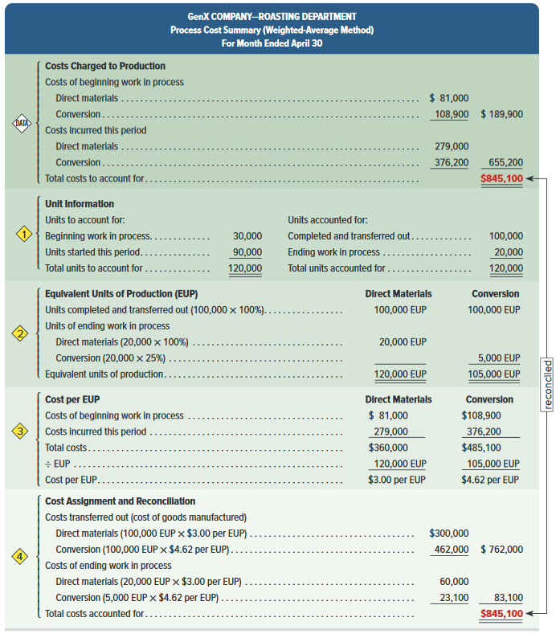
Process Cost Summary
Exhibit 16.13
© McGraw-Hill Education
Learning Objective C3: Describe accounting for production activity and preparation of a process cost summary using weighted average.
20
Notes:
An important managerial accounting report for a process costing system is the process cost summary (also called production report), which is prepared separately for each process or production department. Three reasons for the summary are to (1) help department managers control and monitor their departments, (2) help factory managers evaluate department managers’ performances, and (3) provide cost information for financial statements. A process cost summary achieves these purposes by describing the costs charged to each department, reporting the equivalent units of production achieved by each department, and determining the costs assigned to each department’s output.

Slide 21
Cost Data For GenX
Exhibit 16.15
Learning Objective C3: Describe accounting for production activity and preparation of a process cost summary using weighted average.
© McGraw-Hill Education
21
Notes:
This slide presents cost data for GenX. Roasting department costs are from earlier slides. We use these data next to show the journal entries in a process costing system.

Slide 22
P1: Record the flow of materials costs in process costing.
Learning Objective
© McGraw-Hill Education
22

Slide 23
Accounting for Material Costs
© McGraw-Hill Education
23
Learning Objective P1: Record the flow of materials costs in process costing.
Notes:
The summary entry for receipts of raw materials in April follows (dates in journal entries are omitted because they are summary entries, often reflecting two or more transactions or events).
The entry to record the use of direct materials by GenX’s production departments in April follows. These direct materials costs flow into each department’s separate Work in Process Inventory account.
The last entry records the cost of indirect materials used by GenX in April.

Slide 24
P2: Record the flow of labor costs in process costing.
Learning Objective
© McGraw-Hill Education
24

Slide 25
Accounting for Labor Costs
© McGraw-Hill Education
25
Learning Objective P2: Record the flow of labor costs in process costing.
Notes:
The first entry then records direct labor used. These direct labor costs flow into each department’s separate Work in Process Inventory account.
The second entry records these indirect labor costs.
After GenX posts these entries for direct and indirect labor, the Factory Wages Payable account has a credit balance of $432,510 ($354,160 + $78,350). The final entry shows the payment of this total payroll. After this entry, the Factory Wages Payable account has a zero balance.

Slide 26
P3: Record the flow of factory overhead costs in process costing.
Learning Objective
© McGraw-Hill Education
26

Slide 27
Accounting for Factory Overhead
© McGraw-Hill Education
27
Learning Objective P3: Record the flow of factory overhead costs in process costing.
Notes:
The first entry records overhead costs other than indirect materials and indirect labor for April. These overhead items include the costs of insuring production assets, renting the factory building, using factory utilities, and depreciating factory equipment not directly related to a specific process.
GenX records its applied overhead with the second entry. Recall that companies use predetermined overhead rates to apply overhead. These rates are estimated at the beginning of a period and used to apply overhead during the period. The application of overhead allows managers to obtain up-to-date estimates of the costs of their processes during the period. This is important for process costing, where goods are transferred across departments before the entire production process is
complete.
Factory overhead is applied to processes by relating overhead cost to another variable such as direct labor hours or machine hours used. In many situations, a single allocation basis such as direct labor hours (or a single rate for the entire plant) fails to provide useful allocations. As a result, management may use different rates for different production departments.

Slide 28
P4: Record the transfer of goods across departments, to finished goods inventory, and to cost of goods sold.
Learning Objective
© McGraw-Hill Education
28

Slide 29
Accounting for Transfers
Learning Objective P4: Record the transfer of goods across departments, to finished goods inventory, and to cost of goods sold.
© McGraw-Hill Education
29
Notes:
The process cost summary for the roasting department shows that the 100,000 units transferred to the blending department are assigned a cost of $762,000. The entry to record this transfer is shown first.
At the end of the month, the blending department transferred 97,000 completed units, with a related cost of $1,262,940, to finished goods. The entry to record this transfer is shown second.
Assume that GenX sold 106,000 units of FitMix this period, and that its beginning finished goods inventory was 26,000 units with a cost of $338,520. Also assume that its ending finished goods inventory consists of 20,000 units at a cost of $260,400. Using this information, cost of goods sold is computed as $1,341,060.
The summary entry to record cost of goods sold for this period is shown last.

Slide 30
Trends in Process Operations
Process design
Just-in-time production
Customer orientation
Yield
Robotics/
Automation
Services
Continuous Processing
© McGraw-Hill Education
Learning Objective P4: Record the transfer of goods across departments, to finished goods inventory, and to cost of goods sold.
30
Notes:
Recent trends in process operations include:
Process design - Management concerns with production efficiency can lead companies to entirely reorganize production processes. For example, instead of producing different types of computers in a series of departments, a separate work center for each computer can be established in one department. The process cost system is then changed to account for each work center’s costs.
Just-in-time production - Companies are increasingly adopting just-in-time techniques. With a just-in-time inventory system, inventory levels can be minimal. If raw materials are not ordered or received until needed, a Raw Materials Inventory account might be unnecessary. Instead, materials cost is immediately debited to the goods in process inventory account. Similarly, a finished goods inventory account may not be needed. Instead, cost of finished goods may be immediately debited to the cost of goods sold account.
Robotics and Automation - Advances in technology increasingly enable companies to automate their production processes. This allows them to reduce direct labor costs.
Continuous Processing - In some companies, like Pepsi Bottling, materials move continuously through the manufacturing process. In these cases, a materials consumption report summarizes the materials used and replaces materials requisitions.
Services - Service-based businesses are increasingly prevalent. For routine, standardized services like oil changes and simple tax returns, computing costs based on the process is simpler and more useful than a cost per individual job.
Customer orientation - Focus on customer orientation also leads to improved processes. A manufacturer of control devices improved quality and reduced production time by forming teams to study processes and suggest improvements. Oregon Ice Cream Company studied customer tastes to develop a more pleasing ice cream texture.
Yield – many process operations convert large amounts of raw materials into finished goods. Yield is the amount of material output relative to the amount of material input. When yields are lower than expected, managers usually ask why and then take corrective action.

Slide 31
A2: Explain and illustrate a hybrid costing system.
Learning Objective
© McGraw-Hill Education
31

Slide 32
Hybrid Costing System
Hybrid system (operation costing system) contains features of both process and job order operations.
Requires a hybrid costing system to determine cost of products/services.
Companies try to standardize processes while also meeting customer needs.
Important to monitor and control costs.
© McGraw-Hill Education
32
Learning Objective A2: Explain and illustrate a hybrid costing system.
Notes:
This chapter explained the process costing system and contrasted it with the job order costing system. Many organizations use a hybrid system that contains features of both process and job order operations. A recent survey of manufacturers revealed that a majority use hybrid systems (also called operation cost
systems).
A hybrid system of processes requires a hybrid costing system to properly cost products or services.
Today companies are increasingly trying to standardize processes while attempting to meet individual customer needs. To the extent that differences among individual customers’ requests are large, understanding the costs to satisfy those requests is important. Thus, monitoring and controlling both process
and job order costs are important.

Slide 33
C4: Describe accounting for production activity and preparation of a process cost summary using FIFO.
Learning Objective
© McGraw-Hill Education
33

Slide 34
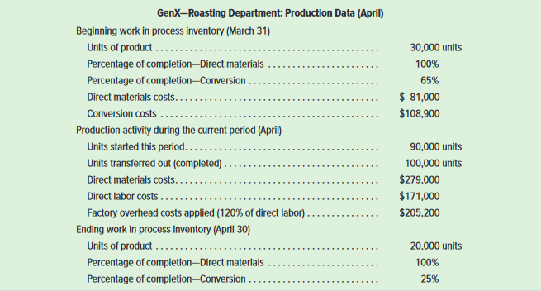
FIFO Method of Process Costing
Exhibit 16A.3
The same GenX data for April will also be used to illustrate the FIFO method.
Learning Objective C4: Describe accounting for production activity and preparation of a process cost summary using FIFO.
© McGraw-Hill Education
34
Notes:
In computing cost per equivalent unit, the FIFO method ignores the cost of beginning work in process inventory. Instead, FIFO uses only the costs incurred in the current period.
This slide shows selected information from GenX’s roasting department for the month of April. Accounting for a department’s activity for a period includes four steps: (1) determine physical flow, (2) compute equivalent units, (3) compute cost per equivalent unit, and (4) determine cost assignment and reconciliation.

Slide 35
Determine Physical Flow of Units (Pt. 2)
Exhibit 16A.4
Learning Objective C4: Describe accounting for production activity and preparation of a process cost summary using FIFO.
© McGraw-Hill Education
35
Notes:
Step 1: determine the physical flow of units. A physical flow reconciliation is a report that reconciles (1) the physical units started in a period with (2) the physical units completed in that period. The physical flow reconciliation for GenX’s roasting department is shown in this slide for April.

Slide 36
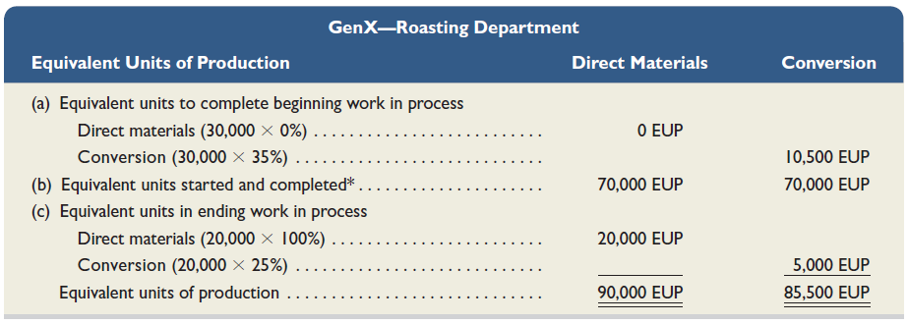
Compute Equivalent Units of Production (Pt. 2)
Exhibit 16A.6
* | Units completed this period | 100,000
 | Less units in beginning goods in process | 30,000
 | Units started and completed this period | 70,000
Learning Objective C4: Describe accounting for production activity and preparation of a process cost summary using FIFO.
© McGraw-Hill Education
36
Notes:
Step 2: compute the equivalent units of production. In computing the equivalent units of production, the roasting department must consider these three distinct groups of units:
Units in beginning work in process inventory (30,000).
Units started and completed during the month (70,000).
Units in ending work in process inventory (20,000).
GenX’s roasting department then computes equivalent units of production under FIFO as shown in this slide. We compute EUP for each of the three distinct groups of units, and sum them to find total EUP.

Slide 37
⬥ Compute Cost Per Equivalent Unit – FIFO (Pt. 2)
Exhibit 16A.7
Learning Objective C4: Describe accounting for production activity and preparation of a process cost summary using FIFO.
© McGraw-Hill Education
37
Notes:
Step 3 is to compute the cost per equivalent unit. To compute cost per equivalent unit, we take the direct materials and conversion costs added in April and divide by the equivalent units of production from Step 2. This slide illustrates these computations.
It is essential to compute costs per equivalent unit for each input because production inputs are added at different times in the process. The FIFO method computes the cost per equivalent unit based solely on this period’s EUP and costs (unlike the weighted-average method, which adds in the costs of the beginning work in process inventory).

Slide 38
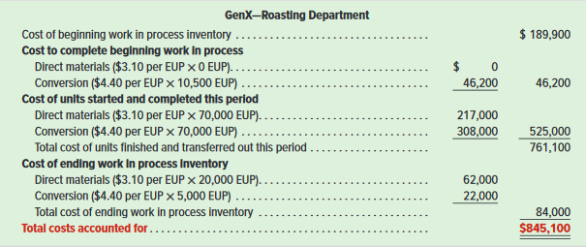
Assign and Reconcile Costs (Pt. 2)
Exhibit 16A.8
Learning Objective C4: Describe accounting for production activity and preparation of a process cost summary using FIFO.
© McGraw-Hill Education
38
Notes:
Step 4 is to assign and reconcile costs. The equivalent units determined in Step 2 and the cost per equivalent unit computed in Step 3 are both used to assign costs (1) to units that the production department completed and transferred to the blending department and (2) to units that remain in process at period-end. In this slide, under the section for cost of units transferred out, we see that the cost of units completed in April includes the $189,900 cost carried over from March for work already applied to the 30,000 units that make up beginning work in process inventory, plus the $46,200 incurred in April to complete those units. This next section includes the $525,000 of cost assigned to the 70,000 units started and completed this period. Thus, the total cost of goods manufactured in April is $761,100. The average cost per unit for goods completed in April is $7.611 ($761,100 / 100,000 completed units).
The computation for cost of ending work in process inventory is in final section of the Exhibit 16A.8. That cost of $84,000 ($62,000 + $22,000) also is the ending balance for the Work in Process Inventory— Roasting account.

Slide 39
Assign and Reconcile Costs (Pt. 2)
Exhibit 16A.9
Learning Objective C4: Describe accounting for production activity and preparation of a process cost summary using FIFO.
© McGraw-Hill Education
39
Notes:
We reconcile the costs accounted for in Step 3 to the costs that production was charged for as shown in this slide.

Slide 40
End of Chapter 16
© McGraw-Hill Education
40

