Slide 1
Activity-Based Costing and Analysis
Chapter 17
Wild and Shaw
Financial & Managerial Accounting
8th Edition
Copyright ©2019 McGraw-Hill Education. All rights reserved. No reproduction or distribution without the prior written consent of McGraw-Hill Education.

Slide 2
Chapter 17 Learning Objectives
CONCEPTUAL
C1 Distinguish between the plantwide overhead rate method, the departmental overhead rate method, and the activity-based costing method.
C2 Explain cost flows for activity-based costing.
C3 Describe the four types of activities that cause overhead costs.
ANALYTICAL
A1 Identify and assess advantages and disadvantages of the plantwide overhead and departmental overhead rate methods.
A2 Identify and assess advantages and disadvantages of activity-based costing.
PROCEDURAL
P1 Allocate overhead costs to products using the plantwide overhead rate method.
P2 Allocate overhead costs to products using the departmental overhead rate method.
P3 Allocate overhead costs to products using activity-based costing.
© McGraw-Hill Education

Slide 3
Distinguish between the plantwide overhead rate method, the departmental overhead rate method, and the activity-based costing method.
Learning Objective C1
© McGraw-Hill Education

Slide 4
Assigning Overhead Costs (1 of 2)
Direct
Materials
Indirect
Factory Overhead
Allocate
Goods in Process
Finished Goods
Indirect
Cost of Goods Sold
Labor
Direct
© McGraw-Hill Education
Learning Objective C1: Distinguish between the plantwide overhead rate method, the departmental overhead rate method, and the activity-based costing method.
4
Notes:
Product cost consists of direct materials, direct labor, and overhead (indirect costs). Because direct materials and direct labor can be traced to units of output, assigning these costs to products is straightforward.
Overhead costs, however, are not directly related to production and cannot be traced to units of product like direct materials and direct labor can. We must use an allocation system to assign overhead costs.

Slide 5
Assigning Overhead Costs (2 of 2)
Overhead can be assigned to production in one of three ways:
Single plant-wide overhead rate
Departmental overhead rates
Activity-based costing
© McGraw-Hill Education
Learning Objective C1: Distinguish between the plantwide overhead rate method, the departmental overhead rate method, and the activity-based costing method.
5
Notes:
There are three methods of overhead allocation: the single plantwide overhead rate method; the departmental overhead rate method; and the activity-based costing method.

Slide 6
Alternative Methods of Overhead Allocation
Exhibit 17.1
© McGraw-Hill Education
Learning Objective C1: Distinguish between the plantwide overhead rate method, the departmental overhead rate method, and the activity-based costing method.
Notes:
The plantwide overhead rate method and the departmental overhead rate method use volume-based measures such as direct labor hours or machine hours to allocate overhead costs to products. The plantwide method uses a single rate and the departmental rate uses at least two rates.
Activity-based costing focuses on activities and their costs. Rates based on these activities are used to assign overhead to products in proportion to the amount of activity required to produce them. Activity-based costing typically uses more overhead allocation rates than the plantwide and departmental methods.

Slide 7
Allocate overhead costs to products using the plantwide overhead rate method.
Learning Objective P1
© McGraw-Hill Education
7

Slide 8
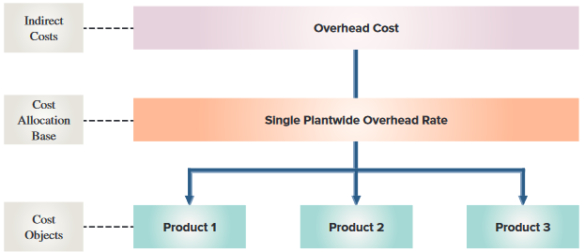
Plantwide Overhead Rate Method
Exhibit 17.2
Learning Objective P1: Allocate overhead costs to products using the plantwide overhead rate method.
© McGraw-Hill Education
8
Notes:
For this method, the target of the cost assignment, or cost object, is the unit of product. The overhead rate is determined using a volume-related measure such as direct labor hours or machine hours, which are readily available in most manufacturing settings.
Under the single plantwide overhead rate method, total budgeted overhead costs are divided by the chosen allocation base, such as total direct labor hours, to arrive at a single plantwide overhead rate. This rate then is applied to assign overhead costs to all products based on their actual usage of the allocation base.
Let’s look at the Exhibit 17.3 and Exhibit 17.4 as an example.

Slide 9
Plantwide Overhead Rate Method Illustration (1 of 4)
Exhibit 17.3
Exhibit 17.4
© McGraw-Hill Education
Learning Objective P1: Allocate overhead costs to products using the plantwide overhead rate method.
9
Notes:
Let’s look at an example. KartCo. manufactures two models of go-karts, standard and custom. They use a plantwide rate and use direct labor hours as the allocation base To calculate total direct labor hours, multiply the number of product units by direct labor hours per unit per product. Kartco’s budgeted overhead cost consists of indirect labor costs of $4,000,000 and factory utilities of $800,000 for a total of $4,800,000. This number will also be needed to calculate the plantwide overhead rate.

Slide 10
Plantwide Overhead Rate Method Illustration (2 of 4)
Plantwide overhead rate
Total budgeted overhead costs
Total budgeted DLH
=
Learning Objective P1: Allocate overhead costs to products using the plantwide overhead rate method.
© McGraw-Hill Education
10
Notes:
Plantwide overhead rate is equal to total budgeted overhead cost divided by total budgeted direct labor hours.

Slide 11
Plantwide Overhead Rate Method Illustration (3 of 4)
Plantwide overhead rate
$4,800,000
100,000 DLH
=
=
$48/DLH
Overhead allocated to each unit produced =
$48 × DLH per unit
Learning Objective P1: Allocate overhead costs to products using the plantwide overhead rate method.
© McGraw-Hill Education
11
Notes:
Dividing $4,800,000 by 100,000 hours gives us a plant overhead rate of $48 per DLH (direct labor hour). This plantwide overhead rate is then used to allocate overhead cost to products based on the number of direct labor hours required to produce each unit as follows.
Overhead allocated to each product unit = Plantwide overhead rate × DLH per unit.

Slide 12
Plantwide Overhead Rate Method Illustration (4 of 4)
Learning Objective P1: Allocate overhead costs to products using the plantwide overhead rate method.
© McGraw-Hill Education
12
Notes:
Using the overhead rate of $48 per direct labor hour KartCo can determine the amount of factory overhead to allocate to each go-kart. They can then use this information to determine the total unit cost of each go-kart.

Slide 13
Allocate overhead costs to products using the departmental overhead rate method.
Learning Objective P2
© McGraw-Hill Education

Slide 14
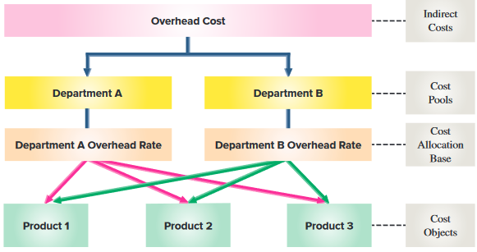
Departmental Overhead Rate Method
Exhibit 17.6
© McGraw-Hill Education
Learning Objective P2: Allocate overhead costs to products using the departmental overhead rate method.
14
Notes:
Exhibit 17.6 shows a four-step process for allocating costs under the departmental overhead rate method.
Assign overhead costs to departmental cost pools.
Select an allocation base for each department.
Compute overhead allocation rates for each department.
Use departmental overhead rates to assign overhead costs to cost objects (products).
The departmental overhead rate method uses several departments and several overhead rates. This allows each department to have its own overhead rate and its own allocation base.

Slide 15
Departmental Overhead Rate Method: First Step
Overhead Cost
$4,800,000
Machining Dept.
$4,200,000
Assembly Dept.
$600,000
© McGraw-Hill Education
Learning Objective P2: Allocate overhead costs to products using the departmental overhead rate method.
15
Notes:
Let’s return to KartCo and calculate their departmental overhead rates. KartCo has two production departments, machining and assembly.
The first step requires that KartCo assign its $4,800,000 overhead cost to its two production departments. KartCo determines that $4,200,000 of its overhead costs are traceable to its machining department and the remaining $600,000 are traceable to its assembly department.

Slide 16
Departmental Overhead Rate Method: Second Step (1 of 2)
Machining Dept.
Overhead Rate based on machine hours (MH)
Assembly Dept.
Overhead Rate based on direct labor hours (DLH)
Product 1
Product 2
Product 3
© McGraw-Hill Education
Learning Objective P2: Allocate overhead costs to products using the departmental overhead rate method.
16
Notes:
The second step requires each department to determine an allocation base. For KartCo, the Machining Department uses machine hours (MH) to allocate its overhead and the Assembly Department uses direct labor hours to allocate its overhead.

Slide 17
Departmental Overhead Rate Method: Second Step (2 of 2)
© McGraw-Hill Education
Learning Objective P2: Allocate overhead costs to products using the departmental overhead rate method.
17
Notes:
Here is the budgeted departmental information about KartCo’s machining and assembly departments. They will be using machine hours as the allocation base in Machining, and direct labor hours in Assembly.

Slide 18
Departmental Overhead Rate Method: Third Step (1 of 2)
Total budgeted departmental overhead costs
Total amount of departmental allocation base
Departmental Overhead Rate
=
© McGraw-Hill Education
Learning Objective P2: Allocate overhead costs to products using the departmental overhead rate method.
18
Notes:
In the third step, each department computes its own overhead rate using this formula:
Departmental overhead rate = Total budgeted departmental overhead costs / Total amount of departmental allocation base.

Slide 19
Departmental Overhead Rate Method: Third Step (2 of 2)
Machining Department Overhead Rate
$4,200,000
70,000 MH
=
=
$60/MH
Assembly Department Overhead Rate
$600,000
30,000 DLH
=
=
$20/DLH
© McGraw-Hill Education
Learning Objective P2: Allocate overhead costs to products using the departmental overhead rate method.
19
Notes:
For KartCo, it’s departmental overhead rates are computed as follows:
Machining department overhead rate = $4,200,000 / 70,000 MH = $60 per MH
Assembly department overhead rate = $600,000 / 30,000 DLH = $20 per DLH

Slide 20
Departmental Overhead Rate Method: Fourth Step
Exhibit 17.7
Exhibit 17.8
© McGraw-Hill Education
Learning Objective P2: Allocate overhead costs to products using the departmental overhead rate method.
20
Notes:
Step 4 applies overhead costs to each product using departmental overhead rates. Because each standard go-kart requires 10 MH from the Machining Department and 5 DLH from the Assembly Department, the overhead cost allocated to each standard go-kart is $600 from Machining Department (10 MH × $60/MH) and $100 from the Assembly Department (5 DLH × $20/DLH). The same procedure is applied for its custom go-kart. Next, we can compare the allocated overhead costs for standard and custom go-karts under the single plant wide overhead rate and the departmental overhead rate methods. The overhead cost allocated to each standard go-kart decreased from $720 under the plant wide overhead rate method to $700 under the departmental overhead rate method, whereas overhead cost allocated to each custom go-kart increased from $1,200 to $1,300. These differences occur because the custom go-kart requires more hours in the machining department (20 MH) than the standard go-kart requires (10 MH).

Slide 21
Identify and assess advantages and disadvantages of the plantwide overhead and departmental overhead rate methods.
Learning Objective A1
© McGraw-Hill Education
21

Slide 22
Plantwide Overhead Rate Method Advantages and Disadvantages
Advantages
Information is readily available
Easy to implement
Consistent with GAAP and can be used for external reporting
Disadvantages
With many different products, assumptions may not be reasonable.
Overhead costs may not bear a relationship with direct labor hours
All products may not use overhead costs in the same proportion
© McGraw-Hill Education
Learning Objective A1: Identify and assess advantages and disadvantages of the plantwide overhead and departmental overhead rate methods.
22
Notes:
The usefulness of the single plantwide overhead rate depends on two assumptions: 1) overhead costs change with the allocation base such as direct labor hours; and 2) all products use overhead costs in the same proportions.

Slide 23
Departmental Overhead Rate Method Advantages and Disadvantages
Advantages
More accurate overhead allocations
More refined than the plantwide overhead rate method
Disadvantages
Assumes that products are similar in volume, complexity, batch size
Assumes that departmental overhead costs are proportional to the allocation base
Can distort product costs
© McGraw-Hill Education
Learning Objective A1: Identify and assess advantages and disadvantages of the plantwide overhead and departmental overhead rate methods.
23
Notes:
The departmental overhead rate method assumes that 1) different products are similar in volume, complexity, and batch size, and 2) departmental overhead costs are directly proportional to the department allocation base such as direct labor hours or machine hours.

Slide 24
Explain cost flows for activity-based costing.
Learning Objective C2
© McGraw-Hill Education

Slide 25
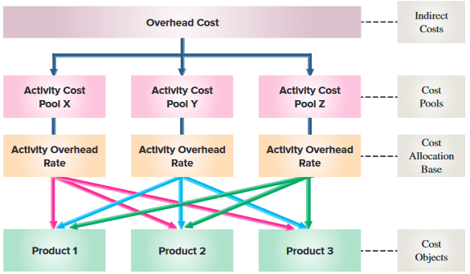
Cost Flows Under Activity-Based Costing
Exhibit 17.9
© McGraw-Hill Education
Learning Objective C2: Explain cost flows for activity-based costing.
25
Notes:
Activity-based costing (ABC) attempts to more accurately assign overhead costs by focusing on activities.
The basic principle underlying activity-based costing is that activities, which are tasks, operations, or procedures, are what cause costs to be incurred. An activity cost pool is a collection of costs that are related to the same or similar activity. Pooling costs to determine an activity overhead (pool) rate for all costs incurred by the same activity reduces the number of cost assignments required.
The four basic steps to the ABC method are:
Identify activities and the overhead costs they cause.
Trace overhead costs to cost pools.
Determine activity rates.
Use the activity overhead rates to assign overhead costs to cost objects (products).
Let’s take a closer look at the four basic steps of activity based costing.

Slide 26
Allocate overhead costs to products using activity-based costing.
Learning Objective P3
© McGraw-Hill Education
26

Slide 27
Applying Activity-Based Costing
4 STEPS:
Identify activities and the costs they cause.
Trace overhead costs to cost pools.
Determine activity rates.
Assign overhead costs to cost objects (products).
© McGraw-Hill Education
Learning Objective P3: Allocate overhead costs to products using activity-based costing.
27
Notes:
ABC differs from using multiple departmental rates in how overhead cost pools are identified and in how overhead cost in each pool is allocated.
This involves four steps:
1. Identify activities and the costs they cause.
2. Trace overhead costs to cost pools.
3. Determine activity rates.
4. Assign overhead costs to cost objects.

Slide 28
Step 1: Identify Activities and the Costs They Cause (1 of 2)
Machine setup
Engineer
salaries
Machine repair
Assembly
line power
Factory
maintenance
Heating and
lighting
© McGraw-Hill Education
Learning Objective P3: Allocate overhead costs to products using activity-based costing.
28
Notes:
Step 1 in applying ABC is to identify activities and the costs they cause. This is one of the biggest challenges. This is done mainly through discussions with employees in the production departments and reviewing production activities. However, tracking too many activities makes the system cumbersome and costly to maintain. The aim of this first step is to understand actions performed in the organization that drive costs.

Slide 29
Step 1: Identify Activities and the Costs They Cause (2 of 2)
Exhibit 17.10
© McGraw-Hill Education
Learning Objective P3: Allocate overhead costs to products using activity-based costing.
29
Notes:
Recall that a premise of ABC is that operations are a series of activities that cause costs to be incurred. Instead of combining costs from different activities into one plant wide pool or multiple departmental pools, ABC focuses on activities as the cost object in the first step of cost assignment. We are then able to trace costs to a cost object and then combine activities that are used by products in similar ways to reduce the number of cost allocations.
KartCo has total overhead cost of $4,800,000 consisting of $4,000,000 indirect labor costs and $800,000 factory utilities cost. After reviewing activities with production employees, KartCo identifies the activities and their costs as shown in Exhibit 17.10.

Slide 30
Step 2: Trace Overhead Costs to Activity Cost Pools (1 of 2)
Overhead Cost
Activity
Cost Pool (Craftsmanship)
Activity
Cost Pool (Setup)
Activity
Cost Pool (Design Modification)
Activity
Cost Pool (Plant Services)
© McGraw-Hill Education
Learning Objective P3: Allocate overhead costs to products using activity-based costing.
30
Notes:
Step 2 in applying ABC is to assign activities and their overhead costs to activity cost pools. KartCo management assigns its overhead costs into four activity cost pools: Craftsmanship, Setup, Design modification and Plant Services

Slide 31
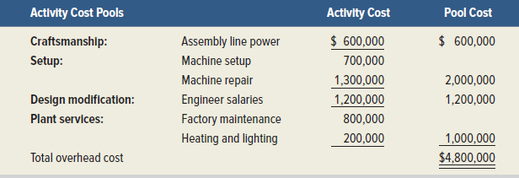
Step 2: Trace Overhead Cost to Activity Cost Pools (2 of 2)
Exhibit 17.11
© McGraw-Hill Education
Learning Objective P3: Allocate overhead costs to products using activity-based costing.
31
Notes:
Exhibit 17.11 shows how KartCo’s management assigned its overhead costs into the four activity cost pools. To form cost pools we look for costs that are caused by the same activities within each activity level. For KartCo, there is only one activity driver within each activity pool, but that is not always the case. It is common to see several different activity drivers within each level of activity pool. We pool only those costs that are related to the same driver.
The exhibit above shows that $600,000 of its overhead costs are assigned to the craftsmanship activity pool, $2,000,000 to the set-up cost pool, $1,200,000 to the design modification cost pool, and $1,000,000 to the plant services cost pool. The use of cost pools reduces the potential number of overhead rates from six (one for each of its six activities) to four (one for each pool).

Slide 32
Step 3: Determine Activity Rates (1 of 4)
Activity
Cost Pool (Craftsmanship)
Activity
Cost Pool (Setup)
Activity
Cost Pool (Design Modification)
Activity
Cost Pool (Plant Services)
Activity Overhead
rate ?
Activity Overhead
Rate ?
Activity Overhead
rate ?
Activity Overhead
rate ?
Step 3 is to compute the activity rates used to assign overhead costs to final cost objects such as products.
© McGraw-Hill Education
Learning Objective P3: Allocate overhead costs to products using activity-based costing.
32
Notes:
Step 3 is to compute the activity overhead (cost pool) rates used to assign overhead costs to final cost objects such as products.

Slide 33
Step 3: Determine Activity Rates (2 of 4)
Proper determination of activity rates depends on:
Proper identification of the factor that drives the cost
Proper measures of activities
and
© McGraw-Hill Education
Learning Objective P3: Allocate overhead costs to products using activity-based costing.
33
Notes:
Proper determination of activity rates depends on:
Proper identification of the factor that drives the cost in each activity cost pool.
Proper measures of activities.
A cost driver is that activity causing the costs in the pool to be incurred. An activity driver is a measure of activity level and is determined for use as the allocation base.

Slide 34
Step 3: Determine Activity Rates (3 of 4)
Cost Pool Activity Rate
Overhead costs assigned to pool
Expected activity level
=
For example:
Craftsmanship cost pool activity rate
= $600,000 / 30,000 DLH
= $20 per DLH
© McGraw-Hill Education
Learning Objective P3: Allocate overhead costs to products using activity-based costing.
34
Notes:
In this step the activity rate is determined by dividing the overhead costs assigned to an activity pool by the expected activity level.
For example:
For KartCo, the activity rate for the craftsmanship cost pool is computed as:
Craftsmanship cost pool activity rate = $600,000 divided by 30,000 direct labor hours equals $20 per direct labor hour.
The activity rate computations for KartCo are summarized on the next slide.

Slide 35
Step 3: Determine Activity Rates (4 of 4)
Exhibit 17.12
÷
=
© McGraw-Hill Education
Learning Objective P3: Allocate overhead costs to products using activity-based costing.
35
Notes:
Take a moment to review how the activity rates were calculated for each of the pools.

Slide 36
Step 4: Assign Overhead Costs to Cost Objects (1 of 4)
Activity Overhead
rate
Activity Overhead
rate
Activity Overhead
rate
Product 1
Product 2
Product 3
Step 4 is to assign overhead costs in each activity cost pool to final cost objects using activity rates.
© McGraw-Hill Education
Learning Objective P3: Allocate overhead costs to products using activity-based costing.
36
Notes:
Step 4 is to assign overhead costs in each activity cost pool to final cost objects using activity rates.
To do this, overhead costs are allocated to products based on the actual levels of activities used.

Slide 37
Step 4: Assign Overhead Costs to Cost Objects (2 of 4)
To illustrate, the overhead costs in the craftsmanship pool are allocated to standard go-karts as follows:
Overhead allocated from craftsmanship pool to standard go-kart =
Activities consumed × Activity rate
25,000 DLH × $20 per DLH = $500,000
© McGraw-Hill Education
Learning Objective P3: Allocate overhead costs to products using activity-based costing.
37
Notes:
To illustrate, the $500,000 of overhead costs in the craftsmanship pool is allocated to standard go-karts as follows:
Overhead allocated to standard go-kart = Activities consumed × Activity rate
=25,000 DLH × $20 =$500,000

Slide 38
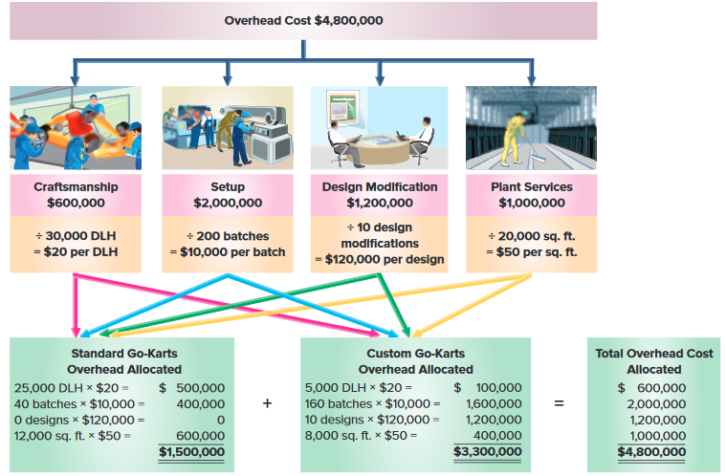
Step 4: Assign Overhead Costs to Cost Objects (3 of 4)
Exhibit 17.13
© McGraw-Hill Education
Learning Objective P3: Allocate overhead costs to products using activity-based costing.
38
Notes:
Overhead costs allocated to Standard and Custom Go-karts under ABC for KartCo are summarized in Exhibit 17.13. This exhibit uses the activity rates from exhibit 17.12 to assign costs to Standard Go-karts and Custom Go-karts. Standard Go-karts used 25,000 direct labor hours and the activity rate for craftsmanship is $20 per direct labor hour. Multiplying the number of direct labor hours by the activity rate yields the craftsmanship costs assigned to Standard Go-karts. Custom Go-karts consumed 5,000 direct labor hours, so we assign $100,000 (5,000 DLH @ $20/DLH) to that product line. Similarly, we allocate overhead costs of setup, design modification, and plant services pools to each type of go-kart.

Slide 39
Step 4: Assign Overhead Costs to Cost Objects (4 of 4)
Exhibit 17.14
© McGraw-Hill Education
Learning Objective P3: Allocate overhead costs to products using activity-based costing.
39
Notes:
The unit overhead costs is computed by dividing total overhead cost allocated to each product by the number of product units. KartCo’s overhead cost per unit for it’s standard and custom go-karts is computed and shown in Exhibit 17.14.

Slide 40
Comparison of Overhead Allocations by Method
Exhibit 17.15
© McGraw-Hill Education
Learning Objective P3: Allocate overhead costs to products using activity-based costing.
40
Notes:
Does the method of overhead allocation really make a difference? Overhead allocation to the standard go-karts is much less under ABC than under either of the volume-based costing methods. One reason for this difference is the large design modification costs that were spread over all go-karts under both the plantwide and departmental rate methods even though standard go-karts require no engineering modification.

Slide 41
Identify and assess advantages and disadvantages of activity-based costing.
Learning Objective A2
© McGraw-Hill Education
41

Slide 42
Activity-Based Costing Advantages and Disadvantages
Advantages:
More accurate overhead cost allocation
More effective overhead cost control
Better production /pricing decisions
Other Uses – ABC can be used to:
Allocate the S&A costs expensed by GAAP activities
Determine profitability of market segments
Costs of Quality
Disadvantages:
Costs to implement and maintain
Some product cost distortion remains
Uncertainty with decisions remains
Not acceptable under GAAP
© McGraw-Hill Education
Learning Objective A2: Identify and assess advantages and disadvantages of activity-based costing.
42
Notes:
Take a minute to look over the advantages and disadvantages of activity based costing. As with all cost information, managers must be able to interpret the data and must use caution when making management decisions. Activity-based costing uses more cost pools and activity rates than other methods. This can increase overhead costing accuracy since the costs in each pool are caused by the same activity. it also has its limitations, and these must be weighed to determine the best approach for the company. It is also important to note that ABC is not acceptable under GAAP for external financial reporting.

Slide 43
Describe the four types of activities that cause overhead costs.
Learning Objective C3
© McGraw-Hill Education

Slide 44
Types of activities
Unit-level
Batch-level
Product-level
Facility-level
44
Learning Objective C3: Describe the four types of activities that cause overhead costs.
© McGraw-Hill Education
Notes:
44
There are four types of activities that cause overhead costs. As mentioned earlier in this presentation, one of the biggest challenges is to identify the activities which cause the costs to occur.
Activities causing overhead cost in an organization are typically separated into four levels:
Unit-level activities
Batch-level activities
Product-level activities
Facility-level activities

Slide 45
Levels of Activities (1 of 4)
Unit-level
Unit-level activities are performed on each product unit; for example, providing electricity to power machinery in the machining department is needed to produce each unit of product.
45
Learning Objective C3: Describe the four types of activities that cause overhead costs.
© McGraw-Hill Education
Notes:
45
Unit-level activities are those tasks that must be performed on each unit of product. For example, each unit may require that materials be cut, or components be assembled.

Slide 46
Levels of Activities (2 of 4)
Batch-level
Batch-level activities are performed only on each batch or group of units.
© McGraw-Hill Education
Learning Objective C3: Describe the four types of activities that cause overhead costs.
46
Notes:
46
Batch-level activities are performed only on each batch or group of units; for example, machine setup is needed only for each batch regardless of the units in that batch, and customer order processing must be performed for each order regardless of the number of units ordered. Batch-level costs do not vary with the number of units, but instead with the number of batches.

Slide 47
Levels of Activities (3 of 4)
Product-level
Product-level activities are performed on each product line and are not affected by either numbers of units or batches.
© McGraw-Hill Education
Learning Objective C3: Describe the four types of activities that cause overhead costs.
47
Notes:
47
Product-level activities are performed on each product line and are not affected by either numbers of units or batches; for example, product design is needed only for each product line. Product-level costs do not vary with the number of units or batches produced.

Slide 48
Levels of Activities (4 of 4)
Facility-level
Facility-level activities are performed to sustain facility capacity as a whole and are not caused by any specific product.
© McGraw-Hill Education
Learning Objective C3: Describe the four types of activities that cause overhead costs.
48
Notes:
48
Facility-level activities are performed to sustain facility capacity as a whole and are not caused by any specific product; for example, factory maintenance costs are incurred to keep the plant clean and safe no matter what is being produced, and so is paying rent on a factory building. Facility-level costs do not vary with what is manufactured, how many batches are produced, or the output quantity.

Slide 49
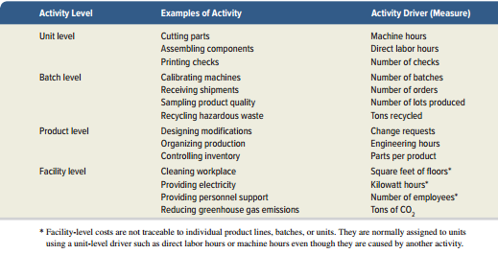
Examples of Activity Levels (1 of 2)
Exhibit 17.16
© McGraw-Hill Education
Learning Objective C3: Describe the four types of activities that cause overhead costs.
49
Notes:
Exhibit 17.16 shows additional examples of activities commonly found within each of the four activity levels. This list also includes common activity drivers.

Slide 50
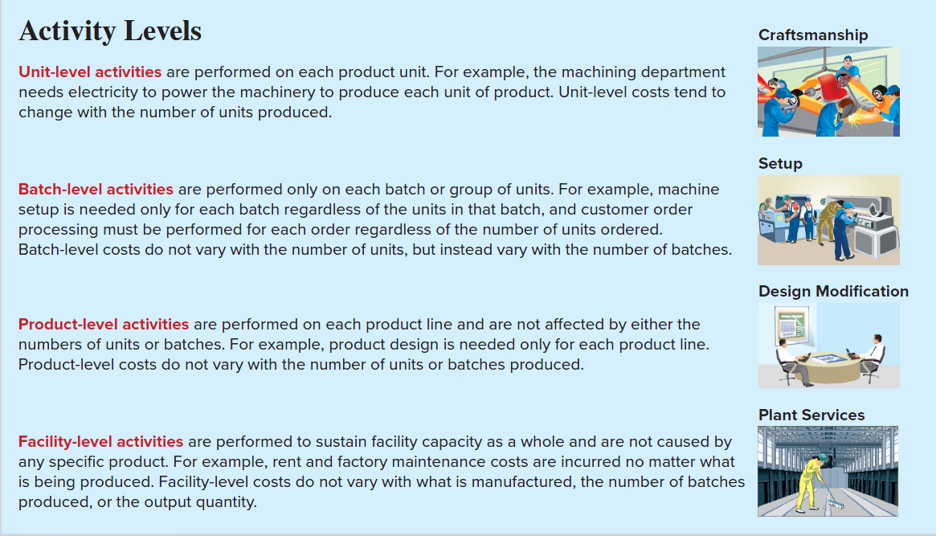
Examples of Activity Levels (2 of 2)
© McGraw-Hill Education
Learning Objective C3: Describe the four types of activities that cause overhead costs.
50

Slide 51
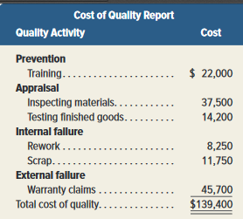
Costs of Quality
Costs resulting from manufacturing defective products or providing services that do not meet customer expectations.
Cost of quality report lists costs of quality activities by category.
Exhibit 17.17
© McGraw-Hill Education
Learning Objective C3: Describe the four types of activities that cause overhead costs.
51
Notes:
51
Costs resulting from manufacturing defective products or providing services that do not meet customer expectations.
Cost of quality report lists costs of quality activities by category.

Slide 52
Costs of Good and Poor Quality
Costs of Good Quality:
Prevention activities focus on quality training and improvement programs to ensure quality.
Appraisal activities include inspections to ensure materials meet specifications of finished goods.
Costs of Poor Quality:
Internal failure costs incurred after a defective product is manufactured but before product is delivered.
External failure costs incurred after customer has been provided a defective product/service.
© McGraw-Hill Education
Learning Objective C3: Describe the four types of activities that cause overhead costs.
52
Notes:
52
Costs of Good Quality:
Prevention and appraisal costs are incurred before a good or service is provided to a customer. The purpose of these costs is to reduce the chance the customer is provided a defective good or service. These are the costs of trying to ensure that only good-quality items are produced.
Prevention activities focus on quality training and improvement programs to ensure quality is built into the product or service.
Appraisal activities include the costs of inspections to ensure that materials and supplies meet specifications and inspections of finished goods.
Costs of Poor Quality:
Internal and external failure costs are the costs of making poor-quality items.
Internal failure costs are incurred after a company has manufactured a defective product but before that product has been delivered to a customer. Internal failure costs include the costs of reworking products, reinspecting reworked products, and scrap.
External failure costs are incurred after a customer has been provided a defective product or service. Examples of this type of cost include costs of warranty repairs and costs of recalling products. This category also includes lost profits due to dissatisfied customers buying from other companies

Slide 53
Lean Operations
Lean Operations –common in lean manufacturing
Common features include:
Just-in-time (JIT) inventory systems to reduce costs of moving and storing inventory.
Cellular manufacturing - products made by teams of employees in small workstations called cells.
Building quality into products by focusing on costs of good quality.
Lean accounting - eliminates waste; uses alternative performance measures; and simplifies product costing.
© McGraw-Hill Education
Learning Objective C3: Describe the four types of activities that cause overhead costs.
53
Notes:
Lean Operations – focusing on activities is common in lean manufacturing which strives to eliminate waste while satisfying customers. Common features include:
Just-in-time (JIT) inventory systems to reduce costs of moving and storing inventory.
Cellular manufacturing where products are made by teams of employees in small workstations called cells.
Building quality into products by focusing on costs of good quality.
Lean accounting includes eliminating waste; alternative performance measures; and simplified product costing.

Slide 54
ABC for Service Providers
ABC also applies to service providers.
Service companies must classify costs by activity levels of unit, batch, service, and facility.
Exhibit 17.18
© McGraw-Hill Education
Learning Objective C3: Describe the four types of activities that cause overhead costs.
54
Notes:
54
ABC also applies to service providers.
Service companies must classify costs by activity levels of unit, batch, service, and facility.

Slide 55
Customer Profitability
Companies should assess the profitability of their customers.
Can create a customer profitability report to determine the profitability of each customer.
Encourages management to consider all resources consumed to serve a customer, not just manufacturing costs.
© McGraw-Hill Education
Learning Objective C3: Describe the four types of activities that cause overhead costs.
55
Notes:
55
Companies should assess the profitability of their customers.
Can create a customer profitability report to determine the profitability of each customer.
Encourages management to consider all resources consumed to serve a customer, not just manufacturing costs.

Slide 56
End of Chapter 17
© McGraw-Hill Education
56

