Slide 1
Variable Costing and Analysis
Chapter 19
Wild and Shaw
Financial & Managerial Accounting
8th Edition
Copyright ©2019 McGraw-Hill Education. All rights reserved. No reproduction or distribution without the prior written consent of McGraw-Hill Education.
Notes:
Chapter 19: Variable Costing and Analysis

Slide 2
Chapter 19 Learning Objectives
CONCEPTUAL
C1 Describe how absorption costing can result in overproduction.
ANALYTICAL
A1 Use variable costing in pricing special orders.
PROCEDURAL
P1 Compute unit cost under both absorption and variable costing.
P2 Prepare and analyze an income statement using absorption costing and using variable costing.
P3 Convert income under variable costing to the absorption cost basis.
P4 Determine product selling price based on absorption costing.
© McGraw-Hill Education
2

Slide 3
Compute unit cost under both absorption and variable costing.
Learning Objective P1
© McGraw-Hill Education
3

Slide 4
Absorption Costing vs. Variable Costing (1 of 3)
Two product costing methods:
Variable costing includes direct materials, direct labor and variable overhead.
Absorption costing includes direct materials, direct labor and both variable and fixed overhead.
Absorption costing required by GAAP for external reporting purposes, but can result in misleading information and poor managerial decisions.
Learning Objective P1: Compute unit cost under both absorption and variable costing
© McGraw-Hill Education
4
Notes:
This chapter illustrates and compares two costing methods:
Variable costing—includes direct materials, direct labor and variable overhead costs in product costs.
Absorption costing—includes direct materials, direct labor and both variable and fixed overhead in product costs.
Absorption costing is used for external reporting purposes under GAAP but this method can result in misleading product cost information and poor managerial decisions.

Slide 5
Absorption Costing vs. Variable Costing (2 of 3)
Differences in income from alternate methods are small when:
Fixed overhead is a small % of total manufacturing costs.
Inventory levels are low.
Inventory turnover is rapid.
Period of analysis is long.
Learning Objective P1: Compute unit cost under both absorption and variable costing
© McGraw-Hill Education
5
Notes:
Differences in income resulting from the alternative costing methods will be small when:
* Fixed overhead is a small percentage of total manufacturing costs.
* Inventory levels are low. As more companies adopt lean techniques, including just-in-time manufacturing, inventory levels fall. Lower inventory levels reduce income differences between absorption and variable costing.
* Inventory turnover is rapid. The more quickly inventory turns over, the more product costs are included in cost of goods sold, relative to the product costs that remain in inventory.
* The period of analysis is long. For example, different costing methods might yield very different income numbers over a quarter or year, but these differences will decrease as income is compared over longer periods.

Slide 6
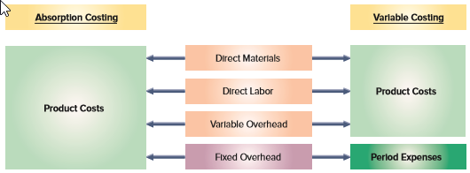
Absorption Costing vs. Variable Costing (3 of 3)
Exhibit 19.1
Learning Objective P1: Compute unit cost under both absorption and variable costing
© McGraw-Hill Education
6
Notes:
Both methods include direct materials, direct labor and variable overhead in product costs. Key difference is that fixed overhead costs are included as part of the product cost under absorption costing, but as period costs under variable costing. Product costs are included in inventory until the goods are sold which then become part of cost of goods sold. Period expenses are reported as expenses immediately in the period incurred.
Differences in income resulting from the alternative costing methods will be small when:
Fixed overhead is a small percentage of total manufacturing costs.

Slide 7
Computing Unit Product Cost (1 of 2)
Exhibit 19.2
Learning Objective P1: Compute unit cost under both absorption and variable costing
© McGraw-Hill Education
7
Notes:
Consider the product cost data for IceAge, a skate manufacturer. In Exhibit 19.2 we can see the product cost data for the company. Direct material cost per unit is $4. Direct labor cost is $8. The overhead is split between variable and fixed. The total units that IceAge expects to manufacture this period is 60,000 units. Keep your eye on the fixed overhead of $600,000 …that is the key difference between absorption costing and variable costing…The next slide will depict how the two different costing methods treats fixed overhead.

Slide 8
Computing Unit Product Cost (2 of 2)
Variable OH cost per unit:
$180,000/ 60,000 units = $3/unit
Fixed OH cost per unit:
$600,000/ 60,000 units = $10/unit
Exhibit 19.3
Learning Objective P1: Compute unit cost under both absorption and variable costing
© McGraw-Hill Education
8
Notes:
Exhibit 19.3 shows the product unit cost computations for both absorption and variable costing. For absorption costing, the product unit cost is $25, which consists of $4 in direct materials, $8 in direct labor, $3 in variable overhead ($180,000/60,000 units), and $10 in fixed overhead ($600,000/60,000 units).
For variable costing, the product unit cost is $15, which consists of $4 in direct materials, $8 in direct labor, and $3 in variable overhead. Fixed overhead costs of $600,000 are treated as a period cost and are recorded as an expense in the period incurred. The difference between the two costing methods is the exclusion of fixed overhead from product costs for variable costing.

Slide 9
Prepare and analyze an income statement using absorption costing and using variable costing.
Learning Objective P2
© McGraw-Hill Education
9

Slide 10
Absorption Costing Units Produced Equal Units Sold
Exhibit 19.4
Notice that the net income is $580,000
Learning Objective P2: Prepare and analyze an income statement using absorption costing and using variable costing.
© McGraw-Hill Education
10
Notes:
Exhibit 19.4 is split and is shown on two slides. This slide shows the absorption costing income statement, and expenses are grouped according to function.

Slide 11
Variable Costing Units Produced Equal Units Sold
Exhibit 19.4
We can see that the income under variable costing is also $580,000. This is because the number of units produced are equal to the number of units sold.
A performance report that excludes fixed expenses and net income is a contribution margin report. It’s bottom line is contribution margin.
Learning Objective P2: Prepare and analyze an income statement using absorption costing and using variable costing.
© McGraw-Hill Education
11
Notes:
This slide shows the variable costing income statement. This format is a contribution margin income statement with expenses grouped according to cost behavior. Contribution margin is the excess of sales over variable costs. As was seen on the previous slide that depicted absorption costing, the net income is also $580,000. This is because when the quantity produced equals the quantity sold, the net income amounts will be identical under both the absorption and variable costing methods.

Slide 12
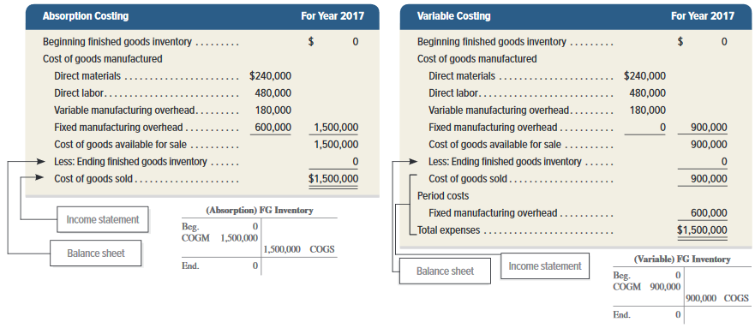
Production Cost Assignment Units Produced Equal Units Sold
Exhibit 19.5
Learning Objective P2: Prepare and analyze an income statement using absorption costing and using variable costing.
© McGraw-Hill Education
12
Notes:
Exhibit 19.5 reorganizes the information from Exhibit 19.4 to show the assignment of costs to different expenses and assets under both absorption costing and variable costing. In this year, there are no units in ending inventory, so the finished goods inventory is $0 under both methods. When units produced equal units sold, there is no difference in total expenses reported on the income statement. Yet, there is a difference in what categories receive those costs. Absorption costing assigns $1,500,000 to cost of goods sold compared to $900,000 for variable costing. The $600,000 difference is a period cost for variable costing.

Slide 13
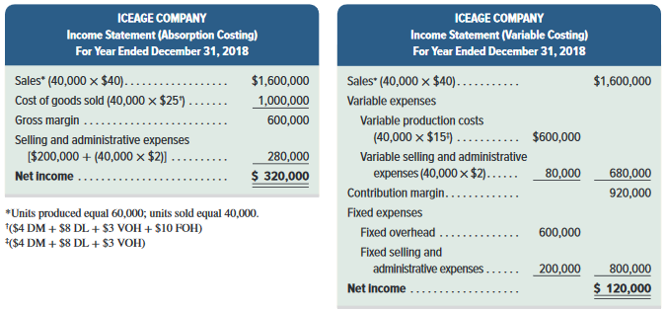
Units Produced Exceed Units Sold (1 of 4)
Exhibit 19.6
Learning Objective P2: Prepare and analyze an income statement using absorption costing and using variable costing.
© McGraw-Hill Education
13
Notes:
What happens if IceAge produces more units than it sells? Let’s look at 2018 when IceAge produced 60,000 units but sold only 40,000 units?
This slide shows the variable costing income statement for 2018. In this year, 60,000 units were produced, which is the same as in 2017. However, only 40,000 units were sold. Net income for this year will be $120,000 and there will exist 20,000 units in ending inventory that will be carried over to the next year. (This is derived by taking the 60,000 units made and subtracting the 40,000 units sold.)

Slide 14
Units Produced Exceed Units Sold (2 of 4)
Exhibit 19.6
Income for 2018 is $320,000
Learning Objective P2: Prepare and analyze an income statement using absorption costing and using variable costing.
© McGraw-Hill Education
14
Notes:
Using absorption costing there will still be 20,000 units in ending inventory but the net income reported in 2018 will be $200,000 higher. The cause of this $200,000 difference rests with the different treatment of fixed overhead under the two costing methods. Let’s investigate this further.

Slide 15
Units Produced Exceed Units Sold (3 of 4)
Exhibit 19.6
Under variable costing, the net income is only $120,000
Learning Objective P2: Prepare and analyze an income statement using absorption costing and using variable costing.
© McGraw-Hill Education
15
Notes:
This slide shows the variable costing income statement for 2018 that we saw earlier in the presentation.
Under variable costing, the net income was $120,000, which is $200,000 less than under absorption costing. As mentioned on a previous slide, the cause of this $200,000 difference rests with the treatment of fixed overhead under the two costing methods. Variable costing expenses the $600,000 of fixed manufacturing overhead as a period cost and absorption costing expenses factory overhead based on the number of units sold, so net income is lower under variable costing by $200,000 (20,000 units × $10).

Slide 16
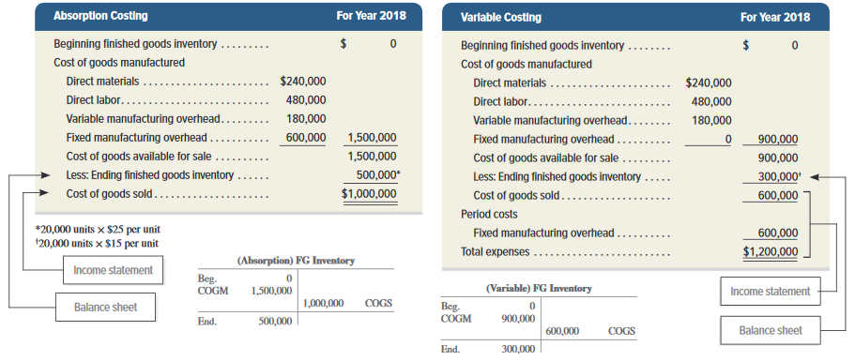
Units Produced Exceed Units Sold (4 of 4)
Exhibit 19.7
Learning Objective P2: Prepare and analyze an income statement using absorption costing and using variable costing.
© McGraw-Hill Education
16
Notes:
Exhibit 19.7 reorganizes the information from Exhibit 19.6 to show the assignment of costs to different expenses and assets under both absorption costing and variable costing. When units produced exceeds units sold there is a difference in total costs assigned. As a result, income under absorption costing is greater than under variable costing because of the greater fixed overhead cost allocated to ending inventory (asset) under absorption costing. Those cost differences extend to cost of goods sold, ending inventory, and period costs.

Slide 17
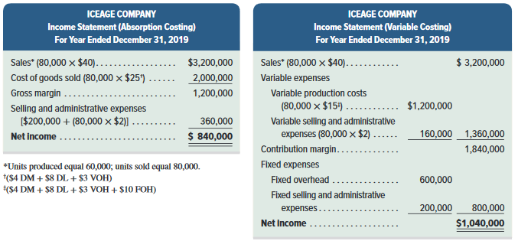
Units Produced Less Than Units Sold (1 of 3)
Exhibit 19.8
Learning Objective P2: Prepare and analyze an income statement using absorption costing and using variable costing.
© McGraw-Hill Education
17
Notes:
By now you should be able to predict what will happen if units produced are less than units sold. let’s look at IceAge’s 2019 income statement under absorption costing where the units produced are less than the units sold. In 2019, IceAge produced 60,000 units and sold 80,000 units. Thus, IceAge produced 20,000 units fewer than it sold. This means the company sold all that it produced during the period and it sold all of its beginning finished goods inventory as well.

Slide 18
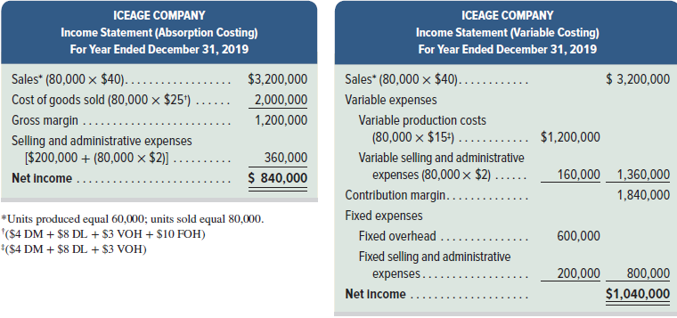
Units Produced Less Than Units Sold (2 of 3)
Exhibit 19.8
Income under variable costing is $1,040,000
Learning Objective P2: Prepare and analyze an income statement using absorption costing and using variable costing.
© McGraw-Hill Education
18
Notes:
IceAge’s income reported for 2019 under variable costing is $200,000 more than that under absorption costing. The income statements reveal that income is $840,000 under absorption costing, but it is $1,040,000 under variable costing. This $200,000 difference is due to the treatment of fixed overhead. Beginning inventory in 2019 under absorption costing included $200,000 of fixed overhead cost incurred in 2018 but is assigned to cost of goods sold in 2019 under absorption costing.

Slide 19
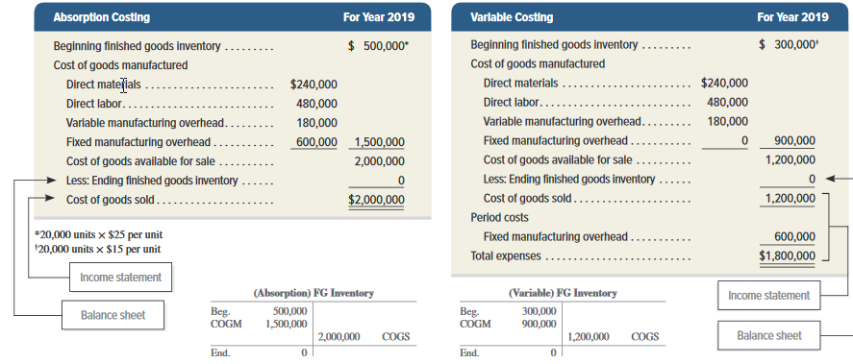
Units Produced Less Than Units Sold (3 of 3)
Exhibit 19.9
Learning Objective P2: Prepare and analyze an income statement using absorption costing and using variable costing.
© McGraw-Hill Education
19
Notes:
Exhibit 19.9 reorganizes the information from Exhibit 19.8 to show the assignment of costs to different expenses and assets under both absorption costing and variable costing. When quantity produced is less than quantity sold there is a difference in total costs assigned.
Specifically, beginning inventory in 2019 under absorption costing was $500,000 (20,000 units × $25), whereas it was only $300,000 (20,000 units × $15) under variable costing. Consequently, when that inventory is sold in 2017, that $200,000 difference in inventory is included in cost of goods sold under absorption costing, thus, the 2019 income under absorption costing is $200,000 less than the income under variable costing.

Slide 20
Summarizing Income Reporting
Exhibit 19.10
Learning Objective P2: Prepare and analyze an income statement using absorption costing and using variable costing.
© McGraw-Hill Education
20
Notes:
Let’s look at a summary of IceAge’s income over the last three years under both absorption and variable costing. Income reported under both variable costing and absorption costing for the period 2017 through 2019 for IceAge is summarized in Exhibit 19.10. Total income is $1,740,000 for this time period under both methods. Further, income under absorption costing and that under variable costing differ whenever the quantity produced and the quantity sold differ. These differences are due to the different timing with which fixed overhead costs are reported in income under the two methods. Specifically, income under absorption costing is higher when more units are produced relative to sales, and is lower when fewer units are produced than are sold. In our illustration using IceAge, the total number of units produced over 2017-2019 was exactly equal to the number of units sold over that period. This meant that the difference between absorption costing income and variable costing income for the total three-year period is zero. In reality, it is unusual for production and sales quantities to exactly equal each other over such a short period of time. We normally will see differences in income for these two methods extending over several years.

Slide 21
Convert income under variable costing to the absorption cost basis.
Learning Objective P3
© McGraw-Hill Education
21

Slide 22
Converting Income under Variable Costing to Absorption Costing (1 of 2)
Exhibit 19.11
Income under variable costing is restated to that under absorption costing utilizing the following formula:
Converting Variable Costing Income to Absorption Costing Income
Learning Objective P3: Convert income under variable costing to the absorption cost basis.
© McGraw-Hill Education
22
Notes:
Given the advantages of both variable costing and absorption costing, we need to apply and understand both methods. For example, companies can use variable costing for internal reporting and business decisions but they must use absorption costing for external reporting and tax reporting. For companies concerned about maintaining two costing systems, we can readily convert reports under variable costing to those using absorption costing. Income under variable costing is restated to that under absorption costing by adding the fixed cost in ending inventory and subtracting the fixed cost in beginning inventory. The formula for this calculation is shown here in Exhibit 19.11

Slide 23
Converting Income under Variable Costing to Absorption Costing (2 of 2)
To restate variable costing income to absorption costing income for 2018, we must add back the fixed overhead cost deferred in ending inventory.
Exhibit 19.12
Similarly, to restate variable costing income to absorption costing income for 2019, we must deduct the fixed overhead cost recognized from beginning inventory, which was incurred in 2018, but expensed in the 2019 cost of goods sold when the inventory was sold.
Learning Objective P3: Convert income under variable costing to the absorption cost basis.
© McGraw-Hill Education
23
Notes:
To illustrate how easy it is to convert income from variable costing to absorption costing, let’s again refer to IceAge’s data for the three years 2017 through 2019 which is shown here in Exhibit 19.12.
Exhibit 19.12 shows the computations of absorption costing income. To restate variable costing income to absorption costing income for 2018, add back the fixed overhead cost deferred in ending inventory. Similarly, to restate variable costing income to absorption costing income for 2017, deduct the fixed overhead cost recognized from beginning inventory, which was incurred in 2018, but expensed in the 2019 cost of goods sold when the inventory was sold.

Slide 24
Describe how absorption costing can result in overproduction.
Learning Objective C1
© McGraw-Hill Education
24

Slide 25
Planning Production
What would happen if IceAge’s manager decided to produce 100,000 units instead of 60,000?
The 40,000 extra units would be stored in inventory and the total production cost PER UNIT is $4 less!
Exhibit 19.13
When 60,000 units are produced:
Fixed overhead per unit is:
$600,000/ 60,000 units = $10/unit
When 100,000 units are produced:
Fixed overhead per unit is:
$600,000/ 100,000 units = $6/unit
Learning Objective C1: Describe how absorption costing can result in overproduction.
© McGraw-Hill Education
25
Notes:
What would happen if IceAge’s manager decided to produce 100,000 units instead of 60,000? The 40,000 extra units would be stored in inventory. What would the income look like? The left side of Exhibit 19.13 shows the product cost per unit under absorption costing when 60,000 units are produced. The right side shows unit costs when 100,000 units are produced. Total product cost per unit is $4 less when 100,000 units are produced. This difference is because the company is spreading the $600,000 fixed overhead cost over 40,000 more units when 100,000 units are produced than when 60,000 are produced.
The difference in product cost per unit impacts income reporting. Exhibit 19.14, on the next slide, presents the income statement under absorption costing for the two alternative production levels.

Slide 26
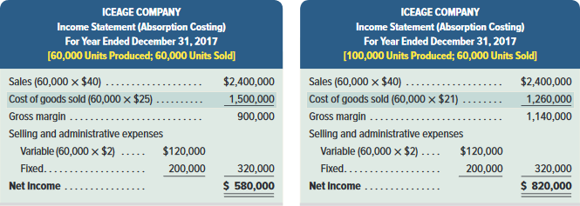
Income under Absorption Costing for Different Production Levels (1 of 2)
Exhibit 19.14
Note: Income under absorption costing is $240,000 greater if management produces 40,000 more units than necessary and builds up ending inventory.
This shows that a manager can report increased income merely by producing more and disregarding whether the excess units can be sold or not.
Learning Objective C1: Describe how absorption costing can result in overproduction.
© McGraw-Hill Education
26
Notes:
Common sense suggests that because the company’s variable cost per unit, total fixed costs, and sales are identical in both case, merely producing more units and creating excess ending inventory should not increase income. Income under absorption costing is $240,000 greater if IceAge produces 40,000 more units than necessary and builds up ending inventory. The reason is that $240,000 of fixed overhead (40,000 units × $6) is assigned to ending inventory instead of being expensed in 2017. This shows that a manager can increase income just by producing more and disregarding whether the excess units can be sold or not.

Slide 27
Income under Absorption Costing for Different Production Levels (2 of 2)
Exhibit 19.15
Under variable costing, even if a manager produces more units, it doesn’t effect the reported net income.
The manager actually has to SELL more units to increase net income.
Learning Objective C1: Describe how absorption costing can result in overproduction.
© McGraw-Hill Education
27
Notes:
This incentive problem encourages inventory build-up, which leads to increased costs in storage, financing, and obsolescence. If the excess inventory is never sold, it will be disposed of at a loss.
This is not the case when variable costing is used in a company. Exhibit 19.15 shows that managers cannot increase income by merely increasing production without increasing sales. Under variable costing, companies increase income by selling more , not by producing excess inventory.

Slide 28
Determine product selling price based on absorption costing.
Learning Objective P4
© McGraw-Hill Education
28

Slide 29
Setting Prices (1 of 2)
Absorption cost information is useful because it reflects the full costs that sales must exceed for the company to be profitable.
Although many factors impact pricing, cost is a crucial factor!
Over the long run, price must be high enough to cover all costs.
Learning Objective P4: Determine product selling price based on absorption costing.
© McGraw-Hill Education
29
Notes:
Over the long run, price must be high enough to cover all costs, including variable costs and fixed costs, and still provide an acceptable return to owners. For this purpose, absorption cost information is useful because it reflects the full costs that sales must exceed for the company to be profitable.

Slide 30
Setting Prices (2 of 2)
Step 1: Determine the product cost per unit using absorption costing.
Step 2: Determine the target markup on product cost per unit.
Step 3: Add the target markup to the product cost to find the target selling price
Learning Objective P4: Determine product selling price based on absorption costing.
© McGraw-Hill Education
30
Notes:
We can use a three-step process to determine product selling prices:
Step 1: Determine the product cost per unit using absorption costing.
Step 2: Determine the target markup on product cost per unit.
Step 3: Add the target markup to the product cost to find the target selling price

Slide 31
Setting Prices Example: IceAge will use absorption costing to determine a target selling price.
Exhibit 19.16
Determining Selling Price with Absorption Costing
Step 1 | Absorption cost per unit (from Exhibit 19.3) | $25
Step 2 | Target markup per unit ($25 times 60%) | 15
Step 3 | Target selling price per unit | $40
In this example, they chose a markup of 60% of cost. So the target selling price is $40 per unit.
Start with product cost.
Then, management needs to determine a target markup.
Learning Objective P4: Determine product selling price based on absorption costing.
© McGraw-Hill Education
31
Notes:
To illustrate, consider IceAge. Under absorption costing, its product cost is $25 per unit (from Exhibit 19.3). IceAge’s management must then determine a target markup on this product cost. This target markup could be based on industry averages, prices that have been charged in the past, or other information. In addition, this markup must be set high enough to cover selling and administrative expenses (both variable and fixed) that are excluded from product costs. In this example, IceAge targets a markup of 60% of absorption cost. With that information, the company computes a target selling price as in Exhibit 19.16 of $40 per unit. IceAge can use this target selling price as a starting point in setting prices.

Slide 32
Controlling Costs
Managers are responsible for their controllable costs.
A cost is controllable if a manager can determine or affect the amount incurred.
Examples: variable production costs are controllable by production supervisors and fixed costs are controllable by higher-level managers.
Uncontrollable costs are not within the manager’s influence.
Example would be production capacity.
Learning Objective P4: Determine product selling price based on absorption costing.
© McGraw-Hill Education
32
Notes:
An effective management control practice is to hold managers responsible only for their controllable costs. A cost is controllable if a manager can determine or affect the amount incurred. Uncontrollable costs are not within the manager’s influence.

Slide 33
Variable Costing for Service Firms
Variable costing also applies to service companies.
Focus on variable costs useful in managerial decisions.
Special order pricing may be used to deeply discount a service; if the discounted price is greater than variable cost, the sale will increase contribution margin and net income.
Learning Objective P4: Determine product selling price based on absorption costing.
© McGraw-Hill Education
33
Notes:
Variable costing also applies to service companies. Since service companies do not produce inventory, the differences in income from absorption and variable costing shown for a manufacturer do not apply. Still, a focus on variable costs can be useful in managerial decisions for service firms. One example is a hotel receiving an offer to reserve a large block of rooms at a discounted price. Another example of “special order” pricing is for airlines when they sell tickets shortly before a flight at deeply discounted prices. If the discounted price exceeds variable costs, such sales increase contribution margin and net income.

Slide 34
Use variable costing in pricing special orders.
Learning Objective A1
© McGraw-Hill Education
34

Slide 35
Pricing Special Orders (1 of 3)
Over the Long Run:
Price must be high enough to cover all costs, including variable costs and fixed costs, and still provide an acceptable return to owners.
© McGraw-Hill Education
Learning Objective A1: Use variable costing in pricing special orders.
35
Notes:
Over the long run, price must be high enough to cover all costs, including variable costs and fixed costs, and still provide an acceptable return to owners. For this purpose, absorption cost information is useful because it reflects the sales level the company must obtain to be profitable.

Slide 36
Pricing Special Orders (2 of 3)
Over the Short Run:
Fixed production costs, such as the cost to maintain plant capacity, do not change with changes in production levels.
With excess capacity, increases in production level would increase variable production costs, but not fixed costs.
While managers try to maintain the long-run price on existing orders, which covers all production costs, managers should accept special orders provided the special order price exceeds variable cost.
© McGraw-Hill Education
Learning Objective A1: Use variable costing in pricing special orders.
36
Notes:
Over the short run, there is some flexibility and special, one-time orders at prices below the normal selling price that should be considered as long as variable costs can be covered.

Slide 37
Pricing Special Orders (3 of 3)
Should the company accept a special order for 1,000 pairs of skates at an offer price of $22 per pair?
Exhibit 19.19
Variable production cost = $15 ($4 DM + $8 DL + $3 VOH)
Order should be accepted because the $22 order price exceeds the $15 variable cost of the product.
© McGraw-Hill Education
Learning Objective A1: Use variable costing in pricing special orders.
37
Notes:
Let’s go back to IceAge to see how we can use our knowledge of variable costing in a special order decision. To illustrate, let’s return to the data of IceAge Company and examine Exhibit 19.3. Recall that its variable production cost per unit is $15 ($4 DM + $8 DL + $3 VOH) and its total production cost per unit is $25 (at production level of 60,000 units). Assume that it receives a special order for 1,000 pairs of skates at an offer price of $22 per pair from a foreign skating school. This special order will not affect IceAge’s regular sales and its plant has excess capacity to fill the order.
Drawing on absorption costing information, we observe that cost is $25 per unit and that the special order price is $22 per unit. These data would suggest that management would reject the order as it would lose $3,000, computed as 1,000 units at $3 loss per pair ($22-$25).
However, closer analysis suggests that this order should be accepted. This is because the $22 order price exceeds the $15 variable cost of the product. Specifically, Exhibit 19.17 reveals that the incremental revenue from accepting the order is $22,000 (1,000 units at $22 per unit) whereas the incremental production cost of the order is $15,000 (1,000 units at $15 per unit) and the incremental variable selling and administrative cost is $2,000 (1,000 units at $2 per unit). Thus, both the contribution margin and net income would increase by $5,000 from accepting the order. We see that variable costing reveals this opportunity while absorption costing hides it. The reason for increased income from accepting the special order lies in the different behavior of variable and fixed production costs. If the order is rejected, only variable costs are saved. Fixed costs, however, do not change in the short run regardless of rejecting or accepting this order. Since incremental revenue from the order exceeds incremental costs (only variable costs in this case), accepting the special order increases company income.

Slide 38
End of Chapter 19
© McGraw-Hill Education
38

