Slide 1
Master Budgets and Performance Planning
Chapter 20
Wild and Shaw
Financial and Managerial Accounting
8th Edition
Copyright ©2019 McGraw-Hill Education. All rights reserved. No reproduction or distribution without the prior written consent of McGraw-Hill Education.
Notes:
Chapter 20: Master Budgets and Performance Planning

Slide 2
Chapter 20 Learning Objectives
CONCEPTUAL
C1 Describe the benefits of budgeting.
ANALYTICAL
A1 Analyze expense planning using activity-based budgeting.
PROCEDURAL
P1 Prepare the operating budgets of a master budget -- for a manufacturing company.
P2 Prepare a cash budget for a manufacturing company.
P3 Prepare budgeted financial statements.
P4 Prepare each component of a master budget —for a merchandising company.
(Appendix 20A)
2
© McGraw-Hill Education

Slide 3
C1: Describe the benefits of budgeting.
Learning Objective
3
© McGraw-Hill Education

Slide 4
Coordination: activities of all units contribute to meeting the company’s overall goals.
Control: provides a benchmark for evaluating performance.
Communicate: management plans throughout the organization.
Benefits of Budgeting
Plan: focuses on future opportunities.
Coordinate: helps employees and
departments work toward
company’s overall goals.
Motivate: through participation in the budgeting process and establishment of attainable goals.
4
© McGraw-Hill Education
Learning Objective C1: Describe the benefits of budgeting.
Notes:
Managers must ensure that activities of employees and departments contribute to meeting the company’s overall goals. Budgeting is the process of planning future business actions and expressing them as formal plans to help achieve coordination. A budget is a formal statement of a company’s plans, expressed in monetary terms. Unlike long-term strategic plans, budgets typically cover shorter periods such as a month, quarter, or year. Budgets are useful in controlling operations.
Budgets benefit the key managerial functions of planning and control.
Plan: a budget focuses on the future opportunities and threats to the organization. This focus on the future is important, because the daily pressures of operating an organization can divert management’s attention from planning.
Control: the control function requires management to evaluate (benchmark) operations against some norm. Budgeted performance considers important company, industry, and economic factors, a comparison of actual to budgeted performance provide an effective monitoring and control system.
Coordinate: helps to coordinate activities so all employees and departments understand and work towards the company’s overall goals.
Communicate: written budgets communicate management’s specific action plans to all employees.
Motivate: employees through participation in the budgeting process and the establishment of attainable goals.

Slide 5
Budgeting and Human Behavior
Budgets can be a positive motivating force when:
Affected employees are consulted
Goals are challenging but attainable
Evaluations offer opportunities to explain differences between actual and budgeted amounts.
Potential negative outcomes of budgeted include:
Employees may understate sales and overstate expenses to allow cushion.
Pressure to meet results may lead to unethical behavior or fraud.
Employees may purchase unnecessary items to ensure budget is not reduced next period.
5
© McGraw-Hill Education
Learning Objective C1: Describe the benefits of budgeting.
Notes:
Budgeting process has three important guidelines:
Employees affected by a budget should be consulted when it is prepared (participatory budgeting).
Goals reflected in a budget should be challenging but attainable.
Evaluations should be made carefully with opportunities to explain differences between actual and budgeted amounts.
Under participatory budgeting, potential negative outcomes of budgeted include:
1. Employees may understate sales and overstate expenses to allow cushion called budgetary slack.
2. Pressure to meet results may lead to employees engaging in unethical behavior or fraud.
3. Employees may purchase might always spend their budgeted amounts, even on unnecessary items to ensure their budget is not reduced next period.

Slide 6
Budget Reporting and Timing
Continuous budgeting applied by preparing rolling budgets over a twelve-month period that rolls forward one month as the current month is completed.
6
© McGraw-Hill Education
Learning Objective C1: Describe the benefits of budgeting.
Notes:
We need to choose a budgeting period. The budget period usually coincides with the company’s fiscal year. To provide specific guidance to help control operations, the annual budget usually is separated into quarterly or monthly budgets. These short-term budgets allow management to periodically evaluate performance and take corrective action.
Many companies apply continuous budgeting by preparing rolling budgets. In continuous budgeting, a company continually revises its budgets as time passes. A company would revise its entire set of budgets by adding a new quarterly budget to replace the quarter that just elapsed.

Slide 7
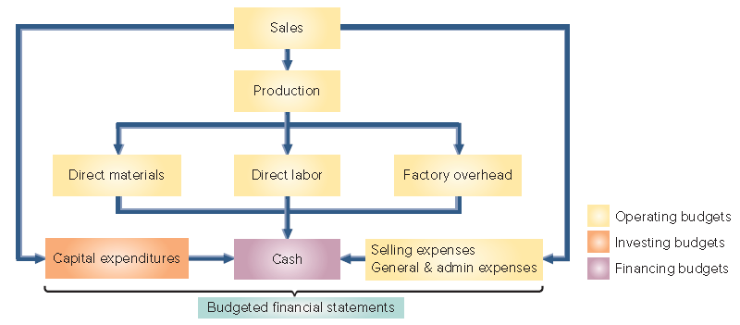
Master Budget Components
Exhibit 20.2
7
© McGraw-Hill Education
Learning Objective C1: Describe the benefits of budgeting.
Notes:
This slide summarizes the master budgeting process for a company that manufacturers a product. The master budgeting process typically begins with the sales budget and ends with a cash budget and budgeted financial statements. The master budget includes individual budgets for sales, production (or purchases), various expenses, capital expenditures, and cash.
The number and types of budgets included in a master budget depend on the company’s size and complexity. A manufacturer’s master budget should include, at a minimum, several operating budgets (shown in yellow in Exhibit 20.2), a capital expenditures budget, and a cash budget. The capital expenditures budget summarizes the effects of investing activities on cash and helps determine the company’s need for financing. Managers also often express the expected financial results of these planned activities with a budgeted balance sheet and a budgeted income statement. Some budgets require the input of other budgets.

Slide 8
P1: Prepare the operating budget of a master budget -- for a manufacturing company.
Learning Objective
8
© McGraw-Hill Education

Slide 9
Sales Budget
The first step in preparing the master budget is the sales budget, which shows the planned sales units and the expected dollars from these sales.
Sales Budget
Estimated Unit Sales
Estimated Unit Price
Analysis of economic and market conditions + Business capacity and advertising plans
9
© McGraw-Hill Education
Learning Objective P1: Prepare the operating budget of a master budget -- for a manufacturing company.
Notes:
The first step in preparing the master budget is the sales budget, which shows the planned sales units and the expected dollars from these sales. The sales budget is the starting point in the budgeting process because plans for most departments are linked to sales.
The sales budget comes from a careful analysis of forecasted economic and market conditions, business capacity and advertising plans. To develop the sales budget, companies must estimate both unit sales and the selling price per unit.

Slide 10
Sales Budget (Pt. 2)
Example: In September 2019, Toronto Sticks Company sold 700 hockey sticks at $60 each. Toronto Sticks prepared the following sales budget for the next three months:
10
© McGraw-Hill Education
Learning Objective P1: Prepare the operating budget of a master budget -- for a manufacturing company.
Notes:
To illustrate the budgeting process, we are going to prepare a detailed budget for Toronto Sticks Company, a manufacturer of youth hockey sticks. We will begin with the sales budget. TSC sold 700 hockey sticks at $60 per unit. After considering sales predictions and market conditions, TSC prepares its sales budget for the next three months. Let’s take a look.
In September of 2019, TSC sold 700 hockey sticks at $60 per unit. After considering sales predictions and market conditions, TSC prepares its sales budget for the next three months. The Sales budget will include forecasts of both unit sales and unit prices.
Using this pricing information and the forecasted unit sales for the colder months of the fall season, the sales budget for the remaining three months of the year can be prepared as shown in Exhibit 20.4.

Slide 11
Production Budget
A manufacturer prepares a production budget, which shows the number of units to be produced in a period.
The production budget is based on the unit sales projected in the sales budget, along with inventory considerations.
Exhibit 20.5
Note: A production budget does not show costs; it is always expressed in units of product.
11
© McGraw-Hill Education
Learning Objective P1: Prepare the operating budget of a master budget -- for a manufacturing company.
Notes:
A manufacturer prepares a production budget, which shows the number of units to be produced in a period. The production budget is based on the budgeted unit sales from the sales budget, along with inventory considerations.
This slide depicts the general computation for the production required for a period. We start with budgeted ending inventory. Then, we add the budgeted sales units for the period which came from the Sales budget. This will give us the required units needed for the period. Then, we subtract the number of units in beginning inventory and we are left with the total units to be produced in the period.
A production budget does not show costs; it is always expressed in units of product.

Slide 12
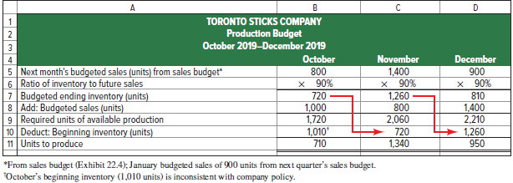
Production Budget (continued)
The production budget is based on the unit sales projected in the sales budget, along with inventory considerations.
Exhibit 20.6
12
© McGraw-Hill Education
Learning Objective P1: Prepare the operating budget of a master budget -- for a manufacturing company.
Notes:
The production budget for Toronto Sticks Company (TSC) is prepared next. Manufacturing companies, like TSC, prepare a production budget, which shows the number of units to be produced in a period. The production budget is based on the unit sales projected in the sales budget, along with inventory considerations.
Use these three steps to complete the production budget:
1. Compute budgeted ending inventory, based on the company’s inventory policy.
2. Add budgeted sales, from the sales budget.
3. Subtract beginning inventory.
The result is the required units to be produced for the period.

Slide 13
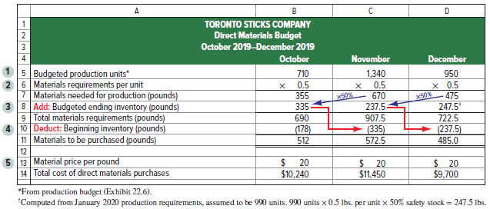
Direct Materials Budget
The direct materials budget shows the budgeted costs for the direct materials that will need to be purchased to satisfy the estimated production for the period
Exhibit 20.7
13
© McGraw-Hill Education
Learning Objective P1: Prepare the operating budget of a master budget -- for a manufacturing company.
Notes:
The direct materials budget shows the budgeted costs for the direct materials that will need to be purchased to satisfy the estimated production for the period. Whereas the production budget shows units to be produced, the direct materials budget translates the units to be produced into budgeted costs.
A direct materials budget requires:
Number of units to produce from the production budget
Materials requirements per unit
Budgeted ending inventory in units of direct materials
Beginning inventory in units of direct materials
Cost per unit of direct materials
It is based on the budgeted production volume from the production budget. The direct materials budget for Toronto Sticks company is shown on your screen. The direct materials budget is driven by the budgeted materials needed to satisfy each month’s production requirement.
This budget begins with the budgeted production from the production budget.
Next, TSC needs to know the amount of direct materials needed for each of the units to be produced—in this case, half a pound (.5) of wood. With these two inputs we can now compute the amount of direct materials needed for production. For example, to produce 710 hockey sticks in October, TSC will need 355 pounds of wood (710 units x 0.5 lbs. = 355 lbs.).
TSC wants to have a safety stock of direct materials on hand at the end of each month to complete 50% of the budgeted units to be produced in the next month. Since TSC expects to produce 1,340 units in November, requiring 670 pounds of materials, it needs ending inventory of direct materials of 335 pounds (50% x 670) in inventory at the end of October. TSC’s total direct materials requirement for October is therefore 690 pounds (355 + 335).
Since TSC already has 178 pounds of direct materials in its beginning inventory it deducts this amount from the total materials requirements for the month. For October, the calculation is 690 pounds - 178 pounds, = 512 pounds of direct materials to be purchased in October.
The direct materials budget next translates the pounds of direct materials to be purchased into budgeted costs. TSC estimates that the cost of direct materials will be $20 per pound over the quarter. At $20 per pound, purchasing 512 pounds of direct materials for October production will cost $10,240.

Slide 14
Direct Labor Budget
The direct labor budget shows the budgeted costs for the direct labor that will be needed to satisfy the estimated production for the period.
Exhibit 20.8
14
© McGraw-Hill Education
Learning Objective P1: Prepare the operating budget of a master budget -- for a manufacturing company.
Notes:
The direct labor budget shows the budgeted costs for the direct labor that will be needed to satisfy the estimated production for the period.
To develop a direct labor budget, companies need the following inputs:
1. Number of units to produce (from production budget).
2. Labor requirements per unit—direct labor hours for each unit of finished product.
3. Cost per direct labor hour.
15 minutes (one-fourth of an hour) of labor time is required to produce one unit. Labor is paid at the rate of $12 per hour.
Include the number of units to be produced from the production budget. For October, 710 units are planned to be produced.
Compute budgeted direct labor hours by multiplying the budgeted production level for each month by one-quarter (0.25) of an hour.
Compute total cost of direct labor by multiplying budgeted labor hours by the labor rate of $12 per hour.

Slide 15
Factory Overhead Budget
The factory overhead budget shows the budgeted costs for factory overhead that are needed to complete the estimated production for the period.
Exhibit 20.9
The variable portion of factory overhead is assigned at the rate of $2.50 per unit of production. The fixed overhead is $1,500 per month.
15
© McGraw-Hill Education
Learning Objective P1: Prepare the operating budget of a master budget -- for a manufacturing company.
Notes:
The factory overhead budget shows the budgeted costs for factory overhead that will be needed to complete the estimated production for the period. TSC’s factory overhead budget is shown on your screen. TSC separates variable and fixed overhead costs in its overhead budget, as do many companies. The variable portion of factory overhead using the predetermined overhead rate of $2.50 per unit of production. The fixed overhead stays constant at $1,500 per month.
Other common overhead budget costs include supervisor salaries, indirect materials, indirect labor, utilities, and maintenance of manufacturing equipment and are discussed in chapter 21.

Slide 16
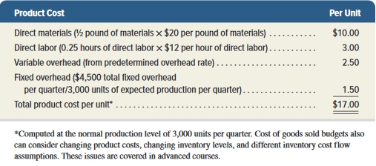
Product Cost Per Unit
TSC’s can compute product cost per unit from the three manufacturing budgets (direct materials, direct labor, and factory overhead).
For budgeting purposes, TSC assumes it will normally produce 3,000 units of product each quarter, yielding fixed overhead of $1.50 per unit. TSC’s other product costs are all variable.
Exhibit 20.10
16
© McGraw-Hill Education
Learning Objective P1: Prepare the operating budget of a master budget -- for a manufacturing company.
Notes:
With the three manufacturing budgets (direct materials, direct labor, and factory overhead), we compute TSC’s budgeted product cost per unit. This amount is then used to prepare:
Cost of goods sold budget – budgets the total manufacturing costs for the period.
Budgeted income statement – summarizes the expected income from budgeted activities.
For budgeting purposes, TSC assumes it will normally produce 3,000 units of product each quarter, yielding fixed overhead of $1.50 per unit (computed as $4,500 / 3,000). TSC’s other product costs are all variable. This slide summarizes the product cost per unit calculation.

Slide 17
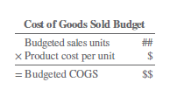
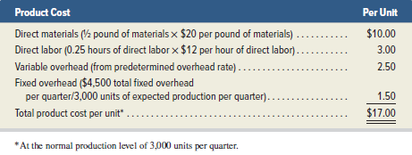
Cost of goods sold budget
The product cost per unit is used to prepare the:
Cost of goods sold budget
Budgeted income statement
Exhibit 20.10
17
© McGraw-Hill Education
Learning Objective P1: Prepare the operating budget of a master budget -- for a manufacturing company.
Notes:
The budgeted product cost per unit is used to prepare:
Cost of goods sold budget – budgets the total manufacturing costs for the period.
Budgeted income statement – summarizes the expected income from budgeted activities.

Slide 18
Selling Expense Budget
The selling expense budget is an estimate of the types and amounts of selling expenses expected during the budget period.
TSC pays sales commissions equal to 10% of total sales.
TSC pays a monthly salary of $2,000 to its sales manager.
Let’s prepare the selling expense budget for Toronto Sticks Company.
18
© McGraw-Hill Education
Learning Objective P1: Prepare the operating budget of a master budget -- for a manufacturing company.
Notes:
The selling expense budget is an estimate of the types and amounts of selling expenses expected during the budget period. It is usually prepared by the vice president of marketing or sales manager. Budgeted selling expenses are based on the sales budget, plus a fixed amount of sales manager salaries.
We use the sales budget to prepare a selling expense budget for TSC. Sales commissions are variable, based on 10% of sales revenue. The sales manager’s salary is a fixed expense. Other common selling expenses include advertising, delivery expenses, and marketing expenses.

Slide 19
Selling Expense Budget (continued)
Exhibit 20.11
From TSC’s sales budget
TSC pays sales commissions equal to 10 percent of total sales.
TSC pays a monthly salary of $2,000 to its sales manager.
19
© McGraw-Hill Education
Learning Objective P1: Prepare the operating budget of a master budget -- for a manufacturing company.
Notes:
We begin the selling expense budget with sales revenues amounts taken from the sales budget. Next, we compute sales commissions for each month by multiplying sales revenue for each month times 10%. The sales manager’s salary of $2,000 per month is then added to sales commissions to get the total selling expense for each month.

Slide 20
General and Administrative Expense Budget
The general and administrative expense budget plans the predicted operating expenses not included in the selling expenses or manufacturing budgets.
Toronto Sticks Company has general and administrative salaries of $54,000 per year or $4,500 per month.
Let’s prepare the general and administrative expense budget for TSC.
20
© McGraw-Hill Education
Learning Objective P1: Prepare the operating budget of a master budget -- for a manufacturing company.
Notes:
The general and administrative expense budget plans the predicted operating expenses not included in the selling expenses or manufacturing budgets. These expenses may be either variable or fixed with respect to sales volume. The office manager responsible for general administration often is responsible for preparing the general and administrative expense budget.
Toronto Sticks Company’s general and administrative expense budget includes salaries of $54,000 per year, or $4,500 per month. Let’s see what their general and administrative expense budget looks like.

Slide 21
General and Administrative Expense Budget (continued)
Toronto Sticks Company has general and administrative salaries of $54,000 per year or $4,500 per month.
Exhibit 20.12
21
© McGraw-Hill Education
Learning Objective P1: Prepare the operating budget of a master budget -- for a manufacturing company.
Notes:
The general and administrative expense budget for each month is the administrative salaries of $4,500. The total amount is the same each month since the amount is a fixed expense.

Slide 22
Capital Expenditures Budget
The capital expenditures budget shows dollar amounts estimated to be spent to purchase additional plant assets and amounts to be received from plant asset disposals.
TSC does not anticipate disposal of any plant assets through December 2019, but management is planning to acquire additional equipment for $25,000 cash in December 2019.
*Since this is the only budgeted capital expenditure for the quarter, no separate capital expenditures budget is shown.
22
© McGraw-Hill Education
Learning Objective P1: Prepare the operating budget of a master budget -- for a manufacturing company.
Notes:
The capital expenditures budget shows dollar amounts estimated to be spent to purchase additional plant assets and any cash expected to be received from plant asset disposals. This budget is prepared after the operating budgets.
Capital budgeting is the process of planning for capital (plant asset) expenditures.
Since TSC only plans one capital expenditure of $25,000 for additional equipment near the end of December, so this information will be incorporated into the cash budget.

Slide 23
P2: Prepare a cash budget for a manufacturing company.
Learning Objective
23
© McGraw-Hill Education

Slide 24
Cash Budgets
The next step is to prepare the cash budget, which shows expected cash inflows and outflows during the budget period.
Exhibit 20.13
The general formula for a cash budget is:
24
© McGraw-Hill Education
Learning Objective P2: Prepare a cash budget for a manufacturing company.
Notes:
The next step is to prepare the cash budget, which shows expected cash inflows and outflows during the budget period. Managing cash flows is vital for the firm’s success. Most companies set an amount of cash they require for operations. The cash budget is important because it helps the company meet this cash balance goal. If the cash budget indicates a potential cash shortfall, the company can prearrange loans to meet its obligations. If the cash budget indicates a potential cash windfall
When preparing a cash budget, we add budgeted cash receipts to the beginning cash balance and deduct budgeted cash disbursements. If the preliminary cash balance is too low, additional cash requirements appear in the budget as planned increases from short-term loans. If the preliminary cash balance exceeds the balance the company wants to maintain, the excess is used to repay loans (if any) or to acquire short-term investments. Information for preparing the cash budget is mainly taken from the operating and capital expenditures budgets. Preparing the cash budget typically requires the preparation of other supporting schedules; we show the first of these, a schedule of cash receipts from sales, next., the company can plan to pay off prior loans or make other investments.

Slide 25
Cash Receipts from Sales
40% of TSC’s sales are for cash.
The remaining 60% are credit sales that are collected in full in the month following the sale.
Let’s prepare the cash receipts budget for TSC.
25
© McGraw-Hill Education
Learning Objective P2: Prepare a cash budget for a manufacturing company.
Notes:
Managers use the sales budget, combined with knowledge about how frequently customers pay on credit sales, to budget monthly cash receipts. Forty percent of TSC’s sales are for cash. The remaining 60 percent of sales are credit sales. None of the sales on account are collected in the month of sale. However they are expected to be collected in the month following the sale.

Slide 26
Budgeted Cash Receipts from Sales
Exhibit 20.14
Cash sales are 40% of each month’s sales
From TSC’ sales budget
Accounts receivable balance at the end of each month is 60% of that month’s budgeted sales.
26
Learning Objective P2: Prepare a cash budget for a manufacturing company.
© McGraw-Hill Education
Notes:
We begin the cash receipts budget with sales revenues amounts taken from the sales budget. September sales revenue is included because 60 percent of September sales will be collected in October.
The accounts receivable balance at the end of each month is 60 percent of that month’s budgeted sales. Cash sales are 40 percent of each month’s sales.
The accounts receivable balance at the end of each month is collected in full during the next month. Cash sales are added to accounts receivable collections to get total cash receipts for the month.
We now can compute the budgeted cash receipts from customers, as shown in the table on this slide. October’s budgeted cash receipts consist of $24,000 from expected cash sales ($60,000 x 40%) plus the anticipated collection of $25,200 of accounts receivable from the end of September.

Slide 27
Cash Payments for Materials
Managers use the beginning balance sheet and the direct materials budget prepared earlier, to help prepare a schedule of cash payments for materials.
TSC’s purchases of materials are entirely on account.
Full payment is made in the month following the purchase.
Let’s look at the schedule of cash payments for materials for TSC.
27
© McGraw-Hill Education
Learning Objective P2: Prepare a cash budget for a manufacturing company.
Notes:
We’re now ready to prepare the cash payments for materials budget. Managers use the beginning balance sheet and the direct materials budget prepared earlier, to help prepare a schedule of cash payments for materials. Managers must also know how TSC purchases direct materials (pay cash or on account), and for credit purchases, how quickly TSC pays.
TSC’s materials purchases are entirely on account. It makes full payment during the month following its purchases. Using this information, the schedule of cash payments for materials can be prepared. Let’s take a look at it on the next slide.

Slide 28
Cash Payments for Materials (continued)
Exhibit 20.15
TSC’s purchases of materials are entirely on account.
Full payment is made in the month following the purchase.
From direct materials budget
28
© McGraw-Hill Education
Learning Objective P2: Prepare a cash budget for a manufacturing company.
Notes:
Remember that TSC’s materials purchases are entirely on account. It makes full payment during the month following its purchases. We start with the direct materials budget and that budget told TSC to purchase $10,240 of materials in October. But none of these purchases will be paid for this month—instead those material costs end up in November’s column. We then add the balance owed from the previous month’s purchases (September) of $7,060. The total cash payments for direct materials in October, is $7,060.

Slide 29
Preparing the Cash Budget
Beginning Cash Balance
Budgeted Cash Receipts
Budgeted Cash Payments
Preliminary Cash Balance
+
–
=
If adequate, repay loans or buy securities.
If inadequate, increase short-term loans.
Additional information for TSC’s cash budget:
Has a September 30 cash balance of $20,000.
Will pay a cash dividend of $3,000 in November.
Continue
29
© McGraw-Hill Education
Learning Objective P2: Prepare a cash budget for a manufacturing company.
Notes:
Now that we have completed the following budgets: cash receipts from sales budget, cash payments for direct materials, cash payments for direct labor, cash payments for variable overhead, cash payments for selling expenses and cash payments for general and administrative expenses, we are ready to complete the cash budget. The fixed overhead assigned to depreciation in the factory overhead budget does not require a cash payment, therefore, it is not included in the cash budget. Other types of fixed overhead such as payments for property taxes and insurance are included if they require cash payments.
When preparing a cash budget, we add expected cash receipts to the beginning cash balance and deduct expected cash payments. If the expected ending cash balance is inadequate, additional cash requirements appear in the budget as planned increases from short-term loans. If the expected ending cash balance exceeds the desired balance, the excess is used to repay loans or to acquire short-term investments.
Some additional events affecting TSC’s cash are displayed on your screen. You may need to make a few notes from this information to keep from referring back to this screen as we use this information. We will continue with the additional information on the next slide.

Slide 30
Cash Budget
Toronto Sticks Company:
Income tax payable of $20,000 from the beginning balance shown in exhibit 20.3.
Will purchase $25,000 of equipment in December.
Has an agreement with its bank for loans at the end of each month to enable a minimum cash balance of $20,000.
Pays interest each month equal to one percent of the prior month’s ending loan balance.
Repays loans when the ending cash balance exceeds $20,000.
Owes $10,000 on this loan arrangement on September 30.
Has 40 percent income tax rate.
Will pay taxes for current quarter next year.
30
© McGraw-Hill Education
Learning Objective P2: Prepare a cash budget for a manufacturing company.
Notes:
Here is the remainder of the information needed to complete TSC’s cash budget. Again, you my find it helpful to take a few notes summarizing this information.

Slide 31
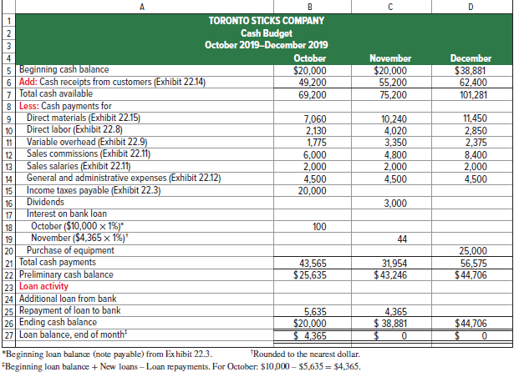
Exhibit 20.16
From Cash Receipts Budget
TSC’s cash balance at the beginning of October is $20,000. Budgeted cash receipts for October are $49,200, resulting in a total of $69,200 available for the month.
Now we are ready to look at TSC’s cash payments
31
© McGraw-Hill Education
Learning Objective P2: Prepare a cash budget for a manufacturing company.
Notes:
We begin the cash budget with October. TSC’s cash balance at the beginning of October is $20,000. Budgeted cash receipts for October are $49,200, resulting in a total of $69,200 available for the month.
Now we are ready to look at TSC’s cash disbursements.

Slide 32
Exhibit 20.16
We next subtract expected cash payments for direct materials, direct labor, overhead, selling expenses, and general and administrative expenses.
Income taxes of $20,000 were due as of the end of September 30, and payable in October.
32
© McGraw-Hill Education
Learning Objective P2: Prepare a cash budget for a manufacturing company.
Notes:
We next subtract expected cash payments for direct materials, direct labor, overhead, selling expenses, and general and administrative expenses. Income taxes of $20,000 were due as of the end of September 30, and payable in October.
Now we are ready to use some of the additional information affecting cash. Let’s take a look at the next slide.

Slide 33
Exhibit 20.16
TSC has a dividend payment of $3,000 that it plans to pay in November.
TSC has a $10,000 loan and pays interest at the rate of one percent per month. October’s interest is $100.
33
© McGraw-Hill Education
Learning Objective P2: Prepare a cash budget for a manufacturing company.
Notes:
TSC has a $10,000 loan and pays interest at the rate of one percent per month. The preliminary cash balance for October is $25,635. TSC has a dividend payment of $3,000 that it plans to pay in November.

Slide 34
Exhibit 20.16
TSC has an agreement with its bank for loans at the end of each month to provide a minimum cash balance of $20,000. If the cash balance exceeds $20,000 at a month-end, as it does here, TSC uses the excess to repay loans.
34
© McGraw-Hill Education
Learning Objective P2: Prepare a cash budget for a manufacturing company.
Notes:
TSC has an agreement with its bank for loans at the end of each month to provide a minimum cash balance of $20,000. If the cash balance exceeds $20,000 at a month-end, TSC uses the excess to repay loans. If the cash balance is less than $20,000 at month-end, the bank loans TSC the difference. At the end of each month, TSC pays the bank interest on any outstanding loan amount, at the monthly rate of 1% of the beginning balance of these loans. For October, this payment is 1% of the $10,000 note payable amount reported on its balance sheet.
Based on our cash budget for the month of October, the preliminary cash balance increases to $25,635 (before any loan-related activity). This amount is more than the $20,000 minimum. Thus, TSC will pay off $5,635 of its outstanding loan.

Slide 35
Exhibit 20.16
Ending cash balance for October
is the beginning November balance.
TSC interest on it’s outstanding loan amount in November is $44.
35
© McGraw-Hill Education
Learning Objective P2: Prepare a cash budget for a manufacturing company.
Notes:
The expected loan repayment of $5,635 is deducted from the preliminary cash balance in October. October’s ending cash balance of $20,000 becomes the beginning cash balance in November.
For November, TSC expects to pay interest of $44, computed as 1% of the $4,365 expected loan balance at October 31. No interest is budgeted for December because the company expects to repay the loans in full at the end of November.

Slide 36
Exhibit 20.16
One last item, before our cash budget is complete…TSC plans to pay $25,000 in December to purchase new equipment.
36
© McGraw-Hill Education
Learning Objective P2: Prepare a cash budget for a manufacturing company.
Notes:
The cash budget is completed with the December cash information. TSC plans to pay $25,000 in December to purchase new equipment. This large cash payment will reduce the December preliminary cash balance to $56,575 and leave an ending cash balance in December of $44,706.

Slide 37
P3: Prepare budgeted financial statements.
Learning Objective
37
© McGraw-Hill Education

Slide 38
Budgeted Income Statement
The budgeted income statement is a managerial accounting report showing predicted amounts
of sales and expenses for the budget period.
Cash
Budget
Budgeted
Income
Statement
Completed
Let’s prepare the budgeted income statement for Toronto Sticks Company.
38
© McGraw-Hill Education
Learning Objective P3: Prepare budgeted financial statements.
Notes:
Now that we have completed the cash budget, we are ready to prepare a budgeted income statement for the quarter. The budgeted income statement shows predicted amounts of sales and expenses for the budget period. It summarizes the predicted income effects of the budgeted activities. Information to prepare a budgeted income statement is primarily taken from already-prepared budgets. Let’s look at the budgeted income statement for Toronto Sticks Company.

Slide 39
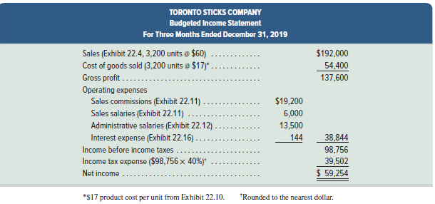
Budgeted Income Statement (continued)
Exhibit 20.17
All information in this budgeted income statement is taken from the component budgets we’ve examined on previous slides.
The predicted amount of income tax expense for the quarter, computed as 40% of the budgeted pretax income, is included.
39
© McGraw-Hill Education
Learning Objective P3: Prepare budgeted financial statements.
Notes:
TSC’s condensed budgeted income statement is shown on this slide. All information in this statement is taken from the component budgets we’ve examined on previous slides. Also, we now can predict the amount of income tax expense for the quarter, computed as 40% of the budgeted pretax income. For TSC, these taxes are not payable until January 31, 2020. Thus, these taxes are not shown on the October–December 2019 cash budget. We can now move on to the budgeted balance sheet.

Slide 40
Budgeted Balance Sheet
The budgeted balance sheet shows predicted amounts for the company’s assets, liabilities, and
equity as of the end of the budget period.
Budgeted
Income
Statement
Budgeted
Balance
Sheet
Completed
Let’s prepare the budgeted balance sheet for Toronto Sticks Company.
40
© McGraw-Hill Education
Learning Objective P3: Prepare budgeted financial statements.
Notes:
Now that we have completed the income statement for the quarter, we can prepare the balance sheet. The final step in preparing the master budget is summarizing the company’s predicted financial position. The budgeted balance sheet shows amounts for the company’s assets, liabilities, and equity as of the end of the budget period.

Slide 41
Budgeted Balance Sheet (continued)
Exhibit 20.18
41
© McGraw-Hill Education
Learning Objective P3: Prepare budgeted financial statements.
Notes:
TSC’s budgeted balance sheet is shown on this slide. It is prepared using information from the other budgets.
a. Ending balance for December from the cash budget (in Exhibit 20.16).
b. 60% of $84,000 sales budgeted for December from the sales budget (in Exhibit 20.4).
c. 247.5 pounds of raw materials in budgeted ending inventory at the budgeted cost of $20 per pound (direct materials budget, Exhibit 20.7).
d. 810 units in budgeted finished goods inventory (Exhibit 20.6) at the budgeted cost of $17 per unit (Exhibit 20.10).
e. September 30 balance of $200,000 from the beginning balance sheet in Exhibit 20.3 plus $25,000 cost of new equipment from the cash budget in Exhibit 20.16.
f. September 30 balance of $36,000 from the beginning balance sheet in Exhibit 20.3 plus $4,500 depreciation expense from the factory overhead budget in Exhibit 20.9.
g. Budgeted cost of materials purchases for December from Exhibit 20.7, to be paid in January.
h. Income tax expense from the budgeted income statement for the fourth quarter in Exhibit 20.17, to be paid in January.
i. Unchanged from the beginning balance sheet in Exhibit 20.3.
j. September 30 balance of $42,870 from the beginning balance sheet in Exhibit 20.3 plus budgeted net income of $59,254 from the budgeted income statement in Exhibit 20.17 minus budgeted cash dividends of $3,000 from the cash budget in Exhibit 20.16.

Slide 42
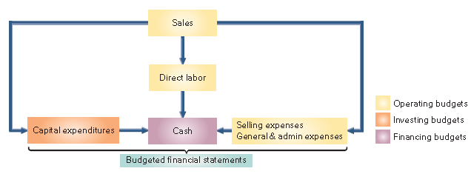
Budgeting for Service Companies
Service providers also use master budgets but typically need fewer operating budgets than manufacturers.
Important budgets for a service companies include:
Exhibit 20.19
42
© McGraw-Hill Education
Learning Objective P3: Prepare budgeted financial statements.
Notes:
Service providers also use master budgets. Since service providers do not manufacture goods and hold no inventory, they typically need fewer operating budgets than manufacturers do. Exhibit 20.19 shows the master budget process for a service provider.
From Exhibit 20.19, service providers do not prepare production or direct materials budgets. In addition, since many services such as accounting, banking, and landscaping are labor-intensive, the direct labor budget is important. If an accounting firm greatly underestimates the hours needed to complete an audit, it might charge too low a price. If the accounting firm greatly overestimates the hours needed, it might bid too high a price (and lose jobs) or incur excessive labor costs. Either way, the firm’s profits can suffer if its direct labor budget is unrealistic.

Slide 43
A1: Analyze expense planning using activity-based budgeting.
Learning Objective
43
© McGraw-Hill Education

Slide 44
Activity-Based Budgeting
Activity-based budgeting is based on activities rather than traditional items such as salaries, supplies, depreciation, and utilities.
Exhibit 20.21
Accounting Department
Comparison of Activity-Based Budget with Traditional Budget
An understanding of the resources required to perform the activities, the costs associated with these resources, and the way resource use changes with changes in activity levels allows management to better assess how expenses will change to accommodate changes in activity levels.
Learning Objective A1: Analyze expense planning using activity-based budgeting.
44
© McGraw-Hill Education
Notes:
Activity-based budgeting is based on expected activities instead of the traditional budget categories that we normally see. Activity-based budgets enable management to more easily plan resource consumption to match related changes in activity.
Traditional budgeting systems list items such as salaries, supplies, equipment, and utilities. With a traditional budget, management often makes across-the-board budget cuts or increases. For example, management might decide that each of the line items in the traditional budget must be cut by 5%. This might not be a good strategic decision.
In contrast, ABB requires management to list activities performed by, say, the accounting department such as auditing, tax reporting, financial reporting, and cost accounting. An understanding of the resources required to perform the activities, the costs associated with these resources, and the way resource use changes with changes in activity levels allows management to better assess how expenses will change to accommodate changes in activity levels.

Slide 45
P4 (Appendix A): Prepare each component of a master budget — for a merchandising company.
Learning Objective
45
© McGraw-Hill Education

Slide 46
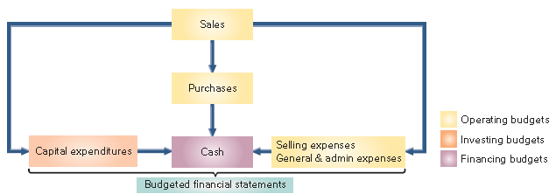
Merchandise Purchases Budget
Unlike a manufacturing company, a merchandiser must prepare a merchandise purchases budget rather than a production budget.
Exhibit 20A.1
Example: Let’s look at the merchandise purchases budget for Hockey Den (HD), a retailer of hockey sticks…
46
Learning Objective P4: Prepare each component of a master budget— for a merchandising company.
© McGraw-Hill Education
Notes:
Unlike a manufacturing company, a merchandiser must prepare a merchandise purchases budget rather than a production budget. In addition, a merchandiser does not prepare direct materials, direct labor, or factory overhead budgets. Let’s look at the merchandise purchases budget for Hockey Den (HD), a retailer of hockey sticks

Slide 47
Merchandise Purchases Budget (Pt. 2)
Example: Hockey Den buys hockey sticks for $60 each and maintains an ending inventory equal to 90 percent of the next month’s budgeted sales. On September 30, 1,010 hockey sticks are on hand.
The general layout for the purchases budget in equation form is:
Exhibit 20A.2
Let’s prepare the purchases budget for Hockey Den.
47
Learning Objective P4: Prepare each component of a master budget— for a merchandising company.
© McGraw-Hill Education
Notes:
A merchandiser usually expresses a merchandise purchases budget in both units and dollars. The slide shows the general layout for this budget in equation form. If this formula is expressed in units and only one product is involved, we can compute the number of dollars of inventory to be purchased for the budget by multiplying the units to be purchased by the cost per unit.
To prepare a merchandise purchases budget, we need the following inputs:
1. Sales budget
2. Budgeted ending inventory
3. Cost per unit
Toronto Sticks Company is an exclusive supplier of hockey sticks to HD, meaning that the companies use the same budgeted sales figures in preparing budgets.
HD predicts unit sales of: October, 1,000; November, 800; December, 1,400; January, 900.
After considering the costs of keeping inventory and inventory shortages, HD set a policy that ending inventory (in units) should equal 90% of next month’s predicted sales. For example, inventory at the end of October should equal 90% of November’s budgeted sales.
Finally, HD expects the per unit purchase cost of $60 to remain unchanged through the budgeting period.

Slide 48
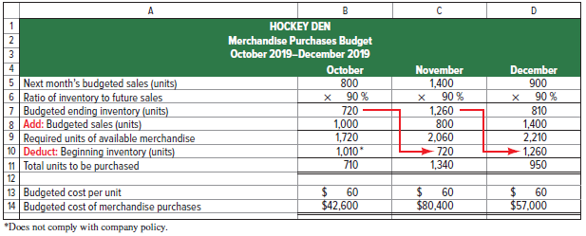
Merchandise Purchases Budget (Pt. 3)
Exhibit 20A.3
Next we add the unit sales for each month to the desired ending inventory to get the total needs for each month.
From the sales budget.
Ending inventory for a month in units, should equal 90% of next month’s unit sales.
48
© McGraw-Hill Education
Learning Objective P4: Prepare each component of a master budget— for a merchandising company.
Notes:
After considering the costs of keeping inventory and inventory shortages, HD set a policy that ending inventory (in units) should equal 90% of next month’s predicted sales. For example, inventory at the end of October should equal 90% of November’s budgeted sales. The unit sales figures are from the sales budget.

Slide 49
Merchandise Purchases Budget (Pt. 4)
Exhibit 20A.3
Required units of available merchandise.
Budgeted cost of the purchases, computed as:
number of units X cost per unit.
Subtract beginning inventory to determine the budgeted number of units to be purchased.
49
© McGraw-Hill Education
Learning Objective P4: Prepare each component of a master budget— for a merchandising company.
Notes:
After we calculate the required units of available merchandise. We then subtract beginning inventory to determine the budgeted number of units to be purchased. The last line is the budgeted cost of the purchases, computed by multiplying the number of units to be purchased by the predicted cost per unit.
HD expects the per unit purchase cost of $60 to remain unchanged through the budgeting period. Here’s our completed merchandise purchases budget. Notice that the ending inventory for each month becomes the beginning inventory for the next month.

Slide 50
End of Chapter 20
50
© McGraw-Hill Education

