Slide 1
Accounting for Merchandising Operations
Chapter 4
Wild & Shaw
Financial and Managerial Accounting
9th Edition
Copyright © 2022 by McGraw-Hill Education. All rights reserved. No reproduction or distribution without the prior written consent of McGraw-Hill Education.

Slide 2
Chapter 4 Learning Objectives
CONCEPTUAL
C1 Describe merchandising activities and cost flows.
ANALYTICAL
A1 Compute and analyze the acid-test ratio and gross margin ratio.
PROCEDURAL
P1 Analyze and record transactions for merchandise purchases using a perpetual system.
P2 Analyze and record transactions for merchandise sales using a perpetual system.
P3 Prepare adjustments and close accounts for a merchandising company.
P4 Define and prepare multiple-step and single-step income statements.
P5 Appendix 4A – Record and compare merchandising transactions using both periodic and perpetual inventory systems.
P6 Appendix 4B – Prepare adjustments for discounts, returns, and allowances per revenue recognition rules.
P7 Appendix 4C – Record and compare merchandising transactions using the gross method and net method.
© McGraw-Hill Education

Slide 3
Describe merchandising activities and cost flows.
Learning Objective C1
© McGraw-Hill Education

Slide 4
Reporting Income for a Service Company
Service companies sell time to earn revenue.
Examples: Accounting firms, law firms,
and plumbing services
Exhibit 4.1
© McGraw-Hill Education
Learning Objective C1: Describe merchandising activities and cost flows.
Notes:
Previous chapters emphasized the accounting activities of service companies.

Slide 5
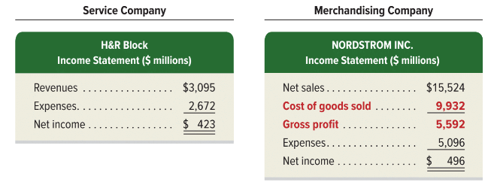
Reporting Income for a Merchandiser
Merchandising companies sell products to earn revenue.
Examples: sporting goods, clothing, and auto parts stores
Exhibit 4.1
Exhibit 4.2
© McGraw-Hill Education
Learning Objective C1: Describe merchandising activities and cost flows.
Notes:
A merchandiser earns net income by buying and selling merchandise. A merchandising company’s activities differ from those of a service company. Merchandise inventory consists of products, also called goods, that a company buys to resell to customers.
The income statements for a service company, H&R Block and for a merchandiser, Nordstrom, are shown in Exhibit 4.2. Nordstrom, a merchandiser, reports cost of goods sold which is not reported by the service company. The merchandiser also reports gross profit or gross margin, which is net sales minus cost of goods sold.

Slide 6
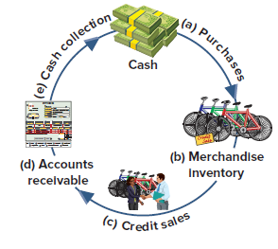
Operating Cycle for a Merchandiser
Begins with the purchase of merchandise and ends with the collection of cash from the sale of merchandise.
Exhibit 4.3
© McGraw-Hill Education
Learning Objective C1: Describe merchandising activities and cost flows.
Notes:
A merchandising company’s operating cycle begins by purchasing merchandise and ends by collecting cash from selling the merchandise. The length of an operating cycle differs across the types of businesses. Department stores often have operating cycles of two to five months. Operating cycles for grocery merchants usually range from two to eight weeks. A grocer has more operating cycles in a year than clothing or electronics retailers.
This slide illustrates an operating cycle for a merchandiser with credit sales.
The cycle moves from:
(a) cash purchases of merchandise to
(b) inventory for sale to
(c) credit sales to
(d) accounts receivable to
(e) receipt of cash.
Companies try to keep their operating cycles short because assets tied up in inventory and receivables are not productive. Cash sales shorten operating cycles.

Slide 7
Inventory Systems: Graphic
Exhibit 4.4
© McGraw-Hill Education
Learning Objective C1: Describe merchandising activities and cost flows.
Notes:
Exhibit 4.4 shows that a company’s merchandise available for sale consists of what it begins with (beginning inventory) and what it purchases (net purchases). The merchandise available is either sold (cost of goods sold) or kept for future sales (ending inventory).

Slide 8
Inventory Systems: Definitions
Perpetual systems
Records cost of goods sold at the time of each sale.
Periodic systems
Records cost of goods sold at the end of the period.
© McGraw-Hill Education
Learning Objective C1: Describe merchandising activities and cost flows.
Notes:
Two alternative inventory accounting systems can be used to collect information about cost of goods sold and cost of inventory: perpetual system or periodic system.
Perpetual inventory system records cost of goods sold at the time of each sale.
Periodic inventory system records cost of goods sold at the end of the period.
Technological advances and competitive pressures have dramatically increased the use of the perpetual system. It gives managers immediate access to information on sales and inventory levels, where they can strategically react to increase profit.

Slide 9
Analyze and record transactions for merchandise purchases using a perpetual system.
Learning Objective P1
© McGraw-Hill Education

Slide 10
Purchases without Cash Discounts
On November 2, Z-Mart purchased $500 of merchandise inventory for cash.
© McGraw-Hill Education
Learning Objective P1: Analyze and record transactions for merchandise purchases using a perpetual system.
Notes:
To illustrate, Z-Mart records a $500 cash purchase of merchandise on November 2 as follows: debit Merchandise Inventory and credit Cash.
If these goods are instead purchased on credit, and no discounts are offered for early payment, Z-Mart would make the same entry except that Accounts Payable would be credited instead of Cash.

Slide 11
Credit Terms
Sellers can grant a cash discount to encourage buyers to pay earlier.
Exhibit 4.5
Learning Objective P1: Analyze and record transactions for merchandise purchases using a perpetual system.
© McGraw-Hill Education
Notes:
The purchase of goods on credit requires a clear statement of expected future payments and dates to avoid misunderstandings. Credit terms for a purchase include the amounts and timing of payments from a buyer to a seller. Credit terms usually reflect an industry’s practices. To illustrate, when sellers require payment within 60 days after the invoice date, the invoice shows credit terms of “n/60,” which stands for net 60 days.
Sellers can grant a cash discount to encourage buyers to pay earlier. A buyer views a cash discount as a purchases discount. A seller views a cash discount as a sales discount. Any cash discounts are described in the credit terms on the invoice. For example, credit terms of “2/10, n/60” mean that full payment is due within a 60-day credit period, but the buyer can deduct 2% of the invoice amount if payment is made within 10 days of the invoice date. This reduced payment applies only for the discount period.

Slide 12
Purchase Discounts
2/10, n/30
Number of Days Discount Is Available
Otherwise, Net (or All) Is Due in 30 Days
Discount Percent
Credit Period
Learning Objective P1: Analyze and record transactions for merchandise purchases using a perpetual system.
© McGraw-Hill Education
Notes:
Purchase discount terms are typically written as this slide shows. This particular discount term would be read as “two ten, net thirty.”
The first number represents the discount percentage.
The second number represents the discount period (in days).
The letter “n” stands for the word net.
The last number represents the entire credit period (in days).
In this case, if the customer pays within 10 days, then a 2% discount may be taken. If not, then all of the amount is due within 30 days.

Slide 13
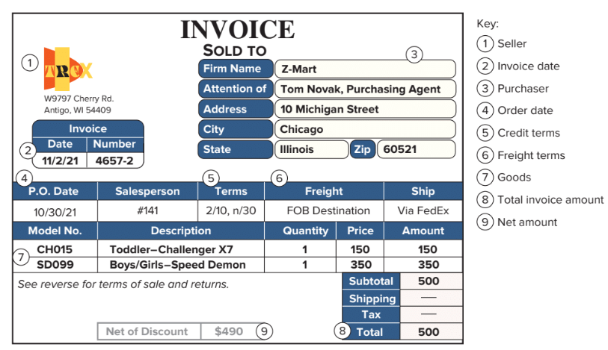
Invoice
Exhibit 4.6
Learning Objective P1: Analyze and record transactions for merchandise purchases using a perpetual system.
© McGraw-Hill Education
Notes:
On November 2, Z-Mart purchases $500 of merchandise on credit with terms 2/10, n/30. The invoice for this purchase is shown in Exhibit 4.6. This is a purchase invoice of Z-Mart (buyer) and the sales invoice for Trex (seller). The amount recorded for merchandise inventory includes its purchase cost, shipping fees, taxes, and any other costs necessary to make it ready for sale.

Slide 14
Purchases with Cash Discounts: Gross Method
On November 2, Z-Mart purchased $500 of merchandise inventory on account; credit terms are 2/10, n/30.
Learning Objective P1: Analyze and record transactions for merchandise purchases using a perpetual system.
© McGraw-Hill Education
Notes:
To illustrate on November 2, Z-Mart purchases $500 of merchandise on credit with terms of 2∕10, n∕30. The amount due, if paid on or before November 12, is $490, computed as $500 − ($500 × 2%)—or alternatively computed as $500 × (100% − 2%). Many buyers take advantage of a purchases discount because of the usually high interest rate implied by not taking it.
If Z-Mart does not pay within the 10-day 2% discount period, it can delay payment by 20 more days, at which point it must pay $500. The gross method for recording purchases enters the full invoice (gross) amount for merchandise. If Z-Mart uses the gross method, it makes the following entry dated as of the invoice date: debit to Merchandise Inventory and credit to Accounts Payable for $500.

Slide 15
Payment within Discount Period: Journal Entry
On November 12, Z-Mart paid the amount due on the purchase of November 2.
Learning Objective P1: Analyze and record transactions for merchandise purchases using a perpetual system.
© McGraw-Hill Education
Notes:
If Z-Mart pays the amount due on (or before) November 12, the entry is a debit for the entire Accounts Payable of $500 which is paid off with a cash payment of $490. The difference of $10 is the purchase discount, which is recorded as a reduction in the cost of the Merchandise Inventory.

Slide 16
Payment within Discount Period: Ledger Accounts
After we post these entries, the accounts involved look like these:
Learning Objective P1: Analyze and record transactions for merchandise purchases using a perpetual system.
© McGraw-Hill Education
Notes:
The Merchandise Inventory account after these entries has the net cost of merchandise purchased, and the Accounts Payable account shows a zero balance.
A buyer’s failure to pay within a discount period can be expensive. If Z-Mart does not pay within the 10-day 2% discount period, it can delay payment by 20 more days. This delay costs Z-Mart $10, computed as 2% × $500. Most buyers take advantage of a purchase discount because of the usually high interest rate implied from not taking it. Also, good cash management means that no invoice is paid until the last day of the discount or credit period.

Slide 17
Payment after Discount Period
On December 2, Z-Mart paid the amount due on the purchase of November 2.
Learning Objective P1: Analyze and record transactions for merchandise purchases using a perpetual system.
© McGraw-Hill Education
Notes:
If the amount is paid after November 12, the discount is lost. If Z-Mart pays the gross amount due on December 2 (the n∕30 due date), it makes the following entry to debit Accounts Payable and credit Cash for $500.

Slide 18
Purchases with Returns and Allowances
Purchase Allowance:
A price reduction to the buyer of defective or unacceptable merchandise.
Purchase Return:
Merchandise returned by the purchaser to the supplier.
Learning Objective P1: Analyze and record transactions for merchandise purchases using a perpetual system.
© McGraw-Hill Education
Notes:
A purchase allowance refers to seller granting a price reduction (allowance) to a buyer of defective or unacceptable merchandise.
Purchase returns are merchandise a buyer purchases but then returns.

Slide 19
Purchases Allowances
On November 5, Z-Mart (buyer) issues a $30 allowance from Trex for defective merchandise.
Learning Objective P1: Analyze and record transactions for merchandise purchases using a perpetual system.
© McGraw-Hill Education
Notes:
Assume that on November 5, Z-Mart (buyer) issues a $30 allowance from Trex for defective merchandise. Z-Mart’s November 5 entry to update its Merchandise Inventory account to reflect the purchase allowance is a debit to Accounts Payable and a credit to Merchandise Inventory for $30. The buyer’s allowance for defective merchandise is subtracted from the buyer’s account payable balance to the seller. When cash is refunded, the Cash account is debited instead of Accounts Payable.

Slide 20
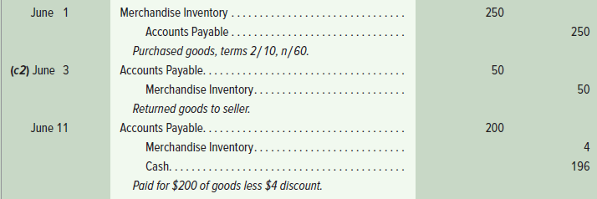
Purchases Returns
Z-Mart purchases $250 of merchandise on June 1 with terms 2/10, n/60. On June 3, Z-Mart returns $50 of goods before paying the invoice. When Z-Mart pays on June 11, it takes the 2% discount only on the $200 remaining balance.
Learning Objective P1: Analyze and record transactions for merchandise purchases using a perpetual system.
© McGraw-Hill Education
Notes:
Returns are recorded at the net costs charged to buyers. To illustrate the accounting for returns, suppose on June 1 that Z-Mart purchases $250 of merchandise with terms 2∕10, n∕60. On June 3, Z-Mart returns $50 of those goods. When Z-Mart pays on June 11, it takes the 2% discount only on the $200 remaining balance ($250 − $50). When goods are returned, a buyer can take a discount on only the remaining balance of the invoice. This means the discount is $4 (computed as $200 × 2%) and the cash payment is $196 ($200 − $4). The entries on this slide reflect this illustration.

Slide 21
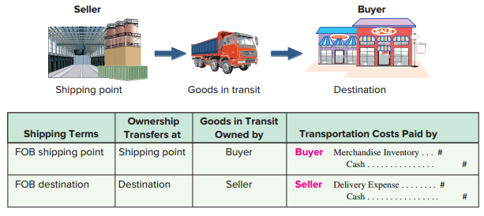
Purchases and Transportation Costs
Exhibit 4.7
Learning Objective P1: Analyze and record transactions for merchandise purchases using a perpetual system.
© McGraw-Hill Education
Notes:
The buyer and seller must agree on who is responsible for paying any freight (shipping) costs and who bears the risk of loss during transit for merchandising transactions. This is the same as asking at what point ownership transfers from the seller to the buyer. The point of transfer is called the FOB (free on board) point.
Exhibit 4.7 identifies two alternative points of transfer. (1) FOB shipping point, means the buyer accepts ownership when the goods depart the seller’s place of business. The buyer pays shipping costs and has the risk of loss in transit. The goods are part of the buyer’s inventory when they are in transit since ownership has transferred to the buyer. (2) FOB destination means ownership of goods transfers to the buyer when the goods arrive at the buyer’s place of business. The seller pays shipping charges and has the risk of loss in transit.

Slide 22
Transportation Costs
Z-Mart purchased merchandise on terms of FOB shipping point. The transportation charge is $75.
Learning Objective P1: Analyze and record transactions for merchandise purchases using a perpetual system.
© McGraw-Hill Education
Notes:
When a buyer is responsible for paying transportation costs (FOB shipping point), the payment is made to a carrier or directly to the seller depending on the agreement. The cost principle requires that any necessary transportation costs of a buyer (often called transportation-in or freight-in) be included as part of the cost of purchased merchandise. Z-Mart’s entry to record a $75 freight charge from UPS for merchandise purchased FOB shipping point is a debit to Merchandise Inventory and a credit to Cash for $75.

Slide 23
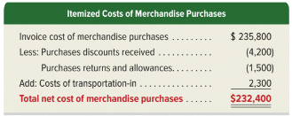
Itemized Costs of Purchases
Exhibit 4.8
Learning Objective P1: Analyze and record transactions for merchandise purchases using a perpetual system.
© McGraw-Hill Education
Notes:
In summary, purchases are recorded as debits to Merchandise Inventory. Purchases discounts, returns, and allowances are credited (decreases) to Merchandise Inventory. Transportation-in is debited (added) to Merchandise Inventory. Z-Mart’s itemized costs of merchandise purchases for the year are shown.

Slide 24
Analyze and record transactions for merchandise sales using a perpetual system.
Learning Objective P2
© McGraw-Hill Education

Slide 25
Gross Profit Computation
Exhibit 4.9
Learning Objective P2: Analyze and record transactions for merchandise sales using a perpetual system.
© McGraw-Hill Education
Notes:
Merchandising companies also must account for sales, sales discounts, sales returns and allowances, and cost of goods sold. Z-Mart reflects these items in its gross profit computation.
This shows that customers paid $314,700 for merchandise that cost Z-Mart $230,400, yielding a markup (gross profit) of $84,300.

Slide 26
Sales of Merchandise
Each sales transaction for a seller of merchandise involves two parts:
Revenue recorded (asset increased) from a customer.
Cost of goods sold incurred (asset decreased) to a customer.
Learning Objective P2: Analyze and record transactions for merchandise sales using a perpetual system.
© McGraw-Hill Education
Notes:
Each sales transaction for a seller of merchandise involves two parts:
Revenue recorded (and asset increased) from a customer; and
Cost of goods sold incurred (and asset decreased) to a customer.

Slide 27
Sales without Cash Discounts
Z-Mart sold $1,000 of merchandise on credit. The merchandise has a cost basis to Z-Mart of $300.
Revenue side journal entry:
Cost side journal entry:
Learning Objective P2: Analyze and record transactions for merchandise sales using a perpetual system.
© McGraw-Hill Education
Notes:
Z-Mart sold $1,000 of merchandise on credit terms n∕60 on November 12. The revenue part of this transaction is recorded as a debit to Accounts Receivable and a credit to Sales.
The cost side of each sale requires that Merchandise Inventory decrease by that item’s cost. The cost of the merchandise Z-Mart sold on November 12 is $300, and the entry to record the cost part of this sales transaction includes a debit to Cost of Goods Sold and a credit to Merchandise Inventory.

Slide 28
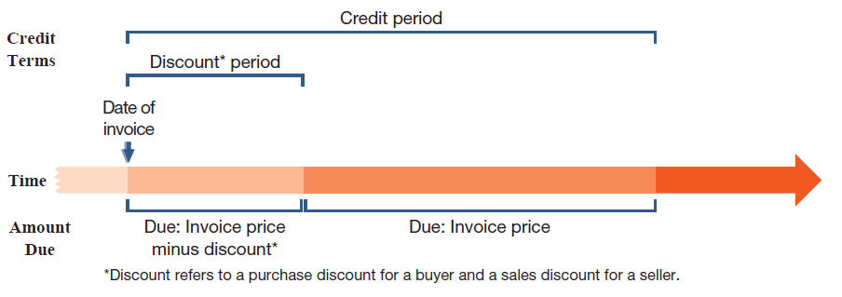
Sales Discounts
Sales discounts on credit sales can benefit a seller by decreasing the delay in receiving cash and reducing future collection efforts.
Exhibit 4.5
Learning Objective P2: Analyze and record transactions for merchandise sales using a perpetual system.
© McGraw-Hill Education
Notes:
Sales discounts on credit sales can benefit a seller through earlier cash receipts and reduced collection efforts. We use the gross method which records sales at the full amount and records sales discounts when taken.
The gross method requires a period-end adjusting entry to estimate future sales discounts. The net method which records sales at the net amount requires an adjusting entry to estimate future discounts loss (see Appendix 4C).
Many sales discounts are favorable to the buyer, and many buyers will take advantage of them. New revenue recognition rules require that sellers report sales net of expected sales discounts.

Slide 29
Sales with Cash Discounts
Z-Mart completes a $1,000 credit sale with terms of 2/10, n/45.
Buyer pays within discount period:
Buyer pays after discount period:
Learning Objective P2: Analyze and record transactions for merchandise sales using a perpetual system.
© McGraw-Hill Education
Notes:
Z-Mart completes a credit sale for $1,000 on November 12 with terms of 2/10, n/45. The entry to record the revenue part of this sale is to debit Accounts Receivable and credit Sales for $1,000. This entry records the receivable and the revenue as if the customer will pay the full amount.
The customer has two options, however. One option is to pay $980 within a 10-day period ending November 22. If the customer pays on (or before) November 22, Z-Mart records the payment as a debit to Cash for $980, debit Sales Discount for $20 (2% × $1,000), and credit Accounts Receivable for the full $1,000.
The second option is to wait 45 days until December 27 and pay the full $1,000. In this case, Z-Mart records that payment as a debit to cash and a credit to accounts receivable for $1,000.
Sales Discounts is a contra revenue account, meaning the Sales Discounts account is deducted from the Sales account when computing net sales. A contra revenue account has a normal debit balance and is paired with sales revenue, which means the Sales Discount account amount is subtracted from the Sales account balance on the Income Statement to calculate Net Sales. Management monitors Sales Discounts to assess the effectiveness and cost of its discount policy.

Slide 30
Sales Returns and Allowances
Sales returns and allowances usually involve dissatisfied customers and the possibility of lost future sales.
Sales returns refer to merchandise that customers return to the seller after a sale.
Sales allowances refer to reductions in the selling price of merchandise sold to customers.
Learning Objective P2: Analyze and record transactions for merchandise sales using a perpetual system.
© McGraw-Hill Education
Notes:
Sales returns refer to merchandise that customers return to the seller after a sale. Many companies allow customers to return merchandise for a full refund, sales return, or keep the merchandise along with a partial refund, sales allowance. Most sellers can reliably estimate returns and allowances (abbreviated R&A).

Slide 31
Sales with Returns and Allowances
Customer returns merchandise which sold for $15 and cost $9.
Returned Goods - Not Defective:
Learning Objective P2: Analyze and record transactions for merchandise sales using a perpetual system.
© McGraw-Hill Education
Notes:
Recall Z-Mart’s sale of merchandise on November 12 for $1,000 that had cost $300. Assume that the customer returns part of the merchandise on December 29, and the returned items sell for $15 and cost $9. The revenue part of this transaction must reflect the decrease in sales from the customer’s return of merchandise by a debit to Sales Returns and Allowances and a credit to Accounts Receivable for $15.
Sales Returns and Allowances, is a contra revenue account to Sales. A contra revenue account has a normal debit balance and is paired with sales revenue, which means the Sales Returns and Allowances account is subtracted from the Sales account on the Income Statement to calculate Net Sales.
If the merchandise returned to Z-Mart is not defective and can be resold, Z-Mart adds these goods to its inventory. The entry to restore the cost of such goods to the Merchandise Inventory account is a debit to Merchandise Inventory and a credit to Cost of Goods Sold for $9.

Slide 32
Buyer Granted Allowance for Defective Goods
Assume that $40 of the merchandise Z-Mart sold on November 12 is defective but the buyer decides to keep it because Z-Mart offers a $10 price reduction.
Learning Objective P2: Analyze and record transactions for merchandise sales using a perpetual system.
© McGraw-Hill Education
Notes:
Assume that $40 of the merchandise Z-Mart previously sold on November 12 is defective but the buyer keeps it because Z-Mart offers a $10 price reduction. Z-Mart records this allowance with a debit to Sales Returns and Allowances and credit to Cash for $10. Note: if the seller had not yet collected cash for the goods sold, the seller could credit the buyer’s Account Receivable.
Sales Returns and Allowances is a contra revenue account, meaning it is deducted from sales when computing net sales and has a normal debit balance. The seller usually prepares a credit memorandum to confirm a buyer’s return or allowance. A seller’s credit memorandum informs a buyer a credit has been made to the buyer’s accounts receivable account in the seller’s records. In summary, net sales equals sales minus sales discounts and minus sales returns and allowances. This means net sales is the amount customers paid for goods kept.
This entry changes if the goods returned are defective. In this case, the returned inventory is recorded at its estimated value, not its cost. If the merchandise (costing $9) returned to Z-Mart are defective and are worth $2, the entry is: debit Merchandise Inventory for $2, debit Loss from Defective Merchandise for $7, and credit Cost of Goods Sold for $9.

Slide 33
Prepare adjustments and close accounts for a merchandising company.
Learning Objective P3
© McGraw-Hill Education

Slide 34
Merchandising Cost Flow in the Accounting Cycle
Exhibit 4.10
Learning Objective P3: Prepare adjustments and close accounts for a merchandising company.
© McGraw-Hill Education
Notes:
This slide shows the flow of merchandising costs during a period and where these costs are reported at period-end. Specifically, beginning inventory plus the net cost of purchases is the merchandise available for sale. As inventory is sold, its cost is recorded in cost of goods sold on the income statement; what remains is ending inventory on the balance sheet. A period’s ending inventory is the next period’s beginning inventory.

Slide 35
Adjusting Entries for Merchandisers
Shrinkage: adjustment to reflect loss of merchandise:
Sales Discounts and Returns and Allowances:
New revenue recognition rules require reporting of sales at net amount expected. Adjusting entries required for:
Expected sales discounts
Expected returns and allowances (revenue side)
Expected returns and allowances (cost side)
Learning Objective P3: Prepare adjustments and close accounts for a merchandising company.
© McGraw-Hill Education
Notes:
A merchandiser using a perpetual inventory system makes an adjustment to Merchandise Inventory for any loss of merchandise, including theft and deterioration. Shrinkage is the loss of inventory, and it is computed by comparing a physical count of inventory with recorded amounts.
To illustrate, Z-Mart’s Merchandise Inventory account at the end of the year has a balance of $21,250, but a physical count reveals that only $21,000 of inventory exists. The adjusting entry to record this $250 shrinkage is a debit to Cost of Goods Sold and a credit to Merchandise Inventory for $250.
Sales are to be reported at the net amount expected, which follows new revenue recognition rules. This means that period-end adjusting entries are commonly made for:
Expected sales discounts.
Expected returns and allowances (revenue side).
Expected returns and allowances (cost side).

Slide 36
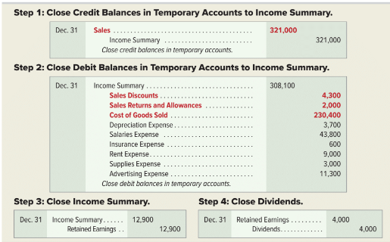
Closing Entries for Merchandisers
Exhibit 4.11
Learning Objective P3: Prepare adjustments and close accounts for a merchandising company.
© McGraw-Hill Education
Notes:
Closing entries are similar for service companies and merchandising companies using a perpetual system. The difference is that we must close some new temporary accounts that arise from merchandising activities. Z-Mart has several temporary accounts unique to merchandisers: Sales (of goods), Sales Discounts, Sales Returns and Allowances, and Cost of Goods Sold. These differences are set in red boldface in the closing entries on this slide.

Slide 37
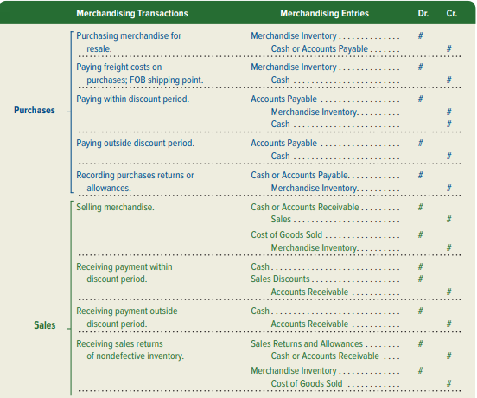
Merchandising Entries Summary
Exhibit 4.12
Learning Objective P3: Prepare adjustments and close accounts for a merchandising company.

Slide 38
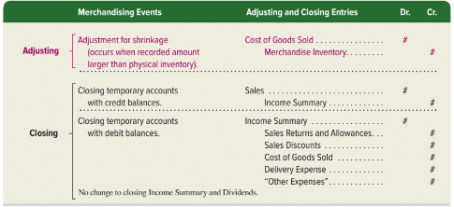
Adjusting and Closing: Merchandising Entries
Exhibit 4.12
Learning Objective P3: Prepare adjustments and close accounts for a merchandising company.

Slide 39
Define and prepare multiple-step and single-step income statements.
Learning Objective P4
© McGraw-Hill Education

Slide 40
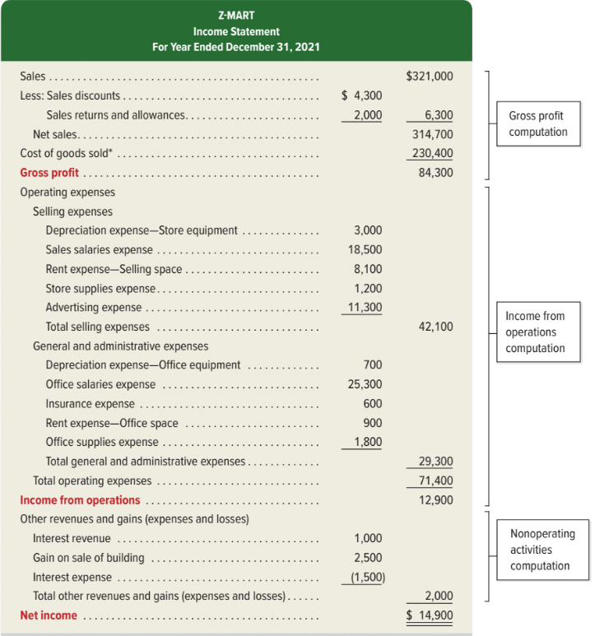
Multiple-Step Income Statement
Exhibit 4.13
Learning Objective P4: Define and prepare multiple-step and single-step income statements.
© McGraw-Hill Education
Notes:
Companies are not required to use any one presentation format for financial statements.
A multiple-step income statement details computations of net sales and expenses and reports subtotals for various items. Exhibit 4.13 shows a multiple-step income statement. The statement has three main parts: (1) gross profit, which is net sales minus cost of goods sold, (2) income from operations, which is gross profit minus operating expenses, and (3) net income, which is income from operations plus or minus nonoperating items.
Operating expenses are separated into two sections. Selling expenses are costs to market and distribute products and services such as advertising merchandise, store supplies and rent, and delivering goods to customers. General and administrative expenses are costs to administer a company’s overall operations such as office salaries, office equipment, and office supplies.
Expenses are allocated between these two sections when they contribute to more than one. Z-Mart allocates rent expense of $9,000 from its store building between two sections: $8,100 to selling expense and $900 to general and administrative expense.
Nonoperating activities consist of other expenses, revenues, losses, and gains that are unrelated to a company’s operations. Other revenues and gains commonly include interest revenue, dividend revenue, rent revenue, and gains from asset disposals. Other expenses and losses commonly include interest expense, losses from asset disposals, and casualty losses. When a company has no reportable nonoperating activities, its income from operations is simply labeled net income.

Slide 41
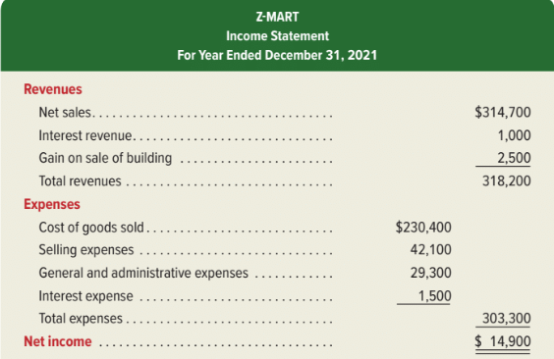
Single-Step Income Statement
Exhibit 4.14
Learning Objective P4: Define and prepare multiple-step and single-step income statements.
© McGraw-Hill Education
Notes:
A single-step income statement is shown in Exhibit 4.14. It lists cost of goods sold as another expense and shows only one subtotal for total expenses. Expenses are grouped into few, if any, categories. Many companies use formats that combine features of both the single- and multiple-step statements. Provided that income statement items are shown sensibly, management can choose the format.
As you can see, net income is the same whether the multi-step or the single-step is used. The only difference is in the amount of detail that is provided on the income statement.

Slide 42
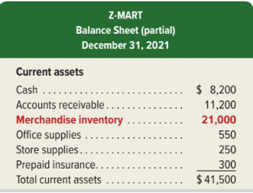
Classified Balance Sheet
Exhibit 4.15
Highly Liquid
Less Liquid
Learning Objective P4: Define and prepare multiple-step and single-step income statements.
© McGraw-Hill Education
Notes:
The classified balance sheet reports merchandise inventory as a current asset, usually after accounts receivable according to how quickly they can be converted to cash. Inventory is converted less quickly to cash than accounts receivable because inventory must first be sold before cash can be received.
This slide shows the current asset section of Z-Mart’s classified balance sheet.

Slide 43
Compute and analyze the acid-test ratio and gross margin ratio.
Learning Objective A1
© McGraw-Hill Education

Slide 44
Acid-Test Ratio
Acid-test
ratio
Quick assets
Current liabilities
=
Exhibit 4.16
Acid-test
ratio
Cash + Short-term investments + Receivables
Current liabilities
=
A common rule of thumb is the acid-test ratio should have a value of at least 1.0. If a company has a ratio of at least 1.0, they are unlikely to face liquidity problems in the near future.
Learning Objective A1: Compute and analyze the acid-test ratio and gross margin ratio.
© McGraw-Hill Education
Notes:
One measure of a merchandiser’s ability to pay its current liabilities (referred to as its liquidity) is the acid-test ratio. It differs from the current ratio by excluding less liquid current assets such as inventory and prepaid expenses that take longer to be converted to cash. The acid-test ratio, also called quick ratio, is defined as quick assets (cash, short-term investments, and current receivables) divided by current liabilities.

Slide 45
Acid-Test Ratio Nike
Acid-test
ratio
Cash + Short-term investments + Current Receivables
Current liabilities
=
Exhibit 4.17
© McGraw-Hill Education
Learning Objective A1: Compute and analyze the acid-test ratio and gross margin ratio.
Notes:
Nike’s acid-test ratio implies that it has enough quick assets to cover current liabilities. Its acid-test ratio is on par with peers. Nike’s current ratio suggests it has more than enough current assets to cover current liabilities. Analysts might argue that Nike could invest some current assets in more productive assets.

Slide 46
Gross Margin Ratio
Exhibit 4.18
Gross
margin
ratio
Net sales - Cost of goods sold
Net sales
=
Percentage of dollar sales available to cover expenses and provide a profit.
Exhibit 4.19
© McGraw-Hill Education
Learning Objective A1: Compute and analyze the acid-test ratio and gross margin ratio.
Notes:
Without enough gross profit, a merchandiser can fail. The gross margin ratio helps understand this link. It differs from the profit margin ratio in that it excludes all costs except cost of goods sold. The gross margin ratio (also called gross profit ratio) is defined as gross margin (net sales minus cost of goods sold) divided by net sales (Exhibit 4.18).
Exhibit 4.19 shows the gross margin ratio of Nike for three recent years. For Nike, each $1 of sales in the current year yielded about 44.7¢ in gross margin to cover all expenses and still produce a net income. This 44.7¢ margin is up from 43.8¢ in the prior year. This increase is favorable.

Slide 47
Appendix 4A Record and compare merchandising transactions using both periodic and perpetual inventory systems.
Learning Objective P5
© McGraw-Hill Education

Slide 48
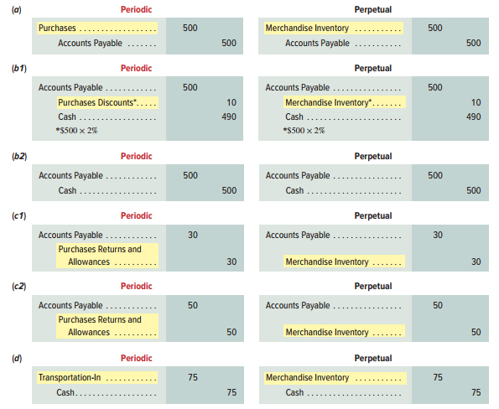
Periodic Inventory System - Purchases
Periodic inventory system updates inventory only at the end of a period to reflect the quantity and cost of goods available and goods sold.
© McGraw-Hill Education
Learning Objective P5: Record and compare merchandising transactions using both periodic and perpetual inventory systems.
Notes:
A periodic inventory system requires updating the inventory account only at the end of a period. During the period, the Merchandise Inventory balance remains unchanged. During the period the cost of merchandise is recorded in a temporary Purchases account. When a company sells merchandise it records revenue but not the cost of the goods sold. At the end of the period, it takes a physical count of inventory. The cost of goods sold is then computed as cost of merchandise available for sale minus ending inventory.
Under a periodic system, purchases, purchase returns and allowances, purchase discounts, and transportation-in transactions are recorded in separate temporary accounts. At period-end, each of these temporary accounts is closed and the Merchandise Inventory account is updated. During the period, the Merchandise Inventory balance remains unchanged.
Journal entries under the periodic inventory system are shown for the most common transactions (codes a through d link these transactions to those in the chapter, and we drop explanations for simplicity). For comparison, perpetual system journal entries are shown to the right of each periodic entry.
The periodic system uses a temporary Purchases account that accumulates the cost of all purchase transactions during each period. Z-Mart’s November 2 entry to record the purchase of merchandise for $500 on credit with terms of 2/10, n/30 is illustrated in entry a.
The periodic system uses a temporary Purchase Discounts account that accumulates discounts taken on purchase transactions during the period.
If Z-Mart pays the supplier for the previous purchase in (a) within the discount period, the required payment is $490 ($500 × 98%) and is recorded as illustrated in entry b1.
If payment in (a) is delayed until after the discount period expires, the entry is to debit Accounts Payable and credit Cash for $50 each as shown in entry b2.
Z-Mart returned merchandise purchased on November 2 because of defects. In the periodic system, the temporary Purchase Returns and Allowances account accumulates the cost of all returns and allowances during a period. The recorded cost (including discounts) of the defective merchandise is $30, and Z-Mart records the return with entry c1.
Z-Mart returns $50 of merchandise within the discount period with the entry shown in c2.
Z-Mart paid a $75 freight charge to transport merchandise to its store. In the periodic system, this cost is charged to a temporary Transportation-In account as illustrated in entry d.

Slide 49
Periodic Inventory System - Sales
Periodic inventory system updates inventory only at the end of a period to reflect the quantity and cost of goods available and goods sold.
© McGraw-Hill Education
Learning Objective P5: Record and compare merchandising transactions using both periodic and perpetual inventory systems.
Notes:
Both the periodic and perpetual systems record sales entries similarly, using the gross method. The same holds for entries related to payment of receivables from sales both within and after the discount period. However, under the periodic system, the cost of goods sold is not recorded at the time of each sale (whereas it is under the perpetual system). The entry to record $1,000 in credit sales (costing $300) is a debit to Accounts Receivable and a credit to Sales. Under the periodic system, the cost of goods sold is not recorded at the time of each sale.
A customer returned part of the merchandise, where the returned items sell for $15 and cost $9. Z-Mart restores the merchandise to inventory and records the November 6 return as illustrated in entry e1 and e2.
A customer received an allowance in transaction f of $10 cash; only the revenue side is impacted as no inventory was returned and cost stays the same. The entry is identical under the periodic and perpetual systems. The seller records this allowance as shown in entry f.

Slide 50
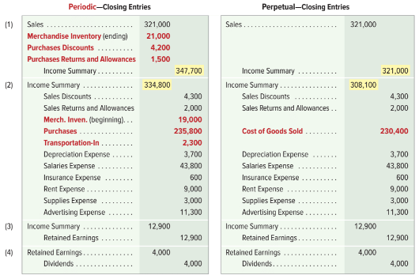
Periodic Inventory System – Adjusting and Closing Entries
Exhibit 4A.1
© McGraw-Hill Education
Learning Objective P5: Record and compare merchandising transactions using both periodic and perpetual inventory systems.
Notes:
Adjusting entries for the two systems are in Exhibit 4A.1. The $250 shrinkage is only recorded under the perpetual system—see entry z in Exhibit 4A.1. Shrinkage in cost of goods is unknown using a periodic system because inventory is not continually updated and therefore cannot be compared to the physical count.
Periodic and perpetual inventory systems have slight differences in closing entries. The period-end Merchandise Inventory balance (unadjusted) is $19,000 under the periodic system. Because the periodic system does not update the Merchandise Inventory balance during the period, the $19,000 amount is the beginning inventory. A physical count of inventory taken at the end of the period reveals $21,000 of merchandise available. Closing entries for the two systems follow. Recording the periodic inventory balance is a two-step process. The ending inventory balance of $21,000 is entered by debiting the inventory account in the first closing entry. The beginning inventory balance of $19,000 is deleted by crediting the inventory account in the second closing entry.

Slide 51
Appendix 4B Prepare adjustments for discounts, returns, and allowances per revenue recognition rules.
Learning Objective P6
© McGraw-Hill Education

Slide 52
Expected Sales Discounts – Adjusting Entry
Adjusting entries required to estimate sales discounts for current-period’s sales expected to be taken in future periods.
Z-Mart has unadjusted Accounts Receivable of $11,250 and Allowance for Sales Discounts of $0.
$2,500 of receivables are within 2% discount period.
Expect buyers to take $50 in future period discounts ($2,500 × 2%).
© McGraw-Hill Education
Learning Objective P6: Prepare adjustments for discounts, returns, and allowances per revenue recognition rules.
Notes:
New revenue recognition rules require sales to be reported at the amount expected to be received. This means that a period-end adjusting entry is made to estimate sales discounts for current-period’s sales that are expected to be taken in future periods.
Assume Z-Mart has the following unadjusted balances: Accounts Receivable, $11,250; and Allowance for Sales Discounts, $0. Of the $11,250 of receivables, $2,500 of them are within the 2% discount period, and we expect buyers to take $50 in future-period discounts (computed as $2,500 × 2%) arising from this period’s sales. The adjusting entry for the $50 update to the allowance for sales discounts is shown in entry g.
Allowance for Sales Discounts is a contra asset account and is reported on the balance sheet as a reduction to the Accounts Receivable asset account. The Allowance for Sales Discounts account has a normal credit balance because it reduces Accounts Receivable, which has a normal debit balance.

Slide 53
Expected Sales Discounts -Financial Statements
Expected Sales Discounts:
Adjusting entries result in Accounts receivable and Sales being reported at their net expected amounts:
Balance Sheet—partial
Accounts receivable | $11,250
Less allowance for sales discounts | 50
Accounts receivable, net | $11,200
Income Statement—partial
Sales | $321,000
Less sales discounts, returns & allowances | 6,300
Net sales | $314,700
© McGraw-Hill Education
Learning Objective P6: Prepare adjustments for discounts, returns, and allowances per revenue recognition rules.
Notes:
The adjusting entry for sales discounts results in both accounts receivable and sales being reported at their net expected amounts.

Slide 54
Expected Returns & Allowances: Revenue Side Adjusting Entries
Seller sets up a Sales Refund Payable, current liability reflecting amount expected to be refunded to customers.
Company estimates future sales refunds to be $1,200.
Unadjusted balance in Sales Refund Payable is $300 credit.
Adjusting entry for $900 update to Sales Refund Payable.
© McGraw-Hill Education
Learning Objective P6: Prepare adjustments for discounts, returns, and allowances per revenue recognition rules.
Notes:
To avoid overstatement of sales and cost of sales, sellers estimate sales returns and allowances in the period of the sale. Estimating returns and allowances requires companies to maintain the following two balance sheet accounts that are set up with adjusting entries: inventory returns estimated, a current asset, and sales refund payable, a current liability.
The Sales Refund Payable account is updated only during the adjusting entry process. Its balance remains unchanged during the period when actual returns and allowances are recorded.

Slide 55
Expected Returns & Allowances: Cost Side Adjusting Entries
Seller sets up an Inventory Returns Estimated account, current asset reflecting the inventory estimated to be returned.
Company estimates future inventory returns to be $500.
Unadjusted balance in Inventory Returns Estimated is $200 debit.
Adjusting entry for $300 update to Inventory Returns Est.
© McGraw-Hill Education
Learning Objective P6: Prepare adjustments for discounts, returns, and allowances per revenue recognition rules.
Notes:
On the cost side, the expected returns and allowances implies that some inventory is expected to be returned, which means that cost of goods sold recorded at the time of sale is overstated due to expected returns. A seller sets up an Inventory Returns Estimated account, which is a current asset reflecting the inventory estimated to be returned.
Extending the example above, assume that the company estimates future inventory returns to be $500 (which is the cost side of the $1,200 expected returns and allowances above). Assume also that the (beginning) unadjusted balance in Inventory Returns Estimated is a $200 debit. The adjusting entry for the $300 update to expected returns is shown in entry h2.
The Inventory Returns Estimated account is updated only during the adjusting entry process. Its balance remains unchanged during the period when actual returns and allowances are recorded.

Slide 56
Appendix 4C Record and compare merchandising transactions using the gross method and net method.
Learning Objective P7
© McGraw-Hill Education

Slide 57
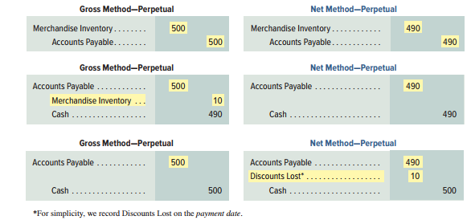
Perpetual System – Net vs. Gross Method: Purchases
Net method records invoice at its amount net of any discounts.
© McGraw-Hill Education
Learning Objective P7: Record and compare merchandising transactions using the gross method and net method.
Notes:
The net method records an invoice at its net amount (net of any cash discount). The gross method initially records an invoice at its gross (full amount). Key differences between these methods are highlighted. When invoices are recorded at net amounts, any cash discounts are deducted from the balance of the Merchandise Inventory account when initially recorded. This assumes that all cash discounts will be taken. If any discounts are later lost, they are recorded in a Discounts Lost expense account reported on the income statement.
A company purchases merchandise on November 2 at a $500 invoice price ($490 net) with terms of 2∕10, n∕30. Its November 2 entries under the gross and net methods are shown in the first entries.
If the invoice is paid on (or before) November 12 within the discount period, it records this as shown in the second entries.
If, instead, the invoice is not paid within the discount period, but is later paid on December 2 (the n∕30 due date), after the discount period, it records the third entries shown.

Slide 58
Perpetual System – Net vs. Gross Method: Sales
Net method records invoice at its amount net of any discounts.
© McGraw-Hill Education
Learning Objective P7: Record and compare merchandising transactions using the gross method and net method.
Notes:
A company sells merchandise on November 2 at a $500 invoice price ($490 net) with terms of 2∕10, n∕30. The goods cost $200. Its November 2 entries under the gross and net methods are shown in the first two entries.
If cash is received on (or before) November 12 within the discount period, the company will record the third entries shown.
If, instead, cash is not received within the discount period, but it is later received on December 2 (the n∕30 due date), after the discount period, it records the last entries shown.
SALES—Periodic For the above sales transactions, the perpetual and periodic entries are identical except that under the periodic system the cost-side entries are not made at the time of each sale nor for any subsequent returns. Instead, the cost of goods sold is computed at period-end based on a physical count of inventory. This entry is illustrated in Exhibit 4A.1.

Slide 59
End of Chapter 4
© McGraw-Hill Education

