Slide 1
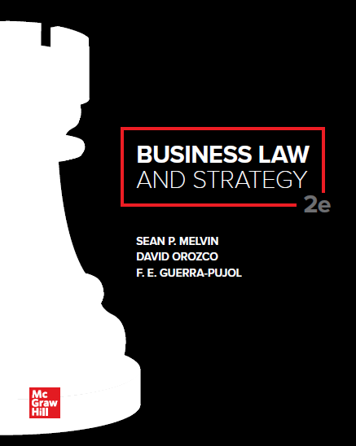

Slide 2
Chapter 2
Business, Societal, and Ethical Contexts
of Law

Slide 3
Chapter Learning Objectives
Analyze how business organizations, law, and ethics are related.
Identify the three main ethical decision-making regimes.
Understand how corporate social responsibility (C S R) supports ethical decision making and identify the three views of CSR.
Identify how values management supports ethical decision making.
Apply an ethical decision-making framework.
Identify the unique attributes of nonprofit and benefit corporations.

Slide 4
The Relationships Between Business Organizations, Law, and Ethics
ETHICS = set of moral principles or core values for deciding between right and wrong.
Ethics applies to everyday decisions, including both personal and business decisions.
Ethical dilemmas include receiving too much money back when you pay for something in a store and the temptation to call in sick when you just want the day off.

Slide 5
Justice
JUSTICE = maintaining or administering a system to achieve fairness.
Three elements of justice as an arbiter of legal disputes:
Justice should apply equally to all; rich or poor; famous or not.
Justice has an enforcement mechanism to impose penalties and ensure compliance and fidelity to the law.
Justice equally considers opposing sides and weighs the merits of the competing arguments carefully and with due consideration.

Slide 6
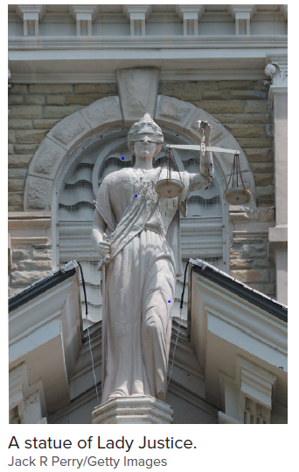
Lady Justice

Slide 7
Law
LAW = code of behaviors to define justice, fairness, right and wrongs.
In an idea system, law will always achieve justice. In practice, law and ethics do not perfectly overlap.
Some things are ethically but not legally required. For example, most people agree that a person is ethically required to help in some way a drowning baby. However, there is no legal duty to do so.
Society maintains balance because many people act ethically beyond the legally required minimum.

Slide 8
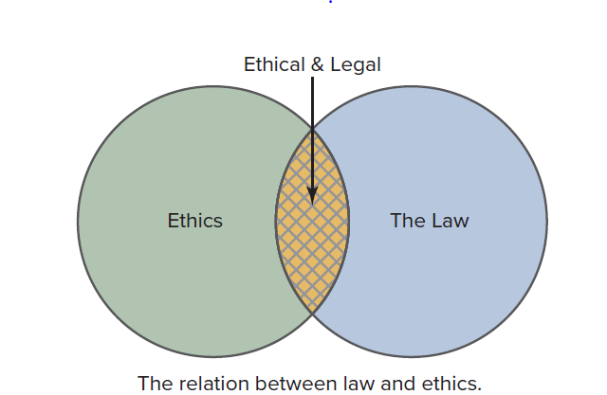
The Relationship Between Law and Ethics

Slide 9
Ethical Decision-Making Regimes: Principles-Based Approach
The principles-based approach encompasses ethical theories based on general or universal moral principles
RELIGION. Ethical decisions are made according to a set of established religious tenets or codes, such as the Koran or the Old Testament.
VIRTUE. Conduct is evaluated based on whether it promotes good moral character.
NATURAL LAW. Uses reason to deduce universal and timeless rules of moral behavior.

Slide 10
Categorical Imperative
Articulated by Immanuel Kant, one should act morally because it is the right thing to do, without any ulterior motive.
Rights imply duties and the duty to respect the rights of others is paramount in acting morally.
Universalization test: “What if everybody took that same action?"

Slide 11
Consequences-Based Approach
Ethical course of action is the one that provides the greatest good (happiness) for the greatest number of people and has the least harmful consequences for the majority of the community.
Utilitarianism is most significant consequences-based philosophical stream.
Business owners and managers who employ a consequences-based approach seek to produce the greatest balance of good over harm for all who are affected, including owners, employees, customers, investors, and the community at large.

Slide 12
Contract-Based Approach
Harvard philosopher John Rawls developed a contract-based theory of ethics.
Rawls imagines a world in which people must negotiate their own ethical rules and principles for themselves without knowing what their class position, social status, assets, intelligence, strength or similar trait would be after the negotiation.
Rawls argues that individuals in this situation would negotiate for a strategy that maximizes the prospect of the least well-off.

Slide 13
Case 2.1: Grimshaw v. Ford Motor Company
HELD: Punitive damages may be awarded for malicious conduct. Malice does not require showing of evil intent. A conscious disregard of the probability that an actor’s conduct will result in injury to others is sufficient to constitute malice.

Slide 14
CORPORATE SOCIAL RESPONSIBILTY (C S R)
NARROW VIEW “Greed is Good” (Maximizing Profits Theory).
Emphasizes the corporation’s ethical duties to its shareholders.
MODERATE VIEW “Just Follow the Law.”
Business’s ethical responsibility is to comply with the law.
BROAD VIEW “Good Corporate Citizenship and a Social License to Operate” “Triple Bottom Line”
Achieve commercial success in ways that honor ethical values and respect people communities and the natural environment.

Slide 15
Case 2.2: Brooks Brothers Group, Inc. v. Bubbles by Brooks, LLC
HELD: The Trademark Trial and Appeal Board dismissed the case before reaching a decision. Counsel for Bubbles by Brooks, LLC had filed a lengthy motion to the court requesting a ruling in Amy’s favor.

Slide 16
C S R and LITIGATION: Walmart Example
Guidelines for corporate legal counsel in litigation:
Honor the spirit, intent and requirements of law.
Conduct themselves with dignity and integrity to justice.
Adhere to rules of conduct on pursuing truth.
Make reasonable responses to discovery requests.
Make good faith efforts to respond to discovery.
Agree to reasonable requests for extensions of time.
Confine discovery to only what is truly necessary for the case.

Slide 17
Challenges and Realities in Business Ethics
Challenge | Reality
Business Ethics is unnecessary because it asserts the obvious: Act ethically. | The value of a code of ethics to an organization is its priority and focus with respect to certain ethical values in the company.
Complying with the law is an organization’s sole guide for ethical conduct. | Unethical acts may operate within the limits of the law. Illegal conduct sometimes has its genesis in unethical behavior that has gone unnoticed.
Ethics can’t be managed. | Management inherently incorporates a value system. Strategic priorities can be very strong influences on ethical decision making.
Ethics is about philosophy and has little to do with the day-to-day realities of running a business. | Business ethics is a management discipline with a programmatic approach that includes several practical tools.
Business ethics cannot be taught. It is religion, not management. | Managing values and conflict among them is the primary objective of business ethics.

Slide 18
Contents of a Comprehensive Code of Ethics and Conduct
Topics | Specific Areas of Discussion
The workplace. | Equal opportunity and diversity; anti-harassment; health and safety; non-retaliation for whistleblowers.
Gifts, favors, and conflicts of interest. | Receiving gifts or favors; insider trading; working outside the company.
Use of company assets and data safeguarding. | Personal data privacy; use of company assets; protecting company information.
Product quality, safety, and environmental matters. | Product quality and safety; protecting the environment.
Competition and antitrust law. | Relations with competitors; relations with suppliers, dealers, and other customers.
International business practices. | Export controls and prohibited transactions; foreign corrupt practices; money laundering.

Slide 19
Common Traits of Effective Value Management
Management establishes a clear vision of ethics and integrity in the organization.
Management’s vision of ethics and integrity is implemented at all levels of the decision making process within the organization.
The reward systems, policies, and practices of the organization are aligned with management’s vision of ethics and integrity.
Individual responsibility and accountability.

Slide 20
ETHICAL DECISION MAKING
Define the ethical dilemma.
Identify impact.
Apply standards.
Develop choices and discuss.
Implement decision and monitor results.

Slide 21
Case 2.3: U.S. House of Representatives Staff Report on MF Global Prepared for the Subcommittee on Oversight and Investigations—Committee on Financial Services
HELD: John Corzine led the company to make risky investments in the sovereign debt of struggling European countries. Due to mismanagement and faulty internal risk controls, $1.6 billion in customer accounts went missing during the process. The report severely criticized Corzine’s actions and suggested that they may have violated the company’s internal controls and various state and federal laws.

Slide 22
Community-Based Nonprofit and Benefit Corporations
Alternative form of organization; allows for social ends outcomes without profit motive.
Community-based nonprofit is a tax-exempt entity created to serve the community. Surplus earnings are reinvested in activities to achieve the organization’s social mission.
Benefit corporation is a hybrid entity. Operates with directors and officers similar to a traditional for-profit corporation. However, the officers and directors of a benefit corporation are required to consider the impact their decisions have on shareholders, society, and the environment.

Slide 23
Accessibility Content: Text Alternatives for Images

Slide 24
Lady Justice—Text Alternative
This picture shows Lady Justice, a statue in front of many courthouses. Lady Justice is shown with a scale of justice in one hand and a sword in the other hand. She is also blindfolded.

Slide 25
The Relationship Between Law and Ethics—Text Alternative
The picture shows a Venn diagram with Ethics as one circle and the Law as another circle, with some overlap between the two circles in the middle. The Venn Diagram is captioned “The relation between law and ethics.”

