Slide 1
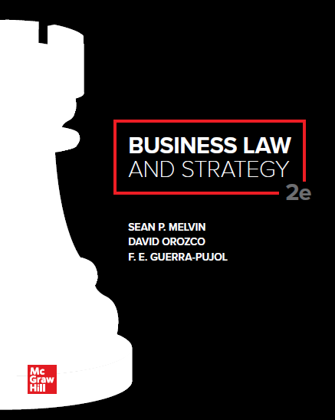

Slide 2
Chapter 5
Resolving Disputes: Litigation and Alternative Dispute Resolution

Slide 3
Chapter Learning Objectives
Identify the various types of business litigation and explain how dispute resolution is used as a part of business planning and strategy.
Name the stages of litigation and identify the characteristics and processes of each stage.
Identify the ways in which dispute resolution can be used in business planning.
List the methods of alternative dispute resolution (A D R) and describe potential advantages or drawbacks of using A D R.

Slide 4
Civil Litigation
Dispute resolution processes of civil (noncriminal) cases in public courts of law.
Many types of business litigation: contract and employment disputes; lawsuits relating to negligence, bankruptcy, and intellectual property issues.

Slide 5
Class Action Lawsuits
Group of people with same or similar injuries sue for damages caused by the same defendant.
Usually involve
Illegal conduct such as discriminatory employment practices.
Involvement in an unlawful transaction such as consumer fraud.
Sale of a defective product such as a pharmaceutical drug or medical device.

Slide 6
Civil Litigation: Decision Options
Action | Potential Benefit(s) | Potential Costs | Threats
Lawsuit | Court-ordered resolution | Significant expenditures: legal fees, travel and expert fees, Possibly lots of employee time, appellate costs. | Loss at trial or upon appeal. Legal fees may be higher than damages awarded. Permanent damage to business relationship.
Nonjudicial dispute resolution (Arbitration, mediation, hybrid) | Enforceable resolution | Moderate range for legal fees, Some employee time, no appellate costs | Loss that is not appealable, potential damage to business relationship
Informal settlement | Parties agree not to sue. Potential to preserve business relationship. | Low range of legal fees. Some employee time. | Extended settlement negotiations.
Revise contract, continue relationship | Transaction is completed, business relationship is preserved. | Low range of legal fees. Some employee time. | Potential litigation in the future and potential future contract disputes.

Slide 7
Case 5.1: In re Subway Sandwich Marketing and Sales Practices Litigation, T. Frank, Objector
HELD: The U.S. Court of Appeals for the Seventh Circuit reversed the decision of the trial court and ruled that the procedures to ensure that footlong sandwiches were at least 12 inches long, which Subway was required to adopt under the settlement, did not benefit the class in a meaningful way so the settlement should not have been approved. The court held that the settlement only enriched counsel because of the approval of legal fees.

Slide 8
Stages of Litigation
Prelawsuit. One party makes an informal demand (often an attorney is involved). Often, this demand is followed by informal discussions.
Determine Standing to Sue. To maintain a lawsuit against another party, a plaintiff must have standing, plaintiff must have suffered an injury in fact that is direct, concrete, and individualized and for which legal redress is available.
Pleadings Stage.
Complaint and Summons. The plaintiff files a complaint to initiate the lawsuit. The complaint is accompanied by a summons notifying he defendant that they are named in a lawsuit and must file an answer by a certain date.
Answer. The answer is the defendant’s response to each paragraph of a complaint.
Counterclaim. A counterclaim arises when a defendant has a claim for damages caused by the plaintiff arising out of the same set of facts.
Cross-Claim. A cross-claim is a claim by a defendant that a third party is partially or fully liable for the plaintiff’s damages.

Slide 9
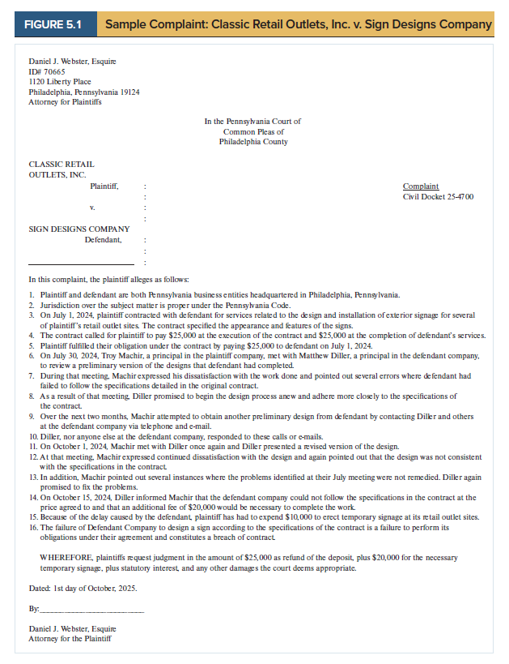
Sample Complaint

Slide 10
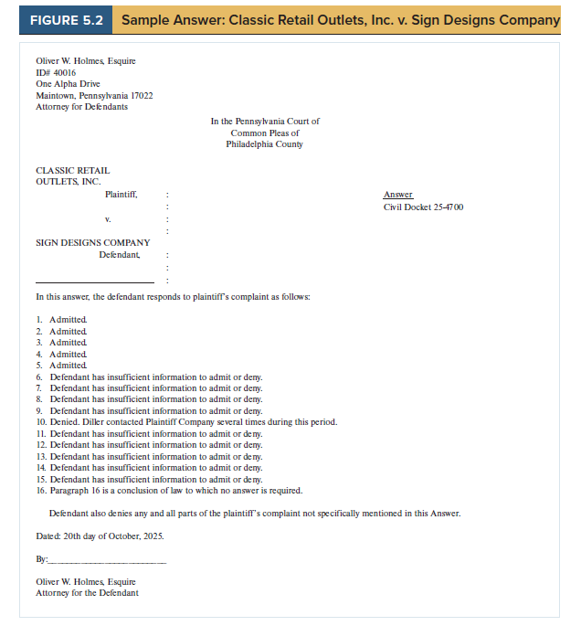
Sample Answer

Slide 11
Motions
Stage of Litigation | Motion | Request
Pretrial | To dismiss | To dismiss a case because of a procedural defect such as a court’s lack of jurisdiction or failure to state a recognized legal theory in the complaint.
Pretrial | For summary judgment | To enter judgment in the requesting party’s favor without a trial because no issues of fact are presented in the case, and thus, no jury trial is needed.
Pretrial | To compel discovery | To issue a court order demanding that a party comply with a lawful discovery request.
Trial | To dismiss for mistrial | To stop the trial in progress and dismiss it because of some extraordinary circumstance resulting in prejudice against one side.
Posttrial | For judgment as a matter of law | To reverse the verdict of the jury because no reasonable jury could have heard the evidence presented at trial and rendered such a verdict.

Slide 12
Case 5.2: Hernandez et al. v. Yellow Transportation
HELD: The Court of Appeals affirmed the U.S. District Court’s grant of summary judgment in favor of the defendant. The court held that Hernandez had not established a framework for a hostile work environment claim because he had not alleged personal racial harassment that was sufficiently severe or pervasive.

Slide 13
DISCOVERY
Discovery is the legal process for the orderly exchange of evidence.
Depositions are oral questions asked of a witness in the case.
Interrogatories are written questions to be answered by one of the parties in a case.
Requests for Production are aimed at producing specific items to help one party discover some important fact in the case.
Requests for Admission are attempts to obtain information that furthers the objective of determining which facts are in dispute.
Discovery can be expensive and includes demands for electronic files, phone and text records.

Slide 14
Pretrial Conference
Conference between the attorneys for the parties and the judge. No court reporter present.
Intended to encourage settlement. The judge can give a neutral view of the case.
Intended to resolve outstanding motions, confirm that discovery is proceeding smoothly, and dispose of procedural issues.

Slide 15
Trial
Bench Trial- Is heard by only the judge.
Jury Trial- Is heard by a jury of peers, usually 12 citizens selected through the jury selection process of each court system.
Known as voir dire.

Slide 16
Process of a Trial
Opening Statements.
Testimony and Submission of Evidence.
Direct examination of witnesses by party calling witness.
Cross examination of witnesses by opposing party.
Closing Arguments.
Charge to the Jury and Jury Deliberations.
Verdict (Decision).

Slide 17
Posttrial Actions
The losing party may file posttrial
The losing party may appeal the judgment to a higher court.
The prevailing party becomes a judgment creditor if the losing party fails to pay the amount of the judgment. In some states, the prevailing party may garnish the wages of the losing party.

Slide 18
Alternative Dispute Resolution (A D R): Advantages
ADR often has lower costs than litigation.
ADR, especially informal ADR, may help preserve business relationships because it is less adversarial than litigation.
ADR usually results in a final decision much more quickly than litigation, which can last for two or three years or more.
An industry expert, rather than a judge or jury who may little about technical aspects of a field, can serve as the neutral.
ADR is usually private and confidential. Court proceedings are matters of public record.

Slide 19
INFORMAL A D R: Negotiations
Settlement agreement, payment in exchange for other party’s promise not to sue.
An agreement to cancel or revise a contract.

Slide 20
FORMAL A D R: Arbitration
Arbitration: an individual third-party neutral arbitrator (or a panel of arbitrators) conducts a hearing between the parties in the dispute.
Decision of the arbitrator is final and binding on all parties. No appeal.
Many employment and business contracts today contain mandatory arbitration clauses and are upheld by the court.

Slide 21
Federal Arbitration Act
The Federal Arbitration Act requires courts to enforce binding arbitration agreements.
There are only four grounds when courts may set aside an arbitrator’s award in the case of an enforceable binding arbitration agreement.
The arbitration involves some degree of corruption or fraud.
The arbitrator has exhibited inappropriate bias.
The arbitrator has committed some gross procedural error (such as refusing to hear relevant evidence) that prejudices the rights of one party.
The arbitrator has exceeded the explicit powers or failed to use them to make an appropriate final award.
Sexual harassment and sexual assault claims may not be the subject of binding arbitration agreements.
Binding arbitration does apply in general in the context of disputes between an employer and an employee, including disputes involving union members.

Slide 22
Case 5.3: American Express v. Italian Colors Restaurant
HELD: The U.S. Supreme Court held in favor of American Express. The Court held that the Federal Arbitration Act does not permit courts to invalidate a contractual waiver of legal rights based solely on the grounds that a plaintiff’s dispute resolution costs exceed any potential amounts to be recovered.

Slide 23
Case 5.4: National Football League Management Council v. Brady
HELD: The U.S. Court of Appeals for the Second Circuit reversed the U.S. District Court and upheld Tom Brady’s four game suspension imposed by a labor arbitrator. Federal courts are highly deferential in their review of labor arbitration awards. Federal courts only ask whether the arbitration proceedings and award met minimum legal standards.

Slide 24
Informal ADR
Mediation is becoming increasingly common because it is relatively informal and less expensive.
The goal of mediation is to work towards a mutually satisfactory resolution, which can also lead to maintaining a long-term business relationship.
Expert evaluation can facilitate settlement by providing a neutral arbitrator who gives a non-binding opinion regarding the outcome.

Slide 25
Other Forms of A D R
Med-Arb involves a process where there is first a non-binding mediation and then binding arbitration.
Summary jury trials is an abbreviated trial that results in a non-binding advisory opinion.
A mini-trial is a non-binding process conducted in front of a neutral expert with top management from both sides observing. The neutral expert may provide an opinion regarding the likely outcome if the disputer were to go to trial.

Slide 26
Accessibility Content: Text Alternatives for Images

Slide 27
Sample Complaint—Text Alternative
This slide shows a sample complaint.
The complaint is drafted by the plaintiff’s counsel, Daniel J. Webster, Esq.
The complaint is filed in the Pennsylvania Court of Common Please of Philadelphia County.
The plaintiff is listed as Classic Retails Outlets, Inc. and the defendant is listed as Sign Designs Company.
The complaint includes a description of the alleged fact regarding a breach of contract because of a failure to deliver sign designs.
The facts are included in a numbered list from one through sixteen.
The complaint includes a request for damages in the amount of $25,000 for a refund of a deposit, $20,000 for temporary signage, statutory interest, and any other damages the court deems appropriate.

Slide 28
Sample Answer—Text Alternative
The sample answer is drafted by Oliver W. Holmes, Esquire.
The sample answer includes a numbered list admitting, denying, or stating that the defendant has insufficient information to admit or deny with respect to each of the numbered statements in plaintiff’s list, following the same numbered order.

