Slide 1
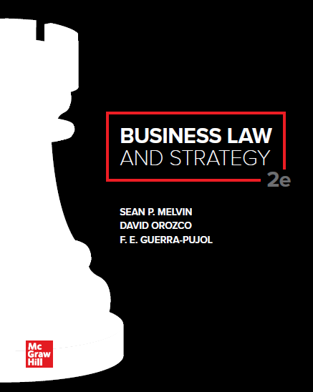

Slide 2
Chapter 6
International Law and Global Commerce

Slide 3
Chapter Learning Objectives
Distinguish between international public law and international private law.
Give examples of and explain the various sources of international law.
Explain the role of the various international courts.
List the different categories of national legal systems used in the world and give an example of a country in each category.
Apply the standards of the Convention on the Recognition and Enforcement of Foreign Arbitral Awards.

Slide 4
Chapter Learning Objectives₂
Explain the various methods of alternate dispute resolution in an international context.
Articulate several specific laws that regulate international commercial law and understand when each law applies.
Identify the methods used to enforce the rights of intellectual property holders in foreign countries.

Slide 5
Chapter Overview
The definition and sources of international law.
International dispute resolution methods.
Commercial and intellectual property regulation in an international context.

Slide 6
Definition, Sources, and Systems of International Law
International law has traditionally been defined in very broad terms: it is not limited simply to rules that are applied to settle disputes in court.
Most legal sources define modern international law as a body of rules and principles of action binding countries, international organizations, and individuals in their relations with one another.
Public international law is the law that governs relations between countries and international organizations.
Private international law focuses on the regulation of private individuals and business entities.

Slide 7
Sources of International Law
Treaties: A treaty is any agreement between two or more nations to cooperate in a certain manner. Treaties may be related to defense, trade, extradition, and other matters. The Vienna Convention on the Law of Treaties is important for interpreting treaties.
Customs: Customary law follows the basic principle of international law that individual conduct is permitted unless expressly forbidden.
Judicial Decisions: Most treaties and national laws recognize both an international tribunal, such as the International Court of Justice, and ruling by a national court applying international law principles. Comity is the general notion that nations will defer to and give effect to the laws and court decisions of other nations.

Slide 8
International Organizations
United Nations (UN): Created after World War II to facilitate common international concerns on defense, trade, the protection of human rights, and other matters. From a business perspective, one of the most significant achievements of the UN is the UN Convention on Contracts for the International Sale of Goods.
World Trade Organization (WTO): Promotes and has certain authority over disputes involving trade barriers.
International Monetary Fund (IMF): Promotes stability of world currencies and provides temporary assistance to prevent collapse of national economies.
Organization for Economic Cooperation and Development (OECD): Coordinates aid to developing countries and takes steps toward eliminating bribery and corruption from developing economies.

Slide 9
International Courts
International Court of Justice (the World Court): Judicial Branch of the UN. Based in the Netherlands. Main function is to settle disputes submitted to it by member states and give advisory opinions on legal questions submitted by international organs, agencies, and the UN General Assembly.
European Court of Justice: Court sits in Luxembourg and is the final arbiter of the codes governing European Union member countries. It is composed of judges from each EU member country and is structured in the civil law tradition. The procedures and decisions are based on treaties governing EU countries regarding commercial regulations, protections, and guarantees.

Slide 10
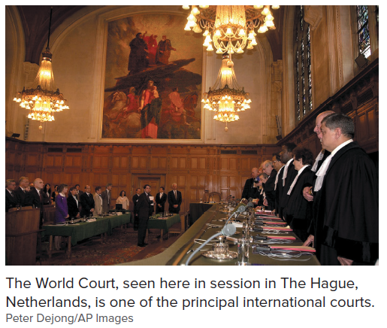
The World Court

Slide 11
Sovereign Immunity
One of the oldest doctrines of international law.
National governments are exempt from jurisdiction by other nations’ courts.
Foreign Sovereign Immunities Act (FSIA) is a federal statute that explicitly prohibits U.S. courts from rendering judicial actions against foreign nations or their government officials unless (1) the foreign nation has waived its immunity explicitly or by implication (2) the foreign nation is engaged in some commercial enterprise on U.S. soil, or (3) the foreign nation’s actions have a direct effect on U.S. interests.

Slide 12
Case 6.1: Butters v. Vance International, Inc.
HELD: The court held that Vance (a private employer) was immune from suit pursuant to the FSIA because the Kingdom of Saudi Arabia was responsible for Butters not being promoted and Vance was entitled to derivative immunity because Vance was acting pursuant to orders from officials of the Saudi Arabian government.

Slide 13
National Legal Systems
Civil Law Systems: Countries using civil law systems draw their body of law from the Roman law heritage and are based on systematic written codes. These countries do not favor the notion of courts filling in statutory gaps.
Common Law Systems: These systems are based on historical English common law concepts and legal organizational methods and strongly favor the use of case law rather than legislation/statutes. Common law systems adhere to the concept of judicial review, whereby a court may strike down a law passed by the legislature if the law is found to violate some other overriding principle of law (such as the U.S. Constitution).
Religious Based Legal Systems: Religious-based legal systems are based on religious tenets. For example, Islamic law is the legal system of several Muslim majority countries. Islamic law is based on the Qur’an (the sacred text of Islam). Islamic law is interpreted by religious authorities and carried out by a government body.
Mixed legal systems: Mixed legal systems apply a combination of systems. For example, Saudi Arabia uses an Islamic-based set of laws to regulate the personal conduct of its citizens and a civil law system to regulate business transactions and other areas of law.

Slide 14
International Dispute Resolution
International arbitration occurs when the two parties are of different nationalities or if the subject matter of the dispute involves a state other than the country in which the parties are nationals.
International treaties, such as the Convention on the Recognition and Enforcement of Foreign Arbitral Awards, allow for the enforcement of arbitration awards in many major countries, provided that the arbitration is international.
Prominent bodies that administer arbitration include the International Chamber of Commerce (ICC’s) International Court of Arbitration in Paris; the London Court of International Arbitration (LCIA), and the American Arbitration Association.
The UN Commission on International Trade Law (UNCITRAL) Arbitration Rules bridge the gap for parties who are unwilling to incur the additional expense involved in using the services of an arbitration body and do not want to spend the time to set up their own procedures.

Slide 15
WIPO
The World International Property Organization (WIPO) in Geneva, Switzerland created an arbitration center for arbitration related to intellectual property such as patents, trademarks, and copyrights.
WIPO lists best practices regarding nomination of arbitrators.
WIPO will consider preferences expressed by the parties and has a database of names and detailed qualifications.
WIPO rules explicitly cater to multiparty arbitrations.

Slide 16
International Mediation
International mediation and conciliation involve a consensual process with the use of a neutral third party.
Mediation and conciliation are growing in popularity because of the cost and delays associated with international arbitration.

Slide 17
Foreign Corrupt Practices Act
The Foreign Corrupt Practices Act (FCPA) of 1977 was enacted principally to prevent corporate bribery of foreign officials.
The FCPA has three major parts:
It requires corporations to keep accurate books, records, and accounts
It requires issuers registered with the Securities and Exchange Commission (i.e., publicly traded companies) to maintain a responsible internal accounting control system
It prohibits bribery by American corporations of foreign officials.
The FCPA prohibits a company and its officers, employees, and agents from giving, offering, or promising anything of value to any foreign (non-U.S.) official with the intent to obtain or retain business or any other advantage.

Slide 18
Case 6.2: United States v. Esquenazi
HELD: The U.S. Court of Appeals affirmed Esquenazi’s criminal conviction for violating the FCPA. The court adopted a fact-based approach to determine who is a foreign official. The court determined that employees of a foreign telecommunications company were government employees because 97 percent of the ownership of the company was held by the Haitian government and the director general of the company was appointed by the Haitian President. Therefore, bribery of this official was bribery of a foreign government official, punishable under the FCPA.

Slide 19
UN Convention on Contracts for the International Sale of Goods (CISG)
UN Convention on Contracts for the International Sale of Goods (CISG) governs transactions between any of its 91 ratifying countries.
Much like the Uniform Commercial Code, the CISG exists to fill in the terms of a sale of goods contract where the parties haven’t otherwise reached agreement.
Parties are free to negotiate their own terms for allocation of risk, insurance requirements, delivery, payment terms, choice of law, etc.
The CISG has no formal writing requirement (such as the UCC’s statute of frauds). However, individual countries may impose a formal writing requirement through an Article 96 declaration. The United States has not done so.

Slide 20
Case 6.3: Forestal Guarani S.A. v. Daros International, Inc.
HELD: The U.S. Court of Appeals for the Third Circuit held that where one country has adopted an Article 96 declaration requiring agreements in writing under the CISG and the other country has not, choice of law principles must be considered and the district court must consider the course of past conduct before ruling on a summary judgment motion that applies the Article 96 declaration.

Slide 21
International Chamber of Commerce Terms
The International Chamber of Commerce provides international abbreviations, known as INCO terms, to designate many of the responsibilities in a contract, such as title, risk of loss, and delivery.
Some examples of terms:
EXW: The parties understand that the goods will not be delivered or transported by the seller.
FCA: The seller provides transportation at the seller’s expense only to the carrier named by the buyer.
FOB: Always accompanied by the name of a port (e.g. FOB New York) and applies only when transporting via freighter ship. The seller’s expense and risk of loss end when the seller delivers goods “over the ship’s rail” to a freighter ship at the designated port.

Slide 22
Enforcing Intellectual Property Rights Abroad
The Agreement on Trade-Related Aspects of Intellectual Property (TRIPS) is a part of the General Agreement on Tariffs and Trade (GATT) administered by the World Trade Organization (WTO).
The Madrid Protocol is intended to harmonize trademark protection by providing a uniform, single-source process. Regional level harmonization has been more successful.
Copyright protection is provided by the Berne Convention. The TWO passed the World Intellectual Property Organization Copyright Treaty (WCT) in 2002 to provide uniform copyright protection for computer programs and certain protectible databases.
The Paris Convention agreement requires 160 member countries to protect the same inventor rights under any member country’s patent laws as those enjoyed by citizens of the member country. However, some inventions that are patentable in the U.S. but not patentable in a foreign jurisdiction may not be protected in the foreign jurisdiction.

Slide 23
Accessibility Content: Text Alternatives for Images

Slide 24
The World Court—Text Alternative
This picture shows a session of the World Court. The judges are standing at the bench and the counsel, parties, and spectators are also standing in the courtroom.

