Slide 1
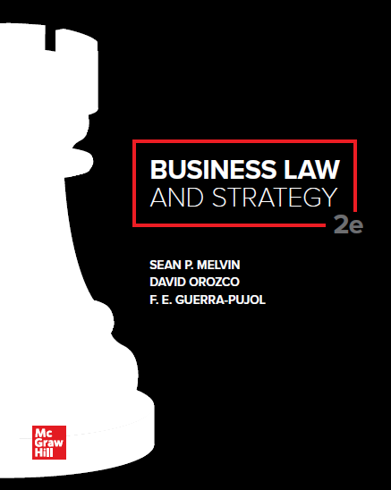
© McGraw Hill LLC. All rights reserved. No reproduction or distribution without the prior written consent of McGraw Hill LLC.

Slide 2
Chapter 8
Contracts: Overview, Mutual Assent, and Consideration

Slide 3
Chapter Learning Objectives
Identify the basic definition and purpose of a contract.
List the basic elements of a valid contract.
Distinguish various ways that contracts can be classified.
List the requirements for a valid offer and explain how offers are terminated.
Articulate the rules for determining when acceptance is effective
Apply the element of consideration in the context of contract formation.
Differentiate agreements that have consideration from those that do not.

Slide 4
NATURE AND APPLICATION OF CONTRACTS
A contract is a legally enforceable promise or set of promises.
United States has tradition of honoring freedom of contract principles. Parties are free to craft bargains that suit their best interests and to structure the terms of the deal to represent their best intentions.
The Restatement (Second) of Contracts is a model law that many state courts have adopted to govern contracts involving services or real estate.
The Uniform Commercial Code (UCC) is a model code for the sale of all types of goods, new or used. Every state has adopted the UCC, in whole or in part.
Value chain activities: the term used for the different business functions that generate value.
Good Faith Dealing is an ethical concept underpinning all contracts. The UCC defines it as: “honesty in fact and the observance of reasonable commercial standards of fair dealing.

Slide 5
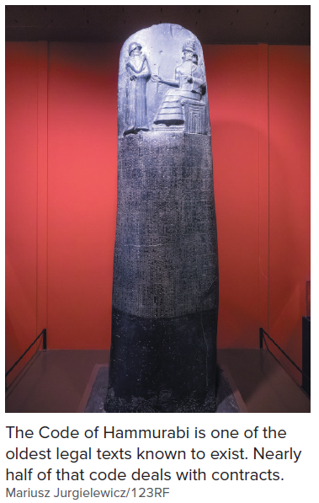
Ancient Contract Law

Slide 6
Noncompete Contracts
One significant area of variation in contract law between states is in their levels of noncompete enforcement.
A noncompete contract is a contract in which one party agrees not to compete with another.
Most states require these agreements to further a legitimate business interest and be reasonable in length, geographical coverage, and scope.
California refuses to enforce noncompete contracts as a matter of public policy.
Florida tends to uphold these contracts in favor of employers.

Slide 7
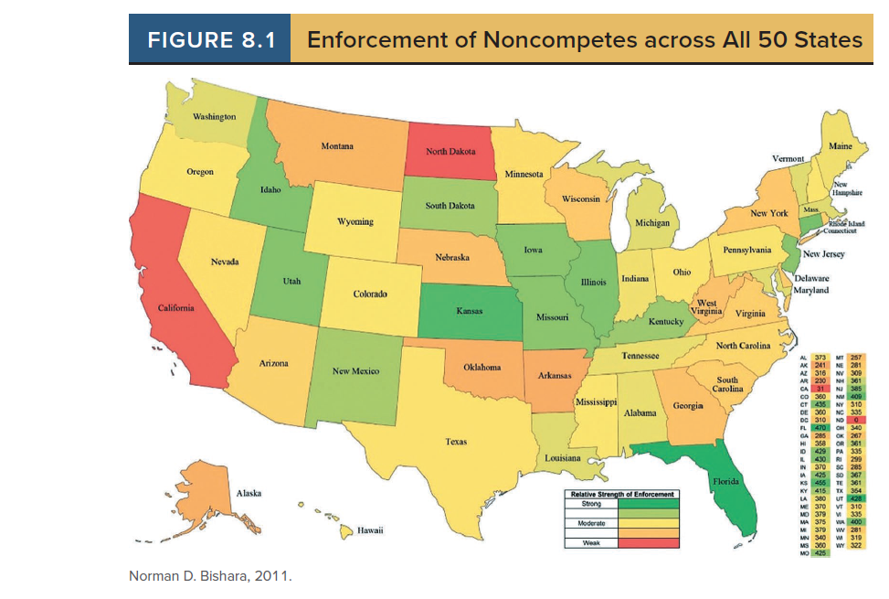
Enforcement of Noncompetes Across all 50 States

Slide 8
Contracts and Value Chain Activities in Business
Business Activity | Transaction | Type of Contract
Research and Development | A technology company hires an engineer as an outside contractor to develop inventions. | Invention assignment
Supply chain and logistics | An almond milk distributor chooses a company to manufacture, package, and label its beverage product. | Manufacturing and packaging agreement
Human resources | The board of directors hires a CEO to lead a company | Employment agreement
Marketing | A sports team licenses is logo to n overseas apparel manufacturer. | License agreement
Distribution | A carmaker agrees to sell vehicles to an independent dealership. | Sales and distribution agreement
Sales | A sales representative negotiates a contract with a client. | Sales contract
Finance | A commercial bank extends a loan to a company. | Loan agreement

Slide 9
Case 8.1: Teacher’s Insurance and Annuity Association of America v. Tribune Co.
HELD: The term sheet and commitment letter were binding when the defendant sent a signed acceptance letter. The defendant was bound to negotiate a final loan agreement in good faith.

Slide 10
Elements of a Contract
Mutual Assent: The parties to a contract must indicate through words or behavior that they willingly agree to enter into a contract. A valid offer and acceptance is usually how parties demonstrate mutual assent.
Consideration: This element requires both sides to obtain something of value (legal benefit) and to give up something of value (legal detriment).
Legality of Purpose: A contract must satisfy a legal purpose to be enforceable.
Capacity to Contract: Both parties to the contract must have legal standing to enter into contracts. Individuals who are minors, mentally incapacitated, or intoxicated may lack the capacity to enter into contracts, which may result in a voidable contract.

Slide 11
Based on Contract Element Status
Contracts may be found:
Valid: When a contract has the required elements, it is called a valid contract.
Void: When an agreement lacks one of the required elements or has not been formed in conformance with the law from the outset, the contract is considered void.
Voidable: A contract is voidable when the law gives one or more parties the right to cancel an otherwise valid contract under the circumstances.
Unenforceable: Although a contract may have all the required elements and be considered valid, it may be unenforceable because one party asserts a legal defense to performing the contract.

Slide 12
Types of Contracts
Bilateral: The legal detriment is incurred through the mutual promises the parties make to each other.
Unilateral: One party’s legal detriment arises from its action or inaction rather than a promise.
Common Law: Contracts for services or real estate are governed by state common law. For example, employment contracts, rental agreements, loan agreements.
UCC Sales: Contracts dealing with the sales of goods are governed by state UCC statutes.
Explicit: The terms are defined by the parties, orally or in writing.
Implied: Lack explicit terms. Terms are defined solely through the parties’ behavior or social custom.

Slide 13
Case 8.2: Dwayne D. Walker, Jr. v. Shawn Carter (“Jay Z”) et al.
HELD: In New York (and many other states), a contract that cannot be performed in less than one year requires a written and signed agreement between the parties to be enforceable. If the writing is lost, there must be testimony from witnesses that the writing existed.
What is the risk of a “handshake deal?”
When is it ever appropriate to enter a contract based on a “handshake deal?”

Slide 14
BASIC CONTRACT STRUCTURE AND TERMINOLOGY
Contract Section | Description | Sample Language
Preamble | Identifies the name of the agreement, dates, and party names. | Sales Representative Agreement
Recitals | Explains why the parties are entering into the agreement. | WHEREAS, the Company wishes to enter into a contract with the Representative for sales representation services for its products.
Definitions | Defines important terms used by the parties | “Current existing sales accounts” means KitchenCraft, MidContinent Cabinetry, Norcraft Canada Corporation, Pro Link, and StarMark.
Clauses | Contains promises made by each party that comprise the exchange of value | All commissions calculated in accourdance with Paragraph 5.1, above, shall be remitted to the Representative by the Company within 30 days of the Company’s receipt of payment for products invoiced.
Termination | States the provisions that govern how and when the contract ceases to be in effect | This Agreement will automatically renew for a like period unless Representative or the Company gives notice of termination. This Agreement may be terminated at any time without cause by either party upon thirty (30) days’ written notice to the other party.
Appendices | Contains supplementary materials, such as incentive compensation formulas or confidentiality agreements. | Confidentiality and Nonsolicitation Agreement

Slide 15
Drafting Contracts with a Strategically Qualified Attorney 1
Listens carefully to business details of a transaction.
Asks questions about background and purpose of transaction.
Understands major risks involved.
Assess major negotiating points.
Translates legal terminology into business terminology.

Slide 16
Drafting Contracts with a Strategically Qualified Attorney 2
Sees big picture, importance of business relationships or reputation.
Drafts customized contracts not templates, legalese, and boilerplates.
Solicits your input in contract-drafting process.
Legally astute businesspeople seek out strategically qualified attorneys.
Legally astute managers have superior knowledge of the law and work proactively with legal counsel to find ethical and value-creating business solutions.

Slide 17
Mutual Assent: Offer
Mutual assent is usually reached by offer and acceptance. Often referred to as a “meeting of the minds.”
Offer is a promise or commitment to do (or refrain from doing) a specified activity.
Objective Intent: A reasonable person would conclude that the offeror is serious in their intent to contract.
Most advertisements are invitations to consumer to make an offer to the seller.
Advertising as a Unilateral Offer: If the advertisement is specific enough, it may constitute a unilateral contract or if it invites a party to accept in a particular manner.

Slide 18
Landmark Case 8.3: Lucy v. Zehmer
HELD: An offeror is bound by the contract even if he had no actual (subjective) intent to sell property and may have been joking. An objective standard is used to determine whether a reasonable person would have viewed the offeror’s action as indicating a serious intent to contract.

Slide 19
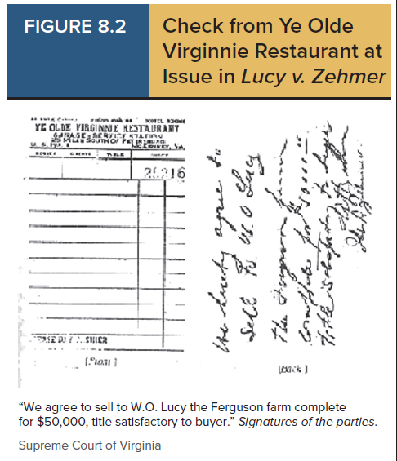
Check from Ye Olde Virginnie Restaurant at Issue in Lucy v. Zehmer

Slide 20
Case 8.4: Leonard v. PepsiCo, Inc.
HELD: An advertisement is not an offer where details of the offer are reserved to a separate writing such as a catalog. An advertisement is only an offer when the promise in the advertisement is clear, definite, and explicit.

Slide 21
Termination of an Offer
Action of the Parties
Revocation: Expression communication by offeror to revoke (withdraw) the offer or an inconsistent act that would give reasonable notice to the offeree that the offer no longer exists. Generally, a revocation is effective upon receipt by the offeree.
Rejection: An offer is terminated when the offeree rejects it. The mirror image rule requires that the offeree’s acceptance may not even slightly alter the terms of the original offer.
Counteroffer: A counteroffer terminates the original offer and makes a new offer even if there is only a slightly change in terms from the original offer.
Operation of Law: An offer may be terminated by certain events covered by operation of law
Lapse of time
Death or incapacity of the offeror or offeree
Destruction of the contract’s subject matter before acceptance
Supervening illegality
Option Contracts: An offer is irrevocable if it is an option to enter into a contract. This holds open the offer for a set time.
Partial Performance and Detrimental Reliance: If the offeree takes an action that relies on the offer; for example, the offeree begins to perform based on a unilateral offer or if the offeree prepares for performance prior to acceptance reasonably relying upon the offer. These actions renders the offer (temporarily) irrevocable.

Slide 22
Acceptance
Acceptance is the offeree’s expression of agreement to the terms of the offer.
Offeror has the power to terminate the contract, modify its terms, or prescribe the method of acceptance until the offer is accepted by the offeree.
Mailbox Rule: a contract is considered accepted upon dispatched of the acceptance when sent in a commercially reasonable manner.
OR
Specific Method set in the Offer.

Slide 23
When is Acceptance Effective?
Method Offeror Used to Make Offer | Method Offeree Used to Accept | Rule
Specified in offer. | Used method specified by offeror, or a commercially reasonable substitute. | Mailbox rule: Acceptance effective upon dispatch by offeree.
Specified in offer. | Used slower method. | Offer considered rejected and considered a counteroffer back to the original offeror.
Not specified in offer. | Used the same/faster method to accept than offeror used to make the offer, or used a commercially reasonable method. | Mailbox rule: Acceptance effective upon dispatch by offeree.
Not specified in the offer. | Used a slower method than the offeror used to make the offer. | Acceptance effective upon receipt of acceptance by offeror.

Slide 24
MISTAKE
Mistake is defined in contract law as a belief that is not in accord with existing facts. It is not a mistaken belief as to predicted future events.
Mutual: Both parties hold an erroneous belief. May be the basis for canceling (also called avoiding) the contract.
Unilateral: Only one party has an erroneous belief. Generally, not the basis for canceling the contract. It may be the basis if the nonmistaken party had reason to know of the mistake or their actions caused the mistake.

Slide 25
Consideration
Something of value bargained for in exchange for an agreement. The mutual exchange of benefits and detriments. A bargained-for exchange.
Legal benefit: receiving something of value from the other party.
Legal Detriment: giving up something of value to the other party.
Forbearance is a promise not to do something you are legally entitled to do.
Amount and Type of Consideration: consideration exchanged does not need to be of equal value and courts will not look to the amount or type of consideration of the bargaining power of the parties (except in rare cases).
Nominal Consideration: nominal consideration can be the basis for a valid contract.

Slide 26
Agreements that Lack Consideration
Preexisting Duty Rule: If a party does or promises to do what she is already legally obligated to do, the law generally does not recognize this as a legal detriment, and thus, the contract is unenforceable.
Illusory Promises
Deathbed promises made to comfort the dying.
Promises of a gift.
Promises of love and friendship.
Promises that by their terms are not binding.
Past Consideration: A promise made in return for a detriment previously made by the promise.

Slide 27
Promissory Estoppel
If one party justifiably relies on the promise of another to her detriment, under certain circumstances the relying party may recover costs of the reliance from the promisor even though the original promise agreement lacked consideration. Under the theory of promissory estoppel, a relying party may recover damages if:
The promisor makes a promise that is reasonable
The promise actually relied on the promise and suffered an injury
The promise’s reliance was reasonably foreseeable to the promisor
Principles of equity and justice are served by providing compensation to the reliant party.

Slide 28
Accessibility Content: Text Alternatives for Images

Slide 29
Ancient Contract Law
This image shows a stele with a portion of the Code of Hammurabi. The Code of Hammurabi is one of the oldest legal texts known to exist. Nearly half of that code deals with contracts.

Slide 30
Enforcement of Noncompetes Across all 50 States
This image shows a map of the fifty states with shading from green to red based on the extent to which states enforce noncompete agreements. Some states have strong enforcement and some states have weaker enforcement. For example, Florida has strong enforcement and often rules in favor of employers in enforcing noncompete agreements. California does not enforce noncompete agreements.

Slide 31
Check from Ye Olde Virginnie Restaurant at Issue in Lucy v. Zehmer
This image shows a handwritten check from a restaurant with a handwritten short contract on the check. The contract says: “We agree to sell to W.O. Lucy the Ferguson farm complete for $50,000, title satisfactory to buyer.” Below that statement, the contract is signed by Lucy and Zehmer.

