Slide 1
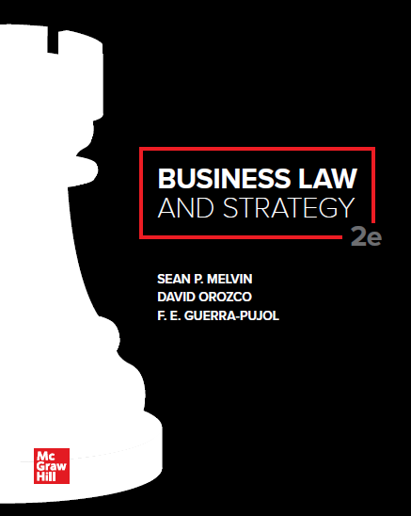
© McGraw Hill LLC. All rights reserved. No reproduction or distribution without the prior written consent of McGraw Hill LLC.

Slide 2
Chapter 17
Breach and Remedies in a Sales Transaction

Slide 3
Chapter Learning Objectives

Slide 4
Definition of a Breach (UCC)
Breach (Def.): Nonperformance of a sales contract
The UCC provides relief for parties who acted in good faith and sustained damages through no fault of their own
The opportunities to obtain relief are called remedies, judicial actions, which can be monetary or equitable, taken by courts to compensate an injured party in a civil lawsuit

Slide 5
Seller’s Breach
A seller’s primary duty is to deliver conforming goods to the buyer as stipulated in the contract
Conforming goods are goods that match what was bargained for in the agreement

Slide 6
Seller’s Breach (Cont.)
The seller may breach the contract if they:
Deliver nonconforming goods—goods that are not of the type described in the contract (e.g., goods of incorrect quantity or specification)
Repudiate their performance under the contract
Fail to deliver the goods altogether

Slide 7
Buyer’s Breach
The buyer’s primary obligation is triggered when the seller tenders delivery of conforming goods (subject to the perfect tender rule)
Once the buyer has accepted the goods, the buyer must pay for them in accordance with the contract
The buyer must also provide adequate facilities to receive the goods

Slide 8
Buyer’s Breach
The buyer breaches the contract if they:
(1) Repudiate the contract before the seller delivers the goods;
(2) Fail to make payment;
(3) Wrongfully reject conforming goods; or
(4) Wrongfully revoke their acceptance of conforming goods

Slide 9
Important Breach-Related Dates
Four critical dates that impact the rights and duties of the buyer or seller and the availability of rem
(1) The contract’s effective date
(2) The scheduled delivery date
(3) When the buyer rejects the goods
(4) When the buyer revokes acceptance of the goods

Slide 10
Important Breach-Related Dates (Cont.)
Four general time periods that impact the duties, rights, and remedies available to the buyer and seller:
Time Period 1: Time between contract’s effective date and the delivery date
Time Period 2: Time between the delivery date and when the buyer rejects the goods
Time Period 3: Time between when the buyer rejects the goods and when the buyer revokes acceptance of goods
Time Period 4: Time after the buyer is allowed to revoke acceptance of the goods and indicates acceptance of the goods

Slide 11
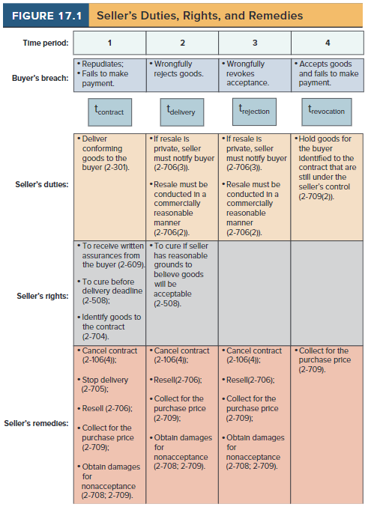
Seller’s Duties, Rights, and Remedies

Slide 12
Case 17.1: Zippy Mart of Alabama, Inc. v. A&B Coffee Service, Inc.
HELD: The Alabama Supreme Court reversed the trial court and agreed with Zippy Mart that A&B has failed to prove that it had suffered damages, and if so, whether A&B had mitigated any damages by attempting to resell the goods in a reasonable manner. Zippy Mart promised to purchase coffee and supplies from A&B for eighteen months, but only purchased for twelve months. The only damage that flowed from Zippy Mart’s breach is the loss of the sale by A&B of six months worth of coffee and supplies. Because the trial court judgment awarded damages in excess of this amount, the judgment is due to be reversed, and the case remanded for a redetermination of the amount of damages. On remand, the court must determine the amount of coffee and supplies that Zippy Mart should have purchased during the final six months of the term of the contract. Then, the court must determine whether A&B could have mitigated the damages by reselling the goods. If so, A&B is only entitled to its lost profits under UCC Section 2-708(2). If not, A&B may recover the price Zippy Mart was due to pay under UCC 2-709.

Slide 13
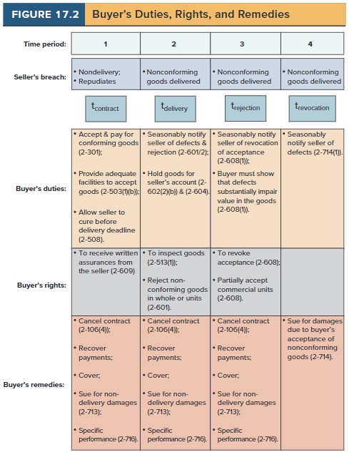
Buyer’s Duties, Rights, and Remedies

Slide 14
Case 17.2: General Motors Corp. v. Acme Refining Co.
HELD: The trial court rejected Acme’s arguments and awarded damages to GM. There was no rejection of the subject scrap material within a reasonable time after Acme went to Dynamic Manufacturing and removed over 850,000 gross tons of scrap material from the GM manufacturing facility. Rejection of goods must be within a reasonable time after their tender or delivery. It is ineffective unless the buyer seasonably notifies the seller. Similarly, Acme never notified GM that it was revoking its acceptance of the subject scrap material. Revocation of acceptance must occur within a reasonable time after the buyer discovers or should have discovered the ground for it and before any substantial change in condition of the goods which is not caused by their own defects. It is not effective until the buyer notifies the seller of it.

Slide 15
Limitation of Remedies
UCC remedies are default rules that apply in cases where the parties have not contractually specified the remedies in advance
If the parties desire, they may craft their own remedies as express terms in the contract

Slide 16
Limitation of Remedies (Cont.)
Contractual remedies are deemed optional unless the parties agree that they are the exclusive remedies available
Example: The parties agree that consequential damages will not be awarded—This express terms will apply unless the term is declared unconscionable

Slide 17
Limitation of Remedies (Cont.)
The parties may agree to define and limit the amount of monetary damages available in the event of a breach
Liquidated damages (Def.): Damages that the parties expressly define in the contract and agree will compensate the nonbreaching party
Liquidated damages will not be enforced if the amount is unreasonably high and constitutes a penalty
A liquidated damages amount that is unreasonably low will not be enforced as unconscionable

