Slide 1
Analysis of Financial Statements
Chapter 13
Wild and Shaw
Financial and Managerial Accounting
9th Edition
Copyright ©2022 McGraw-Hill Education. All rights reserved. No reproduction or distribution without the prior written consent of McGraw-Hill Education.

Slide 2
Chapter 13 Learning Objectives
CONCEPTUAL
C1 Define the building blocks of analysis and the standards for comparisons.
ANALYTICAL
A1 Summarize and report results of analysis.
A2 Appendix 13A—Explain the form and assess the content of a complete income statement.
PROCEDURAL
P1 Explain and apply methods of horizontal analysis.
P2 Describe and apply methods of vertical analysis.
P3 Define and apply ratio analysis.
13-2
© McGraw-Hill Education

Slide 3
Define the building blocks of analysis and the standards for comparisons.
Learning Objective C1
13-3
© McGraw-Hill Education

Slide 4
Purpose of Analysis
Common goal of financial statement analysis for both external and internal users is to evaluate company performance and financial condition and to assist in evaluating:
Past and current performance
Current financial position
Future performance and risk
Internal Users Managers Officers Internal Auditors
External Users Shareholders Lenders Suppliers
© McGraw-Hill Education
13-4
Learning Objective C1: Define the building blocks of analysis and the standards for comparisons.
Notes:
Financial statement analysis applies analytical tools to financial statements and related data for making business decisions.
Internal users of accounting information manage and operate the company. They include managers, officers, and internal auditors. The purpose of financial statement analysis for internal users is to provide information to improve efficiency and effectiveness in providing products and services.
External users of accounting information are not directly involved in running the company. They include shareholders, lenders, and suppliers. External users use financial statement analysis to make more informed decisions to pursue their own goals.
The common goal of these users is to evaluate company performance and financial condition. This includes evaluating (1) past and current performance, (2) current financial position, and (3) future performance and risk.

Slide 5
Building Blocks of Analysis
Liquidity and efficiency
Solvency
Profitability
Market prospects
13-5
© McGraw-Hill Education
Learning Objective C1: Define the building blocks of analysis and the standards for comparisons.
Notes:
Financial statement analysis focuses on one or more elements of the four areas that are the building blocks of financial statement analysis:
Liquidity and efficiency—ability to meet short-term obligations and to efficiently generate revenues.
Solvency—ability to generate future revenues and meet long-term obligations.
Profitability—ability to provide financial rewards sufficient to attract and retain financing.
Market prospects—ability to generate positive market expectations.

Slide 6
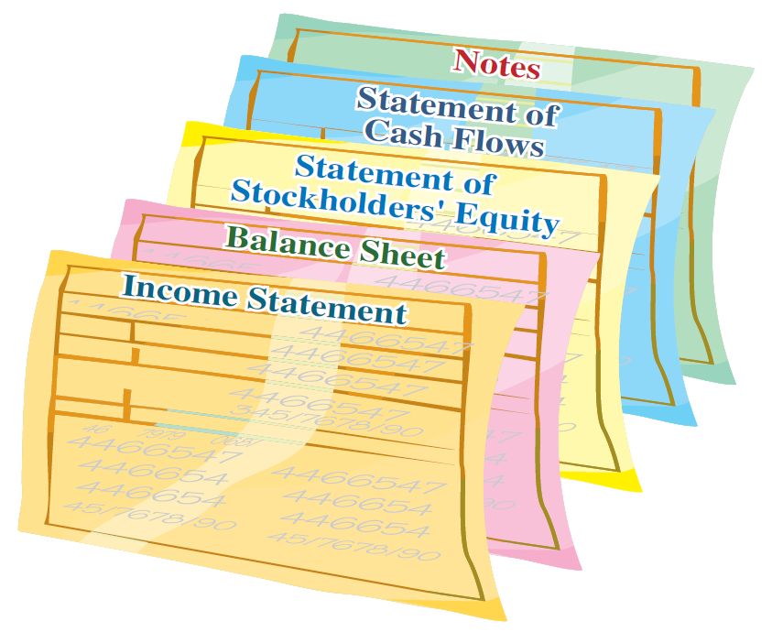
Information for Analysis
General-purpose financial statements:
Income Statement
Balance Sheet
Statement of Stockholders’ Equity
Statement of Cash Flows
Notes to the Financial Statements
© McGraw-Hill Education
13-6
Learning Objective C1: Define the building blocks of analysis and the standards for comparisons.
Notes:
Most users conduct analysis using general-purpose financial statements that include the (1) income statement, (2) balance sheet, (3) statement of stockholders’ equity (or statement of retained earnings), (4) statement of cash flows, and (5) notes to these statements.
Financial reporting refers to the communication of financial information useful for making investment, credit, and other business decisions. Financial reporting includes not only general-purpose financial statements but also information from SEC 10-K or other filings, press releases, shareholders’ meetings, forecasts, management letters, auditors’ reports, and webcasts.

Slide 7
Standards for Comparison
When we interpret our analysis, it is essential to compare the results we obtained to other standards or benchmarks.
Intracompany
Competitor
Industry
Guidelines
13-7
© McGraw-Hill Education
Learning Objective C1: Define the building blocks of analysis and the standards for comparisons.
Notes:
When analyzing financial statements, we use the following standards (benchmarks) for comparison:
Intracompany—The company’s current performance is compared to its prior performance and its relations between financial items. Apple’s current net income, for instance, can be compared with its prior years’ net income and in relation to its revenues or total assets.
Competitor—Competitors provide standards for comparisons. Coca-Cola’s profit margin can be compared with PepsiCo’s profit margin.
Industry—Industry statistics provide standards of comparisons. Intel’s profit margin can be compared with its industry’s profit margin.
Guidelines (rules of thumb)—Standards of comparisons can develop from experience. Examples are the 2:1 level for the current ratio or 1:1 level for the acid-test ratio.
Benchmarks from a competitor or group of competitors are often best. Intracompany and industry measures are also important. Guidelines or rules of thumb should be applied with care, and then only if they seem reasonable given past experience and industry norms.

Slide 8
Tools of Analysis
Horizontal Analysis
Comparing the financial condition and performance across time.
Vertical Analysis
Comparing the financial condition and performance to a base amount.
Ratio Analysis
Measurement of key relations between financial statement items.
© McGraw-Hill Education
13-8
Learning Objective C1: Define the building blocks of analysis and the standards for comparisons.
Notes:
Common tools of financial statement analysis are:
Horizontal analysis—comparison of financial condition and performance across time.
Vertical analysis—comparison of financial condition and performance to a base amount.
Ratio analysis—measurement of key relations between financial statement items.

Slide 9
Explain and apply methods of horizontal analysis.
Learning Objective P1
© McGraw-Hill Education
13-9

Slide 10
Horizontal Analysis
Horizontal analysis refers to examination of financial statement data across time.
Horizontal analysis is the review of financial statement data
across time.
© McGraw-Hill Education
13-10
Learning Objective P1: Explain and apply methods of horizontal analysis.
Notes:
Horizontal analysis is the review of financial statement data across time. Horizontal comes from the left-to-right [or right-to-left] movement of our eyes as we review comparative financial statements across time.

Slide 11
Comparative Statements: Dollar Change
Dollar
change
Analysis period
amount
Base period
amount
=
–
When measuring the amount of the change in dollar amounts, compare the analysis period to the base period.
The analysis period refers to the financial statements under analysis.
The base period refers to the financial statements used for comparison.
© McGraw-Hill Education
13-11
Learning Objective P1: Explain and apply methods of horizontal analysis.
Notes:
Comparing financial statements is done by analyzing dollar amount changes and percent changes in line items. Both analyses are relevant because dollar changes can yield large percent changes inconsistent with their importance.
A 50% change from a base figure of $100 is less important than the same percent change from a base amount of $100,000 in the same statement. We compute the dollar change for a financial statement item as shown in this slide.
Analysis period refers to the financial statements under analysis, and base period refers to the financial statements used for comparison. The prior year is commonly used as a base period.

Slide 12
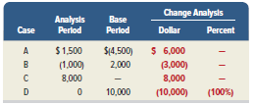
Comparative Statements: Percent Change
%
change
Analysis period amount – Base period amount
Base period amount
=
×
100
When calculating the change as a percentage, divide the amount of the dollar change by the base period amount, and then multiply by 100 to convert to a percentage.
Four cases require additional analysis.
© McGraw-Hill Education
Learning Objective P1: Explain and apply methods of horizontal analysis.
13-12
Notes:
We compute the percent change by dividing the analysis period amount minus the base period amount by the base period amount and then multiplying by 100.
There are a few rules in working with percent changes. Let’s look at four separate cases.
Cases A and B: When a negative amount is in one period and a positive amount is in the other, we cannot compute a meaningful percent change.
Case C: When no amount is in the base period, no percent change is computable.
Case D: When a positive amount is in the base period and zero is in the analysis period, the decrease is 100%.

Slide 13
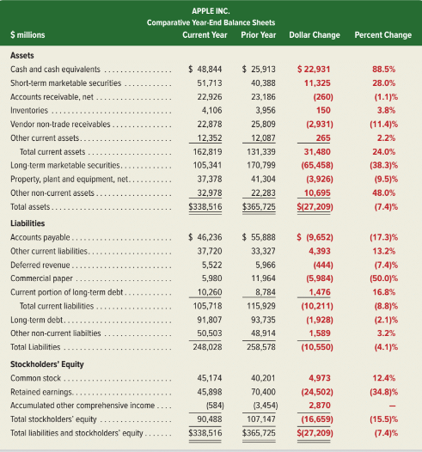
Comparative Balance Sheets
Exhibit 13.1
13-13
© McGraw-Hill Education
Learning Objective P1: Explain and apply methods of horizontal analysis.
Notes:
Analysis of comparative financial statements begins by focusing on large dollar and percent changes. We then identify the reasons and implications for these changes. We also review small changes when we expected the changes to be large.
Exhibit 13.1 shows comparative balance sheets for Apple Inc. (Nasdaq: AAPL). A few items stand out on the asset side. Apple’s long-term marketable securities decreased by $65,458 million, or 38.3%, in the current year. This substantial decrease is partially the result of many of these securities maturing or being sold. The substantial decrease also coincides with large increases in cash and cash equivalents and in short-term marketable securities. Cash and cash equivalents increased 88.5% and short-term marketable securities increased 28.0% in the current year. Looking at these changes, a user of accounting information could assume that Apple is shifting away from investing in long-term securities, and instead choosing to hold cash and cash equivalents or invest in short-term securities. This strategy has led to an increase in current assets of 24.0%, or $31,480 million, even while total assets slightly decreased.
On Apple’s financing side, we see that total liabilities and equity declined by 7.4%, or $27,209 million. The 4.1% decrease in total liabilities is largely driven by a decrease in accounts payable, suggesting Apple made significant payments to suppliers in the current year or is potentially making fewer purchases on credit. The 15.5% reduction in equity is caused by a marked decrease in retained earnings, which results from Apple’s share buyback and dividend plan. In reviewing the notes to Apple’s financial statements in Appendix A, we see that dividends of $14,129 million and common stock repurchased of $67,101 million reduced retained earnings.

Slide 14
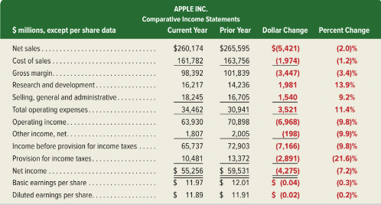
Comparative Income Statements
Exhibit 13.2
© McGraw-Hill Education
13-14
Learning Objective P1: Explain and apply methods of horizontal analysis.
Notes:
Comparative income statements are prepared similarly to comparative balance sheets.
Apple’s comparative income statements are shown in Exhibit 13.2. Apple reports a slight decrease in net sales of 2.0%, and an 11.4% increase in total operating expenses, neither of which are favorable. The increase in operating expenses is mainly driven by the 13.9% increase in research and development costs, from which management and investors hope to reap future income.
We also see a decline in the provision for income taxes, which is the result of corporate tax decrease along with a lower income. Apple’s net income decreased by 7.2%. However, its basic earnings per share only decreased 0.3%, mostly due to fewer shares outstanding because of Apple’s share buyback policy.

Slide 15
Trend Analysis: Equation
Trend analysis is used to reveal patterns in data across periods.
Trend
Percent (%)
Analysis period amount
Base period amount
=
×
100
© McGraw-Hill Education
13-15
Learning Objective P1: Explain and apply methods of horizontal analysis.
Notes:
Trend analysis involves computing trend percents that show patterns in data across periods.
Trend percent is computed as: (analysis period amount divided by base period amount) times 100.

Slide 16
Trend Analysis: Illustration
Exhibit 13.3
Using the number reported 4 years ago as the base period, we get the following trend percents for each year by dividing that year’s amount by the base period amount:
Exhibit 13.4
13-16
© McGraw-Hill Education
Learning Objective P1: Explain and apply methods of horizontal analysis.
Notes:
The trend percents—using data from Exhibit 13.3—are shown in Exhibit 13.4. The base period is the number reported four years ago, and the trend percent is computed for each year by dividing that year’s amount by the base period amount. For example, the net sales trend percent for the current year is 111.3%, computed as $260,174/$233,715.

Slide 17
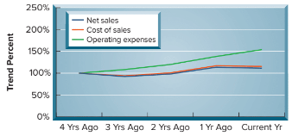
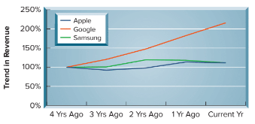
Line Graph of Trend Percents
Exhibit 13.5
Exhibit 13.6
We can use the trend percentages to construct a graph so we can see the trend over time.
© McGraw-Hill Education
13-17
Learning Objective P1: Explain and apply methods of horizontal analysis.
Notes:
This slide shows the trend percents from the prior slide in a line graph, which can help us identify trends and detect changes in direction or magnitude.
The graph shows that the trend line for operating expenses exceeds net sales in each of the recent 3 years shown. This is not positive for Apple. Apple’s net income will suffer if expenses rise faster than sales.

Slide 18
Describe and apply methods of vertical analysis.
Learning Objective P2
© McGraw-Hill Education
13-18

Slide 19
Vertical Analysis
Common-Size Statements
Common-size
percent (%)
Analysis amount
Base amount
×
=
100
Financial Statement Base Amount
Balance Sheet Total Assets
Income Statement Revenues
© McGraw-Hill Education
13-19
Learning Objective P2: Describe and apply methods of vertical analysis.
Notes:
Vertical analysis, also called common-size analysis, is used to evaluate individual financial statement items.
The term vertical analysis arises from the up-down [or down-up] movement of our eyes as we review common-size financial statements.
We use common-size financial statements to reveal changes in the relative importance of each financial statement item. All individual amounts in common-size statements are redefined in terms of common-size percents. A common-size percent is calculated as: (analysis amount divided by base amount) times 100.

Slide 20
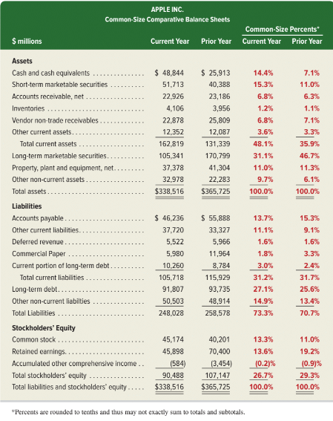
Common-Size Balance Sheet
Exhibit 13.8
© McGraw-Hill Education
13-20
Learning Objective P2: Describe and apply methods of vertical analysis.
Notes:
Common-size statements express each item as a percent of a base amount, which for a common-size balance sheet is total assets. The base amount is assigned a value of 100%. (Total liabilities plus equity also equals 100% since this amount equals total assets.) We then compute a common-size percent for each asset, liability, and equity item using total assets as the base amount.
Exhibit 13.8 shows common-size comparative balance sheets for Apple. Two results that stand out on both a magnitude and percentage basis include (1) an increase in cash and cash equivalents and in short-term marketable securities and (2) a decrease in long-term marketable securities. These changes may represent a shift in Apple strategy to keep excess funds in cash and cash equivalents and short-term securities, instead of long-term securities.
The common-size percents also reveal Apple’s smaller retained earnings balance, which is the result of cash dividends and stock buybacks. Relatively minor changes across the rest of the balance sheet is common among mature companies such as Apple.

Slide 21
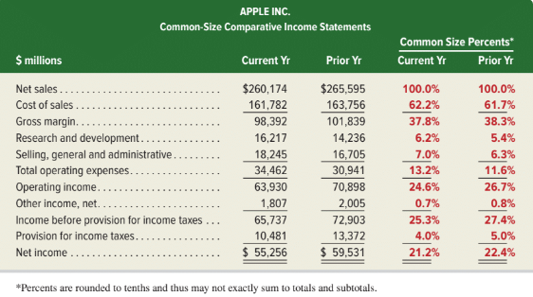
Common-Size Income Statement
Exhibit 13.9
© McGraw-Hill Education
13-21
Learning Objective P2: Describe and apply methods of vertical analysis.
Notes:
Analysis also benefits from use of a common-size income statement. Revenue is the base amount, which is assigned a value of 100%. Each common-size income statement item appears as a percent of revenue. If we think of the 100% revenue amount as representing one sales dollar, the remaining items show how each revenue dollar is distributed among costs, expenses, and income.
Exhibit 13.9 shows common-size comparative income statements for each dollar of Apple’s net sales. The past two years’ common-size numbers are similar with two exceptions. One is the increase of 0.8 cents in research and development costs, which can be a positive development if these costs lead to future revenues. Another is the decrease in provision for income taxes, which mainly results from a lower corporate tax rate.

Slide 22
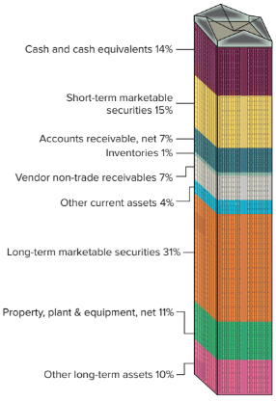
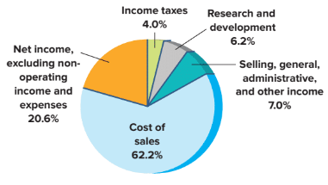
Data Visualizations
Exhibit 13.10
Exhibit 13.12
Common-Size Graphic of
Asset Components
Common-Size Graphic of
Income Statement
© McGraw-Hill Education
13-22
Learning Objective P2: Describe and apply methods of vertical analysis.
Notes:
Data visualizations reveal trends and insights not easily seen by looking at numbers.
Exhibit 13.10 is a graphic of Apple’s current year common-size income statement. This pie chart shows the contribution of each cost component of net sales for net income.
Exhibit 13.12 shows a visualization of Apple’s assets, a high percentage of which are in securities, followed by property, plant and equipment.

Slide 23
Define and apply ratio analysis.
Learning Objective P3
© McGraw-Hill Education
13-23

Slide 24
Ratio Analysis
Liquidity and efficiency
Solvency
Profitability
Market prospects
© McGraw-Hill Education
Learning Objective P3: Define and apply ratio analysis.
13-24
Notes:
Ratios are used to uncover conditions and trends difficult to detect by inspecting individual amounts.
A ratio shows a relation between two quantities. It can be expressed as a percent, rate, or proportion. For instance, a change in an account balance from $100 to $250 can be expressed as (1) 150% increase, (2) 2.5 times, or (3) 2.5 to 1 (or 2.5:1).
This section describes important financial ratios. The ratios are organized into the four building blocks of financial statement analysis: (1) liquidity and efficiency, (2) solvency, (3) profitability, and (4) market prospects. We use four common standards for comparisons: intracompany, competitor, industry, and guidelines.

Slide 25
Liquidity and Efficiency
Current
Ratio
Working Capital
Inventory Turnover
Acid-test
Ratio
Days’ Sales Uncollected
Accounts Receivable Turnover
Days’ Sales in Inventory
Total Asset Turnover
© McGraw-Hill Education
Learning Objective P3: Define and apply ratio analysis.
13-25
Notes:
Liquidity is the availability of resources to pay short-term cash requirements. It is affected by the timing of cash inflows and outflows along with prospects for future performance.
Efficiency is how productive a company is in using its assets.

Slide 26
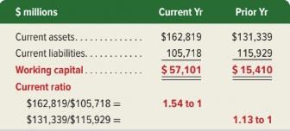
Working Capital
Working capital is the amount of current assets minus current liabilities.
 | Current assets
– | Current liabilities
= | Working capital
Exhibit 13.14
More working capital suggests a strong liquidity position and an ability to pay debts or continue operating.
© McGraw-Hill Education
Learning Objective P3: Define and apply ratio analysis.
13-26
Notes:
The amount of current assets minus current liabilities is called working capital, or net working capital. A company that runs low on working capital is less likely to pay debts or to continue operating.
When evaluating a company’s working capital, we look at the dollar amount of current assets minus current liabilities and at their ratio.

Slide 27
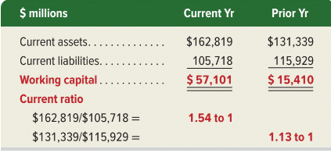
Current Ratio
Current ratio = | Current assets
 | Current liabilities
Exhibit 13.14
This ratio measures the short-term debt-paying ability of the company.
A higher current ratio suggests a strong ability to meet current obligations.
© McGraw-Hill Education
Learning Objective P3: Define and apply ratio analysis.
13-27
Notes:
The current ratio is defined as shown.
Apple’s working capital and current ratio are shown in Exhibit 13.14. Also, Google’s (3.37),Samsung’s (2.84), and the industry’s (2.5) current ratios are shown in the margin. Although its ratio (1.54) is lower than competitors’ ratios, Apple is not in danger of defaulting on loan payments. A high current ratio suggests a strong ability to meet current obligations. An excessively high current ratio can mean that the company has invested too much in current assets compared to current obligations. An excessive investment in current assets is not an efficient use of funds be-cause current assets normally earn a low return on investment (compared with long-term assets).
Many analysts use a guideline of 2:1 (or 1.5:1) for the current ratio. A 2:1 or higher ratio is considered low risk in the short run. Analysis of the current ratio, and many other ratios, must consider type of business, composition of current assets, and turnover rate of current asset components.

Slide 28
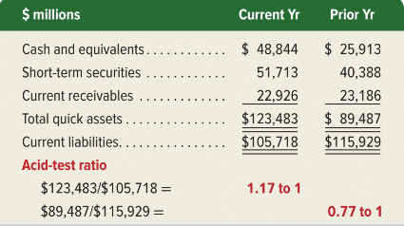
Acid-Test Ratio
Acid-test ratio = | Cash + Short-term investments + Current receivables
 | Current liabilities
Referred to as Quick Assets
Exhibit 13.15
This ratio is like the current ratio but excludes current assets such as inventories and prepaid expenses that may be difficult to quickly convert into cash.
13-28
Learning Objective P3: Define and apply ratio analysis.
© McGraw-Hill Education
Notes:
Quick assets are cash, short-term investments, and current receivables. These are the most liquid types of current assets. The acid-test ratio, also called quick ratio, and introduced in Chapter 5, reflects on a company’s short-term liquidity and is shown on this slide.
As with analysis of the current ratio, we must consider other factors. How frequently a company converts its current assets into cash also affects its ability to pay current obligations. This means analysis of short-term liquidity should consider receivables and inventories.

Slide 29
Accounts Receivable Turnover
Accounts receivable = turnover | Net sales
 | Average accounts receivable, net
Average accounts receivable = | (Beg Accts. Rec. + End Accts. Rec.)
 | 2
This ratio measures how many times a company converts its receivables into cash.
© McGraw-Hill Education
Learning Objective P3: Define and apply ratio analysis.
13-29
Notes:
Accounts receivable turnover measures how frequently a company converts its receivables into cash. Accounts receivable turnover is high when accounts receivable are quickly collected.
Apple’s turnover of 11.3 exceeds Google’s 7.0 and Samsung’s 6.7 turnover.
A high turnover is favorable because it means the company does not tie up assets in accounts receivable. However, accounts receivable turnover can be too high; this can occur when credit terms are so restrictive that they decrease sales.

Slide 30
Inventory Turnover
Inventory turnover = | Cost of goods sold
 | Average inventory
Average inventory = | (Beginning inventory + Ending inventory)
 | 2
This ratio measures how long a company holds inventory before selling it.
© McGraw-Hill Education
Learning Objective P3: Define and apply ratio analysis.
13-30
Notes:
Inventory turnover measures how long a company holds inventory before selling it. Apple’s inventory turnover at 40.1. Apple’s inventory turnover is higher than Samsung’s 5.3 but lower than Google’s 68.3.
A company with a high turnover requires a smaller investment in inventory than one producing the same sales with a lower turnover. Inventory turnover can be too high, however, if the inventory is so low that stock-outs occur.

Slide 31
Days’ Sales Uncollected
Day's sales = uncollected | Accounts receivable, net | × 365
 | Net sales
This ratio measures how frequently a company collects its accounts receivable.
© McGraw-Hill Education
Learning Objective P3: Define and apply ratio analysis.
13-31
Notes:
Days’ sales uncollected measures how frequently a company collects accounts receivable.
Apple’s days’ sales uncollected of 32.2 days is shown next to the formula. Both Google’s days’ sales uncollected of 57.1 days and Samsung’s 62.3 days are more than the 32.2 days for Apple.
Days’ sales uncollected is more meaningful if we know company credit terms. A rough guideline states that days’ sales uncollected should not exceed 1 1⁄3 times the days in its (1) credit period, if discounts are not offered or (2) discount period, if favorable discounts are offered.

Slide 32
Days’ Sales in Inventory
Day's sales in = Inventory | Ending inventory | × 365
 | Cost of goods sold
This ratio is a useful measure in evaluating inventory liquidity.
© McGraw-Hill Education
Learning Objective P3: Define and apply ratio analysis.
13-32
Notes:
Days’ sales in inventory is used to evaluate inventory liquidity.
We compute days’ sales in inventory as follows. Apple’s days’ sales in inventory of 9.3 days is shown next to the formula. If the products in Apple’s inventory are in demand by customers, this formula estimates that its inventory will be converted into receivables (or cash) in 9.3 days. If all of Apple’s sales were credit sales, the conversion of inventory to receivables in 9.3 days plus the conversion of receivables to cash in 32.2 days implies that inventory will be converted to cash in about 41.5 days (9.3 + 32.2).

Slide 33
Total Asset Turnover
Total asset turnover = | Net sales
 | Average total assets
Average assets = | (Beginning assets + Ending assets)
 | 2
This ratio measures a company’s ability to use its assets to generate sales.
It is an important indication of operating efficiency.
© McGraw-Hill Education
Learning Objective P3: Define and apply ratio analysis.
13-33
Notes:
Total asset turnover measures a company’s ability to use its assets to generate sales and reflects on operating efficiency.
Apple’s total asset turnover of 0.74 is shown next to the formula. Apple’s turnover is greater than that for Google’s of 0.64, and Samsung’s of 0.67.

Slide 34
Solvency
Debt
Ratio
Equity
Ratio
Debt-to-Equity Ratio
Times Interest Earned
© McGraw-Hill Education
Learning Objective P3: Define and apply ratio analysis.
13-34
Notes:
Solvency is a company’s ability to meet long-term obligations and generate future revenues. Analysis of solvency is long term and uses more encompassing measures than liquidity. An important part of solvency analysis is a company’s capital structure. Capital structure refers to a company’s makeup of equity and debt financing.

Slide 35
Debt Ratio and Equity Ratio
$248,028 ÷ $338,516 = 73.3%
The debt ratio shows total liabilities as a percent of total assets.
The equity ratio shows total equity as a percent of total assets.
© McGraw-Hill Education
Learning Objective P3: Define and apply ratio analysis.
13-35
Notes:
One element of solvency analysis is to assess a company’s mix of debt and equity financing. The debt ratio shows total liabilities as a percent of total assets. The equity ratio shows total equity as a percent of total assets. Apple’s debt and equity ratios are shown on this slide.
Apple’s ratios reveal more debt than equity. A company is considered less risky if its capital structure (equity plus debt) has more equity. Debt is considered more risky because of its required payments for interest and principal. Stockholders cannot require payment from the company. However, debt can increase income for stockholders if the company earns a higher return than interest paid on the debt.

Slide 36
Debt-to-Equity Ratio
Debt-to-equity ratio = | Total liabilities
 | Total equity
This ratio measures what portion of a company’s assets are contributed by creditors. A larger debt-to-equity ratio implies less opportunity to expand through use of debt financing.
© McGraw-Hill Education
Learning Objective P3: Define and apply ratio analysis.
13-36
Notes:
The debt-to-equity ratio measures solvency and is computed as total liabilities divided by total equity.
Apple’s debt-to-equity ratio is 2.74. Apple’s ratio is higher than those of Google (0.37) and Samsung (0.34), and greater than the industry ratio of 0.6. Apple’s capital structure has more debt than equity.
Debt must be repaid with interest, while equity does not. Debt payments can be burdensome when the industry and/or the economy experience a downturn.

Slide 37
Times Interest Earned
Times interest earned = | Income before interest expense and income taxes
 | Interest expense
 | Net income
+ | Interest expense
+ | Income taxes
= | Income before interest and taxes
This is the most common measure of a company’s ability to pay interest expense.
13-37
Learning Objective P3: Define and apply ratio analysis.
© McGraw-Hill Education
Notes:
Times interest earned is the amount of income before subtracting interest expense and income taxes and is the amount available to pay interest expense. The times interest earned ratio measures a company’s ability to pay interest.
Apple’s times interest earned ratio is 19.4 which suggests that creditors have little risk of nonrepayment.
The larger this ratio, the less risky is the company for creditors. One guideline says that creditors are reasonably safe if the company has a ratio of two or more.

Slide 38
Profitability
Profit
Margin
Return on Total Assets
Return on Equity
Gross Margin Ratio
© McGraw-Hill Education
Learning Objective P3: Define and apply ratio analysis.
13-38
Notes:
Profitability refers to a company’s ability to generate an adequate return on invested capital. Return is judged by assessing earnings relative to the level and sources of financing.

Slide 39
Gross Margin Ratio
Gross margin ratio = | Net sales – Cost of goods sold
 | Net sales
This ratio measures a company’s percent of gross margin in each dollar of net sales.
© McGraw-Hill Education
Learning Objective P3: Define and apply ratio analysis.
13-39
Notes:
Gross margin ratio is a company’s percent of gross margin in each dollar of net sales. Gross margin is net sales minus cost of goods sold. The gross margin ratio is the amount of each dollar left over to cover all other operating expenses and still yield a profit. Apple’s gross margin ratio is 37.8%; see its calculation next to the formula. Apple’s 37.8% profit margin is lower than Google’s 55.6% but higher than Samsung’s 36.1% and the industry’s 30% margin.

Slide 40
Profit Margin
Profit margin = | Net income
 | Net sales
This ratio measures a company’s ability to earn net income from each sales dollar.
© McGraw-Hill Education
Learning Objective P3: Define and apply ratio analysis.
13-40
Notes:
Profit margin measures a company’s ability to earn net income from sales.
Apple’s profit margin of 21.2% is shown next to the formula. To evaluate profit margin, we must consider the industry. For instance, an appliance company might require a profit margin of 15%, whereas a retail supermarket might require a profit margin of 2%.
Apple’s 21.2% profit margin is the same as Google’s 21.2%, but higher than Samsung’s 9.4% and the industry’s 11% margin.

Slide 41
Return on Total Assets
Return on total asset = | Net income
 | Average total assets
Return on total assets measures how well assets are utilized by the company.
The relation between profit margin, total asset turnover, and return on total assets is:
© McGraw-Hill Education
Learning Objective P3: Define and apply ratio analysis.
13-41
Notes:
Return on total assets is defined as net income divided by average total assets. We can determine the return a company earns on its total assets.
Apple’s return on total assets of 15.7% is shown next to the formula. Apple’s 15.7% return on total assets is higher than Google’s 13.5%, Samsung’s 6.3%, and the industry’s 8%. We also should evaluate any trend in the return.
Both profit margin and total asset turnover affect operating efficiency, as measured by return on total assets. This analysis shows that Apple’s superior return on assets versus that of Google is driven by its higher asset turnover.

Slide 42
Return on Equity
Return on equity = | Net income
 | Average total equity
This measure indicates the company’s ability to earn income for common stockholders.
© McGraw-Hill Education
Learning Objective P3: Define and apply ratio analysis.
13-42
Notes:
Return on equity measures a company’s ability to earn income for its owners and is computed as net income divided by average total equity.
Apple’s 55.9% return on equity is superior to Google’s 18.1% and Samsung’s 8.4%.

Slide 43
Market Prospects
Price-Earnings Ratio
Dividend Yield
13-43
Learning Objective P3: Define and apply ratio analysis.
© McGraw-Hill Education
Notes:
Market measures are useful for analyzing corporations with publicly traded stock. These market measures use stock price, which reflects the market’s (public’s) expectations for the company. This includes expectations of both company return and risk—as the market perceives it.
Key measures of market prospects include the price-earnings ratio and dividend yield.

Slide 44
Price-Earnings Ratio
Price-earnings ratio = | Market price per common share
 | Earnings per share
This ratio measures market expectations for future growth.
© McGraw-Hill Education
Learning Objective P3: Define and apply ratio analysis.
13-44
Notes:
Computation of the price-earnings ratio is computed as market price per common share divided by earnings per share.
The price-earnings ratio measures market expectations for future growth.
The market price of Apple’s common stock at the start of the current fiscal year was $293.65. Using Apple’s $11.97 basic earnings per share, we compute its price-earnings ratio as shown above. Apple’s price-earnings ratio is less than that for Google, but it is higher than that for Samsung and the industry for this period.

Slide 45
Dividend Yield
Dividend yield = | Annual cash dividends per share
 | Market price per share
This ratio is used to compare the dividend-paying performance of different companies.
© McGraw-Hill Education
Learning Objective P3: Define and apply ratio analysis.
13-45
Notes:
Dividend yield is used to compare the dividend-paying performance of different companies. It is computed as annual cash dividends per share divided by market price per share.
Apple’s dividend yield of 1.0%, based on its fiscal year-end market price per share of $293.65 and its $3.00 cash dividends per share.
Some companies, such as Google, do not pay dividends because they reinvest the cash to grow their businesses in the hope of generating greater future earnings and dividends.

Slide 46
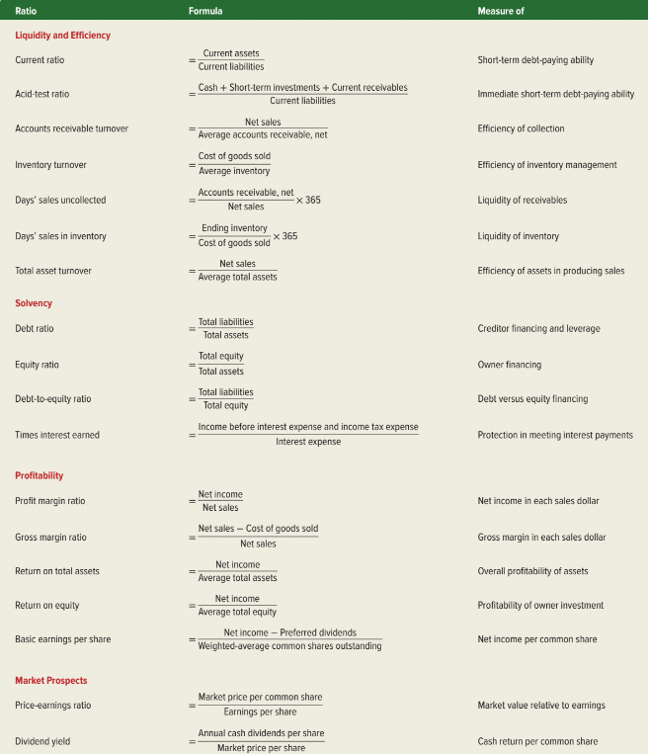
Summary of Ratios
Exhibit 13.16
Learning Objective P3: Define and apply ratio analysis.
13-46
© McGraw-Hill Education
Notes:
This slide summarizes the major financial statement analysis ratios illustrated in this chapter and throughout the book. This summary includes each ratio’s title, its formula, and the purpose for which it is commonly used.

Slide 47
Summarize and report results of analysis.
Learning Objective A1
© McGraw-Hill Education
13-47

Slide 48
Analysis Reporting
Executive Summary
Analysis Overview
Evidential Matter
Assumptions
Key Factors
Inferences
© McGraw-Hill Education
13-48
Learning Objective A1: Summarize and report results of analysis.
Notes:
A financial statement analysis report usually consists of six sections:
Executive summary—brief analysis of results and conclusions.
Analysis overview—background on the company, its industry, and the economy.
Evidential matter—financial statements and information used in the analysis, including ratios, trends, comparisons, and all analytical measures used.
Assumptions—list of assumptions regarding a company’s industry and economic environment, and other assumptions underlying estimates.
Key factors—list of favorable and unfavorable factors, both quantitative and qualitative, for company performance; usually organized by areas of analysis.
Inferences—forecasts, estimates, interpretations, and conclusions of the analysis report.
We must remember that the user dictates relevance, meaning that the analysis report should include a brief table of contents to help readers focus on those areas most relevant to their decisions. Finally, writing is important. Mistakes in grammar and errors of fact compromise the report’s credibility.

Slide 49
Appendix 13A Explain the form and assess the content of a complete income statement.
Learning Objective A2
© McGraw-Hill Education
13-49

Slide 50
Sustainable Income
Changes in Accounting Principles: Retrospective application on prior financial statements.
Discontinued
Segments
Continuing
Operations
Net Income
Earnings per share
© McGraw-Hill Education
13-50
Learning Objective A2: Explain the form and assess the content of a complete income statement.
Notes:
When a company’s activities include income-related events not part of its normal, continuing operations, it must disclose information about these events. To alert users to these activities, companies separate the income statement into continuing operations, discontinued segments, comprehensive income, and earnings per share.
The separations of discontinued segments, comprehensive income, and earnings per share from continuing operations helps us measure sustainable income, which is the income level most likely to continue into the future. Sustainable income is commonly used in performance measures.

Slide 51
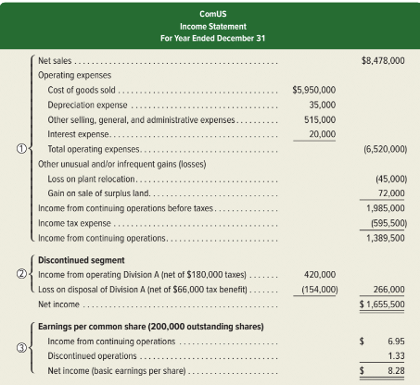
Income Statement All-inclusive
Exhibit 13A.1
© McGraw-Hill Education
13-51
Learning Objective A2: Explain the form and assess the content of a complete income statement.
Notes:
Section 1: Continuing Operations shows revenues, expenses, and income from continuing operations. This information is used to predict future operations, and most view this section as the most important. Gains and losses that are normal and frequent are reported as part of continuing operations. Gains and losses that are either unusual and/or infrequent are reported as part of continuing operations but after the normal revenues and expenses. Items considered unusual and/or infrequent include (1) property taken away by a foreign government, (2) condemning of property, (3) prohibiting use of an asset from a new law, (4) losses and gains from an unusual and infrequent calamity (“act of God”), and (5) financial effects of labor strikes.
Section 2: Discontinued Segments. A business segment is a part of a company that is separated by its products/services or by geographic location. A segment has assets, liabilities, and financial results of operations that can be separated from those of other parts of the company. A gain or loss from selling or closing down a segment is separately reported. Section 2 of Exhibit 13A.1 reports both (a) income from operating the discontinued segment before its disposal and (b) the loss from disposing of the segment’s net assets. The income tax effects of each are reported separately from the income tax expense in section 1.
Section 3: Earnings per Share of Exhibit 13A.1 reports earnings per share for both continuing operations and discontinued segments (when they both exist). Earnings per share is covered in Chapter 11.
Changes in Accounting Principles. Changes in accounting principles require retrospective application to prior periods’ financial statements. Retrospective application means applying a different accounting principle to prior periods as if that principle had always been used. Retrospective application enhances the consistency of financial information between periods, which improves the usefulness of information, especially with comparative analyses.

Slide 52
End of Chapter 13
13-52
© McGraw-Hill Education

