Slide 1
Managerial Accounting Concepts and Principles
Chapter 14
Wild and Shaw
Financial and Managerial Accounting
9th Edition
Copyright ©2022 McGraw-Hill Education. All rights reserved. No reproduction or distribution without the prior written consent of McGraw-Hill Education.

Slide 2
Chapter 14 Learning Objectives
CONCEPTUAL
C1 Explain the roles and ethics of managerial accounting.
C2 Describe accounting concepts useful in classifying costs.
C3 Explain manufacturing activities and the flow of manufacturing costs.
C4 Describe trends in managerial accounting.
ANALYTICAL
A1 Assess raw materials inventory management using raw materials inventory turnover and days’ sales in raw materials inventory.
PROCEDURAL
P1 Prepare an income statement and balance sheet for a manufacturer.
P2 Prepare a schedule of cost of goods manufactured and explain its purpose and links to financial statements.
© McGraw-Hill Education
14-2

Slide 3
Explain the roles and ethics of managerial accounting.
Learning Objective C1
© McGraw-Hill Education
14-3

Slide 4
Managerial Accounting Basics
Managerial accounting provides financial and
nonfinancial information to an organization’s managers.
© McGraw-Hill Education
Learning Objective C1: Explain the roles and ethics of managerial accounting.
14-4
Notes:
Managerial accounting provides financial and nonfinancial information to an organization’s managers. Managers include, for example, employees in charge of a company division; the heads of marketing, information technology, and human resources; and top-level managers such as the chief executive officer (CEO) and chief financial officer (CFO). This section explains the purpose of managerial accounting (also called management accounting) and compares it with financial accounting.

Slide 5
Purpose of Managerial Accounting
Exhibit 14.1
Planning
Process of setting goals and making plans to achieve them.
Control
Process of monitoring and evaluating an organizations activities and employees.
© McGraw-Hill Education
Learning Objective C1: Explain the roles and ethics of managerial accounting.
14-5
Notes:
The purpose of managerial accounting is to provide useful information to aid in:
determining the costs of an organization’s products and services
planning future activities
comparing actual results to planned results
Planning is the process of setting goals and making plans to achieve them. Long-term strategic plans usually span 5-10 years. Strategic plans are then turned into short-term action plans which are more concrete with better-defined goals. Short-term plans often cover a one-year period.
Control is the process of monitoring and evaluating an organization’s activities and employees. Feedback from the control function helps managers compare actual results with planned results and take corrective actions.

Slide 6
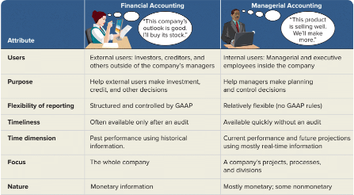
Nature of Managerial Accounting
Exhibit 14.2
© McGraw-Hill Education
Learning Objective C1: Explain the roles and ethics of managerial accounting.
14-6
Notes:
Managerial accounting differs from financial accounting in the following ways:
Users of Accounting Information. Financial accounting information is provided primarily to external users including investors, creditors, and regulators. Managerial accounting information is provided primarily to internal managerial and executive employees who are in charge of a company’s business activities.
Purpose of Information. External users of financial accounting information often decide whether to invest in or lend to a company. Internal decision makers use managerial accounting information to understand, analyze, plan, and control company activities.
Flexibility of Reporting. Financial accounting follows concepts and rules known as generally accepted accounting principles (GAAP) to provide consistency and comparability of financial statements. Managerial accounting provides internal information and is much more flexible, not rules-based.
Timeliness of Information. Financial accounting provides information to external users following required time periods (such as annual and quarterly). Managerial accounting provides information to internal users as they request it.
Time Dimension. External users of financial accounting information get historical reports using information that is often months old. Internal users of managerial accounting information often get real-time data that are used to evaluate current performance, plan future activities, and make projections.
Focus of Information. External users of financial accounting data often focus on the performance of a company as a whole for investing and lending decisions. Internal users of managerial accounting data often focus on a specific activity, product, department, or division for which they are responsible.
Nature of Information. Both financial and managerial accounting reports have monetary information. Managerial accounting reports also have nonmonetary information, which includes customer and employee satisfaction data, percentage of on-time deliveries, product defect rates, energy from renewable sources, and employee diversity.

Slide 7
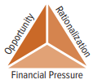
Fraud and Ethics in Managerial Accounting
Fraud affects all business and it is costly: The Association of Certified Fraud Examiners (ACFE) estimates the average U.S. business loses 5% of its annual revenues to fraud.
An internal control system is procedures managers use to:
Ensure reliable accounting
Protect assets
Uphold company policies
Promote efficient operations.
The Institute of Management Accountants requires that management accountants be competent, maintain confidentiality, act with integrity, and communicate information in a fair and credible manner.
© McGraw-Hill Education
Learning Objective C1: Explain the roles and ethics of managerial accounting.
14-7
Notes:
Fraud affects all business and is costly. The Association of Certified Fraud Examiners (ACFE) estimates the average U.S. business loses 5% of its annual revenues to fraud.
Three factors that push a person to commit fraud include: opportunity, pressure, and rationalization. This is known as the fraud triangle.
The key to stopping fraud is prevention. It is much less expensive and more effective to prevent fraud than to detect it. An internal control system is used to: ensure reliable accounting, protect assets, uphold company policies, and promote efficiency.
Ethics are beliefs that distinguish right from wrong.
The Institute of Management Accountants (IMA), the professional association for management accountants, requires that management accountants be competent, maintain confidentiality, act with integrity, and communicate information in a fair and credible manner.

Slide 8
Career Paths
Managerial accounting information is used in many careers:
Marketing staff need sales and cost data to decide which products to promote.
Management needs sales force details to evaluate performance.
Entrepreneurs use costs, budgets, and financial statements.
Decision makers in both for-profit and non-profit organizations use accounting data to make informed decisions and secure financing from donors.
Exhibit 14.4
© McGraw-Hill Education
Learning Objective C1: Explain the roles and ethics of managerial accounting.
14-8
Notes:
Managerial accountants are highly regarded and their professional standing is sometimes denoted by a certificate. Managerial accountant skills are highly valued and useful in many careers including marketing, management, entrepreneurs, and decision makers. Exhibit 14.4 shows estimated annual salaries from recent surveys.

Slide 9
Describe accounting concepts useful in classifying costs.
Learning Objective C2
© McGraw-Hill Education
14-9

Slide 10
Direct versus Indirect Costs
Direct costs
Cost-effectively traceable to a cost object.
Indirect costs
Cannot be cost-effectively traced to a cost object.
Exhibit 14.5
14-10
© McGraw-Hill Education
Learning Objective C2: Describe accounting concepts useful in classifying costs.
Notes:
A cost is often traced to a cost object, which is a product, process, department, or customer to which costs are assigned. Direct costs are cost-effectively traced to a cost object and includes direct materials and direct labor.
Indirect costs cannot be cost-effectively traced to a single cost object. Indirect costs include the salary of a manufacturing supervisor and wages of maintenance department employees who clean the factory.

Slide 11
Direct Materials
Direct materials costs are costs for direct materials that are can be cost-effectively traced through the manufacturing process to finished goods.
Examples in manufacturing a bike:
Tires, seats, frame, pedals, brakes, and cables.
© McGraw-Hill Education
14-11
Learning Objective C2: Describe accounting concepts useful in classifying costs.
Notes:
Direct materials are materials that are crucial parts of a finished product. Direct material costs are costs for direct materials that can be cost-effectively traced through the manufacturing process to finished goods. Examples of direct materials in manufacturing a bike include its tires, seat, frame, pedals, brakes, cables, gears, and handlebars.

Slide 12
Direct Labor
Direct labor costs are the wages and salaries for direct labor that are cost-effectively traced through the manufacturing process to finished goods.
Example in manufacture of a bike:
Wages paid to bike assembly worker.
© McGraw-Hill Education
14-12
Learning Objective C2: Describe accounting concepts useful in classifying costs.
Notes:
Direct labor refers to the employees who directly convert materials to finished product. Direct labor costs are the wages and benefits for direct labor that can be cost-effectively traced through the manufacturing process to finished goods. Examples of direct labor in manufacturing a bike include operators directly involved in converting raw materials into finished products (welding, painting, forming) and assembly workers who attach materials such as tires, seats, pedals, and brakes.

Slide 13
Factory Overhead
Factory overhead consists of all manufacturing costs that are not direct materials or direct labor and cannot be cost-effectively traced to finished goods.
Examples:
Indirect labor – maintenance workers.
Indirect material – screws, nuts, staples. Indirect other costs - factory utility costs.
14-13
© McGraw-Hill Education
Learning Objective C2: Describe accounting concepts useful in classifying costs.
Notes:
Factory overhead, also called manufacturing overhead, consists of all manufacturing costs that are not direct materials or direct labor. Factory overhead costs are manufacturing costs that cannot be cost-effectively traced to finished goods. Factory overhead costs include indirect materials, indirect labor, and other indirect costs.
Indirect materials are materials used in manufacturing that cannot be cost-effectively traced to finished goods. Materials are often classified as indirect materials when their costs are low. Examples include screws and nuts used in assembling bikes, and staples and glue used in manufacturing shoes.
Indirect labor is labor needed in manufacturing that cannot be cost-effectively traced to finished goods. Indirect labor costs are the costs of workers who assist or supervise in manufacturing. Examples include costs for employees who maintain and repair manufacturing equipment and salaries of production supervisors.
Indirect other costs include factory utilities (water, gas, electricity), factory rent, depreciation on factory buildings and equipment, factory insurance, and property taxes on factory.

Slide 14
Prime and Conversion Costs
Manufacturing costs are often combined as follows:
Direct Material
Direct Labor
Factory Overhead
Prime Cost
Conversion Cost
© McGraw-Hill Education
14-14
Learning Objective C2: Describe accounting concepts useful in classifying costs.
Notes:
We can classify product costs into prime or conversion costs. Prime costs include both direct material and direct labor costs. Conversion costs are costs incurred in converting raw materials to finished goods, which includes both direct labor costs and factory overhead costs. Notice that direct labor costs are considered both prime costs and conversion costs.

Slide 15
Manufacturing Costs
Direct Labor
Direct Material
Factory Overhead
Product
Period costs are nonproduction costs linked to a time period, (not products).
Selling expenses are costs to obtain orders and to deliver finished goods to customers.
General and Administrative expenses are costs of staff support and administrative functions.
© McGraw-Hill Education
14-15
Learning Objective C2: Describe accounting concepts useful in classifying costs.
Notes:
Product costs are those production costs necessary to create a product and consist of: direct materials, direct labor, and factory overhead.
Period costs are non-production costs associated with activities linked to a time period and not to the completed products.

Slide 16
Product versus Period Costs
Exhibit 14.7
14-16
© McGraw-Hill Education
Learning Objective C2: Describe accounting concepts useful in classifying costs.
Notes:
Product costs are production costs necessary to create a product and consist of direct materials, direct labor, and factory overhead. Product costs are added to inventory, or capitalized, during manufacturing of products. When products are sold, these costs are expected as cost of goods sold.
Period costs are non-production costs linked to a time period (not specific products). Period costs are expensed in the period when incurred and reported on the income statement as either selling expenses or as general and administrative expenses. Common examples of selling expenses are advertising costs, delivery costs, and salesperson salaries, commissions, and travel costs. Common examples of general and administrative expenses are office accounting costs, office employee wages, office rent, depreciation on office equipment, and office manager salaries. For a manufacturer, period costs are also called nonmanufacturing costs.

Slide 17
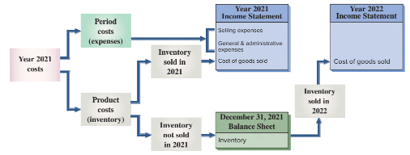
Reporting Product and Period Costs in Financial Statements
Exhibit 14.8
© McGraw-Hill Education
14-17
Learning Objective C2: Describe accounting concepts useful in classifying costs.
Notes:
Period costs go directly to the current income statement as expenses. They are not reported as assets.
Product costs are first assigned to inventory. Their final treatment depends on when inventory is sold. Product costs assigned to inventory that is sold in 2021 are reported on the 2021 income statement as cost of goods sold. Product costs assigned to unsold inventory are reported on the 2021 balance sheet. If this inventory is sold in 2022, product costs assigned to it are reported as cost of goods sold in the 2022 income statement.

Slide 18
Cost Concepts for Service Companies
The cost concepts described are generally applicable to service organizations.
Service companies can classify costs as direct materials, direct labor, overhead, selling, or general and administrative costs.
14-18
© McGraw-Hill Education
Learning Objective C2: Describe accounting concepts useful in classifying costs.
Notes:
The cost concepts also apply to service organizations. Service companies can classify costs as direct materials, direct labor, overhead, selling or general and administrative costs. Classification as product versus period costs is not relevant to service companies because services are not inventoried. Instead, costs incurred by a service firm are expensed in the reporting period when incurred.
For Southwest Airlines the cost object is a flight. The airline’s cost of beverages for passengers is a direct cost. The cost of ground crew’s wages is an indirect cost.

Slide 19
Prepare an income statement and balance sheet for a manufacturer.
Learning Objective P1
14-19
© McGraw-Hill Education

Slide 20
Reporting Inventory on the Balance Sheet
Raw Materials
Inventory
Work in Process
Inventory
Finished Goods
Inventory
Materials waiting to be processed.
Partially complete products.
Some materials, labor and/or overhead have been added.
Completed products ready for sale.
14-20
© McGraw-Hill Education
Learning Objective P1: Prepare an income statement and balance sheet for a manufacturer.
Notes:
Manufacturers report three types of inventories: raw materials, work in process, and finished goods.
Raw materials inventory is the cost of materials a company acquires to use in making products. Raw materials that are cost-effectively traced to a product are called direct materials; they are included in raw materials inventory.
Work in process inventory, also called goods in process inventory consists of costs of direct materials, direct labor, and overhead for partially completed products.
Finished goods inventory consists of costs of direct materials, direct labor, and overhead of completed products ready for sale.

Slide 21
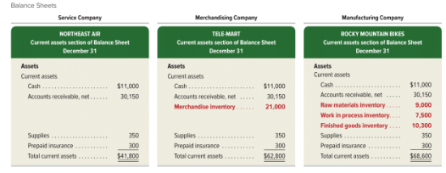
Balance Sheets for Manufacturers, Merchandisers, and Servicers
Exhibit 14.10
The primary difference is inventory.
14-21
© McGraw-Hill Education
Learning Objective P1: Prepare an income statement and balance sheet for a manufacturer.
Notes:
The primary difference in the balance sheet of a merchandiser and a manufacturer is inventory. Merchandisers have one inventory called merchandise inventory. Manufacturers have three major categories of inventory: raw materials, work in process, and finished goods.
The current assets section of the balance sheet will look different for merchandising and service companies as compared to manufacturing companies. A merchandiser will report only merchandise inventory rather than the three types of inventory reported by a manufacturer. A service company’s balance sheet does not have any inventory held for sale.

Slide 22
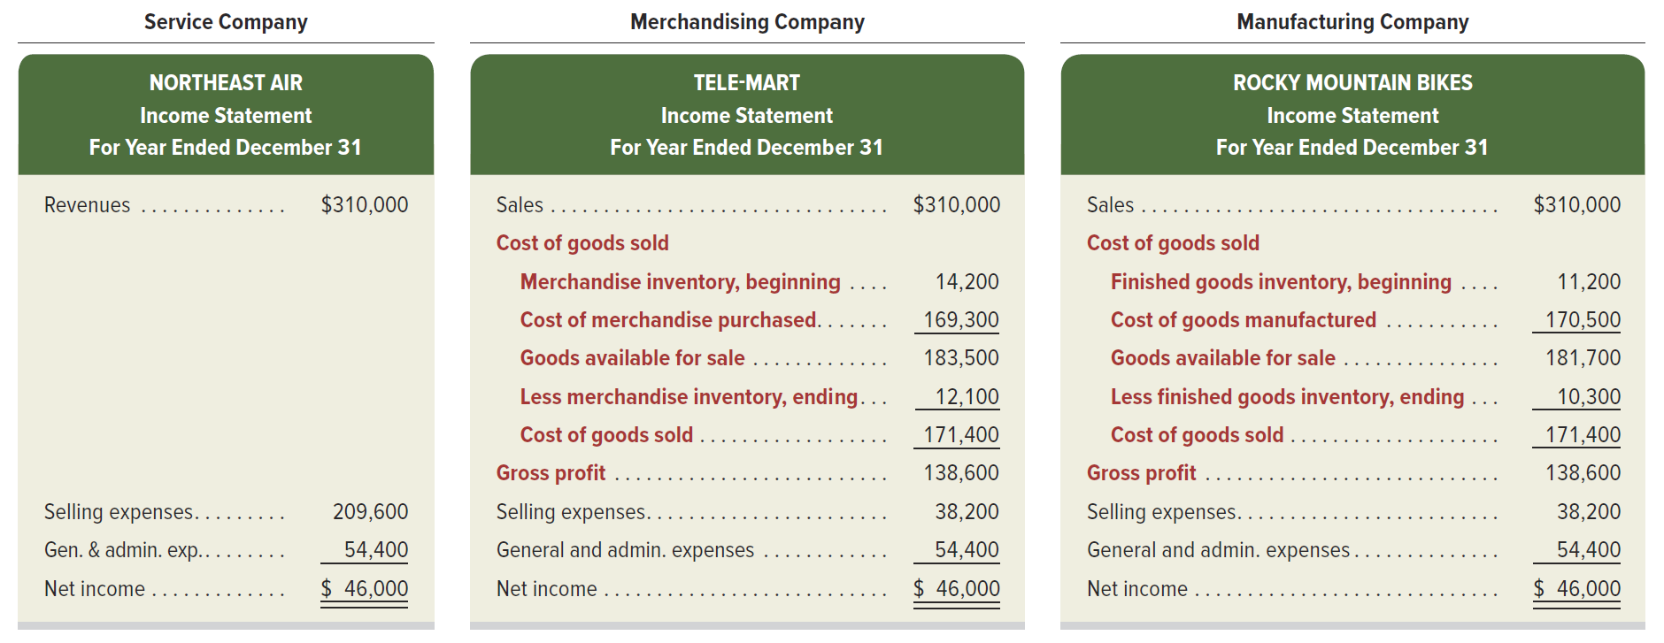
Reporting Costs and the Income Statement
Exhibit 14.11
Exhibit 14.12
14-22
© McGraw-Hill Education
Learning Objective P1: Prepare an income statement and balance sheet for a manufacturer.
Notes:
The main difference between a manufacturer and a merchandiser is the content of cost of goods sold.
Merchandisers add cost of goods purchased to beginning merchandise inventory and then subtract ending merchandise inventory to compute cost of goods sold.
Manufacturers add cost of goods manufactured to beginning finished goods inventory and then subtract ending finished goods inventory to compute cost of goods sold.
The key differences on the income statement include:
Merchandisers have merchandise inventory while manufacturers have finished goods inventory.
Merchandisers have cost of merchandise purchased while manufacturers have cost of goods manufactured (direct materials, direct labor, and factory overhead).
Since a service company does not make or buy inventory to sell, it does not report cost of goods sold.

Slide 23
Explain manufacturing activities and the flow of manufacturing costs.
Learning Objective C3
14-23
© McGraw-Hill Education

Slide 24
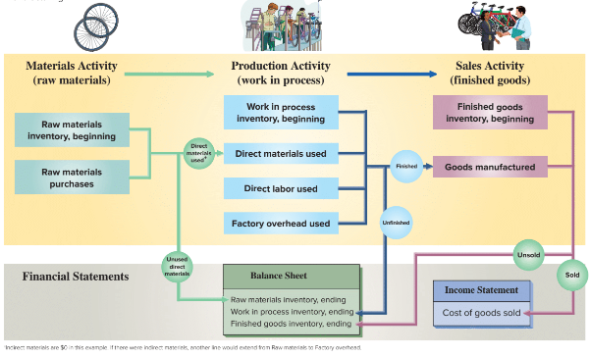
Flow of Manufacturing Activities
Exhibit 14.13
14-24
© McGraw-Hill Education
Learning Objective C3: Explain manufacturing activities and the flow of manufacturing costs.
Notes:
This slide shows the flow of manufacturing activities and their cost flows. Looking across the top row, the activities flow consists of materials activity followed by production activity followed by sales activity. The boxes below those activities show the costs for each activity and how costs flow across the three activities.
Materials Activity: manufacturers usually start a period with beginning raw materials inventory left over from the prior period, then buys more raw materials in the current period. Adding these purchases to beginning inventory gives total raw materials available for use in production. These raw materials are then either used in production in the current period or remain in raw materials inventory at the end of the period for use in future periods.
Production Activity: manufacturers usually start a period with beginning work in process inventory, which equal the costs of partially complete products from prior periods. Production then adds the costs of direct materials, direct labor, and factory overhead for the current period. Production activity results in products that are either finished or unfinished at the end of the period.
Total cost of direct materials, direct labor, and factory overhead for finished products makes up the cost of goods manufactured. That amount is carried over to the current period income statement in the computation of cost of goods sold.
Total cost of direct materials, direct labor, and factory overhead for unfinished products makes up ending work in process inventory. That amount is carried over to the current period balance sheet.
Sales Activity: the cost of beginning inventory of finished goods plus the cost of newly completed units (goods manufactured) equals total finished goods available for sale in the current period. The cost of finished products sold is reported on the income statement as cost of goods sold. The cost of any finished products not sold is reported as a current asset, finished goods inventory, on the balance sheet.

Slide 25
Prepare a schedule of cost of goods manufactured and explain its purpose and links to financial statements.
Learning Objective P2
14-25
© McGraw-Hill Education

Slide 26
Schedule of Cost of Good Manufactured
Summarizes the types and amounts of costs
incurred in a company’s manufacturing process.
Direct Materials Used
+ Direct Labor
+ Factory Overhead
= Total Manufacturing Costs
+ Beginning Work in Process
– Ending Work in Process
= Cost of Goods Manufactured
14-26
© McGraw-Hill Education
Learning Objective P2: Prepare a schedule of cost of goods manufactured and explain its purpose and links to financial statements.
Notes:
Managers of manufacturing firms analyze product costs. Those managers aim to make better decisions about materials, labor, and overhead to reduce the cost of goods manufactured and improve income. Manufacturing activities are described in a report called a schedule of cost of goods manufactured also called a manufacturing statement or a statement of cost of goods manufactured. The schedule of cost of goods manufactured lists the types and amounts of costs incurred in manufacturing.

Slide 27
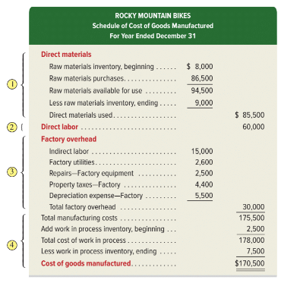
Manufacturing Statement
Exhibit 14.14
14-27
© McGraw-Hill Education
Learning Objective P2: Prepare a schedule of cost of goods manufactured and explain its purpose and links to financial statements.
Notes:
The schedule of cost of goods manufactured is divided into four parts: direct materials, direct labor, factory overhead, and computation of cost of goods manufactured.
Compute direct materials used. Add beginning raw materials inventory of $8,000 to the purchases of $86,500 to get $94,500 of raw materials available for use. A year-end count of inventory shows $9,000 of ending raw materials inventory. If $94,500 of materials were available for use and $9,000 of materials remain in inventory, then $85,500 of direct materials were used in the period.
Compute direct labor used. Total direct labor costs are $60,000 for the period. This includes wages, payroll taxes, and employee benefits for workers who make bikes.
Compute factory overhead used. The schedule lists each factory overhead cost. All of these costs are indirectly related to manufacturing activities. (Period expenses, such as selling expenses and general and administrative expenses, are not reported on this schedule.) Total factory overhead is $30,000.
Compute cost of goods manufactured. Total manufacturing costs are $175,500 ($85,500 + $60,000 + $30,000), the sum of direct materials, direct labor, and overhead. We take the $175,500 total manufacturing costs and add the $2,500 beginning work in process inventory to get total work in process of $178,000. We then subtract the $7,500 ending work in process inventory to get cost of goods manufactured of $170,500. Cost of goods manufactured is also called net cost of goods manufactured or cost of goods completed.

Slide 28
Key Calculations in Schedule of Cost of Goods Manufactured.
14-28
© McGraw-Hill Education
Learning Objective P2: Prepare a schedule of cost of goods manufactured and explain its purpose and links to financial statements.
Notes:
Management uses the schedule of cost of goods manufactured to plan and control manufacturing activities. To provide timely information for business decisions, the schedule is often prepared monthly, weekly, or even daily.
Estimating Cost Per Unit Managers use the schedule of cost of goods manufactured to estimate per unit costs. For example, if Rocky Mountain Bikes made 1,000 bikes during the year, the average manufacturing cost per unit is $170.50 (computed as $170,500/1,000).

Slide 29
Manufacturing Cost Flows Across Accounting Reports
Exhibit 14.15
14-29
© McGraw-Hill Education
Learning Objective P2: Prepare a schedule of cost of goods manufactured and explain its purpose and links to financial statements.
Notes:
Cost information is used in financial statements. Exhibit 14.15 shows how product costs affect financial statements. Direct materials, direct labor, and overhead costs are in the schedule of cost of goods manufactured. The cost of goods manufactured from that schedule is used to compute cost of goods sold on the income statement. The ending work in process inventory is carried from that schedule to the balance sheet, and both the balance sheet and income statement include finished goods inventory.

Slide 30
Describe trends in managerial accounting.
Learning Objective C4
14-30
© McGraw-Hill Education

Slide 31
Trends in Managerial Accounting
Digital Manufacturing
Customer Orientation
Global
Economy
Service Economy
E-Commerce
Lean Practices
Value Chain
14-31
Learning Objective C4: Describe trends in managerial accounting.
© McGraw-Hill Education
Notes:
Tools and techniques of managerial accounting continue to evolve due to changes in the business environment. This slide presents some of these changes.
Digital manufacturing: combines machines, computers, and human control to manufacture products. Humans then use data analytics and data visualizations to plan and control operations. Growth of digital manufacturing means employers seek employees with data analytics and visualization skills.
Data analytics is a process of analyzing data to identify meaningful relations and trends.
Data visualization is a graphical presentation of data to help people understand their meaning.
Customer orientation: managers and employees must understand the changing needs and wants of customers and align management and operations accordingly.
Global economy: our global economy expands competitive boundaries and provides customers more choices.
E-commerce: people are increasingly interconnected via smartphones, text messaging, and other electronic applications.
Service economy: businesses that provide services, such as telecommunications and health care, constitute an ever-growing part of our economy.
Lean principles: many companies have adopted a lean business model, whose goal is to eliminate waste while “satisfying the customer” and “providing a positive return” to the company. This is often paired with continuous improvement.
Value chain: the series of activities that add value to a company’s products or services.

Slide 32
Lean Principles
The goal of a lean business model is to eliminate waste while “satisfying the customer” and “providing a positive return” to the company.
Continuous improvement rejects the notion of “good enough” and challenges employees and managers to continuously improve operations.
14-32
Learning Objective C4: Describe trends in managerial accounting.
© McGraw-Hill Education
Notes:
Many companies have adopted a lean business model, whose goal is to eliminate waste while “satisfying the customer” and “providing a positive return” to the company. This is often paired with continuous improvement. Continuous improvement rejects the notion of “good enough” and challenges employees and managers to continuously improve operations. This has led companies to adopt practices such as total quality management (TQM) and just-in-time (JIT) manufacturing.

Slide 33
Total Quality Management
Quality improvement
applied to its
business activities.
Seek and uncover
waste.
Constant Focus on Higher Standards
14-33
Learning Objective C4: Describe trends in managerial accounting.
© McGraw-Hill Education
Notes:
Total quality management focuses on quality improvement to business activities. Managers and employees seek to uncover waste in business activities, including accounting activities such as payroll and disbursements.

Slide 34
Just-In-Time (JIT) Manufacturing
Receive customer orders
Complete products just-in-time to ship to customers
Schedule
Production
Receive materials just-in-time for production
Complete parts just-in-time for assembly into products
14-34
Learning Objective C4: Describe trends in managerial accounting.
© McGraw-Hill Education
Notes:
Just-in-time manufacturing is a system that acquires inventory and produces only after they receive an order (a demand-pull system) and then deliver the customer’s requirements on time. This means that processes must be aligned to eliminate delays and inefficiencies. Companies must establish good communications with their suppliers. On the downside, JIT is more susceptible to disruption than traditional systems. As one example, several General Motors plants were temporarily shut down due to a strike at a supplier which supplied components just in time to the assembly division.

Slide 35
Value Chain
Exhibit 14.16
The value chain refers to the series of principles that add value to a company’s products or services. Companies can use lean principles to increase efficiency and profits.
14-35
Learning Objective C4: Describe trends in managerial accounting.
© McGraw-Hill Education
Notes:
The value chain refers to the series of activities that add value to a company’s products or services. This slide illustrates a possible value chain for a retail cookie company. Companies can use lean practices across the value chain to increase efficiency and profits.

Slide 36
Corporate Social Responsibility
Corporations must consider demands of employees, suppliers, and society.
Corporate social responsibility (CSR) goes beyond law.
Triple bottom line focuses on financial, social and environmental measures.
Adopting a triple bottom line impacts how business report.
14-36
Learning Objective C4: Describe trends in managerial accounting.
© McGraw-Hill Education
Notes:
In addition to maximizing shareholder value, corporations must consider the demands of other stakeholders, including employees, suppliers, and society in general. Corporate social responsibility (CSR) is a concept that goes beyond following the law.
Triple bottom line, focuses on three measures: financial (“profits”), social (“people”), and environmental (“planet”).
Adopting a triple bottom line impacts how businesses report. In response to a growing trend of such reporting, the Sustainability Accounting Standards Board (SASB) was established to develop reporting standards for businesses’ sustainability activities. Some of the business sectors for which the SASB has developed reporting standards include health care, nonrenewable resources, renewable resources, and alternative energy.

Slide 37
Assess raw materials inventory management using raw materials inventory turnover and days’ sales in raw materials inventory.
Learning Objective A1
14-37
© McGraw-Hill Education

Slide 38
Raw Materials Inventory Turnover
Raw materials Inventory turnover = | Raw materials used
 | Average raw materials inventory
Beg material Inv. + End material Inv.
2
Where Average materials inventory =
Learning Objective A1: Assess raw materials inventory management using raw materials inventory turnover and days’ sales in raw materials inventory.
14-38
© McGraw-Hill Education
Notes:
A manager can assess how effectively a company manages its raw materials inventory by computing the raw materials inventory turnover ratio as shown in this slide.
This ratio reveals how many times a company turns over (uses in production) its raw materials inventory during a period. Generally, a high ratio of raw materials inventory turnover is preferred, as long as raw materials inventory levels are adequate to meet demand.

Slide 39
Days’ Sales in Raw Materials Inventory
Days’ sales in raw materials inventory = | Ending raw materials inventory
 | Raw materials used
X 365
Learning Objective A1: Assess raw materials inventory management using raw materials inventory turnover and days’ sales in raw materials inventory.
14-39
© McGraw-Hill Education
Notes:
To further assess raw materials inventory management, a manager can measure the adequacy of raw materials inventory to meet production demand. Days’ sales in raw materials inventory reveals how much raw materials inventory is available in terms of the number of days’ sales. It is a measure of how long it takes raw materials to be used in production.

Slide 40
End of Chapter 14
14-40
© McGraw-Hill Education

