Slide 1
Master Budgets and Planning
Chapter 20
Wild and Shaw
Financial and Managerial Accounting
9th Edition
Copyright ©2022 McGraw-Hill Education. All rights reserved. No reproduction or distribution without the prior written consent of McGraw-Hill Education.

Slide 2
Chapter 20 Learning Objectives
CONCEPTUAL
C1 Describe the benefits of budgeting.
ANALYTICAL
A1 Prepare a direct labor budget for a service firm and analyze revenue per employee.
PROCEDURAL
P1 Prepare the operating budgets of a master budget for a manufacturing company.
P2 Prepare a cash budget for a manufacturing company.
P3 Prepare budgeted financial statements.
P4 Prepare each component of a master budget for a merchandising company.
(Appendix 20A)
20-2
© McGraw-Hill Education

Slide 3
Describe the benefits of budgeting.
Learning Objective C1
20-3
© McGraw-Hill Education

Slide 4
Budgeting Process
Exhibit 20.1
Budgeting – process of planning future business actions
and expressing them as formal plans.
Budget – formal statement of a company’s plans in dollars.
Budgetary control process – management’s use of budgets
to see that planned objectives are met.
20-4
© McGraw-Hill Education
Learning Objective C1: Describe the benefits of budgeting.
Notes:
Managers must ensure that activities of employees and departments contribute to meeting the company’s overall goals. Budgeting is the process of planning future business actions and expressing them as formal plans. A budget is a formal statement of a company’s plans, expressed in dollars. Unlike long-term strategic plans, budgets typically cover shorter periods such as a month, quarter, or year.
The budgetary control process involves four steps: (1) develop the budget from planned objectives, (2) compare actual results to budgeted amounts and analyze differences, (3) take corrective and strategic actions, and (4) establish new objectives and a new budget.

Slide 5
Plan: focuses on future opportunities
and threats.
Control: provides benchmark for evaluating performance.
Motivate: budgeting performance levels provide
goals for employees to attain or exceed.
Coordinate: activities of all employees and departments to work toward the company’s overall goals.
Benefits of Budgeting
Communicate: management specific action plans to all employees.
20-5
© McGraw-Hill Education
Learning Objective C1: Describe the benefits of budgeting.
Notes:
Budgets benefit the key managerial functions of planning and controlling.
Plan: A budget focuses on future opportunities and threats to the organization. This focus on the future is important because the daily pressures of operating an organization can divert management’s attention from planning. Budgeting forces managers to plan for the future.
Control: The control function requires management to evaluate (benchmark) operations against some norm. Because budgeted performance considers important company, industry, and economic factors, a comparison of actual to budgeted performance provides an effective monitoring and control system. This comparison assists management in identifying problems and take corrective actions if necessary.
Coordinate: Budgeting helps to coordinate activities so that all employees and departments understand and work toward the company’s overall goals.
Communicate: Written budgets effectively communicate management’s specific action plans to all employees. When plans are not written down, conversations can lead to uncertainty and confusion among employees.
Motivate: Budgets can be used to motivate employees. Budgeted performance levels can provide goals for employees to attain or even exceed. Many companies provide incentives, like cash bonuses, for employee performance that meets or exceeds budget goals.

Slide 6
Budgeting and Human Behavior
Budgets can be a positive motivating force when:
Goals reflected in budget are challenging but attainable.
Employees affected by budget help prepare it.
Evaluations offer opportunities to explain differences between actual and budgeted amounts.
Potential negative outcomes include:
Pressure to meet results can employees to engage in unethical behavior or commit fraud.
Employees might understate sales budgets and overstate expense budgets to allow a cushion.
Employees might spend budgets on unnecessary items to ensure budget is not reduced next period.
20-6
© McGraw-Hill Education
Learning Objective C1: Describe the benefits of budgeting.
Notes:
Budgeting process has three important guidelines:
Goals reflected in a budget should be challenging but attainable.
Employees affected by a budget should help prepare it (participatory budgeting).
Evaluations offer opportunities to explain differences between actual and budgeted amounts.
Under participatory budgeting, potential negative outcomes of budgeted include:
1. Pressure to meet results can cause employees to engage in unethical behavior or commit fraud.
2. Employees may understate sales budgets and overstate expense budgets to allow cushion called budgetary slack.
3. Employees might spend their budgeted amounts, even on unnecessary items, to ensure their budget is not reduced next period.

Slide 7
Budget Reporting and Timing
Continuous budgeting applied by preparing rolling budgets.
Continually revise budgets as time passes.
Rolling budget – company revises entire set of budgets by adding new quarterly budget to replace the quarter just elapsed.
20-7
© McGraw-Hill Education
Learning Objective C1: Describe the benefits of budgeting.
Notes:
The budget period usually is tied to the company’s fiscal year. To help control operations the annual budget can be separated into quarterly or monthly budgets. These short-term budgets allow management to periodically evaluate performance and take timely corrective action.
Many companies apply continuous budgeting by preparing rolling budgets. In continuous budgeting, a company continually revises its budgets as time passes. In a rolling budget, a company revises its entire set of budgets by adding a new quarterly budget to replace the quarter that just elapsed. Thus, at any point in time, monthly or quarterly budgets are available for the next 12 months or four quarters.

Slide 8
Prepare the operating budgets of a master budget for a manufacturing company.
Learning Objective P1
20-8
© McGraw-Hill Education

Slide 9
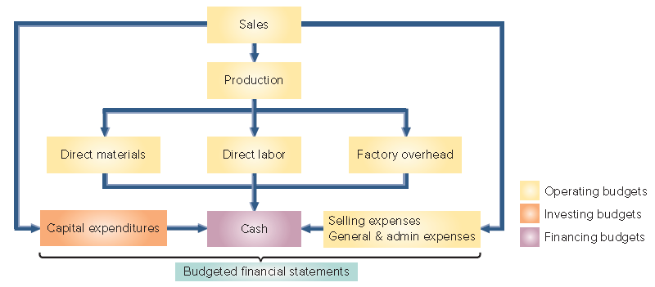
Master Budget Components
Exhibit 20.2
20-9
© McGraw-Hill Education
Learning Objective P1: Prepare the operating budgets of a master budget for a manufacturing company.
Notes:
A master budget is a formal, comprehensive plan that contains several interconnected budgets. Exhibit 20.2 summarizes the master budgeting process. The master budgeting process begins with the sales budget. The master budget includes individual budgets for sales, production (or merchandise purchases), expenses, capital expenditures, and cash. The process ends with preparation of budgeted financial statements.

Slide 10
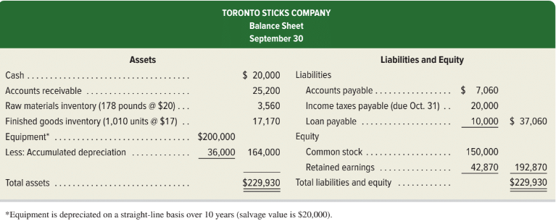
Master Budget Balance Sheet
Exhibit 20.3
20-10
© McGraw-Hill Education
Learning Objective P1: Prepare the operating budgets of a master budget for a manufacturing company.
Notes:
This chapter explains how Toronto Sticks Company (TSC), a manufacturer of hockey sticks, prepares its budgets. Its master budget includes operating, capital expenditures, and cash budgets for each month in each quarter. It also includes a budgeted income statement for each quarter and a budgeted balance sheet as of the last day of each quarter. We show how TSC prepares budgets for October, November, and December. Exhibit 20.3 presents TSC’s balance sheet at the start of this budgeting period, which we refer to in preparing the component budgets.

Slide 11
Sales Budget
In September, Toronto Sticks Company sold 700 hockey sticks at $60 each. Toronto Sticks prepared the following sales budget for the next three months:
Exhibit 20.4
20-11
© McGraw-Hill Education
Learning Objective P1: Prepare the operating budgets of a master budget for a manufacturing company.
Notes:
The first step in preparing the master budget is the sales budget, which shows the planned sales units and the budgeted dollars from these sales. The sales budget is the starting point in the budgeting process because many costs, such as variable costs, change with sales. The sales budget comes from analysis of forecasted economic and market conditions, business capacity, and advertising plans.
TSC sold 700 hockey sticks at $60 per unit in September. After considering sales predictions and market conditions, TSC prepares its sales budget for the next three months, and the three-month total. The sales budget in Exhibit 20.4 includes forecasts of both unit sales and unit prices.

Slide 12
Computing Production Requirements
A manufacturer prepares a production budget, which shows the number of units to be produced in a period.
The production budget is based on the unit sales projected in the sales budget, along with inventory considerations.
Exhibit 20.5
Note: A production budget does not show costs; it is always expressed in units of product.
20-12
© McGraw-Hill Education
Learning Objective P1: Prepare the operating budgets of a master budget for a manufacturing company.
Notes:
A manufacturer prepares a production budget, which shows the number of units to be produced in a period to meet budgeted sales and a desired inventory level.
Manufacturers often set a safety stock, a quantity of inventory that helps protect against lost sales caused by unfulfilled demands from customers or delays in shipments from suppliers. Exhibit 20.5 shows how to compute units to produce for a period. A production budget does not show costs; it is always expressed in units of product.
This slide depicts the general computation for the production required for a period. We start with budgeted ending inventory. Then, we add the budgeted sales units for the period which come from the Sales budget. This will give us the required units needed for the period. Then, we subtract the number of units in beginning finished inventory to get the total units to be produced in the period.

Slide 13
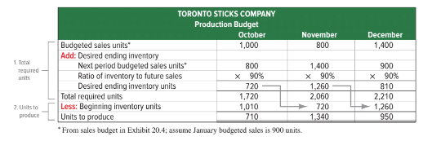
Production Budget
The production budget is based on the unit sales projected in the sales budget, along with inventory considerations.
Exhibit 20.6
20-13
© McGraw-Hill Education
Learning Objective P1: Prepare the operating budgets of a master budget for a manufacturing company.
Notes:
Starting in October, TSC decides that the number of units in its finished goods inventory at each month-end should equal 90% of next month’s budgeted sales. For example, inventory at the end of October should equal 90% of budgeted November sales, and so on. We can now prepare the production budget in Exhibit 20.6.
The production budget can be viewed in two parts.
Total required units. Budgeted sales units + Desired ending inventory units.
Units to produce. Total required units − Beginning inventory units.
This budget reports units to produce each period. Units to produce is the basis of the manufacturing budgets for direct materials, direct labor, and overhead.

Slide 14
Computing Materials to be Purchased
The direct materials budget is based on the production budget.
Expressed in costs.
20-14
© McGraw-Hill Education
Learning Objective P1: Prepare the operating budgets of a master budget for a manufacturing company.
Notes:
The direct materials budget shows the budgeted costs for direct materials that must be purchased to meet the budgeted production. Whereas the production budget shows units to produce, the direct materials budget translates the units to produce into budgeted costs.
Materials to be purchased is computed by multiplying units to be produced times the materials required per unit plus the desired ending materials inventory minus the beginning materials inventory.

Slide 15
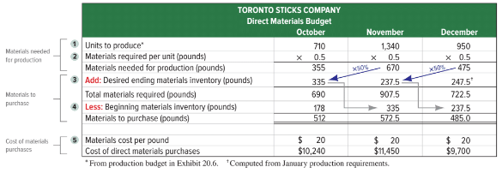
Direct Materials Budget
The direct materials budget shows the budgeted costs for the direct materials that will need to be purchased to satisfy the estimated production for the period
Exhibit 20.7
20-15
© McGraw-Hill Education
Learning Objective P1: Prepare the operating budgets of a master budget for a manufacturing company.
Notes:
The direct materials budget shows the budgeted costs for the direct materials that must be purchased to meet the budged production. Whereas the production budget shows units to be produced, the direct materials budget translates the units to be produced into budgeted costs.
Exhibit 20.7 shows the direct materials budget for TSC which has 5 steps to prepare it.
Enter units to produce from the production budget.
Enter materials required per unit. For TSC, this is 0.5 pound of wood required per unit. We then compute materials needed for production: for October, we take the 710 units to produce and multiply it by 0.5 pound to get 355 lbs.
Add desired ending materials inventory. For TSC, its policy (starting in October) is to have ending materials equal to 50% of next period’s materials needed. This is 335 lbs. for October (50% of 670).
Subtract beginning materials inventory. For TSC, this is 178 lbs. for October from Exhibit 20.3. We then compute materials to purchase, which is 512 lbs. (690 − 178).
Enter materials cost. Materials cost is $20 per pound. We then compute cost of direct materials purchases as $10,240 for October ($20 × 512 pounds).

Slide 16
Computing Cost of Direct labor
The direct labor budget is based on the production budget.
Expressed in costs.
20-16
© McGraw-Hill Education
Learning Objective P1: Prepare the operating budgets of a master budget for a manufacturing company.
Notes:
The direct labor budget shows the budgeted costs for the direct labor needed for the budgeted production for the period.
To develop a direct labor budget, companies need the following inputs:
1. Number of units to produce (from production budget).
2. Labor requirements per unit—direct labor hours for each unit of finished product.
3. Cost per direct labor hour.

Slide 17
Direct Labor Budget
The direct labor budget shows the budgeted costs for the direct labor that will be needed to satisfy the estimated production for the period.
Exhibit 20.8
20-17
© McGraw-Hill Education
Learning Objective P1: Prepare the operating budgets of a master budget for a manufacturing company.
Notes:
This exhibit shows the direct labor budget for TSC which has 3 steps to prepare it.
1 Enter units to produce from the production budget.
2 Enter labor hours required per unit. For TSC, this is 0.25 hour. We then compute direct labor hours needed. For TSC, we multiply the 710 units to produce in October by 0.25 hour to get 177.5 hours needed.
3 Enter labor cost per hour. For TSC, labor cost is $12 per hour. We then compute the cost of direct labor as $2,130 (177.5 hours x $12).

Slide 18
Factory Overhead Budget
The factory overhead budget shows the budgeted costs for factory overhead that are needed to complete the estimated production for the period.
Exhibit 20.9
The variable portion of factory overhead is assigned at the rate of $2.50 per unit of production. The fixed overhead is $1,500 per month.
20-18
© McGraw-Hill Education
Learning Objective P1: Prepare the operating budgets of a master budget for a manufacturing company.
Notes:
The factory overhead budget shows the budgeted costs for factory overhead that will be needed to complete the estimated production for the period. TSC separates variable and fixed overhead costs in its overhead budget, as do many companies.
Exhibit 20.9 shows the factory overhead budget for TSC which has three parts:
Compute budgeted variable overhead. This is the direct labor hours from Exhibit 20.8 multiplied by the variable overhead rate per direct labor hour, or 177.5 x $10 for October.
Compute budgeted fixed overhead. TSC’s fixed overhead consists entirely of depreciation on manufacturing equipment. From Exhibit 20.3, this is $18,000 per year [($200,000 – $20,000)∕10 years], or $1,500 per month ($18,000∕12 months).
Compute budgeted total overhead as the total of parts 1 and 2.
Variable cost items commonly include indirect materials, indirect labor, factory utilities, and maintenance of manufacturing equipment. Fixed cost items commonly include supervisor salaries, depreciation, and property taxes. We cover overhead budgets in detail in the next chapter

Slide 19
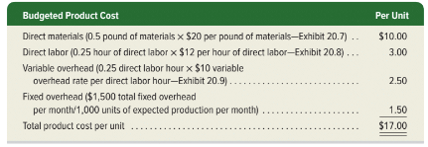
Product Cost Per Unit
TSC’s can compute product cost per unit from the three manufacturing budgets (direct materials, direct labor, and factory overhead).
For budgeting purposes, TSC assumes it will normally produce 3,000 units of product each quarter, yielding fixed overhead of $1.50 per unit. TSC’s other product costs are all variable.
Exhibit 20.10
20-19
© McGraw-Hill Education
Learning Objective P1: Prepare the operating budgets of a master budget for a manufacturing company.
Notes:
With the three manufacturing budgets (direct materials, direct labor, and factory overhead), we can compute TSC’s budgeted product cost per unit and prepare a cost of goods sold budget.
Exhibit 20.10 summarizes the product cost per unit calculation for TSC. The cost of direct materials is from Exhibit 20.7 and cost of direct labor is from Exhibit 20.8. The predetermined variable overhead rate is from Exhibit 20.9. To compute product cost per unit for fixed overhead, we note that TSC expects to produce, on average, 1,000 units per month, which means its fixed overhead per unit is $1.50 ($1,500/1,000 units). Total product cost per unit is $17.00.

Slide 20
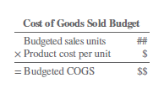
Cost of goods sold budget
The product cost per unit is used to prepare the:
Cost of goods sold budget
Budgeted income statement
20-20
© McGraw-Hill Education
Learning Objective P1: Prepare the operating budgets of a master budget for a manufacturing company.
Notes:
The budgeted product cost per unit is used to prepare the cost of goods sold budget. We use the budgeted sales units from Exhibit 20.4 multiplied by the budgeted cost per unit from Exhibit 20.10.

Slide 21
Selling Expense Budget
Exhibit 20.11
TSC pays sales commissions equal to 10 percent of total sales.
TSC pays a monthly salary of $2,000 to its sales manager.
20-21
© McGraw-Hill Education
Learning Objective P1: Prepare the operating budgets of a master budget for a manufacturing company.
Notes:
The selling expense budget shows the types and amounts of selling expenses expected during the budget period. TSC’s selling expense budget is in Exhibit 20.11. Its selling expenses consist of commissions of 10% of total sales paid to sales personnel and a $2,000 monthly salary paid to the sales manager. Sales commissions vary with sales volume, but the sales manager’s salary is fixed. Other common selling expenses include advertising and delivery expenses.

Slide 22
General and Administrative Expense Budget
Toronto Sticks Company has general and administrative salaries of $54,000 per year or $4,500 per month.
Exhibit 20.12
20-22
© McGraw-Hill Education
Learning Objective P1: Prepare the operating budgets of a master budget for a manufacturing company.
Notes:
The general and administrative expense budget reports those expenses expected during the budget period. Exhibit 20.12 shows TSC’s general and administrative expense budget. It reports administrative salaries of $4,500 per month. Other common examples of general and administrative expenses include property taxes, office expenses, and insurance and depreciation on non-manufacturing assets.

Slide 23
Prepare a cash budget for a manufacturing company.
Learning Objective P2
20-23
© McGraw-Hill Education

Slide 24
Capital Expenditures Budget
The capital expenditures budget reports expected cash receipts and cash payments related to the sale and purchase of plant assets.
20-24
© McGraw-Hill Education
Learning Objective P2: Prepare a cash budget for a manufacturing company.
Notes:
The capital expenditures budget reports expected cash receipts and cash payments related to the sale and purchase of plant assets. The capital expenditures budget is usually prepared after the operating budgets. The process of preparing operating budgets can reveal that the company requires more (or less) plant assets.
This slide includes the capital expenditures budget for TSC. TSC does not plan to dispose of any plant assets through December, but it does plan to buy equipment for $25,000 cash in December.

Slide 25
Cash Budget (Financing Budget)
The next step is to prepare the cash budget, which shows budged cash receipts and cash payments during the budget period.
The general formula for a cash budget is:
Exhibit 20.13
20-25
© McGraw-Hill Education
Learning Objective P2: Prepare a cash budget for a manufacturing company.
Notes:
A cash budget shows budgeted cash receipts and cash payments during the budget period. Managing cash flows is vital and a cash budget helps with that task. Most companies set a minimum cash balance to have available. If the cash budget indicates cash is below this minimum, the company can arrange loans. If the cash budget indicates cash above the minimum, the company can plan to pay off loans. Exhibit 20.13 shows the layout for the cash budget.
When preparing a cash budget, add budgeted cash receipts to the beginning cash balance and subtract budgeted cash payments. the layout for the cash budget.

Slide 26
Budgeted Cash Receipts from Sales
Exhibit 20.14
From TSC’ sales budget
Cash sales are 40% of each month’s sales.
Accounts receivable balance at the end of each month is 60% of that month’s budgeted sales.
© McGraw-Hill Education
20-26
Learning Objective P2: Prepare a cash budget for a manufacturing company.
Notes:
Managers use the sales budget, combined with knowledge about how frequently customers pay on credit sales, to budget monthly cash receipts.
We begin with budgeted sales. Analysis of past sales indicates that 40% of sales are for cash. The remaining 60% are credit sales; these customers are expected to pay in full in the month following the sales. For example, October’s budgeted cash receipts consist of $24,000 from October cash sales ($60,000 × 40%) plus the anticipated collection of $25,200 ($42,000 x 60%) from September credit sales.

Slide 27
Budgeted Cash Receipts: Timing
© McGraw-Hill Education
20-27
Learning Objective P2: Prepare a cash budget for a manufacturing company.
Notes:
Collection of Credit Sales over Several Periods When credit sales take several periods to collect, the collections from prior periods reflect the multi-period collection pattern. For example, if TSC collects credit sales over two months such as 80% of credit sales in the first month after the sale and 20% of credit sales in the second month after the sale, and cash sales remain at 40% of current sales, budgeted cash receipts for December are shown here.
Uncollectible Accounts Let’s consider uncollectible accounts and assume that 5% of credit sales are uncollectible. For the remaining 95% that are collectible, assume TSC collects 80% of credit sales in the first month after sale and collects 15% of credit sales in the second month after sale. The schedule of cash receipts for December is shown here.

Slide 28
Cash Payments for Direct Materials
Exhibit 20.15
Payments Over Several Periods
20-28
© McGraw-Hill Education
Learning Objective P2: Prepare a cash budget for a manufacturing company.
Notes:
Managers prepare a schedule of cash payments for direct materials. To do this, managers must know how direct materials are purchased (with cash or on credit) and, if on credit, when payment is made. TSC’s materials purchases are entirely on credit. It makes full payment in the month following purchases. Using this information, the schedule of cash payments for direct materials is in Exhibit 20.15.
Payment of Materials over Several Periods When payment for materials occurs over several periods, the payments for those prior periods reflect the multi-period payment pattern. For example, if TSC pays for 20% of purchases in the month of purchase and pays for 80% of purchases in the month after purchase, then its schedule of cash payments for direct materials is as shown in the bottom schedule on this slide.

Slide 29
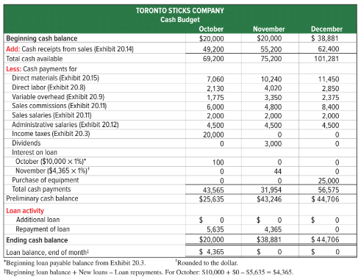
Preparing Cash Budget
Exhibit 20.16
20-29
© McGraw-Hill Education
Learning Objective P2: Prepare a cash budget for a manufacturing company.
Notes:
To prepare the cash budget, managers use the cash receipts and cash payments from several budgets and schedules. Exhibit 20.16 shows the cash budget for TSC. The company begins October with $20,000 in cash (see Exhibit 20.3). We add $49,200 in cash receipts from customers. We then subtract $43,565 in cash payments for direct materials, direct labor, overhead, selling expenses, general and administrative expenses and income taxes due and paid in October. A few additional points about TSC’s cash budget:
Fixed overhead from depreciation in the factory overhead budget (Exhibit 20.9) does not require a cash payment. Therefore, it is not in the cash budget. Other fixed overhead—such as payments for factory property taxes and insurance—are included if they require cash payments.
It announces plans to pay $3,000 of cash dividends in November.
It sets a minimum cash balance of $20,000 at each month-end. If TSC borrows cash, it must pay interest at 1% per month.
The October 31 preliminary cash balance is $25,635 (before any loan activity). This amount is more than the $20,000 minimum. TSC uses the excess cash of $5,635 ($25,635 – $20,000) to pay off a portion of its loan. Looking at November, TSC’s preliminary cash balance is $43,246, and its $23,246 excess is sufficient to pay off its entire loan balance.

Slide 30
Preparing the Cash Budget – Loan Activity
20-30
© McGraw-Hill Education
Learning Objective P2: Prepare a cash budget for a manufacturing company.
Notes:
Interest on Loan Activity If the cash balance exceeds $20,000 at month-end, TSC uses the excess to repay loans. If the cash balance is below $20,000 at month-end, TSC takes out a loan for the shortage. Interest on loans is computed as the beginning loan balance times interest rate %.
Using TSC’s interest rate of 1% per month, budgeted cash payments for interest follow and are reported in Exhibit 20.16.

Slide 31
Prepare budgeted financial statements.
Learning Objective P3
20-31
© McGraw-Hill Education

Slide 32
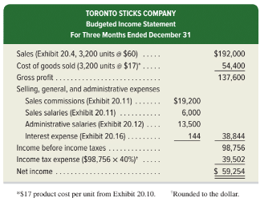
Budgeted Income Statement
Exhibit 20.17
All information in the budgeted income statement is taken from the component budgets we’ve examined on previous slides.
The predicted amount of income tax expense for the quarter, computed as 40% of the budgeted pretax income, is included.
20-32
© McGraw-Hill Education
Learning Objective P3: Prepare budgeted financial statements.
Notes:
Now that we have completed the cash budget, we are ready to prepare a budgeted income statement for the quarter. The budgeted income statement shows budgeted sales and expenses for the budget period. Let’s look at the budgeted income statement for TSC.
TSC’s budgeted income statement is in Exhibit 20.17. All information is taken from budgets in this chapter. We predict income tax expense, as 40% of the budgeted income before income taxes. These taxes are not payable until next year and are not included on this quarter’s cash budget.

Slide 33
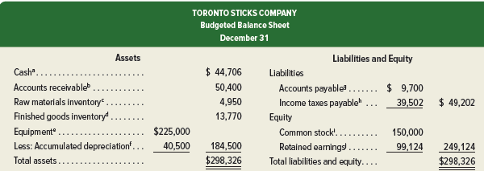
Budgeted Balance Sheet
Exhibit 20.18
20-33
© McGraw-Hill Education
Learning Objective P3: Prepare budgeted financial statements.
Notes:
The budgeted balance sheet shows budgeted amounts for assets, liabilities, and equity as of the end of the budget period. TSC’s budgeted balance sheet in Exhibit 20.18 is prepared using information from other budgets. Sources of amounts are in notes to the budgeted balance sheet.
TSC’s budgeted balance sheet is shown on this slide. It is prepared using information from the other budgets.
a. Ending balance for December from the cash budget (in Exhibit 20.16).
b. 60% of $84,000 sales budgeted for December from the sales budget (in Exhibit 20.4).
c. 247.5 pounds of raw materials in budgeted ending inventory at the budgeted cost of $20 per pound (direct materials budget, in Exhibit 20.7).
d. 810 units in budgeted finished goods inventory (Exhibit 20.6) at the budgeted cost of $17 per unit (Exhibit 20.10).
e. September 30 balance of $200,000 from the beginning balance sheet in Exhibit 20.3 plus $25,000 cost of new equipment from the cash budget in Exhibit 20.16.
f. September 30 balance of $36,000 from the beginning balance sheet in Exhibit 20.3 plus $4,500 depreciation expense from the factory overhead budget in Exhibit 20.9.
g. Budgeted cost of materials purchases for December from Exhibit 20.7, to be paid in January.
h. Income tax expense from the budgeted income statement for the fourth quarter in Exhibit 20.17, to be paid in January.
i. Unchanged from the beginning balance sheet in Exhibit 20.3.
j. September 30 balance of $42,870 from the beginning balance sheet in Exhibit 20.3 plus budgeted net income of $59,254 from the budgeted income statement in Exhibit 20.17 minus budgeted cash dividends of $3,000 from the cash budget in Exhibit 20.16.

Slide 34
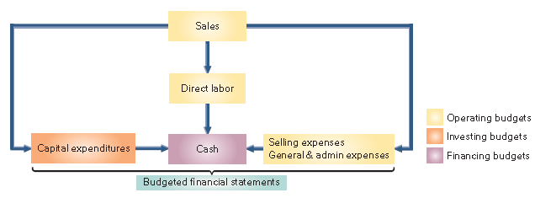
Budgeting for Service Companies
Service providers also use master budgets but typically need fewer operating budgets than manufacturers.
Important budgets for a service companies include:
Exhibit 20.19
20-34
© McGraw-Hill Education
Learning Objective P3: Prepare budgeted financial statements.
Notes:
Service providers also use master budgets. Since service providers do not manufacture goods and hold no inventory, they typically need fewer operating budgets than manufacturers do. Exhibit 20.19 shows the master budget process for a service provider.
From Exhibit 20.19, service providers do not prepare production, direct materials, or factory overhead budgets. In addition, since many services such as accounting, banking, and landscaping are labor-intensive, the direct labor budget is especially important.

Slide 35
Prepare a direct labor budget for a service firm and analyze revenue per employee.
Learning Objective A1
© McGraw-Hill Education
20-35

Slide 36
Direct Labor Budget
Exhibit 20.21
20-36
© McGraw-Hill Education
Learning Objective A1: Prepare a direct labor budget for a service firm and analyze revenue per employee.
Notes:
A direct labor budget is the key budget for a service firm. If an accounting firm underestimates the direct labor hours needed to complete an audit, it might charge too low a price. If the accounting firm overestimates the direct labor hours needed, it might bid too high a price (and lose jobs). Either way, income suffers if direct labor budgets are inaccurate.
The direct labor cost for each employee is shown here.
Exhibit 20.21 shows the direct labor budget for a services job. The firm would use the $6,200 total direct labor cost in determining a price to bid for the job.

Slide 37
Revenue per Employee
20-37
© McGraw-Hill Education
Learning Objective A1: Prepare a direct labor budget for a service firm and analyze revenue per employee.
Notes:
Services and other types of businesses can assess effectiveness of their workforce using revenue per employee, a ratio which measures the revenue generated per employee and is computed as shown here.
Revenue per employee is shown for Microsoft and Hewlett Packard. Microsoft’s revenue per employee increased during the current year, suggesting the company’s workforce became more effective in generating revenue. However, current year revenue per employee is higher for its competitor Hewlett Packard.

Slide 38
Appendix A Prepare each component of a master budget for a merchandising company.
Learning Objective P4
20-38
© McGraw-Hill Education

Slide 39
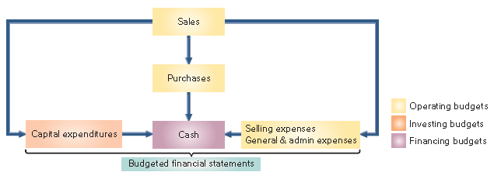
Master Budget Process for a Merchandiser
Unlike a manufacturing company, a merchandiser must prepare a merchandise purchases budget rather than a production budget.
Exhibit 22A.1
20-39
Learning Objective P4: Prepare each component of a master budget for a merchandising company.
© McGraw-Hill Education
Notes:
Unlike a manufacturing company, a merchandiser must prepare a merchandise purchases budget rather than a production budget. In addition, a merchandiser does not prepare direct materials, direct labor, or factory overhead budgets. Let’s look at the merchandise purchases budget for Hockey Den (HD), a retailer of hockey sticks.

Slide 40
Preparing the Merchandise Purchases Budget
The general layout for the purchases budget in equation form is:
Exhibit 22A.2
Let’s prepare the purchases budget for Hockey Den.
20-40
Learning Objective P4: Prepare each component of a master budget for a merchandising company.
© McGraw-Hill Education
Notes:
A merchandiser usually expresses a merchandise purchases budget in both units and dollars. The slide shows the general layout for this budget. If only one product is involved, we can compute the number of dollars of inventory to be purchased for the budget by multiplying the units to be purchased by the cost per unit.
A merchandise purchases budget, consists of 3 parts:
1. Budgeted sales units. HD predicts unit sales as follows: October, 1,000; November, 800; December, 1,400, and January, 900.
2. Desired ending inventory units. Starting with October, HD set a policy that ending inventory units should equal 90% of next month’s budgeted sales. For example, inventory units at the end of October should equal 90% of November’s budgeted sales units.
3. Cost of merchandise purchases. HD expects the per unit purchase cost of $60 to remain unchanged through the budgeting period. Given 1,010 units are in inventory at September 30, HD can prepare the merchandise purchases budget shown in Exhibit 20A.3.

Slide 41
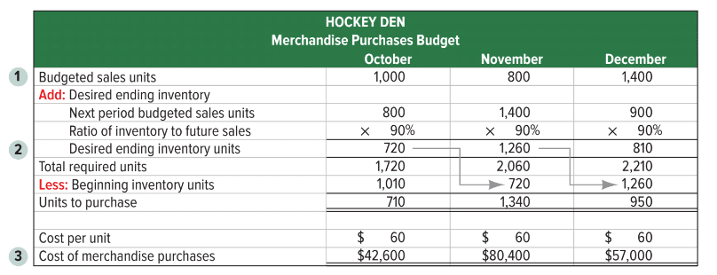
Merchandise Purchases Budget
Exhibit 22A.3
Ending inventory for a month in units, should equal 90% of next month’s unit sales.
20-41
© McGraw-Hill Education
Learning Objective P4: Prepare each component of a master budget for a merchandising company.
Notes:
Toronto Sticks Company is an exclusive supplier of hockey sticks to HD, meaning that the companies use the same budgeted sales figures in preparing budgets. To prepare the merchandise purchases budget, we need three key inputs:
Budget sales units. HD predicts unit sales as: October, 1,000; November, 800; December, 1,400; January, 900.
Desired ending inventory units. HD set a policy that ending inventory should equal 90% of next month’s predicted sales. For example, inventory units at the end of October should equal 90% of November’s budgeted sales units.
Cost. HD expects the per unit purchase cost of $60 to remain unchanged through the budgeting period.
Given 1,010 units are in inventory at September 30, HD can prepare the merchandise purchases budget shown in Exhibit 20A.3.

Slide 42
Schedule of Cash Payments for Merchandise Purchases
Exhibit 22A.4
Subtract beginning inventory to determine the budgeted number of units to be purchased.
20-42
© McGraw-Hill Education
Learning Objective P4: Prepare each component of a master budget for a merchandising company.
Notes:
Using the budgeted cost of merchandise purchases from Exhibit 20A.3, and given September purchases of $50,000, Hockey Den’s schedule of cash payments for merchandise is in Exhibit 20A.4. HD pays 40% of a month’s purchases in the month of purchase, and the remaining 60% is paid in the month after purchase.

Slide 43
End of Chapter 20
20-43
© McGraw-Hill Education

