Slide 1
Relevant Costs for Managerial Decisions
Chapter 23
Wild and Shaw
Financial and Managerial Accounting
9th Edition
Copyright ©2022 McGraw-Hill Education. All rights reserved. No reproduction or distribution without the prior written consent of McGraw-Hill Education.

Slide 2
Chapter 23 Learning Objectives
CONCEPTUAL
C1 Describe the use of relevant costs and benefits for short-term decisions.
ANALYTICAL
A1 Determine price of services using time and materials pricing.
PROCEDURAL
P1 Evaluate make or buy decisions.
P2 Evaluate sell or process decisions.
P3 Determine sales mix with constrained resources.
P4 Evaluate segment elimination decisions.
P5 Evaluate keep or replace decisions.
P6 Determine product selling price.
P7 Evaluate special offer decisions.
23-2
© McGraw-Hill Education

Slide 3
Describe the use of relevant costs and benefits for short-term decisions.
Learning Objective C1
23-3
© McGraw-Hill Education

Slide 4
Decision Making
Decision making has five steps:
Exhibit 23.1
23-4
© McGraw-Hill Education
Learning Objective C1: Describe the use of relevant costs and benefits for short-term decisions.
Notes:
Managerial decision making has five steps: (1) Define the decision, (2) identify alternatives, (3) collect relevant information and evaluate alternatives, (4) select the course of action, and (5) analyze and assess decisions made. These five steps are illustrated in Exhibit 23.1. Managers use financial information, like expected revenues and costs, for decision making. Nonfinancial information is also important and includes environmental and social data.

Slide 5
Relevant Costs and Benefits
Incremental revenues: additional revenues generated by selecting one action over another.
Incremental costs: additional costs incurred if a company pursues a certain course of action.
Incremental income: incremental revenues minus incremental costs.
Rule: choose alternative that most increases income.
23-5
© McGraw-Hill Education
Learning Objective C1: Describe the use of relevant costs and benefits for short-term decisions.
Notes:
Managers must be able to distinguish between relevant and irrelevant costs and benefits. Relevant costs and benefits must be considered in managerial decisions. Irrelevant costs and benefits must be ignored for managerial decisions. Relevant costs and benefits are future-oriented, tied to cash flows, and/or focus on incremental effects across alternative managerial decisions. Those incremental, also called differential or avoidable, effects are important to identify so good managerial decisions are made.
Incremental revenues are additional revenues generated by selecting a certain course of action over another.
Incremental costs, or differential costs, are the additional costs incurred if a company pursues a certain course of action.
Incremental income is incremental revenues minus incremental costs. A good rule of thumb is to choose the alternative that most increases incremental income.

Slide 6
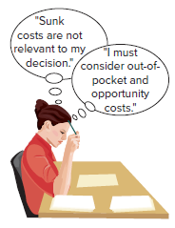
Relevant vs. Irrelevant Costs
Sunk cost arises from a past decision and cannot be avoided or changed. Sunk costs are irrelevant to current and future decisions.
Out-of-pocket cost requires a future outlay of cash. Out-of-pocket costs are relevant.
Opportunity cost is the potential benefit lost by taking an action over an alternative action. Opportunity costs are relevant.
Avoidable cost can be eliminated by choosing one alternative versus another. Avoidable costs are relevant.
23-6
© McGraw-Hill Education
Learning Objective C1: Describe the use of relevant costs and benefits for short-term decisions.
Notes:
Four types of costs are important when distinguishing relevant costs including:
Sunk costs which arise from a past decision and cannot be avoided or changed; it is irrelevant to current and future decisions. An example is the $1,000 we previously paid for a smartphone. That sunk cost is not relevant to a decision to replace it if it breaks. Likewise, depreciation of the original cost of an asset is a sunk cost. Most of a company’s allocated costs, including fixed overhead, are sunk costs.
Out-of-pocket cost requires a future outlay of cash and is relevant for decisions. For instance, the cost of a future phone purchase is relevant to the decision of whether to replace a phone.
Opportunity cost is the potential benefit lost by taking a specific action instead of alternative actions. They are relevant to many managerial decisions. An example is a student giving up wages from a job to attend summer school. The lost wages are part of the cost of attending summer school. Although opportunity costs are not entered in accounting records, they are relevant to many managerial decisions.
Avoidable cost is a cost that can be eliminated by choosing one alternative versus another; an avoidable cost is always relevant. An example is an employee salary that is avoidable if their work is automated.

Slide 7
Evaluate make or buy decisions.
Learning Objective P1
© McGraw-Hill Education
23-7

Slide 8
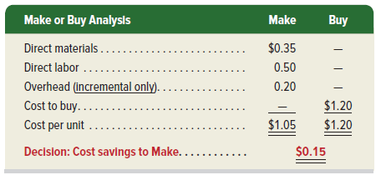
Make or Buy Analysis
FasTrac currently buys a key part for $1.20 per unit.
Cost to make is $1.05 and includes direct materials, direct labor, and incremental overhead.
Exhibit 23.2
Decision rule: Make the part to save $0.15 per unit.
23-8
© McGraw-Hill Education
Learning Objective P1: Evaluate make or buy decisions.
Notes:
Buying goods or services from an external supplier is called outsourcing. The decision to make or buy depends on the costs of each alternative. To illustrate, let’s look at FasTrac, an exercise supplements and equipment manufacturer operating at 80% of capacity, and consider its production decisions.
FasTrac currently buys a key part for its main product for $1.20 per unit. With excess capacity, making this part would incur per unit variable costs of $0.35 for direct materials and $0.50 for direct labor. As shown on your screen, the unit cost of the part includes direct material, direct labor, and factory overhead. Management must also consider incremental overhead costs which include power for operating machines, extra supplies, and added cleanup costs. Management estimates this incremental overhead at $0.20 per unit.
Our cost per unit analysis is shown in this exhibit. The cost to make the part is $1.05 which is less than the $1.20 cost to buy it.
Decision rule: Cost savings to MAKE is $0.15 per unit.
Additional Factors While it is less costly to make the part in this case, the company also should consider nonfinancial factors. These include product quality, timeliness of delivery, reactions of suppliers, and employee morale and workload. When additional factors are considered, small cost per unit differences might not matter.

Slide 9
Evaluate sell or process decisions.
Learning Objective P2
23-9
© McGraw-Hill Education

Slide 10
Sell or Process
Companies must decide whether to sell partially completed products as is or to process them as other products.
Decision depends on the costs and revenues of processing further.
Company will select the action with the higher income.
23-10
© McGraw-Hill Education
Learning Objective P2: Evaluate sell or process decisions.
Notes:
Many companies must decide whether to sell partially completed products as is or to process them further into other products. For example, a peanut grower could sell its peanut harvest as is, or it could process peanuts further into other products such as peanut butter, peanut oil, and peanut lotion. The decision depends on the incremental costs and revenues of processing further.
To illustrate, suppose a company has spent $30,000 to harvest peanuts. The company can sell the peanuts to another manufacturer as raw material for $50,000. Alternatively, it can process them further and produce a nutritional supplement. Processing further costs an additional $80,000 and will result in revenues of $150,000. The company must decide whether selling as is or processing further produces the higher income.

Slide 11
Sell or Process Analysis
Exhibit 23.3
The $30,000 of previously incurred costs are excluded from the analysis. These costs are sunk costs and are not relevant!
Decision rule: Select the alternative with the higher income.
Company should process further to earn $20,000
of incremental income ($70,000 – $50,000).
23-11
© McGraw-Hill Education
Learning Objective P2: Evaluate sell or process decisions.
Notes:
Exhibit 23.3 shows the sell or process analysis. The income of $70,000 from processing further is greater than the income of $50,000 from selling as is. The company should process further and earn $20,000 of incremental income ($70,000 - $50,000). The $30,000 of previously incurred harvesting costs are excluded from the analysis. Those are sunk costs and are not relevant to the decision.
Decision rule: Select the action with the higher income, so they will process further to earn $20,000 incremental income.

Slide 12
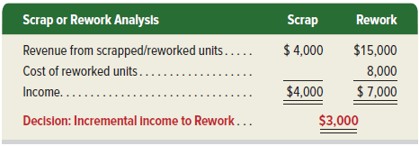
Scrap or Rework
Variation of sell or process is scrap or rework.
Often in manufacturing, we have products that do not pass inspection and are therefore, defective. We can either scrap them or rework them.
Decision rule: selection option with highest income.
Exhibit 23.4
23-12
© McGraw-Hill Education
Learning Objective P2: Evaluate sell or process decisions.
Notes:
A variation of the sell or process decision is the scrap or rework decision. Manufacturing processes sometimes yield defective products. Managers must decide whether to scrap or rework these products.
Assume that FasTrac has 1,000 defective units of a product that have already cost $10,000 to manufacture. These units can be sold as scrap for $4,000, or they can be reworked for $8,000 and then sold for $15,000. Should FasTrac sell the units as scrap or rework them?
The $10,000 manufacturing cost already incurred is a sunk cost and is irrelevant. The $4,000 revenue as scrap is the opportunity cost of reworking and is relevant. Analysis is in this exhibit. FasTrac should rework the units and obtain $3,000 ($7,000 - $4,000) of incremental income.

Slide 13
Determine sales mix with constrained resources.
Learning Objective P3
23-13
© McGraw-Hill Education

Slide 14
Sales Mix When Resources Constrained
When a company sells a variety of products, some are likely to be more profitable than others.
Management looks for most profitable sales mix of products.
If production facilities are limited, producing more of one product usually means producing less of others.
In this case, management must identify the most profitable combination, or sales mix of products.
Management focuses on the contribution margin per unit of scarce resource.
23-14
© McGraw-Hill Education
Learning Objective P3: Determine sales mix with constrained resources.
Notes:
When a company sells a variety of products and its production facilities are constrained, management looks for the most profitable sales mix of products. Management focuses on the contribution margin per unit of scarce resource.

Slide 15
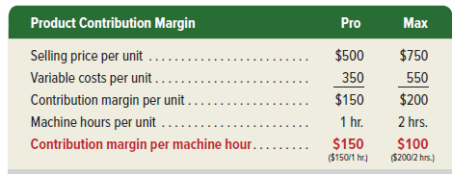
Sales Mix When Resources are Constrained – Illustration
Company makes and sells two models of scooters, using the same machines.
Pro uses one machine hour per unit; Max uses two machine hours per unit. We need to determine each product’s contribution margin per machine hour.
Exhibit 23.5
Decision rule: Produce the model that yields the highest contribution margin per machine hour until market demand is satisfied.
Pro model has a higher contribution margin of $150 per machine hour. The company should produce as many units of Pro as possible, up to market demand.
© McGraw-Hill Education
23-15
Learning Objective P3: Determine sales mix with constrained resources.
Notes:
To illustrate, let’s look at a company that makes two models of scooters with selling prices and variable costs in Exhibit 23.5. The same machines are used to produce both models. The company has a capacity of 2,000 machine hours (MH) per year. Pro model uses 1 machine hour per unit while Max uses 2 machine hours per unit. The company should produce the model that yields the highest contribution margin per machine hour, until market demand is satisfied.
Exhibit 23.5 shows the contribution margin per machine hour for both models. The Pro model has a higher contribution margin of $150 per machine hour. The company should produce as many units of Pro as possible, up to the market demand.

Slide 16
Sales Mix When Resources are Constrained and Unlimited Demand - Illustration
Company makes and sells two models of scooters, using the same machines.
Pro uses one machine hour per unit; Max uses two machine hours per unit. We need to determine each product’s contribution margin per machine hour.
Exhibit 23.6
Decision rule: If demand for products is unlimited, devote all machine hours to production of the most profitable product (per unit of scarce resource).
23-16
© McGraw-Hill Education
Learning Objective P3: Determine sales mix with constrained resources.
Notes:
Unlimited Demand:
If the market will buy all that the company can produce, the company should devote all 2,000 machine hours to production of the Pro model (2,000 MH / 1MH per unit = 2,000 units of Pro), and none to the Max model. This sales mix would yield a contribution margin of $300,000 per year, the maximum the company could make under the existing capacity of 2,000 machine hours per year as shown in Exhibit 23.6.

Slide 17
Sales Mix When Resources are Constrained and Limited Demand - Illustration
Company makes and sells two models of scooters, using the same machines.
Pro uses one machine hour per unit; Max uses two machine hours per unit. We need to determine each product’s contribution margin per machine hour.
Exhibit 23.7
Decision rule: If demand for products is limited, produce the most profitable product (per unit of scarce resource) up to point of total demand. Use remaining capacity to produce the next most profitable product.
23-17
© McGraw-Hill Education
Learning Objective P3: Determine sales mix with constrained resources.
Notes:
Limited Demand:
If demand for the Pro model is limited to 1,200 units, the company will first produce 1,200 units of Pro using 1,200 machine hours required to make them. This leaves 800 machine hours to produce the Max model. The 800 MH result in 400 Max scooters as each Max requires 2 MH to make. This sales mix yields a $220,000 contribution margin in Exhibit 23.7.
Decision rule: If product demand is limited, produce the product with the highest contribution margin per unit of scarce resource up to its total demand. Use remaining capacity to produce the product with the next highest contribution margin per unit of scarce resource.

Slide 18
Evaluate segment elimination decisions.
Learning Objective P4
23-18
© McGraw-Hill Education

Slide 19
Segment Elimination
A segment is a candidate for elimination if its contribution margin is less than its avoidable fixed costs.
Avoidable costs are amounts that are eliminated when the segment is eliminated.
Unavoidable costs are amounts that would remain even if the segment was eliminated.
© McGraw-Hill Education
23-19
Learning Objective P4: Evaluate segment elimination decisions.
Notes:
When a segment of a business is performing poorly, management must consider eliminating it. Segments with contribution margin less than avoidable fixed costs are candidates for elimination.
Avoidable costs: are eliminated when the segment is eliminated; they include all variable costs and direct fixed costs such as rent on that segment’s space and insurance on that segment’s eliminated equipment.
Unavoidable costs: remain even if the segment is eliminated; these costs are allocated to remaining segments when a segment is eliminated.

Slide 20
Segment Income
Exhibit 23.8
Decision Rule: A segment should be eliminated if income increases from elimination. It should continue if income decreases from elimination.
23-20
© McGraw-Hill Education
Learning Objective P4: Evaluate segment elimination decisions.
Notes:
FasTrac reports results for its three segments in Exhibit 23.8. Total income is $95,000. However, its Treadmill segment shows a $10,000 loss. Management is considering eliminating its Treadmill segment. We must be careful as some segment costs might be unavoidable even if the segment is eliminated.
Decision rule: A segment should be eliminated if income increases from elimination; it should continue if income decreases from elimination.

Slide 21
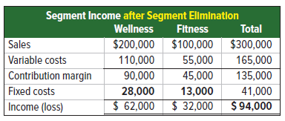
Segment Elimination Analysis
Exhibits 23.9 & 23.10
23-21
© McGraw-Hill Education
Learning Objective P4: Evaluate segment elimination decisions.
Notes:
Eliminating the Treadmill division would eliminate its sales, variable costs, and contribution margin. Its $15,000 in fixed costs consists of $4,000 in avoidable costs and $11,000 in unavoidable costs. The $11,000 in unavoidable costs would be reallocated to Wellness ($8,000) and Fitness ($3,000). Revised results are in Exhibit 23.9. We see that if the Treadmill segment is eliminated, total income decreases by $1,000, from $95,000 to $94,000. This means the Treadmill segment should continue.
The same decision is made using the segment elimination analysis in Exhibit 23.10. The Continue column shows Treadmill results for the current period. The Eliminate column shows what items remain after the segment is eliminated. We see $0 for sales, variable costs, and contribution margin as they all disappear if the segment is eliminated. The Eliminate column does show $11,000 of fixed costs that are unavoidable even if the segment is eliminated.
The Income Increase (Decrease) column shows the $1,000 decreased income if the segment is eliminated. This indicates the segment should not be eliminated and is the same result from comparing Exhibit 23.8 to Exhibit 23.9.
Decision rule: A segment should be eliminated if income increases from elimination; it should continue if income decreases from elimination.

Slide 22
Evaluate keep or replace decisions.
Learning Objective P5
23-22
© McGraw-Hill Education

Slide 23
Keep or Replace
Managers must periodically decide whether to keep using a plant asset or replace it.
Compare revenues and costs of keeping the old asset versus replacing it with a new asset.
Decision rule: Replace an asset if overall income increases. Keep the asset if overall income decreases with replacement.
23-23
© McGraw-Hill Education
Learning Objective P5: Evaluate keep or replace decisions.
Notes:
Managers periodically must decide whether to keep using a plant asset such as equipment or to replace it. Advances in technology typically mean newer equipment can operate more efficiently and at lower cost.
The keep or replace analysis compares the revenues and costs of keeping the old asset versus replacing with the new asset. Relevant revenues and costs include any change in variable manufacturing costs with the new asset and the net cost of the new asset (computed as its purchase price minus any trade-in allowance or cash received from sale of the old asset).
Decision rule: Replace an asset if income increases (but keep the asset if income decreases) from the replacement.

Slide 24
Keep or Replace Analysis
FasTrac is considering replacing an existing machine with a new machine.
Exhibit 23.11
Decision rule: Keep the current machine
23-24
© McGraw-Hill Education
Learning Objective P5: Evaluate keep or replace decisions.
Notes:
To illustrate, FasTrac is considering replacing an existing machine with a new machine.
The keep or replace analysis is in Exhibit 23.11. We should keep the existing machine because the new machine will decrease overall income by $5,000. The $20,000 book value of the old machine is not relevant as book value is a sunk cost and cannot be changed.
Decision rule: Keep the current machine.

Slide 25
Determine product selling price.
Learning Objective P6
23-25
© McGraw-Hill Education

Slide 26
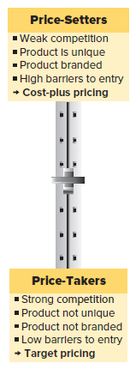
Normal Pricing
Companies can be a price taker or a price setter (or somewhere in between).
Price takers have less control over setting prices.
Price setters have more control over setting prices.
Price takers use more target pricing type methods.
Price setters use more cost-plus pricing.
© McGraw-Hill Education
23-26
Learning Objective P6: Determine product selling price.
Notes:
Pricing decisions are one of the more important decisions that managers make. It is also one of the most difficult decisions. Managers must take concepts involving supply and demand and apply that to its product or service pricing. For that purpose it is important for managers to understand the setting in which they set prices.
Companies can be price takers or price setters or anywhere in between these extremes. The graphic below reflects this range and the characteristics of companies at the extremes. Price takers have less control over setting prices, whereas price setters have more control. Price takers use more target pricing type methods, and price setters use more cost-plus pricing. Most companies lie somewhere in between these extremes. We describe three normal pricing methods.

Slide 27
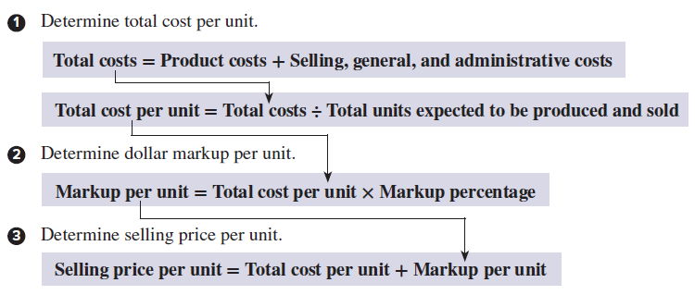
Cost-Plus Methods
Cost-plus pricing methods common when companies are price-setters.
Management adds a markup to cost to get selling price.
23-27
© McGraw-Hill Education
Learning Objective P6: Determine product selling price.
Notes:
Cost-plus methods are common when companies are price-setters. Management adds a markup to cost to get selling price: Selling price per unit = Cost per unit + Markup per unit.
The total cost method, or cost-plus pricing, is a three-step process.
Determine total cost per unit: product costs plus selling and administrative costs. Total costs divided by total units expected to be produced and sold.
Determine dollar markup per unit: total cost per unit x markup percentage.
Determine selling price per unit: total cost per unit plus markup per unit.

Slide 28
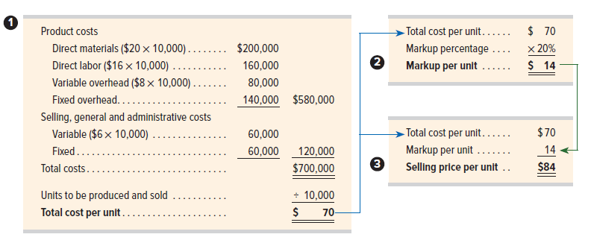
Total Cost Method
Applying the three-step process to determine price:
23-28
© McGraw-Hill Education
Learning Objective P6: Determine product selling price.
Notes:
To illustrate, a company produces headphones and it targets a 20% markup on total cost. It expects to produce and sell 10,000 headphones. The following additional information is available.
We apply the three-step total cost method to determine selling price per unit.
Step 1: Total cost per unit: add product costs (direct materials, direct labor, variable overhead, and fixed overhead), to selling, general and administrative costs to get total cost which is divided by the units to be produced and sold to get total cost per unit of $70.
Step 2: Markup per unit: Total cost per unit of $70 times 20% markup percentage = $14.
Step 3: Selling price per unit: Total cost per unit of $70 plus $14 markup per unit = $84 Selling price per unit.

Slide 29
Target Costing Method
Target costing can be used when competition is high.
Expected selling price is $80.
Company wants profit of $14 per unit.
Company must reduce target cost per unit to $66 ($80 price - $14 target profit).
23-29
© McGraw-Hill Education
Learning Objective P6: Determine product selling price.
Notes:
When competition is high, companies might be price-takers and have little control in setting prices. In such cases target costing, or target pricing, can be useful.
Target cost = Expected selling price – Target profit.
If the target cost is too high, lean techniques can be used to determine whether the cost can be reduced enough that the target profit can be made. For example, if the expected selling price for headphones is $80 each and the company wants to make a profit of $14 per unit, it must find a way to reduce its target cost per unit to $66 ($80 price − $14 target profit).

Slide 30
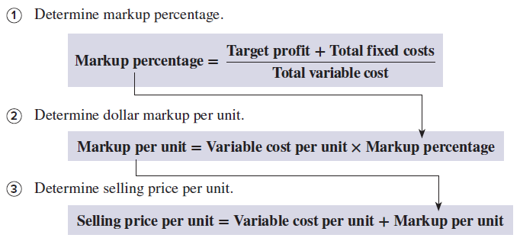
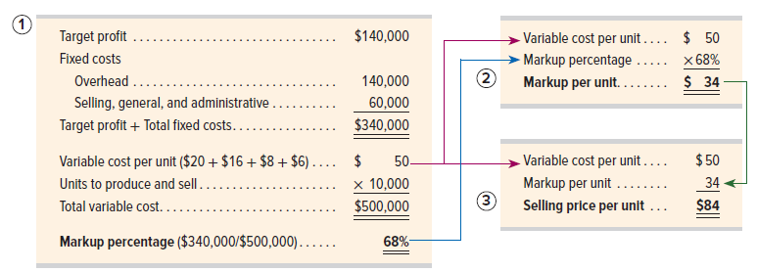
Variable Cost Method
23-30
© McGraw-Hill Education
Learning Objective P6: Determine product selling price.
Notes:
The variable cost method determines price by adding a markup to variable cost. The markup is set to cover fixed costs plus target profit on top of variable cost. Three steps are needed.
Determine markup percentage. (Target profit + Total fixed costs) / Total variable cost.
Determine dollar markup per unit. Variable cost per unit x Markup percentage.
Determine selling price per unit. Variable cost per unit + Markup per unit.
To illustrate, we draw on the variable and fixed cost data for 10,000 headphones from the previous total cost example. Our target profit is $140,000. At a selling price of $84 per unit, income equals the contribution margin (10,000 units x $34 markup per unit) minus $200,000 fixed costs, which is $140,000.

Slide 31
Evaluate special offer decisions.
Learning Objective P7
23-31
© McGraw-Hill Education

Slide 32
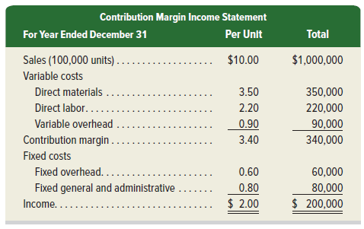
Special Pricing
Companies sometimes receive special offers at prices lower than normal selling price.
The decision to accept special offers should be based their income effects.
Decision rule: Accept the special offer if income increases (and reject it if income decreases).
Exhibit 23.12
23-32
© McGraw-Hill Education
Learning Objective P7: Evaluate special offer decisions.
Notes:
Companies sometimes receive special offers at prices lower than their normal selling prices. We evaluate these special offers by computing their income effects.
To illustrate, FasTrac produces and sells 100,000 units annually. Its per unit and annual sales and costs are in the contribution margin income statement in this exhibit. Its normal selling price is $10.00 per unit, and each unit sold generates $2.00 per unit of income.
Decision rule: Accept the special offer if income increases (and reject it if income decreases).

Slide 33
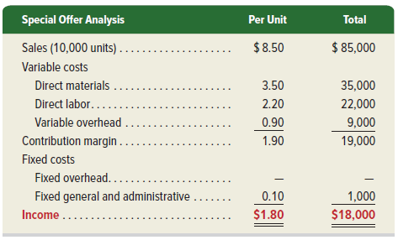
Special Pricing Analysis
Decision: FasTrac should accept the offer to earn additional income of $18,000.
Exhibit 23.13
23-33
© McGraw-Hill Education
Learning Objective P7: Evaluate special offer decisions.
Notes:
A new customer wants to buy 10,000 units at $8.50 each and export them to another country. The offer price is below the normal price of $10.00 per unit, but this sale would be several times larger than any single previous sale and it would use idle capacity. Because the units will be exported, this new business will not affect current sales.
We focus on incremental costs to determine whether accepting the offer will increase income. The historical cost per unit is not necessarily the cost of this special order.
Variable manufacturing costs to produce this order will be the same as for its normal business—$3.50 per unit for direct materials, $2.20 per unit for direct labor, and $0.90 per unit for variable overhead.
Fixed overhead costs will not change regardless of whether this order is accepted. Fixed overhead costs of $0.60 per unit on normal business are not relevant to this decision.
This order will incur incremental fixed general and administrative costs of $1,000.
We prepare a contribution margin income statement covering only this special offer. This exhibit shows that accepting this special offer results in $18,000 of additional income.

Slide 34
Determine price of services using time and materials pricing.
Learning Objective A1
23-34
© McGraw-Hill Education

Slide 35
Time and Materials Pricing
Time and materials pricing commonly used to price services.
Companies set a price for direct labor, direct materials, overhead, and a target profit.
Follows three steps:
Compute time charge (in $) per hour of direct labor. This rate includes a charge for non-materials overhead.
Compute the materials markup (%), which includes the overhead costs relating to buying, storing, and handling materials, plus a target profit margin on the materials’ cost.
Estimate direct labor hours and costs, direct materials cost, and the markup to get price.
23-35
© McGraw-Hill Education
Learning Objective A1: Determine price of services using time and materials pricing.
Notes:
It is common to price services using time and materials pricing. With this method, companies set a price for direct labor and a price for direct materials, and each includes a charge for overhead costs and a target profit. Auto mechanics, construction companies, electricians, and accounting firms commonly use time and materials pricing.
Time and materials pricing follows these steps.
Compute the time charge (in $) per hour of direct labor. This includes a charge for non-materials related overhead costs plus a target profit
Compute the materials markup (%), which includes overhead costs related to buying, storing, and handling materials, plus a target profit margin on materials’ cost.
Estimate direct labor hours and costs, direct materials cost, and the markup to get price.

Slide 36
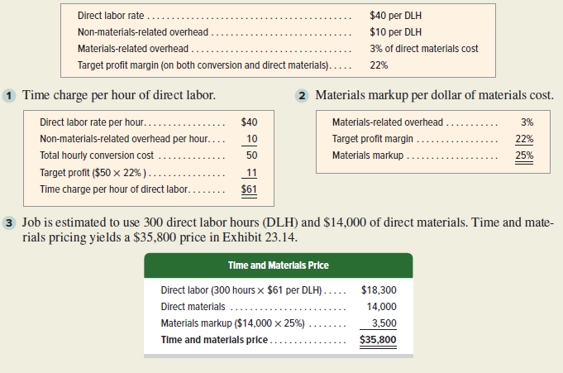
Time and Materials Pricing Analysis
Exhibit 23.14
23-36
© McGraw-Hill Education
Learning Objective A1: Determine price of services using time and materials pricing.
Notes:
Erin Builders reports the information for the coming year as shown in this slide.
The rate per hour of direct labor is computed as:
Direct labor rate ……………………………………………………………… $40/DLH
Non-materials related overhead …………………………………… $10/DLH
Materials-related overhead ……………………………………………… 3% of direct materials cost
Target profit margin ……………………………………………………… $22%
Time charge per hour of direct labor is shown in step 1.
Materials markup per dollar of materials cost is shown in step 2.
The job is estimated to use 300 direct labor hours and $14,000 of direct materials.
Time and materials price is shown in step 3 as $35,800.

Slide 37
End of Chapter 23
23-37
© McGraw-Hill Education

