Slide 1
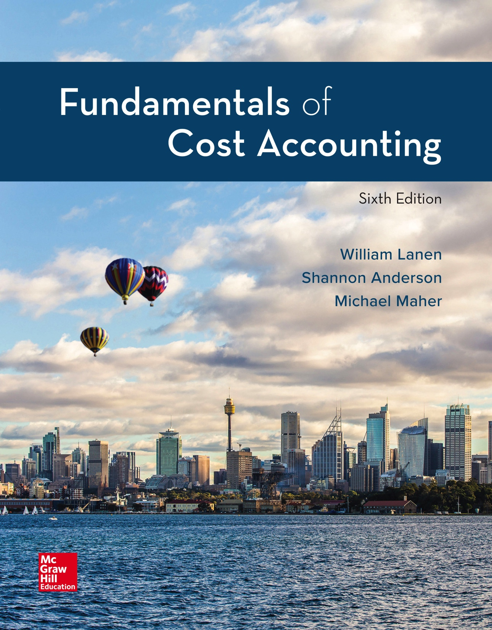
Copyright ©2020 McGraw-Hill Education. All rights reserved. No reproduction or distribution without the prior written consent of McGraw-Hill Education.
Notes:
Fundamentals of Cost Accounting, 6th edition
Lanen/Anderson/Maher

Slide 2
Cost Accounting: Information for Decision Making
Chapter 1
Notes:
Chapter 1: Cost Accounting: Information for Decision Making
The study of the Fundamentals of Cost Accounting begins with a review and overview of information necessary for decision making.

Slide 3
Learning Objectives
LO 1-1 Describe the way managers use accounting
information to create value in organizations. LO 1-2 Distinguish between the uses and users of cost
accounting and financial accounting information.
LO 1-3 Explain how cost accounting information is used
for decision making and performance evaluation
in organizations.
LO 1-4 Identify current trends in cost accounting.
LO 1-5 Understand ethical issues faced by accountants
and ways to deal with ethical problems that you
face in your career.
Notes:
After studying this chapter, you should be able to: First, describe the way managers use accounting information to create value in organizations. Second, distinguish between the uses and users of cost accounting and financial accounting information. Third, explain how cost accounting information is used for decision making and performance evaluation in organizations. Fourth, identify current trends in cost accounting. And finally, understand ethical issues faced by accountants and ways to deal with ethical problems that you face in your career.

Slide 4
Value Chain
LO 1-1
LO 1-1 Describe the way managers use accounting
information to create value in organizations.
The value chain describes a set of activities that transforms raw materials and resources into the goods and services end users purchase and consume.
Value-Added Activities
Those activities that
customers perceive as
adding utility to the goods or services they purchase.
Notes:
The value chain describes the set of activities that increase the value of an organization’s products or services. Value-added activities are activities that customers perceive as valuable because the activity adds utility to the goods or services they purchase. In other words, customers define value.

Slide 5
The Value Chain Components
LO 1-1
Research &
Development
Design
Purchasing
Production
Marketing &
Sales
Distribution
Customer
Service
Notes:
All products start with research and development. Is research and development (creating and developing ideas related to a new product) value-added or nonvalue-added?
Once we have the idea for a new product, the product must be developed and engineered. Does this add value?
The purchasing department is responsible for acquiring all of the necessary components and supplies in order to produce the product. Does this add value?
We must produce the product or deliver the service in order for the product or service to have value to a customer.
We need to inform potential customers about the attributes of our product or service.
Delivering the product or service to the customer adds value. If the customer does not have the product or service, it has no value.
Finally, chances are you have experienced the value of customer service. Have you ever called the technical support line for a software application you installed on your computer? If so, I hope the support added value to your product.

Slide 6
Accounting Systems
LO 1-2
LO 1-2 Distinguish between the uses and users of cost
accounting and financial accounting information.
Financial
accounting
Financial
position and
income
Reports
Cost
accounting
Information
about costs
Reports
Notes:
Financial accounting information is designed for decision makers who are not directly involved in the daily management of the firm. Cost accounting information is designed for managers.

Slide 7
Accounting Systems (2)
LO 1-2
The primary purpose of financial accounting is to provide investors and creditors information regarding company and management performance.
The financial data prepared for this purpose are governed by generally accepted accounting principles (GAAP) in the United States and by international financial reporting standards (IFRS) in many other countries.
In contrast, cost data for managerial use need not comply with GAAP or IFRS.
Notes:
Who establishes or defines the system? For financial accounting, external standard-setting groups (FASB, IFRS) do this. For cost accounting, management does this.

Slide 8
Customers of Accounting
LO 1-2
Accountants must work with the users of cost accounting information to provide the best possible information for managerial purposes.
Different uses of accounting information require different types of accounting information.
Notes:
The most important participant in any business is the customer. A customer is an individual who purchases or uses the product or service offered. Having said that, let’s consider the customers of cost accounting.
Who uses the information provided by the cost accounting system? Managers use the information in making decisions. Managers continually make decisions about how to improve operations. Owners of the firm also use cost accounting information. Owners use the information to evaluate the performance of the managers.

Slide 9
Managerial Decisions
LO 1-3
LO 1-3 Explain how cost accounting information is used
for decision making and performance evaluation
in organizations.
Individuals make decisions.
Decisions determine the performance of the organization.
Managers use information from the accounting system to make decisions.
Owners evaluate organizational and managerial performance with accounting information.
Notes:
The key question is: What adds value to the firm? Let’s look at how cost information adds value to the organization. Cost information adds value to the organization if that information improves managers’ decisions.

Slide 10
Cost Data for Managerial Decisions
LO 1-3
Costs for decision making
Costs for control and evaluations
Different data for different decisions
Notes:
We emphasize that it is individuals (people) like us who make decisions.

Slide 11
Costs for Decision Making
LO 1-3
The AM Bakery has been making and selling baked goods through a small store.
One of the customers suggests that the business expand operations and sell the bakery offerings at the morning and afternoon break times at the office park using a food truck.
Should the company expand operations?
Notes:
Now we are going to look at an example involving decision making using the company AM Bakery.

Slide 12
AM Bakery’s Cost Drivers
LO 1-3
Cost
Driver
Utilities
Number of distribution
channels
Marketing
Labor
Number of baked goods
Ingredients
Notes:
What drives the cost of utilities and the cost of marketing? The number of distribution channels for AM Bakery drives utilities and marketing. If AM Bakery opens a new channel (food truck), the utilities and marketing costs will increase. On the other hand, what drives the cost of labor or the cost of the ingredients for the baked goods? The number of baked goods produced will determine how many employees are needed and how much flour, butter, and other ingredients are required.

Slide 13
Differential Costs
LO 1-3
Costs that change in response to a particular course of action.
Differential costs change (differ) between actions.
Notes:
After identifying the cost drivers, AM Bakery looks at its differential costs. Differential costs are costs that differ between alternatives. AM’s differential costs are those costs that are different if they expand versus if they do not expand. Get it? Differential costs differ.

Slide 14
Differential Revenues
LO 1-3
Revenues that change in response to a particular course of action.
Differential revenues change (differ) between actions.
Notes:
Like differential costs, differential revenues differ between actions. What are AM’s expected revenues if they expand? What are the expected revenues if they do not expand? The difference between these expected revenues is differential revenue.

Slide 15
Differential Costs, Revenues, and Profits
LO 1-3
AM Bakery
Projected Income Statement for a Representative Week
(1) Status Quo
Original Bakery
Sales Only
(2) Alternative
Original Bakery
Plus Food Truck
Sales
(3)
Difference
Sales revenue
Costs:
Ingredients
Labor
Utilities
Rent
Marketing
Truck Lease
Truck Costs
Total costs
Operating profits
$11,200
$2,700
3,100
500
900
25
0
0
$7,225
$3,975
$16,800ª
$3,915^{b}
4,495^{b}
600^{c}
900^{d}
75e
900^{f}
150^{f}
$11,035
$5,765
$5,600
$1,215
1,395
100
-0-
50
900
150
$3,810
$1,790
(a) 50 percent higher than status quo
(d) No additional rent required
(e) 300 percent higher than status quo
(f) New costs for food trucks only
(b) 45 percent higher than status quo
(c) 20 percent higher than status quo
Notes:
Look at AM’s projected income statement. If AM maintains the status quo and does not expand, revenue will be $11,200. However, they expect revenues to increase 50% if they expand. Differential revenue is $5,600. If ingredients and labor increase 45%, AM has differential costs of $1,215 and $1,395 for those costs. Additionally, the cost of utilities will increase by 20%, while marketing costs will increase by 300%. These amounts are $100 and $50 in terms of being additional differential costs. Rent is not a differential cost. Finally, the new distribution channel of using a food truck for sale adds new costs related only to the food truck of $900 and $150, for the truck lease and truck operating costs.
Using this cost information to analyze revenues and costs, AM Bakery determines that it has differential profits of $1,790 if it expands, rather than maintaining the status quo.

Slide 16
Costs for Control and Evaluation
LO 1-3
A responsibility center is a specific unit of an organization assigned to a manager who is held accountable for its operations and resources.
Notes:
Responsibility centers may be departments, divisions, segments, or subsidiaries. The manager assigned to lead the unit is accountable for the unit’s operations and resources.

Slide 17
Responsibility Centers, Revenues, and Costs
LO 1-3
Adam Mercer
President
Ed Walsh
Vice-President
Bakery Sales
Ady Joss
Vice-President
Food Truck Sales
Notes:
This is an example of an organization’s chart. Please notice that Ed Walsh is in charge of bakery sales and Ady Joss is in charge of food truck sales. Are these responsibility centers?

Slide 18
Responsibility Centers, Revenues, and Costs (2)
LO 1-3
The AM Bakery
Income Statement, For the Month Ending August 31
Bakery
Food Trucks
Total
Sales revenue
Department costs:
Ingredients
Laborª
Utilities
Rent
Marketing
Truck Lease
Truck operating cost
Total channel costs
Channel margin^{b}
General and admin. costs:
Corp. office operations^{c}
Other
Total general and admin. costs
Operating profit
$52,200
12,500
15,200
2,400
3,600
200
0
0
$33,900
$18,300
$28,000
6,100
7,000
550
0
225
3,900
700
$18,475
$9,525
$80,200
18,600
22,200
2,950
3,600
425
3,900
700
$52,375
$27,825
5,400
2,900
$8,300
$19,525
Notes:
Do you think that general and administrative costs should be distributed to the two operations?
Notations a, b, and c shown on next slide

Slide 19
Responsibility Centers, Revenues, and Costs (3)
LO 1-3
NOTATIONS from the Income Statement shown on the previous slide:
Includes channel managers’ salaries, but excludes the President’s (Adam’s) salary.
The difference between revenues and costs attributable to a specific channel.
Includes the General Manager’s salary
Notes:
Notations a, b, and c from the previous slide

Slide 20
Responsibility Centers, Revenues, and Costs (4)
LO 1-3
AM Bakery
Bakery Sales
Actual and Budgeted Costs
For the Month Ending August 31
Actual
Budgeted
Difference
Ingredients:
Flour
Butter
Oil
Fruit
Nuts
Chocolate
Other
Total Ingredients
Labor:
Channel Manager
Other
Utilities
Rent
Marketing
Total bakery costs
Revenues
$ 3,900
3,500
1,700
1,300
900
800
400
$12,500
$4,500
10,700
2,400
3,600
200
$33,900
$52,200
$ 3,700
3,400
1,800
1,000
800
800
300
$11,800
$4,500
10,900
2,300
3,600
100
$33,200
$52,200
$ 200
100
(100)
300
100
-0-
100
$700
$ -0-
(200)
100
-0-
100
$700
-0-
Notes:
A budget, or a financial plan for the revenues and resources needed to meet financial goals, is an important tool for the financial success of both individuals and organizations. Do you have a budget?
Another important use of cost accounting information is the evaluation of the performance of an organization. Comparing the actual results to the budgeted results allows managers to evaluate the performance of the organization and owners to evaluate the performance of individual managers. For example, look at the AM Bakery’s actual activity and costs compared to budgeted activity and costs. If AM Bakery budgeted selling $52,200 worth of cookies and actually sold $52,200 worth of cookies in the month of August, why were the food costs $700 less than anticipated?
In evaluating activities for August, AM Bakery is also interested in seeing if actual labor costs equaled the amount budgeted? As part of the planning and control process, managers prepare budgets containing expectations about revenues and costs for the coming period. At the end of the period, managers compare actual results with the budget. This allows them to see whether changes can be made to improve future operations.

Slide 21
Trends in Cost Accounting
LO 1-4
LO 1-4 Identify current trends in cost accounting.
Research and development
Design
Purchasing
Production
Marketing
Distribution
Customer service
8. ERP – Enterprise resource planning
9. Creating value in the organization
Notes:
Cost accounting continues to experience dramatic changes. Developments in information technology (IT) have nearly eliminated manual bookkeeping. Emphasis on cost control is increasing in all types of organizations.

Slide 22
Cost Accounting in Research and Development
LO 1-4
Lean manufacturing techniques are not simply about production.
Companies partner with suppliers in the development stage to ensure cost-effective deigns for products.
Notes:
Product engineers need cost accounting information to make decisions about alternative materials. For example, Johnson Controls, a manufacturer of automobile seats, needs to make trade-offs between the cost and weight of materials.

Slide 23
Cost Accounting in Design
LO 1-4
Product designers must write detailed specifications on a product’s design.
This is often referred to as design for manufacturing (DFM).
Activity-based costing (ABC) assigns costs of activities needed to make a product, then sums the cost of those activities to compute the total cost of the product.
Notes:
Product designers must write detailed specification on a product’s design and manufacture. In general, activity-based costing provides more detailed cost information, enabling managers to make more informed decisions.

Slide 24
Cost Accounting in Purchasing
LO 1-4
Performance measurement indicates how well a process is working.
It minimizes unnecessary transaction processes.
Benchmarking methods measure products, services, and activities against the best performance.
Benchmarking is an ongoing process resulting in continuous improvement.
Notes:
The cost accounting system provides performance measures which summarize the increase or decrease in how well a process, unit, individual, or organization is working.

Slide 25
Cost Accounting in Production
LO 1-4
A lean accounting system provides measures at a work cell or process level.
JIT is an inventory system designed to lower the cost of maintaining excess inventory.
Notes:
Just-in-time (JIT) method in production or purchasing means each unit is produced or purchased just in time for its use.

Slide 26
Cost Accounting in Marketing
LO 1-4
Customer relationship management (CRM) is a system that allows firms to target profitable customers by assessing customer revenues and costs.
Harrah’s Entertainment provides complimentary services to some customers (typically called “comping”).
Notes:
Customers are the life-blood of companies. It is essential to satisfy the customer’s needs. In order to provide competitive services, many companies offer premium customers perks such as complimentary services, frequent flyer miles, or points which can be redeemed for products or services.

Slide 27
Cost Accounting in Distribution
LO 1-4
Outsourcing occurs when a firm’s activities are performed by another organization or individual in the supply or distribution chain.
Nikon, for example, relies on UPS for distribution.
Notes:
In order to minimize costs or provide better quality, firms frequently hire other firms to help in particular aspects of their business. A common example is the use of shipping companies such as Federal Express.

Slide 28
Cost Accounting in Customer Service
LO 1-4
TQM is a management method which focuses on excelling in all dimensions.
The emphasis is placed on quality. Quality is defined by the customer.
Cost of quality (COQ) is a system that identifies the costs of producing defective items.
Notes:
Total Quality Management is a management system which places emphasis on quality. All aspects of the business are analyzed, from purchasing to selling to customer support, for ways to improve the quality of the good or service.

Slide 29
Enterprise Resource Planning
LO 1-4
Information technology linking various processes of the enterprise into a single comprehensive information system
Purchasing
Production
Technology
Human
Resources
Finance
Marketing
Notes:
Enterprise resource planning (ERP) uses information technology to link the various processes of the enterprise into a single comprehensive information system. Because all of the company’s processes are integrated, ERP has significant potential for providing information on the cost of products and services. However, implementation problems are keeping many companies from realizing this potential.

Slide 30
Key Financial Players in an Organization
LO 1-4
Title
Major Responsibilities
Example Activities
Chief financial
officer (CFO)
Manages entire finance
and accounting function
Signs off on financial
statements
Treasurer
Manages liquid assets
Determines where to
invest cash balances
Controller
Plans and designs
information systems
Determines cost
accounting policies
Internal
auditor
Ensures compliance
with laws
Ensures that procurement
rules are followed
Cost
accountant
Records, measures,
and analyzes costs
Evaluates costs of
products and processes
Notes:
As a financial or operation manager in an organization, you will work with many financial professionals.

Slide 31
Ethical Issues for Accountants
LO 1-5
LO 1-5 Understand ethical issues faced by accountants
and ways to deal with ethical problems that you
face in your career.
The design of the cost accounting system has the potential to be misused to defraud customers, employees, or shareholders.
Notes:
Accountants report information that can have a substantial impact on the careers of managers who are generally held accountable for achieving financial performance targets. Failure to achieve a target can have serious negative consequences for a manager. Therefore, accountants may find themselves under pressure by management to make accounting choices that improve performance reports rather than accurately reflecting performance. As a professional accountant, manager, or business owner, you will face ethical situations on an everyday basis.

Slide 32
Ethics
LO 1-5
Follow the Institute of Management Accountants (IMA) guidelines:
DISCUSS conflicts with the immediate superior, unless the superior is involved. If so, go to the next authority level.
CLARIFY the relevant issues and concepts by discussion with a disinterested party or contact the appropriate confidential ethics “hotline.”
CONSULT an attorney about your rights and obligations.
Notes:
In an attempt to influence the accounting profession, professional organizations such as the Institute of Management Accountants (the IMA) and the American Institute of Certified Public Accountants (the AICPA) have developed codes of ethics to which their members are expected to adhere. The IMA code of conduct appears both in this chapter and in the appendix to this chapter. The IMA’s Standards of Ethical Conduct prescribe the established course of action a member should take when faced with significant ethical issues.

Slide 33
Sarbanes-Oxley Act of 2002
LO 1-5
What is the
intent?
Address problem
of corporate
governance
Who is
impacted?
Accounting firms
and
corporations
How are
corporations
impacted?
Corporate
responsibility
Notes:
When there is a public perception of widespread ethical problems, the result is often legislation making certain conduct not only unethical, but also illegal. Congress passed the Sarbanes-Oxley Act of 2002 to address some of the more serious problems of corporate governance that surfaced in the late 1990s and early 2000s.

Slide 34
Corporate Responsibility
LO 1-5
Who is impacted?
CEO – Chief Executive Officer
– Manages entire corporation
CFO – Chief Financial Officer
– Manages accounting and finance
What is the impact?
The officers of the corporation must sign the financial
reports stipulating that the financial statements do not
omit material information.
The company must disclose the evaluation of their
internal controls.
Notes:
Title III of the Sarbanes-Oxley Act deals with corporate responsibility. The law requires that the chief executive officer, the individual who manages the entire corporation, and the chief financial officer, the individual who manages the entire accounting and finance function of the corporation, to sign financial reports and stipulate that the financial statements do not omit material information. According to Title IV, they must further disclose that they have evaluated the company’s internal controls and have notified the company’s auditors and the audit committee of any fraud that involves management.

Slide 35
Appendix: Institute of Management Accountants Code of Ethics
Competence
Confidentiality
Integrity
Credibility
Notes:
Appendix: Institute of Management Accountants Code of Ethics (as of July 2017)
The Institute of Management Accountants Code of Ethics addresses four standards: competence, confidentiality, integrity, and credibility.

Slide 36
Competence
Members have a responsibility to:
1. Maintain an appropriate level of professional leadership and
expertise by enhancing knowledge and skills.
2. Perform professional duties in accordance with
relevant laws, regulations, and technical standards.
3. Provide decision support information and recommendations
that are accurate, clear, concise, and timely. Recognize and
help manage risk.
Notes:
The competence standard addresses members’ responsibilities related to the level of professional competence, the performance of professional duties, and the preparation of reports and recommendations.

Slide 37
Confidentiality
Members have a responsibility to:
1. Keep information confidential except when disclosure
is authorized or legally required.
2. Inform all relevant parties regarding appropriate use
of confidential information. Monitor to ensure compliance.
3. Refrain from using confidential information for unethical
or illegal advantage.
Notes:
The confidentiality standard requires members to refrain from disclosing confidential information, to inform subordinates regarding the confidentiality of information acquired, and to refrain from using confidential information for personal gain.

Slide 38
Integrity
Members have a responsibility to:
1. Mitigate actual conflicts of interest. Regularly communicate
with business associates to avoid apparent conflicts of
interest. Advise all parties of any potential conflicts of
interest.
2. Refrain from engaging in any conduct that would prejudice
carrying out duties ethically.
3. Abstain from engaging in or supporting any activity that
might discredit the profession.
4. Contribute to a positive ethical culture and place integrity
of the profession above personal interests.
Notes:
The integrity standard addresses conflict of interest, the communication of unfavorable as well as favorable information, and the members’ responsibility to the profession.

Slide 39
Credibility
Members have a responsibility to:
1. Communicate information fairly and objectively.
2. Provide all relevant information that could reasonably
be expected to influence an intended user’s understanding
of the reports, analyses, or recommendations.
3. Report delays or deficiencies in information, timeliness,
processing, or internal controls in conformance with
organization policy and/or applicable law.
4. Communicate professional limitations or other constraints
that would preclude responsible judgment or successful
performance of an activity.
Notes:
And finally, the credibility standard refers to members’ responsibility to be fair and objective and to disclose all relevant information.

Slide 40
End of Chapter 1
Notes:
End of Chapter 1.

