Slide 1
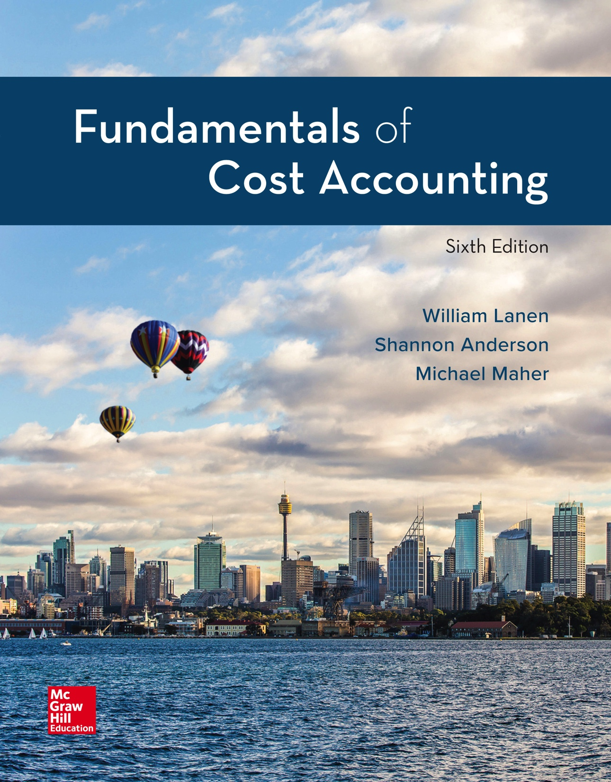
Copyright ©2020 McGraw-Hill Education. All rights reserved. No reproduction or distribution without the prior written consent of McGraw-Hill Education.
Notes:
Fundamentals of Cost Accounting, 6th edition
Lanen/Anderson/Maher

Slide 2
Fundamentals of Cost-Volume-Profit Analysis
Chapter 3
Notes:
Chapter 3: Fundamentals of Cost-Volume-Profit Analysis
In order to be a well prepared leader and manager, one must have a systematic method of analyzing the ever-changing environment. Chapter 3 focuses on how decision-makers analyze changes in the volume of sales.

Slide 3
Learning Objectives
LO 3-1 Use cost-volume-profit (CVP) analysis to analyze decisions.
LO 3-2 Understand the effect of cost structure on decisions.
LO 3-3 Use Microsoft Excel to perform CVP analysis.
LO 3-4 Incorporate taxes, multiple products, and alternative cost
structures into the CVP analysis.
LO 3-5 Understand the assumptions and limitations of CVP analysis.
Notes:
Each objective covers relations to make pricing and production decisions that increase profit. Successful understanding of the five learning objectives will support good decision making. First, you must be able to use cost-volume-profit (CVP) analysis to analyze decisions. Second, understand how cost structure affects decisions. Third, use Microsoft Excel to perform CVP analysis. Fourth, incorporate taxes, multiple products, and alternative cost structures into the CVP analysis. And finally, understand the assumptions and limitations of CVP analysis.

Slide 4
Cost-Volume-Profit Analysis
LO 3-1
LO 3-1 Use cost-volume-profit (CVP) analysis
to analyze decisions.
CVP analysis explores the relationship between revenue, cost, and volume and their effect on profits.
Notes:
Managers must make decisions about volume, pricing, and costs and are concerned about the impact of their decisions on profit. Therefore, they need to understand the relations among revenues, costs, volume, and profit. Cost-volume-profit, or CVP, analysis provides managers with information for decision making.

Slide 5
Profit Equation
LO 3-1
The Income Statement
Total revenues
– Total costs
= Operating profit
The Income Statement written horizontally
Operating profit
=
Total revenues
–
Total costs
Profit
=
TR
–
TC
Notes:
In studying CVP we will start with the profit equation. The profit equation is: Operating profit = Total revenues – Total costs. Don’t let the profit equation confuse you. It is nothing more than the income statement written horizontally.

Slide 6
Profit Equation (2)
LO 3-1
Total revenue (TR)
Selling price per unit (P)
× Units of output produced and sold (X)
TR = PX
Total cost (TC)
[Variable cost per unit (V) × Units of output (X)]
+ Fixed costs (F)
TC = VX + F
Notes:
Now let’s take the profit equation apart. Total revenue, or TR, equals the sales price (P) times the number of units of output sold (X). Simplified, TR = PX. Total costs, TC, equals variable cost per unit (V) times units of output (X), that is total variable cost, plus fixed costs (F). Simplified, TC = VX + F.

Slide 7
Profit Equation (3)
LO 3-1
Profit = Total revenue – Total costs
= TR – TC
TC = VX + F
Therefore, Profit = PX – (VX + F)
Profit = (Price – Variable costs) × Units of output – Fixed costs
= X(P – V) – F
Notes:
The income statement shows total revenues minus total costs equals profit. The profit equation, the income statement written horizontally, is profit equals total revenues (TR) minus total costs (TC).
Let’s look at the individual “pieces” of the equation.
Total revenues equal sales price, P, times the number of units sold, X, or PX. Total costs equal variable cost per unit, V, times the number of units sold, X, or VX, plus fixed cost, F. Profit equals PX minus (VX plus F). Continue to work through this equation. Now let’s isolate X. (P − V) times X, put all of that in parentheses, (in parentheses (P – V) in parentheses times X), minus F. The P minus V should ring a bell for you.
In Chapter 2, we defined contribution margin as sales price minus variable cost. P minus V is the contribution margin per unit. X(P – V) is the total contribution margin. Profit equals (sales minus variable costs), the contribution margin, minus fixed cost.

Slide 8
Contribution Margin
LO 3-1
This is the difference between price and variable cost.
It is what is leftover to cover fixed costs and then add to operating profit.
Contribution margin = Price per unit – Variable cost per unit
P – V
Notes:
Let’s review the contribution margin from Chapter 2. The unit contribution margin is the difference between the sales price per unit and variable costs per unit. That is (P − V).

Slide 9
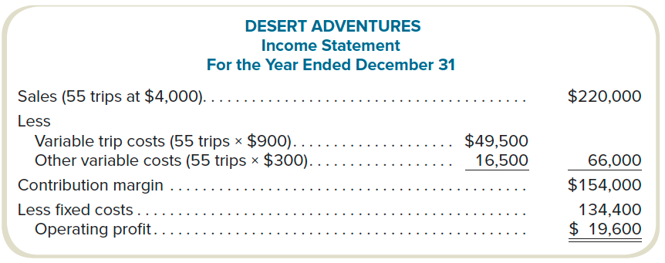
CVP Example
LO 3-1
Contribution margin = $154,000 ÷ 55 = $2,800
Notes:
Let’s look at an example. Desert Adventures is a company selling excursions (trips). Here is Desert Adventures’ Income Statement for the year ending December 31. It charges $4,000 (per unit) for trips sold. During the year, it sold 55 trips and earned sales revenue of $220,000. It’s variable cost of goods sold is $900 per unit for a total variable cost of goods sold of $49,500 (55 times $900). Its other variable selling cost is $300 per unit for a total of $16,500 (55 times $300). Sales price of $4,000 per unit less variable cost of $1,200 per unit ($900 + $300) equals a contribution margin per unit of $2,800. Its total contribution margin for the year was $154,000. The contribution margin of $154,000 less fixed costs of $134,400 equals an operating profit of $19,600.

Slide 10
Break-Even Volume in Units
LO 3-1
This is the volume level at which profits equal zero.
Profit 0 = X(P – V) – F
If profit = 0, then X = F ÷ (P – V)
Break-even volume (in units)
=
Fixed costs
Unit contribution margin
= $134,400 ÷ $2,800
= 48 trips
Notes:
Since Desert Adventures has $134,400 in fixed costs and it has a CM per unit of $2,800, Desert Adventures has a unit break-even of 48 trips.
If Desert Adventures sells less than 48 trips, it will have a net loss. If Desert Adventures sells exactly 48 trips it will have zero net income (break-even). If Desert Adventures sells more than 48 trips, each trip over 48 will add $2,800 to net income.

Slide 11
Break-Even Volume in Sales Dollars
LO 3-1
Contribution margin percentage (contribution
margin ratio) is the contribution margin as a
percentage of sales revenue.
Contribution Margin Ratio
$2,800 ÷ $4,000 = 0.70 (or 70%)
Break-even in Sales Dollars
$134,400 ÷ 0.70 = $192,000
Notes:
If all we do is change our break-even analysis by using the CM Ratio instead of CM per dollar, we will calculate the amount of sales revenue necessary to break-even. In Desert Adventures case, it must sell $192,000 in order to break-even. You can check this by multiplying break-even point in units by sales price per unit. 48 x $2,800 = $134,400!

Slide 12
Target Volume
LO 3-1
Assume that management wants to have a profit of $70,000.
How many trips must be sold?
What is the target dollar sales?
Target Volume in Units
($134,400 + $70,000) ÷ $2,800 = 73
Target Volume in Sales Dollars
($134,400 + $70,000) ÷ 0.70 = $292,000
Notes:
Suppose the goal is to earn a specified amount of net income. Since you already know how to calculate break-even, adding a target net income is simple. Just view the target as required, hence, similar to a fixed cost. Many large corporations set a required net income for their subsidiaries.
Suppose Desert Adventures wants to know how many units it needs to sell to earn $70,000 profit. Well, it has to sell enough units to cover the fixed costs and then earn that $70,000 profit. Think about this for a moment. You know that every unit it sells contributes $2,800 towards covering fixed costs and then turning a profit. So, how many units must Desert Adventures sell to earn a profit of $70,000?

Slide 13
CVP Summary: Break-Even
LO 3-1
Break-even volume
(units)
=
Fixed costs
Unit contribution margin
Break-even volume
(sales dollars)
=
Fixed costs
Contribution margin ratio
Notes:
In summary, at break-even, target profit is zero. Therefore, break-even sales volume in units equals fixed costs divided by unit contribution margin, and break-even sales volume in dollars equals fixed costs divided by contribution margin ratio.

Slide 14
CVP Summary: Target Volume
LO 3-1
Target volume
(units)
=
Fixed costs + Target profit
Unit contribution margin
Target volume
(sales dollars)
=
Fixed costs + Target profit
Contribution margin ratio
Notes:
Now we will review the contribution margin ratio. The contribution margin ratio is the contribution margin as a percentage of sales revenue. The total contribution margin ratio equals total contribution margin as a percent of total sales revenue. The unit contribution margin ratio equals the contribution margin per unit as a percent of sales price per unit. Recall our discussion in Chapter 2 of relevant range. A relevant range is a range of activity where our cost structure remains constant. Therefore, as long as we are in the relevant range, the total contribution margin ratio and the unit contribution margin ratio will be the same. Again let’s look at Desert Adventures.

Slide 15
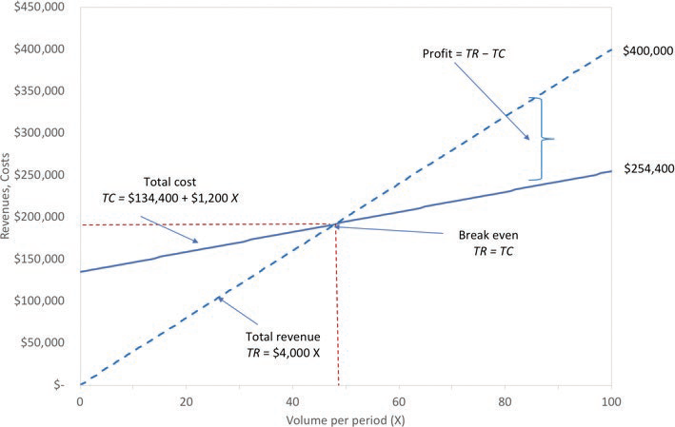
Graphic Presentation
LO 3-1
Notes:
Look at the graphic presentation of break-even. Dollars are on the vertical axis and trips are on the horizontal axis. The total revenue line is solid and the total cost line is dotted. If Desert Adventures sells zero trips total revenue equals zero. However, even if Desert Adventures sells zero trips it still has fixed cost of $134,400. Break-even is where total revenues equal total costs. Break-even is where the total revenue and total cost lines cross.

Slide 16
Use of CVP to Analyze the Effect of Different Cost Structures
LO 3-2
LO 3-2 Understand the effect of cost structure on decisions.
Cost Structure
The proportion of fixed and
variable costs to total costs.
Operating Leverage
The extent to which the cost structure
is comprised of fixed costs.
Notes:
Let’s talk about cost structure. Cost structure is the proportion of fixed and variable costs to total costs. An organization’s cost structure has a significant effect on the sensitivity of its profits to changes in volume. You are probably starting to see just how important cost behavior is in decision making. Fixed costs remain the same in total regardless of the activity level. This means that even if there is no activity fixed costs remain the same. However, variable costs vary with the activity level. And remember, no activity means no variable costs. Operating leverage describes the extent to which an organization’s cost structure is made up of fixed costs, those costs that do not change when the level of activity changes.

Slide 17
Use of CVP to Analyze the Effect of Different Cost Structures (2)
LO 3-2
Operating leverage
=
Contribution margin
Operating profit
The higher the organization’s operating leverage, the higher the break-even point.
Notes:
Operating leverage equals the contribution margin divided by operating profit. The higher the organization’s operating leverage, the higher the organization’s break-even point. Let’s look at an example.

Slide 18
Comparison of Cost Structures
LO 3-2
Lo-Lev Company
(1,000,000 units)
Hi-Lev Company
(1,000,000 units)
Amount
%
Amount
%
Sales
Variable costs
Contribution margin
Fixed costs
Operating profit
Break-even point
Contribution margin per unit
$1,000,000
750,000
$ 250,000
50,000
$ 200,000
200,000 units
$0.25
100
75
25
5
20
$1,000,000
250,000
$ 750,000
550,000
$ 200,000
733,334 units
$0.75
100
25
75
55
20
Notes:
Let’s compare Lo-Lev and Hi-Lev. Lo-Lev company has a low operating leverage and Hi-Lev has a high operating leverage. Suppose both companies had sales of $1 million. Lo-Lev’s variable costs are 75% of sales and the contribution margin is 25% of sales. Hi-Lev’s variable costs are 25% of sales and the contribution margin is 75% of sales. Lo-Lev has a contribution margin of $250,000. Hi-Lev has a contribution margin of $750,000. Lo-Lev’s and Hi-Lev’s fixed costs are $50,000 and $550,000 respectively. Both companies have operating profit of $200,000. Notice, however, Lo-Lev’s break-even is 200,000 units and Hi-Lev’s break-even is 733,334 units. You can do these break-even calculations. Lo-Lev has a contribution margin per unit of $0.25. Fixed costs of $50,000 divided by contribution margin per unit of $0.25 equals break even of 200,000 units. Hi-Lev has a contribution margin per unit of $0.75. Fixed costs of $550,000 divided by contribution margin per unit of $0.75 equals 733,334 units.

Slide 19
Comparison of Cost Structures (2)
LO 3-2
Suppose Low-Lev and High-Lev both increase sales 10% or $100,000.
Lo-Lev
Hi-Lev
Sales increase
Contribution margin
Increase in profit
Prior net income
Net income with sales increase of 10%
$100,000
0.25
$ 25,000
$200,000
$225,000
$100,000
0.75
$ 75,000
$200,000
$275,000
Notes:
An increase in sales of $100,000 gives Hi-Lev a 75% (the contribution margin ratio), or $75,000, increase in profits, and Lo-Lev an increase of 25%, or $25,000.

Slide 20
Margin of Safety
LO 3-2
The excess of projected or actual sales volume over break-even volume
or
The excess of projected or actual sales revenue over break-even revenue
Suppose Desert Adventures sells 55 trips.
At a break-even volume of 48 trips, its margin of safety is:
Sales – Break-even
55 – 48 = 7 trips
Notes:
Margin of safety is the excess of projected or actual sales volume over break-even volume, or the excess of projected or actual sales revenue over break-even revenue. In other words, the margin of safety indicates the risk of losing money that a company faces. How much can sales decrease in either volume or revenue before the company experiences a net loss? Suppose Desert Adventures sells 8,000 trips. Recall that Desert Adventures’ break-even was 48 trips. The margin of safety is 7 trips (55 - 48), or in dollars $19,600 ($28,000 - $8,400).

Slide 21
CVP Analysis with Spreadsheets
LO 3-3
LO 3-3 Use Microsoft Excel to perform CVP analysis.
A spreadsheet program is ideally suited to performing CVP routinely.
1. Choose “Tools: Goal Seek…” from the
menu bar.
Desert Adv.
Price
$4,000
2. In the “Set cell:” edit field, enter the cell
address for the target profit calculation.
Variable cost
$1,200
Fixed cost
$134,400
Profit
($22,400)
3. In the “To value:” edit field, enter the
target profit.
Volume
40
Desert Adv.
4. In the “By changing cell:” edit field, enter
the cell address of the volume variable.
Price
$4,000
Variable cost
$1,200
Fixed cost
$134,400
5. Click “OK” and the program will find the
break-even volume.
Profit
$0.00
Volume
48
Notes:
It is important to be able to perform CVP analysis and understand the relations and it is important to work examples and do problems by hand at first. However, a spreadsheet program is ideally suited to performing CVP routinely.

Slide 22
Extensions of the CVP Model: Income Taxes
LO 3-4
LO 3-4 Incorporate taxes, multiple products, and
alternative cost structures into the CVP analysis.
The owners of Desert Adventures want to generate after-tax operating profits of $25,200.
The tax rate is 25%.
What is the target operating profit?
Target operating profit = TOP ÷ (1 – Tax rate)
TOP = $25,200 ÷ (1 – 0.25)
TOP = $33,600
Notes:
So far we have ignored taxes. What if Desert Adventures is in a 25% tax bracket and wants a profit of $25,200 after paying income taxes?
Now what needs to be covered by the contribution margin per unit? Fixed cost and the before-tax profit required to earn an after-tax profit of $25,200. Dividing the after-tax profit of $25,200 by one minus the tax rate results in the before-tax profit of $33,600 required for an after-tax profit of $25,200.

Slide 23
Extensions of the CVP Model: Income Taxes (2)
LO 3-4
How many units must be sold?
Fixed costs + [Target profit ÷ (1 – Tax rate)]
Unit contribution margin
($134,400 + $33,600)
$2,800
= 60 trips
Notes:
The target volume for Desert Adventures is 60 trips. At this volume, Desert Adventures will cover the $134,400 in fixed costs plus the $33,600 required before-tax income.

Slide 24
Extensions of the CVP Model: Income Taxes (3)
LO 3-4
Proof:
Sales: 60 × $4,000 $240,000
Variable costs: 60 × $1,200 72,000
Contribution margin $168,000
Fixed costs 134,400
Net income before taxes $33,600
Income taxes: $33,600 × 25% 8,400
Net income $25,200
Notes:
Let’s check our figures. 60 units at $4,000 a unit equals $240,000 in revenue. 60 units at $1,200 per unit VC equals $72,000 in variable costs. The contribution margin of $168,000 minus fixed costs of $134,400 gives us net income before taxes of $33,600. $33,600 times a 25% tax rate gives us a tax liability of $8,400. Subtract taxes from net income before taxes and Desert Adventures has an after-tax net income of $25,200.

Slide 25
Extensions of the CVP Model: Multiproduct Analysis
LO 3-4
Management expects to sell excursions and rafting trips in a ratio of 25:75.
Excursions
Rafting
Selling price
Less: Variable cost
Contribution margin
$4,000
1,200
$2,800
$500
100
$400
Total fixed cost = $144,000
Notes:
What happens when a company has multiple products? Suppose Desert Adventures sells both excursions and rafting trips. Excursions have a contribution margin of $2,800 per unit. Notice that rafting trips have a contribution margin of $400 per unit. Assume total fixed costs are $144,000. To calculate break-even divide total fixed costs by the contribution margin per unit. In order to use the single product mix method, managers must define a package or bundle of products and compute break-even or target volume for the package or bundle. And, because excursions have a contribution margin per unit of $2,800 and rafting trips have a contribution margin per unit of $400 we need a weighted-average contribution margin.

Slide 26
Extensions of the CVP Model: Multiproduct Analysis (2)
LO 3-4
What is the contribution margin of the mix?
(25 × $2,800) + (75 × $400) = $70,000 + $30,000
= $100,000
What is the weighted-average contribution margin of the mix?
(.25 × $2,800) + (.75 × $400) = $1,000
Notes:
To calculate the weighted-average contribution margin multiply the $2,800 contribution margin per excursion sold times 25% and the contribution margin of $400 per rafting experience sold times 75%. The weighted-average contribution margin is $1,000 per unit.

Slide 27
Extensions of the CVP Model: Multiproduct Analysis (3)
LO 3-4
What is the break-even of the mix?
144 × 25% = 36 excursions
144 × 75% = 108 rafting experiences
Total units = 144
$144,000 fixed costs ÷ $1,000 = 144 units
Break-even Sales in Dollars
36 excursions × $4,000 = $144,000
108 rafting experiences × $500 = $54,000
Total dollars = $198,000
Notes:
Now divide fixed costs of $144,000 by the weighted-average contribution margin per unit of $1,000 and you find that 144 units must be sold to break-even. Of the 144 units, 36 (or 25%) are excursions and 108 (or 75%) are rafting experiences. We can use what we know about the break-even product mix to determine the break-even sales in dollars. Break-even sales in dollars is calculated by multiplying the break-even units in the product mix by their respective sales prices of each product.

Slide 28
Extensions of the CVP Model: Multiproduct Analysis (4)
LO 3-4
Weighted-Average Revenue
(.25 × $4,000 for excursions) + (.75 × $500 for rafting)
= $1,375
What is the weighted-average contribution margin percentage?
$1,000 ÷ $1,375 = 72.7273%
Notes:
To determine the weighted-average revenue, we multiply the sales price of a product by the percentage of the product in the product mix. For example, excursions account for 25% of the product mix, so we multiply 25% times $4,000. Rafting experiences account for 75% of the product mix, so we multiply 75% times $500. When we add these two products together we get $1,375, which is the weighted-average revenue for the product mix.
To obtain the weighted-average contribution margin percentage, we divide the weighted-average contribution margin ($1,000) by the weighted-average revenue ($1,375). The weighted-average contribution percentage is 72.7273% (rounded).

Slide 29
Extensions of the CVP Model: Multiproduct Analysis (5)
LO 3-4
Weighted-Average Revenue
(.25 × $4,000 for excursions) + (.75 × $500 for rafting)
= $1,375
Weighted-Average Contribution Margin
$1,000 ÷ $1,375 = 72.7273%
Break-even Sales in Dollars
$144,000 ÷ 0.727273 = $198,000
Notes:
Now we can solve for the break-even in dollars. Fixed costs divided by the weighted-average contribution margin provide the answer in dollars.

Slide 30
Extensions of the CVP Model: Alternative Cost Structures
LO 3-4
Given: Fixed costs of $134,400 are sufficient for monthly volumes less than or equal to 40 excursion trips. For every additional 40 trips, Desert Adventures must rent a machine for $19,600 per year. Original break-even was 48 units.
With the increased in fixed costs, Desert Adventures is no longer able to break-even by selling 48 units.
($4,000 - $1,200) × 48 – ($134,400 + $19,600) =
($19,600) net loss
Notes:
That’s a lot of information! But we are not finished yet. Sometimes firms need to rent more equipment and therefore their fixed costs change. Let’s assume that Desert Adventures can sell 48 trips a year with its existing equipment. This would mean that it could not break-even using only its equipment since break-even was 48 trips.

Slide 31
Extensions of the CVP Model: Alternative Cost Structures (2)
LO 3-4
What is the break-even using the new fixed cost containing the rental of the additional machine?
Break-even units = ($134,400 + $19,600) ÷ $2,800 = 55 trips
Notes:
New fixed costs are now $154,000. Since the sales price and variable costs are not changing, the CM per unit remains at $2,800. The new break-even is 55 trips.

Slide 32
Assumptions and Limitations of CVP Analysis
LO 3-5
LO 3-5 Understand the assumptions and
limitations of CVP analysis.
Although the CVP model is a very strong tool, the output is dependent upon the assumptions made by cost analysts.
These assumptions include which costs are fixed and which are variable.
Notes:
As with all models, there are assumptions and limitations. CVP is a very powerful tool, yet it is only as strong as the assumptions made by the analyst. The analyst must make assumptions with respect to which costs are fixed and which are variable.

Slide 33
Assumptions and Limitations of CVP Analysis (2)
LO 3-5
With the aid of software programs, many of the limitations have been eliminated.
Complicated cost structures are easily incorporated in CVP analysis when software tools are used.
Notes:
The model is also limited to the accuracy of the estimated cost structure. Since software programs allow users to design more complex cost structures, this limitation is becoming less of a problem.

Slide 34
End of Chapter 3
Notes:
End of Chapter 3.

