Slide 1
Chapter 17
Pensions and Other
Postretirement Benefits
Notes:
We discuss pension benefits and other postretirement benefits in this chapter. Accounting for pension benefits recognizes that they represent deferred compensation for current service. Accordingly, the cost of these benefits is recognized on an accrual basis during the years that employees earn the benefits.

Slide 2
The Nature of Pension Plans
LO17-1
Pension plans provide employees with a degree of retirement security and often enhance productivity, reduce turnover, satisfy union demands, and allow employers to compete in the labor market.
Pension plans:
Designed to provide income to individuals during their retirement years
Accomplished by setting aside funds during an employee’s working years
Upon retirement
The accumulated funds
Earnings from investing those funds
17-02
Notes:
United States pension funds total more than $15 trillion. Periodic pension costs constitutes one of the largest expenses many companies report. The corporate liability for providing pension benefits is huge. Obviously, then, the financial reporting responsibility for pensions has important social and economic implications.
Pension plans are designed to provide income to individuals during their retirement years. This is accomplished by setting aside funds during an employee’s working years so that at retirement the accumulated funds plus earnings from investing those funds are available to replace wages. Corporations establish pension plans for a variety of reasons. Sponsorship of pension plans provides employees with a degree of retirement security and fulfills a moral obligation felt by many employers. This security also can induce a degree of job satisfaction and perhaps loyalty that might enhance productivity and reduce turnover. Motivation to sponsor a plan sometimes comes from union demands and often relates to being competitive in the labor market.

Slide 3
Types of Pension Plans
LO17-1
Defined contribution pension plans
Promise fixed annual contributions to a pension fund
Example:
Employer contributes 5% of the employees’ pay
Defined benefit pension plans
Promise fixed retirement benefits defined by a designated formula
Pension formula bases retirement pay on the employees’ (a) years of service, (b) annual compensation, and sometimes (c) age
17-03
Notes:
Sometimes, employers agree to annually contribute a specific (defined) amount to a pension fund on behalf of employees but make no commitment regarding benefit amounts at retirement. In other arrangements, employers don’t specify the amount of annual contributions but promise to provide determinable (defined) amounts at retirement.
These two arrangements describe defined contribution pension plans and defined benefit pension plans, respectively:
Defined contribution pension plans promise fixed annual contributions to a pension fund (say, 5% of the employees’ pay or, more often, to match contributions by workers). Employees choose (from designated options) where funds are invested—usually stocks or fixed-income securities. Retirement pay depends on the size of the fund at retirement.
Defined benefit pension plans promise fixed retirement benefits defined by a designated formula. Typically, the pension formula bases retirement pay on the employees’ (a) years of service, (b) annual compensation (often final pay or an average for the last few years), and sometimes (c) age. Employers are responsible for ensuring that sufficient funds are available to provide promised benefits.

Slide 4
Defined Benefit Plan vs. Defined Contribution Plan
LO17-1
Companies shift from defined benefit plans to defined contribution plans for three main reasons:
1. Government regulations make defined benefit plans cumbersome and costly to administer
2. Employers are increasingly unwilling to bear the risk of defined benefit plans
With defined contribution plans, the company’s obligation ends when contributions are made
3. There has been a shift among many employers from trying to “buy long-term loyalty” (with defined benefit plans) to trying to attract new talent (with more mobile defined contribution plans)
17-04
Notes:
Today, approximately three-fourths of workers covered by pension plans are covered by defined contribution plans, roughly one-fourth by defined benefit plans. This represents a radical shift from previous years when the traditional defined benefit plan was far more common. In fact, many new companies are terminating long-standing defined benefit plans and substituting defined contribution plans. This shift is due to three main reasons:
Government regulations make defined benefit plans cumbersome and costly to administer.
Employers are increasingly unwilling to bear the risk of defined benefit plans; with defined contribution plans, the company’s obligation ends when contributions are made.
There has been a shift among many employers from trying to “buy long-term loyalty” (with defined benefit plans) to trying to attract new talent (with more mobile defined contribution plans).

Slide 5
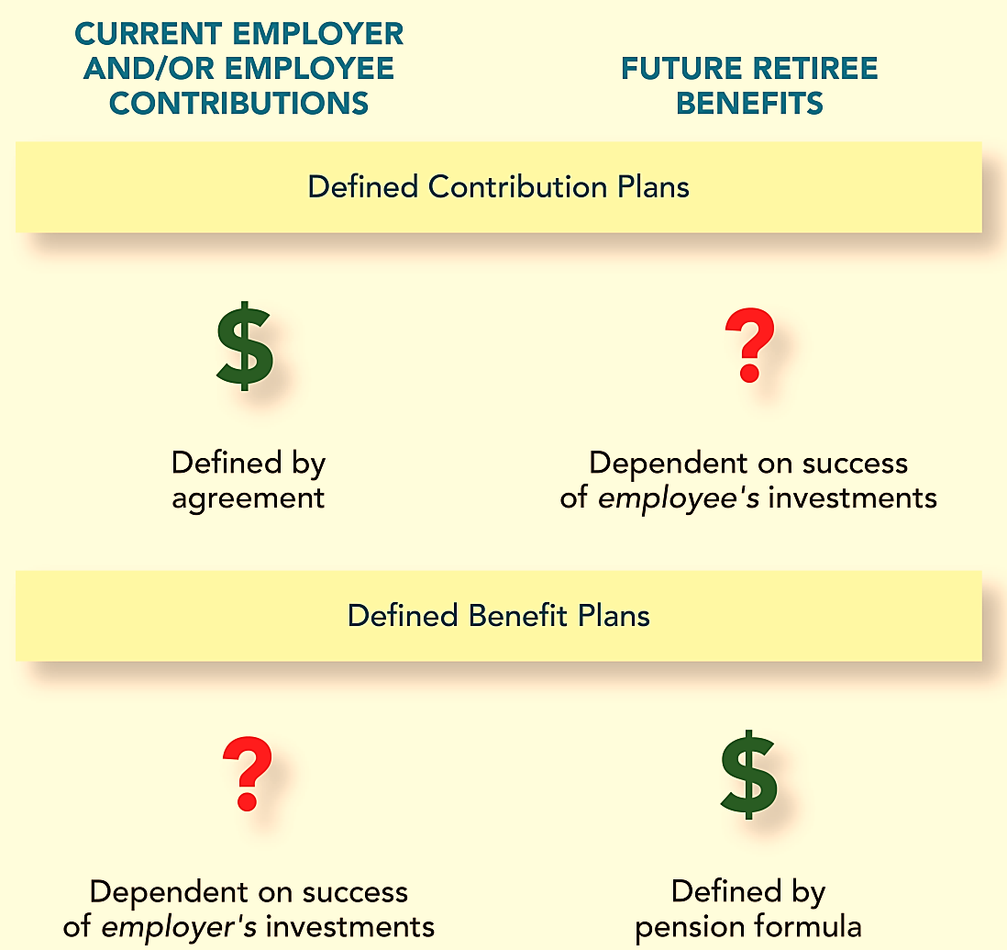
Defined Contribution and Defined Benefit Pension Plans
LO17-1
17-05
Notes:
Illustration 17–1 Defined Contribution and Defined Benefit Pension Plans
Both types of plans have a common goal: to provide income to employees during their retirement years. Still, the two types of plans differ regarding who bears the risk—the employer or the employees—for whether the retirement objectives are achieved. The two types of plans also have entirely different implications for accounting and financial reporting.
Our discussion of defined contribution plans will be brief. Although these are now the most popular type of corporate pension plan, their relative simplicity permits a rather straightforward accounting treatment that requires little explanation. On the other hand, defined benefit plans require considerably more complex accounting treatment and constitute the primary focus of this chapter.

Slide 6
Defined Contribution Pension Plans
LO17-1
Promise defined periodic contributions to a pension fund, without further commitment regarding benefit amounts at retirement
Variations of this plan include:
Money purchase plan
Thrift plan
Savings plan
401(k) plan
Contributory plan
When plans link the amount of contributions to company performance, labels include profit sharing plans, incentive savings plans, 401(k) profit sharing plans, and similar titles
– Employers contribute a fixed percentage of employees’ salaries
– Permit voluntary contributions by employees
– Employees make contributions to the plan in addition to employer contributions
17-06
Notes:
Defined contribution plans promise fixed periodic contributions to a pension fund. Retirement income depends on the size of the fund at retirement. No further commitment is made by the employer regarding benefit amounts at retirement.
These plans have several variations. In money purchase plans, employers contribute a fixed percentage of employees’ salaries. Thrift plans, savings plans, and 401(k) plans (named after the Tax Code section that specifies the conditions for the favorable tax treatment of these plans) permit voluntary contributions by employees. These contributions typically are matched to a specified extent by employers. Many employers match up to 50% of employee contributions up to the first 5% or 6% of salary.
When plans link the amount of contributions to company performance, labels include profit sharing plans, incentive savings plans, 401(k) profit sharing plans, and similar titles. When employees make contributions to the plan in addition to employer contributions, it’s called a contributory plan.

Slide 7
Defined Contribution Plan —Microsoft Corporation
LO17-1
Sometimes the amount the employer contributes is tied to the amount of the employee contribution
Note 20 (in part) Savings plan We have a savings plan in the U.S. that qualifies under Section 401(k) of the Internal Revenue Code, and a number of savings plans in international locations. Participating U.S. employees may contribute a portion of their salary, subject to certain limitations. Beginning January 2016, we contribute fifty cents for each dollar a participant contributes in this plan, with a maximum employer contribution of 50% of the IRS contribution limit for the calendar year. Prior to January 2016, we contributed fifty cents for each dollar of the first 6% a participant contributed in this plan, with a maximum contribution of the lesser of 3% of a participant’s earnings or 3% of the IRS compensation limit for the calendar year. Matching contributions for all plans were $734 million, $549 million, and $454 million in fiscal years 2017, 2016, and 2015, respectively, and were expensed as contributed.
17-07
Notes:
Illustration 17–2 Defined Contribution Plan—Microsoft Corporation
Sometimes the amount the employer contributes is tied to the amount of the employee contribution. An example from a recent annual report of Microsoft Corporation is shown in the above illustration.

Slide 8
Accounting for a Defined Contribution Plan
LO17-1
No additional liability is created
Suppose a plan promises an annual contribution equal to 3% of an employee’s salary. If an employee’s salary amounts to $110,000 in a particular year, the employer would simply recognize pension expense for the amount of the contribution.
Journal Entry
Debit
Credit
Pension expense
3,300
Cash ($110,000 × 3%)
3,300
17-08
Notes:
Accounting for these plans is quite easy. Each year, the employer simply records pension expense equal to the amount of the annual contribution. Suppose a plan promises an annual contribution equal to 3% of an employee’s salary. If an employee’s salary is $110,000 in a particular year, the employer would simply recognize pension expense in the amount of the contribution.
For defined contribution plans, the employer simply records pension expense equal to the cash contribution. Here we debit the pension expense account with $3,300, calculated as annual salary times three percent ($110,000 × .03 = $3,300). We credit cash account with the same amount, as the contribution is paid.

Slide 9
Defined Benefit Pension Plans
LO17-1
Promise fixed retirement benefits defined by a pension formula
Example
An employee retires after 30 years of service with a final salary of $100,000. The annual benefits are calculated as 1.5% times 30 years times final year’s salary:
1½% × Years of service × Final year’s salary
1½% × 30 years × $100,000
= $45,000
17-09
Notes:
Unlike defined contribution pension plans, defined benefit pension plans promise fixed retirement benefits defined by a designated formula.
A typical formula might specify that a retiree will receive annual retirement benefits based on the employee’s years of service and annual pay at retirement (say, pay level in the final year, highest pay achieved, or average pay in the last two or more years).
For example, a pension formula might define annual retirement benefits as:
1½% × Years of service × Final year’s salary
By this formula, the annual benefits to an employee who retires after 30 years of service, with a final salary of $100,000, would be:
1½% × 30 years × $100,000 = $45,000

Slide 10
Defined Benefit Pension Plans (continued)
LO17-1
Uncertainties inherent in a defined benefit plan:
Rate of return on plan assets
Number of employees eligible for retirement benefits
Age at which employees will choose to retire
Life expectancies of the retirees
Inflation, future compensation levels, and interest rates
Actuary: A professional trained in a particular branch of statistics and mathematics, hired by the firm, to assess the various uncertainties and to estimate the company’s obligation to employees in connection with its pension plan
Invariably deviates from the actual outcome
17-10
Notes:
When setting aside cash to fund a pension plan, the uncertainty surrounding the rate of return on plan assets is but one of several uncertainties inherent in a defined benefit plan. Employee turnover affects the number of employees who ultimately will become eligible for retirement benefits. The age at which employees will choose to retire as well as life expectancies will impact both the length of the retirement period and the amount of the benefits. Inflation, future compensation levels, and interest rates also have obvious influence on eventual benefits.
Typically, a firm will hire an actuary, a professional trained in a particular branch of statistics and mathematics, to assess the various uncertainties (employee turnover, salary levels, mortality, etc.) and to estimate the company’s obligation to employees in connection with its pension plan. Such estimates are inherently subjective, so regardless of the skill of the actuary, estimates invariably deviate from the actual outcome to one degree or another.

Slide 11
Concept Check: Defined Benefit Pension Plan
LO17-1
Which of the following describes defined benefit pension plans?
The investment risk is borne by the employee
The plans are simple and easy to construct
The investment risk is borne by the employer
Retirement benefits depend on the individual’s account balance
The correct answer is c. Employers bear the investment risks under defined benefit pension plans.
17-11
Notes:
The correct answer is c. Employers bear the investment risks under defined benefit pension plans.

Slide 12
Defined Benefit Pension Plans (concluded)
LO17-1
Pension gains and losses
When the pension obligation is higher or lower than expected
When the return on plan assets is higher or lower than expected
Key elements of a defined benefit pension plan:
Employer’s obligation to pay retirement benefits in the future
Plan assets set aside by the employer from which to pay the retirement benefits in the future
Periodic expense of having a pension plan
17-12
Notes:
The return on assets can turn out to be more or less than expected. These deviations are referred to as gains and losses on pension assets. When it’s necessary to revise estimates related to the pension obligation because it’s determined to be more or less than previously thought, these revisions are referred to as losses and gains, respectively, on the pension liability. Later, we will discuss the accounting treatment of gains and losses from either source. The point here is that the risk of the pension obligation changing unexpectedly or the pension funds being inadequate to meet the obligation is borne by the employer with a defined benefit pension plan.
The key elements of a defined benefit pension plan are:
The employer’s obligation to pay retirement benefits in the future.
The plan assets set aside by the employer from which to pay the retirement benefits in the future.
The periodic expense of having a pension plan.
As you will learn in this chapter that the first two elements are not reported individually in the employer’s financial statements. It is critical to understand the composition of both the pension obligation and the plan assets because (a) they are reported as a net amount in the balance sheet, and (b) their balances are reported in disclosure notes. And, importantly, the pension expense reported in the income statement is a direct composite of periodic changes that occur in both the pension obligation and the plan assets.

Slide 13
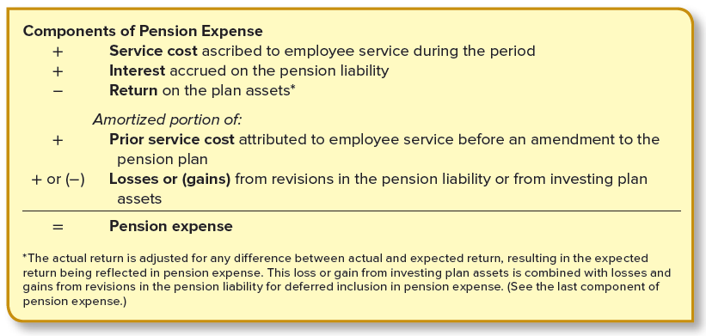
Components of Pension Expense—Overview
LO17-1
Interest and investment return are financing aspects of the pension cost
Recognition of some elements of the pension expense is delayed
17-13
Notes:
Illustration 17–3 Components of Pension Expense—Overview (More Later)
The annual pension expense reflects changes in both the pension obligation and the plan assets. The above illustration provides a brief overview of how these changes are included in pension expense.
The actual return is adjusted for any difference between actual and expected return, resulting in the expected return being reflected in pension expense. This loss or gain from investing plan assets is combined with losses and gains from revisions in the pension liability for deferred inclusion in pension expense.
Interest and investment return are financing aspects of the pension cost. The recognition of some elements of the pension expense is delayed.

Slide 14
Ways to Measure the Pension Obligation
LO17-2
The three different ways to measure the pension obligation that have meaning in pension accounting:
Accumulated benefit obligation (ABO) The actuary’s estimate of the total retirement benefits (at their discounted present value) earned so far by employees, applying the pension formula using existing compensation levels. Vested benefit obligation (VBO) The portion of the accumulated benefit obligation that plan participants are entitled to receive regardless of their continued employment. Projected benefit obligation (PBO) The actuary’s estimate of the total retirement benefits (at their discounted present value) earned so far by employees, applying the pension formula using estimated future compensation levels. (If the pension formula does not include future compensation levels, the PBO and the ABO are the same.)
17-14
Notes:
Illustration 17–4 Ways to Measure the Pension Obligation
Now we consider more precisely what is meant by the pension obligation.
Unfortunately, there’s not just one definition, nor is there uniformity concerning which definition is most appropriate for pension accounting. Actually, three different ways to measure the pension obligation have meaning in pension accounting, as shown in the above illustration.
Accumulated benefit obligation (ABO) The actuary’s estimate of the total retirement benefits (at their discounted present value) earned so far by employees, applying the pension formula using existing compensation levels.
Vested benefit obligation (VBO) The portion of the accumulated benefit obligation that plan participants are entitled to receive regardless of their continued employment.
Projected benefit obligation (PBO) The actuary’s estimate of the total retirement benefits (at their discounted present value) earned so far by employees, applying the pension formula using estimated future compensation levels. (If the pension formula does not include future compensation levels, the PBO and the ABO are the same.)

Slide 15
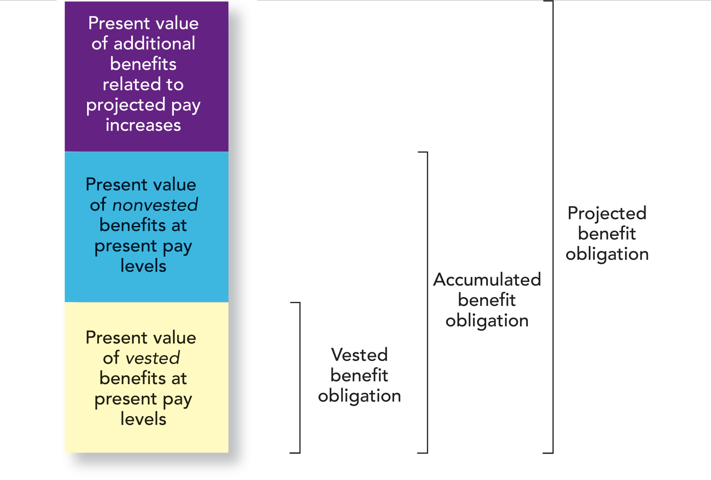
Alternative Measures of the Pension Obligation
LO17-2
17-15
Notes:
Illustration 17–5 Alternative Measures of the Pension Obligation
Later you will learn that the projected benefit obligation is the basis for some elements of the periodic pension expense. Remember, there is but one obligation; these are three ways to measure it. The relationship among the three is depicted in the above illustration.

Slide 16
Accumulated Benefit Obligation
LO17-2
An estimate of the discounted present value of the retirement benefits earned so far, applying the plan’s pension formula using existing compensation levels
Ignores possible pay increases in the future
17-16
Notes:
The accumulated benefit obligation (ABO) is an estimate of the discounted present value of the retirement benefits earned so far by employees, applying the plan’s pension formula using existing compensation levels. When we look at a detailed calculation of the projected benefit obligation later, keep in mind that simply substituting the employee’s existing compensation in the pension formula for her projected salary at retirement would give us the accumulated benefit obligation.

Slide 17
Vested Benefit Obligation
LO17-2
Vested benefits: Those that employees have the right to receive even if their employment were to cease today
Today, benefits must vest:
Fully within five years or
20% within three years with another 20% vesting each subsequent year until fully vested after seven years
The vested benefit obligation is a subset of the accumulated benefit obligation.
17-17
Notes:
Suppose an employee leaves the company to take another job. Will she still get earned benefits at retirement? The answer depends on whether the benefits are vested under the terms of this particular pension plan. If benefits are fully vested—yes. Vested benefits are those that employees have the right to receive even if their employment were to cease today.
Pension plans typically require some minimum period of employment before benefits vest. Today, benefits must vest (a) fully within five years or (b) 20% within three years with another 20% vesting each subsequent year until fully vested after seven years. Five-year vesting is most common.

Slide 18
Vested Benefit Obligation (continued)
LO17-2
Pension Benefit Guaranty Corporation (PGBC)
Established by the Employee Retirement Income Security Act (ERISA)
Imposes liens on corporate assets for unfunded pension liabilities in certain instances and to administer terminated pension plans
Financed by premiums from employers
17-18
Notes:
Through the Employee Retirement Income Security Act (ERISA), passed in 1974, vesting requirements were tightened drastically to protect employees. These requirements have been changed periodically since then.
ERISA also established the Pension Benefit Guaranty Corporation (PBGC) to impose liens on corporate assets for unfunded pension liabilities in certain instances and to administer terminated pension plans. The PBGC provides a form of insurance for employees similar to the role of the FDIC for bank accounts and is financed by premiums from employers equal to specified amounts for each covered employee. It makes retirement payments for terminated plans and guarantees basic vested benefits when pension liabilities exceed assets.

Slide 19
Projected Benefit Obligation
LO17-3
Estimates retirement benefits by applying the pension formula using projected future compensation levels
Less reliable, but more relevant and representationally faithful
This is the measurement of the pension liability used to report amounts in the balance sheet and income statement
17-19
Notes:
Since it’s unlikely that there will be no salary increases between now and retirement, a more meaningful measurement should include a projection of what the salary might be at retirement. Measured this way, the liability is referred to as the projected benefit obligation (PBO). The PBO estimates retirement benefits by applying the pension formula using projected future compensation levels. Hereafter in the chapter, when we mention the “pension obligation,” we are referring to the PBO. The PBO measurement may be less reliable than the ABO but is more relevant and representationally faithful.

Slide 20
Concept Check: Projected Benefit Obligation
LO17-3
The projected benefit obligation (PBO) is best described as the:
Present value of benefits accrued to date based on future salary levels
Present value of benefits accrued to date based on current salary levels
Increase in retroactive benefits at the date of the amendment of the plan
Amount of the adjustment necessary to reflect the difference between actual and estimated actuarial returns
The correct answer is a. The projected benefit obligation (PBO) represents the present value of benefits earned by employees to date based on estimated future salary levels.
17-20
Notes:
The correct answer is a. The projected benefit obligation (PBO) represents the present value of benefits earned by employees to date based on estimated future salary levels.

Slide 21
Projected Benefit Obligation (continued)
LO17-3
Jessica Farrow was hired by Global Communications at the beginning of 2010. The company has a defined benefit pension plan that specifies annual retirement benefits equal to:
1.5% × Service years × Final year’s salary
Farrow is expected to retire in 2049 after 40 years of service.
Her retirement period is expected to be 20 years.
At the end of 2019, 10 years after being hired, her salary is $100,000.
The interest rate is 6%.
The company’s actuary projects Farrow’s salary to be $400,000 at retirement
What is the company’s projected benefit obligation with respect to Jessica Farrow?
Steps to calculate the projected benefit obligation:
Use the pension formula (including a projection of future salary levels) to determine the retirement benefits earned to date
Find the present value of the retirement benefits as of the retirement date (end of 2049)
Find the present value of retirement benefits as of the current date (end of 2019)
17-21
Notes:
Illustration 17–6 Projected Benefit Obligation
To understand the concepts involved, we will look at a numerical example. We will simplify our illustration by looking at how pension amounts would be determined for a single employee. Here, in this illustration, Jessica Farrow was hired by Global Communication at the beginning of 2010. The company has a defined benefit pension plan. Thus, the annual retirement benefits are calculated by the pension formula. Farrow is expected to retire in 2049 after 40 years of service. Her retirement period is expected to be 20 years. Her salary is $100,000 at the end of 2019 and the interest rate is 6%. The actuary projects that Farrow’s salary will be $400,000 at the time of her retirement. We are asked to find the company’s projected benefit obligation.
The steps to calculate the PBO are:
Use the pension formula (including a projection of future salary levels) to determine the retirement benefits earned to date.
Find the present value of the retirement benefits as of the retirement date (end of 2049).
Find the present value of retirement benefits as of the current date (end of 2019).

Slide 22
Projected Benefit Obligation (cont. 2)
LO17-3
3. Present value (n = 30, i = 6%) of
retirement benefits at 2019 is
$688,195 × .17411 =
$119,822 (PBO)
1. Actuary estimates employee has
earned (as of 2019) retirement benefits of
1.5% × 10 years × $400,000 =
$60,000 per year
2010
(beg.)
2019
(end)
2049
(end)
2069
(end)
10 years
30 years
20 years
Service period
Retirement
2. Present value (n = 20, i = 6%) of the retirement annuity at the retirement date is
$60,000 × 11.46992 =
$688,195
17-22
Notes:
Illustration 17–6 Projected Benefit Obligation (continued)
Step 1: Using the pension formula where the projected future salary is $400,000 and service years is 10, we determine the retirement benefits earned to date to be $60,000 per year.
Step 2: We find the present value of the retirement benefits as of the retirement date to be $688,195.
Step 3: We find the present value of retirement benefits as of the current date by discounting the retirement annuity of $688,195 for 30 years: $119,822.

Slide 23
Projected Benefit Obligation in 2020
LO17-3
If the actuary’s estimate of the final salary hasn’t changed, the PBO a year later at the end of 2020 would be $139,715 as demonstrated:
3. Present value (n = 29, i = 6%) of
retirement benefits at 2020 is
$757,015 × .18456 =
$139,715 (PBO)
1. Actuary estimates employee has
earned (as of 2020) retirement benefits of
1.5% × 11 years × $400,000 =
$66,000 per year
2010
2020
2049
2069
11 years
29 years
20 years
Service period
Retirement
One more service year
is included in the pension formula calculation (Service cost)
The employee is one year closer to retirement (Interest cost)
2. Present value (n = 20, i = 6%) of the retirement annuity at the retirement date is
$66,000 × 11.46992 =
$757,015
17-23
Notes:
Illustration 17–6A PBO in 2020
Now for the same illustration, if the actuary’s estimate of the final salary hasn’t changed, the PBO a year later at the end of 2020 would be $139,715 as demonstrated in the above illustration.
Notice that the PBO increased during 2020 (as shown in the illustration) from $119,822 to $139,715 for two reasons:
One more service year is included in the pension formula calculation (service cost).
The employee is one year closer to retirement, causing the present value of benefits to increase due to the time value of future benefits (interest cost).
Note that in the pension formula the service years is now 11 years instead of 10. Consequently, 2020 is one year closer to the retirement date, that is n = 29, for the purpose of calculating the present value.

Slide 24
Five Events That Might Cause Change in PBO Balance
LO17-3
1) Service cost
Each year’s service adds to the obligation to pay benefits
This represents the increase in the projected benefit obligation attributable to employee service performed during the period
2) Interest cost
Interest accrues on PBO balance each year
Calculated as the assumed discount rate multiplied by the projected benefit obligation at the beginning of the year
17-24
Notes:
The five events that might possibly cause the balance of the PBO to change are (1) service cost, (2) interest cost, (3) prior service cost, (4) gains and losses, and (5) payments to retired employees.
1) Service cost:
As we just witnessed in the illustration, the PBO increases each year by the amount of that year’s service cost. This represents the increase in the projected benefit obligation attributable to employee service performed during the period. Also, it is the primary component of the annual pension expense.
2) Interest cost:
Even though the projected benefit obligation is not formally recognized as a liability in the company’s balance sheet, it is a liability nevertheless. And, as with other liabilities, interest cost accrues on its balance as time passes. The amount can be calculated directly as the assumed discount rate multiplied by the projected benefit obligation at the beginning of the year.

Slide 25
Five Events That Might Cause Change in PBO Balance (continued)
LO17-3
3) Prior service cost
When a pension plan is amended, credit often is given for employee service rendered in prior years. The cost of doing so is called prior service cost
Example
Global Communications in our illustration revised the pension formula. The formula’s salary percentage is increased in 2020 from 1.5% to 1.7%.
1.7% × Service years × Final year’s salary
(revised pension formula)
17-25
Notes:
3) Prior service cost:
Another reason the PBO might change is if the pension plan itself is amended to revise the way benefits are determined. For example, assume that Global Communications in our illustration revised the pension formula; assume the formula’s salary percentage is increased in 2020 from 1.5% to 1.7%.
Obviously, the annual service cost from this date forward will be higher than it would have been without the amendment. But it also might cause an immediate increase in the PBO as well. This is because most companies choose to make amendments retroactive to prior years. In other words, the more beneficial terms of the revised pension formula are not applied just to future service years, but benefits attributable to all prior service years also are recomputed under the more favorable terms. Making the amendment retroactive to prior years adds an extra layer of retirement benefits, increasing the company’s benefit obligation. The increase in the PBO attributable to making a plan amendment retroactive is referred to as prior service cost.

Slide 26
Prior Service Cost
LO17-3
Cost increase in the PBO as a result of making an amendment retroactive
– That is, previous benefits are recalculated using the “more generous” formula in addition to applying it to future years’ service
PBO without Amendment
PBO with Amendment
1. 1.5% × 10 yrs. × $400,000
= $ 60,000
1.7% × 10 yrs. × $400,000
= $ 68,000
2. $60,000 × 11.46992
= 688,195
$68,000 × 11.46992
= 779,955
3. $688,195 × .17411
= 119,822
$779,955 × .17411
= 135,798
$15,976
Prior service cost
17-26
Notes:
Let’s put prior service cost in the context of our prior illustration using Jessica Farrow and Global Communications. At the end of 2019, and therefore the beginning of 2020, the PBO is $119,822. If the plan is amended on January 3, 2020, the PBO for that date could be recomputed as shown above. Note that the amended salary percentage is now 1.7%.

Slide 27
Prior Service Cost (continued)
LO17-3
Increase in the PBO as a result of making an amendment retroactive
PBO at the beginning of 2020 (end of 2019)
$119,822
Prior service cost (determined previously)
15,976
135,798
PBO including prior service cost at the beginning of 2020
135,798
Service cost: (1.7% × 1 yr. × $400,000) × 11.46992 × .18456
14,395
Annual retirement benefits
from 2020 service
To discount
to 2049
To discount
to 2020
Interest cost: $135,798 × 6%
8,148
PBO at the end of 2020
$158,341
Present value of an ordinary annuity of $1: n = 20, i = 6%.
Present value of $1: n = 29, i = 6%
Includes the beginning balance plus the prior service cost because
the amendment occurred at the beginning of the year
17-27
Notes:
Prior service cost increased the PBO at the beginning of the year.
The $15,976 increase in the PBO attributable to applying the more generous terms of the amendment to prior service years is the prior service cost. And, because we assumed the amendment occurred at the beginning of 2020, both the 2020 service cost and the 2020 interest cost would change as a result of the prior service cost.

Slide 28
Prior Service Cost (cont. 2)
LO17-3
The plan amendment would affect not only the year in which it occurs, but also each subsequent year because the revised pension formula determines each year’s service cost.
PBO at the beginning of 2021 (end of 2020)
$158,341
Service cost: (1.7% × 1 yr. × $400,000) × 11.46992 × .19563
15,258
Annual retirement benefits
from 2021 service
To discount
to 2049
To discount
to 2021
Interest cost: $158,341 × 6%
9,500
PBO at the end of 2021
$183,099
Present value of an ordinary annuity of $1: n = 20, i = 6%
Present value of $1: n = 28, i = 6%
17-28
Notes:
The plan amendment would affect not only the year in which it occurs, but also each subsequent year because the revised pension formula determines each year’s service cost. Note that in the above illustration, during 2021, the PBO increased as a result of service cost and interest cost.

Slide 29
Five Events That Might Cause Change in PBO Balance (cont. 2)
LO17-3
4) Gains or losses
Decrease and increase in estimates of the PBO because of periodic re-evaluation of uncertainties
Assume future salary estimate is increased by 5%
PBO without Revised Estimate
PBO with Revised Estimate
1. 1.7% × 12 yrs. × $400,000
= $ 81,600
1.7% × 12 yrs. × $420,000
= $ 85,680
2. $81,600 × 11.46992
= 935,945
$85,680 × 11.46992
= 982,743
3. $935,945 × .19563
= 183,099
$982,743 × .19563
= 192,254
$9,155
Loss on PBO
PBO at the beginning of 2021
$158,341
Service cost (calculated above)
15,258
Interest cost (calculated above)
9,500
Loss on PBO (calculated above)
9,155
PBO at the end of 2021
$192,254
Notes:
4) Gains or losses:
We mentioned earlier that a number of estimates are necessary to derive the PBO. When one or more of these estimates requires revision, the estimate of the PBO also will require revision. The resulting decrease or increase in the PBO is referred to as a gain or loss, respectively. Let’s modify our illustration to imitate the effect of revising one of the several possible estimates involved. Suppose, for instance, that new information at the end of 2021 about inflation and compensation trends suggests that the estimate of Farrow’s final salary should be increased by 5% to $420,000.
The difference of $9,155 represents a loss on the PBO because the obligation turned out to be higher than previously expected. Now there would be three elements of the increase in the PBO during 2021.

Slide 30
Five Events That Might Cause Change in PBO Balance (cont. 3)
LO17-3
4) Gains or losses (continued)
If a revised estimate causes the PBO to be lower than previously expected, a gain would be indicated
Other possible estimate changes that would affect the PBO:
Change in life expectancies
Expectation that retirement will occur earlier than previously thought
Change in the assumed discount rate
17-30
Notes:
If a revised estimate causes the PBO to be lower than previously expected, a gain would be indicated.
Consider how a few of the other possible estimate changes would affect the PBO:
A change in life expectancies might cause the retirement period to be estimated as 21 years rather than 20 years. Calculation of the present value of the retirement annuity would use n = 21, rather than n = 20. The estimate of the PBO would increase.
The expectation that retirement will occur two years earlier than previously thought would cause the retirement period to be estimated as 22 years rather than 20 years and the service period to be estimated as 28 years rather than 30 years. The new expectation would probably also cause the final salary estimate to change. The net effect on the PBO would depend on the circumstances.
A change in the assumed discount rate would affect the present value calculations. A lower rate would increase the estimate of the PBO. A higher rate would decrease the estimate of the PBO.

Slide 31
Five Events That Might Cause Change in PBO Balance (concluded)
LO17-3
5) Payment of retirement benefits
Obligation is reduced as benefits actually are paid to retired employees
17-31
Notes:
5) Payment of retirement benefits:
Another change in the PBO occurs when the obligation is reduced as benefits actually are paid to retired employees.
The payment of such benefits is not applicable in our present illustration because we’ve limited the situation to calculations concerning an individual employee who is several years from retirement. Remember, though, in reality the actuary would make these calculations for the entire pool of employees covered by the pension plan.

Slide 32
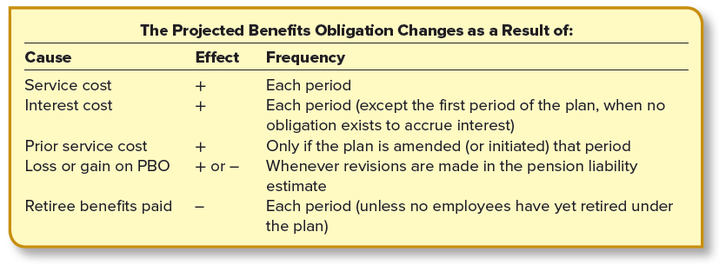
Components of Change in the PBO
LO17-3
17-32
Notes:
Illustration 17–8 Components of Change in the PBO
The above illustration summarizes the five ways the PBO can change.

Slide 33
The PBO Expanded to Include All Employees
LO17-3
The changes in the PBO for Global Communications during 2021 were as follows:
($ in millions)
PBO at the beginning of 2021 (assumed)
$400
Service cost, 2021 (assumed)
41
24
Interest cost: $400 × 6%
Loss (gain) on PBO (assumed)
23
Less: Retiree benefits paid (assumed)
(38)
$450
PBO at the end of 2021
17-33
Notes:
Illustration 17–9 The PBO Expanded to Include All Employees
For our single employee, the PBO at the end of 2021 is $192,254. Let’s say now that Global Communications has 2,000 active employees covered by the pension plan and 100 retired employees receiving retirement benefits. The above illustration expands the numbers to represent all covered employees.

Slide 34
Concept Check: Computing PBO
LO17-3
M-Howard Inc. has a defined benefit pension plan. On December 31 (the end of the fiscal year), the company received the PBO report from the actuary. Among the information included in the report were the following items: ending PBO, $110,000; benefits paid to retirees, $10,000; interest cost, $7,200. The discount rate applied by the actuary was 8%. What was the beginning PBO?
$ 90,000
$100,000
$107,200
$112,000
The correct answer is a:
PBO 1/1 $ ?
Service cost xxx Interest cost ($ ? × 8%) 7,200
Loss (gain) xxx
Prior service cost xxx
Benefits paid (10,000)
PBO 12/31 $110,000
PBO, 1/1 = $7,200 ÷ 8% = $90,000
17-34
Notes:
The correct answer is a:
PBO 1/1 $ ?
Service cost xxx Interest cost ($ ? × 8%) 7,200
Loss (gain) xxx
Prior service cost xxx
Benefits paid (10,000)
PBO 12/31 $110,000
PBO, 1/1 = $7,200 ÷ 8% = $90,000

Slide 35
Pension Plan Assets
LO17-4
Resources with which a company will provide the retirement benefits
Netted together with the PBO to report either a net pension asset (debit balance) or a net pension liability (credit balance) in the balance sheet
Invests
Accepts employer contributions
TRUSTEE
Stocks, bonds, and
other income-producing assets
An individual,
a bank, or
a trust company
Pays benefits to retired employees or their beneficiaries
Accumulates the earnings
Notes:
So far our focus has been on the employer’s obligation to provide retirement benefits in the future. We turn our attention now to the resources with which the company will satisfy that obligation—the pension plan assets. Like the PBO, the pension plan assets are not reported separately in the employer’s balance sheet but are netted together with the PBO to report either a net pension asset (debit balance) or a net pension liability (credit balance). Its separate balance, too, must be reported in the disclosure notes to the financial statements (as does the separate PBO balance), and as explained below, the return on these assets is included in the calculation of the periodic pension expense.
The assets of a pension fund must be held by a trustee. A trustee accepts employer contributions, invests the contributions, accumulates the earnings on the investments, and pays benefits from the plan assets to retired employees or their beneficiaries. The trustee can be an individual, a bank, or a trust company. Plan assets are invested in stocks, bonds, and other income-producing assets. The accumulated balance of the annual employer contributions plus the return on the investments (dividends, interest, market price appreciation) must be sufficient to pay benefits as they come due.

Slide 36
How Plan Assets Change
LO17-4
Global Communications funds its defined benefit pension plan by contributing each year the year’s service cost plus a portion of the prior service cost. Cash of $48 million was contributed to the pension fund at the end of 2021.
Plan assets at the beginning of 2021 were valued at $300 million. The expected rate of return on the investment of those assets was 9%, but the actual return in 2021 was 10%. Retirement benefits of $38 million were paid at the end of 2021 to retired employees. (Also, recall that Global’s PBO at the end of 2021 is $450 million.) What is the value of the company’s pension plan assets at the end of 2021?
($ in millions)
Plan assets at the beginning of 2021
$300
Actual return on plan assets (10% × $300)
30
Cash contributions
48
Less: Retiree benefits paid
(38)
Plan assets at the end of 2021
$340
17-36
Notes:
Illustration 17–10 How Plan Assets Change
When an employer estimates how much it must set aside each year to accumulate sufficient funds to pay retirement benefits as they come due, it’s necessary to estimate the return those investments will produce. This is the expected return on plan assets. The higher the return, the less the employer must actually contribute. On the other hand, a relatively low return means the difference must be made up by higher contributions.
In this illustration, we shift the focus of our numerical illustration to emphasize Global’s pension plan assets.
Plan assets at the beginning of 2021 were valued at $300 million. The expected rate of return on the investment of those assets was 9%, but the actual return in 2021 was 10%. Retirement benefits of $38 million were paid at the end of 2021 to retired employees. Using this information we can determine that Global’s 2021 ending balance for Plan Assets is $340 million.

Slide 37
Concept Check: Actual Return on Plan Assets
LO17-4
Information regarding the defined benefit pension plan of Corey Services included the following for 2021 ($ in millions):
Plan assets, January 1 $ 70
Plan assets, December 31 105
Retiree benefits paid (end of year) 17
Employer contributions to the pension plan (end of year) 42
What was the actual return on plan assets for 2021?
$10 million
$24 million
$35 million
$60 million
The correct answer is a:
Beginning balance $ 70
+ actual return ?
+ contributions 42
− retiree benefits paid (17)
= ending balance $105
$10 million
17-37
Notes:
The correct answer is a:
Beginning balance $ 70
+ actual return ? = $10
+ contributions 42
− retiree benefits paid (17)
= ending balance $105

Slide 38
Concept Check: Computing Employer Contributions
LO17-4
Information regarding the defined benefit pension plan of Chumlee Company included the following for 2021 ($ in millions):
Plan assets, January 1 $350
Plan assets, December 31 525
Retiree benefits paid (end of year) 85
Return on plan assets 50
What were the employer contributions to the pension plan at the end of 2021?
$30 million
$175 million
$210 million
$225 million
The correct answer is c:
Beginning balance $350
+ actual return 50
+ contributions ?
− retiree benefits paid (85)
= ending balance $525
210
17-38
Notes:
The correct answer is c:
Beginning balance $350
+ actual return 50
+ contributions ? = $210
− retiree benefits paid (85)
= ending balance $525

Slide 39
Reporting the Funded Status of the Pension Plan
LO17-5
Firms report the net difference between plan assets and PBO, referred to as the “funded status” of the plan
A company must report in its balance sheet a liability for the underfunded (or asset for the overfunded) status of its postretirement plans
($ in millions)
2021
2020
Projected benefit obligation (PBO)
$450
$400
Fair value of plan assets
340
300
Underfunded status
$110
$100
Net pension liability in 2021 balance sheet
17-39
Notes:
A company’s PBO is not reported separately among liabilities in the balance sheet. Similarly, the plan assets a company sets aside to pay those benefits are not separately reported among assets in the balance sheet. However, firms do report the net difference between those two amounts, referred to as the “funded status” of the plan. From our previous discussion, we see the funded status for Global as shown in this illustration at December 31, 2021, and December 31, 2020.
Because the plan is underfunded, Global reports a net pension liability of $110 million in its 2021 balance sheet and $100 million in 2020. It is important to note that the “net pension liability” is not an actual account balance. Instead, it is the PBO account balance and the plan assets account balance simply reported in the balance sheet as a single net amount. If the plan becomes overfunded in the future, Global will report a net pension asset instead.
A company must report in its balance sheet a liability for the underfunded (or asset for the overfunded) status of its postretirement plans.

Slide 40
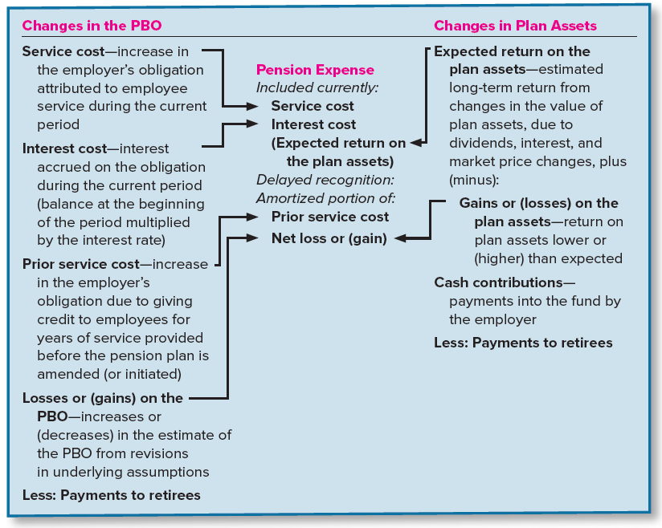
Components of the Periodic Pension Expense
LO17-6
17-40
Notes:
Illustration 17–11 Components of the Periodic Pension Expense
Like wages, salaries, commissions, and other forms of pay, pension expense is part of a company’s compensation for employee services each year. Accordingly, the accounting objective is to achieve a matching of the costs of providing this form of compensation with the benefits of the services performed. However, the fact that this form of compensation actually is paid to employees many years after the service is performed means that other elements in addition to the annual service cost will affect the ultimate pension cost. These other elements are related to changes that occur over time in both the pension obligation and the pension plan assets. The above illustration provides a summary of how some of these changes influence pension expense.

Slide 41
Pension Expense
LO17-6
Reports from the actuary and the trustee of plan assets indicate the following changes during 2021 in the PBO and plan assets of Global Communications ($ in millions).
PBO
Plan Assets
Beginning of 2021
$400
Beginning of 2021
$300
Service cost
41
Actual return on plan assets,
10% (9% expected)
30
Interest cost, 6%
24
Loss (gain) on PBO
23
Cash contributions
48
Less: Retiree benefits
(38)
Less: Retiree benefits
(38)
End of 2021
$450
End of 2021
$340
Assume a prior service cost of $60 million was incurred at the beginning of the previous year (2020) due to a plan amendment increasing the PBO. Also assume that at the beginning of 2021 Global had a net loss of $55 million (previous losses exceeded previous gains). The average remaining service life of employees is estimated at 15 years.
17-41
Notes:
Illustration 17–12 Pension Expense
We’ve examined each of the components of pension expense from the viewpoint of its effect on the PBO or on plan assets, using the Global Communications illustration to demonstrate that effect. Now, let’s expand the same in the illustration to see how these changes affect pension expense.

Slide 42
Pension Expense (continued)
LO17-6
($ in millions)
PBO
Plan Assets
Beginning of 2021
$400
Beginning of 2021
$300
Service cost
41
Actual return on plan assets,
10% (9% expected)
30
Interest cost, 6%
24
Loss (gain) on PBO
23
Cash contributions
48
Less: Retiree benefits
(38)
Less: Retiree benefits
(38)
End of 2021
$450
End of 2021
$340
Global’s 2021 pension expense is determined as follows:
($ in millions)
Service cost
$41
Interest cost (6% × $400)
24
Expected return on the plan assets ($30 actual, less $3 gain)
(27)
Amortization of prior service cost (calculated later)
4
Amortization of net loss (calculated later)
1
Pension expense
$43
Notes:
Illustration 17–12 Pension Expense (continued)
The above illustration demonstrates the relationship between some of the changes in the PBO and in plan assets and the components of pension expense: service cost, interest cost, the return on plan assets, prior service cost amortization, and net gain or loss amortization.
We will look at these five components of pension expense one at a time.

Slide 43
Pension Expense (cont. 2)
LO17-6
Global’s 2021 pension expense:
1) Service Cost
$41 million service cost represents the increase in the projected benefit obligation attributable to employee service
Each year, this is the first component of the pension expense
($ in millions)
Service cost
$41
24
Interest cost (6% × $400)
Expected return on the plan assets ($30 actual, less $3 gain)
(27)
Amortization of prior service cost (calculated later)
4
Amortization of net loss (calculated later)
1
Pension expense
$43
17-43
Notes:
Illustration 17–12 Pension Expense (continued)
The $41 million service cost represents the increase in the projected benefit obligation attributable to employee service performed during 2021 (benefits earned by employees during the year). Each year this is the first component of the pension expense.

Slide 44
Pension Expense (cont. 3)
LO17-6
Global’s 2021 pension expense:
2) Interest Cost
Calculated as the discount rate times by the projected benefit obligation at the beginning of the year
Reported as the second component of the annual pension expense
($ in millions)
Service cost
$41
24
Interest cost (6% × $400)
Expected return on the plan assets ($30 actual, less $3 gain)
(27)
Amortization of prior service cost (calculated later)
4
Amortization of net loss (calculated later)
1
Pension expense
$43
17-44
Notes:
Illustration 17–12 Pension Expense (continued)
The interest cost is calculated as the interest rate (discount rate) multiplied by the projected benefit obligation at the beginning of the year. In 2021, this is 6% times $400 million, or $24 million.
The PBO balance is not separately reported as a liability in the company’s balance sheet, but it is a liability nevertheless. The interest expense that accrues on its balance is not separately reported in the income statement but instead becomes the second component of the annual pension expense.

Slide 45
Pension Expense (cont. 4)
LO17-6
Global’s 2021 pension expense:
3) Return on Plan Assets
Includes dividends, interest, and capital gains earned from plan assets
When accounting for the return, we need to differentiate between its two modes: the expected return and the actual return
($ in millions)
Service cost
$41
24
Interest cost (6% × $400)
Expected return on the plan assets ($30 actual, less $3 gain)
(27)
Amortization of prior service cost (calculated later)
4
Amortization of net loss (calculated later)
1
Pension expense
$43
17-45
Notes:
Illustration 17–12 Pension Expense (continued)
Remember, plan assets comprise funds invested in stocks, bonds, and other securities that presumably will generate dividends, interest, and capital gains. Each year, these earnings represent the return on plan assets during that year. When accounting for the return, we need to differentiate between its two modes: the expected return and the actual return.

Slide 46
Pension Expense (cont. 5)
LO17-6
Global’s 2021 pension expense:
Actual versus expected return
Expected return on plan assets each year reduces the amount recorded as pension expense
Interest and return-on-assets components are financial items created rather than direct employee compensation
($ in millions)
Service cost
$41
24
Interest cost (6% × $400)
Expected return on the plan assets ($30 actual, less $3 gain)
(27)
Amortization of prior service cost (calculated later)
4
Amortization of net loss (calculated later)
1
Pension expense
$43
17-46
Notes:
Illustration 17–12 Pension Expense (continued)
Actual versus expected return: We’ve assumed Global’s expected rate of return is 9%, so its expected return on plan assets in 2021 was 9% times $300 million, or $27 million. But, as previously indicated, the actual rate of return in 2021 was 10%, producing an actual return on plan assets of 10% times $300 million, or $30 million.
Obviously, investing plan assets in income-producing assets lessens the amounts employers must contribute to the fund. So, the return on plan assets reduces the net cost of having a pension plan. Accordingly, the return on plan assets each year reduces the amount recorded as pension expense. Just as the interest expense that accrues on the PBO is included as a component of pension expense rather than being separately reported, the investment revenue on plan assets is not separately reported either. In actuality, both the interest and return-on-assets components of pension expense do not directly represent employee compensation. Instead, they are financial items created only because the future obligation to retirees must be funded currently.

Slide 47
Pension Expense (cont. 6)
LO17-6
Global’s 2021 pension expense:
Adjustment for loss or gain
The actual return should first be adjusted by any difference between that return and the amount that had been expected (gain or loss)
Any loss or gain is not included in pension expense right away
($ in millions)
Service cost
$41
24
Interest cost (6% × $400)
Expected return on the plan assets ($30 actual, less $3 gain)
(27)
Amortization of prior service cost (calculated later)
4
Amortization of net loss (calculated later)
1
Pension expense
$43
17-47
Notes:
Illustration 17–12 Pension Expense (continued)
Adjustment for loss or gain: Since the net cost of having a pension plan is reduced by the actual return on plan assets, the charge to pension expense should be the actual return on plan assets. However, the FASB concluded that the actual return should first be adjusted by any difference between that return and the return amount that had been expected. So, it’s actually the expected return that is included in the calculation of pension expense. In our illustration, Global’s pension expense is reduced by the expected return of $27 million.
The difference between the actual and expected return is considered a loss or gain on plan assets. Although we don’t include these losses and gains as part of pension expense when they occur, it’s possible they will affect pension expense at a later time.

Slide 48
Pension Expense (cont. 7)
LO17-6
$60 million ÷ 15 years
4) Amortization of Prior Service Cost
Amortized over the average remaining service life of the active employee group
Prior service cost is reported as a component of accumulated other comprehensive income (AOCI)
Amortization of Prior Service Cost:
($ in millions)
Service cost
$41
Interest cost
24
Expected return on the plan assets
(27)
Amortization of prior service cost–AOCI
4
Amortization of net loss–AOCI
1
2021 Pension expense
$43
17-48
Notes:
Illustration 17–12 Pension Expense (continued)
Amortization of Prior Service Cost: Recall that the $60 million increase in Global’s PBO due to recalculating benefits employees earned in prior years as a result of a plan amendment is referred to as the prior service cost. In the illustration, the amendment occurred in 2020, increasing the PBO at that time.
The prior service cost at the beginning of 2021 is $56 million. The amount was computed as follows. First we assume that the average remaining service life of the active employee group is 15 years. To amortize the prior service cost of $60 million in equal annual amounts, we use the straight-line method. By the straight-line method, prior service cost is recognized over the average remaining service life of the active employee group is 15 years. To recognize the $60 million prior service cost in equal annual amounts over this period, the amount amortized as an increase in pension expense each year is $4 million.
Be sure to note that, even though we’re amortizing it, the prior service cost is not an asset, but instead a part of accumulated other comprehensive income (AOCI), a shareholders’ equity account. This is a result of the FASB’s disinclination to treat the cost as an expense as it is incurred. The Board, instead, prefers to consider it to be other comprehensive income (OCI) like the handful of losses and gains also categorized the same way and not reported among the gains and losses in the traditional income statement.

Slide 49
Pension Expense (cont. 8)
LO17-6
Prior Service Cost–AOCI
($ in millions)
The prior service cost balance in AOCI declines by the amortization each year
Prior service cost at the beginning of 2021
$56
Less: 2021 amortization
(4)
Prior service cost at the end of 2021
$52
17-49
Notes:
Illustration 17–12 Pension Expense (continued)
By the straight-line method, prior service cost is recognized over the average remaining service life of the active employee group. Prior service cost is not expensed as it is incurred. Instead, it is reported as a component of AOCI to be amortized over time. Thus, we calculate the prior service cost balance at the end of 2021 as $52.

Slide 50
Pension Expense (concluded)
LO17-6
5) Amortization of a Net Loss or Net Gain
Gains and losses are reported as OCI in the statement of comprehensive income as they occur
Gains and losses (net of subsequent amortization) accumulate as a net loss–AOCI or a net gain–AOCI, depending on whether we have greater losses or gains over time
We report this amount in the balance sheet as a part of accumulated other comprehensive income (AOCI), a shareholders’ equity account
17-50
Notes:
Illustration 17–12 Pension Expense (concluded)
Amortization of a Net Loss or Gain: Gains and losses can occur when expectations are revised concerning either the PBO or the return on plan assets. Like the prior service cost we just discussed, we don’t include these gains and losses as part of pension expense in the income statement, but instead report them as OCI in the statement of comprehensive income as they occur.
We then report the gains and losses (net of subsequent amortization) on a cumulative basis as a net loss–AOCI or a net gain–AOCI, depending on whether we have greater losses or gains over time. We report this amount in the balance sheet as a part of accumulated other comprehensive income (AOCI), a shareholders’ equity account.
There is no conceptual justification for not including losses and gains in earnings. After all, these increases and decreases in either the PBO or plan assets immediately impact the net cost of providing a pension plan and, conceptually, should be included in pension expense as they occur. Nevertheless, the FASB requires that income statement recognition of gains and losses from either source be delayed for practical reasons.

Slide 51
Concept Check: Reporting Gains and Losses
LO17-6
Brendon Health Services reported a net loss–AOCI in last year’s balance sheet. This year, the company revised its estimate of future salary levels causing its PBO estimate to decline by $24. Also, the $48 million actual return on plan assets was less than the $54 million expected return. As a result:
The statement of comprehensive income will report a $6 million gain and a $24 million loss
The net pension liability will increase by $18 million
Accumulated other comprehensive income will increase by $18 million
The net pension liability will decrease by $24 million
The correct answer is c:
PBO 24
Gain–OCI 24
Loss–OCI ($54 − 48) 6
Plan assets 6
The $24M gain and $6M loss combine for a net gain of $18M, which reduces the net loss–AOCI, which is an increase in AOCI.
17-51
Notes:
The correct answer is c:
PBO 24
Gain–OCI 24
Loss–OCI ($54 − 48) 6
Plan assets 6
The $24M gain and $6M loss combine for a net gain of $18M, which reduces the net loss–AOCI, which is an increase in AOCI.

Slide 52
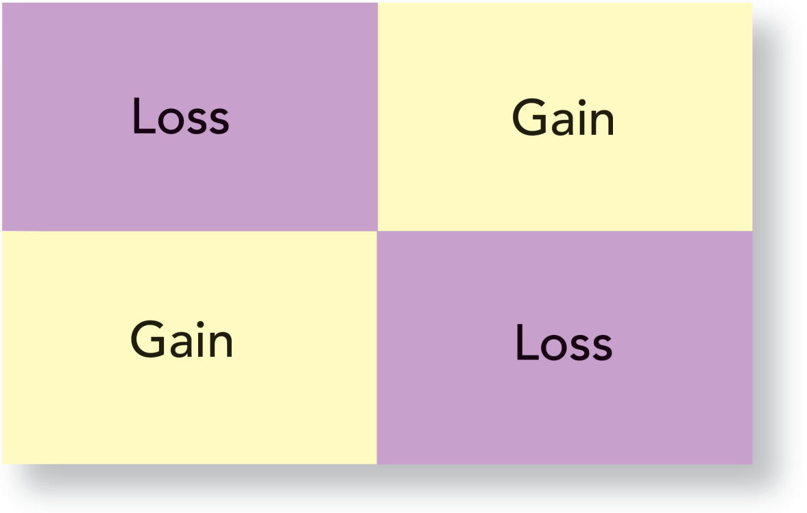
Gains and Losses
LO17-6
Projected Benefit
Obligation
Return on
Plan Assets
Higher
than
expected
Lower
than
expected
17-52
Notes:
Illustration 17–13 Gains and Losses
The above illustration summarizes the possibilities of gains and losses that occur when expectations are revised concerning either the PBO or the return on plan assets.

Slide 53
“Amortizing” Net Gain or Loss
LO17-6
If a net gain or a net loss gets “too large,” pension expense must be adjusted
If a net gain or net loss exceeds the corridor, the excess is not charged to pension expense all at once
Instead, as a further concession to income smoothing, only a portion of the excess is included in pension expense
If it exceeds an amount equal to 10% of the PBO,
or 10% of plan assets, whichever is higher
This threshold amount is referred to as the “corridor”
17-53
Notes:
The FASB acknowledged the conceptual shortcoming of delaying the recognition of a gain or a loss while opting for this more politically acceptable approach. The practical justification for delayed recognition is that, over time, gains and losses might cancel one another out. Given this possibility, why create unnecessary fluctuations in reported income by letting temporary gains and losses decrease and increase (respectively) pension expense? Of course, as years pass there may be more gains than losses, or vice versa, preventing their offsetting one another completely. So, if a net gain or a net loss gets “too large,” pension expense must be adjusted.
The FASB defines too large rather arbitrarily as being when a net gain or a net loss at the beginning of the year exceeds an amount equal to 10% of the PBO, or 10% of plan assets, whichever is higher. This threshold amount is referred to as the “corridor.” When the corridor is exceeded, the excess is not charged to pension expense all at once. Instead, as a further concession to income smoothing, only a portion of the excess is included in pension expense.

Slide 54
“Amortizing” Net Gain or Loss (continued)
LO17-6
Amount that should be included is:
Excess at the beginning of the year
Average remaining service period of active employees expected to receive benefits under the plan
Determining Net Loss Amortization - 2021
($ in millions)
Net loss (previous losses exceeded previous gains)
$55
10% of $400 ($400 is greater than $300): the “corridor”
(40)
$15
Excess at the beginning of the year
Average remaining service period
÷ 15 years
Amount amortized to 2021 pension expense
$ 1
Assumed
17-54
Notes:
The minimum amount that should be included is the excess divided by the average remaining service period of active employees expected to receive benefits under the plan.
In our illustration, we’re assuming a net loss–AOCI of $55 million at the beginning of 2021. Also recall that the PBO and plan assets are $400 million and $300 million, respectively at that time.
Based on this information, we are going to calculate the amount that should be amortized to the 2021 pension expense. The corridor is 10% of PBO, that is $40 million. We have taken PBO as the base for the calculation because, in this case, PBO is higher than the plan assets. Thus we find that the net loss is $15 million in excess at the beginning of the year. Previously, we assumed that the average remaining service life of employees is estimated at 15 years. Dividing the excess of loss of $15 by the average remaining service period of 15 years, we determine the amount amortized to 2021 pension expense to be $1 million.

Slide 55
“Amortizing” Net Gain or Loss (concluded)
LO17-6
If a net gain were being amortized, this amount would be deducted from pension expense
Amortization of the Net Loss–AOCI:
($ in millions)
Service cost
$41
Interest cost
24
Expected return on the plan assets
(27)
Amortization of prior service cost–AOCI
4
Amortization of net loss–AOCI
1
2021 Pension expense
$43
Net Loss–AOCI
($ in millions)
Net loss–AOCI at the beginning of 2021
$55
Less: 2021 amortization
(1)
Plus: 2021 loss on PBO
23
Less: 2021 gain on plan assets
(3)
Net loss–AOCI at the end of 2021
$74
Notes:
The pension expense is increased because a net loss is being amortized. If a net gain were being amortized, the amount would be deducted from pension expense because a gain would indicate that balance of the net cost of providing the pension plan had decreased.
This amortization reduces the net loss–AOCI in 2021 by $1 million. Also recall that Global incurred (a) a $23 million loss in 2021 from revising estimates relating to the PBO and (b) a $3 million gain when the 2021 return on plan assets was higher than expected. These three changes affected the net loss–AOCI in 2021 as shown here (note New losses add to a net loss; new gains reduce a net loss).

Slide 56
Recording Gains and Losses
LO17-7
Global records a loss–OCI for the $23 million loss that occurs in 2021 when it revises its estimate of future salary levels causing its PBO estimate to increase. Global also records a $3 million gain–OCI that occurred when the $30 million actual return on plan assets exceeded the $27 million expected return.
To record new gains and losses
($ in millions)
Journal Entry
Debit
Credit
Loss–OCI (from change in assumption)
23
PBO
23
Plan assets
3
Gain–OCI
3
($30 actual return on assets − $27 expected return)
17-56
Notes:
As we discussed earlier, gains and losses (either from changing assumptions regarding the PBO or from the return on assets being higher or lower than expected) are deferred and not immediately included in pension expense and net income. Instead, we report them as other comprehensive income (OCI) in the statement of comprehensive income. So Global records a loss–OCI for the $23 million loss that occurs in 2021 when it revises its estimate of future salary levels causing its PBO estimate to increase. Global also records a $3 million gain–OCI that occurred when the $30 million actual return on plan assets exceeded the $27 million expected return.
The loss is an increase in the PBO due to a change in an assumption. In this entry, we are recording that increase in the PBO account balance. If the change in assumption had caused the PBO to be reduced instead, we would debit the PBO here and credit a gain–OCI.
Similarly, the gain due to the actual return on plan assets exceeding the expected return is an increase in plan assets. In the next section, we record a journal entry that increases plan assets for the expected return (as a component of pension expense), so the two adjustments together cause the plan assets account balance to reflect the actual return (expected increase plus the additional increase represented by the gain). Of course, if the actual return had been less than expected, we would debit a loss–OCI and credit plan assets here.

Slide 57
IFRS: Accounting for Gains and Losses
LO17-12
U.S. GAAP | IFRS
Accounting for Losses and Gains in Defined Benefit Plans
We use different rates for the interest cost on the defined benefit obligation and the interest revenue on the plan assets. | We use the same rate for both the interest cost on the defined benefit obligation and the interest revenue on the plan assets.
OCI items in the statement of comprehensive income are gradually amortized or recycled out of OCI and into expense, when the accumulated net gain or net loss exceeds the 10% threshold. | OCI items in the statement of comprehensive income are not subsequently amortized out of OCI and into expense, instead, those amounts remain in the balance sheet as accumulated other comprehensive income.
17-57
Notes:
Accounting for Gains and Losses. Accounting for gains and losses in defined benefit plans (called “remeasurement” gains and losses under IFRS) under IAS No. 19 is similar to U.S. GAAP, but there are two important differences.
The first difference relates to the make-up of the gain or loss on plan assets. As we know from the chapter, this amount under U.S. GAAP is the difference between the actual and expected returns, where the expected return is different from company to company and usually different from the interest rate used to determine the interest cost. Not so under IFRS, which requires that we use the same rate (the rate for “high grade corporate bonds”) for both the interest cost on the defined benefit obligation (called projected benefit obligation or PBO under U.S. GAAP) and the interest revenue on the plan assets.
A second difference relates to the treatment of gains and losses after they are initially recorded in OCI. We’ve seen that U.S. GAAP requires that gains and losses (either from the actual return exceeding an assumed amount or from changing assumptions regarding the pension obligation) are to be (a) included among OCI items in the statement of comprehensive income when they first arise and then (b) gradually amortized or recycled out of OCI and into expense (when the accumulated net gain or net loss exceeds the 10% threshold). Similar to U.S. GAAP, under IFRS these gains and losses are included in OCI when they first arise, but unlike U.S. GAAP those amounts are not subsequently amortized out of OCI and into expense. Instead, under IFRS those amounts remain in the balance sheet as accumulated other comprehensive income.

Slide 58
Recording the Pension Expense
LO17-7
Service cost
$41
Interest cost
24
Expected return on assets
(27)
Amortization of prior service cost
4
Amortization of net loss
1
Pension expense
$43
To record pension expense
($ in millions)
Pension expense (total)
43
Plan assets ($27 Expected return on assets)
27
PBO ($41 Service cost + $24 Interest cost)
65
Amortization of prior service cost—OCI (2021 amort)
4
Amortization of net loss—OCI (2021 amort)
1
17-58
Notes:
Global’s 2021 pension expense is $43 million. The expense includes the $41 million service cost and the $24 million interest cost, both of which add to Global’s PBO. The pension expense also includes a $27 million expected return on plan assets, which adds to the plan assets. The pension expense also includes the $4 million amortization of the prior service cost and the $1 million amortization of the net loss. As we discussed earlier, we report prior service cost when it arises as well as gains and losses as they occur as other comprehensive income (OCI) in the statement of comprehensive income. These OCI items accumulate as Prior service cost–AOCI and Net loss (or gain)–AOCI. So, when we amortize these AOCI accounts, we report the amortization amounts as OCI items in the statement of comprehensive income as well. These amortized amounts are being “reclassified” from OCI to net income.
Amortization reduces the Prior service cost–AOCI and the Net loss–AOCI. Since these accounts have debit balances, we credit the accounts for the amortization. If we were amortizing a net gain, we would debit the account because a net gain has a credit balance.
Remember, we report the funded status of the plan in the balance sheet. That’s the difference between the PBO and plan assets. In this case, it’s a net pension liability since the plan is underfunded; that is, the PBO exceeds plan assets.

Slide 59
Concept Check: Computing Pension Expense
LO17-7
The pension plan was amended last year, creating a prior service cost of $20 million. Service cost and interest cost for the year were $10 million and $4 million, respectively. At the end of the year, there was a negligible balance in the net gain–pensions account. The actual return on plan assets was $4 million although it was expected to be $6 million. On average, employees’ remaining service life with the company is 10 years. What was the pension expense for the year?
$ 8 million
$10 million
$12 million
$18 million
The correct answer is b:
Service cost $10
Interest cost 4
Expected return on the plan assets ($4 actual, plus $2 loss) (6)
Amortization of prior service cost 2*
Amortization of net loss (gain) 0
Pension expense $10
* $20 ÷ 10 years = $2
0
17-59
Notes:
The correct answer is b:
Service cost $10
Interest cost 4
Expected return on the plan assets ($4 actual, plus $2 loss) (6)
Amortization of prior service cost 2*
Amortization of net loss (gain) 0
Pension expense $10
* $20 ÷ 10 years = $2

Slide 60
Reporting Pension Expense in the Income Statement
LO17-7
The service cost component of pension expense is reported separate from the non-service cost components of pension expense in the income statement as part of the total compensation costs.
Reflects the nature of service cost being different from that of the other elements of pension cost
In our illustration, Global will report the $41 million service cost as one of the elements of compensation expense and the $2 million net amount of the remaining components of pension expense on a separate line below income from operations
17-60
Notes:
The service cost represents benefits earned by employees during the year as part of their compensation. Consistent with that characteristic, companies report the service cost component of pension expense in the income statement as part of the total compensation costs arising from services rendered by the employees during the period, separate from the other (non-service cost) components of pension expense. This presentation reflects the nature of service cost being different from that of the other elements of pension cost. The non-service cost components of pension expense are presented in the income statement also, but separate from the service cost component and outside the subtotal of income from operations. In our illustration, then, Global will report the $41 million service cost as one of the elements of compensation expense and the $2 million net amount of the remaining components of pension expense on a separate line below income from operations.

Slide 61
Reporting Pension Expense in the Income Statement
LO17-7
Components of Pension Expense
($ In millions) | 2017 | 2016 | 2015
Service cost | $ 96 | $ 98 | $114
Interest cost | 164 | 174 | 206
Expected return on plan assets | (371) | (152) | (399)
Amortization of losses (gains) | (36) | 323 | 303
Amortization of prior service costs (credits) | 9 | 13 | 13
Curtailment and special termination benefits | (151) | 1 | (1)
Net expense | $(289) | $457 | $236
17-61
Notes:
Illustration 17–14 Disclosure of Pension Expense—Kellogg Company
The components of pension expense are itemized in disclosure notes. For instance, Kellogg Company described the composition of its pension expense in the disclosure note in a recent annual report, shown here.

Slide 62
IFRS: Prior Service Cost
LO17-12
U.S. GAAP | IFRS
Prior Service Cost
Prior service cost is reported as a separate component of other comprehensive income. | Prior service cost is combined with the current service cost and reported within the income statement.
17-62
Notes:
Under IAS No. 19, prior service cost (called past service cost under IFRS) is combined with the current service cost and reported within the income statement rather than as a component of other comprehensive income as it is under U.S. GAAP.

Slide 63
Recording the Funding of Plan Assets and Payment of Benefits
LO17-7
Global adds $48 million to its plan assets and pays $38 million to retired employees:
To Record Funding
($ in millions)
Journal Entry
Debit
Credit
Plan assets
48
Cash (contribution to plan assets)
48
To Record Payment of Benefits
($ in millions)
Journal Entry
Debit
Credit
PBO
38
Plan assets (payments to retired employees)
38
17-63
Notes:
When Global adds its annual cash investment to its plan assets in 2021, the value of those plan assets increases by $48 million. Thus, we debit plan assets with $48 million, and credit cash account with the same amount, as cash has been invested in its plan assets.
It’s not unusual for the cash contribution to differ from that year’s pension expense. Determining the periodic pension expense and the funding of the pension plan are two separate processes. Pension expense is an accounting decision. How much to contribute each year is a financing decision affected by cash flow and tax considerations, as well as minimum funding requirements. The Pension Protection Act of 2006 and the Employee Retirement Income Security Act of 1974 (ERISA) establish the pension funding requirements. Subject to these considerations, cash contributions are actuarially determined with the objective of accumulating, along with investment returns, sufficient funds to provide promised retirement benefits.
We saw earlier that when pension benefits are paid to retired employees, those payments reduce the plan assets established to pay the benefits and also reduce the obligation to pay the benefits, the PBO. We know that PBO is a liability so to reduce it, we debit PBO by $38 million and reduce plan assets by the same amount.

Slide 64
Recording Changes in the PBO and Plan Assets
LO17-7
($ in millions)
PBO
400
Balance
23
Loss
41
Service cost
24
Interest cost
Benefits paid
38
450
Balance
($ in millions)
Plan Assets
$450 − 340 = $110 million
Balance
300
Gain
3
Expected return
27
Funded status of the pension plan
Funding
48
38
Benefits paid
Balance
340
17-64
Notes:
Now that we’ve recorded the entries for the funding of the pension plan and payment of benefits, we can show all the changes in the PBO and plan assets for 2021.
Remember we don’t report either of these balances separately in the balance sheet. Instead, we net the two and report a net pension liability of $450 − 340 = $110 million, the funded status of the pension plan.

Slide 65
Statement of Comprehensive Income
LO17-7
More expansive view of income than traditional net income
Encompasses all changes in equity other than from transactions with owners
Includes up to four other changes in equity
17-65
Notes:
Illustration 17–15 Statement of Comprehensive Income
Comprehensive income is a more expansive view of income than traditional net income. In fact, it encompasses all changes in equity other than from transactions with owners. So, in addition to net income, comprehensive income includes up to four other changes in equity. A statement of comprehensive income is demonstrated in the illustration, highlighting the presentation of the components of OCI pertaining to Global’s pension plan.

Slide 66
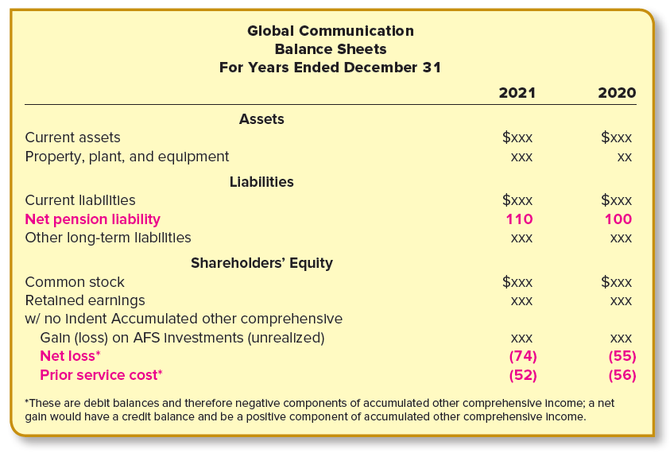
Balance Sheet Presentation of Pension Amounts
LO17-7
17-66
Notes:
Illustration 17–16 Balance Sheet Presentation of Pension Amounts
Other comprehensive income (OCI) items are reported both (a) as they occur and then (b) as an accumulated balance within shareholder’s equity in the balance sheet shown here.
In addition to reporting the gains or losses (and other elements of comprehensive income) that occur in the current reporting period, we also report these amounts on a cumulative basis in the balance sheet. Comprehensive income includes (a) net income and (b) OCI. Remember that we report net income that occurs in the current reporting period in the income statement and also report accumulated net income (that hasn’t been distributed as dividends) in the balance sheet as retained earnings. Similarly, we report OCI as it occurs in the current reporting period and also report accumulated other comprehensive income in the balance sheet. In its 2021 balance sheet, Global will report the amounts as shown here.

Slide 67
Income Tax Considerations
LO17-7
Gains and losses are reported along with their tax effects in the statement of comprehensive income
Accomplished by presenting components of other comprehensive income either net of related income tax effects or before income tax effects
It should be accompanied with disclosure of the income taxes allocated to each component either in a disclosure note or parenthetically in the statement
AOCI in the balance sheet also is reported net of tax
Tax expense for a gain, tax savings for a loss
17-67
Notes:
We have ignored the income tax effects of the amounts in order to focus on the core issues. Note, though, that as gains and losses occur, they are reported along with their tax effects (tax expense for a gain, tax savings for a loss) in the statement of comprehensive income. This can be accomplished by presenting components of other comprehensive income either net of related income tax effects or before income tax effects with disclosure of the income taxes allocated to each component either in a disclosure note or parenthetically in the statement. Likewise, AOCI in the balance sheet also is reported net of tax.

Slide 68
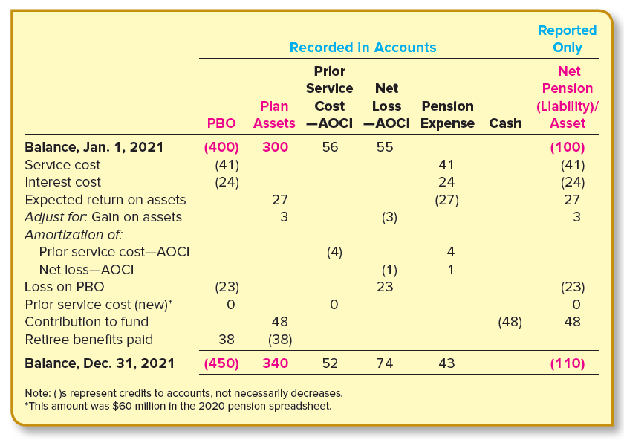
Pension Spreadsheet
LO17-8
17-68
Notes:
Illustration 17–17 Pension Spreadsheet
In preceding sections, we’ve discussed:
the projected benefit obligation (including changes due to periodic service cost, accrued interest, revised estimates, plan amendments, and the payment of benefits)
the plan assets (including changes due to investment returns, employer contributions, and the payment of benefits)
prior service cost
gains and losses
the periodic pension expense (comprising components of each of these) and
the funded status of the plan
These elements of a pension plan are interrelated. It is helpful to see how each element relates to the others. One way of bringing each part together in order to see how each element relates to others is a pension spreadsheet. In this illustration we show a pension spreadsheet for Global Communications.
Notice that the first numerical column simply repeats the actuary’s report of how the PBO changed during the year, as explained previously. Likewise, the second column reproduces the changes in plan assets we discussed earlier. We’ve also previously noted the changes in the prior service cost–AOCI and the net loss–AOCI that are duplicated in the third and fourth columns. The fifth column repeats the calculation of the 2021 pension expense we determined earlier, and the cash contribution to the pension fund is the sole item in the next column.
The last column shows the changes in the funded status of the plan. Notice that the funded status is the difference between the PBO (column 1) and the plan assets (column 2). That means that each of the changes we see in either of the first two columns is reflected as a change in the funded status in the last column. The net pension liability (or net pension asset) balance is not carried in company records. Instead, we use this label to report the PBO and plan assets in the balance sheet as a single net amount.

Slide 69
IFRS: Reporting Pension Expense
LO17-12
U.S. GAAP | IFRS
Reporting Pension Expense
Pension expense is reported as: The service cost component as part of the total compensation costs, separate from the other components of pension expense Net amount of the remaining components of pension expense on a separate line below income from operations | Reporting of pension expense is divided into: The service cost component, including past service cost The net interest cost/income component in the income statement Remeasurement gains and losses as other comprehensive income
17-69
Notes:
Under U.S. GAAP, pension expense is reported as a single net amount.
Under IFRS, we report separately the three costs of having a defined benefit plan:
In net income:
service cost
net interest cost
In OCI:
remeasurement cost

Slide 70
Settlement or Curtailment of Pension Plans
LO17-8
Companies sometimes terminate defined benefit plans to reduce costs and lessen risk
Instead many provide defined contribution plans
Gain on the Termination of a Defined Benefit Plan—Accenture
U.S. Defined Benefit Pension Plan Settlement Charges (in part)
In May 2017, the Company settled its U.S. pension plan obligations. Plan participants elected to receive either a lump-sum distribution or to transfer benefits to a third-party annuity provider. As a result of the settlement, the Company was relieved of any further obligation under its U.S. pension plan. During fiscal 2017, the Company recorded a pension settlement charge of $509,793, and related income tax benefits of $198,219.
17-70
Notes:
Illustration 17–18 Gain on the Termination of a Defined Benefit Plan—Accenture
To cut down on cumbersome paperwork and lessen their exposure to the risk posed by defined benefit plans, many companies are providing defined contribution plans instead. When a plan is terminated, a change in earnings is reported at that time. For instance, Accenture described the termination of its pension plan in the disclosure note shown here.

Slide 71
IFRS: Components of the Net Pension Cost
LO17-12
17-71
Notes:
Accounting for pensions and other postretirement benefits under IFRS is specified in a recent IASB amendment to its postemployment benefit standard, IAS No. 19. Under the update the changes that constitute the components of the net pension cost are separated into:
The cost of service,
The cost of financing that cost, and
Gains or losses from occasional remeasurement of the cost

Slide 72
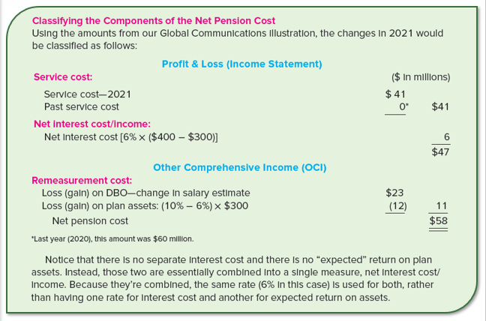
IFRS: Classifying the Components of the Net Pension Cost
LO17-12
17-72
Notes:
Now that we know the components of the net pension cost are separated into service cost, net interest cost/income, and remeasurement cost, we can show an illustration to demonstrate how the components of net pension cost are classified under IFRS. For this, we use the amounts from the Global Communications illustration. Notice that there is no separate interest cost and there is no “expected” return on plan assets. Instead, these two are essentially combined into a single measure, net interest cost/income. Because they are combined, the same rate (6% in this case) is used for both, rather than having one rate for interest cost and another for expected return on assets.

Slide 73
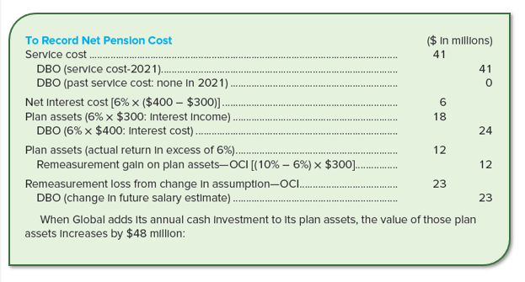
IFRS: Recording the Components of the Net Pension Cost
LO17-12
17-73
Notes:
This illustration shows how the components of net pension cost are recorded under IFRS. We report the (a) service cost and (b) net interest cost/income in net income and (c) remeasurement costs in OCI, as each of those amounts occurs. By recording each component, we record the total pension expense. Remember, each component is a change in either plan assets (the return on assets) or the defined benefit obligation (all others), so as we record each component we also record its effect on plan assets and the defined benefit obligation. First, we record the service cost of 2021, $41. As there is no prior service cost, it is recorded as zero.

Slide 74
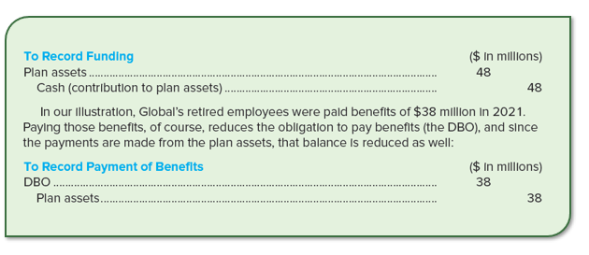
IFRS: Recording the Components of the Net Pension Cost (continued)
LO17-12
17-74
Notes:
When Global adds its annual cash investment to its plan assets, the value of those plan assets increases by $48 million. Thus, we debit plan assets and credit cash for $48 million. We next record the payment of benefits. In the earlier illustration, Global’s retired employees were paid benefits of $38 million in 2021. The payment of those benefits to retired employees reduces the obligation to pay benefits, the DBO. Since the payments are made from the plan assets, that balance is reduced by $38 million as well.

Slide 75
IFRS: Reporting the Components of the Net Pension Cost (cont. 2)
LO17-12
17-75
Notes:
This illustration shows how to report the components of the total pension cost in the statement of comprehensive income. We report separately the three costs of having a defined benefit plan. In net income, we report the service cost and the net interest cost, while remeasurement cost is reported under OCI. Notice in the journal entries that we have no pension expense being recorded as we had using U.S. GAAP in the chapter. Instead, individual components of the net pension cost are recorded. The reason is that the amendment calls for components, not the net total, to be reported in the income statement and statement of comprehensive income.

Slide 76
Postretirement Benefits Other Than Pensions
LO17-9
Medical coverage
Other benefits
Life insurance
Other postretirement benefits
Dental coverage
Group legal services
Health care benefits
17-76
Notes:
As we just discussed, most companies have pension plans that provide for the future payments of retirement benefits to compensate employees for their current services. Many companies also furnish other postretirement benefits to their retired employees. These may include medical coverage, dental coverage, life insurance, group legal services, and other benefits. By far the most common is health care benefits.

Slide 77
Postretirement Benefits Other Than Pensions (continued)
LO17-9
Expected future health care costs for retirees must be recognized as an expense over the years necessary for employees to become entitled to the benefits
Accrual basis
17-77
Notes:
Prior to 1993, employers accounted for postretirement benefit costs on a pay-as-you-go basis, meaning that the expense each year was simply the amount of insurance premiums or medical claims paid, depending on the way the company provided health care benefits. The FASB revised GAAP to require a completely different approach. The expected future health care costs for retirees now must be recognized as an expense over the years necessary for employees to become entitled to the benefits. This is the accrual basis that also is the basis for pension accounting.

Slide 78
Postretirement Benefits Other Than Pensions (concluded)
LO17-9
Accounting for postretirement benefits is similar in most respects to accounting for pension benefits
Two forms of benefits are fundamentally similar
Form of deferred compensation earned during the employee’s service life
Estimated as the present value of the cost of providing the expected future benefits
17-78
Notes:
In fact, accounting for postretirement benefits is similar to accounting for pension benefits. This is because the two forms of benefits are fundamentally similar. Each is a form of deferred compensation earned during the employee’s service life, and each can be estimated as the present value of the cost of providing the expected future benefits.

Slide 79
Disclosures—General Motors
LO17-9
Note 5: Other Postretirement Benefits (in part) The Corporation and certain of its domestic subsidiaries maintain hourly and salaried benefit plans that provide postretirement medical, dental, vision, and life insurance to retirees and eligible dependents. . . . [GAAP] requires that the cost of such benefits be recognized in the financial statements during the period employees provide service to the Corporation.
17-79
Notes:
Illustration 17–19 Disclosures—General Motors
Shown above is the disclosure note that describes the other postretirement benefits provided by General Motors.

Slide 80
What is a Postretirement Benefit Plan?
LO17-9
Important to differentiate between
Eligibility usually is based on age and/or years of service
Retiree health care benefits
Health care benefits during an employee’s working years
Benefits continue into retirement
Benefits are simply part of the annual compensation expense
17-80
Notes:
It is important to distinguish retiree health care benefits from health care benefits provided during an employee’s working years. The annual cost of providing preretirement benefits is simply part of the annual compensation expense. However, many companies offer coverage that continues into retirement. It is the deferred aspect of these postretirement benefits that creates an accounting issue. Usually, a plan promises benefits in exchange for services performed over a designated number of years, or reaching a particular age, or both. In other words, eligibility usually is based on age and/or years of service. Eligibility requirements and the nature of benefits usually are specified by a written plan, or sometimes only by company practice.

Slide 81
Postretirement Health Benefits and Pension Benefits Compared
LO17-9
Retiree health benefits differ fundamentally from pension benefits in some important respects:
The amount of pension benefits generally is based on the number of years an employee works for the company.
Although coverage might be identical, the cost of providing the coverage might vary significantly from retiree to retiree and from year to year because of differing medical needs.
Postretirement health care plans often require the retiree to share in the cost of coverage through monthly contribution payments.
Coverage often is provided to spouses and eligible dependents.
17-81
Notes:
Keep in mind that retiree health benefits differ fundamentally from pension benefits in some important respects:
The amount of pension benefits generally is based on the number of years an employee works for the company so that the longer the employee works, the higher are the benefits. On the other hand, the amount of postretirement health care benefits typically is unrelated to service. It’s usually an all-or-nothing plan in which a certain level of coverage is promised upon retirement, independent of the length of service beyond that necessary for eligibility.
Although coverage might be identical, the cost of providing the coverage might vary significantly from retiree to retiree and from year to year because of differing medical needs.
Postretirement health care plans often require the retiree to share in the cost of coverage through monthly contribution payments. For instance, a company might pay 80% of insurance premiums, with the retiree paying 20%. The net cost of providing coverage is reduced by these contributions as well as by any portion of the cost paid by Medicare or other insurance.
Coverage often is provided to spouses and eligible dependents.

Slide 82
Estimating the Net Cost of Benefits
LO17-9
Many of the assumptions needed to estimate postretirement health care benefits are the same as those needed to estimate pension benefits:
A discount rate
Expected return on plan assets (if the plan is funded)
Employee turnover
Expected retirement age
Expected compensation increases (if the plan is pay-related)
Expected age of death
Number and ages of beneficiaries and dependents
17-82
Notes:
Illustration 17–20 Estimating the Net Cost of Benefits
To determine the postretirement benefit obligation and the postretirement benefit expense, the company’s actuary first must make estimates of what the postretirement benefit costs will be for current employees. As given in the illustration, the estimated net cost of benefits is calculated as the estimated medical costs in each year of retirement minus retiree share of costs minus Medicare payments. Remember, postretirement health care benefits are anticipated actual costs of providing the promised health care and not an amount estimated by a defined benefit formula. This makes the estimates inherently more intricate, especially because health costs in general are very difficult to forecast.
Many of the assumptions needed to estimate postretirement health care benefits are the same as those needed to estimate pension benefits. They are:
A discount rate
Expected return on plan assets (if the plan is funded)
Employee turnover
Expected retirement age
Expected compensation increases (if the plan is pay-related)
Expected age of death
Number and ages of beneficiaries and dependents

Slide 83
Estimating the Net Cost of Benefits (continued)
LO17-9
Additional assumptions become necessary as a result of differences between pension plans and other postretirement benefit plans. They are:
Current cost of providing health care benefits at each age that participants might receive benefits
Demographic characteristics of plan participants
Benefit coverage provided by Medicare, other insurance, or other sources
Expected health care cost trend rate
17-83
Notes:
Also, additional assumptions become necessary as a result of differences between pension plans and other postretirement benefit plans. Specifically, it’s necessary to estimate:
The current cost of providing health care benefits at each age that participants might receive benefits
Demographic characteristics of plan participants that might affect the amount and timing of benefits
Benefit coverage provided by Medicare, other insurance, or other sources that will reduce the net cost of employer-provided benefits
The expected health care cost trend rate
Taking these assumptions into account, the company’s actuary estimates what the net cost of postretirement benefits will be for current employees in each year of their expected retirement. The discounted present value of those costs is the expected postretirement benefit obligation.

Slide 84
Postretirement Benefit Obligation
LO17-10
The Postretirement Benefit Obligation is the discounted present value of the benefits during retirement
There are two related obligation amounts:
APBO is reported in the balance sheet only to the extent that it exceeds plan assets
1. Expected postretirement benefit obligation (EPBO): The actuary’s estimate of the total postretirement benefits (at their discounted present value) expected to be received by plan participants. 2. Accumulated postretirement benefit obligation (APBO): The portion of the EPBO attributed to employee service to date.
17-84
Notes:
Illustration 17–21 Two Views of the Obligation for Postretirement Benefits Other Than Pensions
There are two related obligation amounts. The accumulated postretirement benefit obligation (APBO) is analogous to the projected benefit obligation (PBO) for pensions. Like the PBO, the APBO is reported in the balance sheet only to the extent that it exceeds plan assets.

Slide 85
Measuring the Obligation
LO17-10
The net cost of providing health care benefits to Jessica Farrow (our illustration employee from earlier in the chapter) during her retirement years has a present value of $10,842 as of the end of 2019. If the benefits (and therefore the costs) relate to an estimated 35 years of service and 10 of those years have been completed, the APBO would be
$10,842
EPBO
10 ⁄ 35
$3,098
APBO
×
=
Fraction attributed to service to date
17-85
Notes:
To illustrate, assume that the actuary estimates that the net cost of providing health care benefits to Jessica Farrow (the illustration employee from earlier in the chapter) during her retirement years has a present value of $10,842 as of the end of 2019. This is the EPBO. Now we will calculate the APBO with the given condition that the benefits, and therefore costs, relate to an estimated 35 years of service and 10 of those years have already been completed by Farrow. Thus, the APBO is calculated as $10,842 (the EPBO), times 10/35 (the fraction attributed to service date). Therefore, the APBO is $3,098 at the end of 2019. Here, $3,098 represents the portion of the EPBO related to the first 10 years of the 35-year service period.

Slide 86
Measuring the Obligation (continued)
LO17-10
If the assumed discount rate is 6%, a year later the EPBO will have grown to $11,493 simply because of a year’s interest accruing at that rate. The APBO, however, is the portion of the EPBO related to service up to a particular date. Consequently, the APBO will have increased both because of interest and because the service fraction will be higher:
$10,842 × 1.06 = $11,493
$11,493
EPBO
11 ⁄ 35
$3,612
APBO
×
=
Fraction attributed to service to date
17-86
Notes:
If the assumed discount rate is 6%, a year later the EPBO will have grown to $11,493 simply because of a year’s interest accruing at that rate ($10,842 × 1.06 = $11,493). Notice that there is no increase in the EPBO for service because, unlike the obligation in most pension plans, the total obligation is not increased by an additional year’s service.
The APBO, however, is the portion of the EPBO related to service up to a particular date. Consequently, the APBO will have increased both because of interest and because the service fraction will be higher (service cost). Therefore, the increased APBO is calculated as $11,493, the EPBO after a year’s interest accrued, times 11/35, the fraction attributed to service to date. Therefore APBO at the end of 2020 is $3,612. Here, $3,612 represents the portion of the EPBO related to the first 11 years of the 35-year service period.

Slide 87
Measuring the Obligation (concluded)
LO17-10
The two elements of the increase in 2020 can be separated as follows:
APBO at the beginning of the year
$3,098
Interest cost: $3,098 × 6%
186
Service cost
328
APBO at the end of the year
$3,612
( $11,493 × 1 ⁄ 35 ) portion of EPBO attributed to the year
17-87
Notes:
The APBO increases each year due to (a) interest accrued on the APBO and (b) the portion of the EPBO attributed to that year. This concept is shown here.

Slide 88
Attribution
LO17-10
Process of assigning the cost of benefits to the years that entitle the employees to the benefits
Accomplished by assigning an equal fraction of the EPBO to each year of service from the employee’s date of hire to the employee’s full eligibility date
The date the employee has performed all the service necessary to have earned all the retiree benefits estimated to be received by the employee
17-88
Notes:
Attribution is the process of assigning the cost of benefits to the years during which those benefits are assumed to be earned by employees. We accomplish this by assigning an equal fraction of the EPBO to each year of service from the employee’s date of hire to the employee’s full eligibility date. This is the date the employee has performed all the service necessary to have earned all the retiree benefits estimated to be received by the employee.

Slide 89
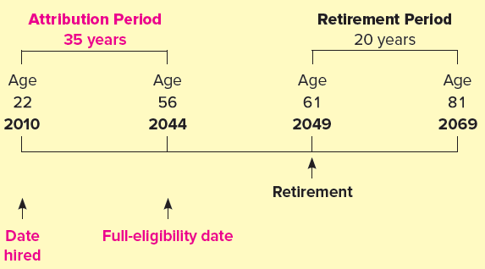
Determining the Attribution Period
LO17-10
Jessica Farrow was hired by Global Communications at age 22 at the beginning of 2010 and is expected to retire at the end of 2049 at age 61. The retirement period is estimated to be 20 years.
Global’s employees are eligible for postretirement health care benefits after both
reaching age 56 while in service and having worked 20 years.
Since Farrow becomes fully eligible at age 56 (the end of 2044), retiree benefits are
attributed to the 35-year period from her date of hire through that date. Graphically, the situation can be described as follows:
17-89
Notes:
Illustration 17–22 Determining the Attribution Period
Next, let’s show how to determine the attribution period. In our earlier example, we assumed the attribution period was 35 years and accordingly accrued 1⁄35 of the EPBO each year. The amount accrued each year increases both the APBO and the postretirement benefit expense. This illustration shows how the 35-year attribution (accrual) period was determined.
Here, Farrow becomes fully eligible at age 56, i.e., at the end of 2044, as in her case both the conditions become valid. This means that retiree benefits are attributed to the 35-year period from her date of hire through that date. Note that the attribution period does not include years of service beyond the full eligibility date even if the employee is expected to work after that date.

Slide 90
Concept Check: Attribution Period
LO17-10
Pierce Products, Inc. sponsors a postretirement plan providing health care benefits to employees who have completed at least 10 years service and are age 53 years or older at retirement. To date, the employees that have retired under the plan have an average age of 60. No employee has worked beyond age 65. Taranda was hired when she was 46 years old. The attribution period for accruing Pierce’s expected postretirement health care benefit obligation to Taranda is during the period when Taranda is:
53 to 60 years old
53 to 65 years old
46 to 56 years old
46 to 65 years old
The correct answer is c:
46 to 56 years old:
date of hire to full eligibility [at least 53, 10 year’s employment] 46 + 10 years = 56
17-90
Notes:
The correct answer is c:
46 to 56 years old:
date of hire to full eligibility [at least 53, 10 year’s employment] 46 + 10 years = 56

Slide 91
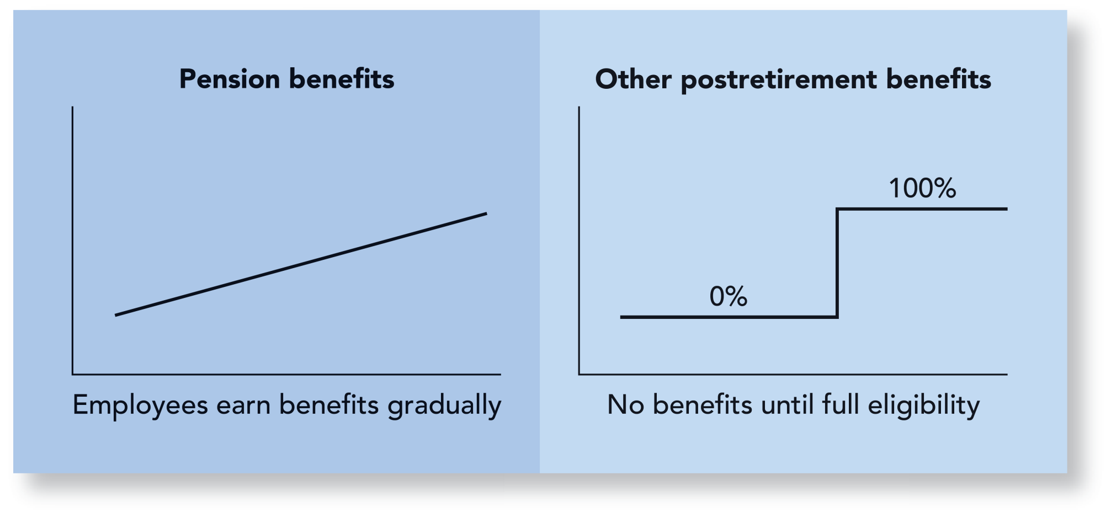
Measuring Service Cost
LO17-11
Primary difference between pensions and other postretirement benefits
17-91
Notes:
Illustration 17–23 Measuring Service Cost
As we just discussed, it’s necessary to attribute a portion of the accumulated postretirement benefit obligation to each year as the service cost for that year as opposed to measuring the actual benefits employees earn during the year as we did for pension plans. That’s due to the fundamental nature of these other postretirement plans under which employees are ineligible for benefits until specific eligibility criteria are met, at which time they become 100% eligible. This contrasts with pension plans under which employees earn additional benefits each year until they retire.

Slide 92
Accounting for Postretirement Benefit Plans Other Than Pensions
LO17-11
To Record Postretirement Benefit Expense
Journal Entry
Debit
Credit
Postretirement benefit expense
XX
Plan assets
XX
Amortization of net gain–OCI
XX
APBO
XX
Amortization of net loss—OCI
XX
Amortization of prior service cost—OCI
XX
To Record Cash Funding of Plan Assets
Journal Entry
Debit
Credit
Plan assets
XX
Cash (contribution to plan assets)
XX
Notes:
While we report service cost and the non-service components the same way as for pensions, the measurement of service cost is the primary difference between accounting for pensions and for other postretirement benefits. Otherwise, though, accounting for the two is virtually identical. The illustration shown here is for the recording of postretirement benefit expense and the funding of plan assets.

Slide 93
Accounting for Postretirement Benefit Plans Other Than Pensions (continued)
LO17-11
To Record Gains and Losses
Journal Entry
Debit
Credit
Loss—OCI
XX
APBO
XX
or
APBO
XX
Gain–OCI
XX
Plan Assets
XX
Gain–OCI
XX
or
Loss—OCI
XX
Plan Assets
XX
Notes:
This illustration shows how we record the gains and losses that occur due to a change in assumption or as a result of the differences between estimated and actual return on plan assets.

Slide 94
Determining the Postretirement Benefit Obligation
LO17-11
Assume the actuary has estimated the net cost of retiree benefits in each year of Jessica Farrow’s 20-year expected retirement period to be the amounts shown in the calculation below. She is fully eligible for benefits at the end of 2044 and is expected to retire at the end of 2049.
Calculating the APBO and the postretirement benefit expense at the end of 2021, 12 years after being hired, begins with estimating the EPBO. Steps to calculate (a) the EPBO, (b) the APBO, and (c) the annual service cost at the end of 2021, 12 years after being hired, follow:
(a). 1. Estimate the cost of retiree benefits in each year of the expected retirement period and deduct anticipated Medicare reimbursements and retiree cost-sharing to derive the net cost to the employer in each year of the expected retirement period.
2. Find the present value of each year’s net benefit cost as of the retirement date.
3. Find the present value of the total net benefit cost as of the current date. This is the EPBO.
(b). Multiply the EPBO by the attribution factor (service to date/total attribution period). This is the APBO. The service cost in any year is simply one year’s worth of the EPBO.
(c). Multiply the EPBO by 1⁄total attribution period.
17-94
Notes:
Illustration 17–24 Determining the Postretirement Benefit Obligation
We assumed earlier that the EPBO at the end of 2019 was determined by the actuary to be $10,842. This was the present value on that date of all anticipated future benefits. Then we noted that the EPBO at the end of the next year would have grown by 6% to $11,493. This amount, too, would represent the present value of the same anticipated future benefits, but as of a year later. The APBO, remember, is the portion of the EPBO attributed to service performed to a particular date. So, we determined the APBO at the end of 2020 to be $11,493 × 11⁄35, or $3,612. We determined the $328 service cost noted earlier for 2020 as the portion of the EPBO attributed to that year: $11,493 × 1⁄35.
Now, let’s review our previous discussion of how the EPBO, the APBO, and the postretirement benefit expense are determined by calculating those amounts a year later, at the end of 2021. Before doing so, however, we can anticipate (a) the EPBO to be $11,493 × 1.06, or $12,182, (b) the APBO to be 12⁄35 of that amount, or $4,177, and (c) the 2021 service cost to be 1⁄35 of that amount, or $348. In the illustration shown here we see if our expectations are borne out by direct calculation.

Slide 95
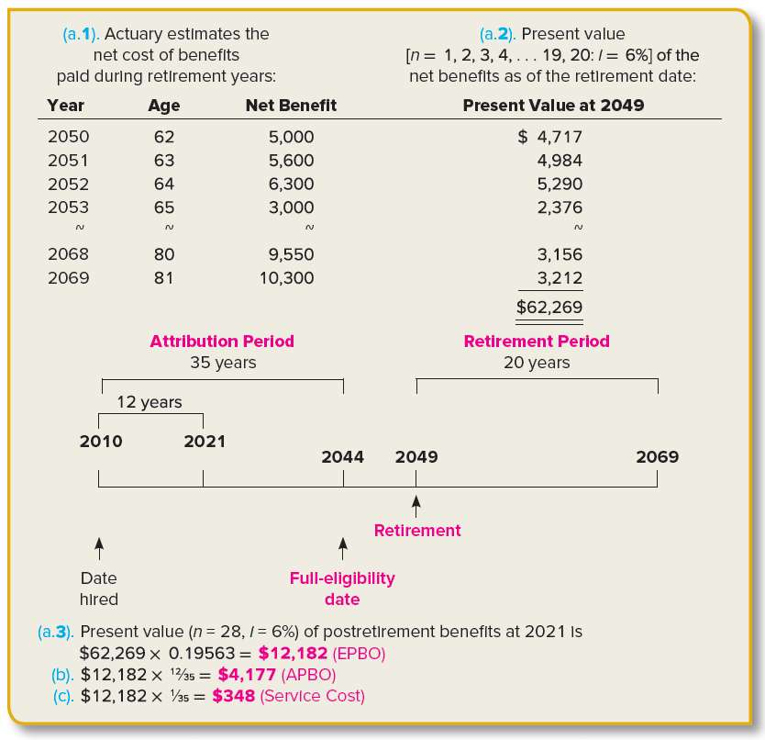
EPBO, APBO, and Service Cost in 2021
LO17-11
17-95
Notes:
Illustration 17–24A EPBO, APBO, and Service Cost in 2019
The steps from the previous illustration are demonstrated here.

Slide 96
Service Method of Allocating Prior Service Cost
Appendix 17
The straight-line method of allocating prior service cost allocates an equal amount of the prior service cost to each year of the average service period
However, fewer of the affected employees will be working for the company toward the end of that period than at the beginning (some probably will retire or quit in each year following the amendment)
An allocation approach that reflects the declining service pattern is called the service method
This method allocates the prior service cost to each year in proportion to the fraction of the total remaining service years worked in each of those years.
17-96
Notes:
When amortizing prior service cost, our objective is to match the cost with employee service. The straight-line method described in this chapter allocates an equal amount of the prior service cost to each year of the 15-year average service period of affected employees. But consider this: fewer of the affected employees will be working for the company toward the end of that period than at the beginning. Some probably will retire or quit in each year following the amendment.
An allocation approach that reflects the declining service pattern is called the service method. This method allocates the prior service cost to each year in proportion to the fraction of the total remaining service years worked in each of those years. To do this, it’s necessary to estimate how many of the 2,000 employees working at the beginning of 2020 when the amendment is made will still be employed in each year after the amendment.

Slide 97
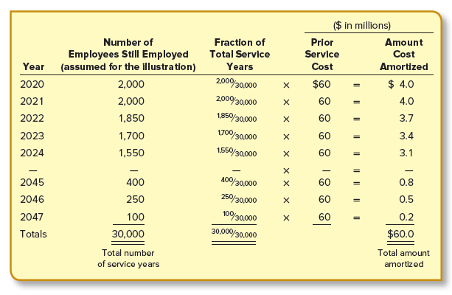
Service Method of Allocating Prior Service Cost (continued)
Appendix 17
By the service method, prior service cost is recognized each year in proportion to the fraction of the total remaining service years worked that year.
17-97
Notes:
Illustration 17A–1 Service Method of Amortizing Prior Service Cost
Let’s suppose, for example, that the actuary estimates that a declining number of these employees still will be employed in each of the next 28 years as indicated in the abbreviated schedule below. The portion of the prior service cost amortized to pension expense each year is $60 million times a declining fraction. Each year’s fraction is that year’s service divided by the 28-year total (30,000). This is demonstrated in the illustration shown.

Slide 98
Service Method of Allocating Prior Service Cost (concluded)
Appendix 17
Conceptually, the service method achieves a better matching of the cost and benefits.
However, GAAP permits the consistent use of any method that amortizes the prior service cost at least as quickly.
The straight-line method meets this condition and is the approach most often used in practice.
In our illustration, the 15-year average service life is simply the total estimated service years divided by the total number of employees in the group
30,000 years
÷
2,000
=
15 years
Total number of service years
Total number of employees
Average service years
17-98
Notes:
Conceptually, the service method achieves a better matching of the cost and benefits. In fact, this is the FASB’s recommended approach. However, GAAP permits the consistent use of any method that amortizes the prior service cost at least as quickly. The straight-line method meets this condition and is the approach most often used in practice. In our illustration, the cost is completely amortized over 15 years rather than the 28 years required by the service method. The 15-year average service life is simply the total estimated service years divided by the total number of employees in the group. Using the illustration from the prior slide this would be 30,000 years (Total number of service years) divided by 2,000 (Total number of employees) which gives us 15 average service years.

Slide 99
End of Chapter 17
17-99

