Slide 1
Accounting in Business
Chapter 1
Wild and Shaw
Financial and Managerial Accounting
8th Edition
Copyright ©2019 McGraw-Hill Education. All rights reserved. No reproduction or distribution without the prior written consent of McGraw-Hill Education.

Slide 2
Chapter 1 Learning Objectives
CONCEPTUAL
C1 Explain the purpose and importance of accounting.
C2 Identify users and uses of, and opportunities in, accounting.
C3 Explain why ethics are crucial to accounting.
C4 Explain generally accepted accounting principles and define and apply several accounting principles.
C5 Appendix 1B Identify and describe the three major activities of organizations.
ANALYTICAL
A1 Define and interpret the accounting equation and each of its components.
A2 Compute and interpret return on assets.
A3 Appendix 1A—Explain the relation between return and risk.
PROCEDURAL
P1 Analyze business transactions using the accounting equation.
P2 Identify and prepare basic financial statements and explain how they interrelate.
© McGraw-Hill Education

Slide 3
Explain the purpose and importance of accounting.
Learning Objective C1
© McGraw-Hill Education

Slide 4
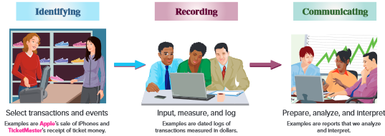
Importance of Accounting
Exhibit 1.1
For example, the sale by Apple of an iPhone.
Keep a chronological log of transactions.
Prepare reports such as financial statements.
Accounting is an information and measurement system that identifies, records, and communicates an organization’s business activities.
Learning Objective C1: Explain the purpose and importance of accounting.
© McGraw-Hill Education
Notes:
Accounting is an information and measurement system that identifies, records, and communicates an organization’s business activities.
Identifying business activities requires that we select relevant transactions and events.
Recording business activities requires that we keep a chronological log of transactions and events measured in dollars.
Communicating business activities includes preparing accounting reports such as financial statements, which we analyze and interpret.
Recordkeeping, or bookkeeping, includes the recording of transactions and events and is just one part of accounting.

Slide 5
Identify users and uses of, and opportunities in, accounting.
Learning Objective C2
© McGraw-Hill Education

Slide 6
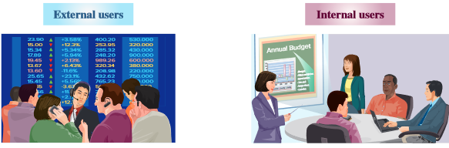
Users of Acccounting Information
Accounting is called the language of business because all organizations set up an accounting information system to communicate data to help people make better decisions. Accounting serves many users who can be divided into two groups: external users and internal users.
Lenders
External auditors
Shareholders
Board of directors
Regulators
Research and development managers
Purchasing managers
Human resource managers
Marketing managers
Production managers
Learning Objective C2: Identify users and uses of, and opportunities in, accounting.
© McGraw-Hill Education
Notes:
Accounting is called the language of business because all organizations set up an accounting information system to communicate data to help people make better decisions. Accounting serves many users, who can be divided into two groups: external users and internal users.
External users of accounting information are not directly involved in running the organization. Financial accounting is the area of account that serves external users. External users include shareholders (investors), lenders, external auditors, board of directors, customers, nonmanagerial and nonexecutive employees, suppliers, regulators, and lawyers. External users have limited access to an organization’s information. Yet their business decisions depend on information that is reliable, relevant, and comparable.
Internal users of accounting information are those directly involved in managing the organization such as the chief executive officer (CEO), and all department managers. They use the information to help improve the efficiency and effectiveness of an organization. Managerial accounting serves their decision-making needs.

Slide 7
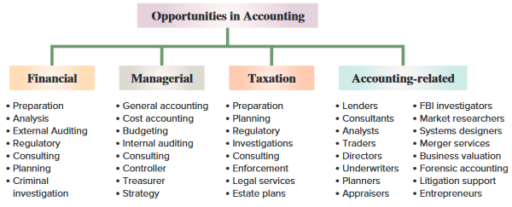
Opportunities in Accounting
Exhibit 1.2
Accounting information is in all aspects of our lives. When we earn money, pay taxes, invest savings, budget earnings, and plan for the future, we use accounting.
Learning Objective C2: Identify users and uses of, and opportunities in, accounting.
© McGraw-Hill Education
Notes:
Accounting has four broad areas of opportunities including financial, managerial, taxation, and accounting-related.
The majority of opportunities are in private accounting, which are employees working for businesses. Public accounting offers the next largest number of opportunities, which involve services such as auditing and tax advice. Still other opportunities exist in government and not-for-profit agencies, including business regulation and investigation of law violations.
Accounting specialists are highly regarded. Their professional standing often is denoted by a certificate. Certified public accountants (CPAs) must meet education and experience requirements, pass an examination, and exhibit ethical character. Two other common certifications include the certificate in management accounting, CMA, and the certified internal auditor, CIA.

Slide 8
Explain why ethics are crucial to accounting.
Learning Objective C3
© McGraw-Hill Education

Slide 9
Ethics – A Key Concept
Exhibit 1.5
The goal of accounting is to provide useful information for decisions. For information to be useful, it must be trusted. This demands ethics in accounting. Ethics are beliefs that distinguish right from wrong. They are accepted standards of good and bad behavior.
Learning Objective C3: Explain why ethics are crucial to accounting.
© McGraw-Hill Education
Notes:
The goal of accounting is to provide useful information for decisions. For information to be useful, it must be trusted. This demands ethics in accounting. Ethics are beliefs that distinguish right from wrong. They are accepted standards of good and bad behavior.
When faced with an ethical concern, the first step is to recognize it as such. Next, we should analyze all of our options. Finally, we must choose the best option after weighing all the consequences.

Slide 10
Fraud Triangle
Three factors must exist for a person to commit fraud: opportunity, pressure, and rationalization.
Envision a way to commit fraud with a low perceived risk of getting caught
Fails to see the criminal nature of the fraud or justifies the action
Must have some pressure to commit fraud, like unpaid bills
Learning Objective C3: Explain why ethics are crucial to accounting.
© McGraw-Hill Education
Notes:
The fraud triangle is a model created by a criminologist that asserts the following three factors must exist for a person to commit fraud: opportunity, pressure, and rationalization.
Opportunity. A person must be able to commit fraud with a low perceived risk of getting caught.
Pressure, or incentive. A person must have pressure or have incentive to commit fraud. Examples are unpaid bills and addictions.
Rationalization, or attitude. A person justifies fraud or does not see its criminal nature.
It is important to recognize that all three factors of the fraud triangle must usually exist for fraud to occur. The absence of one or more factors suggests fraud is unlikely. The key to stopping fraud is to focus on prevention. It is less expensive and more effective to prevent fraud from happening than it is to try to detect the crime. By the time the fraud is discovered, the money is gone. Additionally, it is costly and time-consuming to investigate a fraud.

Slide 11
Sarbanes–Oxley (SOX)
Congress passed the Sarbanes–Oxley Act to help stop financial abuses at companies that issue public stock.
SOX requires documentation and verification of internal controls and emphasizes effective internal controls.
Failure to comply can lead to penalties and criminal prosecution of executives.
Learning Objective C3: Explain why ethics are crucial to accounting.
© McGraw-Hill Education
Notes:
Congress passed the Sarbanes–Oxley Act to help stop financial abuses at companies that issue their stock to the public.
SOX requires documentation and verification of internal controls and emphasizes effective internal controls. Management must issue a report stating that internal controls are effective. Auditors verify the effectiveness of internal controls. Ignoring SOX can lead to penalties and criminal prosecution of executives. CEOs and CFOs who knowingly sign off on bogus accounting reports risk millions of dollars in fines and years in prison.

Slide 12
Dodd-Frank Wall Street Reform and Consumer Protection Act
This act has two important provisions:
Clawback provision, which mandates recovery of excessive pay
and
Whistleblower provision whereby the SEC will pay whistleblowers 10% to 30% of sanctions exceeding $1,000,000.
Learning Objective C3: Explain why ethics are crucial to accounting.
© McGraw-Hill Education
Notes:
The Dodd-Frank Wall Street Reform and Consumer Protection Act was passed by Congress and has two important provisions:
Clawback – mandates recovery of excessive pay.
Whistleblower – SEC pays whistleblowers 10% to 30% of sanctions exceeding $1 million.

Slide 13
Explain generally accepted accounting principles and define and apply several accounting principles.
Learning Objective C4
© McGraw-Hill Education

Slide 14
Generally Accepted Accounting Principles (GAAP)
Financial accounting is governed by concepts and rules known as generally accepted accounting principles (GAAP). GAAP aims to make information relevant, reliable, and comparable.
Reliable information is trusted by users.
Relevant information affects decisions
of users.
Comparable information is helpful in contrasting organizations.
Learning Objective C4: Explain generally accepted accounting principles and define and apply several accounting principles.
© McGraw-Hill Education
Notes:
Financial accounting is governed by concepts and rules known as generally accepted accounting principles (GAAP). GAAP aims to make information relevant, reliable, and comparable. Relevant information affects decisions of users. Comparable information is helpful in contrasting organizations.

Slide 15
International Standards
In today’s global economy, there is increased demand by external users for comparability in accounting reports.
International Accounting Standards Board (IASB) Issues International Financial Reporting Standards (IFRS)
International Financial Reporting Standards (IFRS)
Identify preferred accounting practices
Learning Objective C4: Explain generally accepted accounting principles and define and apply several accounting principles.
© McGraw-Hill Education
Notes:
In today’s global economy, there is increased demand by external users for comparability in accounting reports. The International Accounting Standards Board (IASB), a group (consisting of individuals from many countries that issues International Financial Reporting Standards (IFRS) that identify preferred accounting practices.
The FASB and IASB are working to reduce the differences between U.S. GAAP and IFRS.

Slide 16
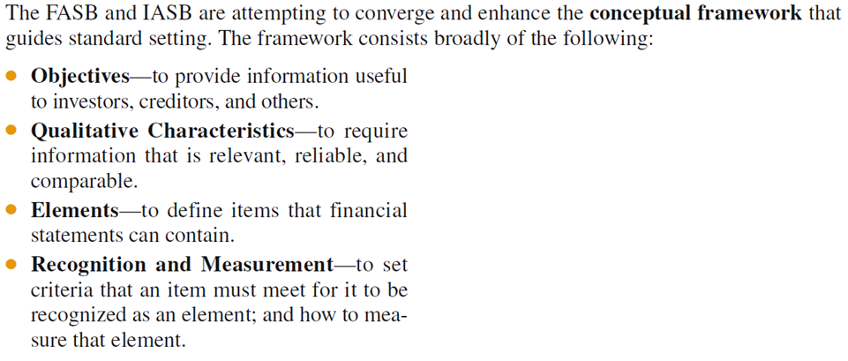
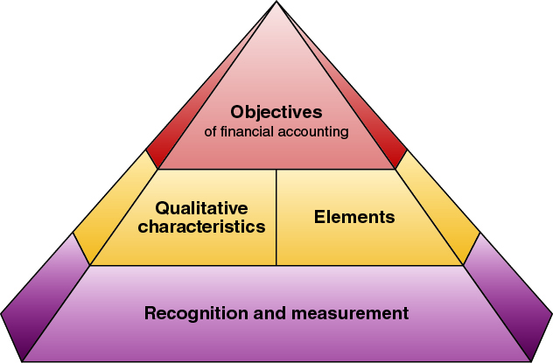
Conceptual Framework
Exhibit 1.6
Learning Objective C4: Explain generally accepted accounting principles and define and apply several accounting principles.
© McGraw-Hill Education
Notes:
The FASB and IASB are attempting to converge and enhance the conceptual framework that guides standard setting. The FASB framework consists of the following:
Objectives—to provide information useful to investors, creditors, and others.
Qualitative Characteristics—to require information that is relevant, reliable, and comparable.
Elements—to define items in financial statements.
Recognition and Measurement—to set criteria that an item must meet for it to be recognized as an element; and how to measure that element.

Slide 17
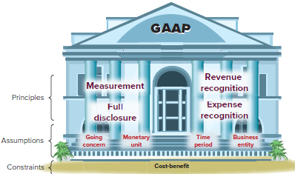
Principles, Assumptions and Constraint
Exhibit 1.7
General principles are the assumptions, concepts, and guidelines for preparing financial statements.
Specific principles are detailed rules used in reporting business transactions and events.
Learning Objective C4: Explain generally accepted accounting principles and define and apply several accounting principles.
© McGraw-Hill Education
Notes:
Accounting principles (and assumptions) are of two types. General principles are the basic assumptions, concepts, and guidelines for preparing financial statements. Specific principles are detailed rules used in reporting business transactions and events.

Slide 18
Accounting Principles
Measurement Principle
(Cost Principle)
Accounting information is based on actual cost. Actual cost is considered objective.
Revenue Recognition Principle
Recognize revenue when goods or services are provided to customers and
at an amount expected to be received from the customer.
Expense Recognition Principle
(Matching Principle)
A company records its expenses incurred to generate the revenue reported.
Full Disclosure Principle
A company reports the details behind financial statements that would impact users’ decisions in the notes to the financial statements.
Learning Objective C4: Explain generally accepted accounting principles and define and apply several accounting principles.
© McGraw-Hill Education
Notes:
The measurement principle, also called the cost principle, usually means that accounting information is based on actual cost. Cost is measured on a cash or equal-to-cash basis. This means if cash is given for a service, its cost is measured as the amount of cash paid. Objectivity means that information is supported by independent, unbiased evidence.
Two concepts are important to the revenue recognition principle:
Revenue is recognized when the services are performed or the goods are provided to the buyer.
(2) Revenue is recognized at the amount expected to be received from the customer. The amount received is usually in cash, but it is also common to receive a customer’s promise to pay at a future date, called credit sales.
The expense recognition principle, also called the matching principle, states that the company records expenses incurred to generate the revenue reported. The principles of matching and revenue recognition are key to modern accounting.
The full disclosure principle states that a company reports the details that would impact users’ decisions. Most of the details are reported in the notes to the financial statements.

Slide 19
Accounting Assumptions
Going-Concern Assumption
The business is presumed to continue operating instead of being closed or sold.
Monetary Unit Assumption
Transactions and events are expressed in monetary, or
money, units.
Business Entity Assumption
A business is accounted for separately from other business entities, including its owner.
Time Period Assumption
The life of a company
can be divided into time periods,
such as months and years.
Learning Objective C4: Explain generally accepted accounting principles and define and apply several accounting principles.
© McGraw-Hill Education
Notes:
Now we will look at four fundamental assumptions of accounting. The going-concern assumption states that, in the absence of information to the contrary, the business entity is assumed to continue operations into the foreseeable future.
The monetary unit assumption tells us that we will only record accounting information that can be expressed in monetary units, usually dollars in the United States.
The business entity assumption tells us that we must separate out the transaction of individual owners of a business from those of the business.
Finally, the time period assumption presumes that the life of a company can be divided into time periods such as months and years, and that useful reports can be prepared for those periods.

Slide 20
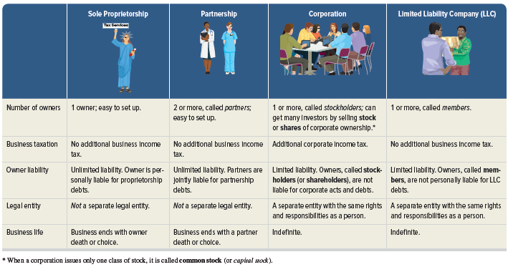
Proprietorship, Partnership, and Corporation
Here are some of the major attributes of sole proprietorships, partnerships, corporations and limited liability companies (LLC):
Exhibit 1.8
Learning Objective C4: Explain generally accepted accounting principles and define and apply several accounting principles.
© McGraw-Hill Education
Notes:
A sole proprietorship, or simply proprietorship, is a business owned by one person. The business is a separate entity for accounting purposes. However, the business is not a separate legal entity from its owner.
A partnership is a business owned by two or more people, called partners, which are jointly liable for tax and other obligations. Like a proprietorship, no special legal requirements must be met in starting a partnership. The only requirement is an agreement between partners to run a business together. The agreement can be either oral or written and usually indicates how income and losses are to be shared. A partnership, like a proprietorship, is not legally separate from its owners.
A corporation, also called a C corporation, is a business legally separate from its owner or owners, meaning it is responsible for its own acts and its own debts. Separate legal status means that a corporation can conduct business with the rights, duties, and responsibilities of a person. A corporation acts through its managers, who are its legal agents. Separate legal status also means that its owners, who are called shareholders (or stockholders), are not personally liable for corporate acts and debts.
A limited liability company (LLC) includes one or more members who are not personally liable for the LLC’s debits. This is a separate entity with the same rights and responsibilities as a person.

Slide 21
Accounting Constraint
Cost-benefit
Only information with benefits of disclosure greater than the cost need be disclosed.
Materiality
Only information that would influence the decisions of a reasonable person need be disclosed.
Learning Objective C4: Explain generally accepted accounting principles and define and apply several accounting principles.
© McGraw-Hill Education
Notes:
The Cost-benefit constraint prescribes that only information with benefits which are greater than their costs need to be disclosed.
Materiality is sometimes included as a constraint and is the ability of information to influence decisions.
Conservatism and industry practices are sometimes included as accounting constraints, also.

Slide 22
Define and interpret the accounting equation and each of its components.
Learning Objective A1
© McGraw-Hill Education

Slide 23
Business Transaction and Accounting
The Accounting Equation
=
+
Assets
Liabilities
Equity
Expanded Accounting Equation:
Net Income
Learning Objective A1: Define and interpret the accounting equation and each of its components.
© McGraw-Hill Education
Notes:
Accounting reflects two basic aspects of a company: what it owns and what it owes.
Assets are resources a company owns or controls. These resources are expected to yield future benefits. Examples are cash, supplies, equipment, land, and Web servers for an online services company. The term receivable refers to an asset that promises a future inflow of resources. A company that provides a service or product on credit is said to have an account receivable from that customer.
Liabilities are creditors’ claims on assets. These claims reflect company obligations to provide assets, products, or services to others. The term payable refers to a liability that promises a future outflow of resources. Examples are wages payable to workers, accounts payable to suppliers, and notes payable to banks.
Equity is the owner’s claim on assets, and is equal to assets minus liabilities. This is the reason equity is also called net assets or residual equity. Equity is increased by owner investments, called stock issuances, and from revenues. It is decreased by dividends and expenses. Equity (also called net assets or residual equity) refers to the claims of its owner(s). Together, liabilities and equity are the source of funds to acquire assets.
Equity has four parts: common stock; dividends, revenues and expenses.
Common Stock reflects inflows of cash and other net assets from stockholders in exchange for stock. Stock is part of contributed capital.
Dividends are outflows of cash and other assets to stockholders that reduce equity.
Revenues increase equity from sales of products and services to customers.
Expenses decrease equity from costs of providing products and services to customers.

Slide 24
Analyze business transactions using the accounting equation.
Learning Objective P1
© McGraw-Hill Education

Slide 25
Transaction 1: Investment by Owner
Chas Taylor invests $30,000 cash to start a corporation named FastFoward.
The accounts involved are:
(1) Cash (asset)
(2) Common Stock (equity)
Learning Objective P1: Analyze business transactions using the accounting equation.
© McGraw-Hill Education
Notes:
21
Let’s look at the identification and recording of business transactions. We can begin by analyzing a transaction where Chas Taylor forms a corporation, named FastForward. Taylor invests thirty thousand dollars cash in exchange for common stock in the new company.
First, we have to identify the assets, liability or equity accounts involved in this transaction. We can see that the cash account will increase by thirty thousand dollars and the common stock account will also increase by thirty thousand dollars.
Let’s see how the books of the company will appear after we record this transaction.

Slide 26
Accounting Equation 1
Chas Taylor invests $30,000 cash to start the business, Fast Forward.
Learning Objective P1: Analyze business transactions using the accounting equation.
© McGraw-Hill Education
Notes:
21
Here we show the increase in the asset account, cash, and the increase in the equity account, Common Stock, by thirty thousand dollars. Our basic accounting equation is in balance. Assets have a total balance of thirty thousand dollars and liabilities plus equity have a total balance of thirty thousand dollars. Let’ move on to another transaction.

Slide 27
Transaction 2: Purchase Supplies for Cash
Company purchased supplies paying $2,500 cash.
The accounts involved are:
(1) Cash (asset)
(2) Supplies (asset)
Learning Objective P1: Analyze business transactions using the accounting equation.
© McGraw-Hill Education
Notes:
25
In this transaction, the company purchases general office supplies by paying two thousand, five hundred dollars cash. The asset account, cash, will decrease by the two thousand, five hundred dollars cash paid. The asset account, supplies, will increase by two thousand, five hundred dollars, the cost of the supplies. In this transaction we are giving up one asset, cash, and receiving another asset, supplies. Let’s look at our books after this transaction is recorded.

Slide 28
Accounting Equation 2
Company purchased supplies paying $2,500 cash.
Accounting Equation must remain in balance!!
Learning Objective P1: Analyze business transactions using the accounting equation.
© McGraw-Hill Education
Notes:
25
We can see the decrease in cash and the increase in supplies. The total assets are still equal to thirty thousand dollars but are divided between cash and supplies. There is no change on the liabilities plus equity section of our books.

Slide 29
Transaction 3: Purchase Equipment for Cash
Purchased equipment for $26,000 cash.
The accounts involved are:
(1) Cash (asset)
(2) Equipment (asset)
Learning Objective P1: Analyze business transactions using the accounting equation.
© McGraw-Hill Education
Notes:
29
This transaction is similar to the last one we recorded. Here we purchase equipment by paying twenty six thousand dollars cash. The asset account, cash, will decrease by twenty six thousand dollars. The asset account, equipment, will increase by twenty six thousand dollars. Once again, we are exchanging one asset for another. Can you predict what our books will look like after recording this transaction?

Slide 30
Accounting Equation 3
Purchased equipment for $26,000 cash.
Accounting Equation still remains in balance!!
Learning Objective P1: Analyze business transactions using the accounting equation.
© McGraw-Hill Education
Notes:
29
Cash is reduced by twenty six thousand dollars and equipment is increased by twenty six thousand dollars. The balance in our cash account is now one thousand five hundred dollars. We have a current balance in supplies of two thousand five hundred dollars, and equipment of twenty six thousand dollars. The three asset accounts total thirty thousand dollars. Once again, there has been no change in the liabilities plus equity side of the equation.

Slide 31
Transaction 4: Purchase Supplies on Credit
Purchased supplies of $7,100 on credit.
The accounts involved are:
(1) Supplies (asset)
(2) Accounts Payable (liability)
Learning Objective P1: Analyze business transactions using the accounting equation.
© McGraw-Hill Education
Notes:
30
In this transaction, the company purchases supplies seventy one hundred dollars on credit. We do not pay cash, but agree to pay off the account at some point in the future. The asset account, supplies increases by seventy one hundred dollars and the liability account, accounts payable, increases by seventy one hundred dollars as well. Let’s see what our books look like now.

Slide 32
Accounting Equation 4
Purchased Supplies of $7,100 on credit.
Accounting Equation still remains in balance!!
Learning Objective P1: Analyze business transactions using the accounting equation.
© McGraw-Hill Education
Notes:
30
You can see the balance in the cash, supplies and equipment accounts. The total on the asset side of the equation is thirty seven thousand, one hundred dollars. We acquired the assets without paying cash. If you use a credit card to purchase gas for your car, you receive an asset, gas, and incur an account payable to the credit card company. The balance in the liabilities accounts is now seventy one hundred dollars, and the common stock account balance is still thirty thousand dollars.

Slide 33
Transaction Analysis: Revenues, Expenses and Withdrawals
Now, let’s look at transactions involving revenues, expenses and dividends.
Learning Objective P1: Analyze business transactions using the accounting equation.
© McGraw-Hill Education
Notes:
To this point, we have not looked at transactions involving revenues, expenses, and dividends. In the next few slides we will address these accounts.

Slide 34
Transaction 5: Provide Services for Cash
Provided consulting services to a customer and received $4,200 cash right away.
The accounts involved are:
(1) Cash (asset)
(2) Revenues (equity)
Learning Objective P1: Analyze business transactions using the accounting equation.
© McGraw-Hill Education
Notes:
32
The company rendered consulting services to a customer receiving forty two hundred dollars cash in full payment. The asset account, cash, will increase by forty two hundred dollars. The equity account, revenues, will also increase by the same amount. Let’s look at our expanded book balances.

Slide 35
Accounting Equation 5
Provided consulting services to a customer and received $4,200 cash right away.
Learning Objective P1: Analyze business transactions using the accounting equation.
© McGraw-Hill Education
Notes:
32
You see that our cash account increases by forty two hundred dollars, to a current balance of five thousand seven hundred dollars. Total assets amount to forty one thousand, three hundred dollars. The revenue account also increased by forty two hundred dollars. Recall that from our expanded accounting equation that revenues increase equity and expenses decrease equity. The total of our liabilities plus equity is now forty one thousand, three hundred dollars.

Slide 36
Transactions 6 and 7: Payment of Expenses in Cash
The accounts involved are:
(1) Cash (asset)
(2) Rent expense (equity)
(3) Salaries expense (equity)
Paid rent of $1,000 and salaries of $700 to employees.
Remember that the balance in the Expense accounts actually increase.
But, total Equity decreases, because expenses reduce equity.
Learning Objective P1: Analyze business transactions using the accounting equation.
© McGraw-Hill Education
Notes:
The company paid cash rent of $1,000 and cash salaries of $700 to employees. The asset account, cash, decreases by one thousand seven hundred dollars. The equity account, rent expense increases by $1,000 and salaries expense increases by $700. Remember, an increase in an expense account will decrease total equity. Do you think you can get this transaction recorded properly in our books?

Slide 37
Accounting Equation 6 and 7
Paid rent of $1,000 and salaries of $700 to employees.
Remember that expenses decrease equity.
Learning Objective P1: Analyze business transactions using the accounting equation.
© McGraw-Hill Education
Notes:
How did you do? You got the decrease in the cash account, but did you remember to show the increase in expenses as a decrease in total equity. Our expanded equation is getting to look more and more complicated. Don’t worry, practice will help you fully understand the recording of these and similar transactions. Our books are still in balance.

Slide 38
Transaction 8: Provide Services and Facilities for Credit
The accounts involved are:
(1) Accounts receivable (asset)
(2) Consulting Revenues (equity)
(3) Rental Revenue (equity)
Provided consulting services of $1,600 and rents facilities for $300 to a customer for credit.
Learning Objective P1: Analyze business transactions using the accounting equation.
© McGraw-Hill Education
Notes:
32
The company provided consulting services of $1,600 and rented its test facilities for $300 to a customer. The asset account, Accounts receivable, will increase by $1,900. The equity account, Consulting revenue will increase by $1,600 and the equity account Rental Revenue, will also increase by the $300. Let’s look at our expanded book balances.

Slide 39
Accounting Equation 8
Provided consulting services of $1,600 and rents facilities for $300 to a customer for credit.
Learning Objective P1: Analyze business transactions using the accounting equation.
© McGraw-Hill Education
Notes:
Our expanded equation is getting to look more and more complicated. Don’t worry, practice will help you fully understand the recording of these and similar transactions. Our books are still in balance.

Slide 40
Transaction 9: Receipt of Cash from Accounts Receivable
The accounts involved are:
(1) Cash (asset)
(2) Accounts receivable (asset)
Client in transaction 8 pays $1,900 for consulting services.
Learning Objective P1: Analyze business transactions using the accounting equation.
© McGraw-Hill Education
Notes:
32
The client in transaction 8 pays $1,900 10 days after it is billed for consulting services.

Slide 41
Accounting Equation 9
Client in transaction 8 pays $1,900 for consulting services.
Learning Objective P1: Analyze business transactions using the accounting equation.
© McGraw-Hill Education
Notes:
The client in transaction 8 pays $1,900 10 days after it is billed for consulting services. The total amount of assets remains the same, and liabilities and equity remain the same as well.

Slide 42
Transaction 10: Payment of Accounts Payable
The accounts involved are:
(1) Cash (asset)
(2) Accounts payable (liability)
FastForward pays $900 as partial payment for supplies purchased in transaction 4.
Learning Objective P1: Analyze business transactions using the accounting equation.
© McGraw-Hill Education
Notes:
32
FastForward pays $900 as partial payment for its earlier purchase of supplies purchased in transaction 4 leaving $6,200 balance unpaid.

Slide 43
Accounting Equation 10
FastForward pays $900 as partial payment for supplies purchased in transaction 4.
Learning Objective P1: Analyze business transactions using the accounting equation.
© McGraw-Hill Education
Notes:
FastForward pays $900 as partial payment for its earlier purchase of supplies purchased in transaction 4 leaving $6,200 balance unpaid in its Accounts payable account.

Slide 44
Transaction 11: Payment of Cash Dividend to Owner
The accounts involved are:
(1) Cash (asset)
(2) Dividends (equity)
Owner withdraws $200 cash for personal use.
Remember that the Dividends account actually increases (just like our Expense accounts).
But, total Equity decreases because dividends cause equity to go down!!
Learning Objective P1: Analyze business transactions using the accounting equation.
© McGraw-Hill Education
Notes:
FastForward pays a $200 cash dividend to its owner (the sole shareholder). The company’s cash account decreased by $200. The equity account, Dividends, increased by $200. Once again, refer back to the expanded accounting equation and you will see that dividends decrease total equity.

Slide 45
Accounting Equation 11
Owner withdraws $200 cash for personal use.
Learning Objective P1: Analyze business transactions using the accounting equation.
© McGraw-Hill Education
Notes:
The company’s cash account decreased by $200. The equity account, Dividends, increased by $200.

Slide 46
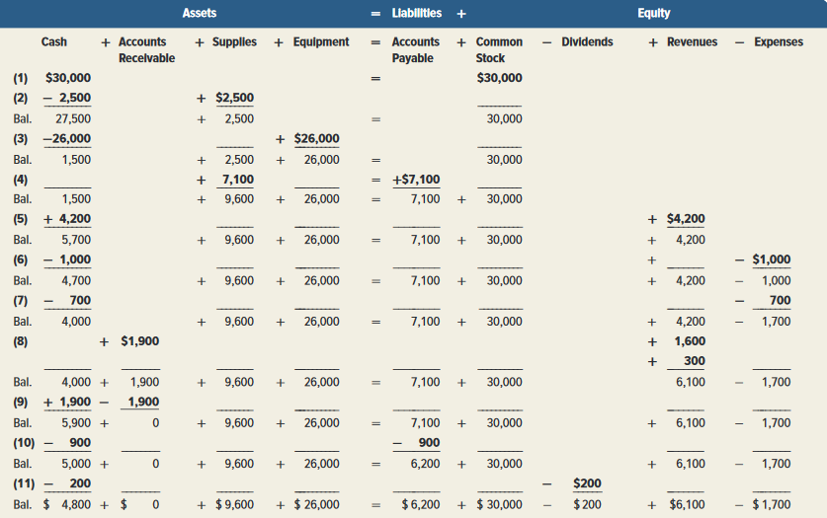
Summary of Transactions
Exhibit 1.9
Learning Objective P1: Analyze business transactions using the accounting equation.
© McGraw-Hill Education
Notes:
Exhibit 1.9 shows the effects of all 11 transactions using the accounting equation.

Slide 47
Identify and prepare basic financial statements and explain how they interrelate.
Learning Objective P2
© McGraw-Hill Education

Slide 48
Financial Statements
The four financial statements and their purposes are:
Income statement — describes a company’s revenues and expenses and computes net income or loss over a period of time.
Statement of retained earnings — explains changes in retained earnings from net income (or loss) and from any dividends over a period of time.
Balance sheet — describes a company’s financial position (types and amounts of assets, liabilities, and equity) at a point in time.
Statement of cash flows — identifies cash inflows (receipts) and cash outflows (payments) over a period of time.
Learning Objective P2: Identify and prepare basic financial statements and explain how they interrelate.
© McGraw-Hill Education
Notes:
This section introduces us to how financial statements are prepared from the analysis of business transactions. The four financial statements and their purposes are:
Income statement — describes a company’s revenues and expenses and computes net income or loss over a period of time.
Statement of retained earnings— reports how retained earnings changes from net income (or loss) and from any dividends over a period of time.
Balance sheet — describes a company’s financial position (types and amounts of assets, liabilities, and equity) at a point in time.
Statement of cash flows — identifies cash inflows (receipts) and cash outflows (payments) over a period of time.

Slide 49
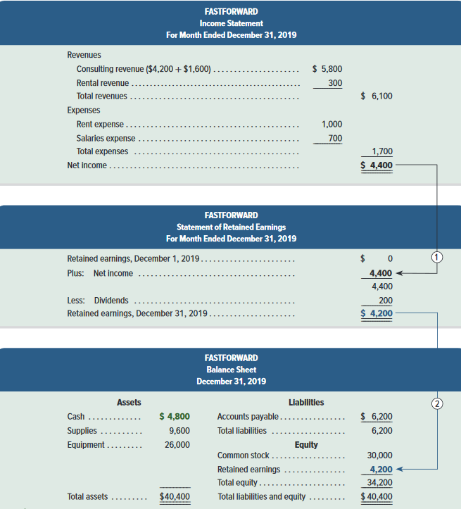
Exhibit 1.10: Financial Statements and Their Links – Part 1
(cont. next slide)
Learning Objective P2: Identify and prepare basic financial statements and explain how they interrelate.
© McGraw-Hill Education
Notes:
Financial Statements and Their Links.
Income Statement for FastForward includes revenues of $6,100 and expenses which total $1,700 for a Net Income of $4,400.
The Statement of Retained Earnings has a beginning balance of 0, adds the net income of $4,400 from the Income Statement, and subtracts dividends of $200 for an ending retained earnings balance of $4,200.
The Balance Sheet shows total assets of $40,400 and total liabilities and equity of $40,400. Notice that the ending Retained Earnings balance from the Statement of Retained Earnings of $4,200 is brought forward into the Equity section of the Balance sheet for total equity of $34,200. Adding the total liabilities of $6,200, we get Total liabilities and equity of $40,400.

Slide 50
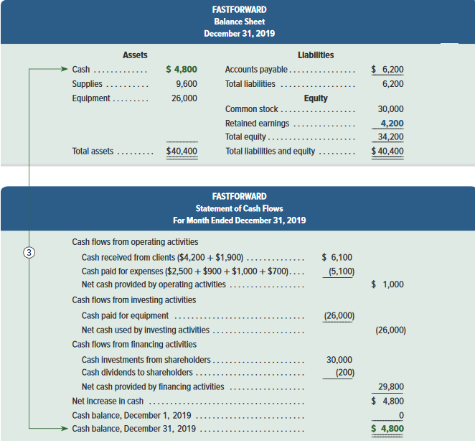
Exhibit 1.10: Financial Statements and Their Links – Part 2
Learning Objective P2: Identify and prepare basic financial statements and explain how they interrelate.
© McGraw-Hill Education
Notes:
The FastForward’s statement of cash flows is the final report in Exhibit 1.10. The first section reports cash flows from operating activities. It shows the $6,100 cash received from clients and the $5,100 cash paid for supplies, rent, and employee salaries. Outflows are in parentheses to denote subtraction. Net cash provided by operating activities for December is $1,000.
The second section reports investing activities, which involve buying and selling assets such as land and equipment that are held for long-term use (typically more than one year). The only investing activity is the $26,000 purchase of equipment.
The third section shows cash flows from financing activities, which include long-term borrowing and repaying of cash from lenders and the cash investments from, and dividends paid to the stockholder. FastForward reports $30,000 from the owner’s initial investment and a $200 cash dividend. The net cash effect of all financing transactions is a $29,800 cash inflow. The final part of the statement shows an increased cash balance of $4,800. The ending balance is also $4,800 as it started with no cash—see line 3. Statement of cash flows identifies the cash inflows (receipts) and cash outflows (payments) over a period of time.

Slide 51
Compute and interpret return on assets.
Learning Objective A2
© McGraw-Hill Education

Slide 52
Return on Assets
Return on assets (ROA) is stated in ratio form as net income divided by the average total assets invested.
Net income
Average total assets
Return on assets =
Exhibit 1.12
Learning Objective A2: Compute and interpret return on assets.
© McGraw-Hill Education
Notes:
This chapter presents a profitability measure: return on assets. Return on assets is useful in evaluating management, analyzing and forecasting profits, and planning activities.
Return on assets (ROA), also called return on investment (ROI), is defined as net income divided by total average assets.
Net income is from the annual income statement, and average total assets is computed by adding the beginning and ending amounts for that same period and dividing by 2.
Is a 17.5% return on assets good or bad for Nike? To help answer this question, we compare (benchmark) Nike’s return with its prior performance and the returns of competitors (such as Under Armour). Nike’s return shows a stable pattern and has outperformed Under Armour in each of the last three years.

Slide 53
Learning Objective A3
Appendix 1A Explain the relation between return and risk.
© McGraw-Hill Education

Slide 54
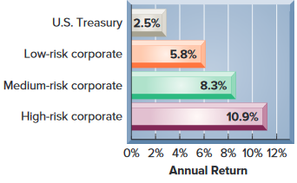
Appendix 1A Return and Risk Analysis
Many different returns may be reported.
Risk is the uncertainty about the return we will earn.
Exhibit 1A.1
The lower the risk, the lower our expected return.
ROA
Interest return on savings accounts.
Interest return on corporate bonds.
Learning Objective A3: Explain the relation between return and risk.
© McGraw-Hill Education
Notes:
Net income is often linked to return. Return on assets (ROA) is stated in ratio form as income divided by assets invested. For example, banks report return from a savings account in the form of an interest return such as 4%. How do we decide among these investment options? The answer depends on our trade-off between return and risk.
Risk is the uncertainty about the return we will earn. All business investments involve risk, but some investments involve more risk than others. The lower the risk of an investment, the lower is our expected return. The bar graph shows recent returns for 10-year bonds with different risks. Bonds are written promises by organizations to repay amounts loaned with interest. U.S. Treasury bonds provide a low expected return, but they also offer low risk since they are backed by the U.S. government. High-risk corporate bonds offer a much larger potential return but with much higher risk.

Slide 55
Learning Objective C5
Appendix 1B Identify and describe the
three major activities of organizations.
© McGraw-Hill Education

Slide 56
Financing Activities
One of the three major types of business activities:
Financing activities provide the means organizations use to pay for resources such as land, buildings, and equipment to carry out plans.
Owner financing—resources contributed by the owner along with any income the owner leaves in the organization.
Nonowner financing—resources contributed by creditors (lenders).
Learning Objective C5: Identify and describe the three major activities of organizations.
© McGraw-Hill Education
Notes:
There are three major types of business activities: financing, investing and operating.
Financing activities provide the means organizations use to pay for resources such as land, buildings, and equipment.
Owner financing refers to resources contributed by the owner along with any income the owner leaves in the organization.
Nonowner (or creditor) financing refers to resources by creditors (lenders).

Slide 57
Investing Activities
One of the three major types of business activities:
Investing activities are the acquiring and disposing of resources (assets) that an organization uses to acquire and sell its products or services.
Asset management—determining the amount and type of assets for operations.
Assets—invested amounts.
Liabilities—creditors’ claims.
Equity—owner’s claim.
Learning Objective C5: Identify and describe the three major activities of organizations.
© McGraw-Hill Education
Notes:
Investing activities are the acquiring and disposing of resources (assets) that an organization uses to buy and sell its products or services. Organizations differ on the amount and makeup of assets. Some require land and factories to operate. Others need only an office. Invested amounts are referred to as assets. Financing is made up of creditor and owner financing, which hold claims on assets. Creditors’ claims are called liabilities, and the owner’s claim is called equity.

Slide 58
Operating Activities
One of the three major types of business activities:
Operating activities involve using resources to research, develop, purchase, produce, distribute, and market products and services.
Strategic management—the process of determining the right mix of operating activities for the type of organization, its plans, and its market.
Learning Objective C5: Identify and describe the three major activities of organizations.
© McGraw-Hill Education
Notes:
Operating activities involve using resources to research, develop, purchase, produce, distribute, and market products and services. Sales and revenues are the inflow of assets from selling products and services. Costs and expenses are the outflow of assets to support operating activities.

Slide 59
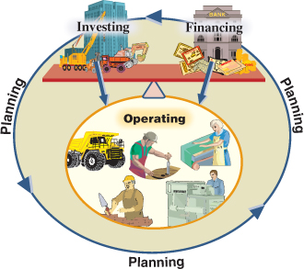
Activities of Organizations
Exhibit 1B.1
Learning Objective C5: Identify and describe the three major activities of organizations.
© McGraw-Hill Education
Notes:
This illustration summarizes business activities. Planning is part of each activity and gives them meaning and focus. Investing (assets) and financing (liabilities and equity) are set opposite each other to stress their balance. Operating activities are below investing and financing activities to show that operating activities are the result of investing and financing.

Slide 60
End of Chapter 1
© McGraw-Hill Education

