Slide 1
Inventories and Cost of Sales
Chapter 5
Wild and Shaw
Financial and Managerial Accounting
8th Edition
Copyright ©2019 McGraw-Hill Education. All rights reserved. No reproduction or distribution without the prior written consent of McGraw-Hill Education.

Slide 2
Chapter 5 Learning Objectives
CONCEPTUAL
C1 Identify the items making up merchandise inventory.
C2 Identify the costs of merchandise inventory.
ANALYTICAL
A1 Analyze the effects of inventory methods for both financial and tax reporting.
A2 Analyze the effects of inventory errors on current and future financial statements.
A3 Assess inventory management using both inventory turnover and days’ sales in inventory.
PROCEDURAL
P1 Compute inventory in a perpetual system using the methods of specific identification, FIFO, LIFO, and weighted average.
P2 Compute the lower of cost or market amount of inventory. P3 Appendix 5A—Compute inventory in a periodic system using the methods of specific identification, FIFO, LIFO, and weighted average.
P4 Appendix 5B—Apply both the retail inventory and gross profit methods to estimate inventory.
© McGraw-Hill Education
2

Slide 3
Identify the items making up merchandise inventory.
Learning Objective C1
© McGraw-Hill Education
3

Slide 4
Determining Inventory Items
Merchandise inventory includes all goods that a company owns and holds for sale, regardless of where the goods are located when inventory is counted.
Items requiring special attention include:
Goods in Transit
Goods Damaged or Obsolete
Goods on Consignment
© McGraw-Hill Education
Learning Objective C1: Identify the items making up merchandise inventory
4
Notes:
Merchandise inventory includes all goods that a company owns and holds for sale. This is true regardless of where the goods are located when inventory is counted. Certain inventory items require special attention, including goods in transit, goods on consignment, and goods that are damaged or obsolete.

Slide 5
Goods in Transit
FOB shipping point – goods included in buyer’s inventory when shipped.
FOB destination – goods included in buyer’s inventory after arrival at destination.
© McGraw-Hill Education
Learning Objective C1: Identify the items making up merchandise inventory
5
Notes:
Does a purchaser’s inventory include goods in transit from a supplier? The answer is that if ownership has passed to the purchaser, the goods are included in the purchaser’s inventory. We determine this by reviewing the shipping terms: FOB destination or FOB shipping point. Goods purchased FOB shipping point are included in the buyer’s inventory once the items are shipped. Goods purchased FOB destination are included in the buyer’s inventory after they arrive at their destination.

Slide 6
Goods on Consignment
Consignor: owner of goods.
Consignee: sells goods for the owner.
Merchandise is included in the inventory of the consignor.
Consignee never reports consigned goods in inventory.
© McGraw-Hill Education
Learning Objective C1: Identify the items making up merchandise inventory
6
Notes:
Goods on consignment are goods shipped by the owner, called the consignor, to another party, the consignee. A consignee sells goods for the owner. The consignor continues to own the consigned goods and reports them in its inventory. The consignee never reports consigned goods in inventory.

Slide 7
Goods Damaged or Obsolete
Damaged or obsolete goods are not reported in inventory if they cannot be sold.
Damaged or obsolete goods which can be sold are included in inventory at net realizable value.
Net realizable value = sales price minus selling costs.
Loss is recorded when damage or obsolescence occurs.
© McGraw-Hill Education
Learning Objective C1: Identify the items making up merchandise inventory
7
Notes:
Damaged and obsolete (and deteriorated) goods are not reported in inventory if they cannot be sold. If these goods can be sold at a reduced price, they are included in inventory at net realizable value. Net realizable value is sales price minus the cost of making the sale. The period when damage or obsolescence (or deterioration) occurs is the period when the loss in value is reported.

Slide 8
Identify the costs of merchandise inventory.
Learning Objective C2
© McGraw-Hill Education
8

Slide 9
Determining Inventory Costs
Include all expenditures necessary to bring an item to a salable condition and location.
Inventory cost = Invoice cost - discounts + other costs
Other costs include:
Shipping
Storage
Insurance
Import duties
© McGraw-Hill Education
9
Learning Objective C2: Identify the costs of merchandise inventory
Notes:
Merchandise inventory includes costs to bring an item to a salable condition and location. This means that the cost of an inventory item includes its invoice cost minus any discount, and plus other costs including shipping, storage, import duties and insurance.

Slide 10
Internal Controls and Taking a Physical Count
Most companies take a physical count of inventory at least once each year.
When the physical count does not match the Merchandise Inventory account, an adjustment must be made.
Good internal controls over count include:
Pre-numbered inventory tickets.
Counters have no inventory responsibility.
Counters confirm existence, amount, and condition of inventory.
Second count is taken by a different counter.
Manager confirms all items counted only once.
© McGraw-Hill Education
10
Learning Objective C2: Identify the costs of merchandise inventory
Notes:
Events can cause the Inventory account balance to be different than the actual inventory available. Such events include theft, loss, damage, and errors. Thus, nearly all companies take a physical count of inventory at least once each year. This physical count is used to adjust the Inventory account balance to the actual inventory available.
A company has adequate internal controls over the inventory count if, (1) it uses pre-numbered inventory tags, (2) inventory counters have no responsibility for inventory, (3) the count confirms the existence, amount, and condition of inventory, (4) a second count of the inventory is made, and (5) a count supervisor confirms that all items in inventory have been counted.

Slide 11
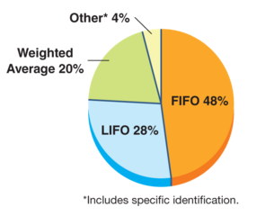
Inventory Costing Methods
Four methods are used
to assign costs to inventory and
to cost of goods sold:
Specific identification
First-in, First-out (FIFO)
Last-in, First-out (LIFO)
Weighted average
© McGraw-Hill Education
11
Learning Objective C2: Identify the costs of merchandise inventory
Notes:
Four methods are used to assign costs to inventory and to cost of goods sold:
specific identification;
first-in, first-out (FIFO);
last-in, first-out (LIFO); and
weighted average.
The exhibit shows the frequency in use of these methods.

Slide 12
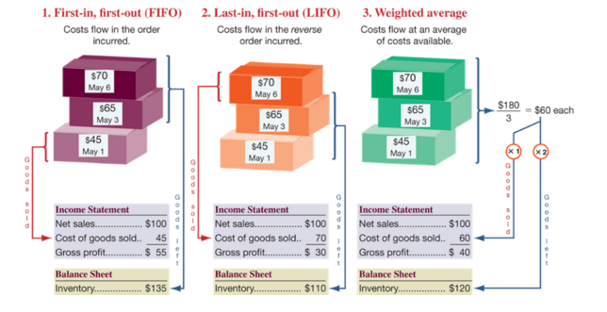
Inventory Cost Flow Assumptions
Exhibit 5.2
© McGraw-Hill Education
Learning Objective C2: Identify the costs of merchandise inventory
12
Notes:
We must make assumptions about the inventory cost flow. First-in, first-out assumes costs flow in the order incurred. Last-in, first-out assumes costs flow in the reverse order incurred. Weighted average assumes costs flow at an average of the costs available.

Slide 13
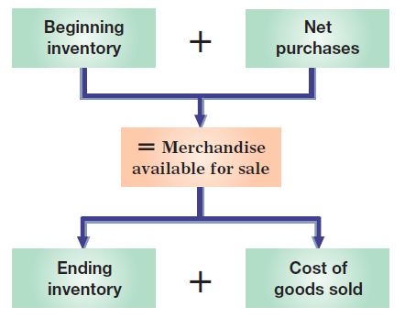
Cost Flow of Inventory
© McGraw-Hill Education
Learning Objective C2: Identify the costs of merchandise inventory
13
Notes:
A company’s merchandise available for sale consists of what it begins with (beginning inventory) and what it purchases (net purchases). The merchandise available is either sold (cost of goods sold) or kept for future sales (ending inventory).

Slide 14
Compute inventory in a perpetual system using the methods of specific identification, FIFO, LIFO and Weighted Average.
Learning Objective P1
© McGraw-Hill Education
14

Slide 15
Inventory Costing under a Perpetual System
Balance Sheet:
Ending Inventory
Income Statement: Cost of Goods Sold
Inventory affects
Physical flow does not need to follow cost flow.
Learning Objective P1: Compute inventory in a perpetual system using specific identification, FIFO, LIFO and weighted average
© McGraw-Hill Education
15
Notes:
When identical items are purchased at different costs, we must determine which amounts to record in cost of goods sold and which amounts remain in inventory. Cost flow assumption does not have to follow the actual physical flow.

Slide 16
Inventory Costing Illustration: Perpetual System
Exhibit 5.3
Here is information about the mountain bike inventory of Trekking for the month of August.
Learning Objective P1: Compute inventory in a perpetual system using specific identification, FIFO, LIFO and weighted average
© McGraw-Hill Education
16
Notes:
Trekking is a sporting goods store. Among its many products, Trekking carries one type of mountain bike whose sales are directed at resorts that provide inexpensive bikes for guest use. We use Trekking’s data from August. Its mountain bike (unit) inventory at the beginning of August and its purchases and sales during August are shown in this slide. It ends August with 12 bikes remaining in inventory.

Slide 17
Specific Identification: Perpetual
Exhibit 5.4
Learning Objective P1: Compute inventory in a perpetual system using specific identification, FIFO, LIFO and weighted average
© McGraw-Hill Education
17
Notes:
When each item in inventory can be matched with a specific purchase and invoice, we can use specific identification or SI (also called specific invoice inventory pricing) to assign costs. We also need sales records that identify exactly which items were sold and when. For example, each bike’s serial number could be used to track costs and compute cost of goods sold. Trekking’s internal documents reveal the following specific unit sales:
August 14 Sold 8 bikes costing $91 each and 12 bikes costing $105 each
August 30 Sold 2 bikes costing $91 each, 3 bikes costing $105 each, 15 bikes costing $115 each, and 3 bikes costing $119 each
Applying specific identification and using the information above, we prepare Exhibit 5.4. This exhibit begins with the $5,990 in total units available for sale—this is from Exhibit 5.3 For the 20 units sold on August 14, the company specifically identified that 8 of them had cost $91 each and 12 had cost $106 each, resulting in an August 14 cost of sales of $2,000. Next, for the 23 units sold on August 30, the company specifically identified that 2 of them had cost $91 each, that 3 had cost $106 each, that 15 had cost $115 each, and 3 had cost $119 each, resulting in an August 30 cost of sales of $2,582. The total cost of sales for the period is $4,582. We then subtract this $4,582 in cost of goods sold from the $5,990 in cost of goods available to get $1,408 in ending inventory. Study Exhibit 5.4 to see the flow of costs. Each unit, whether sold or remaining in inventory, has its own specific cost attached to it.
When using specific identification, Trekking’s cost of goods sold reported on the income statement totals $4,582, the sum of $2,000 and $2,582 from the third column above. Trekking’s ending inventory reported on the balance sheet is $1,408, which is the final inventory balance from the fourth column.

Slide 18
First-In, First-Out (FIFO): Definition Perpetual
Oldest Costs
Cost of Goods Sold
Recent Costs
Ending Inventory
Learning Objective P1: Compute inventory in a perpetual system using specific identification, FIFO, LIFO and weighted average
© McGraw-Hill Education
18
Notes:
The first-in, first-out (FIFO) method of assigning costs assumes that inventory items are sold in the order acquired. When sales occur, the costs of the earliest units acquired are charged to cost of goods sold. This leaves the costs from the most recent purchases in ending inventory.

Slide 19
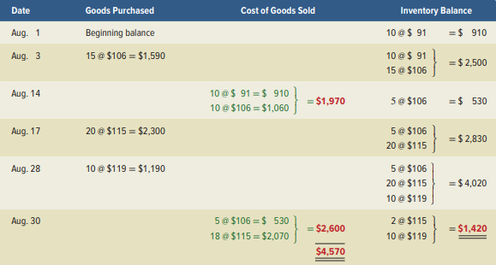
First-In, First-Out (FIFO): Perpetual
Exhibit 5.5
Learning Objective P1: Compute inventory in a perpetual system using specific identification, FIFO, LIFO and weighted average
© McGraw-Hill Education
19
Notes:
Use of FIFO for computing the cost of inventory and cost of goods sold is shown in this slide.
This exhibit starts with beginning inventory of 10 bikes at $91 each.
August 3 Purchased 15 bikes costing $106 each are bought for $1,590. Inventory now consists of 10 bikes at $91 each and 15 bikes at $106 each, for a total of $2,500.
August 14 Sold 20 bikes—applying FIFO, the first 10 sold cost $91 each and the next 10 sold cost $106 each, for a total cost of $1,970. This leaves 5 bikes costing $106 each, or $530, in inventory.
August 17 Purchased 20 bikes costing $115 each.
August 28 Purchased another 10 bikes costing $119 each. Total inventory is now $4,020.
August 30 Sold 23 bikes—applying FIFO, the first 5 bikes sold cost $106 each and the next 18 sold cost $115 each, for a total of $2,600, which leaves 12 bikes costing $1,420 in ending inventory.
Trekking’s FIFO cost of goods sold reported on its income statement (reflecting the 43 units sold) is $4,570 ($1,970 + $2,600), and its ending inventory reported on the balance sheet (reflecting the 12 units unsold) is $1,420.

Slide 20
Last-In, First-Out (LIFO): Definition Perpetual
Recent Costs
Cost of Goods Sold
Oldest Costs
Ending Inventory
Learning Objective P1: Compute inventory in a perpetual system using specific identification, FIFO, LIFO and weighted average
© McGraw-Hill Education
20
Notes:
The last-in, first-out method is abbreviated as LIFO, and pronounced as Lifo. When using LIFO, we assign the most recent costs to the units sold. That leaves the older costs to be used to value ending inventory.

Slide 21
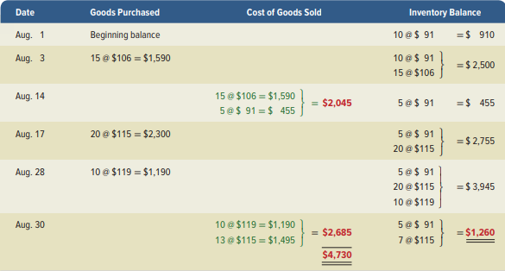
Last-In, First-Out (LIFO): Perpetual
Exhibit 5.6
Learning Objective P1: Compute inventory in a perpetual system using specific identification, FIFO, LIFO and weighted average
© McGraw-Hill Education
21
Notes:
The last-in, first-out (LIFO) method of assigning costs assumes that the most recent purchases are sold first. These more recent costs are charged to the cost of goods sold, and the costs of the earliest purchases are assigned to inventory. By assigning costs from the most recent purchases to cost of goods sold, LIFO comes closest to matching current costs of goods sold with revenues (compared to FIFO or weighted average).
This slide shows the LIFO computations. It starts with beginning inventory of 10 bikes at $91 each.
August 3 Purchased 15 bikes costing $106 each are bought for $1,590. Inventory now consists of 10 bikes at $91 each and 15 bikes at $106 each, for a total of $2,500.
August 14 Sold 20 bikes—applying LIFO, the first 15 sold are from the most recent purchase costing $106 each, and the next 5 sold are from the next most recent purchase costing $91 each, for a total cost of $2,045. This leaves 5 bikes costing $91 each, or $455, in inventory.
August 17 Purchased 20 bikes costing $115 each and on August 28, another 10 bikes costing $119 each are purchased, for a total of 35 bikes costing $3,945 in inventory.
August 30 Sold 23 bikes—applying LIFO, the first 10 bikes sold are from the most recent purchase costing $119 each and the next 13 sold are from the next most recent purchase costing $115 each for a total of $2,685. This leaves 12 bikes costing $1,260 in ending inventory.
Trekking’s LIFO cost of goods sold reported on the income statement is $4,730 ($2,045 + $2,685), and its ending inventory reported on the balance sheet is $1,260.

Slide 22
Weighted Average: Perpetual
When a unit is sold, the average cost of each unit in inventory is assigned to cost of goods sold.
Cost of Goods Available for Sale
Units on hand on the date of sale
÷
Learning Objective P1: Compute inventory in a perpetual system using specific identification, FIFO, LIFO and weighted average
© McGraw-Hill Education
22
Notes:
The weighted average (also called average cost) method of assigning cost requires that we use the weighted average cost per unit of inventory at the time of each sale. Weighted average cost per unit at the time of each sale equals the cost of goods available for sale divided by the units available.

Slide 23
Weighted Average: Perpetual Part 1
On August 14, 20 bikes are sold. To determine the cost of the units sold, we first, need to compute the weighted average cost per unit of items in inventory.
÷
The cost of goods sold for the August 14 sale is $2,000. After this sale, there are five $100 units in inventory totaling $500.
Learning Objective P1: Compute inventory in a perpetual system using specific identification, FIFO, LIFO and weighted average
© McGraw-Hill Education
23
Notes:
On August 1 and August 3, the company purchases inventory. On August 14, it sold 20 bikes. What is the total cost assigned to the bikes sold on August 14?
First, we need to compute the weighted average cost per unit of the items in inventory. We do this by dividing the cost of goods available for sale of $2,500 by the total units in inventory of 25. The average cost per unit is $100.
The cost of goods sold for August 14 is $2,000, or 20 bikes @ $100 each.
After this sale, there are five units left in inventory at an average cost of $100 each for a total inventory balance of $500.

Slide 24
Weighted Average: Perpetual Part 2
÷
After the August 14 sale, there are 5 units in inventory totaling $500.
On August 17, 20 units are purchased for $2,300.
($2,300+500) / 25 = $2,800 / 25 = $112 per unit.
Learning Objective P1: Compute inventory in a perpetual system using specific identification, FIFO, LIFO and weighted average
© McGraw-Hill Education
24
Notes:
Next, a purchase is made on August 17. What is the weighted average cost per unit of the items in inventory on August 17? There were 5 units in ending inventory plus the 20 units purchased on August 17. Total cost of goods available for sale is $2,800 divided by 25 units = $112 weighted average cost per unit.

Slide 25
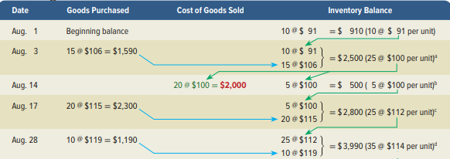
Weighted Average: Perpetual Part 3
÷
After the August 28 purchase, there are (5+20+10) = 35 units in inventory totaling ($2,800+1,190) = $3,990.
$3,900 / 35 = $114 per unit.
© McGraw-Hill Education
Learning Objective P1: Compute inventory in a perpetual system using specific identification, FIFO, LIFO and weighted average
25
Notes:
After the August 28 purchase, there are (5+20+10) = 35 units in inventory totaling ($2,800+1,190) = $3,990. Then $3,900 / 35 = $114 per unit.

Slide 26
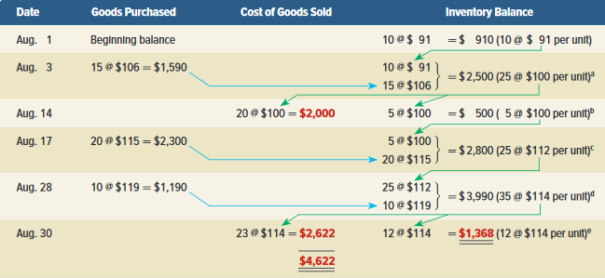
Weighted Average: Perpetual Part 4
Exhibit 5.7
Cost of goods sold for August 30 sale is = $2,622
Ending inventory is composed of 12 units @ an average cost of $114 each or $1,368.
© McGraw-Hill Education
Learning Objective P3: Compute inventory in a perpetual system using specific identification, FIFO, LIFO and weighted average
26
Notes:
The cost of goods sold for the August 31 sale is $2,622.
After the August 30 sale, there are 12 units in inventory at $1,368, or 12 units at an average cost of $114 each.

Slide 27
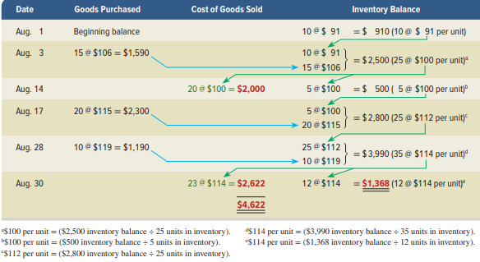
Weighted Average: Perpetual Part 5
Exhibit 5.7
Learning Objective P1: Compute inventory in a perpetual system using specific identification, FIFO, LIFO and weighted average
© McGraw-Hill Education
27
Notes:
This exhibit starts with beginning inventory of 10 bikes at $91 each.
August 3 Purchased 15 bikes costing $106 each are bought for $1,590. Inventory now consists of 10 bikes at $91 each and 15 bikes at $106 each, for a total of $2,500. The average cost per bike for that inventory is $100, computed as $2,500/(10 bikes + 15 bikes).
August 14 Sold 20 bikes—applying WA, the 20 sold are assigned the $100 average cost, for a total cost of $2,000. This leaves 5 bikes with an average cost of $100 each, or $500, in inventory.
August 17 Purchased 20 bikes costing $115 each, and on August 28, purchased 10 bikes costing $119 each. Total now consists of 35 bikes costing $3,990 in inventory at August 28. The average cost per bike for the August 28 inventory is $114, computed as $3,990/(5 bikes + 20 bikes + 10 bikes).
August 30 Sold 23 bikes—applying WA, the 23 sold are assigned the $114 average cost, for a total cost of $2,622. This leaves 12 bikes costing $1,368 in ending inventory.
Trekking’s cost of goods sold reported on the income statement (reflecting the 43 units sold) is $4,622 ($2,000 + $2,622), and its ending inventory reported on the balance sheet (reflecting the 12 units unsold) is $1,368.

Slide 28
Analyze the effects of inventory methods for both financial and tax reporting.
Learning Objective A1
© McGraw-Hill Education
28

Slide 29
Financial Statement Effects of Costing Methods
First-In, First-Out
Last-In, First-Out
Weighted Average
Ending inventory approximates current cost.
Cost of goods sold on income statement approximates its current costs.
Smoothes out price changes.
© McGraw-Hill Education
29
Learning Objective A1: Analyze the effects of inventory methods for both financial and tax reporting
Notes:
All four inventory costing methods are acceptable. However, a company must disclose the inventory method it uses in its financial statements or notes.
FIFO – inventory on the balance sheet approximates its current costs; it also follows the actual flow of goods for most businesses.
LIFO – cost of goods sold on the income statement approximates its current cost; it also better matches current costs with revenues in computing gross profit.
3. Weighted average smooths out erratic changes in costs.
4. Specific identification matches the costs of items with the revenues they generate.

Slide 30
Financial Statement Effects of Inventory Costing Methods: Perpetual Method
Exhibit 5.8
Because prices change, inventory methods nearly always assign different cost amounts.
© McGraw-Hill Education
30
Learning Objective A1: Analyze the effects of inventory methods for both financial and tax reporting
Notes:
Each method offers certain advantages as follows:
Rising Costs:
FIFO reports lowest cost of goods sold yielding the highest gross profit and net income.
LIFO reports highest cost of goods sold yielding the lowest gross profit and net income.
Weighted average yields results between FIFO and LIFO.
Falling Costs:
FIFO reports the highest cost of goods sold yielding the lowest gross profit and income.
LIFO reports the lowest cost of goods sold yielding the highest gross profit and income.

Slide 31
Tax Effects of Costing Methods
The Internal Revenue Service (IRS) requires that when LIFO is used for tax reporting, it must also be used for financial reporting:
LIFO conformity rule.
© McGraw-Hill Education
31
Learning Objective A1: Analyze the effects of inventory methods for both financial and tax reporting
Notes:
Companies can and often do use different costing methods for financial reporting and tax reporting. The only exception is when LIFO is used for tax reporting; in this case, the IRS requires that it also be used in financial statements—called the LIFO conformity rule.

Slide 32
Compute the lower of cost or market amount of inventory.
Learning Objective P2
© McGraw-Hill Education
32

Slide 33
Lower of Cost or Market
Inventory must be reported at market value when market is lower than cost.
Defined as current replacement cost (not sales price).
Consistent with the conservatism principle.
Can be applied three ways:
(1) separately to each
individual item.
(2) to major categories of
assets.
(3) to the whole inventory.
© McGraw-Hill Education
33
Learning Objective P2: Compute the lower of cost or market amount of inventory
Notes:
After companies apply one of four costing methods (FIFO, LIFO, weighted average, or specific identification), inventory is reviewed to ensure it is reported at the lower of cost or market (LCM). LCM requires that inventory be reported at the market value (cost) of replacing inventory when market value is lower than cost.
Market in the term LCM is defined as the replacement cost for LIFO, but net realizable value for the other three methods. Advanced courses cover the specifics.
A decline in market value means a loss of value in inventory. When market value is lower than cost, a loss is recorded. When market value is higher than cost, no adjustment is made.
LCM is applied in one of three ways: (1) to each individual item separately, (2) to major categories of items, or (3) to the whole of inventory.

Slide 34
Lower of Cost or Market (continued)
A motor sports retailer has the following items in inventory:
Exhibit 5.9
Journal entry to write down inventory follows:
© McGraw-Hill Education
34
Learning Objective P2: Compute the lower of cost or market amount of inventory
Notes:
When LCM is applied to individual items of inventory, the number of comparisons equals the number of items. For Roadster, $140,000 is the lower of the $760,000 cost and the $140,000 market. For Sprint, $50,000 is the lower of the $50,000 cost and the $60,000 market. This yields a $190,000 reported inventory, computed from $140,000 for Roadster plus $50,000 for Sprint.
The journal entry to record the adjustment downward of inventory to lower of cost or market includes a debit to Cost of Goods Sold and a credit to Merchandise Inventory for $30,000.

Slide 35
Analyze the effects of inventory errors on current and future financial statements.
Learning Objective A2
© McGraw-Hill Education
35

Slide 36
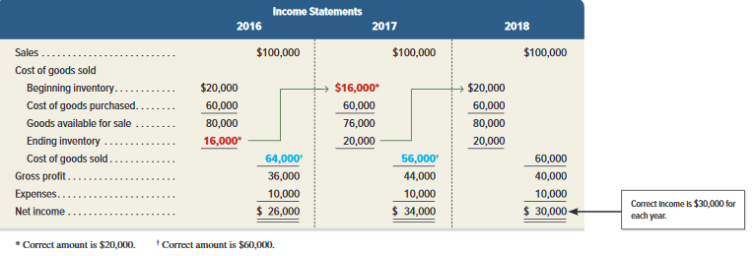
Income Statement Effects of Inventory Errors
Exhibits 5.10 and 5.11
© McGraw-Hill Education
36
Learning Objective A2: Analyze the effects of inventory errors on current and future financial statements
Notes:
This slide shows the effects of inventory errors on key amounts in the current and next periods’ income statements.
Row 1, Year 1: Understating ending inventory overstates cost of goods sold. This is because we subtract a smaller ending inventory in computing cost of goods sold. A higher cost of goods sold yields a lower income.
Row 1, Year 2: Understated ending inventory for year 1 becomes an understated beginning inventory for year 2. If beginning inventory is understated, cost of goods sold is understated (because we are starting with a smaller amount). A lower cost of goods sold yields a higher income.
Row 2, Year 1: Overstating ending inventory understates cost of goods sold. A lower cost of goods sold yields a higher income.
Row 2, Year 2: Overstated ending inventory for year 1 becomes an overstated beginning inventory for year 2. If beginning inventory is overstated, cost of goods sold is overstated. A higher cost of goods sold yields a lower income

Slide 37
Financial Statement Effects of Inventory Errors Balance Sheet Effects
Exhibit 5.12
© McGraw-Hill Education
37
Learning Objective A2: Analyze the effects of inventory errors on current and future financial statements
Notes:
Understating ending inventory understates both current and total assets. An understatement in ending inventory also yields an understatement in equity because of the understatement in net income. This slide shows the effects of inventory errors on the current period’s balance sheet amounts.

Slide 38
Assess inventory management using both inventory turnover and days’ sales in inventory.
Learning Objective A3
© McGraw-Hill Education
38

Slide 39
Inventory Turnover
Shows how many times a company turns over its inventory during a period. Indicator of how well management is controlling the amount of inventory available.
Inventory
Cost of goods sold
=
turnover
Average inventory
Average Inventory | = | (Beg. Inv. + End Inv.) ÷ 2
© McGraw-Hill Education
Learning Objective A3: Assess inventory management using both inventory turnover and days’ sales in inventory
39
Notes:
Inventory turnover, also called merchandise inventory turnover or, simply, turns, is one ratio used to assess this and is calculated as cost of goods sold/average inventory.
This ratio reveals how many times a company turns over (sells) its inventory in a period. It is used to assess whether management is doing a good job controlling the amount of inventory. A low ratio means the company may have more inventory than it needs. Similarly, a very high ratio means inventory might be too low. This can cause lost sales if customers must back-order merchandise. Inventory turnover has no simple rule except to say a high ratio is preferable provided inventory is adequate to meet demand.

Slide 40
Days’ Sales in Inventory
Reveals how much inventory is available in terms of the number of days’ sales.
Days‘ sales in
Ending inventory
=
×
365
inventory
Cost of goods sold
Learning Objective A3: Assess inventory management using both inventory turnover and days’ sales in inventory
© McGraw-Hill Education
40
Notes:
Days’ sales in inventory is a ratio that reveals how much inventory is available in terms of the number of days’ sales. It can be interpreted as the number of days one can sell from inventory if no new items are purchased. This ratio is often viewed as a measure of the buffer against out-of-stock inventory and is useful in evaluating how quickly inventory is being sold. It is calculated as ending inventory/cost of goods sold x 365.
Days’ sales in inventory focuses on ending inventory whereas inventory turnover focuses on average inventory.

Slide 41
Analysis of Inventory Management
Merchandisers plan and control inventory purchases and sales.
Costco and Walmart’s inventory turnover and days’ sales in inventory are shown below:
Exhibit 5.15
© McGraw-Hill Education
Learning Objective A3: Assess inventory management using both inventory turnover and days’ sales in inventory
41
Notes:
Costco’s current year inventory turnover of 11.9 times means that it turns over its inventory 11.9 times per year. Costco’s inventory turnover exceeded Walmart’s turnover in each of the last three years. This is a positive for Costco, as we prefer inventory turnover to be high provided inventory is not out of stock and the company is not losing customers. The current year days’ sales in inventory of 32.1 days means that Costco is carrying 32.1 days of sales in inventory. This inventory buffer seems sufficient. As long as Costco is not at risk of running out of stock, it prefers its assets not be tied up in inventory.

Slide 42
Appendix 5A: Compute inventory in a periodic system using the methods of specific identification, FIFO, LIFO, and weighted average.
Learning Objective P3
© McGraw-Hill Education
42

Slide 43
Inventory Costing under a Periodic System
Balance Sheet:
Ending Inventory
Income Statement: Cost of Goods Sold
Inventory affects
Physical flow does not need to follow cost flow.
Learning Objective P3: Compute inventory in a perpetual system using specific identification, FIFO, LIFO and weighted average
© McGraw-Hill Education
43
Notes:
When identical items are purchased at different costs, we must determine which amounts to record in cost of goods sold and which amounts remain in inventory. Cost flow assumption does not have to follow the actual physical flow.

Slide 44
Inventory Costing Illustration Periodic System
Exhibit 5A.1
Learning Objective P3: Compute inventory in a periodic system using specific identification, FIFO, LIFO and weighted average
© McGraw-Hill Education
44
Notes:
Take a minute and review this chart. We will use this data throughout our inventory examples so we can compare our results at the end.
The basic aim of the periodic system and the perpetual system is the same: to assign costs to inventory and cost of goods sold. The same four methods are used to assign costs under both systems: specific identification; first-in, first-out; last-in, first-out; and weighted average. The results are the same for both a periodic and perpetual inventory system when using specific identification and FIFO.

Slide 45
Inventory Costing Illustration Periodic System Specification Identification
Total cost of 55 units available for sale |  | $5,990
Cost of goods sold:
Aug 14 (8 @ $91) + (12 @ $106) | $2,000
Aug 30 (2 @ $91) + (3@ $106) + (15@ $115) + (3 @ $119) | 2,582 | 4,582
Ending inventory |  | $1,408
8/14, sold 8 bikes costing $91 and 12 bikes costing $106.
8/30, sold 23 bikes: 2 units costing $91; 3 units costing $106; 15 units costing $115 and 3 units costing $119.
COGS = $4,582. Ending Inventory = $5,990 – 4,582 = $1,408
Learning Objective P3: Compute inventory in a periodic system using specific identification, FIFO, LIFO and weighted average
© McGraw-Hill Education
45
Notes:
First, let’s look at the specific identification method. In this method, we know the specific cost of each unit that is sold. It is most commonly used in businesses that have low sales volume of high dollar items, like car dealerships, exclusive jewelry stores, and custom builders.
On August 1 Trekking has beginning inventory. On August 3, 17 and 28 Trekking purchases inventory. On August 14, it sold 8 bikes that cost $91 each and 12 bikes that cost $106 each. The cost of goods sold for August 14 is $2,000. This is calculated by multiplying the 8 bikes in the first lot by their cost of $91 each and then multiplying 12 bikes in the second lot at $106 each, for a total of $2,000.
On August 30, Trekking sold 23 bikes: 2 that cost $91 each; 3 that cost $106 each; 15 that cost $115 each; and 3 that cost $119 each for a total of $2,582.
Using the specific identification method, the company would report cost of goods sold on its August income statement of $4,582. And, it would report ending inventory of $1,408 on its balance sheet, which is the difference between the total units available for sale and the cost of goods sold.

Slide 46
Inventory Costing Illustration Periodic System - FIFO
Total cost of 55 units available for sale |  | $ 5,990
Less ending inventory priced using FIFO:
10 units from Aug 28 purchase at $119 | $ 1,190
2 units from Aug 17 purchase at $115 | 230
Ending inventory |  | 1,420
Cost of goods sold |  | $4,570
Trekking had a total of 55 units available for sale.
12 units in ending inventory and sold 43 units.
Cost of 12 bikes in ending inventory valued using most recent purchases since the earlier units are assumed sold under FIFO.
© McGraw-Hill Education
Learning Objective P3: Compute inventory in a periodic system using specific identification, FIFO, LIFO and weighted average
46
Notes:
The first-in, first-out method is abbreviated as FIFO and pronounced as Fifo. FIFO assumes that inventory is sold in the order acquired. We assign the older, earlier costs to the units sold. That leaves the more recent costs to be used to value ending inventory.
During August, Trekking had a total of 55 units available for sale. They had 12 units left in ending inventory and sold 43 units. Under FIFO, the cost of the 12 bikes in ending inventory will be valued using the most recent purchases since the earlier units are assumed sold under FIFO.

Slide 47
Inventory Costing Illustration Periodic System - LIFO
Total cost of 55 units available for sale |  | $ 5,990
Less ending inventory priced using LIFO:
10 units from Aug 1 beginning inventory $91 | $ 910
2 units from Aug 3 purchase at $106 | 212
Ending inventory |  | 1,122
Cost of goods sold |  | $ 4,868
Trekking had a total of 55 units available for sale.
12 units in ending inventory and sold 43 units.
Cost of 12 bikes in ending inventory valued using the earliest purchases since the most recently purchased units are assumed sold under LIFO.
Learning Objective P3: Compute inventory in a periodic system using specific identification, FIFO, LIFO and weighted average
© McGraw-Hill Education
47
Notes:
The last-in, first-out method is abbreviated as LIFO and pronounced as Lifo. LIFO assumes that the most recent purchases are sold first. That leaves the earlier costs to be used to value ending inventory.
During August, Trekking had a total of 55 units available for sale. They had 12 units left in ending inventory and sold 43 units. Under LIFO, the cost of the 12 bikes in ending inventory will be valued using the earlier purchases beginning with the beginning inventory. The units sold are assumed to be the most recently purchased units.

Slide 48
Inventory Costing Illustration Periodic System – Weighted Average
When a unit is sold, the average cost of each unit in inventory is assigned to cost of goods sold.
Learning Objective P3: Compute inventory in a periodic system using specific identification, FIFO, LIFO and weighted average
© McGraw-Hill Education
48
Notes:
When using weighted average, we assign an average cost per unit of the goods available for sale to cost of goods sold. The average cost per unit is determined by dividing the cost of goods available for sale by the units on hand.

Slide 49
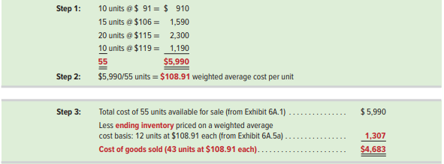
Inventory Costing Illustration Periodic System – Weighted Average: Cost per Unit
Exhibit 5A.5a
Learning Objective P3: Compute inventory in a periodic system using specific identification, FIFO, LIFO and weighted average
© McGraw-Hill Education
49
Notes:
There are three steps to computing the cost of goods sold using the weighted average method. Step 1 is to determine the total units and total cost of goods sold. Trekking has 55 units available for sale at a total cost of $5,990. Step 2 is to compute the weighted average cost per unit of the items in inventory. We do this by dividing the cost of goods available for sale of $5,990 by the total units available for sale of 55. The average cost per unit is $108.91 . In Step 3, we use the weighted average cost per unit to assign costs to ending inventory and to units sold.

Slide 50
Periodic Inventory System Financial Statement Effects of Costing Methods
Because prices change, inventory methods nearly always assign different cost amounts.
© McGraw-Hill Education
50
Learning Objective A1: Analyze the effects of inventory methods for both financial and tax reporting
Notes:
This exhibit reveals two important results. First, when purchase costs regularly rise, as in Trekking’s case, the following occurs:
FIFO reports the lowest cost of goods sold—yielding the highest gross profit and net income.
LIFO reports the highest cost of goods sold—yielding the lowest gross profit and net income.
Weighted average yields results between FIFO and LIFO which smooths out erratic changes in costs.
Specific identification matches the costs of items with the revenues they generate.
Second, when costs regularly decline, the reverse occurs for FIFO and LIFO. Namely, FIFO gives the highest cost of goods sold—yielding the lowest gross profit and income. However, LIFO then gives the lowest cost of goods sold—yielding the highest gross profit and income.

Slide 51
Appendix 5B: Apply both the retail inventory and gross profit methods to estimate inventory.
Learning Objective P4
© McGraw-Hill Education
51

Slide 52
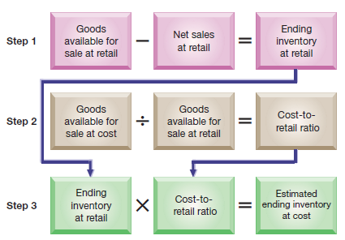
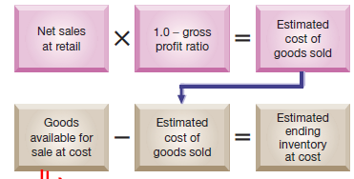
Inventory Estimation Methods
Inventory sometimes requires estimation for interim statements or if some casualty such as fire or flood makes taking a physical count impossible.
Retail Inventory Method
Gross Profit Method
Exhibits 5B.1 & 5B3
© McGraw-Hill Education
52
Learning Objective P4: Apply both the retail inventory and gross profit methods to estimate inventory
Notes:
Inventory sometimes is estimated for two reasons. First, companies often report interim financial statements (financial statements prepared for periods of less than one year), but they only annually take a physical count of inventory. Second, companies may require an inventory estimate if some casualty such as fire or flood makes taking a physical count impossible. Estimates are usually only required for companies that use the periodic system. Companies using a perpetual system would presumably have updated inventory data.
This slide summarizes two methods to estimate inventory: the retail inventory method and the gross profit method.

Slide 53
End of Chapter 5
© McGraw-Hill Education
53

