Slide 1
Accounting for Long-Term Liabilities
Chapter 10
Wild and Shaw
Financial and Managerial Accounting
8th Edition
Copyright ©2019 McGraw-Hill Education. All rights reserved. No reproduction or distribution without the prior written consent of McGraw-Hill Education.

Slide 2
Chapter 10 Learning Objectives
CONCEPTUAL
C1 Explain the types of notes and prepare entries to account for notes.
C2 Appendix 10A—Explain and compute bond pricing.
C3 Appendix 10C—Describe accounting for leases and pensions.
ANALYTICAL
A1 Compare bond financing with stock financing.
A2 Assess debt features and their implications.
A3 Compute the debt-to-equity ratio and explain its use.
PROCEDURAL
P1 Prepare entries to record bond issuance and interest expense.
P2 Compute and record amortization of a bond discount using the straight-line method.
P3 Compute and record amortization of a bond premium using the straight-line method.
P4 Record the retirement of bonds.
P5 Appendix 10B—Compute and record amortization of a bond discount using the effective interest method.
P6 Appendix 10B—Compute and record amortization of a bond premium using the effective interest method.
© McGraw-Hill Education
2

Slide 3
Compare bond financing with stock financing.
Learning Objective A1
© McGraw-Hill Education
3

Slide 4
Bond Financing
Transactions during the bond life
Bond Interest Payments
Corporation
Investors
Bond Interest Payments
Interest Payment = Bond Par Value × Contract Interest Rate × Time
Bond Issue Date
© McGraw-Hill Education
4
Learning Objective A1: Compare bond financing with stock financing.
Notes:
Projects that need a lot of money often are financed with bonds. A bond is its issuer’s written promise to pay the par value of the bond with interest. The par value of a bond, also called face value, is paid at a specified future date called the maturity date. Most bonds also require the issuer to make semiannual interest payments. The amount of interest paid each period is determined by multiplying the par value by the bond’s contract rate of interest for that same period.

Slide 5
Bond Financing: Advantages and Disadvantages
Advantages
Disadvantages
Bonds do not affect owner control.
Bonds require payment of both periodic interest and par value at maturity.
Interest on bonds is tax deductible.
Bonds can decrease return on equity.
Bonds can increase return on equity.
© McGraw-Hill Education
5
Learning Objective A1: Compare bond financing with stock financing.
Notes:
There are three main advantages of bond financing:
1. Bonds do not affect owner control. Equity affects ownership in a company, but bonds do not. A person who contributes $1,000 of a company’s $10,000 equity financing typically controls one-tenth of the company. A person who owns a $1,000, 11%, 20-year bond has no ownership right. This person, or bond- holder, is to receive from the bond issuer 11% interest, or $110, each year the bond is outstanding and $1,000 when it matures in 20 years.
2. Interest on bonds is tax deductible. Bond interest payments are tax deductible, but equity payments (distributions) to owners are not. To illustrate, assume that a corporation with no bond financing earns $15,000 in income before paying taxes at a 40% tax rate, which amounts to $6,000 ($15,000 × 40%) in taxes. If a portion of its financing is in bonds, however, the resulting bond interest is deducted in computing taxable income. That is, if bond interest expense is $10,000, the taxes owed would be $2,000 ([$15,000 × $10,000] × 40%), which is less than the $6,000 owed with no bond financing.
3. Bonds can increase return on equity. A company that earns a higher return with borrowed funds than it pays in interest on those funds increases its return on equity. This process is called financial leverage or trading on the equity.
The two main disadvantages of bond financing are these:
1. Bonds can decrease return on equity. When a company earns a lower return with the borrowed funds than it pays in interest, it decreases its return on equity. This downside risk of financial leverage is more likely to arise when a company has periods of low income or net losses.
2. Bonds require payment of both periodic interest and the par value at maturity. Bond payments can be especially burdensome when income and cash flow are low. Equity financing, in contrast, does not require any payments because cash withdrawals (dividends) are paid at the discretion of the owner (or board).

Slide 6
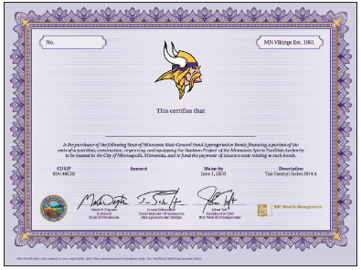
Bond Issuance
Exhibit 10.2
© McGraw-Hill Education
6
Learning Objective A1: Compare bond financing with stock financing.
Notes:
Bond issuances state the number of bonds authorized, their par value, and the contract interest rate. The legal contract between the bondholders and the issuer is called the bond indenture. A bondholder may also receive a bond certificate as evidence of the company’s debt. A bond certificate, such as that shown in this slide, includes specifics such as the issuer’s name, the par value, the contract interest rate, and the maturity date.

Slide 7
Bond Trading
Bonds are securities that can be purchased or sold in the securities markets. They have a market value which is expressed as a percent of their par value. The closing price indicates that the IBM stock is being sold at 103.08% of face value.
© McGraw-Hill Education
7
Learning Objective A1: Compare bond financing with stock financing.
Notes:
The IBM bond quote here is interpreted (left to right) as Bonds, issuer name; Rate, contract interest rate (4%); Mat, matures in year 2042 when principal is paid; Yld, yield rate (3.81%) of bond at current price; Vol, daily dollar worth ($110,000) of trades (in 1,000s); Close, closing price (103.08) for the day as percentage of par value; Chg, change (0.73%) in closing price from prior day’s close.

Slide 8
Prepare entries to record bond issuance and interest expense.
Learning Objective P1
© McGraw-Hill Education
8

Slide 9
Issuing Bonds at Par: Issue Date
On Dec. 31, 2019, a company issued the following bonds:
Par Value: $100,000
Stated Interest Rate: 8%
Interest Dates: 6/30 and 12/31
Maturity Date = Dec. 31, 2021 (2 years)
© McGraw-Hill Education
9
Learning Objective P1: Prepare entries to record bond issuance and interest expense.
Notes:
Suppose a company receives authorization to issue $100,000 of 8%, 2-year bonds dated December 31, 2019, that mature on December 31, 2021, and pay interest semiannually on each June 30 and December 31. After accepting the bond indenture on behalf of the bondholders, the trustee can sell all or a portion of the bonds to an underwriter. If all bonds are sold at par value, the issuer records the sale as shown.
This entry reflects increases in the issuer’s cash and long-term liabilities.

Slide 10
Issuing Bonds at Par: Interest Payments
On June 30, 2020, the issuer of the bond pays the first semiannual interest payment of $4,000.
$100,000 × 8% × ½ year = $4,000
This entry is made every six months until the bonds mature.
© McGraw-Hill Education
10
Learning Objective P1: Prepare entries to record bond issuance and interest expense.
Notes:
The issuer records the first semiannual interest payment as shown. The issuer pays and records its semiannual interest obligation every six months until the bonds mature.

Slide 11
Issuing Bonds at Par: Maturity
On December 31, 2021, the bonds mature and the issuer of the bond pays face value of $100,000 to the bondholders.
© McGraw-Hill Education
11
Learning Objective P1: Prepare entries to record bond issuance and interest expense.
Notes:
When the bonds mature, the issuer records its payment of principal as shown in this slide.

Slide 12
Bond Discount or Premium
Exhibit 10.3
© McGraw-Hill Education
12
Learning Objective P1: Prepare entries to record bond issuance and interest expense.
Notes:
The bond issuer pays the bond interest try to set a contract rate (also called coupon rate, stated rate, or nominal rate).
The annual interest rate is computed by multiplying the bond par value by the contract rate which is usually stated on an annual basis, even though interest is paid semiannually.
The bond’s market rate of interest is the rate that borrowers are willing to pay and lenders are willing to accept for a bond and its risk level.
When the contract rate and market rate are equal, a bond sells at par value. If they are not equal, it is sold at a premium above par value or at a discount below par value. Exhibit 10.3 shows the relation between the contract rate, the market rate, and a bond’s issue price.

Slide 13
Compute and record amortization of a bond discount using the straight-line method.
Learning Objective P2
© McGraw-Hill Education
13

Slide 14
Discount Bond
Fila issues bonds with the following provisions:
Par Value: $100,000
Issue Price: 96.400% of par value
Stated Interest Rate: 8%
Market Interest Rate: 10%
Interest Dates: 6/30 and 12/31
Bond Date: Dec. 31, 2019
Maturity Date: Dec. 31, 2021 (2 years)
}
Bond will sell at a discount.
© McGraw-Hill Education
Learning Objective P2: Compute and record amortization of a bond discount using the straight-line method.
14
Notes:
A discount on bonds payable occurs when a company issues bonds with a contract rate less than the market rate. This means that the issue price is less than par value.
To illustrate, assume that Fila issues bonds with a $100,000 par value, an 8% annual contract rate (paid semiannually), and a two-year life. Also assume that the market rate for Fila bonds is 10%. These bonds will sell at a discount since the contract rate is less than the market rate. The exact issue price for these bonds is stated as 96.454 (implying 96.454% of par value, or $96,454).

Slide 15
Discount Bonds: Issue Date
On Dec. 31, 2019, Fila should record the bond issue.
Par value | $ 100,000
Cash proceeds | 96,400 | *
Discount | $ 3,600
*$100,000 × 96.400%
Contra-Liability
Account
Learning Objective P2: Compute and record amortization of a bond discount using the straight-line method.
© McGraw-Hill Education
15
Notes:
When Fila accepts $96,400 cash for its bonds on the issue date of December 31, 2019, it records the sale as shown.

Slide 16
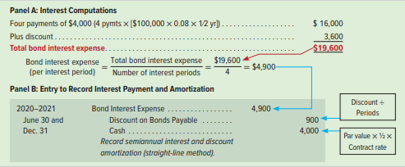
Discount Bonds: Interest
Exhibit 10.6
Maturity Value
Carrying Value
© McGraw-Hill Education
Learning Objective P2: Compute and record amortization of a bond discount using the straight-line method.
16
Notes:
These bonds are reported in the long-term liability section of the issuer’s December 31, 2019, balance sheet as shown in the top portion of this slide. A discount is deducted from the par value of bonds to yield the carrying (book) value of bonds. Discount on Bonds Payable is a contra liability account.
Fila receives $96,400 for its bonds; in return it must pay bondholders $100,000 after two years (plus semiannual interest payments). The $3,600 discount is paid to bondholders at maturity and is part of the cost of using the $96,400 for two years. The upper portion of panel A in this slide shows that total bond interest expense of $19,600 is the difference between the total amount repaid to bondholders ($116,000) and the amount borrowed from bondholders ($96,400). Alternatively, we can compute total bond interest expense as the sum of the four interest payments and the bond discount. This alternative computation is shown in the lower portion of panel A.

Slide 17
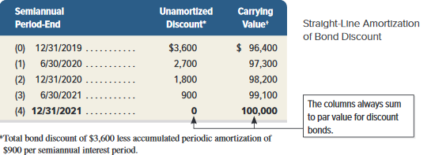
Discount Bonds: Amortization
Exhibit 10.7
These two columns always sum to par value for a discount bond.
© McGraw-Hill Education
Learning Objective P2: Compute and record amortization of a bond discount using the straight-line method.
17
Notes:
This slide shows the pattern of decreases in the Discount on Bonds Payable account and the pattern of increases in the bonds’ carrying value. The following points summarize the discount bonds’ straight-line amortization:
At issuance, the $96,400 carrying value equals the $100,000 par value minus the $3,600 unamortized discount.
During the bonds’ life, the (unamortized) discount decreases each period by the $900 amortization ($3,600 / 4), and the carrying value (par value less unamortized discount) increases each period by $900.
At maturity, the unamortized discount equals zero, and the carrying value equals the $100,000 par value that the issuer pays the holder.
We see that the issuer incurs a $4,900 bond interest expense each period but pays only $4,000 cash. The $900 unpaid portion of this expense is added to the bonds’ carrying value. (The total $3,600 unamortized discount is “paid” when the bonds mature; $100,000 is paid at maturity but only $96,400 was received at issuance.)

Slide 18
Compute and record amortization of a bond premium using the straight-line method.
Learning Objective P3
© McGraw-Hill Education
18

Slide 19
Premium Bonds
Adidas issues bonds with the following provisions:
Par Value: $100,000
Issue Price: 103.600% of par value
Stated Interest Rate: 12%
Market Interest Rate: 10%
Interest Dates: 6/30 and 12/31
Bond Date: Dec. 31, 2019
Maturity Date: Dec. 31, 2021 (2 years)
}
Bond will sell at a premium.
© McGraw-Hill Education
19
Learning Objective P3: Compute and record amortization of bond premium using straight-line method.
Notes:
When the contract rate of bonds is higher than the market rate, the bonds sell at a price higher than par value. The amount by which the bond price exceeds par value is the premium on bonds. To illustrate, assume that Adidas issues bonds with a $100,000 par value, a 12% annual contract rate, semiannual interest payments, and a two-year life. Also assume that the market rate for Adidas bonds is 9.97% on the issue date. The Adidas bonds will sell at a premium because the contract rate is higher than the market rate. The issue price for these bonds is stated as 103.600 (implying 103.600% of par value, or $103,600); we show how to compute this issue price later in the chapter. These bonds obligate the issuer to pay out two separate future cash flows:
1. Par value of $100,000 cash at the end of the bonds’ two-year life.
2. Cash interest payments of $6,000 ($100,000 × 12% × 1/2 year) at the end of each semiannual period during the bonds’ two-year life.

Slide 20
Premium Bonds: Issue Date
On Dec. 31, 2019, Adidas will record the bond issue as:
Par value | $ 100,000
Cash proceeds | 103,600 | *
Premium | $ 3,600
*$100,000 × 103.600%
Adjunct-Liability
Account
© McGraw-Hill Education
Learning Objective P3: Compute and record amortization of a bond premium using the straight-line method.
20
Notes:
When Adidas receives $103,600 cash for its bonds on the issue date of December 31, 2019, it records this transaction as shown.

Slide 21
Premium Bonds: Carrying Value
Maturity Value
Carrying Value
© McGraw-Hill Education
Learning Objective P3: Compute and record amortization of a bond premium using the straight-line method.
21
Notes:
These bonds are reported in the long-term liability section of the issuer’s December 31, 2019 balance sheet as shown in this slide. A premium is added to par value to yield the carrying (book) value of bonds. Premium on Bonds Payable is an adjunct liability account.

Slide 22
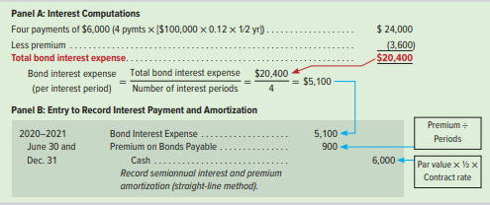
Premium Bonds: Interest
Adidas will make the following entry every six months to record the cash interest payment and the amortization of the discount.
Exhibit 10.10
$3,600 ÷ 4 periods = $900 (rounded)
$100,000 × 12% × ½ = $6,000
© McGraw-Hill Education
Learning Objective P3: Compute and record amortization of a bond premium using the straight-line method.
22
Notes:
The straight-line method allocates an equal portion of total bond interest expense to each of the bonds’ semiannual interest periods. To apply this method to Adidas bonds, we divide the two years’ total bond interest expense of $20,400 by four (the number of semiannual periods in the bonds’ life). This gives a total bond interest expense of $5,100 per period.
This entry shows how the issuer records bond interest expense and updates the balance of the bond liability account for each semiannual period (June 30, 2020, through December 31, 2021).

Slide 23
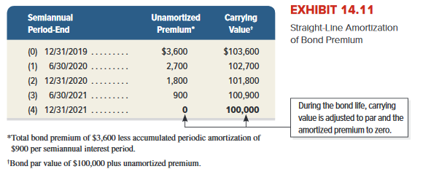
Premium Bond: Amortization
Exhibit 10.11
© McGraw-Hill Education
Learning Objective P3: Compute and record amortization of a bond premium using the straight-line method.
23
Notes:
This amortization table shows the pattern of decreases in the unamortized Premium on Bonds Payable account and in the bonds’ carrying value. The following points summarize straight-line amortization of the premium bonds:
At issuance, the $103,546 carrying value equals the $100,000 par value plus the $3,600 unamortized premium.
During the bonds’ life, the (unamortized) premium decreases each period by the $887 amortization ($3,546 / 4), and the carrying value decreases each period by the same $887.
At maturity, the unamortized premium equals zero, and the carrying value equals the $100,000 par value that the issuer pays the holder.

Slide 24
Record the retirement of bonds.
Learning Objective P4
© McGraw-Hill Education
24

Slide 25
Bond Retirement
Retirement of the Fila bonds at maturity for $100,000 cash.
Because any discount or premium will be fully amortized at
maturity, the carrying value of the bonds will be equal to par value.
© McGraw-Hill Education
25
Learning Objective P4: Record the retirement of bonds.
Notes:
The carrying value of bonds at the end of their lives equals par value ($100,000). The retirement of these bonds at maturity, assuming interest is already paid and entered, is recorded as shown.

Slide 26
Bond Retirement before Maturity
Carrying Value > Retirement Price = Gain
Carrying Value < Retirement Price = Loss
Assume that $100,000 of callable bonds will be retired
on July 1, after the first interest payment. The bond
carrying value is $104,500.The bonds have a
call premium of $3,000.
© McGraw-Hill Education
26
Learning Objective P4: Record the retirement of bonds.
Notes:
Issuers sometimes retire some or all of their bonds prior to maturity. For instance, if interest rates decline greatly, an issuer may wish to replace high-interest-paying bonds with new low-interest bonds. Two common ways to retire bonds before maturity are to (1) exercise a call option or (2) purchase them on the open market. In the first instance, an issuer can reserve the right to retire bonds early by issuing callable bonds. The bond indenture can give the issuer an option to call the bonds before they mature by paying the par value plus a call premium to bondholders. In the second case, the issuer retires bonds by repurchasing them on the open market at their current price. Whether bonds are called or repurchased, the issuer is unlikely to pay a price that exactly equals their carrying value. When a difference exists between the bonds’ carrying value and the amount paid, the issuer records a gain or loss equal to the difference.
To illustrate the accounting for retiring callable bonds, assume that a company issued callable bonds with a par value of $100,000. The call option requires the issuer to pay a call premium of $3,000 to bondholders in addition to the par value. Next, assume that after the June 30 interest payment, the bonds have a carrying value of $104,500. Then on July 1, the issuer calls these bonds and pays $103,000 to bondholders. The issuer recognizes a $1,500 gain from the difference between the bonds’ carrying value of $104,500 and the retirement price of $103,000. The issuer records this bond retirement as shown on this slide.

Slide 27
Bond Retirement: Conversion
Conversion of Bonds to Stock
On January 1, $100,000 par value bonds of Converse, with a carrying value of $100,000, are converted to 15,000 shares of $2 par value common stock.
15,000 shares × $2 par value per share
© McGraw-Hill Education
27
Learning Objective P4: Record the retirement of bonds.
Notes:
Holders of convertible bonds have the right to convert their bonds to stock. When conversion occurs, the bonds’ carrying value is transferred to equity accounts and no gain or loss is recorded.
To illustrate, assume that on January 1 the $100,000 par value bonds of Converse, with a carrying value of $100,000, are converted to 15,000 shares of $2 par value common stock. The entry to record this conversion is shown on this slide.

Slide 28
Explain the types of notes and prepare entries to account for notes.
Learning Objective C1
© McGraw-Hill Education
28

Slide 29
Long-Term Notes Payable
Cash
Company
Lender
Note Payable
When is the repayment of the principal and interest going to be made?
Note Date
Note Maturity Date
© McGraw-Hill Education
29
Learning Objective C1: Explain the types of notes and prepare entries to account for notes.
Notes:
Like bonds, notes are issued to obtain assets such as cash. Unlike bonds, notes are typically transacted with a single lender such as a bank. An issuer initially records a note at its selling price—that is, the note’s face value minus any discount or plus any premium. Over the note’s life, the amount of interest expense allocated to each period is computed by multiplying the market rate (at issuance of the note) by the beginning-of-period note balance. The note’s carrying (book) value at any time equals its face value minus any unamortized discount or plus any unamortized premium; carrying value is also computed as the present value of all remaining payments, discounted using the market rate at issuance.

Slide 30
Long-Term Notes Payable: Single Payment
Single Payment of Principal plus Interest
Company
Lender
Single Payment of Principal plus Interest
Note Date
Note Maturity Date
© McGraw-Hill Education
30
Learning Objective C1: Explain the types of notes and prepare entries to account for notes.
Notes:
For some notes, the principal and interest are paid in a single payment at the end of the note term.

Slide 31
Long-Term Notes Payable: Regular Payments
Regular Payments of Principal plus Interest
Company
Lender
Regular Payments of Principal plus Interest
Note Date
Note Maturity Date
© McGraw-Hill Education
31
Learning Objective C1: Explain the types of notes and prepare entries to account for notes.
Notes:
Other notes require regular payments during the note term. In some cases, the regular payments consist of equal principal payments plus interest. In other cases, the regular payments consist of equal payments that include both principal payments and interest payments. Most car loans are like this latter example. The payment is the same every month and consists of interest and some principal payment.

Slide 32
Installment Notes
On January 1, 2019 Foghog borrows $60,000 from a bank to purchase equipment. It signs an 8% installment note requiring 3 annual payments of principal plus interest.
Compute the periodic payment by dividing the face amount of the note by the present value factor.
© McGraw-Hill Education
32
Learning Objective C1: Explain the types of notes and prepare entries to account for notes.
Notes:
An installment note is an obligation requiring a series of payments to the lender. Installment notes are common for franchises and other businesses when lenders and borrowers agree to spread payments over several periods. To illustrate, assume that Foghog borrows $60,000 from a bank to purchase equipment. It signs an 8% installment note requiring three annual payments. Payments on an installment note normally include the accrued interest expense plus a portion of the amount borrowed (the principal).
The equal total payments pattern consists of changing amounts of both interest and principal. To illustrate, assume that Foghog borrows $60,000 by signing a $60,000 note that requires three equal payments of $23,282 at the end of each year. (The present value of an annuity of three annual payments of $23,282, discounted at 8%, equals $60,000.) The $23,282 includes both interest and principal, the amounts of which change with each payment.

Slide 33
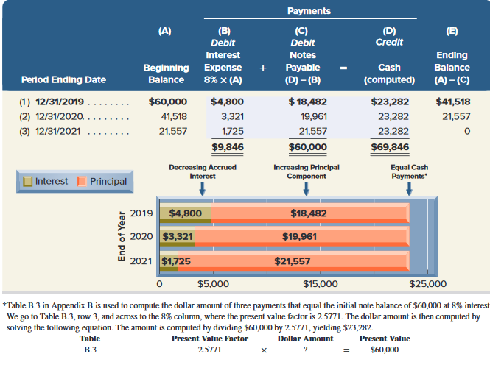
Installment Notes with Equal Payments
Exhibit 10.12
© McGraw-Hill Education
33
Learning Objective C1: Explain the types of notes and prepare entries to account for notes.
Notes:
This slide shows the pattern of equal total payments and its two parts, interest and principal. Column A shows the note’s beginning balance. Column B shows accrued interest for each year at 8% of the beginning note balance. Column C shows the impact on the note’s principal, which equals the difference between the total payment in column D and the interest expense in column B. Column E shows the note’s year-end balance. Although the three cash payments are equal, accrued interest decreases each year because the principal balance of the note declines. As the amount of interest decreases each year, the portion of each payment applied to principal increases.

Slide 34
Installment Notes with Equal Payments: Journal Entries
Let’s record the first payment made on December 31, 2019 by Foghog to the bank.
Refer back to the amortization schedule to make the December 31, 2020 payment on the note.
© McGraw-Hill Education
34
Learning Objective C1: Explain the types of notes and prepare entries to account for notes.
Notes:
Foghog uses the amounts in the prior slide to record its first two payments (for years 2019 and 2020) as shown in this slide. Foghog records similar entries but with different amounts for the last payment. After three years, the Notes Payable account balance is zero.

Slide 35
Mortgage Notes and Bonds
A mortgage is a legal agreement that helps protect the lender if the borrower fails to make the required payments.
It gives the lender the right to be paid out of the cash proceeds from the sale of the borrower’s assets specifically identified in the mortgage contract.
© McGraw-Hill Education
35
Learning Objective C1: Explain the types of notes and prepare entries to account for notes.
Notes:
A mortgage is a legal agreement that helps protect a lender if a borrower fails to make required payments on notes or bonds. A mortgage gives the lender a right to be paid from the cash proceeds of the sale of a borrower’s assets identified in the mortgage. A mortgage contract describes the mortgage terms.
Mortgage notes pledge title to specific assets as security for the note. Mortgage notes are especially popular in the purchase of homes and plant assets. Less common mortgage bonds are backed by the issuer’s assets. Accounting for mortgage notes and bonds is similar to that for unsecured notes and bonds, except that the mortgage agreement must be disclosed.

Slide 36
Assess debt features and their implications.
Learning Objective A2
© McGraw-Hill Education
36

Slide 37
Features of Bonds and Notes
Secured and Unsecured
Convertible and Callable
Term and Serial
Registered and Bearer
© McGraw-Hill Education
37
Learning Objective A2: Assess debt features and their implications.
Notes:
Secured or Unsecured Secured bonds (and notes) have specific assets of the issuer pledged (or mortgaged) as collateral. If the issuer fails to pay interest or par value, the secured holders can demand that the collateral be sold and the proceeds used to pay the obligation.
Unsecured bonds (and notes), also called debentures, are backed by the issuer’s general credit standing. Unsecured debt is riskier than secured debt.
Term or Serial Term bonds (and notes) mature on one specified date. Serial bonds (and notes) mature at more than one date (often in series) and thus are usually repaid over a number of periods. For instance, $100,000 of serial bonds might mature at the rate of $10,000 each year from six to 15 years after they are issued. Sinking fund bonds, which to reduce the holder’s risk require the issuer to create a sinking fund of assets set aside at specified amounts and dates to repay the bonds.
Registered or Bearer: Bonds issued in the names and addresses of their holders are registered bonds. The issuer makes bond payments by sending checks (or cash transfers) to registered holders. Bonds payable to whoever holds them (the bearer) are called bearer bonds or unregistered bonds. Sales or exchanges might not be recorded, so the holder of a bearer bond is presumed to be its rightful owner. As a result, lost bearer bonds are difficult to replace. Many bearer bonds are also coupon bonds. This term reflects interest coupons that are attached to the bonds. When each coupon matures, the holder presents it to a bank or broker for collection. At maturity, the holder follows the same process and presents the bond certificate for collection. Issuers of coupon bonds cannot deduct the related interest expense for taxable income. This is to prevent abuse by taxpayers who own coupon bonds but fail to report interest income on their tax returns.
Convertible and/or Callable Convertible bonds (and notes) can be exchanged for a fixed number of shares of the issuing corporation’s common stock. Convertible debt offers holders the potential to participate in future increases in stock price. Holders still receive periodic interest while the debt is held and the par value if they hold the debt to maturity. In most cases, the holders decide whether and when to convert debt to stock. Callable bonds (and notes) have an option exercisable by the issuer to retire them at a stated dollar amount before maturity.

Slide 38
Compute the debt-to-equity ratio and explain its use.
Learning Objective A3
© McGraw-Hill Education
38

Slide 39
Debt-to-Equity Ratio
Debt-to-
equity ratio
Total liabilities
Total equity
Exhibit 10.14
=
This ratio helps investors determine the risk of investing in a company by dividing its total liabilities by total equity.
© McGraw-Hill Education
39
Learning Objective A3: Compute the debt-to-equity ratio and explain its use.
Notes:
A company financed mainly with debt is more risky because liabilities must be repaid—usually with interest—whereas equity financing does not. A measure to assess the risk of a company’s financing structure is the debt-to-equity ratio.
The debt-to-equity ratio for Nike and Under Armour is shown in this exhibit.
Nike’s current year debt-to-equity ratio is 0.87, meaning that debtholders contributed $0.87 for each $1 contributed by equity holders. This implies a low-risk financing structure for Nike and is similar to its competitors. Analysis across the years shows that Nike’s debt-to-equity ratio has risen to a riskier level in recent years. Increases in debt are viewed positively by some investors because Nike has historically earned higher returns with this financing than the interest rate it pays. Still, investors and debtholders will continue to monitor Nike’s debt-to-equity ratio to be sure it does not reach risky levels.

Slide 40
Appendix 10A Explain and compute bond pricing.
Learning Objective C2
© McGraw-Hill Education
40

Slide 41
Bond Pricing
Cash Outflows related to Interest Payments
Cash Outflows for par value at end of Bond life
© McGraw-Hill Education
41
Learning Objective C2: Explain and compute bond pricing.
Notes:
To compute the price of a bond, we apply present value concepts. A bond’s market value (price) at issuance equals the present value of its future cash payments, where the interest (discount) rate used is the bond’s market rate.

Slide 42
Present Value of Discount Bond
Fila issues bonds with the following provisions:
Par Value: $100,000
Issue Price: ?
Stated Interest Rate: 8%
Market Interest Rate: 10%
Interest Dates: 6/30 and 12/31
Bond Date: Dec. 31, 2018
Maturity Date: Dec. 31, 2020 (2 years)
© McGraw-Hill Education
42
Learning Objective C2: Explain and compute bond pricing.
Notes:
The issue price of bonds is found by computing the present value of the bonds’ cash payments, discounted at the bonds’ market rate. When computing the present value of the Fila bonds, we work with semiannual compounding periods because this is the time between interest payments; the annual market rate of 10% is considered a semiannual rate of 5%. Also, the two-year bond life is viewed as four semiannual periods. The price computation is twofold:
Find the present value of the $100,000 par value paid at maturity; and
Find the present value of the series of four semiannual payments of $4,000 each.

Slide 43
Present Value of Discount Bond: Calculating Price of Bond
To calculate Present Value, we need relevant interest rate and number of periods.
Semiannual rate = 5% (Market rate 10% ÷ 2)
Semiannual periods = 4 (Bond life 2 years × 2)
Exhibit 10A.1
$100,000 × 8% × ½ = $4,000
© McGraw-Hill Education
43
Learning Objective C2: Explain and compute bond pricing.
Notes:
These present values can be found by using present value tables. Appendix B at the end of this book shows present value tables and describes their use. Table B.1 at the end of Appendix B is used for the single $100,000 maturity payment, and Table B.3 in Appendix B is used for the $4,000 series of interest payments. Specifically, we go to Table B.1, row 4, and across to the 5% column to identify the present value factor of 0.8227 for the maturity payment. Next, we go to Table B.3, row 4, and across to the 5% column, where the present value factor is 3.5460 for the series of interest payments. We compute bond price by multiplying the cash flow payments by their corresponding present value factors and adding them together.

Slide 44
Present Value of Premium Bond
To calculate Present Value, we need relevant interest rate and number of periods.
Semiannual rate = 5% (Market rate 10% ÷ 2)
Semiannual periods = 4 (Bond life 2 years × 2)
Exhibit 10A.2
$100,000 × 12% × ½ = $6,000
© McGraw-Hill Education
44
Learning Objective C2: Explain and compute bond pricing.
Notes:
These present values can be found by using present value tables. Appendix B at the end of this book shows present value tables and describes their use. Table B.1 at the end of Appendix B is used for the single $100,000 maturity payment, and Table B.3 in Appendix B is used for the $6,000 series of interest payments. Specifically, we go to Table B.1, row 4, and across to the 5% column to identify the present value factor of 0.8227 for the maturity payment. Next, we go to Table B.3, row 4, and across to the 5% column, where the present value factor is 3.5460 for the series of interest payments. We compute bond price by multiplying the cash flow payments by their corresponding present value factors and adding them together.

Slide 45
Appendix 10B Compute and record amortization of a bond discount using the effective interest method.
Learning Objective P5
© McGraw-Hill Education
45

Slide 46
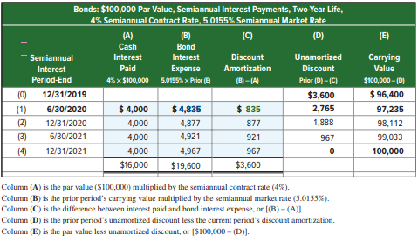
Effective Interest Amortization: Discount
Exhibit 10B.1
Effective Interest Amortization of Bond Discount
Stated Rate: 8%
Effective Rate: 10.031%
© McGraw-Hill Education
Learning Objective P5: Compute and record amortization of a bond discount using the effective interest method.
46
Notes:
The effective interest method, allocates total bond interest expense over the bonds’ life in a way that yields a constant rate of interest. This constant rate of interest is the market rate at the issue date. Thus, bond interest expense for a period equals the carrying value of the bond at the beginning of that period multiplied by the market rate when issued.
This slide shows an effective interest amortization table for the Fila bonds example earlier in the slides. The key difference between the effective interest and straight-line methods lies in computing bond interest expense. Instead of assigning an equal amount of bond interest expense to each period, the effective interest method assigns a bond interest expense amount that increases over the life of a discount bond. Both methods allocate the same $19,600 of total bond interest expense to the bonds’ life, but in different patterns. Specifically, the amortization table in this slide shows that the balance of the discount (column D) is amortized until it reaches zero. Also, the bonds’ carrying value (column E) changes each period until it equals par value at maturity.

Slide 47
Appendix 10B Compute and record amortization of a bond premium using the effective interest method.
Learning Objective P6
© McGraw-Hill Education
47

Slide 48
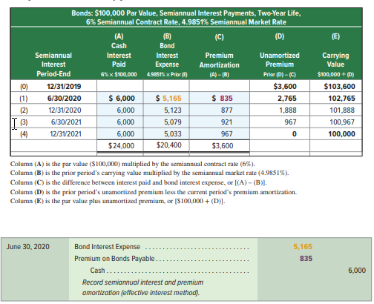
Effective Interest Amortization: Premium
Exhibit 10B.2
Effective Interest Amortization of Bond Premium
Stated Rate: 12%
Effective Rate: 9.9702%
© McGraw-Hill Education
Learning Objective P6: Compute and record amortization of a bond premium using the effective interest method.
48
Notes:
This slide shows the amortization table using the effective interest method for the Adidas bonds example earlier in the slides. Column A lists the semiannual cash payments. Column B shows the amount of bond interest expense, computed as the 4.9851% semiannual market rate at issuance multiplied by the beginning-of-period carrying value. The amount of cash paid in column A is larger than the bond interest expense because the cash payment is based on the higher 6% semiannual contract rate. The excess cash payment over the interest expense reduces the principal. These amounts are shown in column C. Column E shows the carrying value after deducting the amortized premium in column C from the prior period’s carrying value. Column D shows the premium’s reduction by periodic amortization.

Slide 49
Appendix 10C Describe accounting for leases and pensions.
Learning Objective C3
© McGraw-Hill Education
49

Slide 50
Leases
A lease is an agreement between the lessor (owner) and the lessee (asset renter or tenant) that gives the lessee the right to use the asset for a period of time in return for cash (rent) payments.
Finance Leases Finance leases are long-term leases where the lessee receives substantially all remaining benefits of the asset. Must meet one or more of five criteria:
transfers ownership of lease asset to lessee;
has a purchase option that lessee is reasonably certain to exercise;
lease term is for major part of lease asset’s remaining economic life;
present value of lease payments equal or exceed substantially all of the lease asset’s fair value; or
lease asset is specialized and expected to have no alternative use to lessor at lease-end.
Examples include leases of airplanes and department store buildings.
© McGraw-Hill Education
50
Learning Objective C3: Describe accounting for leases and pensions.
Notes:
A lease is a contractual agreement between a lessor (asset owner) and a lessee (asset renter or tenant) that grants the lessee the right to use the asset for a period of time in return for cash (rent) payments. The advantages of lease financing include no upfront, full cash payment and the potential to deduct rental payments in computing taxable income. Leases are classified as either operating or capital leases.
Finance leases are long-term leases by which the lessee receives substantially all remaining benefits of the asset. Examples include most leases of airplanes and department store buildings. The lessee records the leased item as its own asset along with a lease liability at the start of the lease term; the amount recorded equals the present value of all lease payments.

Slide 51
Operating Lease
Operating Leases Operating leases are long-term leases that do not meet any of the five criteria for finance leases. Examples include most car and apartment rental agreements.
© McGraw-Hill Education
51
Learning Objective C3: Describe accounting for leases and pensions.
Notes:
Operating leases are long-term leases that do not meet any of the five criteria for finance leases. Examples include most car and apartment rental agreements. The lessee records such lease payments as expenses; the lessor records them as revenue. The lessee does not report the leased item as an asset or a liability (it is the lessor’s asset).

Slide 52
Pensions
A pension is an agreement for the employer to provide benefits (payments) to employees after they retire.
Defined Benefit Plans
The employer’s contributions vary, depending on assumptions about future pension assets and liabilities. A pension liability is reported when the accumulated benefit obligation is more than the plan assets, a so-called underfunded plan.
© McGraw-Hill Education
52
Learning Objective C3: Describe accounting for leases and pensions.
Notes:
A pension plan is an agreement for the employer to provide benefits (payments) to employees after they retire. Some employers pay the full cost of the pension, and some pay part of the cost. An employer records its payment into a pension plan with a debit to Pension Expense and a credit to Cash.
Many pensions are known as defined benefit plans that define future benefits; the employer’s contributions vary, depending on assumptions about future pension assets and liabilities.

Slide 53
End of Chapter 10
© McGraw-Hill Education
53

