Slide 1
Flexible Budgets and Standard Costs
Chapter 21
Wild and Shaw
Financial and Managerial Accounting
8th Edition
Copyright ©2019 McGraw-Hill Education. All rights reserved. No reproduction or distribution without the prior written consent of McGraw-Hill Education.

Slide 2
Chapter 21 Learning Objectives
CONCEPTUAL
C1 Define standard costs and explain how standard cost information is useful for
management by exception.
ANALYTICAL
A1 Analyze changes in sales from expected amounts.
PROCEDURAL
P1 Prepare a flexible budget and interpret a flexible budget performance report.
P2 Compute the total cost variance.
P3 Compute materials and labor variances.
P4 Compute overhead controllable and volume variances.
P5 Compute overhead spending and efficiency variances. (Appendix 21A)
P6 Prepare journal entries for standard costs and account for price and quantity variances. (Appendix 21A)
2
© McGraw-Hill Education

Slide 3
Fixed and Flexible Budgets
Managers use budgets to control operations and see that planned objectives are met.
A master budget based on a predicted level of activity for the budget period.
Two alternative approaches: fixed or flexible budgeting.
A fixed budget, or static budget, based on a single predicted amount of sales or other activity measure.
A flexible budget, or variable budget, based on several different amounts of sales.
3
© McGraw-Hill Education
Notes:
Managers use budgets to control operations and see that planned objectives are met. Budget reports compare budgeted results to actual results.
A master budget is based on a predicted level of activity, such as sales volume, for the budget period. In preparing a master budget, two alternative approaches can be used: fixed budgeting or flexible budgeting.
A fixed budget, also called a static budget, is based on a single predicted amount of sales or other activity measure.
A flexible budget, also called a variable budget, is based on several different amounts of sales.

Slide 4
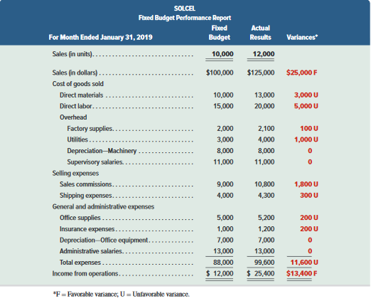
Fixed Budget Performance Report
A fixed budget is based on a single predicted amount of sales.
Exhibit 21.2
4
© McGraw-Hill Education
Notes:
SolCel’s fixed budget was prepared for January at an expected sales level of 10,000 units. However, SolCel actually sold 12,000 units during the month. All of the expense variances are unfavorable because actual expenses are greater than budgeted expenses.
As a result of the increase in sales from 10,000 units to 12,000 units, variances for sales and income are favorable.
Since the cost variances are unfavorable, has SolCel done a poor job controlling costs? But wait, if sales volume is greater than expected, shouldn’t we expect SolCel’s costs to be higher? If so, what portion of the higher costs is due to activity and what portion is due to poor cost control?
The question is really difficult to answer using a fixed budget. The sales level was higher than the budgeted level, so it follows that variable expenses should be higher to support the higher level of sales. We actually don’t have a grip on cost control. One of the ways we can answer the question about the effectiveness of cost control is to use flexible budgeting. We will prepare a budget at the actual level of activity. In other words, we will flex SolCel’s fixed budget up to the actual level of sales.

Slide 5
Purpose of Flexible Budgets
Show revenues and expenses that should have occurred at the actual level of activity.
May be prepared for several activity levels in the relevant range to provide a “what-if” look at operations.
Provides an “apples to apples”
comparison.
Improve performance evaluation and helps managers focus on problem areas.
5
© McGraw-Hill Education
Notes:
A flexible budget shows us the revenue and expenses that should have been incurred at the actual level of activity, rather than just the budgeted level of activity. One of the real strengths of flexible budgeting is that it helps us get a firm grasp on cost control. In addition, performance evaluation is improved using flexible budgeting.
The central concept behind flexible budgeting is that if you can tell me what your activity was during the period, I can tell you what your revenue and expenses should have been at that level of activity.

Slide 6
P1: Prepare a flexible budget and interpret a flexible budget performance report.
Learning Objective
6
© McGraw-Hill Education

Slide 7
Preparation of Flexible Budgets
To a budget for different activity levels, we must know how costs behave with changes in activity levels.
Total variable costs change in direct proportion to changes in activity.
Total fixed costs remain unchanged within the relevant range.
7
© McGraw-Hill Education
Learning Objective P1: Prepare a flexible budget and interpret a flexible budget performance report.
Notes:
The total variable costs change in direct proportion to a change in activity level. The total fixed cost remains unchanged regardless of changes in the level of activity as long as we stay within the relevant range of activity. In a flexible budget, each variable cost is expressed as either 1) constant dollar amount per unit of sales, or 2) a constant percentage of a sales dollar. Fixed costs are expressed as a total amount expected to occur at any sales volume within the relevant range.

Slide 8
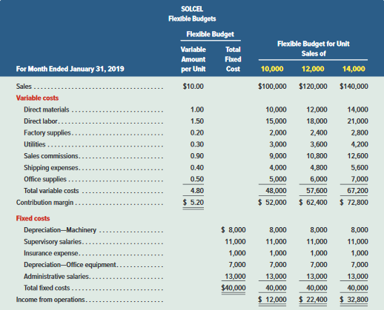
Preparation of Flexible Budgets (continued)
Variable costs are a constant amount per unit.
Exhibit 21.3
8
© McGraw-Hill Education
Learning Objective P1: Prepare a flexible budget and interpret a flexible budget performance report.
Notes:
To prepare a flexible budget, follow these steps:
1. Identify the activity level, such as units produced or sold.
Identify costs and classify them as fixed or variable within the relevant range of activity.
Compute budgeted sales (Sales price per unit x Number of units of activity), and then subtract the sum of budgeted variable costs (Variable cost per unit x Number of units of activity) plus budgeted fixed costs.
Formula for total budgeted costs: management can easily compute total budgeted costs at any activity level with this flexible budget formula.
Total Budgeted Costs = Total Fixed Costs + (Total Variable Cost Per Unit x Units of Activity Level).
Let’s see how flexible budgeting works by preparing flexible budgets for 10,000 units, 12,000 units, and 14,000 units for SolCel. Notice that SolCel’s costs have been classified by behavior, either variable or fixed, in the flexible budget. The flexible budget follows a contribution margin format beginning with sales followed by variable costs and then fixed costs.
The first thing we do is express the variable costs in per unit amounts. At the three different activity levels, sales are budgeted to equal $100,000 (computed as $10 x 10,000), $120,000 (computed as $10 x 12,000), and $140,000 (computed as $10 x 14,000), respectively.
Budgeted direct labor equals $15,000 (computed as $1.50 × 10,000) if 10,000 units are
sold and $21,000 (computed as $1.50 × 14,000) if 14,000 units are sold. SolCel then lists each of the fixed costs in total.
Total fixed costs remain unchanged in the budgeting process as long as we operate within the relevant range of activity. The amounts in the first flexible budget column are the same as those in the fixed budget report in Exhibit 21.2, as both budgets are based on 10,000 units. As budgeted activity levels increase to 12,000 and 14,000 units, total variable costs increase but total fixed costs stay unchanged.
A flexible budget like that in Exhibit 21.3 can be useful to management in planning operations. In addition, a flexible budget prepared after period-end is particularly useful in analyzing performance when the actual activity level differs from that predicted by a fixed budget.

Slide 9
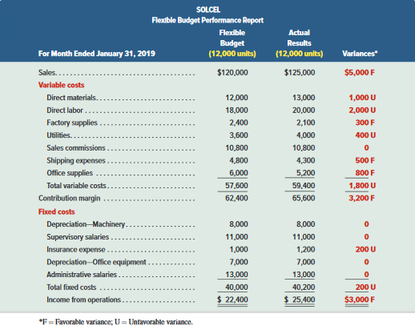
Flexible Budget Performance Report
A flexible budget performance report compares actual performance and budgeted performance based on actual sales. In SolCel’s case, January’s sales are 12,000 units.
Favorable sales variance because average selling price was greater than $10.00 per unit.
Unfavorable total variable cost and total fixed cost variances because actual costs are greater than expected.
Favorable income from operations variance because sales variance is greater than unfavorable variable cost variance.
Exhibit 21.4
9
© McGraw-Hill Education
Learning Objective P1: Prepare a flexible budget and interpret a flexible budget performance report.
Notes:
A flexible budget performance report compares actual performance and budgeted performance based on actual sales volume (or other activity level). In SolCel’s case, we prepare this report after January’s sales volume is known to be 12,000 units.
At 12,000 units, we would expect sales revenue to be $120,000. Since the actual sales revenue was $125,000, we conclude that SolCel’s average selling price was greater than $10 per unit. Now we can begin to analyze cost control.
Comparing actual variable costs at 12,000 units with a flexible budget prepared at 12,000 units reveals that SolCel has an unfavorable total variable cost and total fixed costs variances. These variances are due to cost control issues because we have removed the activity differences by flexing the fixed budget from 10,000 units up to the actual activity of 12,000 units.
Part III
The favorable variances for contribution margin and income indicate that the favorable sales variance is larger than the unfavorable cost variances.

Slide 10
C1: Define standard costs and explain how standard cost information is useful for management by exception.
Learning Objective
10
© McGraw-Hill Education

Slide 11
Standard Costing
Standard costs can be used in a flexible budgeting system to enable management to better understand the reasons for variances
Preset costs for delivering a product
or service under normal conditions.
Established by personnel, engineering, and accounting studies using past experiences.
Standard costs are
The expected level of performance.
Manufacturers use standard costing for direct materials, direct labor and overhead costs.
11
© McGraw-Hill Education
Learning Objective C1: Define standard costs and explain how standard cost information is useful for management by exception.
Notes:
In the next few slides, we show how standard costs can be used in a flexible budgeting system to enable management to better understand the reasons for variances. Standard costs are preset costs for delivering a product or service under normal conditions. We can think of standard costs as budgeting on a per unit basis. We expect to operate within the standard cost allowances under normal conditions.
When actual costs vary from standard costs, management follows up to identify potential problems and take corrective actions. Management by exception means that managers focus attention on the most significant differences between actual costs and standard costs and give less attention to areas where performance is reasonably close to standard. Management by exception is especially useful when directed at controllable items, enabling top management to affect the actions of lower-level managers responsible for the company’s revenues and costs.
Standard costs are often used in preparing budgets because they are the anticipated costs incurred under normal conditions. Terms such as standard materials cost, standard labor cost,
and standard overhead cost are often used to refer to amounts budgeted for direct materials, direct labor, and overhead.
Standard costs can also help control nonmanufacturing costs. Companies providing services instead of products can also benefit from the use of standard costs. For example, while quality medical service is paramount, efficiency in providing that service is also important in controlling medical costs. The use of budgeting and standard costing is touted as an effective means to control and monitor medical costs, especially overhead.

Slide 12
Setting Standard Costs
Price Standards
Direct Materials
Quantity Standards
Rate Standards
Direct Labor
Time Standards
Rate Standards
Variable Overhead
Activity Standards
12
© McGraw-Hill Education
Learning Objective C1: Define standard costs and explain how standard cost information is useful for management by exception.
Notes:
An ideal standard is based on 100% efficiency. A practical standard is based on normal operating conditions which allow for some inefficiency.
Direct materials standards are based on the final delivered cost of materials, net of any applicable discounts. Standard quantities are amounts needed to meet the production designs. The standard materials cost for a unit of product is the standard price for one unit of material multiplied by the standard quantity of materials required for each unit of product.
Instead of the terms price and quantity used for materials, we use rate and time when we apply standard cost concepts to direct labor. Labor rates are determined by wage surveys of rates paid in comparable companies or by labor contracts. Time standards are developed by production and manufacturing experts such as industrial engineers. The standard labor cost for a unit of product is the standard rate for one hour of direct labor multiplied by the standard time required for each unit of product.
The rate standard for variable overhead is the variable portion of the predetermined overhead rate. The activity standard is the units of activity in the base used to apply the predetermined overhead. Examples of the activity base might be direct labor hours or machine hours. The standard variable overhead cost for a unit of product is the standard variable overhead rate multiplied by the standard number of activity units for each unit of product.

Slide 13
Standard Costs Example
The standard costs of direct materials, direct labor, and overhead for one bat, manufactured by ProBat, are shown below. This is called a standard cost card.
Exhibit 21.5
These standard cost amounts are then used to prepare manufacturing budgets for a budgeted level of production.
13
© McGraw-Hill Education
Learning Objective C1: Define standard costs and explain how standard cost information is useful for management by exception.
Notes:
The standard costs of direct materials, direct labor, and overhead for one bat, manufactured by ProBat, are shown on this slide. This is called a standard cost card.
In the first column, we see a standard quantity. In this case, direct materials is expressed in terms of kilograms, direct labor in hours, and manufacturing overhead in hours. In the second column, we have a standard price or standard rate, and finally, in the last column, we have a standard cost per unit.

Slide 14
P2: Compute the total cost variance.
Learning Objective
14
© McGraw-Hill Education

Slide 15
Cost Variances
Cost variance is the difference between actual and standard cost.
If actual cost > standard cost Variance is unfavorable (U).
If actual cost < standard cost Variance is favorable (F).
15
© McGraw-Hill Education
Learning Objective P2: Compute the total cost variance.
Notes:
The difference between actual cost and standard cost is called a standard cost variance. Cost variances can be favorable or unfavorable.
If actual costs are less than standard costs, variance is favorable.
If actual costs are greater than standard cost, variance is unfavorable.

Slide 16
Cost Variance Analysis
Exhibit 21.6
Variance analysis involves preparing a standard cost performance report.
Computing and analyzing variances.
Identifying questions and their answers.
Taking corrective and strategic actions (if needed).
16
© McGraw-Hill Education
Learning Objective P2: Compute the total cost variance.
Notes:
Variance analysis involves comparing actual costs with standard costs. If variances exists, we investigate by asking appropriate managers for explanations and possible causes for the variances. Our objective is to correct problems that caused unfavorable variances and to possibly adopt and reward the practices that resulted in favorable variances.
The flow of events in variance analysis is: (1) prepare a standard cost performance report, (2) compute and analyzing variances, (3) identify questions and their explanations, and (4) take corrective and strategic actions. These variance analysis steps are interrelated and are frequently applied in good organizations.

Slide 17
Cost Variance Computation
Management needs information about the factors causing a cost variance, but first it must properly compute the variance. In its most simple form, a cost variance (CV) is computed as:
Exhibit 21.7
Actual quantity (AQ) is the actual amount of material or labor used to manufacture the actual quantity of output.
Standard quantity (SQ) is the standard amount of input for the actual quantity of output.
Actual price (AP) is the actual amount paid to acquire the actual direct material or direct labor used during the period.
Standard price (SP) is the standard price.
17
© McGraw-Hill Education
Learning Objective P2: Compute the total cost variance.
Notes:
Cost variance (CV) is computed as: Actual Cost (AC) minus Standard Cost (SC). We can break the formula down even further by defining how to calculate Actual Cost and how to calculate Standard Cost. The formulas for both are listed on this screen.
A cost variance is further defined by its components. Actual quantity (AQ) is the actual amount of material or labor used to manufacture the actual quantity of output. Standard quantity (SQ) is the standard amount of input for the actual quantity of output. Actual price (AP) is the actual amount paid to acquire the actual direct material or direct labor used during the period, and standard price (SP) is the standard price.
Price variances result when we pay an actual price for a resource that differs from the standard price that should have been paid. Quantity variances are caused by using an actual amount of a resource that differs from the standard amount that should have been used.

Slide 18
Materials and Labor Variances
Two main factors cause materials and labor variances:
Exhibit 21.8
Isolating these price and quantity factors in a cost variance lead to these formulas.
18
© McGraw-Hill Education
Learning Objective P2: Compute the total cost variance.
Notes:
Two main factors cause materials and labor variances:
1. The difference between actual price per unit of input and standard price per unit of input results in a price (or rate) variance.
2. The difference between actual quantity of input used and standard quantity of input that should have been used results in a quantity (or usage or efficiency) variance.
Isolating these price and quantity factors in a cost variance lead to these formulas.

Slide 19
Cost Variance Computation (Pt. 2)
Standard quantity is the quantity that should have been used for the actual good output.
Actual Quantity Actual Quantity Standard Quantity × × × Actual Price Standard Price Standard Price
Price Variance
Quantity Variance
Standard price is the amount that should have been paid for the resources acquired.
19
© McGraw-Hill Education
Learning Objective P2: Compute the total cost variance.
Notes:
Here’s a general model for computing materials and labor variances. We multiply the actual quantity times the actual price and compare that to the actual quantity times the standard price. The difference is the price variance. Then we compare the actual quantity times the standard price to the standard quantity at the standard price. The difference is the quantity variance.
The standard quantity is the standard quantity for one unit multiplied times the number of good units produced. It is the amount of a resource that should have been used given the actual good output achieved.
The standard price is the amount we should pay for the resource acquired.

Slide 20
Cost Variance Computation (Pt. 3)
Actual Cost
Standard Cost
Actual Quantity Actual Quantity Standard Quantity × × × Actual Price Standard Price Standard Price
Price Variance
Quantity Variance
(AP - SP) x AQ (AQ - SQ) x SP
AQ = Actual Quantity SP = Standard Price AP = Actual Price SQ = Standard Quantity
20
© McGraw-Hill Education
Learning Objective P2: Compute the total cost variance.
Notes:
We can reduce these relationships to mathematical equations. For example, we can determine the material price variance by multiplying the actual quantity times the difference between the actual price and the standard price, and we can determine the material quantity variance by multiplying the standard price times the difference between the actual quantity and the standard quantity.

Slide 21
P3: Compute materials and labor variances.
Learning Objective
21
© McGraw-Hill Education

Slide 22
Materials Standard Cost
G-Max Company makes golf club heads with the following standard cost information:
22
© McGraw-Hill Education
Learning Objective P3: Compute materials and labor variances.
Notes:
We show how to compute the direct materials and direct labor variances using data from G-Max, a manufacturer of specialty golf equipment and accessories. G-Max set the following standard quantities and costs for direct materials and direct labor per unit for one of its handcrafted golf clubheads: The direct materials standard allows one-half pound per club head at $20.00 per pound. The direct labor standard allows one hour per club head at $16.00 per hour.

Slide 23
Materials Variances
During May, G-Max produced 3,500 club heads using 1,800 pounds of material. G-Max paid $21.00 per pound for the material. Compute the material price and quantity variances.
Use this information to compute the material price and quantity variances before you go to the next slide.
23
© McGraw-Hill Education
Learning Objective P3: Compute materials and labor variances.
Notes:
During May, G-Max budgeted to produce 4,000 club heads (units). It actually produced only 3,500 units. It used 1,800 pounds of material costing $21 per pound so its total direct materials cost was $37,800. To produce 3,500 clubheads, Gmax should have used 1,750 pounds of direct materials (3,500 x .5 lb. per unit). This amount of 1,750 pounds is the standard quantity of direct materials that should have been used to produce 3,500 units.. Use this information to compute the material price and quantity variances before you go to the next slide.

Slide 24
Materials Variances (Pt. 2)
SQ = 3,500 units × 0.5 lb. per unit = 1,750 lbs.
Actual Cost
Standard Cost
Actual Quantity Actual Quantity Standard Quantity × × × Actual Price Standard Price Standard Price
1,800 lbs. 1,800 lbs. 1,750 lbs. × × × $21.00 per lb. $20.00 per lb. $20.00 per lb.
$37,800 $36,000 $35,000
Price Variance $1,800 Unfavorable
Quantity Variance $1,000 Unfavorable
+
$2,800 Total Direct Materials Variance (U)
24
© McGraw-Hill Education
Learning Objective 3: Compute materials and labor variances.
Notes:
Now you can check your work. The total actual price paid for the material was $37,800. Since the standard price was $20.00 per pound, G-Max should have paid only $36,000 for the material. The difference between $37,800 and $36,000 is the $1,800 unfavorable price variance. G-Max actually used 1,800 pounds of material, 50 pounds more than the standard quantity of 1,750 pounds. Using an extra 50 pounds resulted in the $1,000 unfavorable quantity variance. If we add the unfavorable price variance of $1,800 plus the unfavorable quantity variance of $1,000, we get a direct materials cost variance of $2,800.

Slide 25
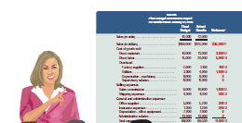
Evaluating Materials Variances
Who is responsible for material cost variances??
I am not responsible for this unfavorable material quantity variance.
You purchased cheap material, so my people had to use more of it.
You used too much material because of poorly trained workers and poorly maintained equipment.
Also, your poor scheduling requires me to rush order material at a higher price, causing unfavorable price variances.
25
© McGraw-Hill Education
Learning Objective P3: Compute materials and labor variances.
Notes:
The purchasing department is usually responsible for the price paid for materials. Responsibility for explaining the price variance in this case rests with the purchasing manager as a price higher than standard caused the variance. The production department is usually responsible for the amount of material used. In this case the production manager is responsible for explaining why the process used more than the standard amount of materials. Perhaps poorly trained workers used excess amounts of materials.
Variance analysis presents challenges. For instance, the production department could have used more than the standard amount of material because the materials’ quality did not meet specifications and led to excessive waste.
In this case, the purchasing manager is responsible for explaining why inferior materials were acquired. However, if analysis shows that waste was due to inefficiencies, not poor-quality material, the production manager is responsible for explaining what happened. Now that we have computed material variances, we can apply the same concepts to labor.

Slide 26
Labor Variances
Instead of price and quantity, for direct labor we use the terms rate and hours.
Actual Cost
Standard Cost
Actual Hours Actual Hours Standard Hours × × × Actual Rate Standard Rate Standard Rate
*NEW
*Rate Variance
*Efficiency Variance
AH(AR - SR) SR(AH - SH)
AH = Actual Hours SR = Standard Rate AR = Actual Rate SH = Standard Hours
26
© McGraw-Hill Education
Learning Objective 3: Compute materials and labor variances.
Notes:
Instead of price and quantity, for direct labor we use the terms rate and hours. Also, instead of price and quantity variances, for labor, we use the terms rate and efficiency variances. The underlying concepts are the same as we saw for material. The standard rate is the amount we should pay per hour for the work performed. Standard hours are the hours that should have been worked for the actual good output achieved. Just as with material, we can reduce these relationships to mathematical equations. For example, we can determine the labor rate variance by multiplying actual hours times the difference between the actual rate and the standard rate, and we can determine the labor efficiency variance by multiplying the standard rate times the difference between actual hours and standard hours.

Slide 27
Labor Variances (Pt. 2)
During May, G-Max produced 3,500 club heads working 3,400 hours. G-Max paid an average of $16.50 per hour for the hours worked. Compute the labor rate and efficiency variances.
Use this information to compute the labor rate and efficiency variances before you go to the next slide.
27
© McGraw-Hill Education
Learning Objective P3: Compute materials and labor variances.
Notes:
During May, G-Max employees worked 3,400 hours to make the 3,500 club heads. G-Max paid an average of $16.50 per hour to the employees for the 3,400 hours worked. Use this information to compute the labor rate and efficiency variances before you go to the next slide.

Slide 28
Labor Cost Variances
SQ = 3,500 units × 1.0 hour per unit = 3,500 hours.
Actual Cost
Standard Cost
Actual Hours Actual Hours Standard Hours × × × Actual Rate Standard Rate Standard Rate
3,400 hours 3,400 hours 3,500 hours × × × $16.50 per hr. $16.00 per hr. $16.00 per hr.
$56,100 $54,400 $56,000
Rate Variance $1,700 Unfavorable
+
Efficiency Variance $1,600 Favorable
$100 Total Cost Variance (U)
28
© McGraw-Hill Education
Learning Objective P3: Compute materials and labor variances.
Notes:
The total actual wages paid for 3,400 hours were $56,100. Since the standard rate was $16.00 per hour, G-Max should have paid only $54,400 for 3,400 hours. The difference between $56,100 and $54,400 is the $1,700 unfavorable rate variance. G-Max employees actually worked 3,400 hours; 100 hours less than the standard of 3,500 hours. Working 100 hours less than allowed by the standard for labor time resulted in the $1,600 favorable efficiency variance.
The unfavorable rate variance of $1,700 minus the favorable efficiency variance of $1,600, we get a total unfavorable direct labor variance of $100.

Slide 29
Evaluating Labor Variances
One possible explanation of G-Max’s labor rate and efficiency variances is the use of workers with different skill levels.
Using highly paid skilled workers to perform unskilled tasks results in an unfavorable rate variance.
However, fewer labor hours might be required for the work resulting in a favorable efficiency variance.
High skill, high rate
Low skill, low rate
29
© McGraw-Hill Education
Learning Objective P3: Compute materials and labor variances.
Notes:
One possible explanation for G-Max’s unfavorable rate variance is that the production manager used highly paid, skilled workers to perform tasks that only required unskilled workers. We pay a higher rate for the same number of hours using workers with higher skills than required for the work. As a result, fewer labor hours might be required for the work, but the wage rate paid these workers is higher than standard because of their greater skills.

Slide 30
Labor Cost Variances (Pt. 2)
Who is responsible for material cost variances??
Production managers who make work assignments are generally responsible for labor cost variances.
I am not responsible for the unfavorable labor efficiency variance.
You purchased cheap material, so it took more time to process it.
You used too much time because of poorly trained workers and poor supervision.
30
© McGraw-Hill Education
Learning Objective P3: Compute materials and labor variances.
Notes:
Other explanations for direct labor variances are possible. Lower-quality materials, poor employee training or supervision, equipment breakdowns, and idle workers due to reduced demand for the company’s products could lead to unfavorable direct labor efficiency variances.
Now that we have mastered material and labor variances, we can apply the same concepts to overhead.

Slide 31
P4: Compute overhead controllable and volume variances.
Learning Objective
31
© McGraw-Hill Education

Slide 32
Overhead Standards and Variances
Recall that overhead costs are assigned to products and services using a predetermined overhead rate (POHR):
Estimated total overhead costs Estimated activity
POHR =
Assigned Overhead = POHR × Standard Activity
32
© McGraw-Hill Education
Learning Objective P4: Compute overhead controllable and volume variances.
Notes:
Recall from our work in previous chapters that the predetermined overhead rate is calculated by dividing estimated overhead costs for the operating period by the estimated activity for the operating period. We then use the predetermined overhead rate to assign overhead costs to products as they are manufactured.

Slide 33
Standard Overhead Rate
Standard overhead costs are the overhead amounts expected to occur at a certain activity level.
To allocate overhead costs to products or services, management needs to establish the standard overhead cost rate. Uses a three-step process:
Step 2: Choose a Predicted Activity Level
Step 1: Determine an Allocation Base
Standard Overhead Rate
Step 3: Compute the Standard
Overhead Rate
Flexible budgets, showing budgeted amount of overhead for various levels of activity, are used to analyze overhead costs.
33
© McGraw-Hill Education
Learning Objective P4: Compute overhead controllable and volume variances.
Notes:
Standard overhead costs are the overhead amounts expected to occur at a certain activity level. Overhead includes fixed costs and variable costs. This requires management to classify overhead costs as fixed or variable (within a relevant range), and to develop a flexible budget for overhead costs. The predetermined overhead rate contains both fixed and variable components of overhead. The variable overhead rate will be the same for all levels of activity. However, the fixed portion of the overhead rate will differ depending on the activity level used in the denominator of the predetermined overhead rate computation.
To allocate overhead costs to products or services, management needs to establish standard overhead cost rate using a three-step process:
Step 1: Determine an Allocation Base – some measure of input that management believes is related to overhead costs. Labor hours is a common allocation base and is what G-Max uses.
Step 2: Choose a Predicted Activity Level - management considers many factors but rarely will set this at 100% of capacity.
Step 3: Compute the Standard Overhead Rate = total overhead cost at predicted activity level divided by total direct labor hours at predicted activity level.

Slide 34
Flexible Overhead Budgets
(Flexible budgets for overhead prepared at several levels of activity)
G-Max predicted an 80 percent activity level.
This standard overhead rate will be used in computing overhead cost variances.
Standard overhead rate is: $8,000 ÷ 4,000 DL hours = $2.00 per DL hour
34
© McGraw-Hill Education
Learning Objective P4: Compute overhead controllable and volume variances.
Notes:
Here we see flexible budgets for overhead prepared at several levels of activity. The activity levels are expressed as a percentage of capacity. Notice that the variable overhead rate is $1.00 per unit for all levels of activity. Multiplying the $1.00 variable overhead rate times the number of units at each production level results in the flexible budget for variable overhead. For example, when G-Max is operating at 70% of capacity or the 3,500 unit level of activity, the variable overhead budget is $3,500, computed by multiplying $1.00 per unit times 3,500 units. The fixed portion of the overhead budget is unchanged at $4,000 for all levels of activity. Including the fixed overhead in the computation of the predetermined overhead rate results in a declining unit cost for overhead, from $2.14 per hour at the 3,500 unit level of activity to $1.80 per hour at the 100% of capacity activity level or 5,000 units.
Because the predetermined overhead rate is different at each level of activity, G-Max must select an activity level for its predetermined overhead rate. In this case, G-Max selected 4,000 units. At 4,000 units of activity, the predetermined overhead rate is $2.00 per hour, made up of $1.00 per hour variable overhead rate, and $1.00 per hour fixed overhead rate. Choosing any other level of activity would have resulted in the same variable overhead rate, but a different fixed overhead rate.
We now have the fixed and variable overhead rates for G-Max. Next, we can use these overhead rates in a standard cost system to calculate overhead variances.

Slide 35
Computing Overhead Cost Variances
The difference between the total overhead cost applied to products and the total overhead cost actually incurred is called an overhead cost variance. It’s defined as:
Overhead cost
variance
(OCV)
Actual overhead
incurred
(AOI)
Standard overhead
applied
(SOA)
=
–
35
© McGraw-Hill Education
Learning Objective P4: Compute overhead controllable and volume variances.
Notes:
Applying Standard Overhead Cost:
Standard overhead applied = Actual x Standard amount of x Standard overhead rate
production allocation base (at predicted activity level)
The standard overhead applied is based on the standard amount of the allocation base that should have been used, based on the actual production. This standard activity amount is then multiplied by the predetermined standard overhead rate (at the predicted activity level). For G-Max, standard overhead applied is computed as:
Standard overhead applied = 3,500 units x 1 Direct labor hour per unit x $2.00 per DLH = $7,000
G-Max produced 3,500 units during the month, which should have used 3,500 direct labor hours. At G-Max’s predicted capacity level of 80%, the standard overhead rate was $2.00 per direct labor hour. So, the standard overhead applied is $7,000 as computed above.
Actual overhead incurred might differ from the standard overhead applied for the period, and management again will use variance analysis. The difference between the standard amount of overhead cost applied and the total actual overhead incurred is the overhead cost variance (total overhead variance), shown on this slide.
Overhead cost variance = Actual overhead incurred minus Standard overhead applied

Slide 36
Total Overhead Cost Variance
Ex: During May, G-Max produced 3,500 club heads working 3,400 hours. G-Max budgeted for 4,000 units (80%). Actual variable overhead was $3,650 and actual fixed overhead was $4,000.
Overhead cost
variance
Actual overhead
incurred
Standard overhead
applied
=
–
=
$3,650 + $4,000
–
3,500 DLH × $2.00 per DLH
=
$7,650
–
$7,000
=
(unfavorable ) $650
To help identify factors causing the overhead cost variance, let’s analyze this variance separately for controllable and volume variances.
36
© McGraw-Hill Education
Learning Objective P4: Compute overhead controllable and volume variances.
Notes:
When standard costs are used, the cost accounting system applies overhead to the good units produced using the predetermined standard overhead rate. At period-end, the difference between the total overhead cost applied to products and the total overhead cost actually incurred is called an overhead cost variance (total overhead variance).
The standard overhead applied is based on the standard number of hours that should have been used, based on the actual production, and the predetermined overhead rate.
To illustrate, G-Max’s actual overhead cost incurred in the month (found in other cost reports) is $7,650. Using the formula in Exhibit 21.14, G-Max’s total overhead variance is $650, computed as: Actual total overhead (given) of $7,650 minus Standard overhead applied (3,500 DLH x $2.00 per DLH) of $7,000 = Total overhead variance (unfavorable) of $650.
To help identify factors causing the overhead cost variance, managers analyze this variance separately for controllable and volume variances. The results provide information useful for taking strategic actions to improve company performance.

Slide 37
Controllable and Volume Variances
Overhead cost
variance
(OCV)
Actual overhead
incurred
(AOI)
Standard overhead
applied
(SOA)
=
–
Exhibit 21.15
37
© McGraw-Hill Education
Learning Objective P4: Compute overhead controllable and volume variances.
Notes:
To help identify factors causing the overhead cost variance, managers analyze this variance separately for overhead volume and overhead controllable variances.
A volume variance occurs when the company operates at a different capacity level than was predicted.

Slide 38
Controllable and Volume Variances for G-Max
Overhead Controllable Variance
Overhead Volume Variance
38
© McGraw-Hill Education
Learning Objective P4: Compute overhead controllable and volume variances.
Notes:
G-Max predicted it would manufacture 4,000 units, but it only manufactured 3,500 units. Whenever a company operates at a capacity level different from what it expected, a volume variance will exist. The volume variance is usually considered outside the control of the production manager, as it depends mainly on customer demand for the company’s products.
The volume variance is based solely on fixed overhead. Recall that G-Max’s standard fixed overhead rate at the predicted capacity level of 4,000 units was $1 per direct labor hour. The volume variance is computed as:
Budgeted fixed overhead (at predicted capacity) $4,000 – Applied fixed overhead (3,500 DLH x $1.00 per DLH) $3,500 = Volume variance (unfavorable) $500.
The volume variance is unfavorable, since G-Max made fewer units than it expected. With a total overhead variance of $650 (unfavorable) and a volume variance of $500 (unfavorable), the controllable overhead variance can be computed as:
Controllable variance = Total overhead variance – Overhead volume variance
= $650 - $500 = $150 (unfavorable)
More formally, the controllable variance is the difference between the actual overhead costs incurred and the budgeted overhead costs for the standard hours that should have been used for the actual production. The controllable variance is the portion of the total overhead variance that is considered to be under management’s control. Since G-Max only produced 3,500 units during the month, we need to compare the actual overhead costs to make 3,500 units to the budgeted cost to make 3,500 units. The budgeted total overhead cost to make 3,500 units is computed as:
Budgeted Total Overhead Cost
Budgeted variable overhead cost (3,500 units x 1 DLH per unit x $1 VOH rate per DLH)……$3,500
Budgeted fixed overhead cost…………………………………………………………………………………………….… 4,000
Budgeted total overhead cost…………………………………………………………………………………………..… $7,500
Overhead Controllable variance is then computed as:
Actual total overhead (given) ………………………………………. $7,650
Budgeted total overhead (from above) ……………………….. 7,500
Controllable variance (unfavorable) ……………………………….$ 150

Slide 39
A1: Analyze changes in sales from expected amounts.
Learning Objective
39
© McGraw-Hill Education

Slide 40
Sales Variances
A similar analysis can be applied to sales variances. We will use two additional G-Max products, Excel golf balls and Big Bert drivers, to illustrate.
Consider the following sales data from G-Max:
40
© McGraw-Hill Education
Learning Objective A1: Analyze changes in sales from expected amounts,
Notes:
We can apply variance concepts to sales as well as costs. To illustrate, we will consider budget and actual sales data from G-Max for two additional products, Excel golf balls and Big Bert drivers. The sales price variance measures the impact of the actual sales price differing from the expected price. The sales volume variance measures the impact of operating at a different capacity level than predicted by the fixed budget.

Slide 41
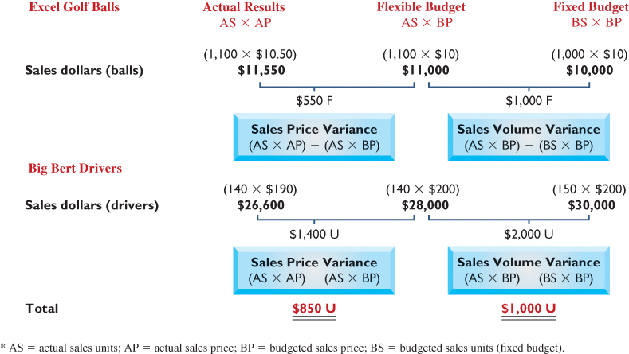
Computing Sales Variances for G-Max
Exhibit 21.18
41
© McGraw-Hill Education
Learning Objective A1: Analyze changes in sales from expected amounts,
Notes:
First, look at the top part of this screen dealing with Excel golf balls. G-Max actually sold 1,100 golf balls at $10.50 each for a total revenue of $11,550. If 1,100 golf balls had been sold at the budgeted price of $10.00, revenue would have been only $11,000. The difference between $11,550 and $11,000 is the $550 favorable sales price variance for golf balls.
G-Max actually sold 1,100 golf balls, 100 more than the budgeted amount of 1,000. Selling 100 more golf balls than originally budgeted resulted in the $1,000 favorable sales volume variance for golf balls.
Next, look at the lower part of the screen that deals with Big Bert drivers. G-Max actually sold 140 drivers at $190 each for a total revenue of $26,600. If the 140 drivers had been sold at the budgeted price of $200 each, revenue would have been $28,000. The difference between $26,600 and $28,000 is the $1,400 unfavorable sales price variance for drivers.
G-Max actually sold 140 drivers, 10 less than the budgeted amount of 150. Selling 10 less drivers than originally budgeted resulted in the $2,000 unfavorable sales volume variance for drivers.

Slide 42
P5 (Appendix): Compute overhead spending and efficiency variances.
Learning Objective
42
© McGraw-Hill Education

Slide 43
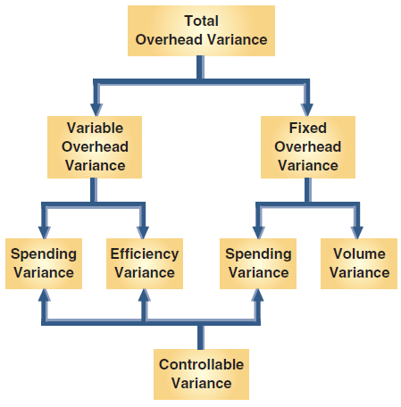
Expanded Overhead Variances and Standard Cost Accounting system
Exhibit 21A.1
43
© McGraw-Hill Education
Learning Objective P5: Compute overhead spending and efficiency variances.
Notes:
Appendix 21A: Expanded Overhead Variances and Standard Cost Accounting System
Similar to analysis of direct materials and direct labor, both the variable and fixed overhead variances can be separately analyzed. A spending variance occurs when management pays an amount different than the standard price to acquire an item. For instance, the actual wage rate paid to indirect labor might be higher than the standard rate. Similarly, actual supervisory salaries might be different than expected. Spending variances such as these cause management to investigate the reasons that the amount paid differs from the standard. Both variable and fixed overhead costs can yield their own spending variances. Analyzing variable overhead includes computing an efficiency variance, which occurs when standard direct labor hours (the allocation base) expected for actual production differ from the actual direct labor hours used. This efficiency variance reflects on the cost effectiveness in using the overhead allocation base (such as direct labor).

Slide 44
Variable Overhead Variances for G-Max
Actual Flexible Budget Applied Variable for Variable Variable Overhead Overhead at Overhead at Incurred Actual Hours Standard Hours
AH × AVR
AH × SVR
SH × SVR
Spending Variance
Efficiency Variance
Let’s split the $150 unfavorable variance into spending and efficiency variances. . .
AH = Actual Hours of Activity AVR = Actual Variable Overhead Rate SVR = Standard Variable Overhead Rate SH = Standard Hours Allowed
44
© McGraw-Hill Education
Learning Objective P5: Compute overhead spending and efficiency variances.
Notes:
When we compare actual hours times actual variable overhead rate to actual hours times the standard variable overhead rate, we get the spending variance for variable overhead. When we compare actual hours times the standard variable overhead rate to standard hours at the standard variable overhead rate, we get the efficiency variance for variable overhead.

Slide 45
Variable Overhead Variances for G-Max
Recall the G-Max information for May:
During May, G-Max produced 3,500 club heads working 3,400 hours. G-Max budgeted for 4,000 units (80%). Actual variable overhead was $3,650 and actual fixed overhead was $4,000. Compute the variable overhead spending and efficiency variances
45
© McGraw-Hill Education
Learning Objective P5: Compute overhead spending and efficiency variances.
Notes:
Let’s continue with our G-Max example. Production volume and hours worked are the same as we used for the material and labor analysis. Recall that in our flexible budget information for G-Max, 4,000 units, 80 percent of capacity, was selected as the activity level used to compute the predetermined overhead rate.

Slide 46
Variable Overhead Variances for G-Max (continued)
Actual Flexible Budget Applied Variable for Variable Variable Overhead Overhead at Overhead at Incurred Actual Hours Standard Hours
AH × AVR
3,400 hrs. x $1.00
3,500 hrs. x $1.00
$3,650
$3,400
$3,500
Spending Variance $250 Unfavorable
Efficiency Variance $100 Favorable
Variable OH Variance $150 Unfavorable
46
© McGraw-Hill Education
Learning Objective P5: Compute overhead spending and efficiency variances.
Notes:
Actual spending for variable overhead was $3,650. Since the standard variable overhead rate was $1.00 per hour, G-Max should have spent $3,400 for the 3,400 hours worked. The difference between $3,650 and $3,400 is the $250 unfavorable spending variance. G-Max actually worked $3,400; 100 hours less than the standard of 3,500 hours. Working 100 hours less than allowed by the standard for direct labor time resulted in the $100 favorable efficiency variance.

Slide 47
Fixed Overhead Variances for G-Max
Actual Budgeted Applied Fixed Fixed Fixed Overhead Overhead Overhead at (Given) (Flexible Budget) Standard Hours
AH × AVR
AH × SVR
SH × SFR
Spending Variance
Volume Variance
Let’s split the $500 unfavorable variance into spending and volume variances. . .
SFR = Standard Fixed Overhead Rate SH = Standard Hours Allowed
47
47
Learning Objective P5: Compute overhead spending and efficiency variances.
© McGraw-Hill Education
Notes:
The spending variance for fixed overhead is determined by comparing the fixed overhead actually incurred to the budgeted fixed overhead. The volume variance for fixed overhead is determined by comparing the budgeted fixed overhead to the fixed overhead applied. The applied fixed overhead is the product of the fixed overhead rate times standard hours.

Slide 48
Fixed Overhead Variances for G-Max (Pt. 2)
Recall the G-Max information for May:
During May, G-Max produced 3,500 club heads working 3,400 hours. G-Max budgeted for 4,000 units (80%). Actual variable overhead was $3,650 and actual fixed overhead was $4,000. Compute the fixed overhead spending and volume variances.
48
© McGraw-Hill Education
Learning Objective P5: Compute overhead spending and efficiency variances.
Notes:
Let’s continue with our G-Max example. Production volume and hours worked are the same as we used for the material and labor analysis. Recall that in our flexible budget information for G-Max, 4,000 units, 80 percent of capacity, was selected as the activity level used to compute the predetermined overhead rate.

Slide 49
Fixed Overhead Variances for G-Max (Pt. 3)
Actual Budgeted Applied Fixed Fixed Fixed Overhead Overhead Overhead at (Given) (Flexible Budget) Standard Hours
AH × AVR
AH × SVR
3,500 hrs × $1.00
$4,000
$4,000
$3,500
Spending Variance $0
Volume Variance $500 Unfavorable
Fixed OH Variance $500 Unfavorable
49
© McGraw-Hill Education
Learning Objective P5: Compute overhead spending and efficiency variances.
Notes:
Actual spending for fixed overhead was $4,000. The budget for fixed overhead was also $4,000, so the budget variance is zero. G-Max applied $3,500 of fixed overhead to products using the fixed overhead rate of $1.00 per standard hour. Since the 3,500 standard hours are less than the 4,000 hours used to compute the predetermined overhead rate, G-Max has an unfavorable $500 volume variance.

Slide 50
Fixed Overhead Cost Variances
Cost
3,500 units × $1.00 fixed overhead rate
$500 Volume Variance Unfavorable
$4,000 expected fixed OH
{
$3,500 applied fixed OH
Fixed overhead
applied to products
Volume
3,500 Actual Units
4,000 Expected Units
50
© McGraw-Hill Education
Learning Objective P5: Compute overhead spending and efficiency variances.
Notes:
Take a few minutes and pay particular attention to this graph of fixed overhead relationships where we have plotted fixed overhead costs on the vertical axis and volume on the horizontal axis. The fixed overhead applied line begins at the origin.
At a volume of 3,500 units, we have applied $3,500 of fixed overhead costs. Since the original fixed overhead budget was $4,000 at a volume of 4,000, the unfavorable volume variance is $500 as shown on the vertical axis.

Slide 51
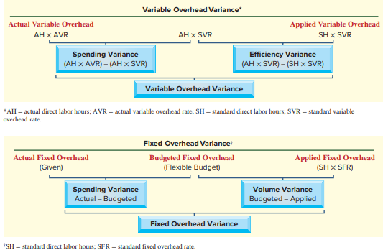
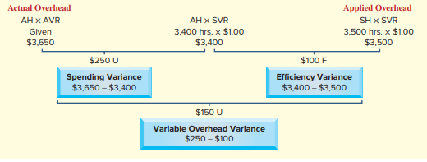
Variable and Fixed Overhead Variances
Exhibit 21A.2
Exhibit 21A.3
51
© McGraw-Hill Education
Learning Objective P5: Compute overhead spending and efficiency variances.
Notes:
The variable overhead spending variance results from paying more or less than expected for variable overhead items, or from the excessive use of those variable overhead items. The variable overhead efficiency variance is controlled through proper management of the overhead cost driver activity level, direct labor hours for G-Max.
The fixed overhead spending variance results from paying more or less than expected for fixed overhead items. The fixed overhead volume variance results from operating at an activity level different from the activity level used to compute the predetermined overhead rate.

Slide 52
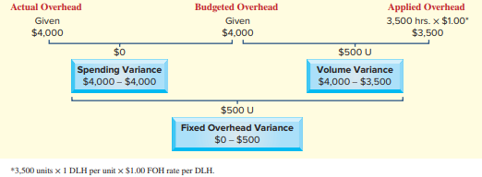
Variable and Fixed Overhead Variances (continued)
Exhibit 21A.3
Exhibit 21A.4
52
© McGraw-Hill Education
Learning Objective P5: Compute overhead spending and efficiency variances.
Notes:
G-Max applies overhead based on direct labor hours. It used 3,400 direct labor hours to produce 3,500 units. This compares favorably to the standard requirement of 3,500 direct labor hours at one labor hour per unit. At a standard variable overhead rate of $1.00 per direct labor hour, this should have resulted in variable overhead costs of $3,400 (middle column of Exhibit 21A.3).
G-Max’s cost records, however, report actual variable overhead of $3,650, or $250 higher than expected. This means G-Max has an unfavorable variable overhead spending variance of $250 ($3,650 − $3,400). On the other hand, G-Max used 100 fewer labor hours than expected to make 3,500 units, and its actual variable overhead is lower than its applied variable overhead. Thus, G-Max has a favorable variable overhead efficiency variance of $100 ($3,400 − $3,500).
Exhibit 21A.4 provides insight into the causes of G-Max’s $500 unfavorable fixed overhead variance. G-Max reports that it incurred $4,000 in actual fixed overhead; this amount equals the budgeted fixed overhead for May at the expected production level of 4,000 units (see Exhibit 21.12). Thus, the fixed overhead spending variance is zero, suggesting good control of fixed
overhead costs. G-Max’s budgeted fixed overhead application rate is $1 per hour ($4,000∕4,000 direct labor hours), but the actual production level is only 3,500 units. With this information, we compute the fixed overhead volume variance shown in Exhibit 21A.4. The applied fixed overhead is computed by multiplying 3,500 standard hours allowed for the actual production by the $1 fixed overhead allocation rate. The volume variance of $500 occurs because 500 fewer units are produced than budgeted; namely, 80% of the manufacturing capacity is budgeted, but only 70% is used. Management needs to know why the actual level of production differs from the expected level.

Slide 53
P6 (Appendix): Prepare journal entries for standard costs and account for price and quantity variances.
Learning Objective
53
© McGraw-Hill Education

Slide 54
Standard Cost Accounting System
Standard cost systems also record costs and variances in accounts. The entries in the next few slides briefly illustrate the important aspects of this process for G-Max’s standard costs and variances for May.
Recording G-Max material costs for May
54
© McGraw-Hill Education
Learning Objective P6: Prepare journal entries for standard costs and account for price and quantity variances.
Notes:
In addition to the use of standard costs in management reports, most standard cost systems also record these costs and variances in accounts. This practice simplifies recordkeeping and helps in preparing reports. The entries in this section briefly illustrate the important aspects of this process for G-Max’s standard costs and variances for May.
The first of these entries records standard materials cost incurred in May in the Work in Process Inventory account. This part of the entry is similar to the usual accounting entry, but the amount of the debit equals the standard cost ($35,000) instead of the actual cost ($37,800). The actual cost is recorded with a credit to Raw Materials Inventory. The difference between standard and actual direct materials costs is recorded with debits to two separate materials variance accounts. Both the materials price and quantity variances are recorded as debits because they reflect additional costs higher than the standard cost (if actual costs are less than the standard, they are recorded as credits). This treatment (debit) reflects their unfavorable effect because they represent higher costs and lower income.

Slide 55
Standard Cost Accounting System (Pt. 2)
Recording G-Max labor costs for May
55
© McGraw-Hill Education
Learning Objective P6: Prepare journal entries for standard costs and account for price and quantity variances.
Notes:
The second entry debits Work in Process Inventory for the standard labor cost of the goods manufactured during May ($56,000). Actual labor cost ($56,100) is recorded with a credit to the Factory Payroll account. The difference between standard and actual labor costs is explained by two variances. The direct labor rate variance is unfavorable and is debited to that account. The direct labor efficiency variance is favorable and that account is credited. The direct labor efficiency variance is favorable because it represents a lower cost and a higher net income.

Slide 56
Standard Cost Accounting System (Pt. 3)
Recording G-Max overhead costs for May
When Factory Overhead is applied to Goods in Process Inventory, the actual amount is credited to the Factory Overhead account. To account for the difference between actual and standard overhead costs, the entry includes a $500 debit to the Volume Variance, a $250 debit to the Variable Overhead Spending Variance, and a $100 credit to the Variable Overhead Efficiency Variance.
56
© McGraw-Hill Education
Learning Objective P6: Prepare journal entries for standard costs and account for price and quantity variances.
Notes:
To assign the standard predetermined overhead to the cost of goods manufactured, we debit the $7,000 predetermined amount to the Goods in Process Inventory account. Actual overhead costs of $7,650 were debited to Factory Overhead when incurred during the period (entries not shown here). When Factory Overhead is applied to Goods in Process Inventory, the actual amount is credited to the Factory Overhead account. To account for the difference between actual and standard overhead costs, the entry includes a $500 debit to the Volume Variance, a $250 debit to the Variable Overhead Spending Variance, and a $100 credit to the Variable Overhead Efficiency Variance. Recall that the fixed overhead spending variance for May was zero.
The balances of the different variance accounts accumulate until the end of the accounting period. As a result, the unfavorable variances of some months can offset the favorable variances of other months. The ending variance account balances, which reflect results of the period’s various transactions and events, are closed at period-end. If the amounts are immaterial, they are added to or subtracted from the balance of the Cost of Goods Sold account. This process is similar to that shown in the job order costing chapter for eliminating an underapplied or overapplied balance in the Factory Overhead account. (Note: These variance balances, which represent differences between actual and standard costs, must be added to or subtracted from the materials, labor, and overhead costs recorded. In this way, the recorded costs equal the actual costs incurred in the period; a company must use actual costs in external financial statements prepared in accordance with generally accepted accounting principles.)

Slide 57
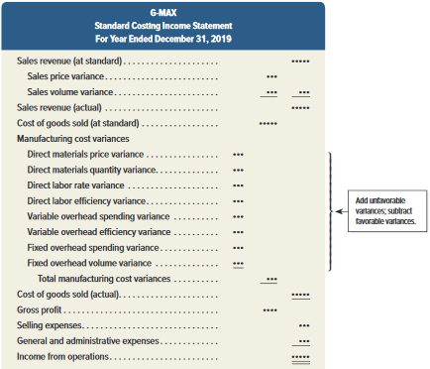
Standard Costing Income Statement
Summarizes company performance for a period.
Exhibit 21A.5
57
© McGraw-Hill Education
Learning Objective P6: Prepare journal entries for standard costs and account for price and quantity variances.
Notes:
A standard costing income statement to summarize company performance for a period. This income statement reports sales and cost of goods sold at their standard amounts, and then lists the individual sales and cost variances to compute gross profit at actual cost. Exhibit 21A.5 provides an example. Unfavorable variances are added to cost of goods sold at standard cost; favorable variances are subtracted from cost of goods sold at standard cost.

Slide 58
End of Chapter 21
58
© McGraw-Hill Education

