Slide 1
Reporting Cash Flows
Chapter 12
Wild and Shaw
Financial and Managerial Accounting
9th Edition
Copyright ©2022 McGraw-Hill Education. All rights reserved. No reproduction or distribution without the prior written consent of McGraw-Hill Education.

Slide 2
Chapter 12 Learning Objectives
CONCEPTUAL
C1 Distinguish between operating, investing, and financing activities, and describe how noncash investing and financing activities are disclosed.
ANALYTICAL
A1 Analyze the statement of cash flows and apply the cash flow on total assets ratio.
PROCEDURAL
P1 Prepare a statement of cash flows.
P2 Compute cash flows from operating activities using the indirect method.
P3 Determine cash flows from both investing and financing activities.
P4 Appendix 12A—Illustrate use of a spreadsheet to prepare a statement of cash flows.
P5 Appendix 12B—Compute cash flows from operating activities using the direct method.
© McGraw-Hill Education
12-2

Slide 3
Distinguish between operating, investing, and financing activities, and describe how noncash investing and financing activities are disclosed.
Learning Objective C1
© McGraw-Hill Education
12-3

Slide 4
Purpose of the Statement of Cash Flows
How does a company receive its cash?
What explains the change in cash balance?
Why do income and cash flows differ?
Where does a company spend its cash?
Learning Objective C1: Distinguish between operating, investing, and financing activities, and describe how noncash investing and financing activities are disclosed.
© McGraw-Hill Education
12-4
Notes:
The statement of cash flows reports cash receipts (inflows) and cash payments (outflows) during a period. Cash flows are separated into operating, investing, and financing activities. The details of sources and uses of cash make this statement useful to users.
Information in this statement helps answer questions such as these:
What explains the change in the cash balance?
Where does a company spend its cash?
How does a company receive its cash?
Why do income and cash flows differ?

Slide 5
Importance of Cash Flows
Cash flows help:
users decide if a company has cash to pay its debts,
users evaluate company’s ability to pursue opportunities,
managers plan day-to-day operations,
managers make long-term investment decisions.
Learning Objective C1: Distinguish between operating, investing, and financing activities, and describe how noncash investing and financing activities are disclosed.
© McGraw-Hill Education
12-5
Notes:
Information about cash flows can influence decision makers in important ways. Information about cash flows helps users decide whether a company has enough cash to pay its debts as they mature. It helps users evaluate a company’s ability to pursue opportunities. Managers use cash flow information to plan day-to-day operations and make long-term investment decisions.

Slide 6
Measurement of Cash Flows
Cash flows includes both cash and cash equivalents
Cash equivalents must meet two criteria:
be readily convertible into cash and
be sufficiently close to maturity so that market value is unaffected by interest rate changes.
Learning Objective C1: Distinguish between operating, investing, and financing activities, and describe how noncash investing and financing activities are disclosed.
© McGraw-Hill Education
12-6
Notes:
Cash flows include both cash and cash equivalents. The statement of cash flows explains the difference between the beginning and ending balances of cash and cash equivalents. We continue to use the phrases cash flows and the statement of cash flows, but remember that both phrases refer to cash and cash equivalents.
A cash equivalent must satisfy two criteria: (1) be readily convertible to a known amount of cash and (2) be sufficiently close to its maturity so its market value is unaffected by interest rate changes.

Slide 7
Classification of Cash Flows
The Statement of Cash Flows includes the following three sections:
Operating Activities
Investing Activities
Financing Activities
Learning Objective C1: Distinguish between operating, investing, and financing activities, and describe how noncash investing and financing activities are disclosed.
© McGraw-Hill Education
12-7
Notes:
Since cash and cash equivalents are combined, the statement of cash flows does not report transactions between cash and cash equivalents, such as cash paid to purchase cash equivalents and cash received from selling cash equivalents. However, all other cash receipts and cash payments are classified and reported on the statement in one of three categories—operating, investing, or financing activities. Individual cash receipts and payments for each of these three categories are labeled to identify their originating transactions or events. A net cash inflow (source) occurs when the receipts in a category exceed the payments. A net cash outflow (use) occurs when the payments in a category exceed the receipts.

Slide 8
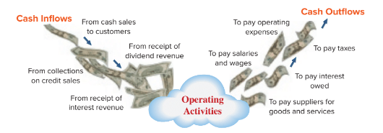
Operating Activities
Exhibit 12.1
Learning Objective C1: Distinguish between operating, investing, and financing activities, and describe how noncash investing and financing activities are disclosed.
© McGraw-Hill Education
12-8
Notes:
Operating activities include transactions and events that affect net income. Examples are the production and purchase of inventory, the sale of goods and services to customers, and the expenditures to operate the business. Not all items in income, such as unusual gains and losses, are operating activities (we discuss these exceptions later). This slide lists the more common cash inflows and outflows from operating activities.

Slide 9
Investing Activities
Exhibit 12.2
Learning Objective C1: Distinguish between operating, investing, and financing activities, and describe how noncash investing and financing activities are disclosed.
© McGraw-Hill Education
12-9
Notes:
Investing activities include transactions and events that come from the purchase and sale of long-term assets. They also include (1) the purchase and sale of short-term investments in other entities, and (2) lending and collecting money for notes receivable. This slide lists examples of cash flows from investing activities. Cash from collecting the principal on notes is an investing activity. However, collecting interest on notes is an operating activity. If a note results from sales to customers, it is as operating activity.

Slide 10
Financing Activities
Exhibit 12.3
Learning Objective C1: Distinguish between operating, investing, and financing activities, and describe how noncash investing and financing activities are disclosed.
© McGraw-Hill Education
12-10
Notes:
Financing activities include transactions and events that affect long-term liabilities and equity. Examples are (1) obtaining cash from issuing debt and repaying debt and (2) receiving cash from or distributing cash to owners. Borrowing and repaying principal on long-term debt are financing activities. Payments of interest are operating activities.

Slide 11
Link between Classification of Cash Flows and the Balance Sheet
Operating, investing, and financing activities are loosely linked to the balance sheet.
Operating activities are affected by changes in current assets and current liabilities.
Investing activities are affected by changes in long-term assets.
Financing activities are affected by changes in long-term liabilities and equity.
Exhibit 12.4
Learning Objective C1: Distinguish between operating, investing, and financing activities, and describe how noncash investing and financing activities are disclosed.
12-11
© McGraw-Hill Education
Notes:
Operating, investing, and financing activities are loosely linked to different parts of the balance sheet. Operating activities are affected by changes in current assets and current liabilities (and the income statement). Investing activities are affected by changes in long-term assets. Financing activities are affected by changes in long-term liabilities and equity. These links are shown in Exhibit 12.4.
Exceptions to these links include (1) current assets unrelated to operations—such as short-term notes receivable from noncustomers and from investment securities, which are investing activities, and (2) current liabilities unrelated to operations—such as dividends payable, which are financing activities.

Slide 12
Noncash Investing and Financing
Examples of Noncash Investing and Financing Activities:
Exhibit 12.5
Learning Objective C1: Distinguish between operating, investing, and financing activities, and describe how noncash investing and financing activities are disclosed.
© McGraw-Hill Education
12-12
Notes:
Some investing and financing activities do not affect cash flows. One example is the purchase of long-term assets by issuing a long-term note (loan). This transaction involves both investing and financing activities but does not impact current-period cash. Such transactions are reported at the bottom of the statement of cash flows or in a note to the statement because of their importance and the full-disclosure principle. This slide lists transactions commonly disclosed as noncash investing and financing activities.

Slide 13
Prepare a statement of cash flows.
Learning Objective P1
© McGraw-Hill Education
12-13

Slide 14
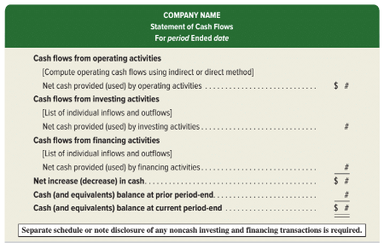
Format of the Statement of Cash Flows
Exhibit 12.6
12-14
© McGraw-Hill Education
Learning Objective P1: Prepare a statement of cash flows.
Notes:
A statement of cash flows reports cash flows from three activities: operating, investing, and financing. The statement shows the net increase or decrease from those activities and ties it into the cash balance. Any non-cash investing and financing transactions are disclosed in a note or separate schedule.

Slide 15
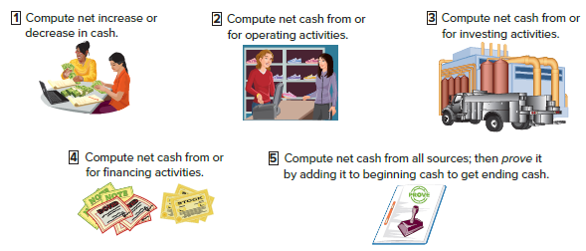
Preparing the Statement of Cash Flows
Exhibit 12.7
12-15
© McGraw-Hill Education
Learning Objective P1: Prepare a statement of cash flows.
Notes:
Preparing a statement of cash flows involves five steps:
Compute the net increase or decrease in cash;
Compute net cash from or used by operating activities;
Compute net cash from or used by investing activities;
Compute net cash from or used by financing activities;
Compute the net cash flow from all sources, and then prove it by adding it to the beginning cash balance to get ending cash balance.
We will follow these steps in the preparation of our example statement of cash flows.

Slide 16
Analyzing the Cash Account
The Cash account is a natural place to look for information about cash flows from operating, investing, and financing activities.
Exhibit 12.8
© McGraw-Hill Education
12-16
Learning Objective P1: Prepare a statement of cash flows.
Notes:
Computing the net increase or net decrease in cash is a simple but crucial computation. It equals the current period’s cash balance minus the prior period’s cash balance. This is the bottom-line figure for the statement of cash flows and is a check on accuracy.
A company’s cash receipts and cash payments are recorded in the Cash account. The Cash account is one place to look for information about cash flows from operating, investing, and financing activities. To illustrate, see the summarized Cash T-account of Genesis, Inc., in this slide. The Cash account increased $5,000, from $12,000 to $17,000. Individual cash transactions are summarized in this Cash account according to the major types of cash receipts and cash payments. For instance, only the total of cash receipts from all customers is listed. Individual cash transactions underlying these totals can number in the thousands. Accounting software is available to provide summarized cash accounts.
The statement of cash flows summarizes and classifies the transactions that led to the $5,000 increase in the Cash account. Preparing a statement of cash flows requires determining whether an individual cash inflow or outflow is an operating, investing, or financing activity, and then listing each by activity.

Slide 17
Analyzing Noncash Accounts
A second approach to preparing the statement of cash flows is analyzing noncash accounts.
Exhibit 12.9
© McGraw-Hill Education
12-17
Learning Objective P1: Prepare a statement of cash flows.
Notes:
A second approach to preparing the statement of cash flows is analyzing noncash accounts and draws on double-entry accounting.
In sum, all cash transactions eventually affect noncash balance sheet accounts. Thus, we can determine cash inflows and outflows by analyzing changes in noncash balance sheet accounts.
This slide uses the accounting equation to show the relation between the Cash account and the noncash balance sheet accounts.

Slide 18
Information to Prepare the Statement
Information to prepare the statement of cash flows comes from three sources:
Comparative
Balance Sheets
Current
Income Statement
Additional
Information
© McGraw-Hill Education
12-18
Learning Objective P1: Prepare a statement of cash flows.
Notes:
Information to prepare the statement of cash flows comes from three sources:
comparative balance sheets,
the current income statement, and
additional information.
Comparative balance sheets are used to compute changes in noncash accounts from the beginning to the end of the period. The current income statement is used to help compute cash flows from operating activities. Additional information often includes details that help explain cash flows and non-cash activities.

Slide 19
Compute cash flows from operating activities using the indirect method.
Learning Objective P2
© McGraw-Hill Education
12-19

Slide 20
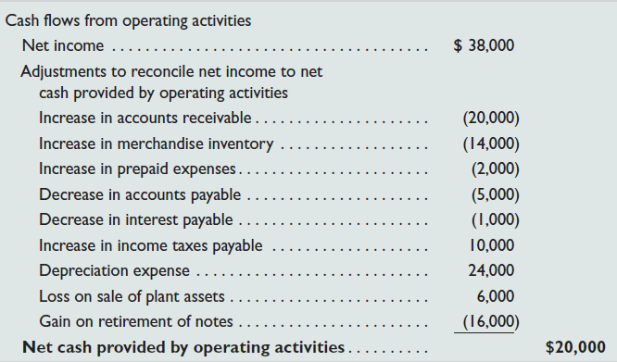
Cash Flows from Operating Indirect and Direct Methods of Reporting
Direct
Method
Indirect
Method
The net cash amount provided by operating activities is identical under both the direct and indirect methods.
© McGraw-Hill Education
12-20
Learning Objective P1: Prepare a statement of cash flows.
Notes:
Cash flows provided (used) by operating activities are reported using the direct method or the indirect method. These two different methods apply only to the operating activities section.
The direct method separately lists operating cash receipts (such as cash received from customers) and operating cash payments (such as cash paid for inventory). The cash payments are then subtracted from cash receipts.
The indirect method reports net income and then adjusts it for items that do not affect cash. It does not report individual items of cash inflows and cash outflows from operating activities.
The net cash amount provided by operating activities is identical under both the direct and indirect methods. This equality always exists. The difference is with the computation and presentation of this amount. The FASB recommends the direct method, but because it is not required and the indirect method is arguably easier to compute, nearly all companies report operating cash flows using the indirect method.

Slide 21
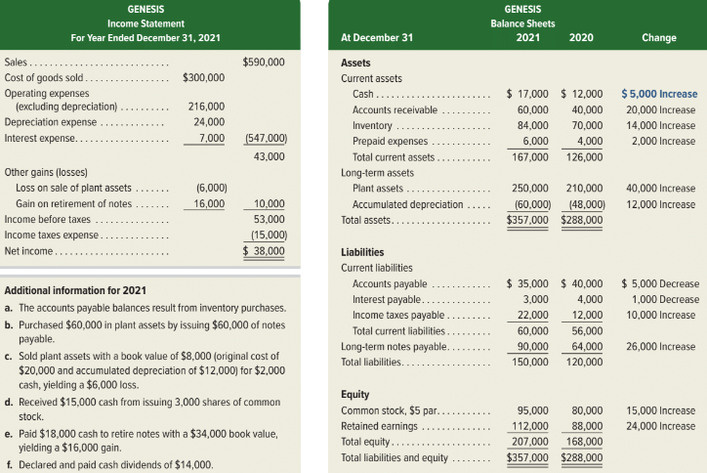
Cash Flows: Indirect Method Illustration
Exhibit 12.10
12-21
© McGraw-Hill Education
Learning Objective P2: Compute cash flows from operating activities using the indirect method.
Notes:
To illustrate, we prepare the operating activities section of the statement of cash flows for Genesis. This slide shows the December 31, 2020 and 2021, balance sheets of Genesis along with its 2021 income statement. We use this information to prepare a statement of cash flows that explains the $5,000 increase in cash for 2021 as reflected in its balance sheets. This $5,000 is computed as Cash of $17,000 at the end of 2021 minus Cash of $12,000 at the end of 2020.
Additional information for 2021:
a. The accounts payable balances result from inventory purchases.
b. Purchased $60,000 in plant assets by issuing $60,000 of notes payable.
c. Sold plant assets with a book value of $8,000 (original cost of $20,000 and accumulated depreciation of $12,000) for $2,000 cash, yielding a $6,000 loss.
d. Received $15,000 cash from issuing 3,000 shares of common stock.
e. Paid $18,000 cash to retire notes with a $34,000 book value, yielding a $16,000 gain.
f. Declared and paid cash dividends of $14,000.

Slide 22
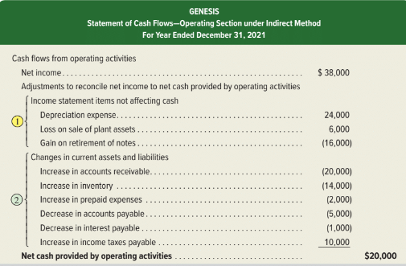
Applying the Indirect Method
Exhibit 12.11
© McGraw-Hill Education
12-22
Learning Objective P2: Compute cash flows from operating activities using the indirect method.
Notes:
The indirect method starts with the accrual based net income and makes two types of adjustments to arrive at cash flows from operating activities. Adjustments to the accrual based net income include (1) adjustments to income statement items that do not impact cash and (2) adjustments for changes current assets and current liabilities.

Slide 23
Adjustments for Income Statement Items Not Affecting Cash
Expenses and losses with no cash outflows are added back to net income.
Revenues and gains with no cash inflows are subtracted from net income.
© McGraw-Hill Education
12-23
Learning Objective P2: Compute cash flows from operating activities using the indirect method.
Notes:
Adjustments for Income Statement Items Not Affecting Cash:
expenses and losses subtracted from net income are not cash outflows. Examples are depreciation, amortization, depletion, bad debts expense, loss from an asset sale, and loss from retirement of notes payable. The indirect method requires that Expenses and losses with no cash outflows are added back to net income.
These expenses and losses did not reduce cash, and adding them back cancels their deductions from net income. Any cash received or paid from a transaction that yields a loss, such as from an asset sale or payoff of a note, is reported under investing or financing activities.
When net income has revenues and gains that are not cash inflows, the indirect method requires that Revenues and gains with no cash inflows are subtracted from net income.
Section 1 of Exhibit 16.11 shows three adjustments for items that did not impact cash for Genesis.
Depreciation: Depreciation expense is Genesis’s only operating item in net income that had no effect on cash flows. We add back the $24,000 depreciation expense to net income because depreciation did not reduce cash.
Loss on Sale of Plant Assets: Genesis reported a $6,000 loss on sale of plant assets that reduced net income but did not affect cash flows. This $6,000 loss is added back to net income because it is not a cash outflow.
Gain on Retirement of Debt: A $16,000 gain on retirement of debt increased net income but did not affect cash flows. This $16,000 gain is subtracted from net income because it was not a cash inflow.

Slide 24
Adjustments for Changes in Current Assets and Current Liabilities: Table
Use this table when adjusting Net Income to Operating Cash Flows.
© McGraw-Hill Education
12-24
Learning Objective P2: Compute cash flows from operating activities using the indirect method.
Notes:
This chart explains how to treat a change in a noncash current asset or current liability in the operating section of the statement of cash flows. Maybe a couple of examples will help you see how this table works. Let’s start with current assets. If accounts receivable, a current asset, decreased during the year, this decrease would be added to net income. A decrease in accounts receivable means that customer cash payments on account exceeded customer charges on account during the period. This excess of cash payments over charges is used to adjust the accrual based revenues reported on the income statement to report the total cash received from customers during the period. Similarly, if accounts receivable increased during the year, this increase would be subtracted from net income. An increase in accounts receivable means that customer charges on account exceeded customer cash payments on account during the period. This excess of charges over cash payments is used to adjust the accrual based revenues reported on the income statement to report the total cash received from customers during the period. Now, let’s look at how to treat changes in current liabilities. If salaries payable, a current liability, decreased during the year, this decrease would be subtracted from net income. A decrease in salaries payable means that the company paid off more in salaries than it charged to expense during the period. This excess of cash payments over charges is used to adjust the accrual based expense reported on the income statement to report the total cash paid for salaries during the period. Similarly, if salaries payable increased during the year, this increase would be added to net income. An increase in salaries payable means the company charged more to expense than it paid off during the period. This excess of charges over cash payments is used to adjust the accrual based expense reported on the income statement to report the total cash paid for salaries during the period.

Slide 25
Adjustments for Changes in Current Assets and Current Liabilities
Decreases in current assets are added to net income.
Increases in current assets are subtracted from net income.
Increases in current liabilities are added to net income.
Decreases in current liabilities are subtracted from net income.
© McGraw-Hill Education
12-25
Learning Objective P2: Compute cash flows from operating activities using the indirect method.
Notes:
This slide shows the results of the indirect method of reporting operating cash flows, which adjusts net income for two types of adjustments.
2. Adjustments for Changes in Current Assets and Current Liabilities:
Adjustments for changes in current assets.
Decreases in current assets require the following adjustment: Decreases in current assets are added to net income.
Increases in current assets require the following adjustment: Increases in current assets are subtracted from net income.
Adjustments for changes in current liabilities.
Increases in current liabilities require the following adjustment to net income when computing operating cash flows: Increases in current liabilities are added to net income.
Accounts Receivable: The $20,000 increase in the current asset of accounts receivable is subtracted from net income. This means that Genesis collects less cash than is reported in sales.
Inventory: The $14,000 increase in inventory is subtracted from income. Cash paid is $14,000 more than COGS which is why we subtract it from income in computing cash flow.
Prepaid Expenses: The $2,000 increase in prepaid expenses is subtracted from income because cash paid is $2,000 more than expenses recorded.
Accounts Payable: The $5,000 decrease in accounts payable is subtracted from income because cash paid is $5,000 more than the purchases recorded.
Interest Payable: The $1,000 decrease in interest payable is subtracted from income because the cash paid is $1,000 more than the interest recorded.
Income Taxes Payable: The $10,000 increase in income taxes payable is added to income because cash paid is less than the taxes recorded.

Slide 26
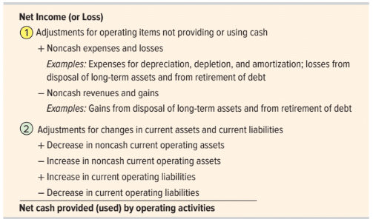
Summary of Adjustments for Indirect Method: Part 2
Common adjustments to net income when computing
net cash provided or used by operating activities
under the indirect method:
Exhibit 12.12
© McGraw-Hill Education
12-26
Learning Objective P2: Compute cash flows from operating activities using the indirect method.
Notes:
This slide summarizes the adjustments to net income when computing net cash provided or used by operating activities under the indirect method.

Slide 27
Determine cash flows from both investing and financing activities.
Learning Objective P3
© McGraw-Hill Education
12-27

Slide 28
Cash Flows from Investing: Three-Step Analysis
A three-step process to determine cash provided or used by investing activities:
Identify changes in investing-related accounts
Determine the cash effects using T-accounts and reconstructed entries
Report the cash flow effects
© McGraw-Hill Education
12-28
Learning Objective P3: Determine cash flows from both investing and financing activities.
Notes:
The second major step in preparing the statement of cash flows is to compute and report cash flows from investing activities. We normally do this by identifying changes in (1) all long-term asset accounts and (2) any current accounts for notes receivable and investments in securities. Reporting of investing activities is identical under the direct method and indirect method.
To determine cash provided or used by investing activities: (1) identify changes in investing-related accounts, (2) determine the cash effects using T-accounts and reconstructed entries, and (3) report the cash flow effects.

Slide 29
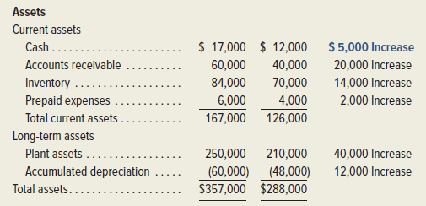
Cash Flows from Investing: First Step
Exhibit 12.10
This analysis reveals a $40,000 increase in plant assets from $210,000 to $250,000 and a $12,000 increase in accumulated depreciation from $48,000 to $60,000.
© McGraw-Hill Education
12-29
Learning Objective P3: Determine cash flows from both investing and financing activities.
Notes:
Information about the Genesis transactions provided earlier reveals that the company both purchased and sold plant assets during the period. Both transactions are investing activities and are analyzed for their cash flow effects in this section.
Plant Asset Transactions: The first step in analyzing the Plant Assets account and its related Accumulated Depreciation account is to identify any changes in these accounts. This analysis shows a $40,000 increase in plant assets from $210,000 to $250,000 and a $12,000 increase in accumulated depreciation from $48,000 to $60,000.

Slide 30
Cash Flows from Investing: Second Step
Item b: Genesis purchased plant assets of $60,000 by issuing $60,000 in notes payable to the seller.
Item c reports that Genesis sold plant assets costing $20,000 (with $12,000 of accumulated depreciation) for $2,000 cash, resulting in a $6,000 loss.
We also reconstruct the entry for Depreciation Expense using information from the income statement.
© McGraw-Hill Education
12-30
Learning Objective P3: Determine cash flows from both investing and financing activities.
Notes:
The second step is to explain these changes. Items b and c of the additional information discussed in an earlier slide affect plant assets. Recall that the Plant Assets account is affected by both asset purchases and sales; its Accumulated Depreciation account is normally increased by depreciation and decreased by the removal of accumulated depreciation in asset sales. To explain changes in these accounts and to identify their cash flow effects, we prepare reconstructed entries from prior transactions; they are not the actual entries made by the preparer.
To illustrate, item b reports that Genesis purchased plant assets of $60,000 by issuing $60,000 in notes payable to the seller. The reconstructed entry for analysis of item b is shown.

Slide 31
Cash Flows from Investing: Third Step
Reconstructed T-accounts show changes in long-term assets.
The identified cash flows are reported in the investing section:
The $60,000 purchase in item b paid using a note payable is a noncash investing and financing activity.
© McGraw-Hill Education
12-31
Learning Objective P3: Determine cash flows from both investing and financing activities.
Notes:
In the third step, the $60,000 purchase described in item b and financed by issuing a note payable is a noncash investing and financing activity. It is reported in a note or in a separate schedule to the statement.
Next, item c reports that Genesis sold plant assets costing $20,000 (with $12,000 of accumulated depreciation) for $2,000 cash, resulting in a $6,000 loss. The reconstructed entry for analysis of item c is shown.
We also reconstruct the entry for Depreciation Expense from the income statement. Depreciation expense results in no cash flow effect.

Slide 32
Cash Flows from Financing: Three-Step Analysis
A three-step process to determine cash provided or used by financing activities:
Identify changes in financing-related accounts
Determine the cash effects using T-accounts and reconstructed entries
Report the cash flow effects
12-32
© McGraw-Hill Education
Learning Objective P3: Determine cash flows from both investing and financing activities.
Notes:
To compute cash flows from financing activities, we analyze changes in all noncurrent liability accounts (including the current portion of any notes and bonds) and equity accounts.
These accounts include long-term debt, notes payable, bonds payable, common stock, and retained earnings. Reporting of financing activities is identical under the direct method and indirect method.
Three-Step Process of Analysis
We again use a three-stage process to determine cash provided or used by financing activities: (1) identify changes in financing-related accounts, (2) determine the cash effects using T-accounts and reconstructed analysis, and (3) report their cash flow effects.

Slide 33
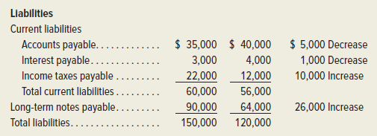
Cash Flows from Financing: First Step
Exhibit 12.10
This analysis reveals: an increase in notes payable from $64,000 to $90,000.
© McGraw-Hill Education
12-33
Learning Objective P3: Determine cash flows from both investing and financing activities.
Notes:
Information about Genesis provided earlier reveals two transactions involving noncurrent liabilities. Genesis retired notes payable by paying cash.
Notes Payable Transactions:
The first step in analysis of notes is to review the comparative balance sheets shown. This analysis reveals an increase in notes payable from $64,000 to $90,000.

Slide 34
Cash Flows from Financing: Second Step
Step two explains the change in item e. Notes with a carrying value of $34,000 are retired for $18,000 cash, resulting in a $16,000 gain.
Cash Flows from Financing: Third Step
Step three reports cash paid for the notes retirement in the financing activities section.
12-34
© McGraw-Hill Education
Learning Objective P3: Determine cash flows from both investing and financing activities.
Notes:
The second step explains this change. Item e of the additional information provided earlier reports that notes with a carrying value of $34,000 are retired for $18,000 cash, resulting in a $16,000 gain. The reconstructed entry for analysis of item e is shown.
This entry reveals an $18,000 cash outflow for retirement of notes and a $16,000 gain from comparing the notes payable carrying value to the cash received. This gain does not reflect any cash inflow or outflow.
The third step reports the cash paid for the notes retirement in the financing activities section.

Slide 35
Cash Flows from Financing: Common Stock Transactions
Step one in analyzing stock reviews comparative balance sheets. Show an increase in common stock from $80,000 to $95,000.
Step two explains change of item d which reports 3,000 shares of common stock are issued at par for $5 per share.
Step three reports cash received from stock issuance in financing activities section.
© McGraw-Hill Education
12-35
Learning Objective P3: Determine cash flows from both investing and financing activities.
Notes:
The Genesis information reveals two transactions involving equity accounts. The first is the issuance of common stock for cash.
The first step in analyzing common stock is to review the comparative balance sheets shown in Exhibit 16.10, which reveal an increase in common stock from $80,000 to $95,000.
The second step explains this change using the T-account. Item d of the additional information provided earlier reports that 3,000 shares of common stock are issued at par for $5 per share. The reconstructed entry for analysis of item d is shown. This entry reveals a $15,000 cash inflow from stock issuance.
Step three reports cash received from stock issuance in the financing activities section.

Slide 36
Cash Flows from Financing: Retained Earnings Transactions
Step one in analyzing Retained Earnings reviews comparative balance sheets. Show an increase in retained earnings from $88,000 to $112,000.
Step two explains change of item f which reports cash dividends of $14,000 are paid.
Step three reports cash paid for dividends in the financing activities section.
© McGraw-Hill Education
Learning Objective P3: Determine cash flows from both investing and financing activities.
12-36
Notes:
The Genesis information reveals two transactions involving equity accounts. The second is the declaration and payment of cash dividends.
The first step in analyzing the Retained Earnings account is to review the comparative balance sheets shown earlier. This reveals an increase in retained earnings from $88,000 to $112,000.
The second step explains this change. Item f of the additional information provided earlier reports that cash dividends of $14,000 are paid. The reconstructed entry is shown.
In step three, the cash paid for dividends is reported in the financing activities section.
We now have identified and explained all of Genesis’ cash inflows and cash outflows and one noncash investing and financing transaction.

Slide 37
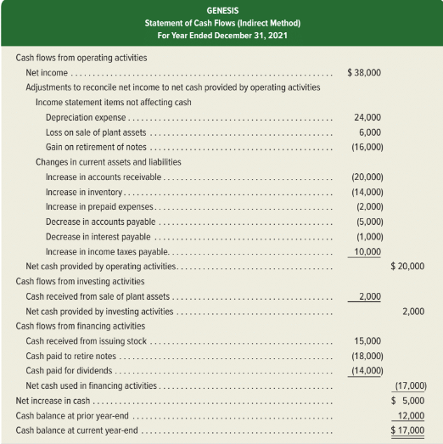
Proving Cash Balances
Exhibit 12.13
12-37
© McGraw-Hill Education
Learning Objective P3: Determine cash flows from both investing and financing activities.
Notes:
The final step in preparing the statement is to report the beginning and ending cash balances and prove that the net change in cash is explained by operating, investing, and financing cash flows. This step is shown here for Genesis.

Slide 38
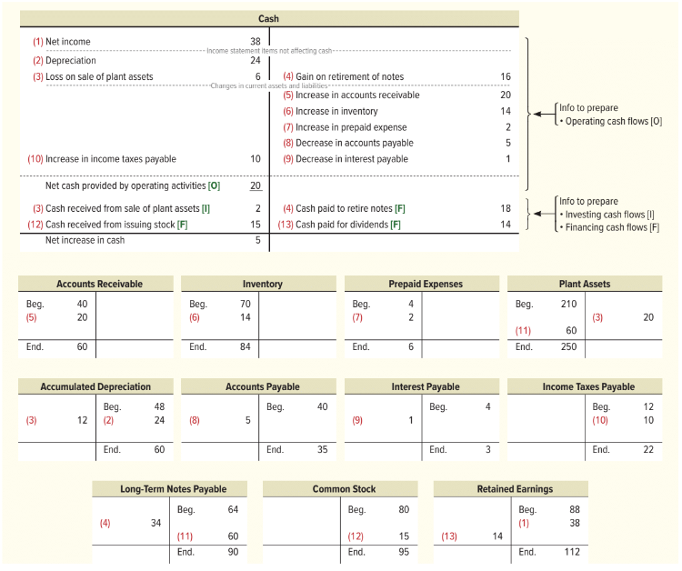
Summary Using T-Accounts
Exhibit 12.14
12-38
© McGraw-Hill Education
Learning Objective P3: Determine cash flows from both investing and financing activities.
Notes:
A statement of cash flows is prepared by analyzing changes in noncash balance sheet accounts.
This slide uses T-accounts to summarize how changes in Genesis’s noncash balance sheet accounts affect its cash inflows and outflows (dollar amounts in thousands). The top of the exhibit shows the company’s Cash T-account, and the lower part shows T-accounts for its remaining balance sheet accounts. We see that the $20,000 net cash provided by operating activities and the $5,000 net increase in cash shown in the Cash T-account agree with the same figures in the statement of cash flows shown in a prior slide.
We explain this slide in five parts (amounts in $ thousands):
a. Entry (1) records $38 net income in the credit side of the Retained Earnings account and the debit side of the Cash account. This $38 net income in the Cash T-account is adjusted until it reflects the $5 net increase in cash.
b. Entries (2) through (4) add the $24 depreciation and $6 loss on asset sale to net income and subtract the $16 gain on retirement of notes.
c. Entries (5) through (10) adjust net income for changes in current asset and current liability accounts.
d. Entry (11) records the noncash investing and financing transaction involving a $60 purchase of assets by issuing $60 of notes.
e. Entries (12) and (13) record the $15 stock issuance and the $14 dividend.

Slide 39
Analyze the statement of cash flows and apply the cash flow on total assets ratio.
Learning Objective A1
© McGraw-Hill Education
12-39

Slide 40
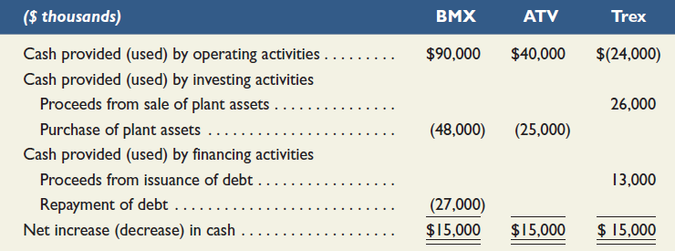
Analyzing Cash Sources and Uses
Managers review cash flows for business decisions.
Creditors evaluate a company’s ability to generate enough cash to pay debt.
Investors assess cash flows before buying and selling stock.
Exhibit 12.15
Learning Objective A1: Analyze the statement of cash flows and apply the cash flow on total assets ratio.
© McGraw-Hill Education
12-40
Notes:
Managers review cash flows for business decisions. Creditors evaluate a company’s ability to generate enough cash to pay debt. Investors assess cash flows before buying and selling stock.
To effectively answer these questions, it is important to separately analyze investing, financing, and operating activities. To illustrate, consider data from three different companies in Exhibit 12.15. These companies operate in the same industry and have been in business for several years. Each company generates an identical $15,000 net increase in cash, but its sources and uses of cash flows are very different. BMX’s operating activities provide net cash flows of $90,000, allowing it to purchase plant assets of $48,000 and repay $27,000 of its debt. ATV’s operating activities provide $40,000 of cash flows, limiting its purchase of plant assets to $25,000. Trex’s $15,000 net cash increase is due to selling plant assets and incurring additional debt. Its operating activities yield a net cash outflow of $24,000. Overall, analysis of these cash flows reveals that BMX is more capable of generating future cash flows than is ATV or Trex.

Slide 41
Cash Flow on Total Assets
Used, along with income-based ratios, to assess company performance.
Exhibit 12.16
Cash flow on
Cash flows from operations
=
total assets
Average total assets
Learning Objective A1: Analyze the statement of cash flows and apply the cash flow on total assets ratio.
© McGraw-Hill Education
12-41
Notes:
Cash flow information can help measure a company’s ability to meet its obligations, pay dividends, expand operations, and obtain financing.
The cash flow on total assets ratio is shown in this slide.
This ratio measures actual cash flows and is not affected by accounting recognition and measurement. It can help estimate the amount and timing of cash flows from operating activities.

Slide 42
Appendix 12A Illustrate use of a spreadsheet to prepare a statement of cash flows.
Learning Objective P4
© McGraw-Hill Education
12-42

Slide 43
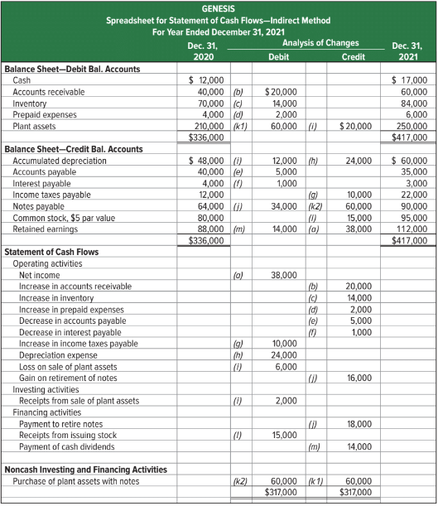
Spreadsheet Preparation
Exhibit 12A.1
A spreadsheet, also called work sheet or working paper, can help us organize the information needed to prepare a statement of cash flows.
© McGraw-Hill Education
Learning Objective P4: Illustrate use of a spreadsheet to prepare a statement of cash flows.
12-43
Notes:
This appendix explains how to use a spreadsheet (work sheet) to prepare the statement of cash flows under the indirect method.
Preparing the Indirect Method Spreadsheet to analyze noncash accounts can be challenging when a company has a large number of accounts and many operating, investing, and financing transactions. A spreadsheet, also called work sheet or working paper, can help us organize the information needed to prepare a statement of cash flows. A spreadsheet also makes it easier to check the accuracy of our work.
The graphic on this slide shows the indirect method spreadsheet for Genesis. We enter both beginning and ending balance sheet amounts on the spreadsheet. We also enter information in the Analysis of Changes columns (keyed to the additional information items a through m) to explain changes in the accounts and determine the cash flows for operating, investing, and financing activities. Information about noncash investing and financing activities is reported near the bottom.

Slide 44
Appendix 12B Compute cash flows from operating activities using the direct method.
Learning Objective P5
© McGraw-Hill Education
12-44

Slide 45
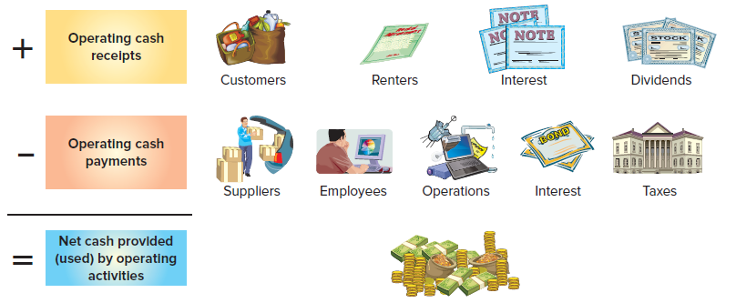
Direct Method of Reporting Operating Cash Flows: Operating Activities
Adjust income statement accounts related to operating activities for changes in their related balance sheet accounts:
Exhibit 12B.1
Framework for reporting cash receipts and cash payments
© McGraw-Hill Education
12-45
Learning Objective P5: Compute cash flows from operating activities using the direct method.
Notes:
We compute cash flows from operating activities under the direct method by adjusting accrual-based income statement items to the cash basis. The usual approach is to adjust income statement accounts related to operating activities for changes in their related balance sheet accounts as illustrated in the first graphic on this slide. The framework for reporting cash receipts and cash payments for the operating section of the cash flow statement under the direct method is shown in the second graphic on this slide.

Slide 46
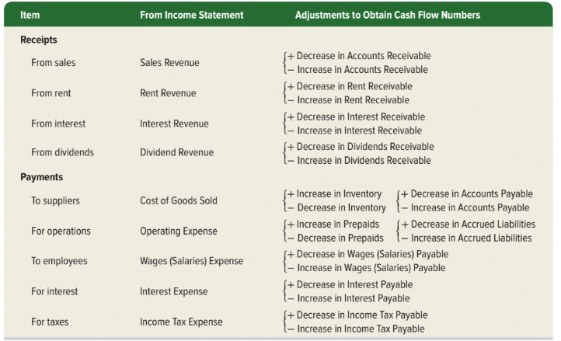
Direct Method of Reporting Operating Cash Flows
Exhibit 12B.6
© McGraw-Hill Education
Learning Objective P5: Compute cash flows from operating activities using the direct method.
12-46
Notes:
This slide summarizes common adjustments for net income to yield net cash provided (used) by operating activities under the direct method.

Slide 47
End of Chapter 12
© McGraw-Hill Education
12-47

